Slide 1
The pop density number of NA values reduce as the buffers are increased
Population density buffer | Number of NA values
Pop density 0m buffer | 7
Pop density 1000m buffer | 7
Pop density 2000m buffer | 7
Pop density 3000m buffer | 7
FB (Facebook) Pop density 0m buffer | 443
FB Pop density 1000m buffer | 49
FB Pop density 2000m buffer | 20
FB Pop density 3000m buffer | 17
DHS Pop density 0m buffer" | 15

Slide 2
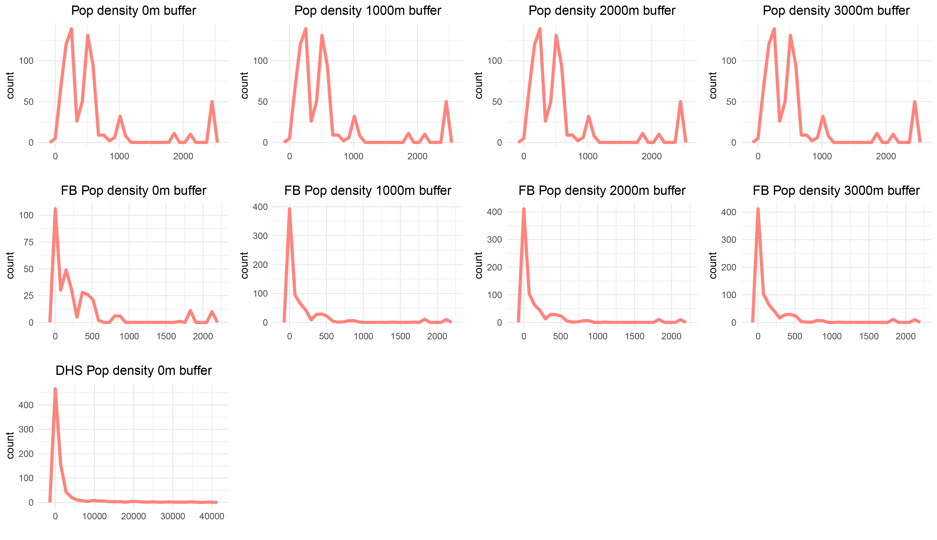
There is no difference in pop densities regardless of buffers size in Columbia dataset

Slide 3
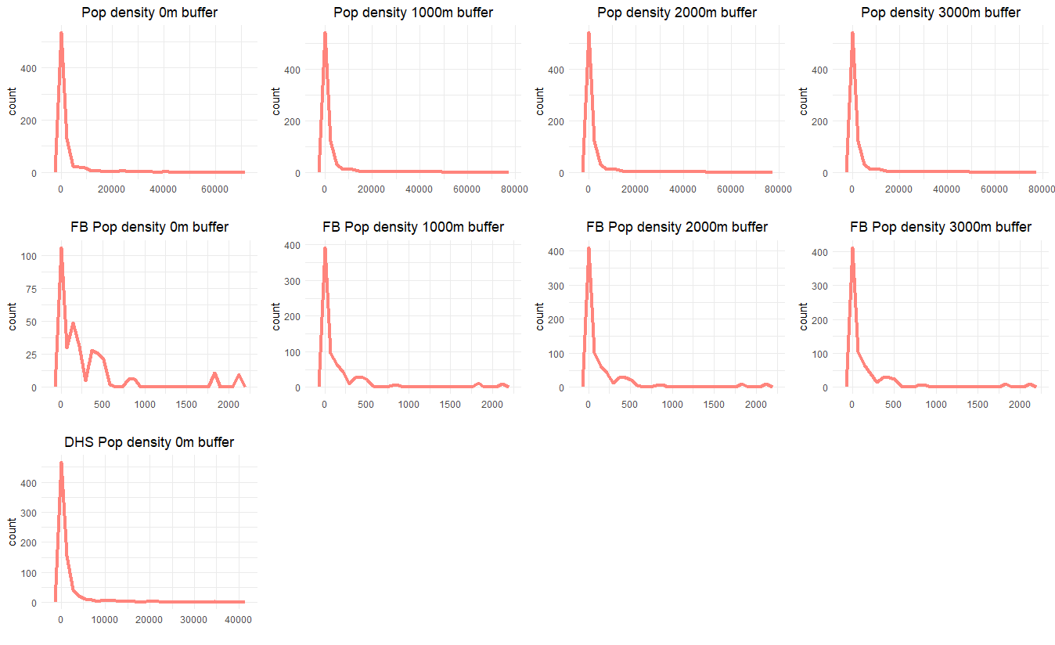
30 Sec Pop Densities

Slide 4
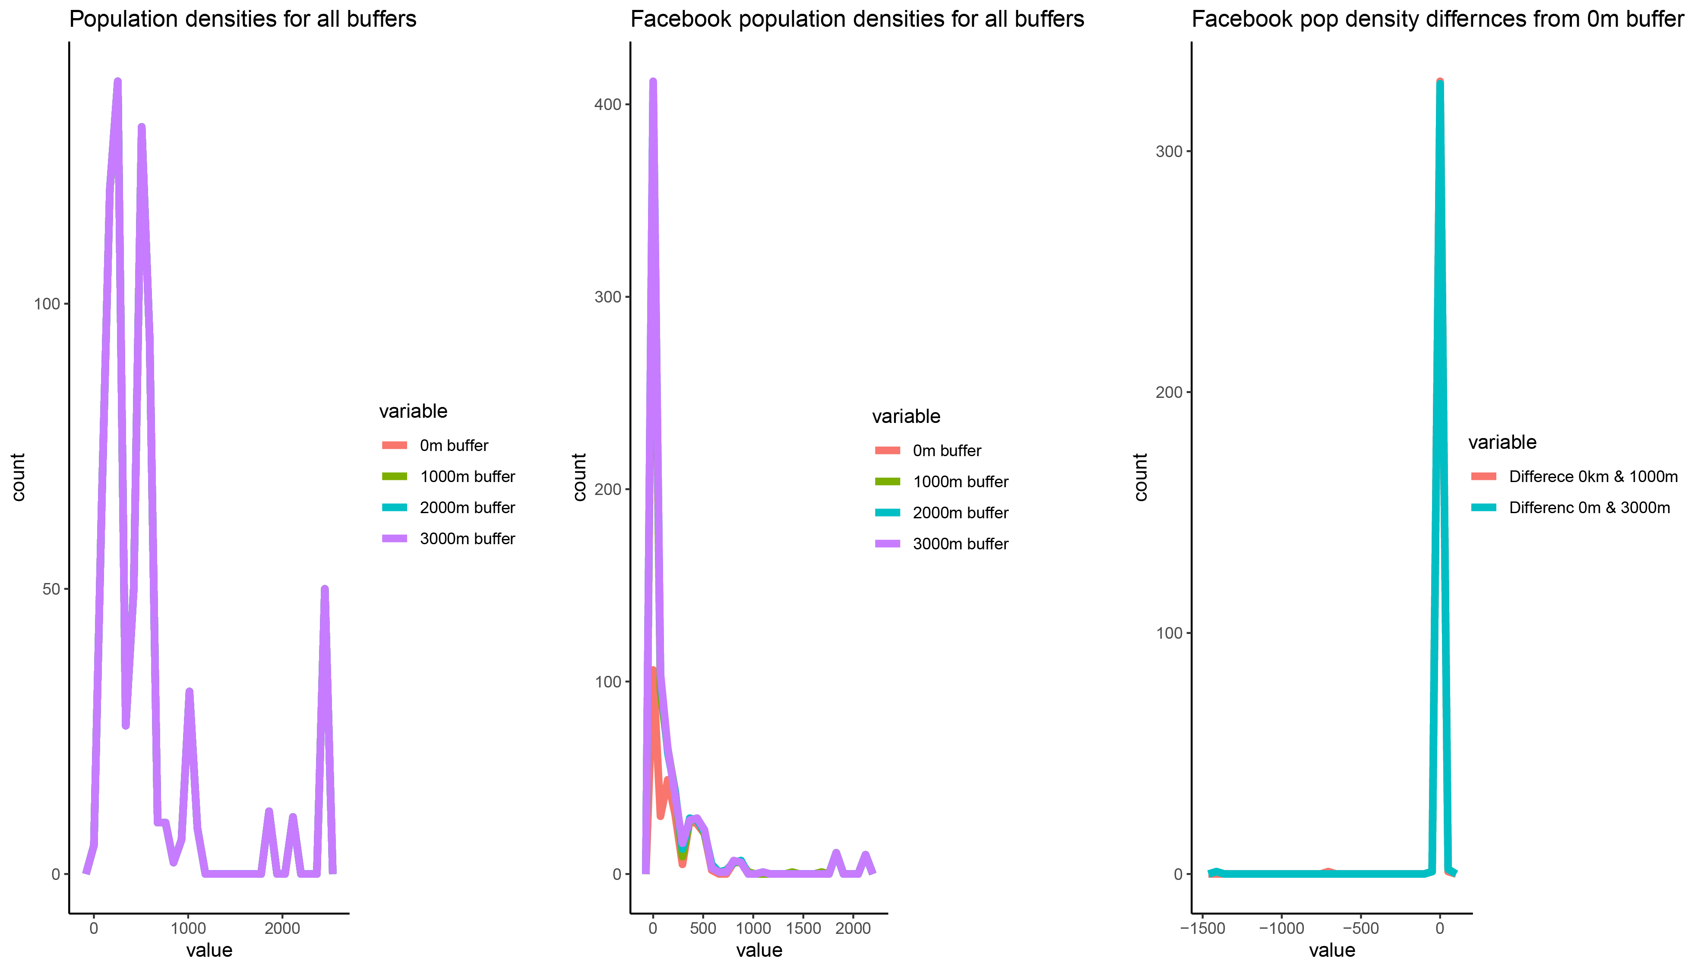
Only the Facebook pop densities vary slightly across different buffers sizes

Slide 5
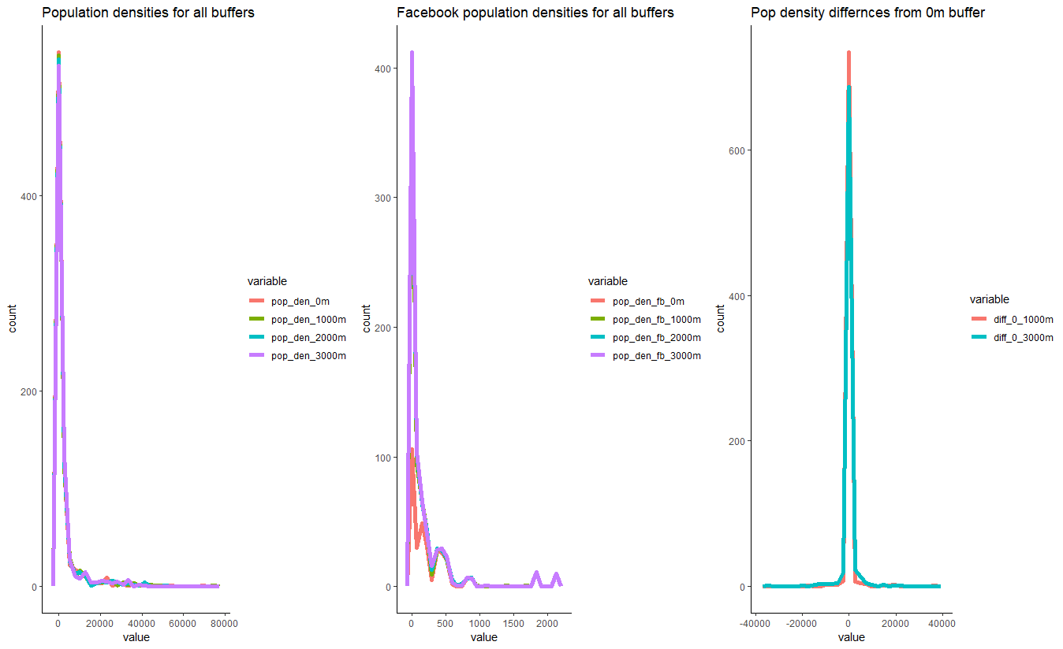
30 Sec Pop Densities

Slide 6
The building density number of NA values reduce as the buffers are increased
Population density buffer | Number of NA values
Building density 0m buffer | 335
Building density 1000m buffer | 35
Building density 2000m buffer | 8
Building density 3000m buffer | 7

Slide 7
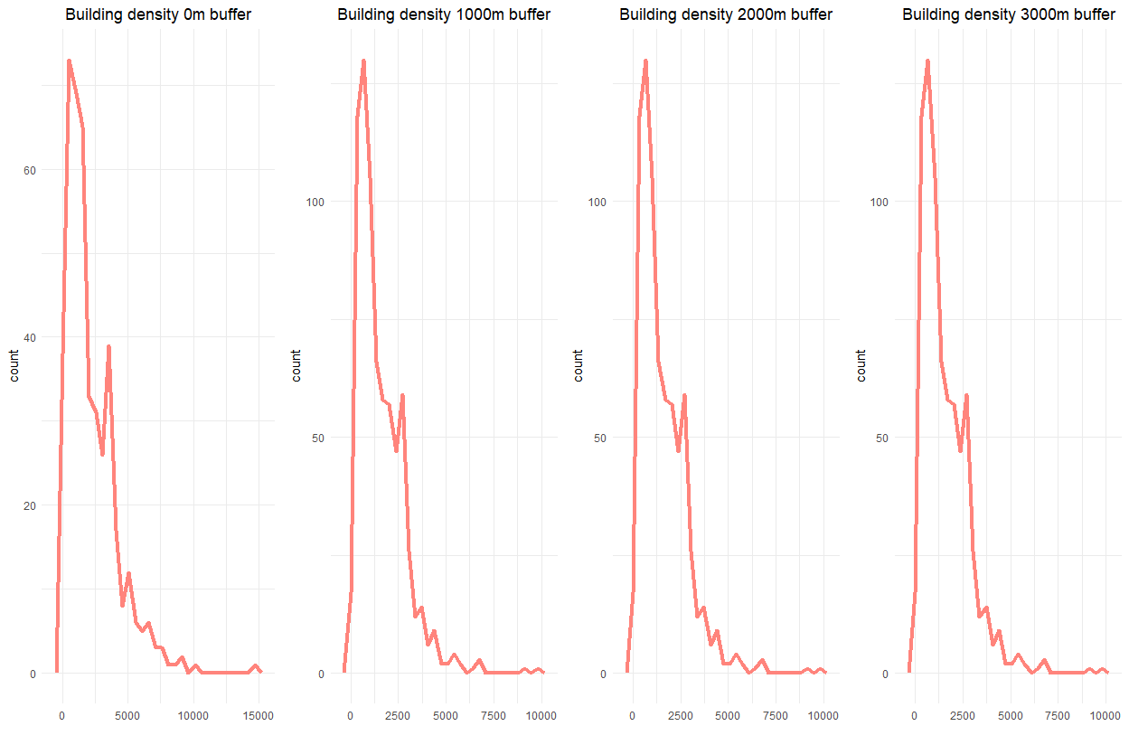
There is a difference in building densities regardless of buffers size

Slide 8
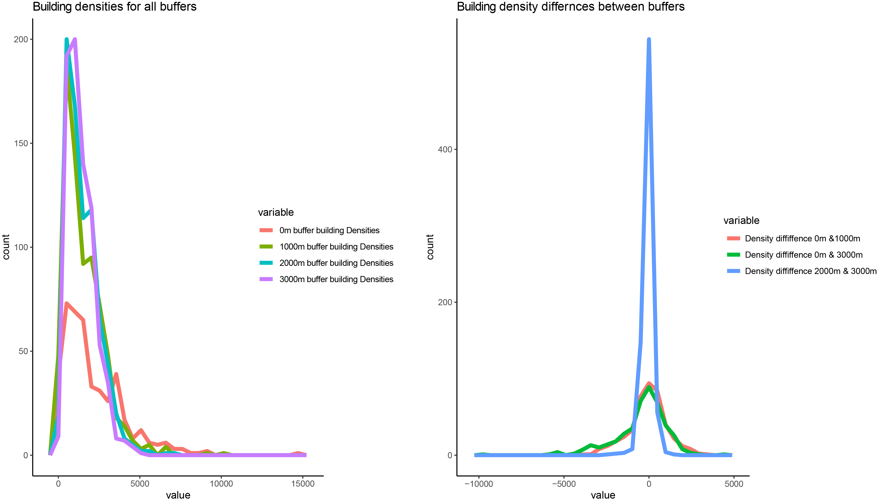
Building densities vary across different buffers sizes with cases of larger values in smaller buffers

Slide 9
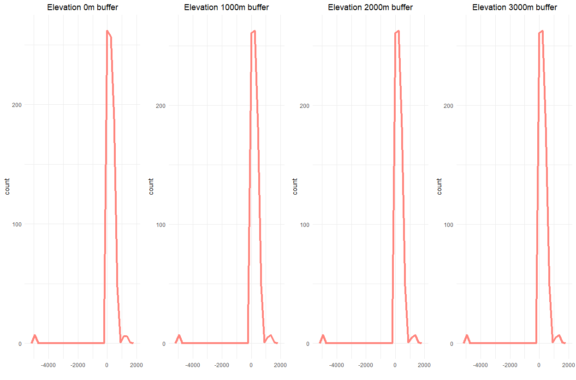
There is a slight difference in elevation regardless of buffers size

Slide 10
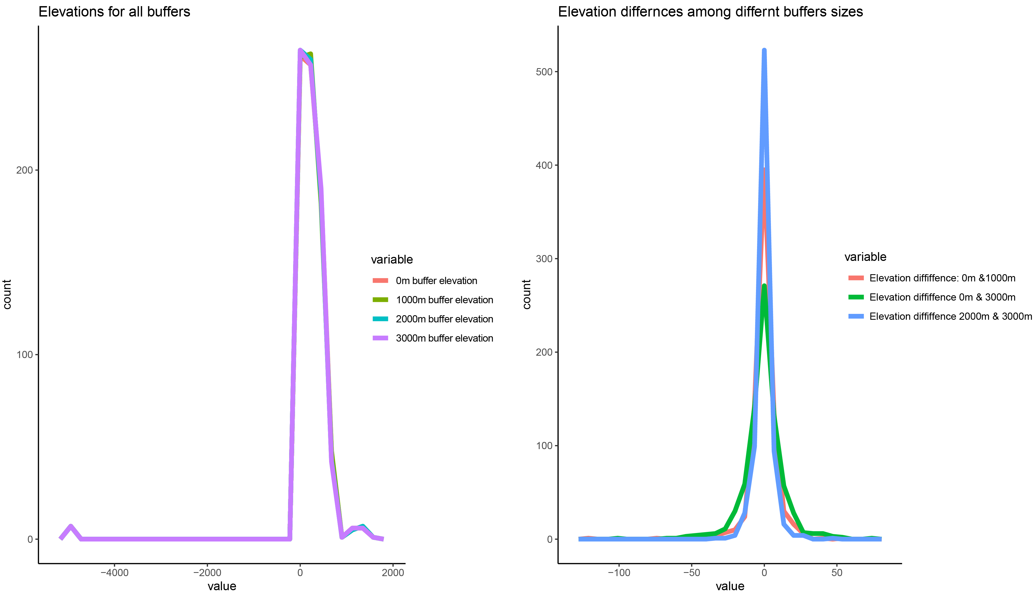
Elevation vary across different buffers sizes with cases of larger values in smaller buffers

