Slide 1
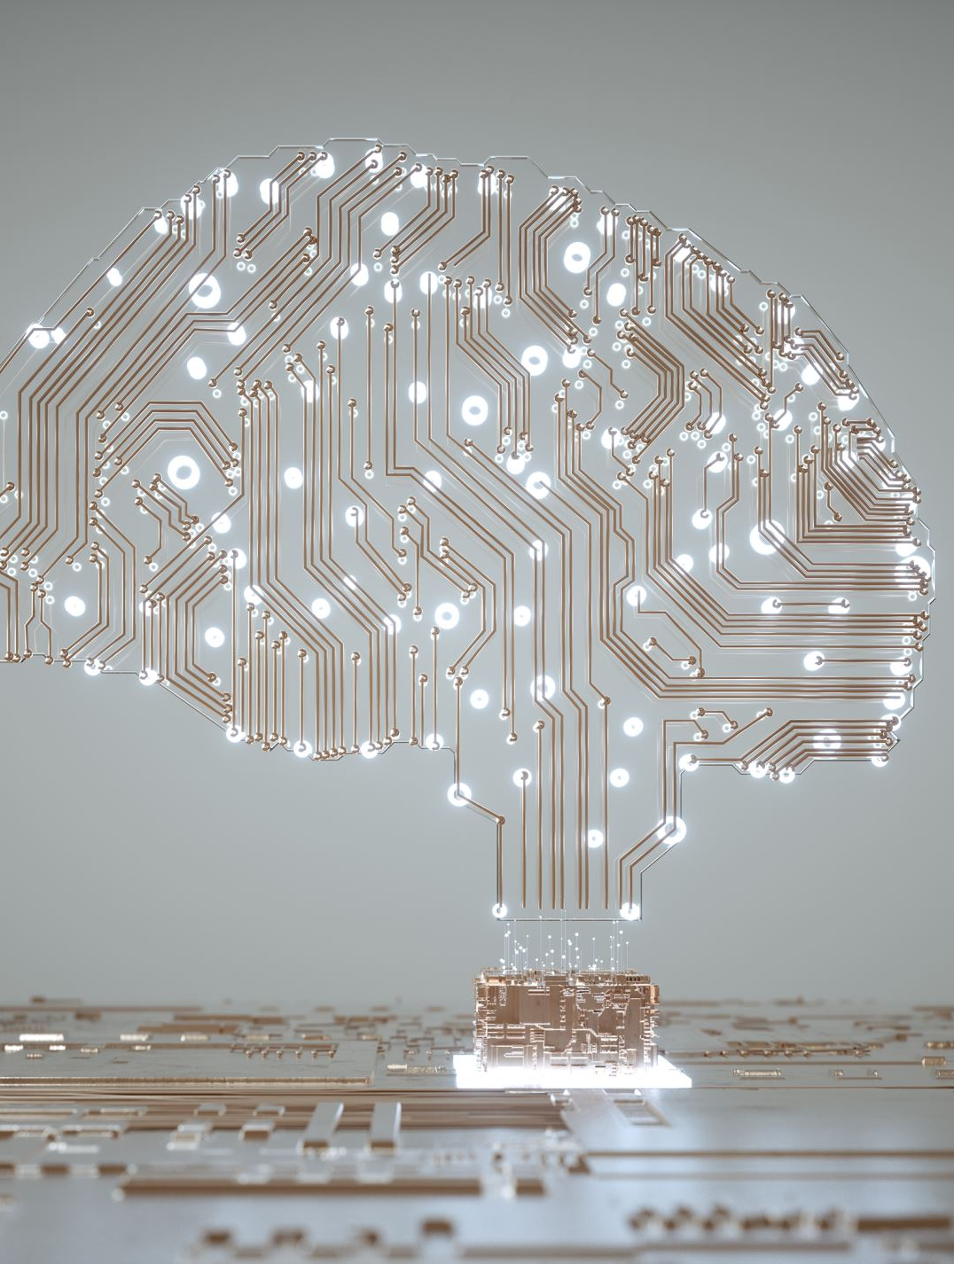
A.I.ducation Analytics
Group Name : NS – 01
Group Members:
Dara Rahmat Samii (40281972)
Numan Salim Shaikh (40266934)
Shahab Amrollahibioki (40292670)

Slide 2
Introduction
The goal of this project is to use PyTorch to create a Deep Learning Convolutional Neural Network (CNN) that can classify students into different states or activities based on the analysis of photos of them in a classroom or online meeting environment.
Stages of this Project :
Data Collection, Cleaning, Labelling & Preliminary Analysis
CNN Model Development and Basic Evaluation

Slide 3
Part 1
Preprocessing Data

Slide 4
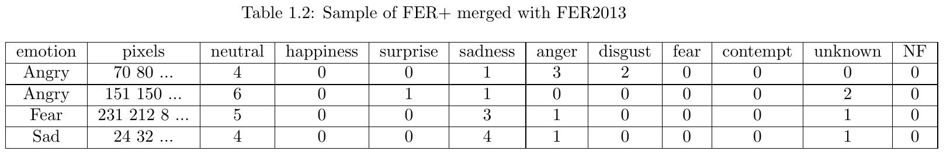
Data Collection, Cleaning, Labelling & Preliminary Analysis
The primary dataset employed in this project is the FER2013 dataset and FER+ dataset.
Comprising grayscale images, each measuring 48 × 48 pixels, the FER2013 dataset boasts an impressive total of 32,298 individual samples.
The FER2013 dataset categorizes emotions into seven distinct classes, each representing a unique spectrum of emotional expressions. These emotions encompass:
1. Angry 2. Disgust 3. Fear 4. Happy 5. Sad 6. Surprise 7. Neutral
FER+ is a crowed sourced scores for the given emotions.

Slide 5
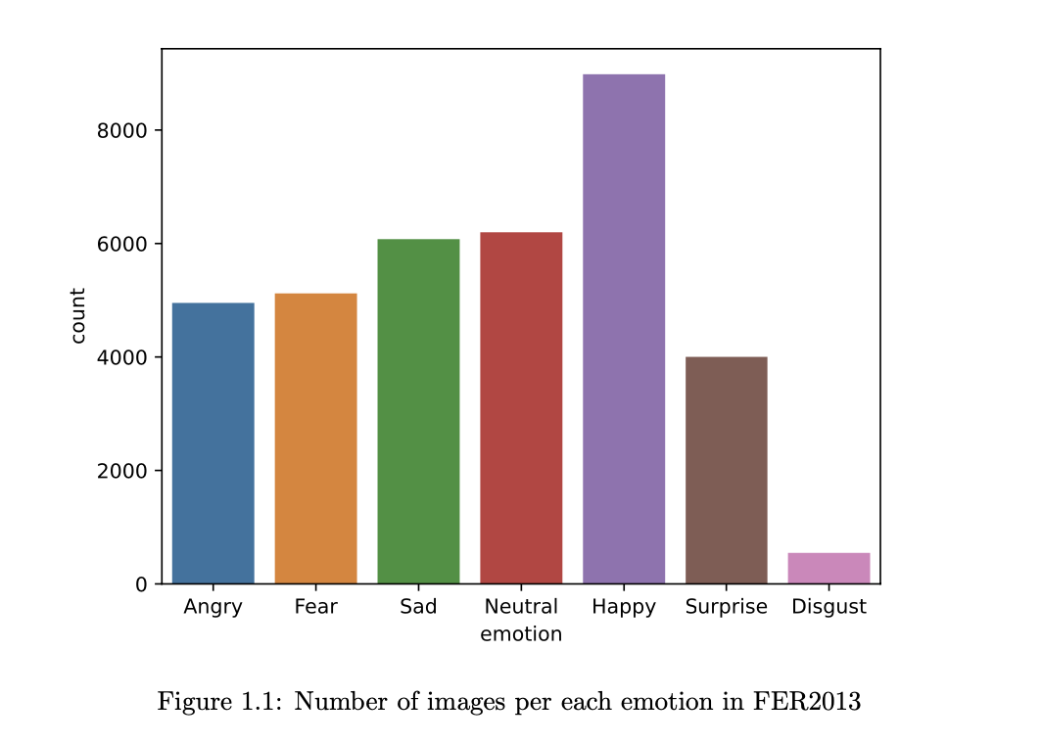
Facial Expression Initial Dataset
Raw dataset containing image samples of various facial expressions. We will apply filters to transform the images as per our requirement

Slide 6

Cleaning the Data
The number of images with a score N F = 10 is 176.
The number of images with a score N F = 4 is 2.
The number of images with a score N F = 2 is 4.
The number of images with a score N F = 1 is 167.
number of images with score unknown=8 is 3.
number of images with score unknown=7 is 3.
number of images with score unknown=6 is 18.
number of images with score unknown=5 is 55.

Slide 7
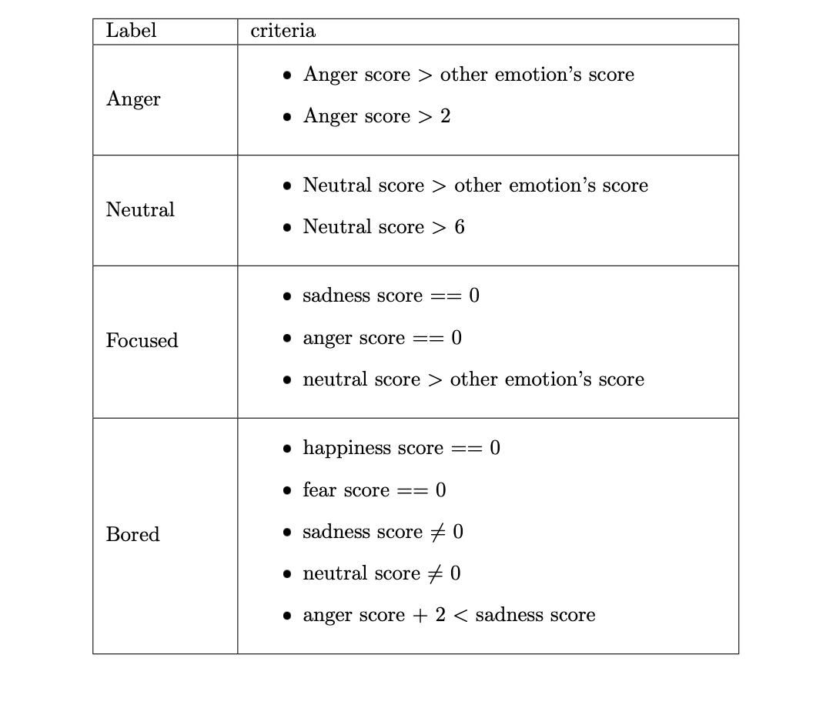
Data classification criterion
 Number of samples labeled as ’Neutral’: 3789
 Number of samples labeled as ’Angry’: 3954
 Number of samples labeled as ’Focused’: 4553
 Number of samples labeled as ’Bored’: 3960

Slide 8
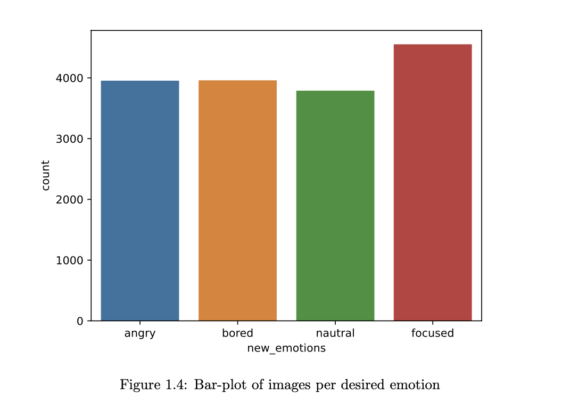
Final facial expression dataset after cleaning
It is imperative to classify images into four distinct labels. While the original dataset inherently includes the emotions Anger and Neutral, it lacked explicit representations for Bored and Focused emotions.

Slide 9
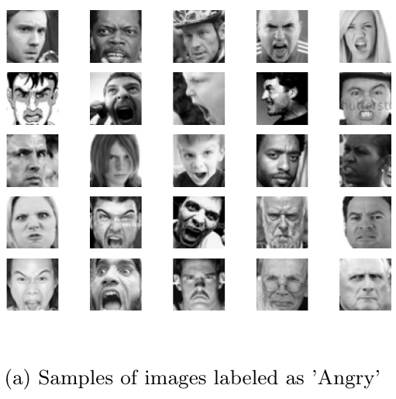
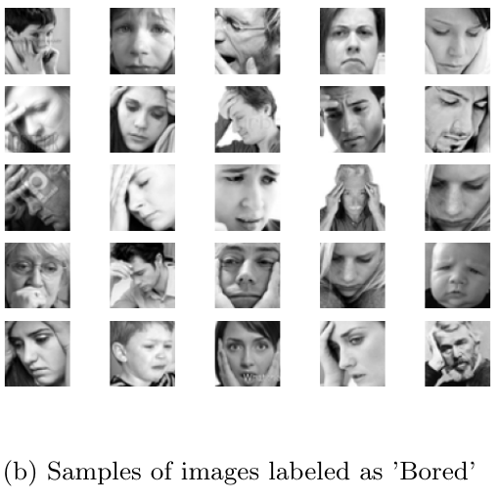
Sample of Dataset

Slide 10
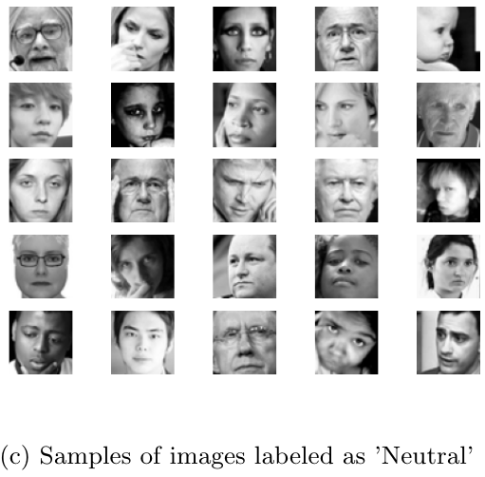
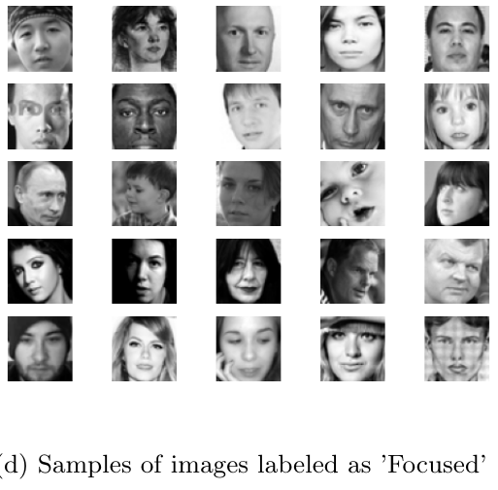
Sample of Dataset(Continue)

Slide 11
Part 2
Training the Models

Slide 12
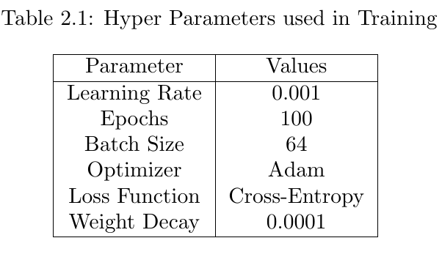
Model Architecture
Total number of 12 models were trained and evaluated
Kernel Sizes and Padding
(3 × 3): Padding was set to 1.
(5 × 5): Padding was set to 2.
(7 × 7): Padding was set to 3.
Number of Channels
16 channels
32 channels
Number of Resblocks
4 ResBlocks and 1 FC Layer
8 ResBlocks and 2 FC Layers

Slide 13
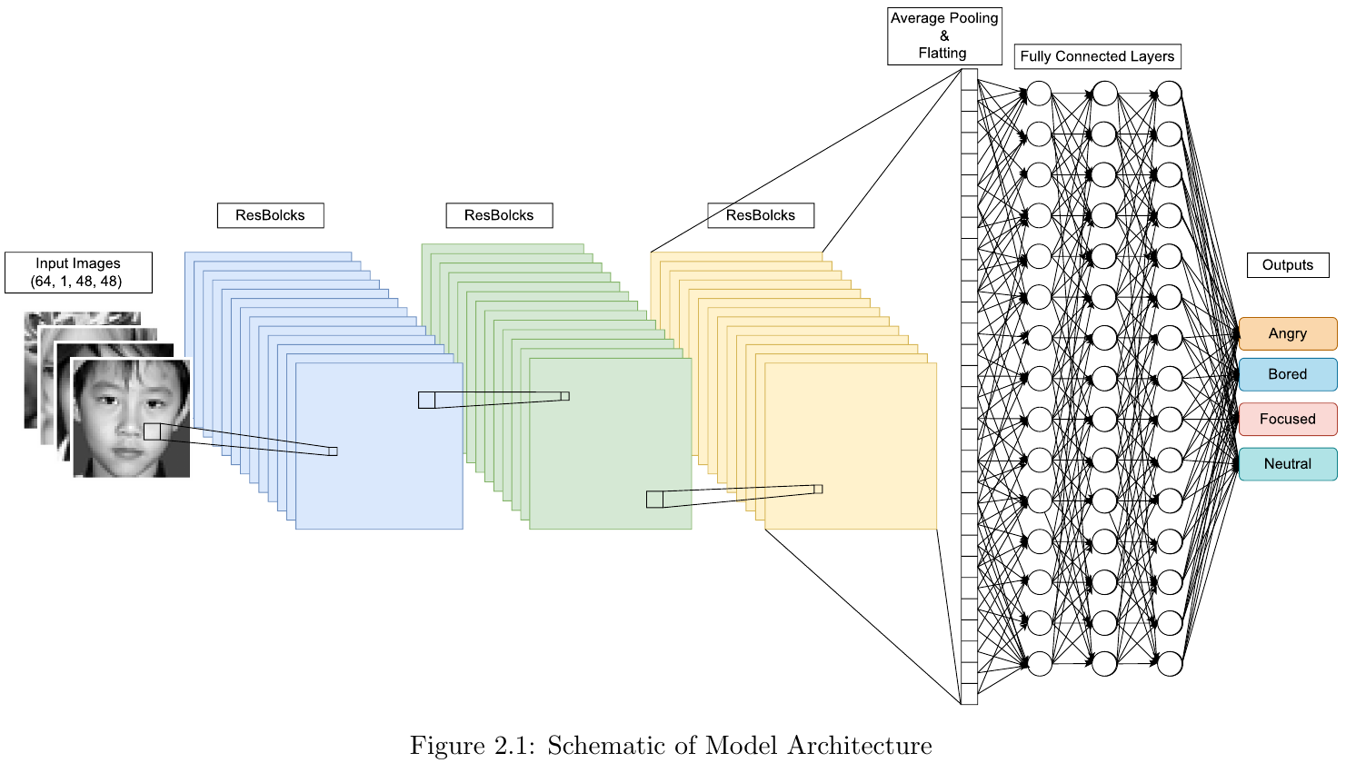
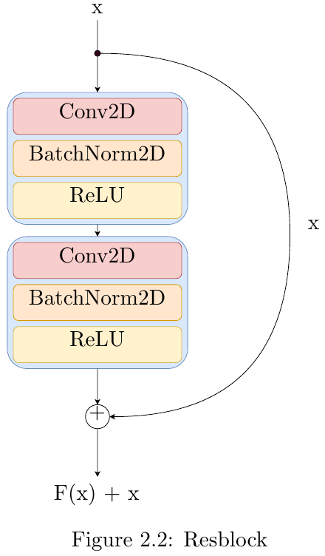
Model Architecture

Slide 14
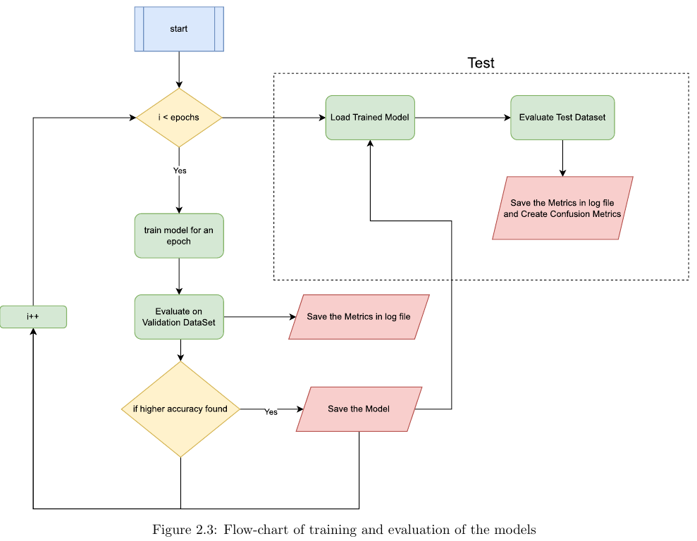
Coding Method
Class Learner
Train_one_epoch
Eval
Train_eval
Load
Save
Save_log
Load_logs
Print metrics
Plot metrics
Plot confusion matrixes

Slide 15
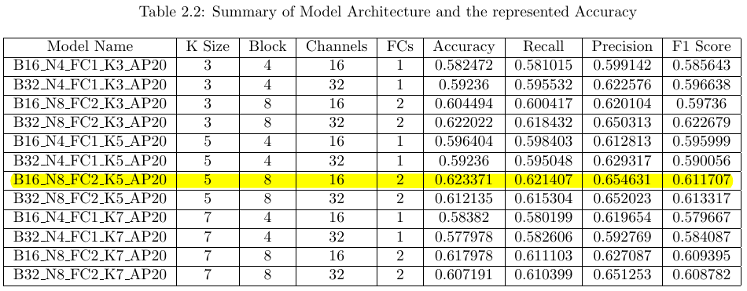
Results
As the categories are balanced in all the logs the micro metrics were exactly the same as the accuracy score.

Slide 16
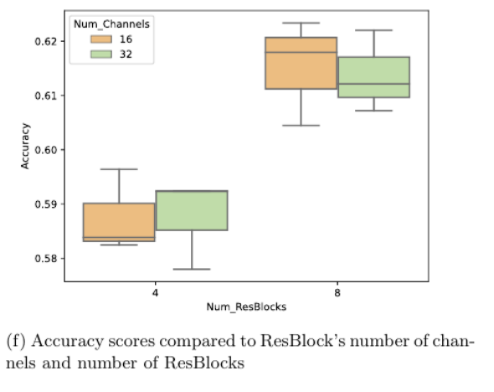
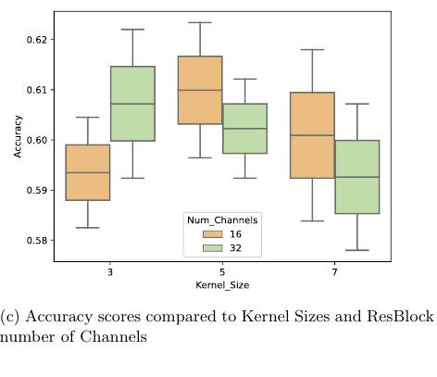
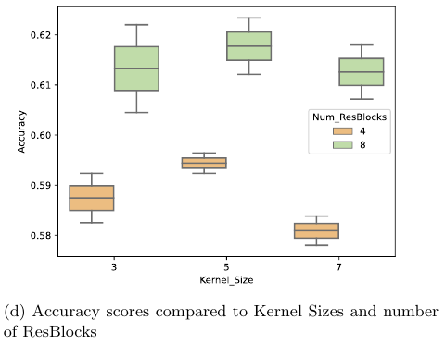
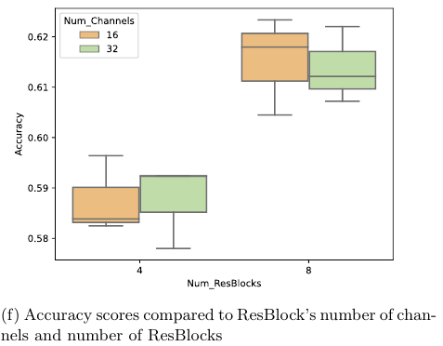
Model Comparison
Models with (5 × 5) kernel sizes outperform (3 × 3) and (7 × 7).
Positive correlation observed between ResBlocks and accuracy; 8 ResBlocks outperform 4.
No significant correlation found between channel count in ResBlocks and accuracy.

Slide 17
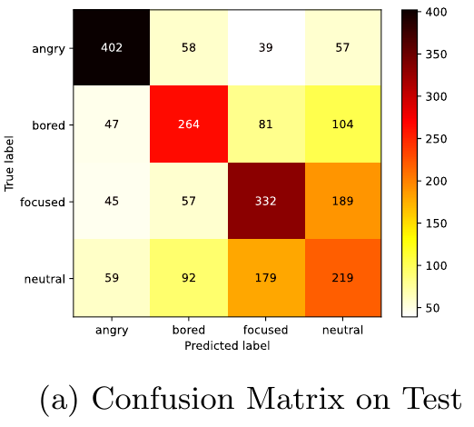
Confusion Matrix
Confusion Matrix shows strong performance in predicting ”Angry” and ”Bored” expressions.
Difficulty distinguishing between ”Focused” and ”Neutral” expressions.

Slide 18
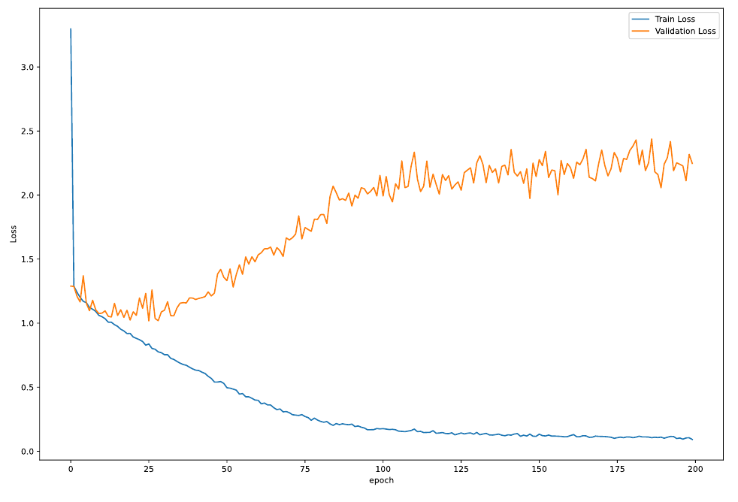
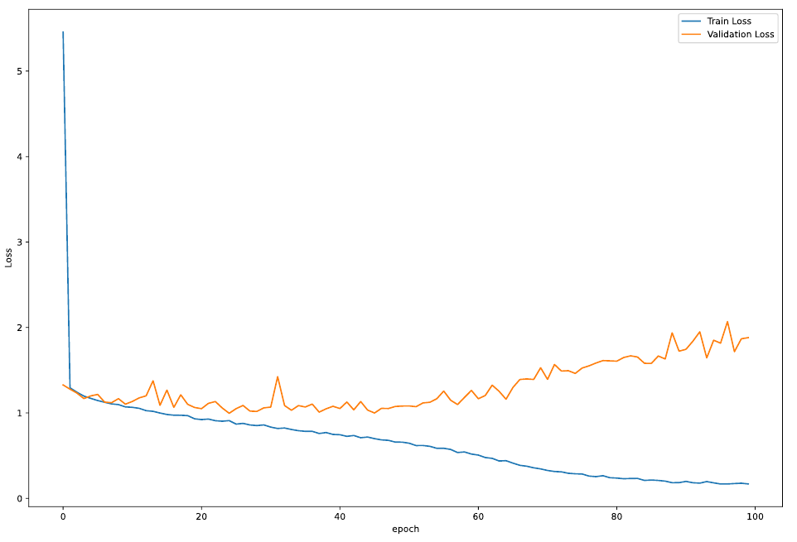
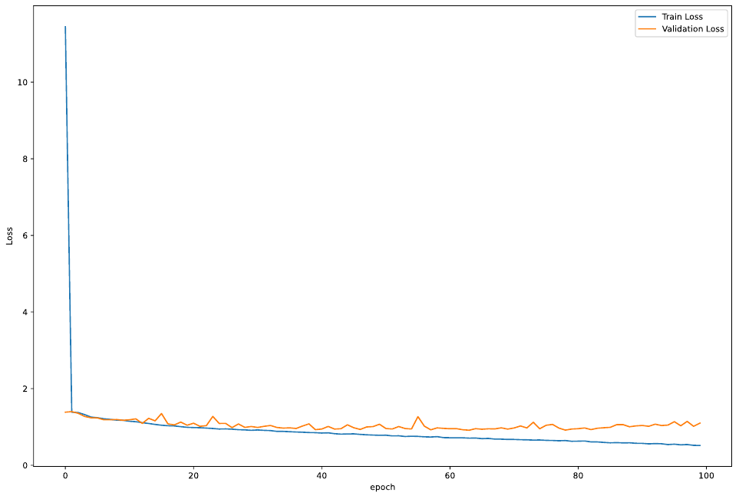
Train and Validation Loss
B16 N4 FC1 K3 AP20
B32 N4 FC1 K3 AP20
B32 N8 FC2 K3 AP20
As Models become Larger, with training progress then tend to fluctuate less

Slide 19
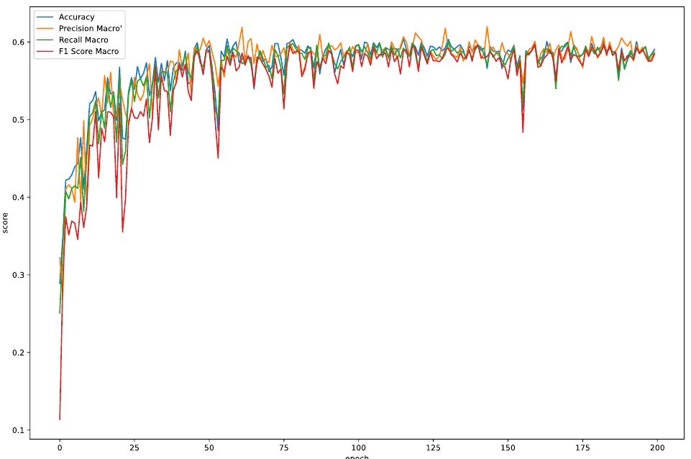
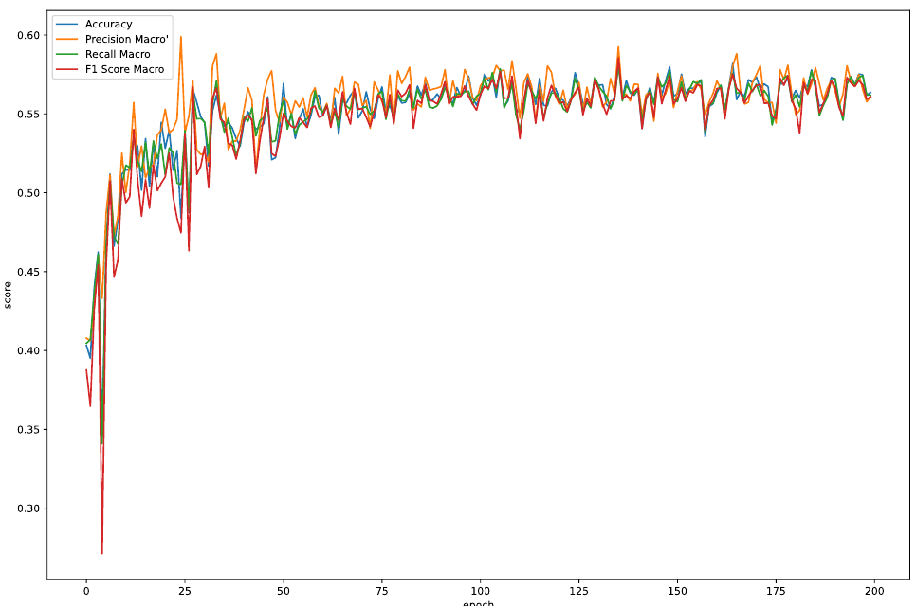
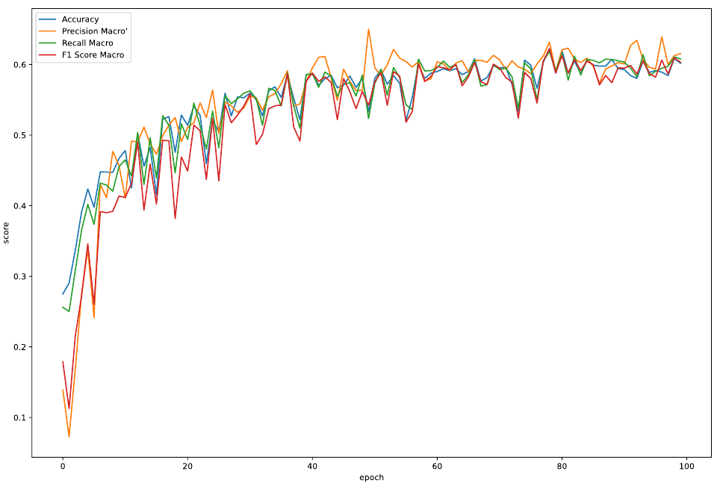
Metrics Plot
B16 N4 FC1 K3 AP20
B32 N4 FC1 K3 AP20
B32 N8 FC2 K3 AP20
Smaller Models' metrics rise and reach the threshold faster than bigger models

Slide 20
Summary
Models with (5 × 5) kernel sizes outperform (3 × 3) and (7 × 7).
Positive correlation observed between number of ResBlocks and accuracy; 8 ResBlocks outperform 4.
No significant correlation found between channel count in ResBlocks and accuracy.
Model B16_N8_FC2_K5_AP20 excels with an accuracy of 0.623371.
Confusion Matrix shows strong performance in predicting ”Angry” and ”Bored” expressions.
Difficulty distinguishing between ”Focused” and ”Neutral” expressions.
Loss plots indicate increased overfitting risk with fewer layers; larger models show more stability.

Slide 21
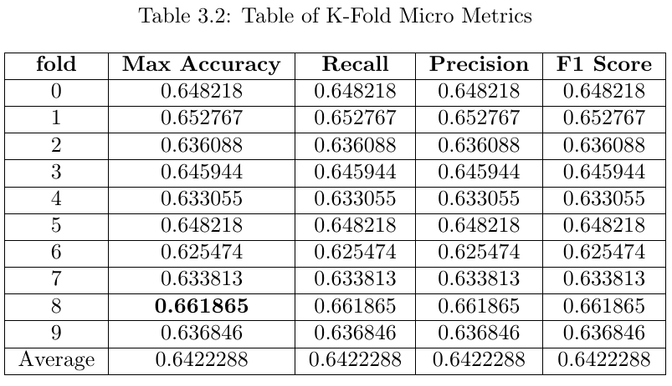
K-Fold

Slide 22
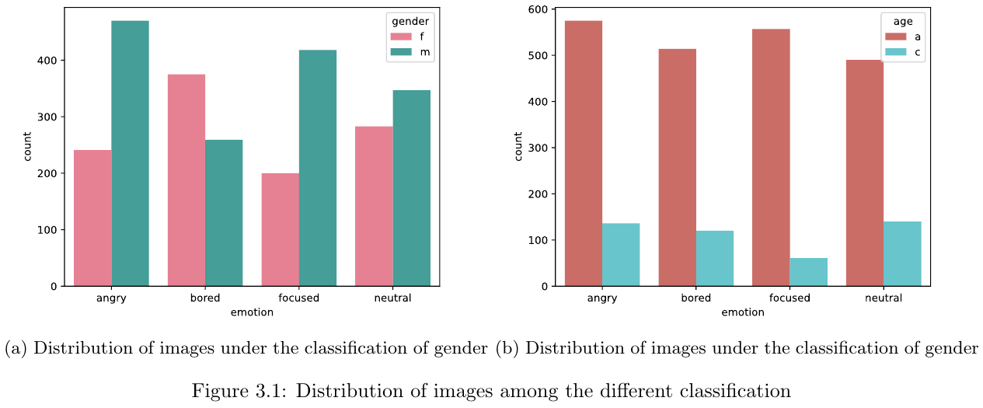
Bias Analysis

Slide 23
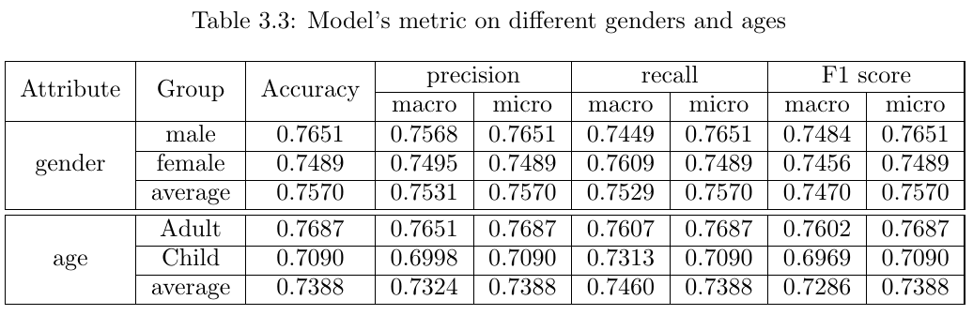
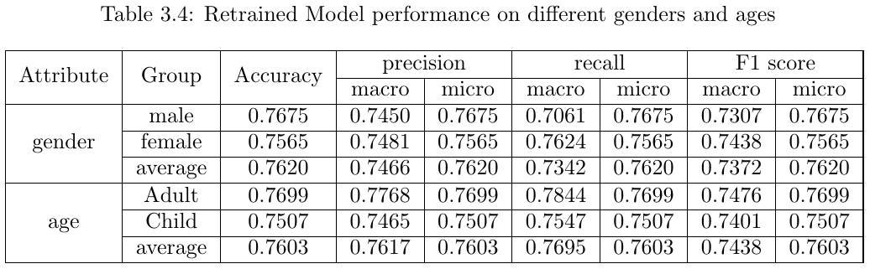
Retraining and Mitigating Bias

Slide 24
Thank You!

