Slide 1



Course Project 2: Microbiome data analysis of Zygnema green algae
Dr. Xuehuan Feng(Postdoc)
Xinpeng Zhang (PhD student)
Numan Islam (PhD student)
Department of Food Science and Technology
12/02/2024
PI: Yanbin Yin

Slide 2
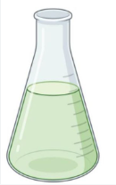
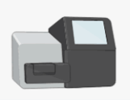








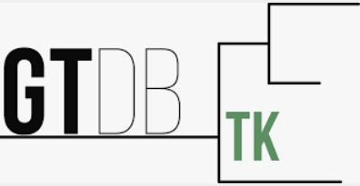


Workflow for Microbiome Data Analysis of Zygnema circumcarinatum MZCH241
Data preparation
MZCH241 microbiome (Algae & bacteria)
Data prepprocessing
Illumina sequencing of the MZCH241
Total reads
Remove host reads
Bacteria fungi reads
Taxonomy, Gene prediction & functional annotation
Assembly
Binning

Slide 3
Part III Assembly (~ 8hrs)

Slide 4
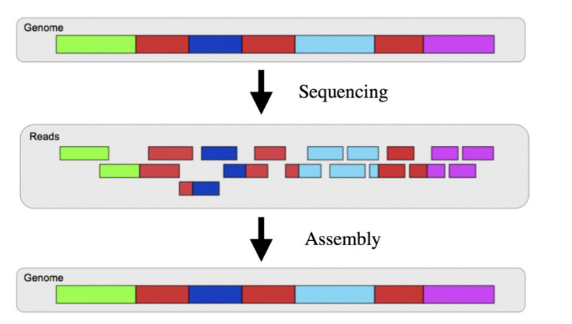
3.1 - Genome Reconstruction Workflow: From Sequencing Reads to Assembly
We will use cleaned and de-contaminated microbiome reads to re-construct the complete genomes.
Genome (Top Panel):
Represents the original genome as a continuous sequence (colored in blocks, each block representing a different part of the genome).
Sequencing (Middle Panel):
The genome is fragmented into smaller pieces during the sequencing process, producing reads.
These reads are short sequences of DNA (or RNA) generated by high-throughput sequencing technologies.
Note that these reads overlap to some extent, which is essential for the next step.
https://www.youtube.com/watch?app=desktop&v=V2xIGdEkA5U&t=985s

Slide 5
3.1 - Genome Reconstruction Workflow: From Sequencing Reads to Assembly
We will use cleaned and de-contaminated microbiome reads to re-construct the complete genomes.
Assembly (Bottom Panel):
Reads are computationally aligned and stitched together based on their overlapping regions to reconstruct the original genome.
The assembly process involves algorithms (e.g., De Bruijn graphs) to find the most accurate way to reassemble the genome.
The goal is to produce a contiguous sequence that closely resembles the original genome. The final output is called contigs or scaffolds.
https://www.youtube.com/watch?app=desktop&v=V2xIGdEkA5U&t=985s

Slide 6
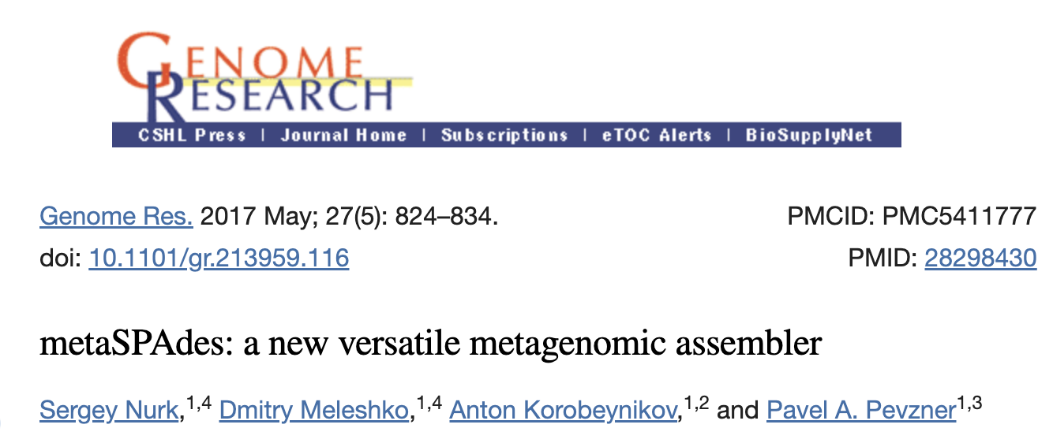
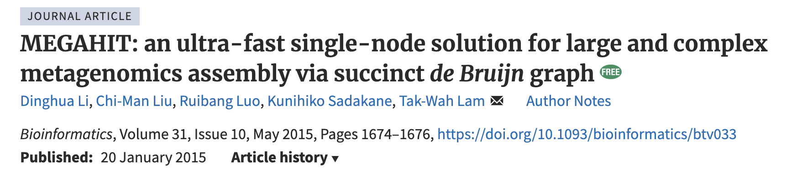
3.2 - Comparing Megahit and MetaSPAdes: Assembly Tools Using De Bruijn Graphs
We will try two different programs to make contigs separately
"Megahit": https://github.com/voutcn/megahit
"MetaSPAdes": https://github.com/ablab/spades
They are developed by similar algorithms using de bruijn graph.

Slide 7
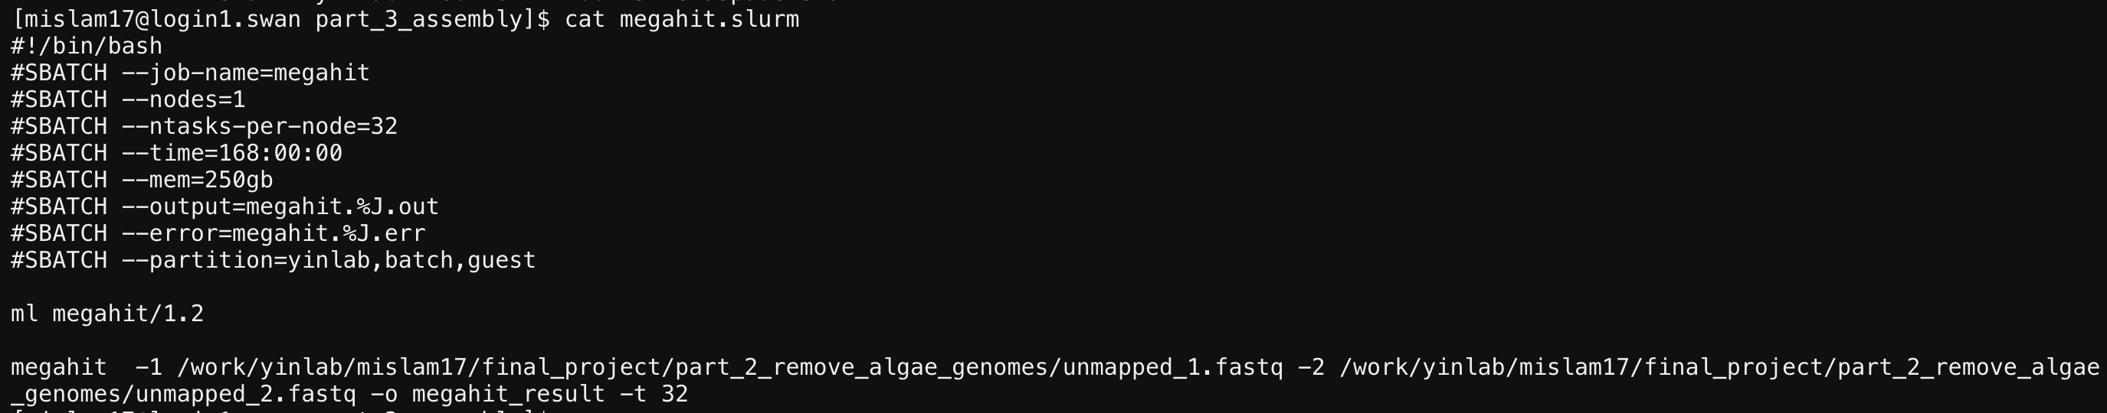
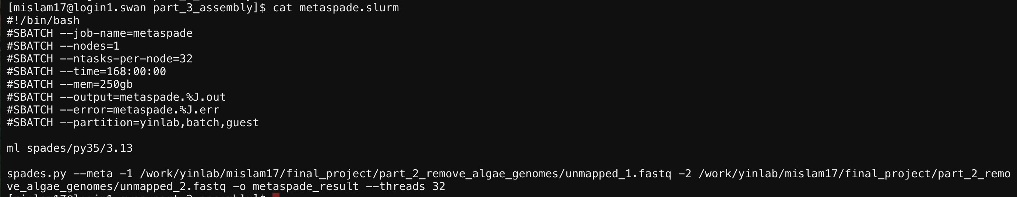
3.2 - Comparing Megahit and MetaSPAdes: Assembly Tools Using De Bruijn Graphs

Slide 8
3.2 - Comparing Megahit and MetaSPAdes: Assembly Tools Using De Bruijn Graphs
From the MEGAHIT, you will get the final result: final.contigs.fa
From MetaSPAde, you will get the final result: contigs.fasta.
Those are the final results we'll use in the next step.
In your report, mention the contig count and length (could find in the err/out files).
For this project, we recommend to use megahit result for the all the following analyses

Slide 9
Part IV Binning and bin refinement (~ 2.5hrs)

Slide 10
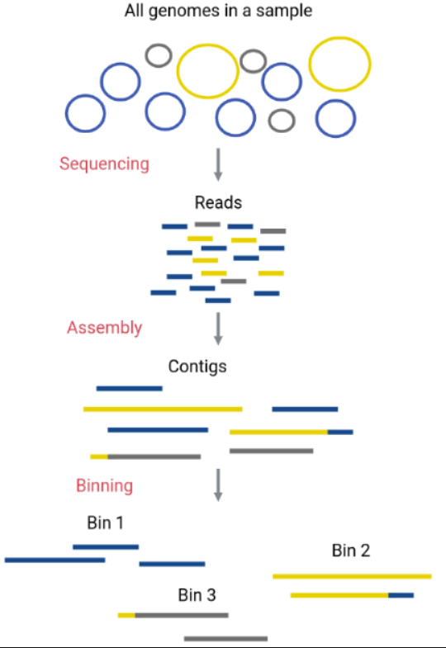
4.1 - Binning in Metagenomics: From Sequencing to Genome Reconstruction
Original Genomes in the Sample:
Metagenomic samples contain DNA from multiple microbial species, which are mixed together.
To study individual species, these genomes must be separated and analyzed independently.
Binning Process:
Definition: Binning is the process of assigning assembled contigs (longer DNA fragments reconstructed from short reads) into separate groups or "bins."
Purpose: Each bin ideally represents one genome, allowing separate analysis of species within the metagenome.
https://carpentries-lab.github.io/metagenomics-analysis/05-binning/index.html

Slide 11
4.1 - Binning in Metagenomics: From Sequencing to Genome Reconstruction
Reconstruction of Genomes:
After binning, the contigs grouped into each bin can be used to reconstruct microbial genomes.
These reconstructed genomes are called Metagenome-Assembled Genomes (MAGs).
Binning Output:
Bins are typically saved as separate FASTA files, each containing the contigs assigned to a single bin.
Ideally, each FASTA file corresponds to one genome (a MAG), representing one species or strain from the original metagenome.
https://carpentries-lab.github.io/metagenomics-analysis/05-binning/index.html

Slide 12
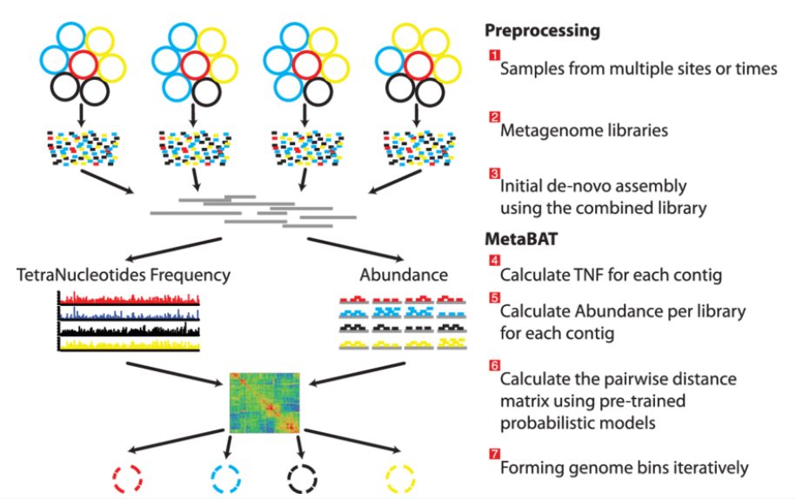
4.1 - Binning in Metagenomics: From Sequencing to Genome Reconstruction
Overview of the MetaBATpipeline
https://www.researchgate.net/publication/281541332_MetaBAT_an_efficient_tool_for_accurately_reconstructing_single_genomes_from_complex_microbial_communities

Slide 13
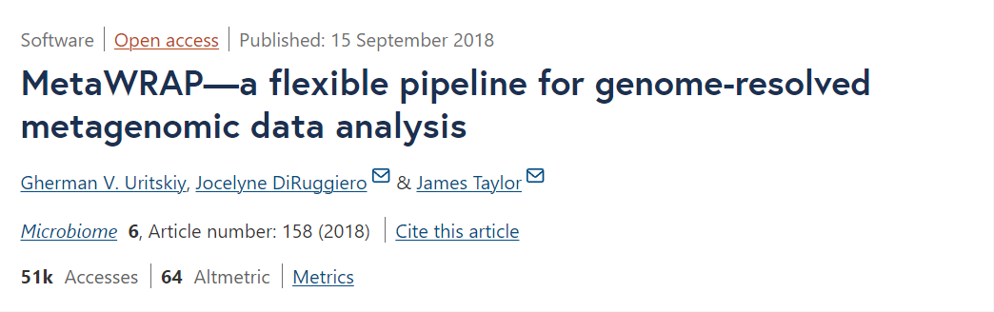
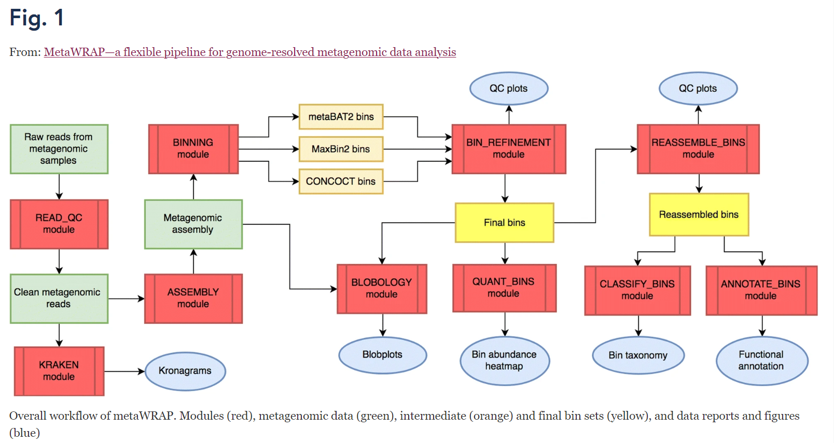
4.2 - MetaWRAP: A Comprehensive Pipeline for Genome-Resolved Metagenomic Analysis
We'll use "MetaWRAP", which contains three different methods.
https://github.com/bxlab/metaWRAP
MetaWRAP is a flexible pipeline for genome-resolved metagenomic data analysis. It could finish the metagenomic analysis from start to the end: read quality control, assembly, visualization, taxonomic profiling, extracting draft genomes (binning), and functional annotation(because it includes different tools as packages such as FastQC we used).
In the future you could use it for your own research, here we'll only use the binning part.

Slide 14
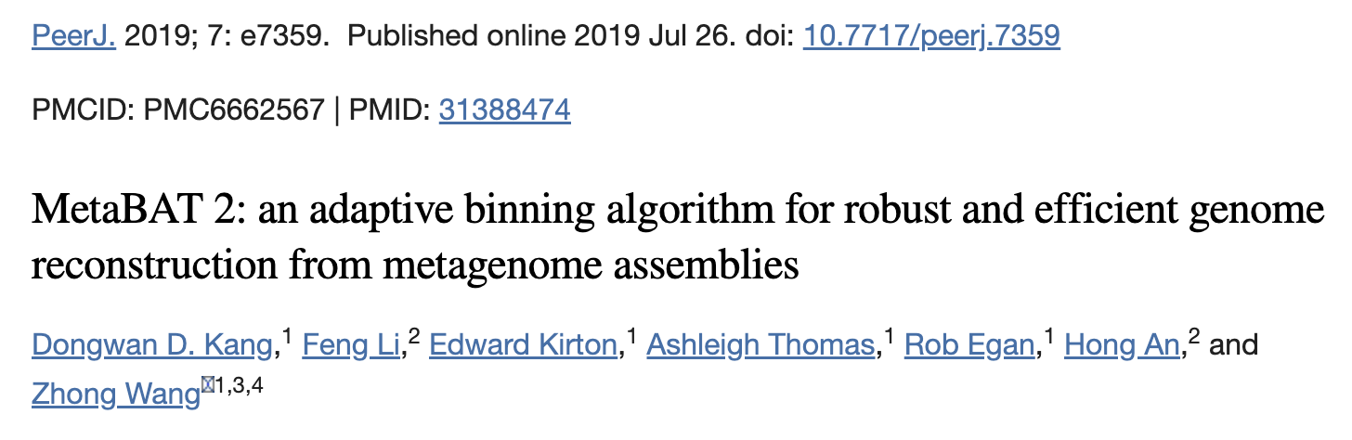
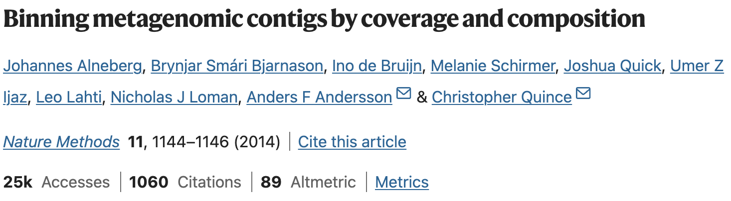
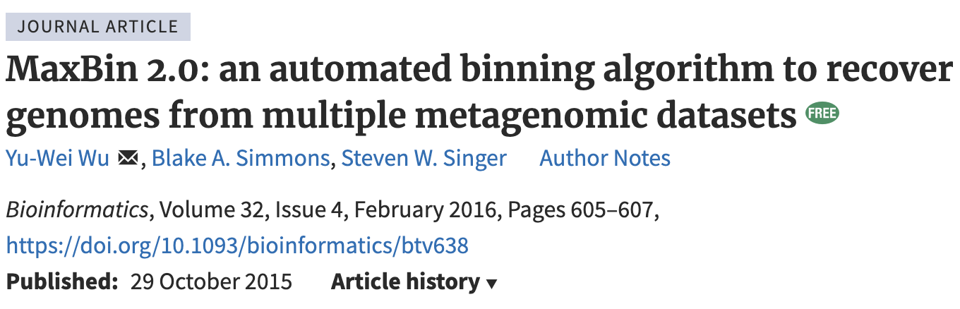
4.2 - MetaWRAP: A Comprehensive Pipeline for Genome-Resolved Metagenomic Analysis
In the binning part, it includes three different program:
MetaBAT2: https://bitbucket.org/berkeleylab/metabat/src/master/
CONCOCT: https://github.com/BinPro/CONCOCT
MaxBin2: https://github.com/assemblerflow/flowcraft/blob/master/docs/user/components/maxbin2.rst

Slide 15
4.2 - MetaWRAP: A Comprehensive Pipeline for Genome-Resolved Metagenomic Analysis
In your report, you could discuss the difference among three programs.
MetaWRAP will combine those three results, give the combinations, for example, A&B, A&C, B&C, A&B&C, and recommend the best result. This step is called "bin refinement".

Slide 16
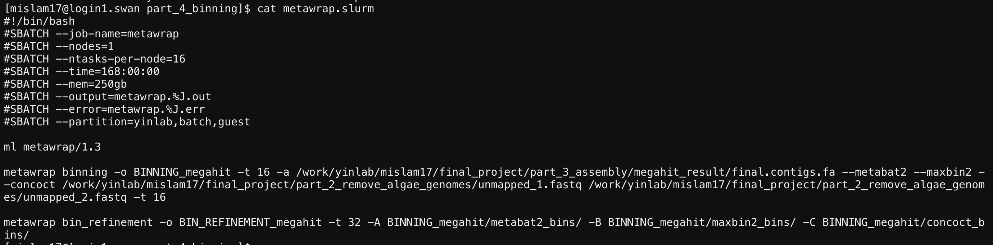
4.2 - MetaWRAP: A Comprehensive Pipeline for Genome-Resolved Metagenomic Analysis

Slide 17
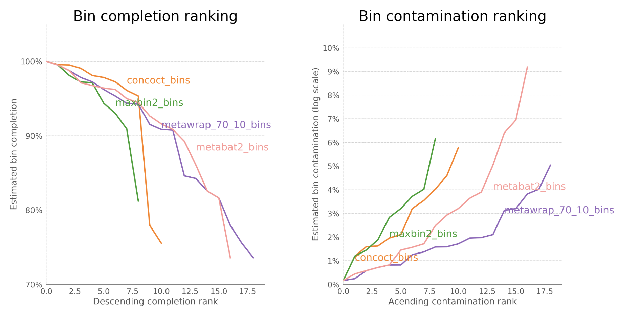
4.3 - Bin Quality Assessment: Completion and Contamination Rankings for MAGs
You will find this figure in theresult folder.
Results are in BIN_REFINEMENT_megahit/metawrap_70_10_bins/*.fa, each is a MAG.

Slide 18
Part V Bin quality check with CheckM2 (~ 30mins)

Slide 19
5.1 - Assessing MAG Quality with CheckM
The output of bin_refinement are: BIN_REFINEMENT_megahit/metawrap_70_10_bins/*.fa.
Those fa files are the MAGs we need. Next we‘ll check the quality and contamination(for example, if it contains wrong reads from other bacteria) of those MAGs.
MetaWRAP includes the program CheckM (default is completeness >70.0%, contamination <10.0%, that‘s the output folder name, metawrap_70_10_bins).

Slide 20
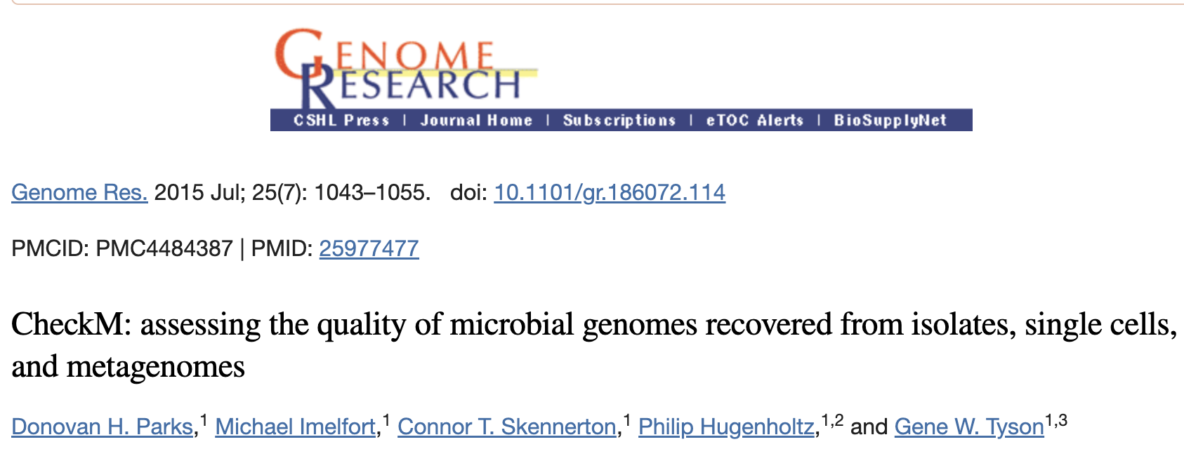
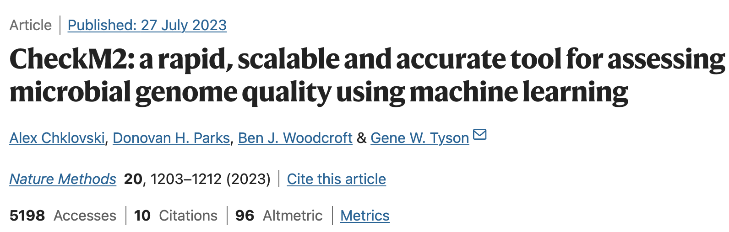
5.1 - Assessing MAG Quality with CheckM
CheckM was updated to CheckM2

Slide 21
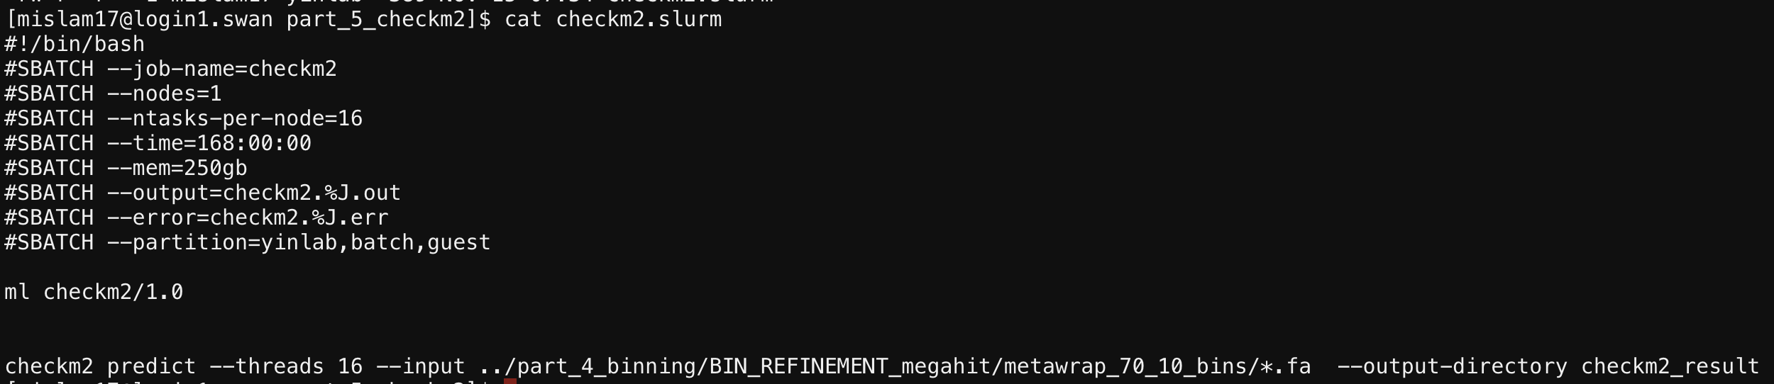
5.1 - Assessing MAG Quality with CheckM
So we'll run the new version CheckM2 to check the quality again.
https://github.com/chklovski/CheckM2

Slide 22
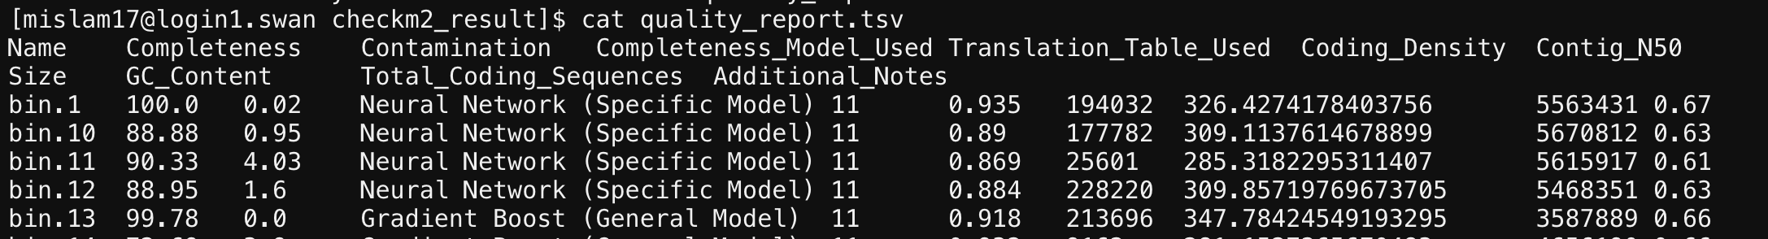
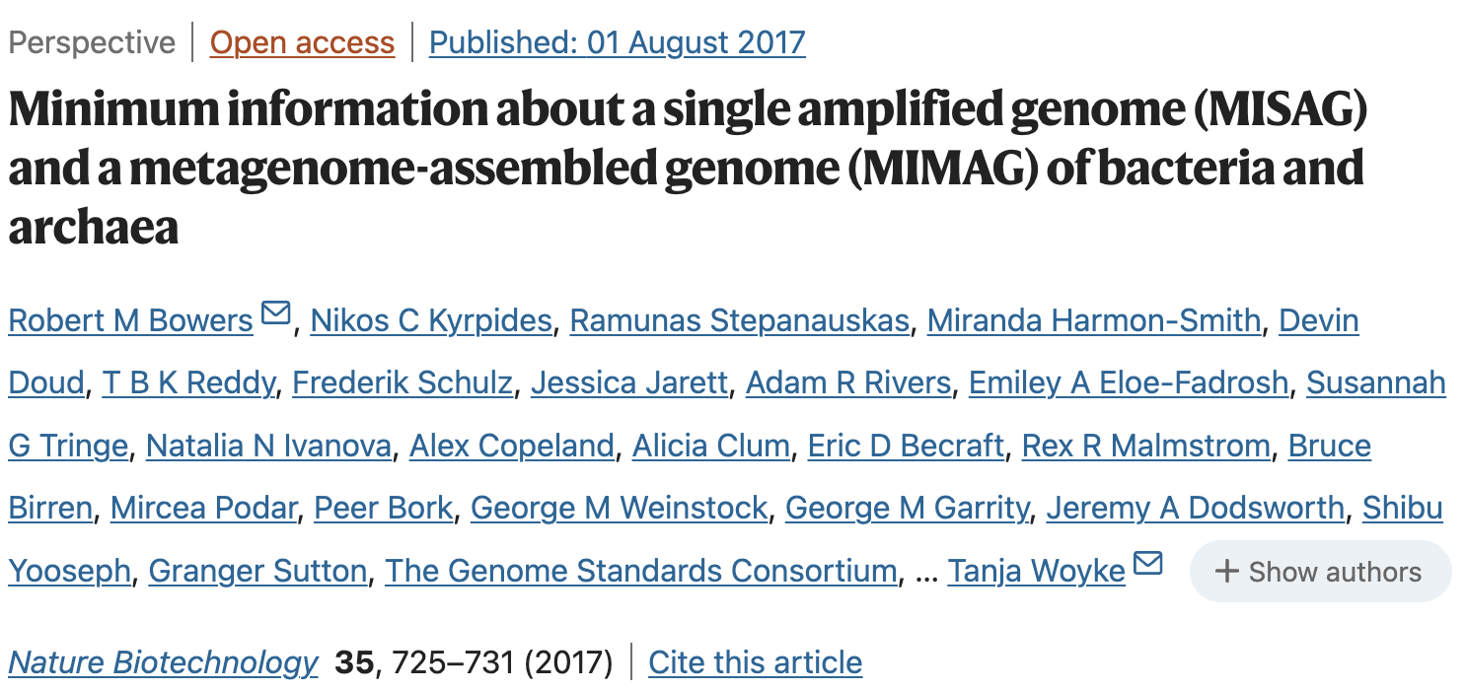
5.1 - Assessing MAG Quality with CheckM
In your report, you should report the whole table of this result.
In the MIMAG paper (see links below), they recommend "more than 90% complete and have less than 5% contamination" as the high-quality MAGs. Report which are the high-quality MAGs.
https://www.nature.com/articles/nbt.3893

Slide 23
Part VI Taxonomy annotation (~ 1-2hrs)

Slide 24
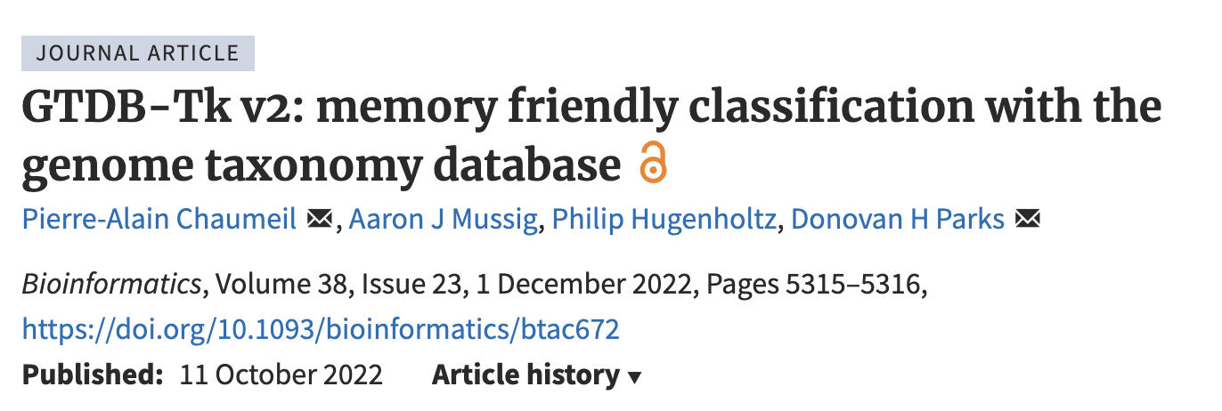
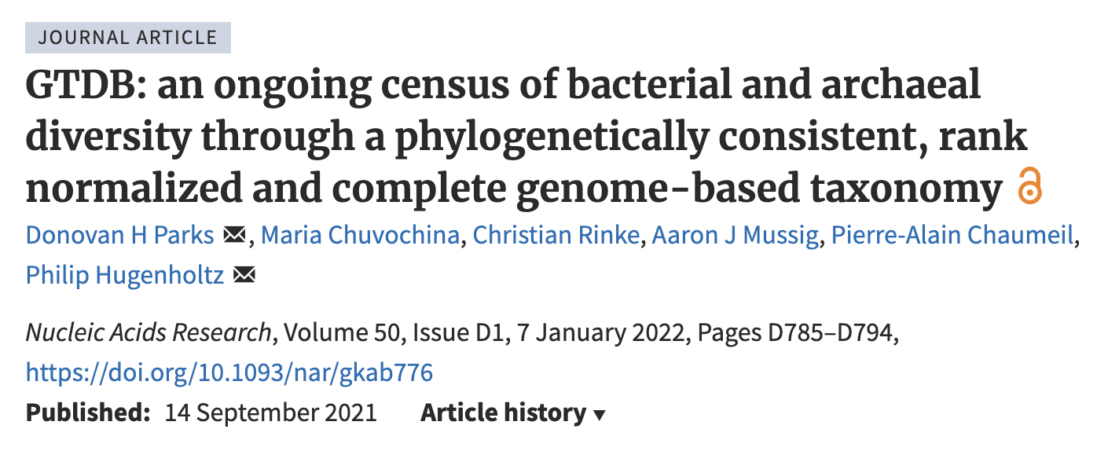
6.1 - Taxonomic Annotation of MAGs Using GTDB and GTDB-Tk
Answer the question: what taxonomic groups do my MAGs belong to?
We'll use the bins( MAGs) to do the taxonomy annotation by "GTDBtk".
GTDB(Genome Taxonomy Database) is a very famous database for taxonomy, and the tool GTDBtk is to do the tax annotation based on that.

Slide 25
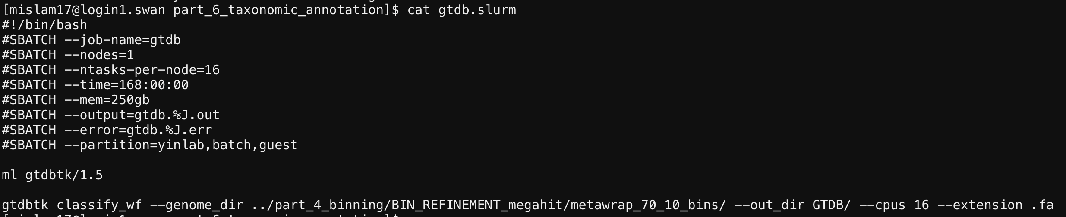
6.1 - Taxonomic Annotation of MAGs Using GTDB and GTDB-Tk
Here we use all the MAGs (70% comp, 10 cont), but in real project, people often only do it for high quality MAGs.

Slide 26
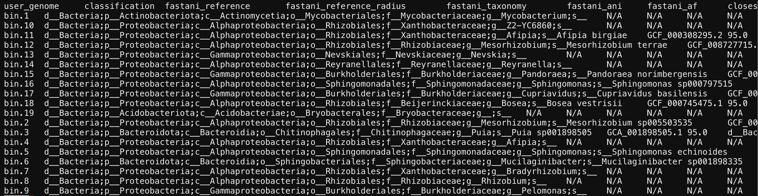
6.1 - Taxonomic Annotation of MAGs Using GTDB and GTDB-Tk
Create a table to report this result.
For each bin, check the details of taxonomy and report.

Slide 27
Part VII Gene prediction and functional annotation (~ 8hrs)

Slide 28
Answer the question: what functional genes do my MAGs encode?
First we need predict proteins by genes from MAGs
Called gene prediction
Then annotate the function of each protein
Called gene annotation

Slide 29
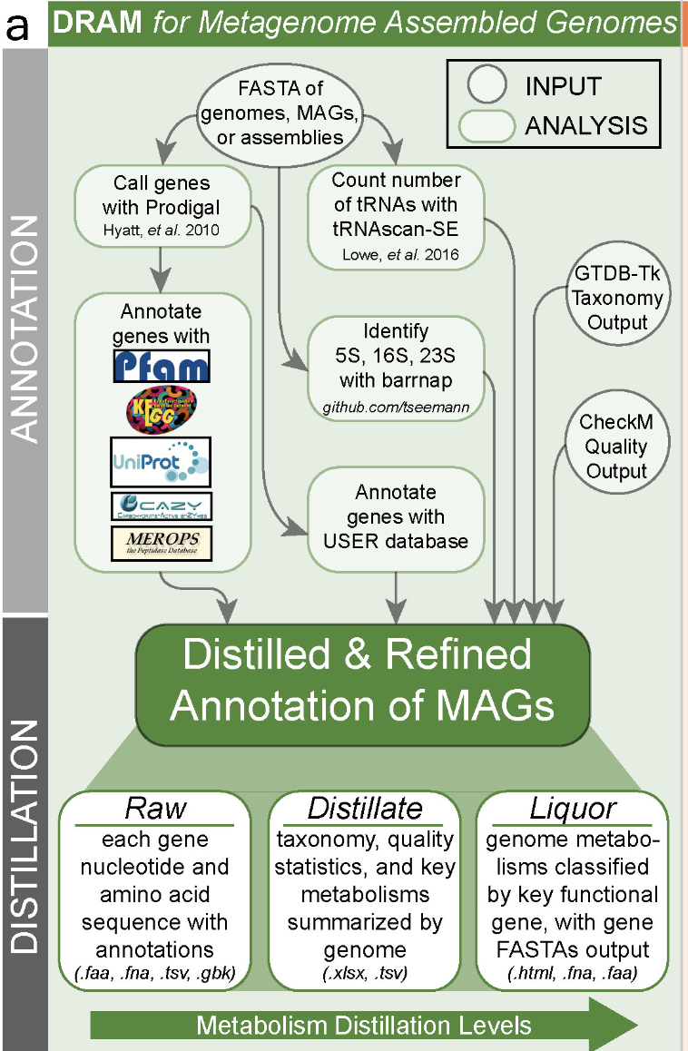
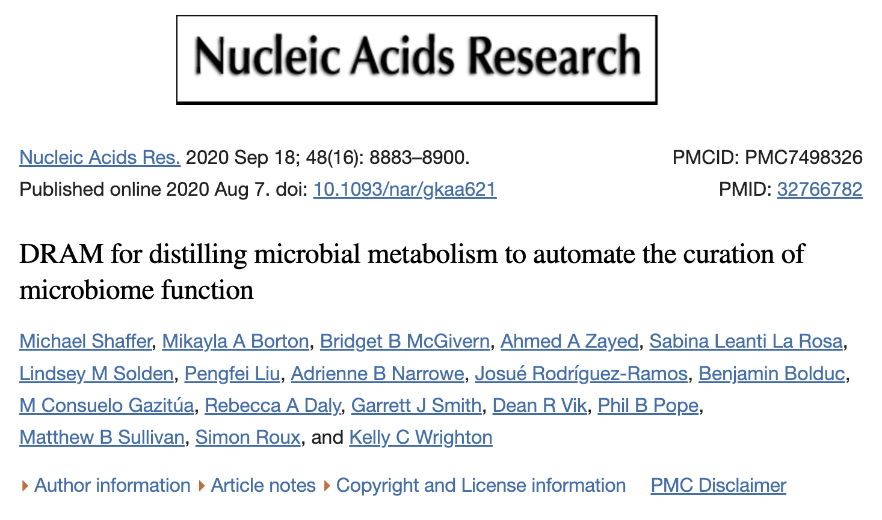
We'll use "DRAM", which does both.
DRAM integrates different tools for both steps including 7 different databases (including dbCAN) for functional annotation (focus on metabolic enzymes).
https://www.ncbi.nlm.nih.gov/pmc/articles/PMC7498326/
https://github.com/WrightonLabCSU/DRAM/wiki

Slide 30
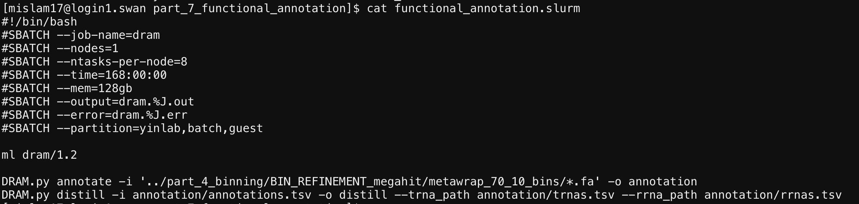

Slide 31
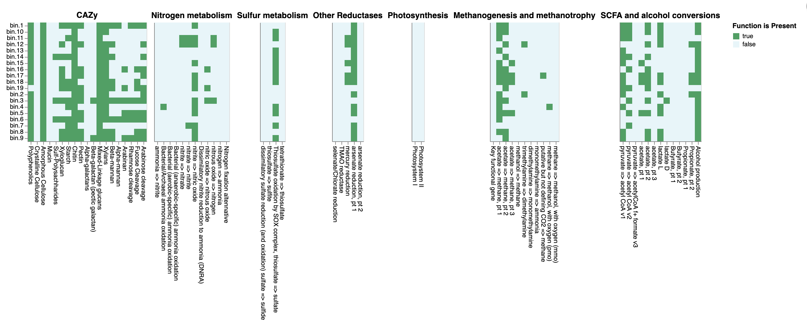
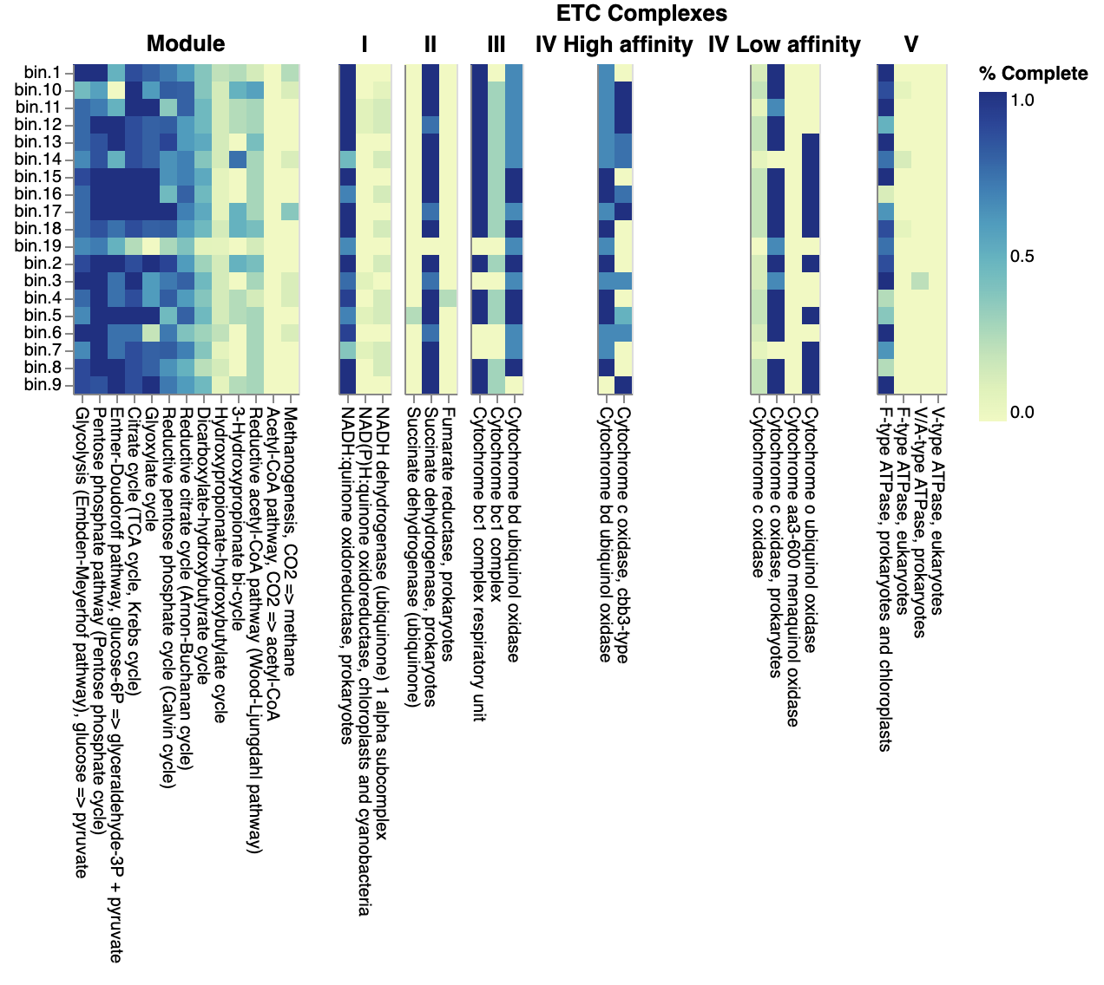
You would get two heatmaps for metabolism.
Report and explain the results(html file) combined with your taxonomy annotation for each MAG.

Slide 32
Summary
We reconstructed MAGs based on raw reads.
For each part you need a result figure and table (if has).
Report the questions and discussion we mentioned in the slides.

Slide 33
Any questions?

