Slide 1

Bit2Bit
Bangalore Institute of Technology, Bengaluru
🎓 STUDENT PARTICIPANTS
👨‍🏫 FACULTY PARTICIPANTS
Dr. Girija J (Backend Dev)
Prof. Thanuja T (Frontend Dev)
Numan Ulla Khan (Team Lead & Backend-AI/ML)
Shweta Kumari (Frontend)
Majushree H (Frontend)
Tejas Gowda G M (UI/UX)
eMudhra Hackathon 2026

Slide 2
Problem Statement
❓ What Problem?
🟣 Root Cause
⚡ Why Important?
Anomaly detection tools analyze isolated events, not how an entity's behavior evolves over time , so meaningful shifts go undetected until damage is already done.
Sequential activity (commits, contributors, dependencies) is rarely modeled as a continuously evolving identity, so teams lack tools to detect meaningful drift over time , only point-in-time anomalies.
Security, DevSecOps & engineering teams depend on early, explainable signals of risk in the open-source software they build and depend on.
BehaviorDrift • eMudhra Hackathon 2026 • Bangalore Institute of Technology

Slide 3
Proposed Solution
BehaviorDrift -Universal Behavioral Drift Intelligence Engine
Solution Overview
Behavior-First
BehaviorDrift learns an entity's historical behavioral identity from sequential data and continuously monitors for behavioral drift. The MVP demonstrates this on GitHub repositories, analyzing weekly activity to generate explainable, evidence-backed drift reports.
Drift detection & characterization
Memory-Driven
How It Addresses the Problem
Memory stores behavioral fingerprints for historical drift comparison
Aggregates GitHub activity into weekly behavioral feature vectors
Compares current behavior against learned historical identity to flag drift
Investigates flagged drift using statistical evidence + commit context
Explainable
Anomaly-scored, human-readable risk reports via AI agents
BehaviorDrift • eMudhra Hackathon 2026 • Bangalore Institute of Technology

Slide 4
Features & Workflow
Workflow
📊 Behavioral Vectors
🔍 Drift Detection
1. Collect Repo Activity
Repo activity becomes weekly feature vectors: commits, contributors, dependency changes
Current behavior vector compared against historical identity baseline to flag behavioral drift
▼
2. Build Behavioral Vectors
🤖 AI Investigation
📄 Explainable Reports
▼
AI agent investigates flagged drift using statistical evidence + commit context; fingerprints persist to Qdrant for retrieval-driven detection next
Risk reports with anomaly scores, built for security & DevSecOps teams
3. Detect & Investigate Drift
▼
4. Generate Explainable Report
BehaviorDrift • eMudhra Hackathon 2026 • Bangalore Institute of Technology

Slide 5
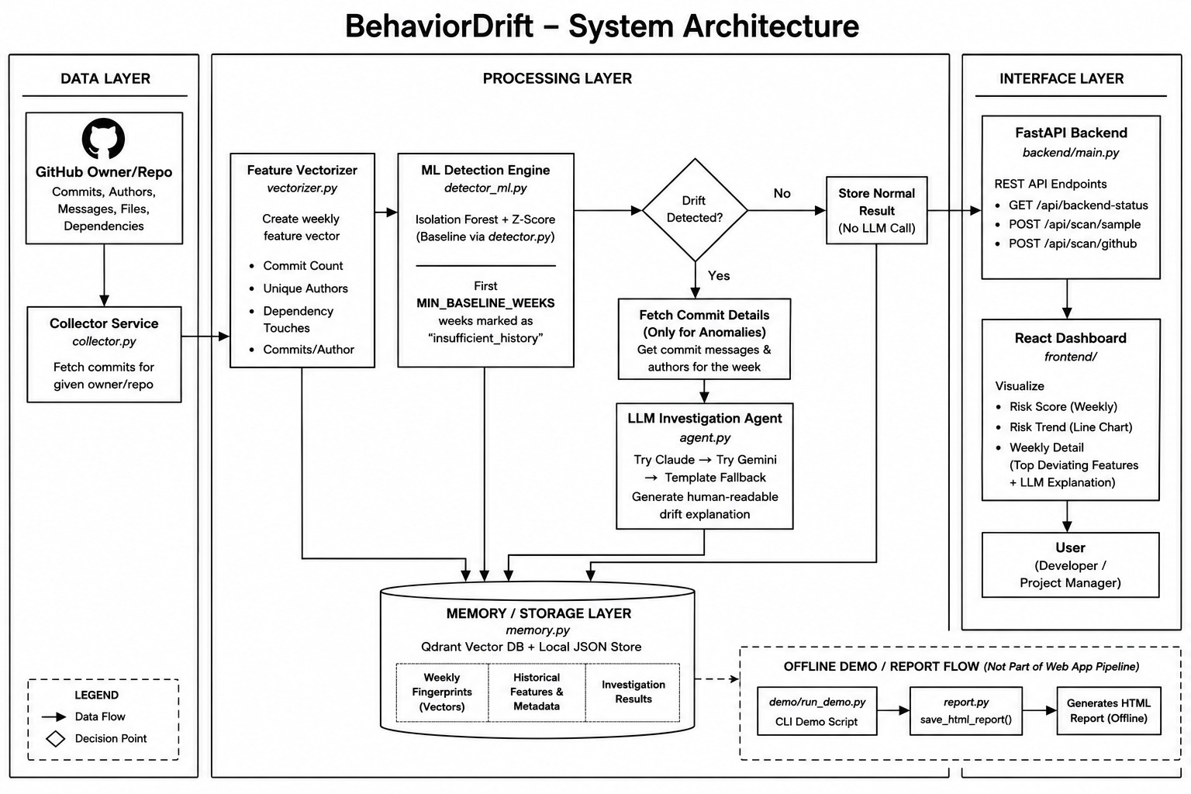
System Architecture
BehaviorDrift • eMudhra Hackathon 2026 • Bangalore Institute of Technology

Slide 6
MVP, Security & Compliance
🎯 Focused MVP
🔌 API-First & Modular
🔒 Secure & Compliant by Design
The MVP already proves the full loop end to end i.e. collect, vectorize, detect, explain, remember as a working FastAPI + React product.
Collector, vectorizer, detector, agent, and memory are independent modules behind one API, so any new activity source plugs into the same detection core.
Secrets via environment variables, scoped GitHub tokens, CORS allow-listing, and a no-LLM-key fallback path so nothing has to leave a customer's environment.
🛠 Guardrails Already Honored
📋 Roadmap to Enterprise-Grade
No proprietary lock-in : Claude, Gemini, and offline template are interchangeable
Fully automated pipeline :no manual step required to produce a report
Runs and is tested completely offline, so evaluation never needs live keys
SSO & role-based access for multi-tenant deployments
Configurable data retention and residency per customer
SOC2-aligned logging and audit trail for compliance-sensitive buyers
BehaviorDrift • eMudhra Hackathon 2026 • Bangalore Institute of Technology

Slide 7
Competitive Landscape
🛡️ Signature Scanners
📉 Generic Anomaly Tools
✅ BehaviorDrift
Dependabot, Snyk & GitHub Advanced Security match known CVEs and vulnerable packages , they say nothing about unfamiliar behavior.
Point-in-time outlier detectors flag isolated spikes but never build a per-entity historical identity to compare against.
Learns each entity's own rolling baseline, lets an ML model decide what's abnormal, and turns flagged weeks into a plain-English, evidence-backed report.
Per-entity behavioral memory is architected to compound in value as retrieval-driven detection ships next
Modular pipeline extends to new activity sources without a rebuild
Explainable-by-construction output fits regulated, compliance-heavy buyers
Why AI Is Actually Differentiating
Moat & Defensibility
Isolation Forest makes the flag / no-flag call ,not a fixed threshold
Z-score layer explains which specific features drove the flag, and by how much
LLM agent reasons over real commit messages, not just numbers, to write the report
BehaviorDrift • eMudhra Hackathon 2026 • Bangalore Institute of Technology

Slide 8
Market Opportunity
🏢 Beyond eMudhra
🌍 Cross-Industry by Design
📈 A Growing Category
Any organization that manages digital trust, code supply chains, or compliance evidence ex, CAs, MSSPs, fintech, SaaS platforms ,needs to know when normal behavior quietly changes, not just when a signature matches.
The same behavioral-vector approach generalizes beyond GitHub commits to signing and authentication logs, CI/CD pipelines, access patterns, and vendor/API activity.
Software-supply-chain security and explainable AI-risk monitoring are among the fastest-growing enterprise security budgets and signature tools like Dependabot or Snyk structurally don't cover behavioral drift.
Certificate authorities & digital-trust providers
Security & DevSecOps platform teams
Enterprise engineering organizations
Open-source foundations & maintainers
CI/CD pipelines & cloud activity logs
Signing / authentication event streams
Vendor and third-party API risk monitoring
Any sequential, entity-level activity data
🎯 Primary Segments
🌐 Expansion Paths
BehaviorDrift • eMudhra Hackathon 2026 • Bangalore Institute of Technology

Slide 9
Business Model
💳 Usage-Based
🏷️ Subscription Tiers
🔐 Platform Licensing
Priced per monitored entity (repo, signing endpoint, pipeline) per month , scales naturally with a customer's footprint and lets teams start small.
Starter / Team / Enterprise plans bundle entity limits, alert integrations, history retention, and support SLAs.
Annual API licensing for partners to embed drift intelligence directly inside existing trust and compliance products.
💰 Cost to Serve
📊 Unit-Economics Levers
Rolling-baseline pipeline keeps compute low per entity, no retraining service
LLM calls fire only on flagged weeks, not every scan and thus controls inference spend
Memory store (Qdrant or local JSON) scales linearly with entities tracked
API-first FastAPI backend → low incremental infrastructure cost per new customer
Claude → Gemini → template fallback chain protects margin if LLM costs spike
Entity-based tiers create natural expansion revenue over time
BehaviorDrift • eMudhra Hackathon 2026 • Bangalore Institute of Technology

Slide 10
Go-To-Market & Roadmap
🧪 Validate
🚀 Land & Expand
🤝 Platform & Scale
Pilot with eMudhra and 2–3 design-partner security/engineering teams against real repos and real incident history and not just a scripted demo.
Self-serve, usage-based entry for open-source maintainers and small security teams; distribute through GitHub/GitLab marketplace listings.
Move design-partner accounts into paid enterprise tiers and license the engine for embedding inside enterprise's trust and compliance suite.
🔭 Future Scope: extend behavioral-drift detection beyond GitHub to CI/CD, cloud activity, signing/authentication logs, and vendor or API behavior : one generalizable trust layer instead of a one-off hackathon tool.
BehaviorDrift • eMudhra Hackathon 2026 • Bangalore Institute of Technology

Slide 11
Expected Impact
Benefits, users & future roadmap
Weekly
Any
4-Agent
Behavioral windows tracked per repository
Entity with sequential activity data
Pipeline: collect, vectorize, detect, report
Expand beyond GitHub to CI/CD & cloud activity
Automated risk scoring for dependency trust
Real-time alerting & integrations for security pipelines
Security & DevSecOps teams
Engineering organizations
Open source maintainers & OSS-dependent orgs
🎯 Target Users
🔭 Future Scope
BehaviorDrift • eMudhra Hackathon 2026 • Bangalore Institute of Technology

