Slide 1

Resume Sample… Key for success

Slide 2

Resume
A resume is a written document that lists your work experience, skills, and educational background.

Slide 3
Types of Resume
1) Chronological Resume: Provide history of your work experience.
2) Functional Resume: This allows the reader to see all of the accomplishments and qualifications of the job applicant presented in a logical fashion.
3) Combinational Resume: Present the knowledge, skills and abilities gained from work in a reverse-chronological order.

Slide 4
Some Resume Categories
1) Accounting Resume:
http://www.samplesofresume.org/accounting-resume.html
2) Nurse Resume:
http://www.samplesofresume.org/nurse-resume.html
3) Entry Level Resume:
http://www.samplesofresume.org/entry-level-resume.html
4) Construction Resume:
http://www.samplesofresume.org/construction-resume.html

Slide 5
Resume Format
1) Details: name, address, phone no., email Id
2) Objective Statement
3) Education Details
4) Work Experience
5) Skills and Abilities

Slide 6
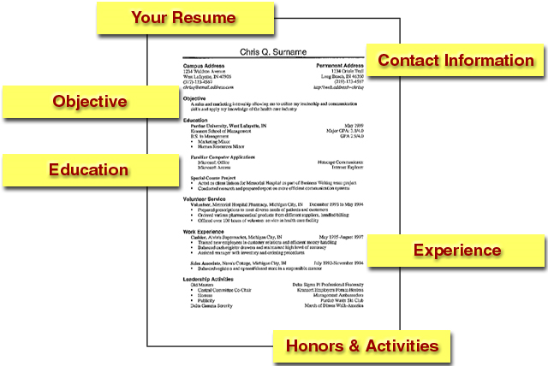
Example

Slide 7
Resume Tips
Top resume tips for choosing a resume format
1) Easy and Understandable
2) Use effective titles
3) Use bullet points
4) Avoid negativity
5) Avoid age discrimination
6) One or two pages
7) No hobbies
8) Selecting a resume font
9) Check grammar mistakes
10) No lies, please

Slide 8

For more Information please visit:
http://www.samplesofresume.org/

