Slide 1
SE.com
User Research
Aug 2021
Anubhav Mittal

Slide 2
Who we tested with
15 Online unmoderated sessions, with UserTesting panel
Male – 8 / Female – 7
UK wide

Slide 3
What we were trying to find out
We are interested in where you would look on our site https://www.scottish-enterprise.com/ for information.
Task: Look for information that would give you more info on selling your company or supporting a management buyout.
We explored the following things:
What the users were hoping to find
If they were able to find the information as set in the task
And
What would they change in order to help find the information better

Slide 4
Results summary
Passes:
Only one user found the event Masterclass selling your business
But
4 users did find the webpage about succession planning
Fails:
One user made it to the learning zone but was unable to find the information
One user made it to the funding and grants webpage and gave up
One user made it to the contact us webpage after failing to find the information
4 users clicked on various bits on the homepage and gave up quickly
3 users used search and then gave up
Conclusions:
Events, podcasts and webinars are not obviously visible from the homepage
Users are not explicitly searching for them
Search doesn’t work as well as it should

Slide 5
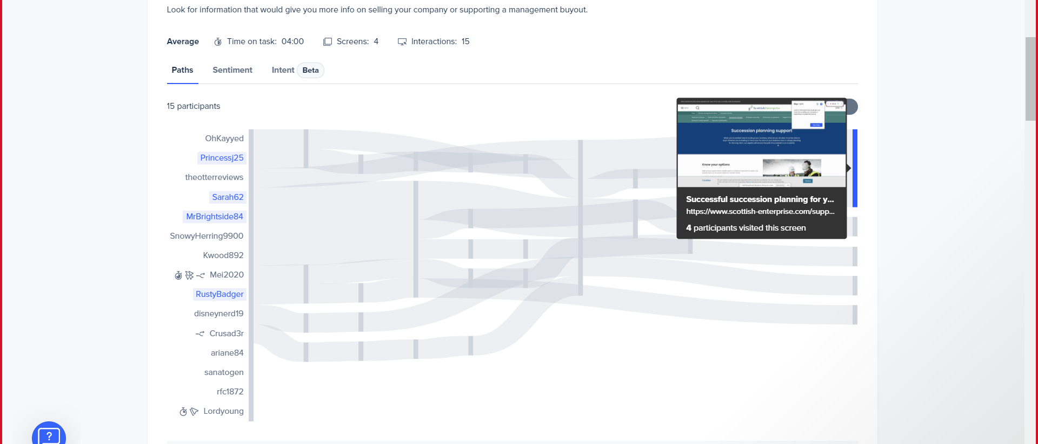
-4 out 15 users were able to reach the succession planning webpage -There was a mix of browsing and searching involved to reach at the webpage -There is also a mix of sentiments along the journey with positive and negative responses

Slide 6
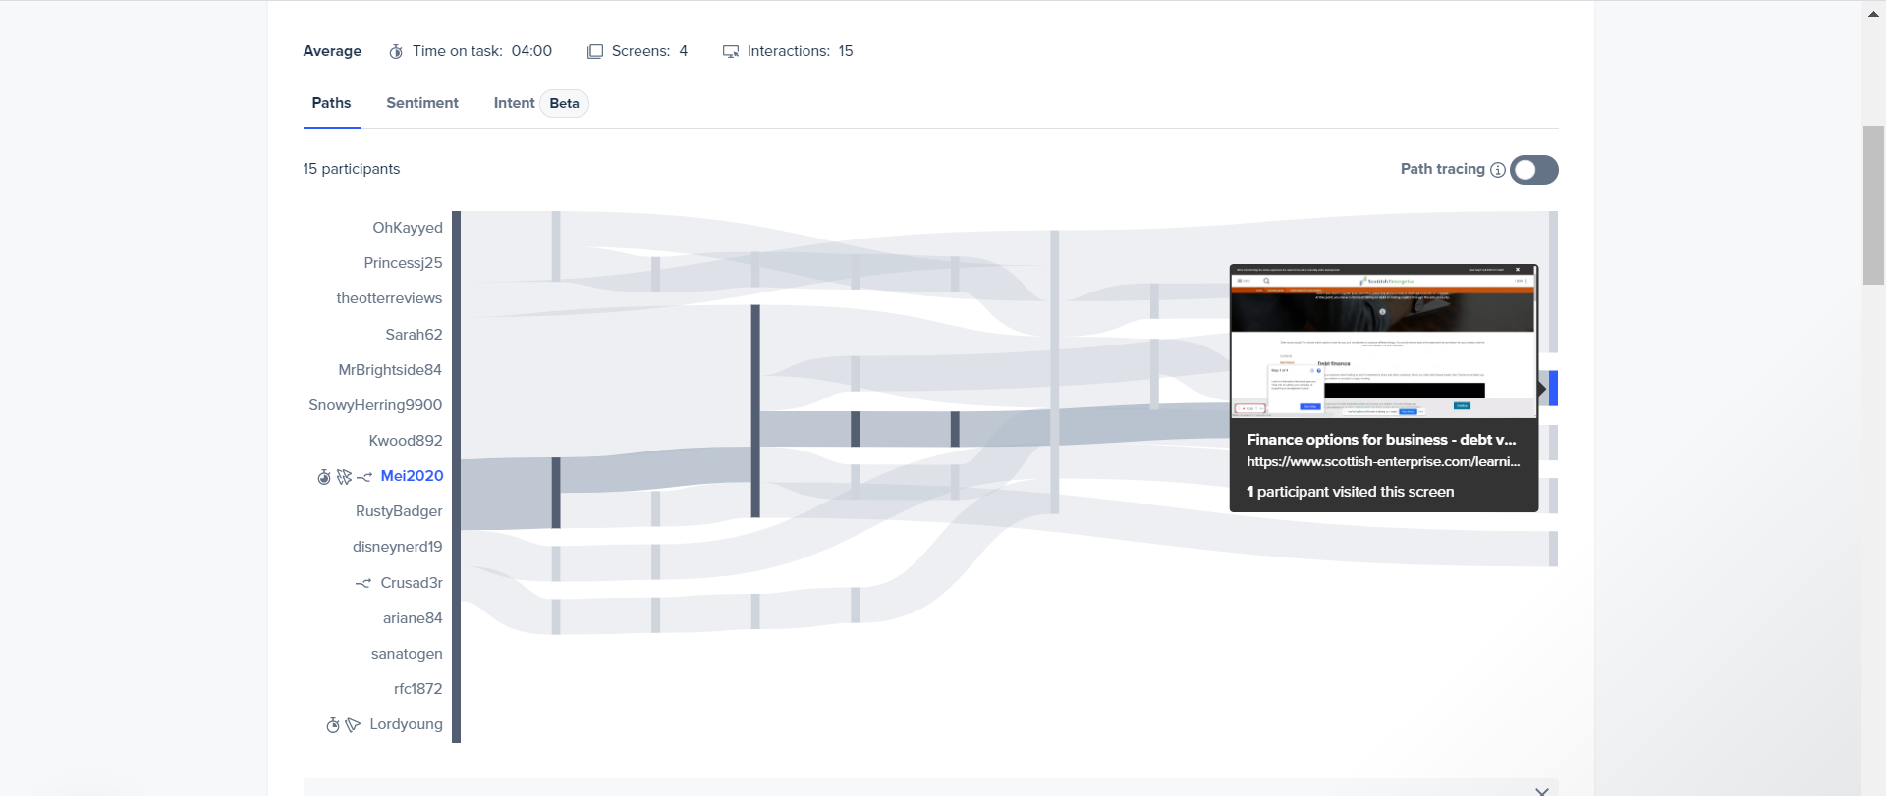
-1 user made was able to find a relevant webpage but the journey was long and involved lots of search, browse, visiting contact us page -Negative to neutral feedback observed for this task

Slide 7
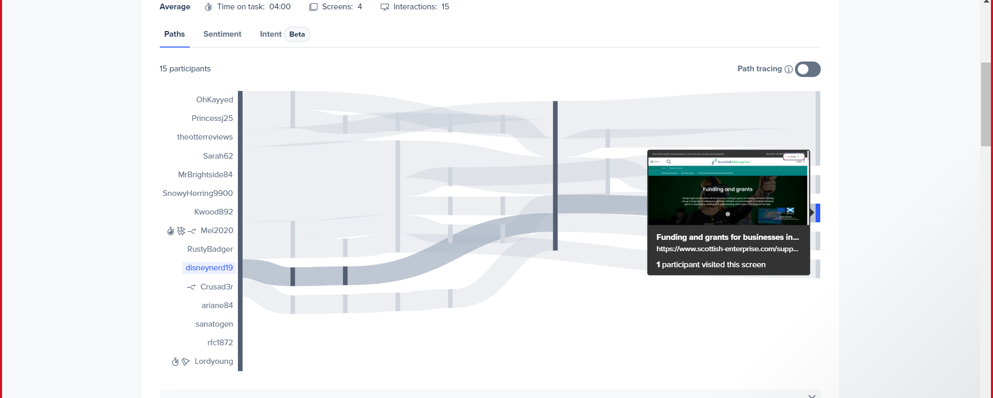
-This user starts searching and then spend a lot of time browsing to reach the funding and grants page -It was observed that they were unable to find the relevant webpage/information -So this could be classified as a failed task

Slide 8
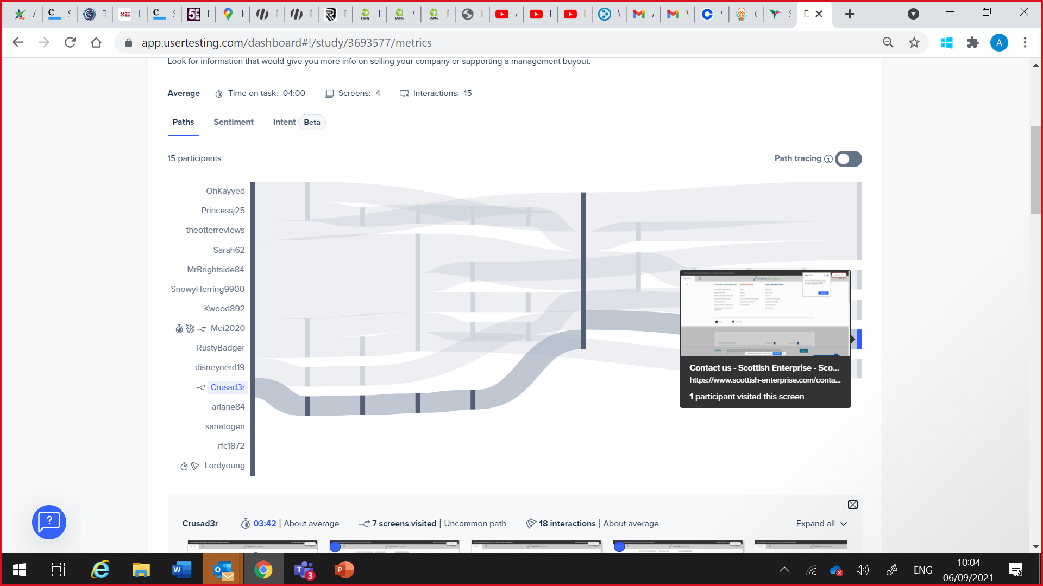
-One person got to the contact us webpage. -They looked up the about us and Brexit sections but eventually failed to find the information they were looking for and hence the contact us webpage

Slide 9
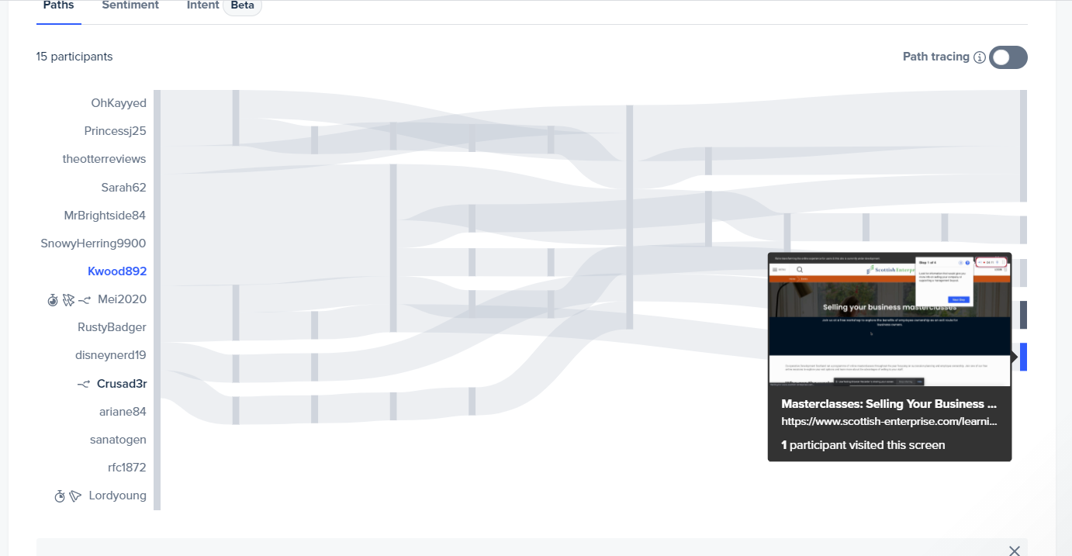
-One user was able to find the Masterclass Selling Your Business event -Search term “selling your company” was used

Slide 10
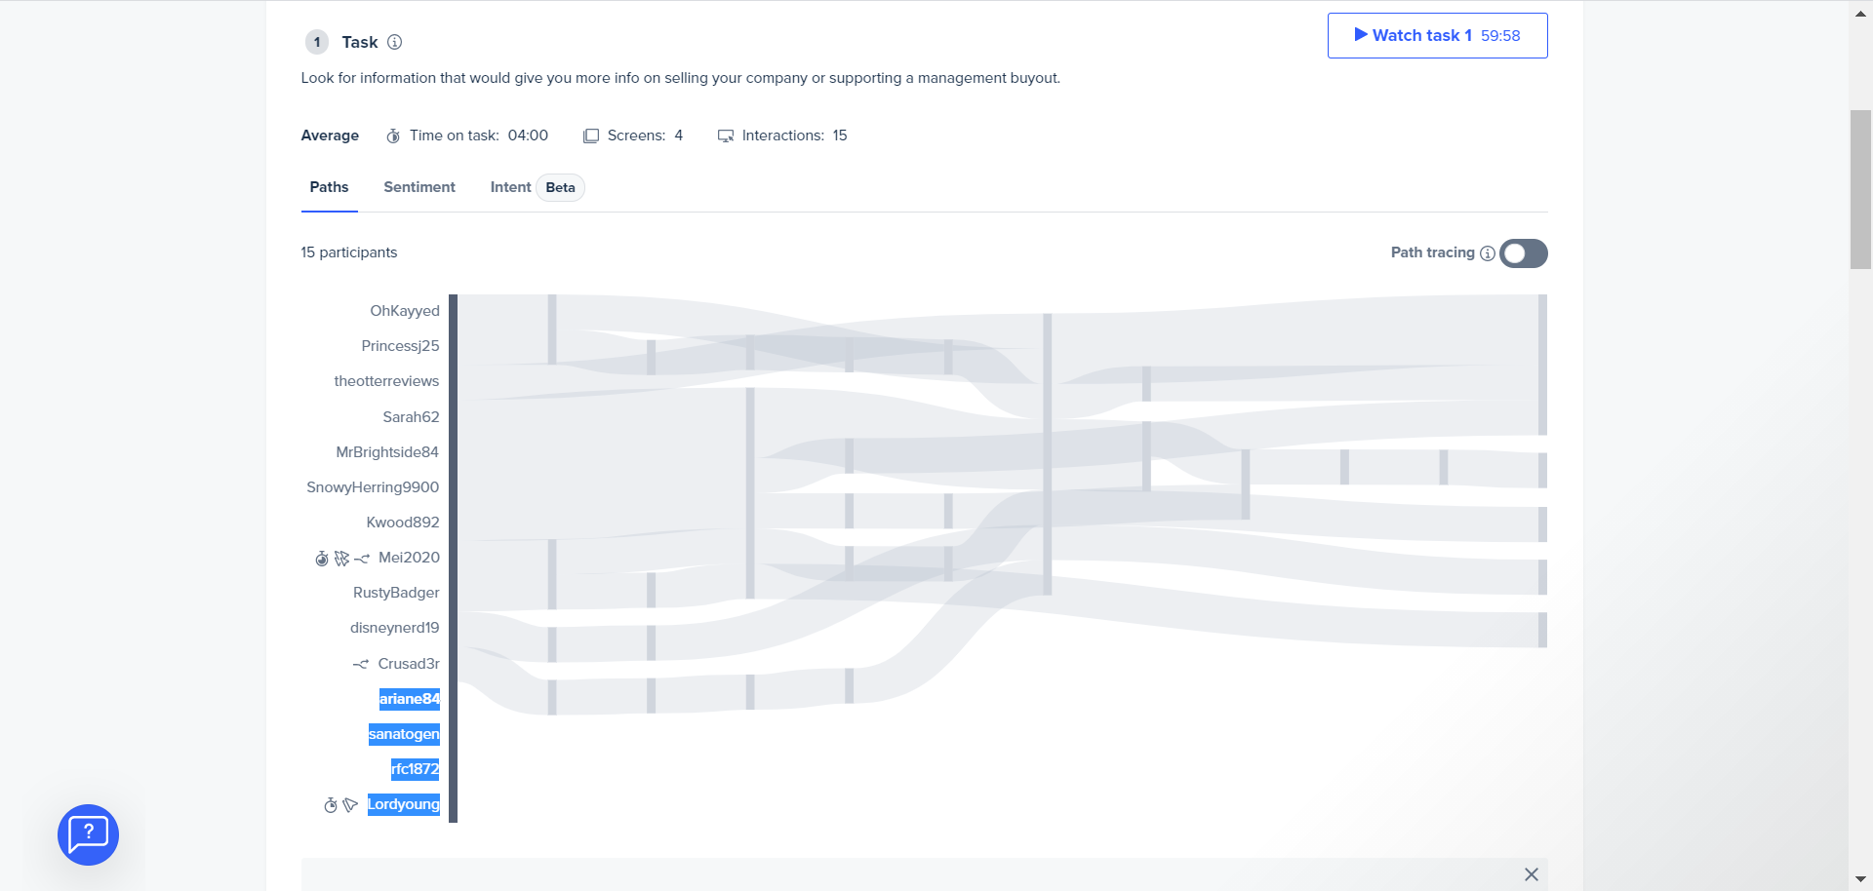
-4 out of 15 users clicked several areas on the homepage but were unable to decide where to go next and gave us quickly

Slide 11
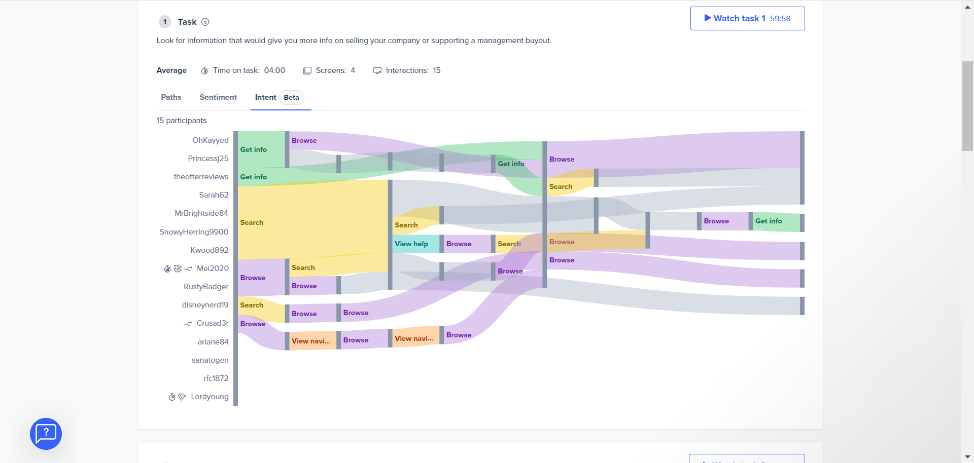
Image showing various things that users did to find relevant information

Slide 12
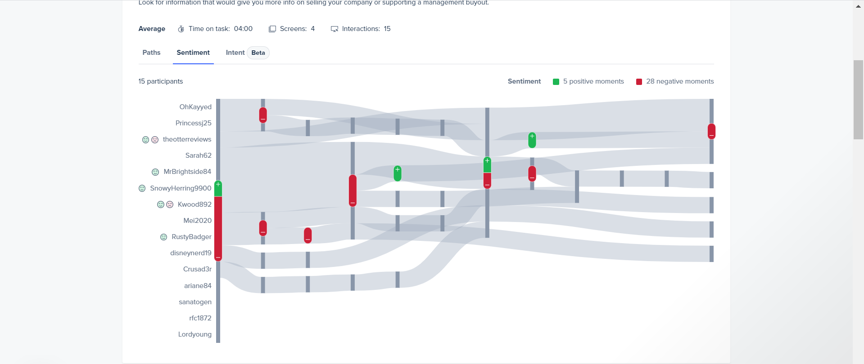
There are a lot of neutral moments but where users did express their moments then it was mainly negative

Slide 13
SE.com
Things users mentioned when asked about what they expected to see when looking to complete the set task:
I was hoping to find a page labeled "management buy out" or "selling your company". I would expect key searches for those words to yield accurate results
I was hoping to find an article or guide that was explicit in giving information on how to sell my company.
I was hoping to find a direct page/link to get this info
A menu option that more clearly labelled for selling companies?
Something at top of page that would lead me to both topics, sell company, support buyout.
I was looking for words i understand, like 'selling my business' or 'management buyout'. I didn't know the phrase succession planning but did work it out, and once I knew that was what I was looking for, I found it.
I was hoping to find an article that would provide me with information on the topic, which it did. However, I did not find this for the term selling your company. I would expect to see how SE can support in that process.
I was hoping to find any information at all on how I would sell my business or join a management buyout. However, there was nothing that I could find that covered this on the website.

Slide 14
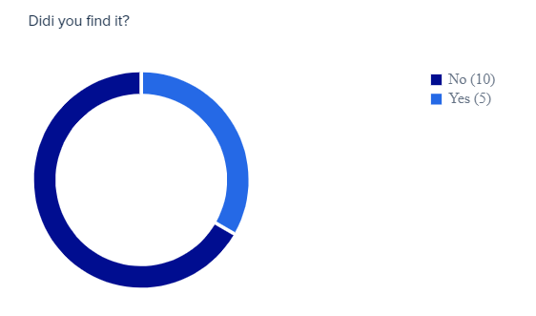
SE.com
Graph showing the split - If they were able to find the information as set out in the task?

Slide 15
SE.com
Following comments were shared when asked about the things that we could change to make the finding of information better:
Seeing everything i saw on this website, everything is perfect to me.
I would add a tag for the term 'selling your business'.... I am also aware that I did not use anything other than the search function. .. So let me try that now.... Found relatively easily using menu also. So can't complain.
I would have probably put it underneath COVID19 as an option, as the current climate a lot of business they are selling their companies, so it would been a naturally search progression as a customer. Probably would have suggested it being under a different tab, instead of development as I felt it didn't fit with developing/growing a business.
I would like to change the search results page. It is because it provides too many less relevant results after using the keywork - selling my company.
I wouldn't associate selling of a business under business development, so I would maybe have a clearer or separate heading for that type of advice. I also don't automatically know the phrase 'succession planning' so maybe having another more widely understandable phrase as a heading would be better.
Have the relevant information at top of page for both management buyout and selling a company. Even if they are unusual queries
Making it easier to fiind.
Improve the search feature to bring up pages with the title/description "management buy our" or "selling your company"

Slide 16
Thank you!

