Slide 1
Question 3
STUDENT NAME, STUDENT NUMBER

Slide 2
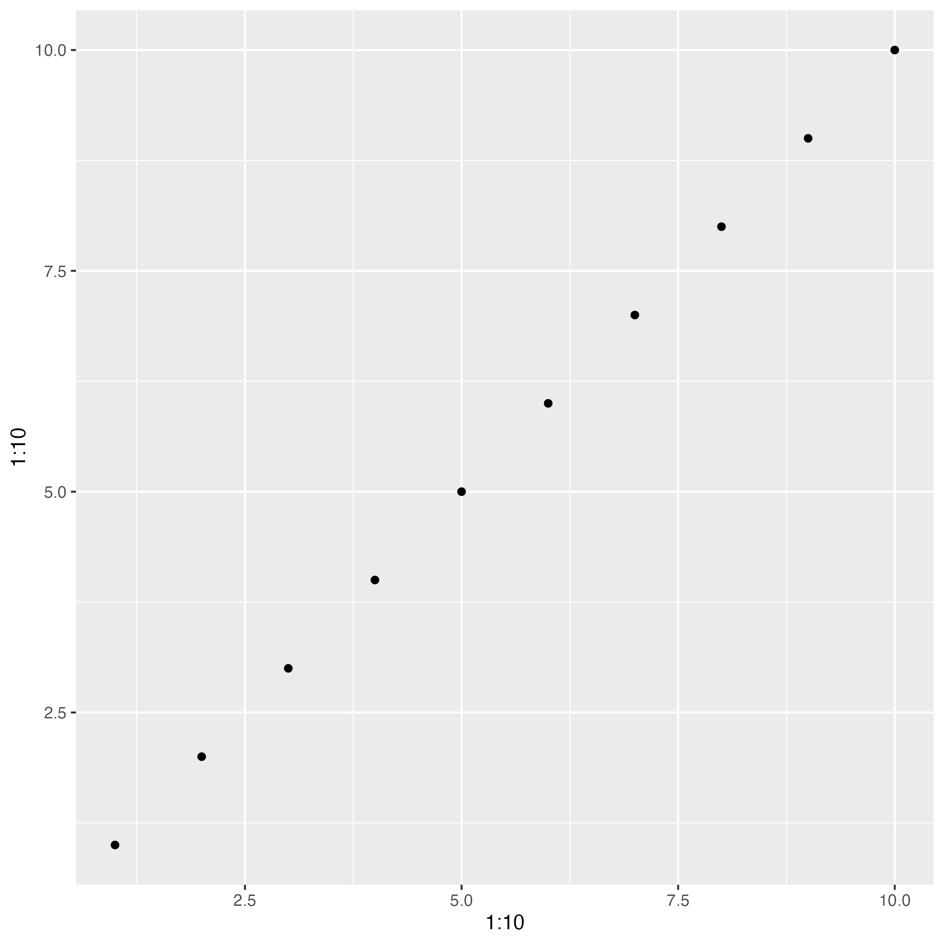
Power BI Plot 1

Slide 3
Power BI Plot 2

Slide 4
Power BI Plot …

Slide 5
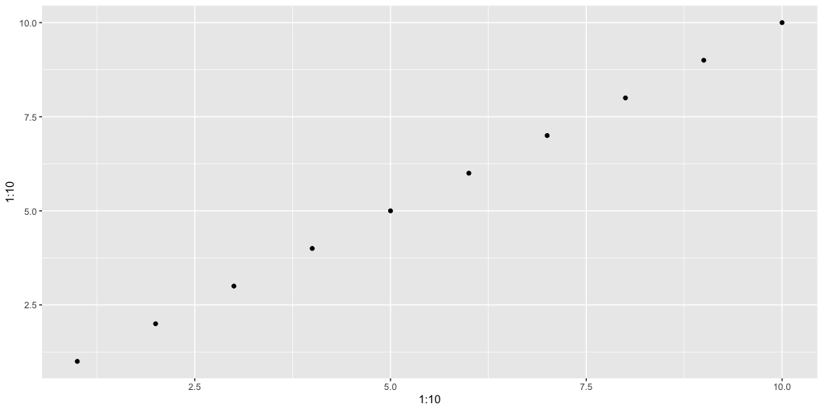
R Plot 1

Slide 6
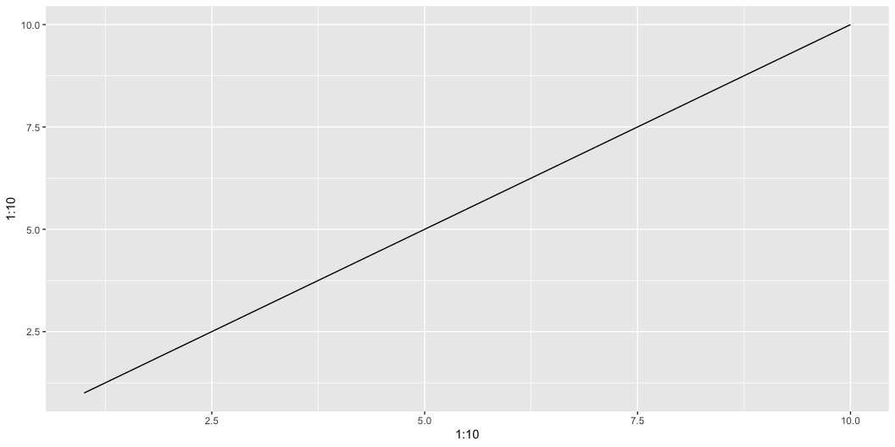
R Plot 2

Slide 7
R Plot …

