Slide 1

Anonymous network
«Hidden Lake»
Kovalenko Gennady Alexandrovich

Slide 2
«Hidden Lake» (HL) is a decentralized anonymous F2F (Friend-to-Friend) network with queue-theoretic provability (QB-problem)

Slide 3

"Hidden Lake" isFriend-to-Friendnetwork. This property defines a specific type of connection of participants in the system by manually setting the list of friends

Slide 4
Queue-based task (QB task)
in simple words
Each message is encrypted with the recipient's key.,
The message is sent during the period= Tto all network participants,
PeriodTone participant is independent of periodsT₁, T₂, ..., T_{n}other participants,
Iffor the periodT messagesdoes not exist, then a false message is sent to the network without a recipient,
Each participant tries to decrypt the message received from the network.

Slide 5
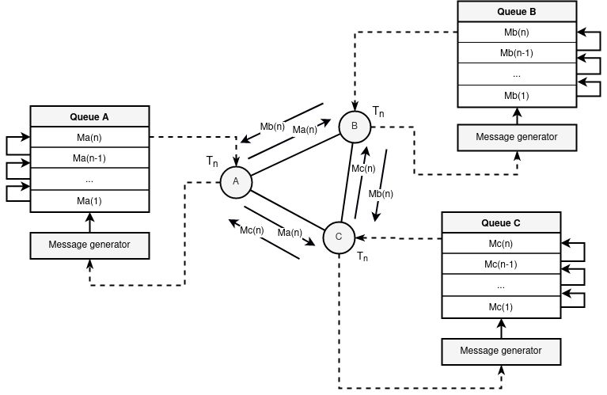
Queue-based task (QB task)

Slide 6
Queue-based task (QB task)
formal language
System:
QB-net =Σ^{n}_{i=1}(T = {t_{i}}, K = {k_{i}}, C = {(c∈{E_{kj}(m), E_{r}(v)})←^{ti}Qi})
States:
Q← (c= E_{ki}(m)), where k_{i} ∈K, c∈ C,
(c= E_{ki}(m))←^{t}Q if Q≠ Ø, where t∈T,k_{i} ∈K, c∈ C,
(c= E_{r}(v))←^{t}Q if Q= Ø, where t∈T,r ∉K, c∈ C,
m' = D_{k}⁻¹(c), wherec∈ C

Slide 7
Comparison with other anonymization tasks
 | QB | E.I. | DC | Onion | Proxy
Theoretical provability | + | + | + | - | -
Cumulative effect of anonymity | - | + | - | - | -
Information polymorphism | - | + | + | + | -
Probabilistic Routing | - | + | - | +/- | +/-
Frequency of message generation | +/- | - | + | - | -
Independence of anonymity from connections | + | - | - | - | -
Easy to scale | - | - | - | + | +
Simplicity of software implementation | + | - | - | + | +
Stage of anonymity | 5^ | 6 | 1^ | 4 or 6 | 3
Representative network | Hidden Lake | - | Herbivore | Tor | Crowds

Slide 8
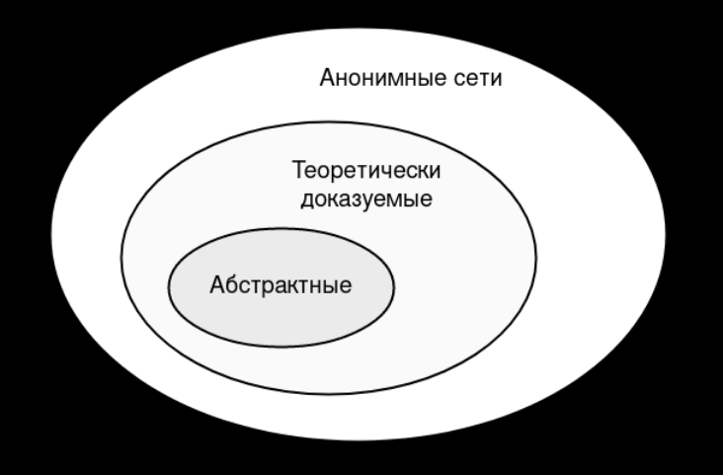
"Hidden Lake" refers toabstractanonymous networks that do not care about criteria such as:
level of centralization
number of nodes
arrangement of nodes
communication between nodes

Slide 9

Due to its abstract nature, the Hidden Lake network is capable ofto formsecret communication channelswith anonymizing properties even within centralized services

Slide 10
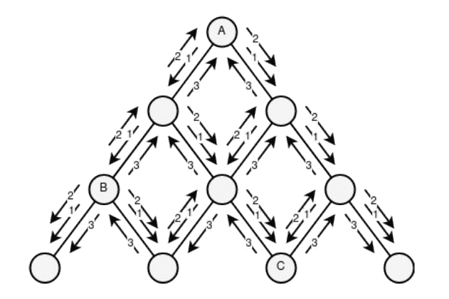
The main disadvantage of the network isllinear loadon a system dependent on the number of participants

Slide 11
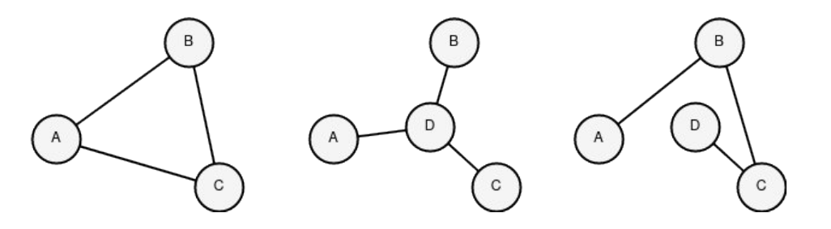
A partial solution to the linear load problem was the creation ofisolated from each other "small lakes"(networks)through applicationnetwork key

Slide 12
Development Philosophy networks«Hidden Lake» is based onmicroservicearchitecture
At the moment there is7 services, where onebasicservice - HLS, threeappliedservices - HLM, HLF, HLR, threeauxiliaryservice - HLT, HLE, HLL
There may also be specific services in the Hidden Lake network description -adapters, referred to as HLA. They perform the role of "implanting" anonymized traffic into a foreign system

Slide 13
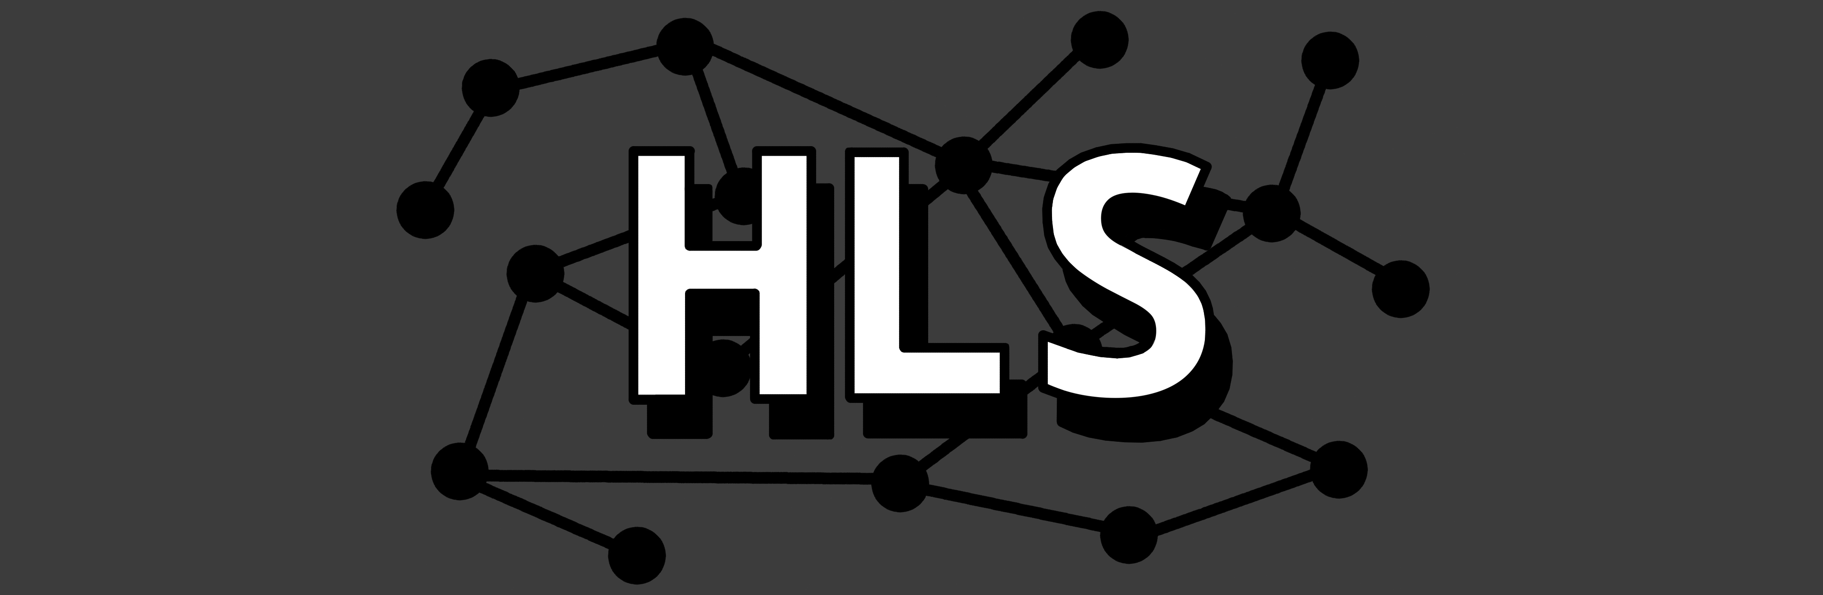
HLS (Hidden Lake Service) —coreanonymous network. RepresentsAPIfor sending/receiving messages over anonymizing traffic

Slide 14
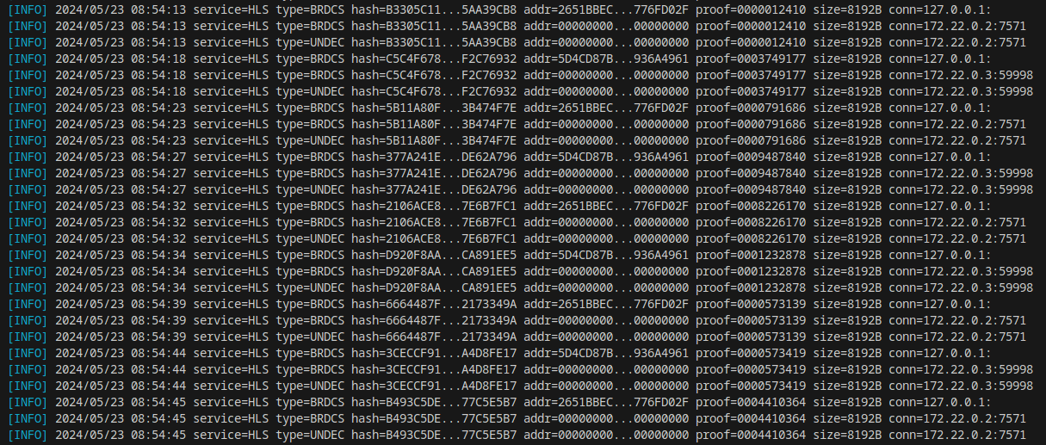
Generating Anonymized Traffic in HLS Application

Slide 15

HLM (Hidden Lake Messenger) -anonymousmessenger, calling HLS functions

Slide 16

Chat interface in HLM application

Slide 17

HLF (Hidden Lake Filesharer) -anonymousfile sharing, calling HLS functions

Slide 18
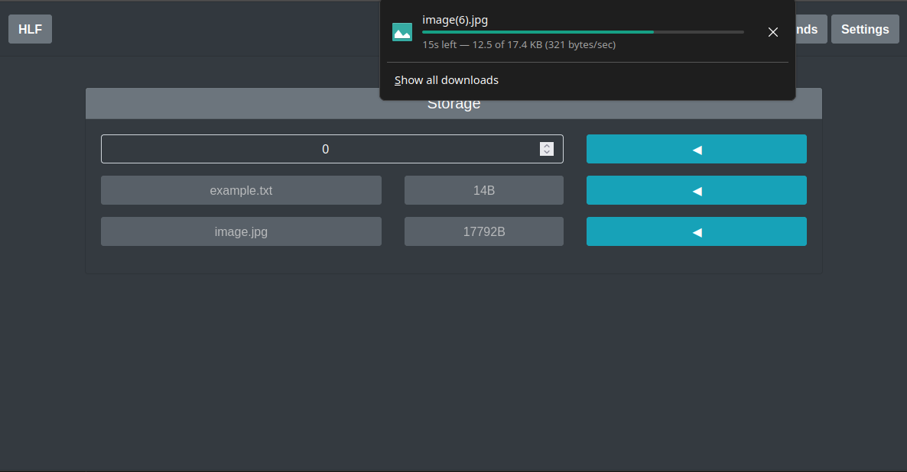
Downloading a file in HLF application

Slide 19

HLR (Hidden Lake Remoter) —anonymousremote access, calling HLS functions

Slide 20
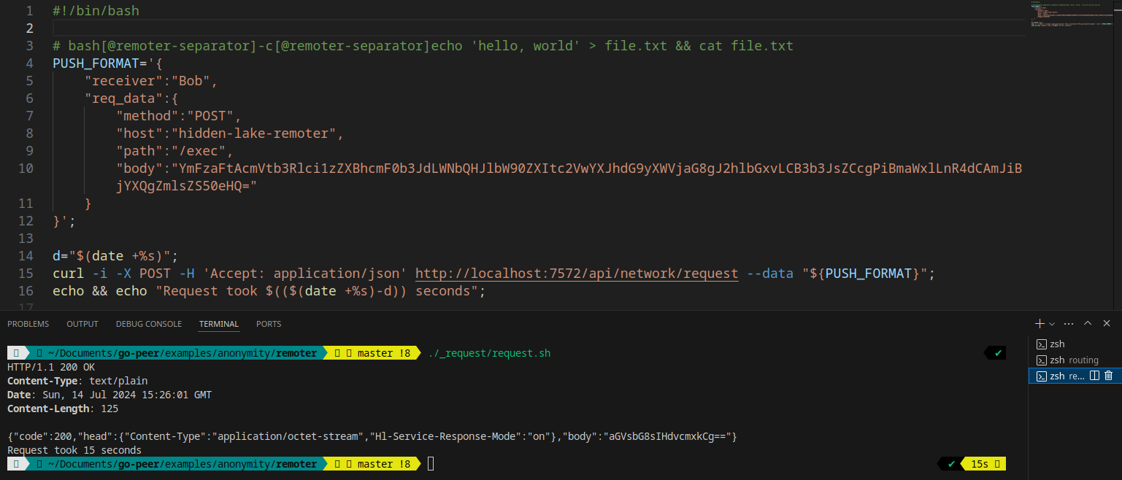
Executing a Remote Command Using HLR

Slide 21

HLT (Hidden Lake Traffic) —distributortraffic in an anonymous network. Can act as a relay and storage of traffic

Slide 22

HLE (Hidden Lake Encryptor) - serviceencryptionAnddecryptionmessages formatgo-peer

Slide 23

HLL (Hidden Lake Loader) —downloaderand manual traffic distributor between several HLT services

Slide 24

HLA (Hidden Lake Adapters) -adaptersto create anonymous communications in foreign systems, including centralized ones

Slide 25
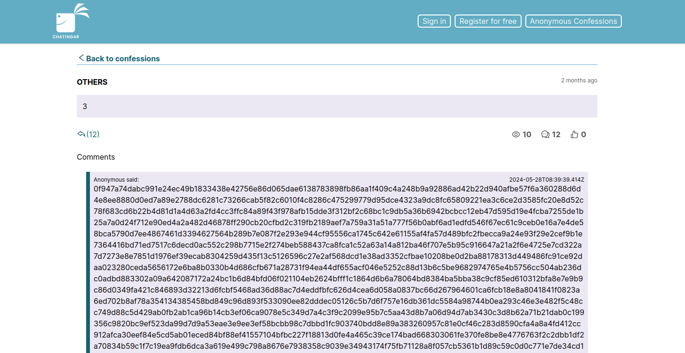
Using the centralized service "chatingar"

Slide 26
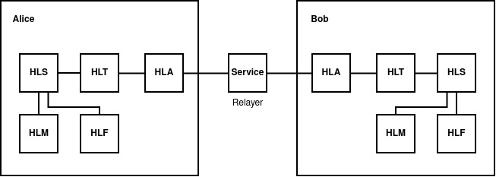
Formaldescription of the composition of services
Hidden Lake =Σ^{n}_{i=1}APP_{i} ×HLS×(HLT× Σ^{m}_{j=1}HLA_{j})^{t}

Slide 27
Comparison with other anonymous networks
 | Hidden Lake | Herbivore | I2P | Tor | Mixminion | Crowds
Decentralized architecture | + | + | + | - | - | +
Service API implementation | + | - | + | + | - | -
Delay in data transmission | + | + | - | - | + | -
Closed network architecture | + | - | + | +/- | - | -
Hiding the fact of data generation | + | - | - | - | - | -
Hiding the recipient from the sender | +/- | - | + | +/- | - | -
Hiding the sender from the recipient | +/- | + | + | + | + | +
Anonymization task | QB | DC | Onion | Onion | Onion | Proxy

Slide 28

Possible Uses of the Hidden Lake Anonymous Network
Protecting local/corporate networks from eavesdropping
Protecting military communications nodes from eavesdropping
Strengthening the security of already existing/formed systems
Using an existing platform to create your own applications

Slide 29

Links
Hidden Lake
https://github.com/number571/hidden-lake
Documentation
https://github.com/number571/hidden-lake/tree/master/docs

