Slide 1
MapReduce Jobs
Big Data Processign and more…

Slide 2
Definition of MapReduce
From http://en.wikipedia.org/wiki/MapReduce
MapReduce is a programming model for processing large data sets with a parallel, distributed algorithm on a cluster.
In essence
A different paradigm
Process large data sets thru simple operations
A goal can be achieved thru 1 or more MapReduce operations
Forget everything you know, and go back to basics… to the simplest!

Slide 3
MapReduce Dataflow
Input Reader and Input Splits
Map
Combine
Sort
Reduce
Output Writer
Example:
Count lines per file in a set of files

Slide 4
Dataflow – Input Reader and Input Splits
Split the input data set into small /easily manageable chunks called Splits
Each Split is fed into a Map function (Mapper) for processing
Input can be:
Usually text files, where each new line is a record to process
Several small files
A single large splittable file (important factors: format, compression)
Input Reader understands the format of the input files
Binary or Text? Compressed or Plain? UTF-8 or ASCII? CSV or JSON?
Example:
A set of 10 text files (i.e. application log files) -> 10 Splits of data

Slide 5
Dataflow - Map
Required Phase
Though it can be an Identity Mapper
A Map function (Mapper) will take the input split, and process each record (line)
The objective is to project, mutate the data into what needs to be Reduced
Write a Key/Value pair to the intermediate output for the Reducer to feed from
Key: Will be used to group all mapped outputs with the same Key together
Value: Will be grouped with all other output values that share the same Key
Can write 0 or more Key/Value pairs per input record
Number of Mappers depends on the # of Input Splits
Example:
Mapper writes (${filename}, 1) pairs

Slide 6
Dataflow - Combine
To be explained later…

Slide 7
Dataflow - Sort
Framework provided (no coding required)
Takes the Output of each Mapper on each of the Cluster nodes
Designates a Key range to each Reducer
The number of Reducers is configurable. Calculated if not specified.
Sorts each output Key/Value pair to the corresponding Reducer
Example:
(‘backend.log’, [1,1,1,1,1,1])
(‘app.log’, [1,1,1])

Slide 8
Dataflow - Reduce
Optional
Write a Key/Value pair as final output
Potentially different data types from Mapper Key and Value data types
The objective is to process and consolidate the multiple grouped input values
Key: Output record identifier (not necessarily unique)
Value: Consolidated output of grouped input values
Can write 0 or more Key/Value pairs per input record
Example:
(‘backend.log’, 6)
(‘app.log’, 3)

Slide 9
Dataflow - Combine
Optional
Reducer that runs locally after the Mapper has finished executing
Example:
Mapper output @ Node #1: (‘backend.log’, [1,1,1,1])
Combines into (‘backend.log’, [4])
Mapper output @ Node #2: (‘backend.log’, [1,1])
Combines into (‘backend.log’, [2])
Sort produces (‘backend.log’, [4,2])
Reducer outputs (‘backend.log’, 6)

Slide 10
Dataflow – Output Writer
Generates the Reducer Output into the right format
Text or Binary?
Compressed or Plain?
UTF-8 or ASCII?
CSV or JSON?
Output can potentially be the Input for a chained MapReduce Job

Slide 11
MapReduce Dataflow - Review
Input Reader and Input Splits
Map
Combine
Sort
Reduce
Output Writer
Keep in mind that this is Distributed!

Slide 12
Hadoop MapReduce
http://hadoop.apache.org/
Open Source
Distributed processing of large data sets across clusters of commodity computers
Hadoop Distributed File System (HDFS)
Hadoop YARN: Job Scheduling and Cluster Resource Management
Hadoop MapReduce
Hadoop Hbase
Hadoop Cassandra
Hadoop Hive

Slide 13
Hadoop Components
Job Tracker
Runs in the Master node
Schedules jobs and keeps track of success/failed tasks
Accepts client requests for M/R jobs
Upon task failures, reschedules the task at a different Data node
Task Tracker
Runs in the Data nodes
Controls the execution of a task (Map or Reduce) within the Data node

Slide 14
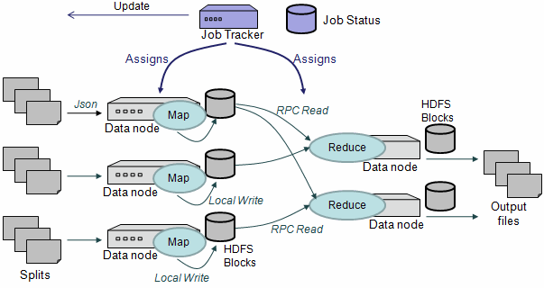
Hadoop Diagram

Slide 15
Demo
WordCount

Slide 16
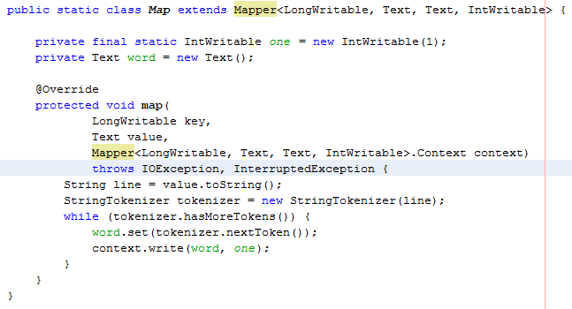
WordCount - Mapper

Slide 17
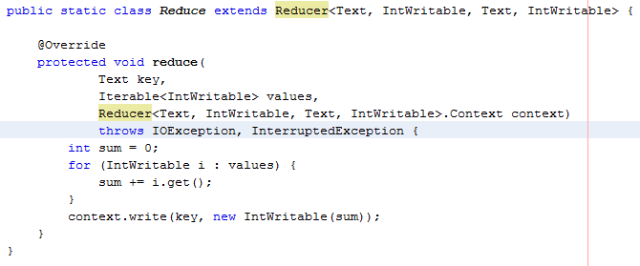
WordCount - Reducer

Slide 18
Demo
HTML Tag Count

Slide 19
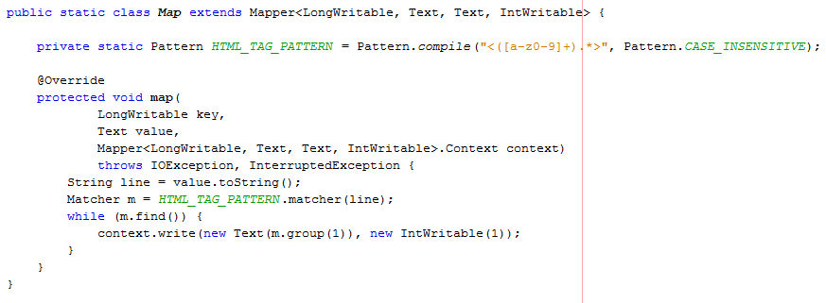
HTML Tag Count - Mapper

Slide 20
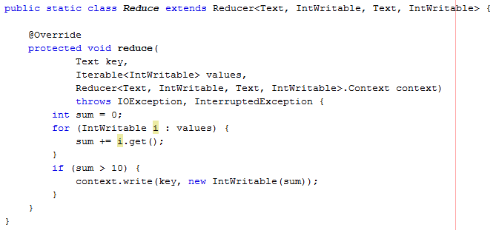
HTML Tag Count - Reducer

Slide 21
Source Code and Documents
https://github.com/prosoft-nearshore/blog/tree/master/2013-09/hadoop-map-reduce

Slide 22
References
http://en.wikipedia.org/wiki/MapReduce
http://en.wikipedia.org/wiki/Hadoop
http://hadoop.apache.org/
http://hadoop.apache.org/docs/stable/mapred_tutorial.html

