Slide 1
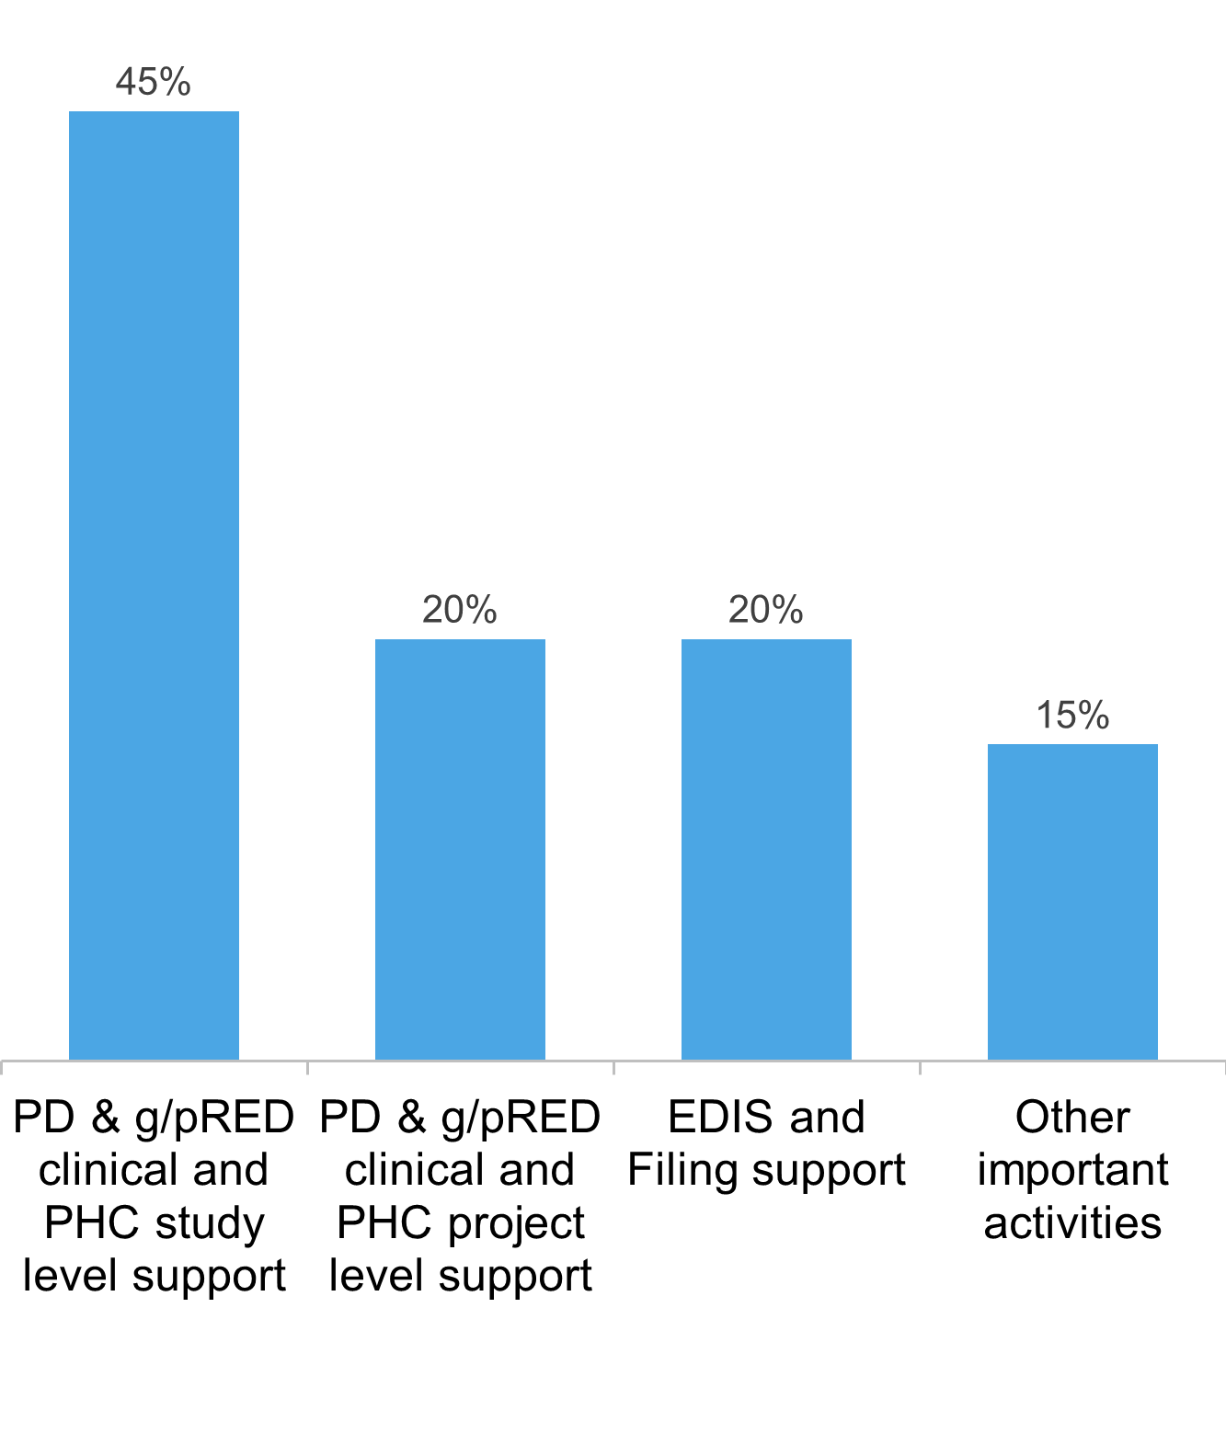
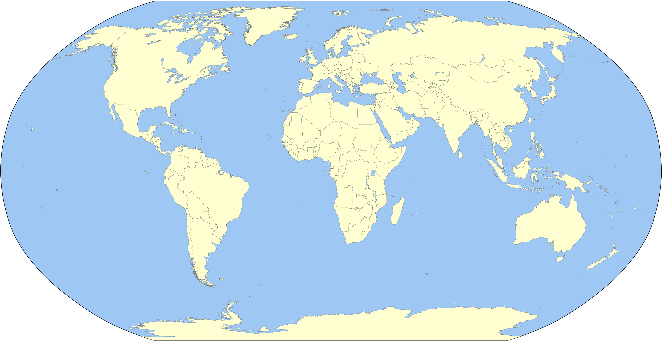
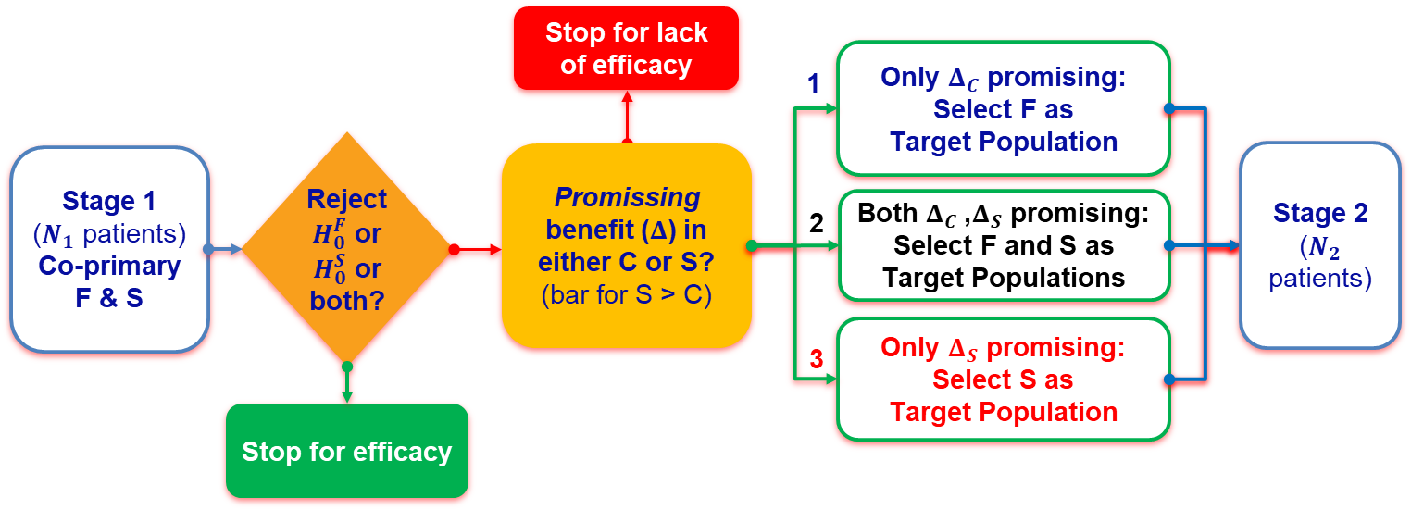
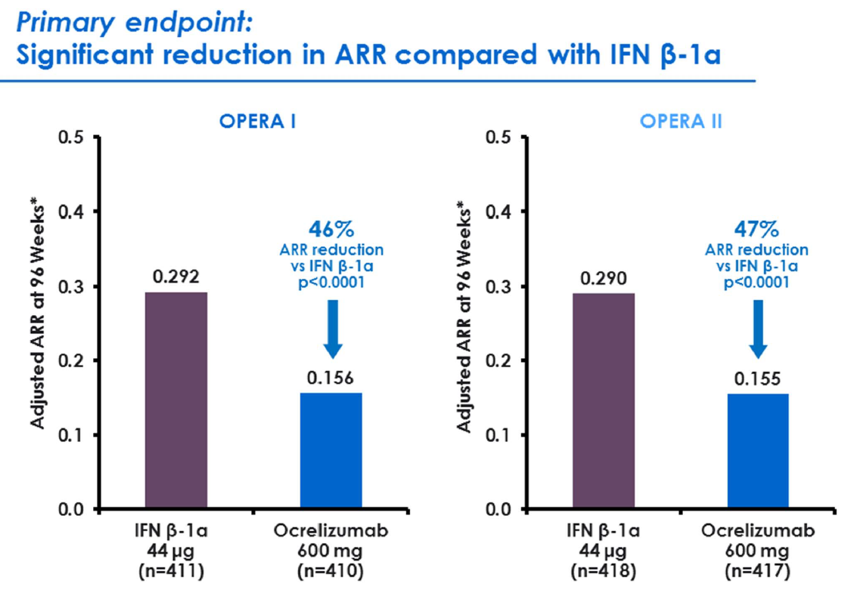
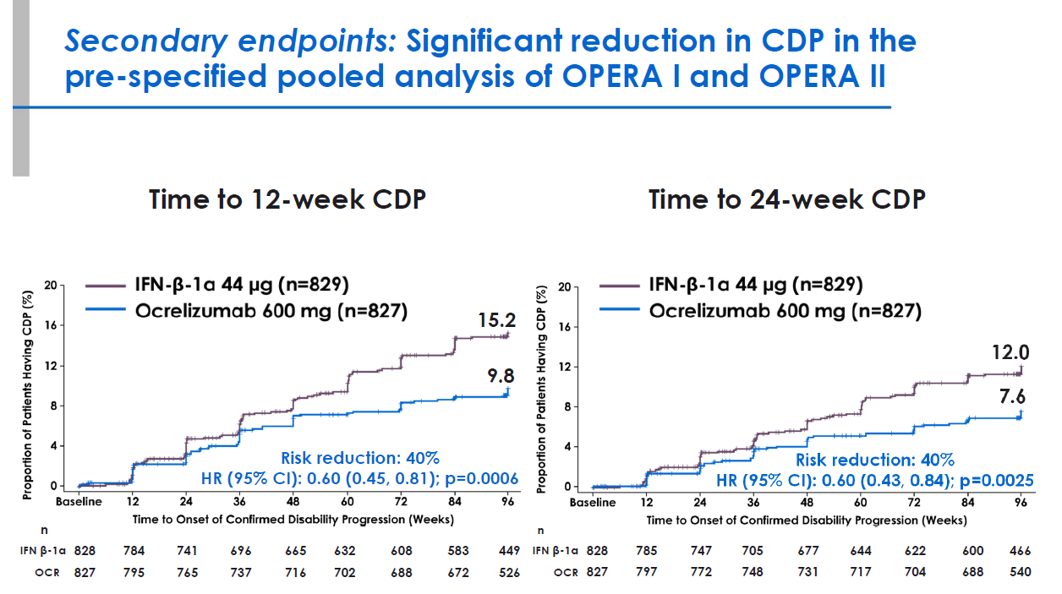
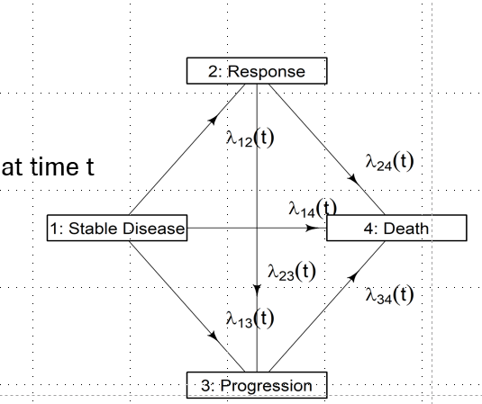
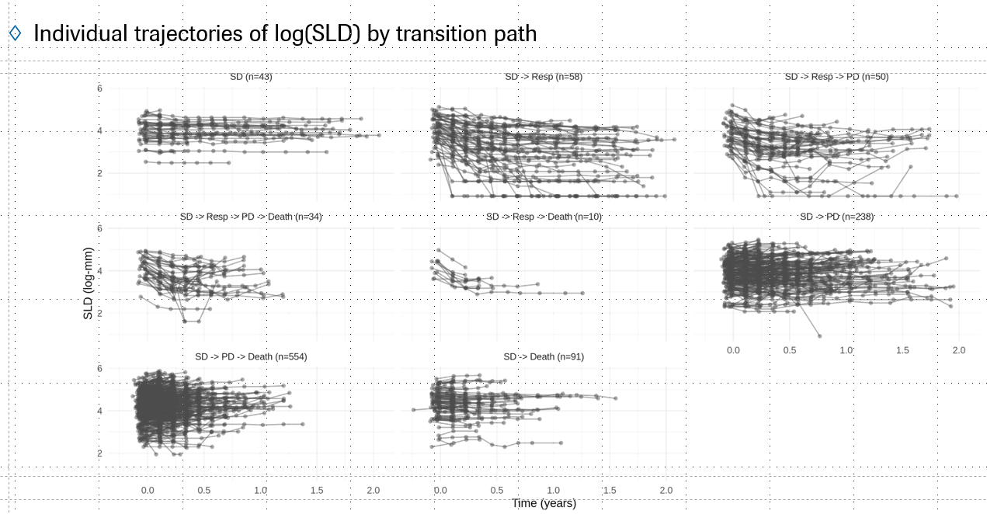
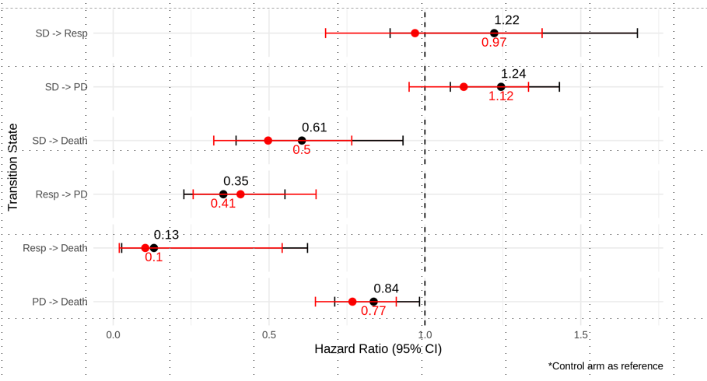
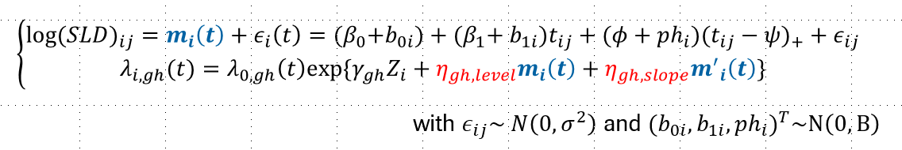


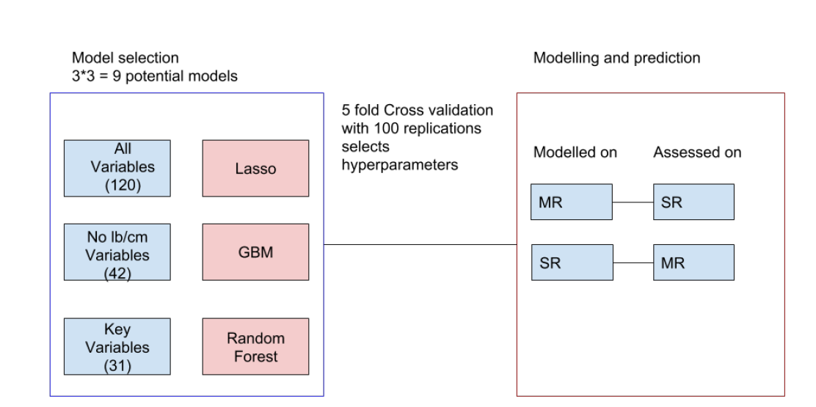
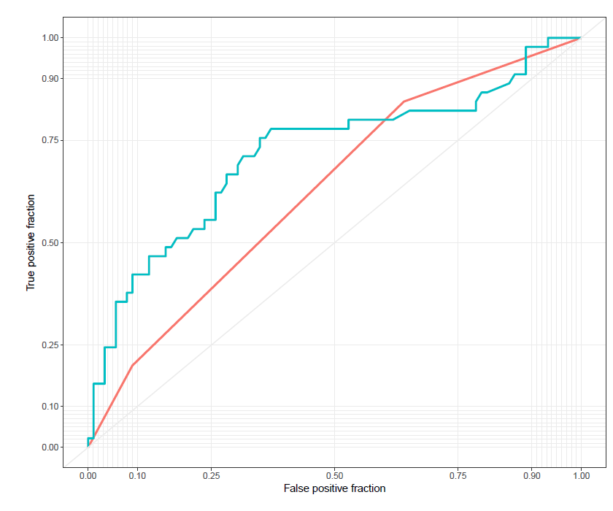
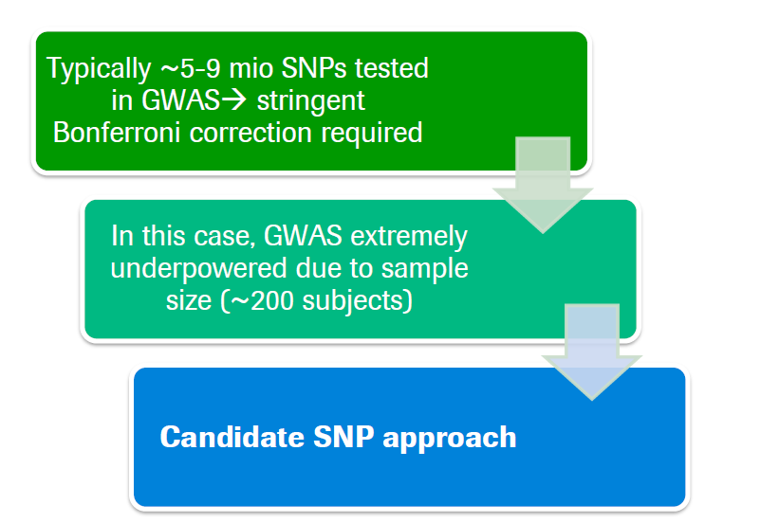
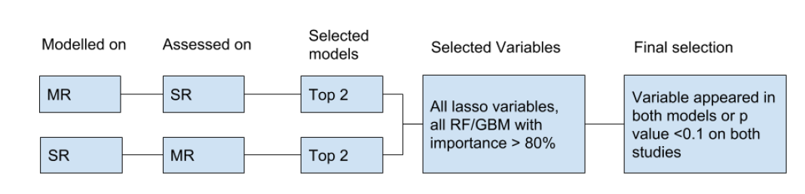
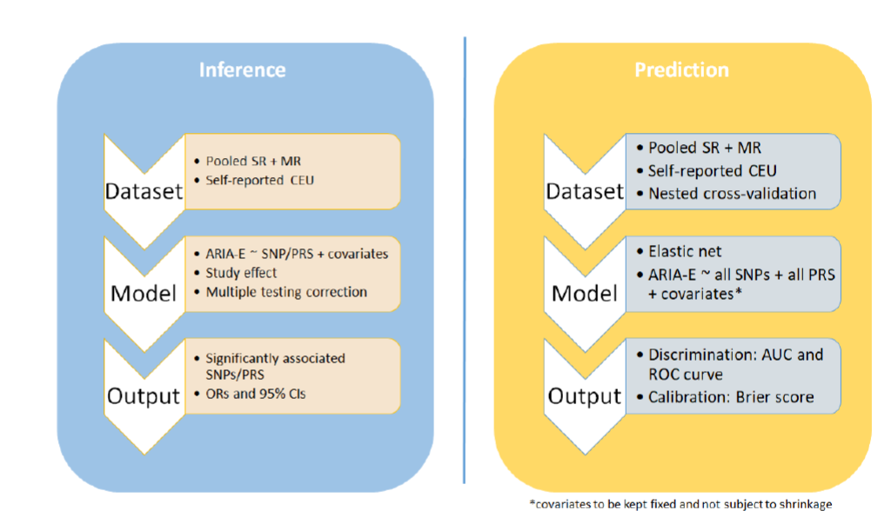
PD-Biometrics/BioStat
BioStatistics
Our Mission / Our Principles
We are strategic partners in drug development
We are leaders in quantitative science with strong statistical expertise
We ask the right questions and use the best methodology to answer them
We promote rigor in planning, conduct, and analysis of experiments, and in the interpretation of results
We support nonclinical projects and clinical studies from entry into human through regulatory approval and market access
“We embrace all data types, including high dimensional data and RWD, and apply
the most appropriate statistical approaches, including advanced analytics”
~ 215 Statisticians
Example 1 : Business-Critical Moment in Clinical Biostat
Clinical Study Design | Clinical Study Read-Out
Clinical
Study Design
Analysis and Interpretation
Non Clinical
Rx/Dvpt Science
Manufacturing
MCO
PHC
Methodology
Collaboration
Outreach
Filling and Beyond
Quality Control
Digital end-point
Biomarker
EDIS / MDAS
Our Deliverables: Regulatory approvals and much more
Example 2 : Advanced Stat Modeling : Joint Modeling of Longitudinal and Time to Event Data in Oncology
TA/Portfolio
Support for partnering due diligence, disease area strategies, exploratory analysis, and methodology for portfolio decision making, PHC efforts (e.g PHC showcases)
Program level
Strategy for CDPs, APAC, PHC, regulatory interactions, phase transition decisions, and new indications; regulatory filings
Study level
Input on design, data collection, data analysis, and interpretation
Communications and Publications
Some of the technical things we do
Example 3 : ML, PHC, Advanced Analytics : Identify Risk factor for Adverse Event with Alzheimer Drug
Clinical Trial Simulation
Innovative Clinical Study Design
Machine Learning
External Control
RWD
Biomarker and Digital Biomarker
Advanced Regression
Bayesian Design
Bayesian Data Analysis
Estimand
Genomics data analysis
Exploratory Data Analysis
Advanced Survival Analysis
HPC
End-Points
Clinical Risk factors | Genetics Risk factors
“We collaborate intentionally across and beyond the whole organization”

