Slide 1
The Computer as the Teacher’s Tool
Grp. 10

Slide 2
Two Learning Perspectives
Constructivism
- introduced by Piaget (1981) and Bruner(1990)
-constructed by the individual learner
Social Constructivism
-an effort to show that the construction of knowledge is governed by social, historical, and cultural context.

Slide 3
Vygotsky
- learning is affected by social influences (interactive process in learning).
Dewey
-human learning is really human language that occurs when students socially share, build and agree upon meanings and knowledge.

Slide 4
Learning Framework
Assumption
-knowledge is constructed by the individual
(constructivism)
-knowledge is constructed within a social context
(social constructivism)

Slide 5
Definition of Learning
-students build their own learning
(constructivism)
-students build knowledge influenced by the social context
(social constructivism)

Slide 6
Learning Strategies
-Gather unorganized information to create new concept/principle
(constructivism)
-Exchange and share form ideas, stimulates thinking
(social constructivism)

Slide 7
General Orientation
-students discuss and discover meanings
(social constructivism)
-personal discovery of knowledge
(constructivism)

Slide 8
Example:
-8*5-8+8+8+8+8
(constructivism)
-two alternative job offers
option1 -8hrs/day for 6days/week
option2 -9hrs/day for 5days/week
(social constructivism)

Slide 9
The Computer’s Capabilities
Without the computer, today’s learners may be still assuming the tedious tasks of low-level information gathering, building and new knowledge packaging.

Slide 10
The teacher can employ the computer as a/an:
Information Tool
Communication Tool
Constructive Tool
Co-constructive Tool
Situating tool

Slide 11
Information/Informative Tool
-The computer can provide vast amount of information in various form, such as text, graphics, sound, and videos. Even multimedia encyclopedias are today available on the internet.

Slide 12
Communication Tool
-The way to become a better listener is to practice “active listening”. This is where you make a conscious effort to hear not only the words that another person is saying but, more importantly, try to understand the complete message being sent.

Slide 13
Constructive Tool
- The computer itself can be used for manipulating information, visualizing one’s understanding and building new knowledge.

Slide 14
Co-constructive Tools
- Students can use co-constructive tools to work cooperatively and construct a shared understanding of new knowledge.
-One way of co-construction is the use of electronic whiteboard where students may post notices to a shared document/whiteboard.

Slide 15
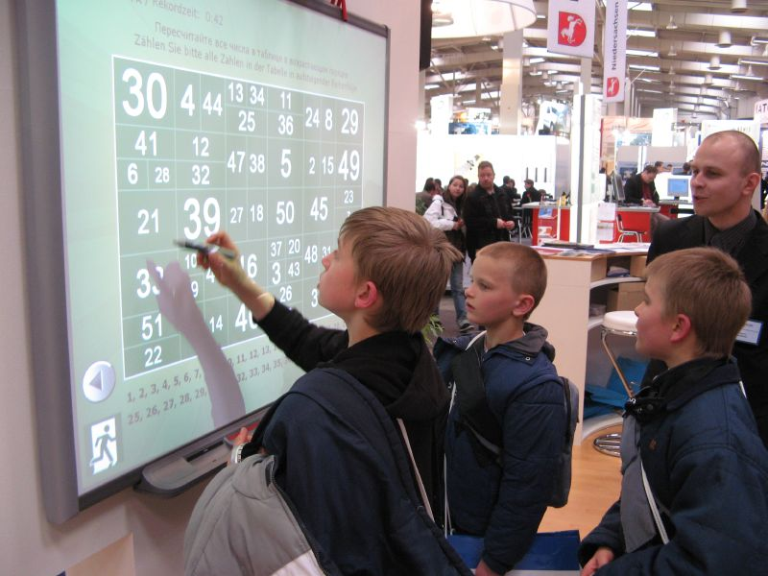
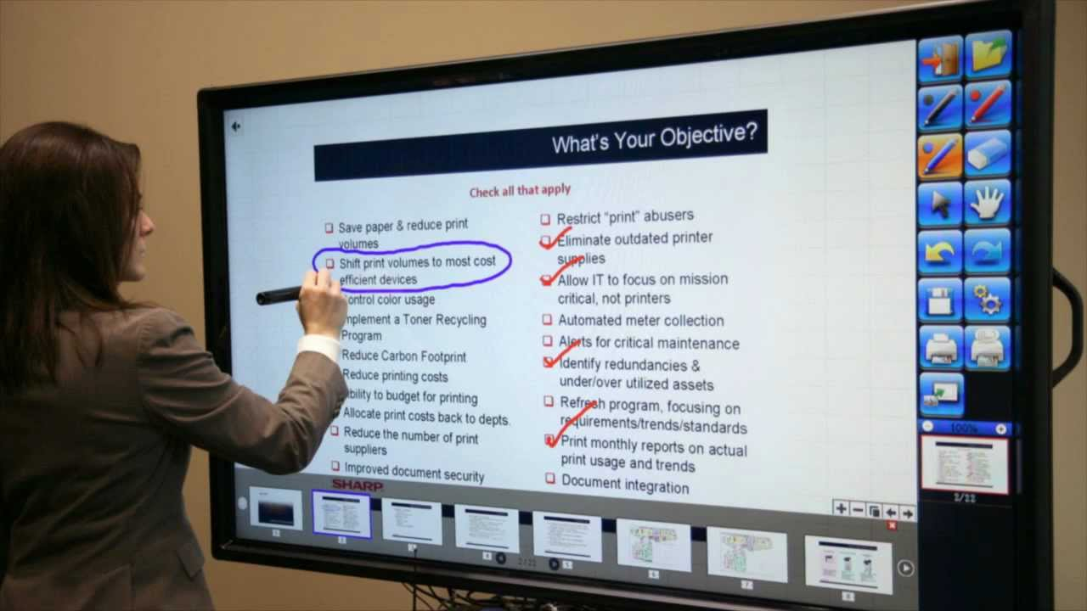

Slide 16
Situation Tool
-By means of virtual reality extension systems, the computer can create 3-D images on display to give the user the feeling that are situated in a virtual environment.
-When users log on to a MOO(board games) environment, they may interact with the virtual reality(such as by writing on a notice board)through simple text-based commands.

Slide 17
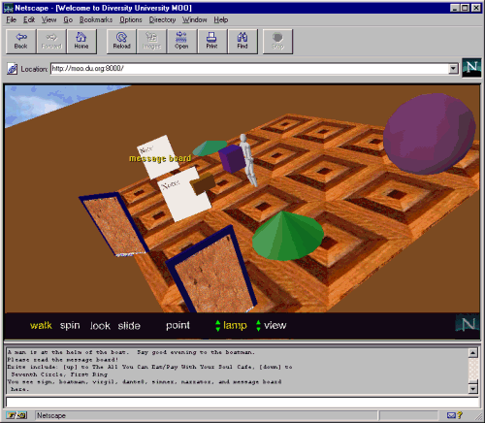

Slide 18
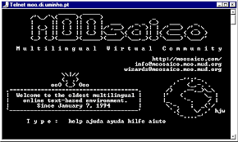

Slide 19
This is still undergoing further research and development.
Thank You!

