Slide 1
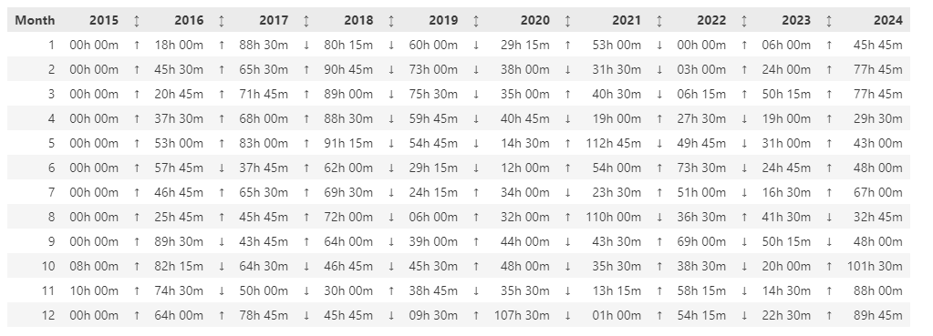
BYMDFManager
The scope of this class is to partition a “by month” table in smaller tables, following a custom logic.
Here a visual example of how its algorithm works.
00
01
07
13
19
Table: [0, ..., 19]
00
01
07
00
07
13
00
13
19
Partition 1: [0, 1, 2, 3, 4, 5, 6, 7]
Partition 2: [0, 7, 8, 9, 10, 11 ,12, 13]
Partition 3: [0, 13, 14, 15, 16, 17, 18, 19]

