Slide 1
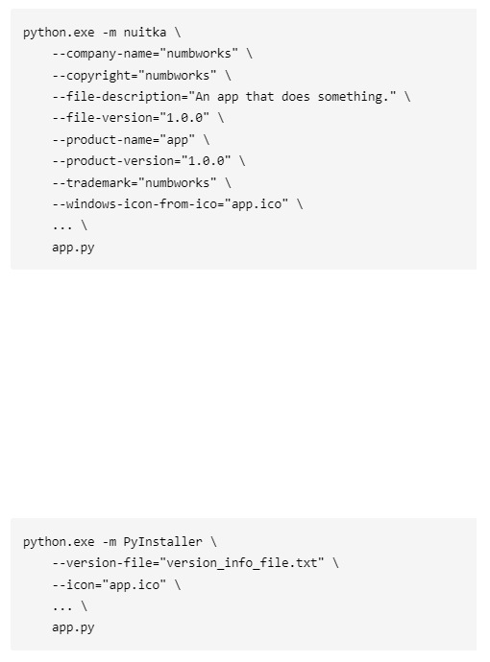
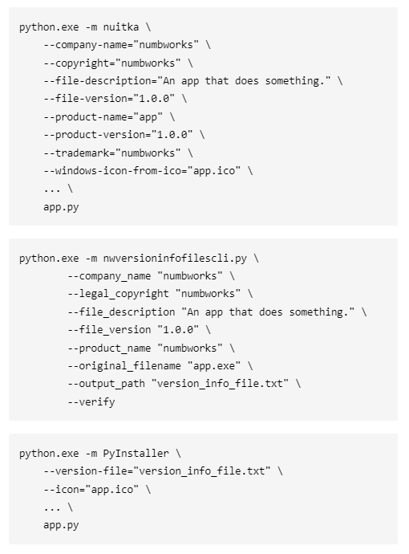
Without nwversioninfofiles
With nwversioninfofiles
High-level flags to inject metadata
in the Windows executable.
PyInstaller doesn't provide a built-in method to generate a compliant Version Info File.
PyInstaller doesn't provide a built-in method to verify if the user-generated Version Info File is compliant or not before starting the build process.
X
External Version Info File to inject metadata in the Windows executable.

