Slide 1

Web Technologies JavaScript: Basics
Cicalî Clementii
University Lecturer @UTM
Software Engineer @Endava

Slide 2
Agenda:

Slide 3

What is JavaScript?
Javascript (JS) is a scripting language, primarily used on the Web.
JavaScript is an interpreted language. Thus, it doesn't need to be compiled.

Slide 4
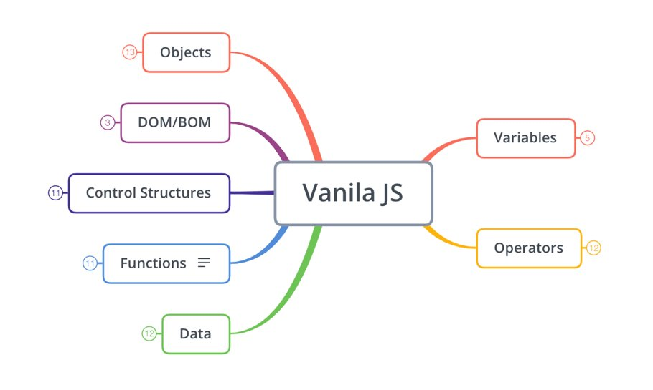

Slide 5
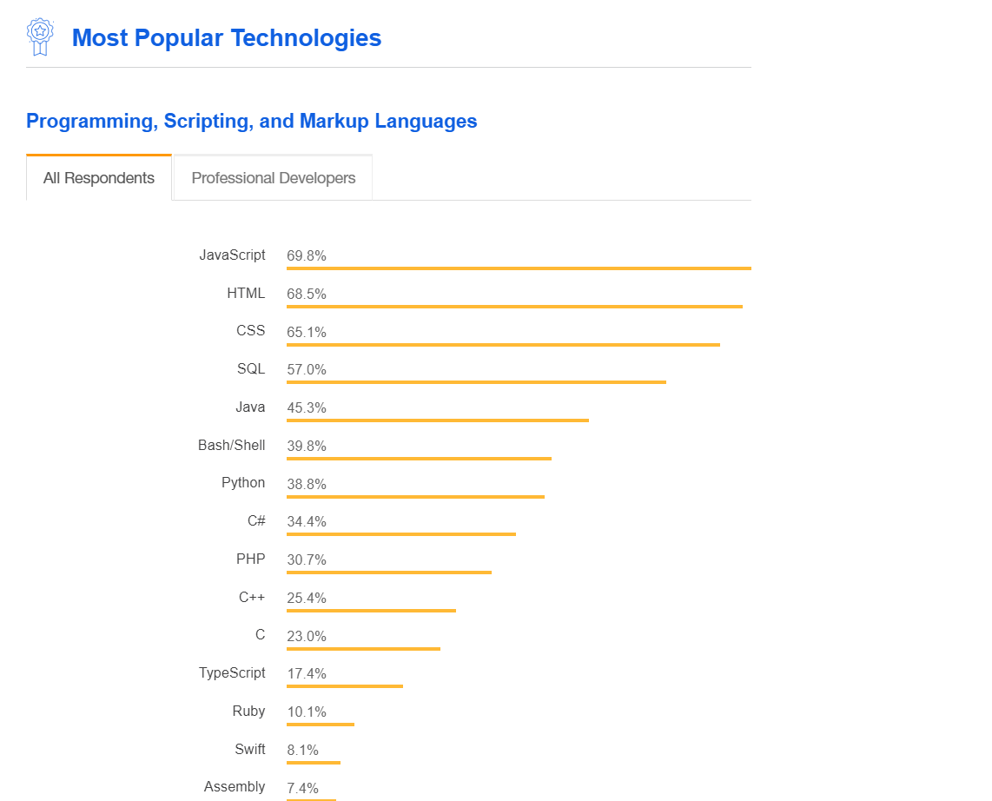
JavaScript
*most popular Stackoverflow languages

Slide 6
What is good for?
Web
Mobile
Desktop Apps
Backend Apps
Networking Apps
Command-line tools

Slide 7
What is ECMA Script?

Slide 8


JavaScript (JS)
ECMAScript (ES)
Programming Language
Specification

Slide 9
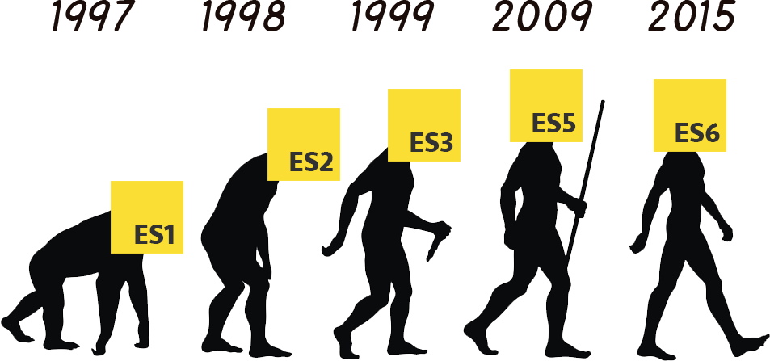
Evolution of JavaScript

Slide 10
JavaScript in a Web Page
<script>
alert('Hello, world!’);
</script>

Slide 11
JavaScript in a Web Page
<!DOCTYPE html> <html> <body> <script> alert('Hello, world!’); </script> </body> </html>

Slide 12
JavaScript in a Web Page
JavaScript comments can be used to explain JavaScript code,
and to make it more readable.
// Single Line Comments
var a = 10;
/*
Multi-line Comments
*/

Slide 13
Variables

Slide 14

Variables
A variable is a “named storage” for data.
You can refer to a variable by name to see its value or to
change its value.
let message = “Hello!”;

Slide 15
Variable Naming
There are two limitations on variable names in JavaScript:
The name must contain only letters, digits, or the symbols $ and _.
The first character must not be a digit.
let userName;
let test123;
* When the name contains multiple words, camelCase is commonly used.

Slide 16
Data types

Slide 17
Data types
The latest ECMAScript standard defines eight data types:
Seven data types that are primitives:
Boolean
Null
Undefined
Number
BigInt
String
Symbol
and

Slide 18
And?

Slide 19
and Object!

Slide 20
Primitive values
All types except objects define immutable values (values, which are incapable of being changed). For example (and unlike in C), Strings are immutable. We refer to values of these types as "primitive values".

Slide 21
Immutability
What the f… is this?

Slide 22
Immutability
In object-oriented and functional programming, an immutable object (unchangeable object) is an object whose state cannot be modified after it is created. This is in contrast to a mutable object (changeable object), which can be modified after it is created.

Slide 23
Immutability
Note that immutability as a design goal that doesn’t make it literally impossible to mutate an object. It means that the normal mechanisms for accessing objects in a given programming language don’t allow modification.

Slide 24
Merge Conflicts

Slide 25
Conflicts and how to not admit them
There are several advices how to not admin conflicts or unpleasant moments in git:
If there are several developers working ON one branch, first – pull all the changes and after – commit
With one main branch:
$ git checkout master
$ git pull origin master
$ git checkout -b “new-feature-branch”

Slide 26
Merge Conflicts
If the two branches you're trying to merge both changed the same part of the same file, Git won't be able to figure out which version to use. When such a situation occurs, it stops right before the merge commit so that you can resolve the conflicts manually.
CONFLICT (content): Merge conflict in foo.js
Automatic merge failed; fix conflicts and then
commit the result.checkout master

Slide 27
Merge Conflicts
<<<<<<< HEAD
your changes => private dashboardModel: DashboardModel,
=======
remote changes => private validationForm: ValidationForm,
>>>>>>> source:327fd18807a36f01b237d1cda9978793cf97a823

Slide 28
Merge Conflicts
When you're ready to finish the merge, all you have to do is run git add on the conflicted file(s) to tell Git they're resolved. Then, you run a normal git commit to generate the merge commit.
$ git add .
$ git commit

Slide 29
Thank you and until the next lesson!
E-mail:
clementii.cicali@gmail.com
LinkedIn:
linkedin.com/in/clementiicicali/

