Slide 1

Web Technologies JavaScript: Advanced
Cicalî Clementii
University Lecturer @UTM
Software Engineer @Endava

Slide 2
Agenda:
DOM
BOM
Objects
Copying by reference
Arrays
Functions
Scope
Closures

Slide 3
DOM

Slide 4
What is DOM?
The Document Object Model or DOM is the data representation of the objects that comprise the structure and content of a document on the web.
… in another words:
When a web page is loaded, the browser creates a Document Object Model of the page.

Slide 5
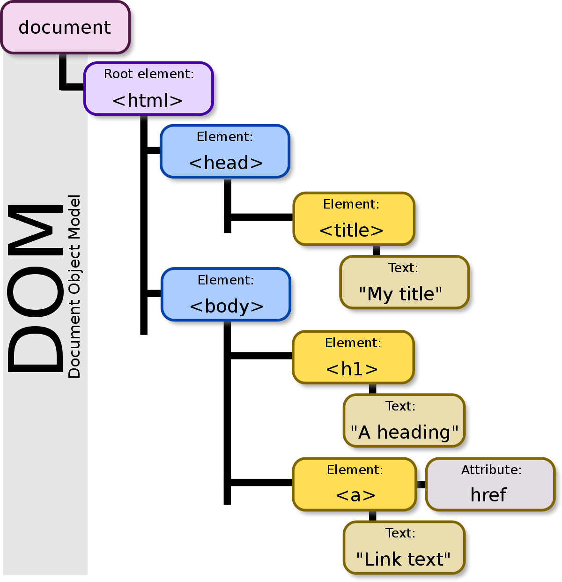
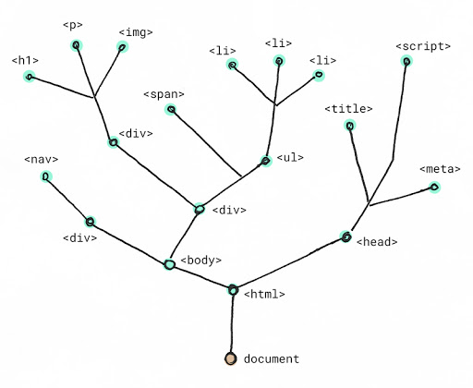

Slide 6
What is good for?
With the object model, JavaScript can:
JavaScript can change all the HTML elements in the page
JavaScript can change all the HTML attributes in the page
JavaScript can change all the CSS styles in the page
JavaScript can remove existing HTML elements and attributes
JavaScript can add new HTML elements and attributes
JavaScript can react to all existing HTML events in the page
JavaScript can create new HTML events in the page

Slide 7
But How??!!

Slide 8
Examples:
For example, the standard DOM specifies that the getElementsByTagName method in the code below must return a list of all the <p> elements in the document:
const paragraphs = document.getElementsByTagName("p");
// paragraphs[0] is the first <p> element
// paragraphs[1] is the second <p> element, etc.
alert(paragraphs[0].nodeName);

Slide 9
But what is BOM?

Slide 10
What is BOM?
The Browser Object Model or BOM in JavaScript includes the properties and methods for JavaScript to interact with the web browser.

Slide 11
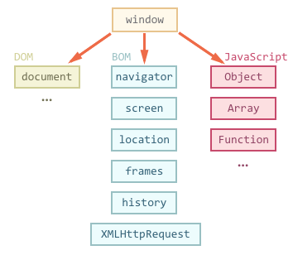
BOM

Slide 12
Examples:
You can try to run the following code to learn how to get screen height and width:
<!DOCTYPE html>
<html>
<body>
<script>
document.write("Screen width: " + screen.width);
document.write("Screen width: " + screen.width);
</script>
</body>
</html>

Slide 13
Objects
{ }

Slide 14
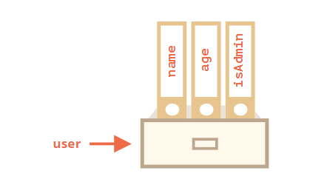
What is an Object?
Objects are used to store keyed collections of various data and more complex entities.
An object can be created with figure brackets {…} with an optional list of properties. A property is a “key: value” pair, where key is a string (also called a “property name”), and value can be anything.

Slide 15
Creation
An empty object can be created using one of two syntaxes:
let user = new Object(); // "object constructor" syntax
let user = {}; // "object literal" syntax
* use second one ;)

Slide 16
Example
An empty object can be created using one of two syntaxes:
let user = {
name: "John",
age: 30,
country: “Germany"
"likes birds": true // multiword property name must be quoted
};

Slide 17
Copying by Reference
One of the fundamental differences of objects vs primitives is that they are stored and copied “by reference”!

Slide 18
Copying by Reference
Primitive values: strings, numbers, booleans – are assigned/copied “as a whole value”.
let message = "Hello!";
let phrase = message;
message = ”Salut";
console.log(message); // Salut
console.log(phrase); // Hello

Slide 19
Copying by Reference
Objects are not like that.
A variable stores not the object itself, but its address in memory, in other words a reference to it.
let user = { name: “Ion" };
let admin = user; // copy the reference
When an object variable is copied – the reference is copied, the object is not duplicated.

Slide 20
Questions!

Slide 21
Question 1
What result will be here:
let a = {};
let b = a; // copy the reference
alert( a == b );
??

Slide 22
TRUE
bcs, both variables reference the same object

Slide 23
Question 2
But here:
let a = {};
let b = {};
alert( a == b );
??

Slide 24
FALSE
bcs, two independent objects are not equal,
they have two different references

Slide 25
Arrays

Slide 26
Arrays
JavaScript arrays are used to store multiple values in a single variable.
var languages = ["Python", "JS", "Java"];

Slide 27
Creation
There are two syntaxes for creating an empty array:
let arr = new Array();
let arr = [];
* use second one ;)

Slide 28
Example
let fruits = ["Apple", "Orange", "Plum"];
alert( fruits[0] ); // Apple
alert( fruits[1] ); // Orange
alert( fruits[2] ); // Plum
// mix of values
let arr = [ 'Apple', { name: 'John' }, true];

Slide 29
Useful Array Methods & Properties
var languages = ["Python", "JS", "Java"];
cars.toString(); // Return all item into string
cars.length; // Return array length
cars.push(“item”); // Add new item
cars.pop(); // Remove last item
cars.shift(); // Remove first item
cars.unshift(“item”); // Add item on the begin
cars.join(“-”); // Return string with joined items
cars.sort(); // Sorting
cars.slice(0, 2); // Remove elements

Slide 30
Functions

Slide 31
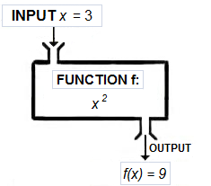
Functions
A function is a block of organized, reusable code that is used to perform a single, related action.

Slide 32
Functions
Function Declaration
function calcRectArea(width, height) {
return width * height;
}
Function Expressions
const getRectArea = function(width, height) {
return width * height;
}
Function Immediately Invoked
( function sayHi(name) { console.log(`Hi ${name}`);
} )("John");

Slide 33
Scope

Slide 34
Scope
In JavaScript there are two types of scope:
Local scope
Global scope
Scope determines the accessibility (visibility) of these variables.
Variables defined inside a function are not accessible (visible) from outside the function.

Slide 35
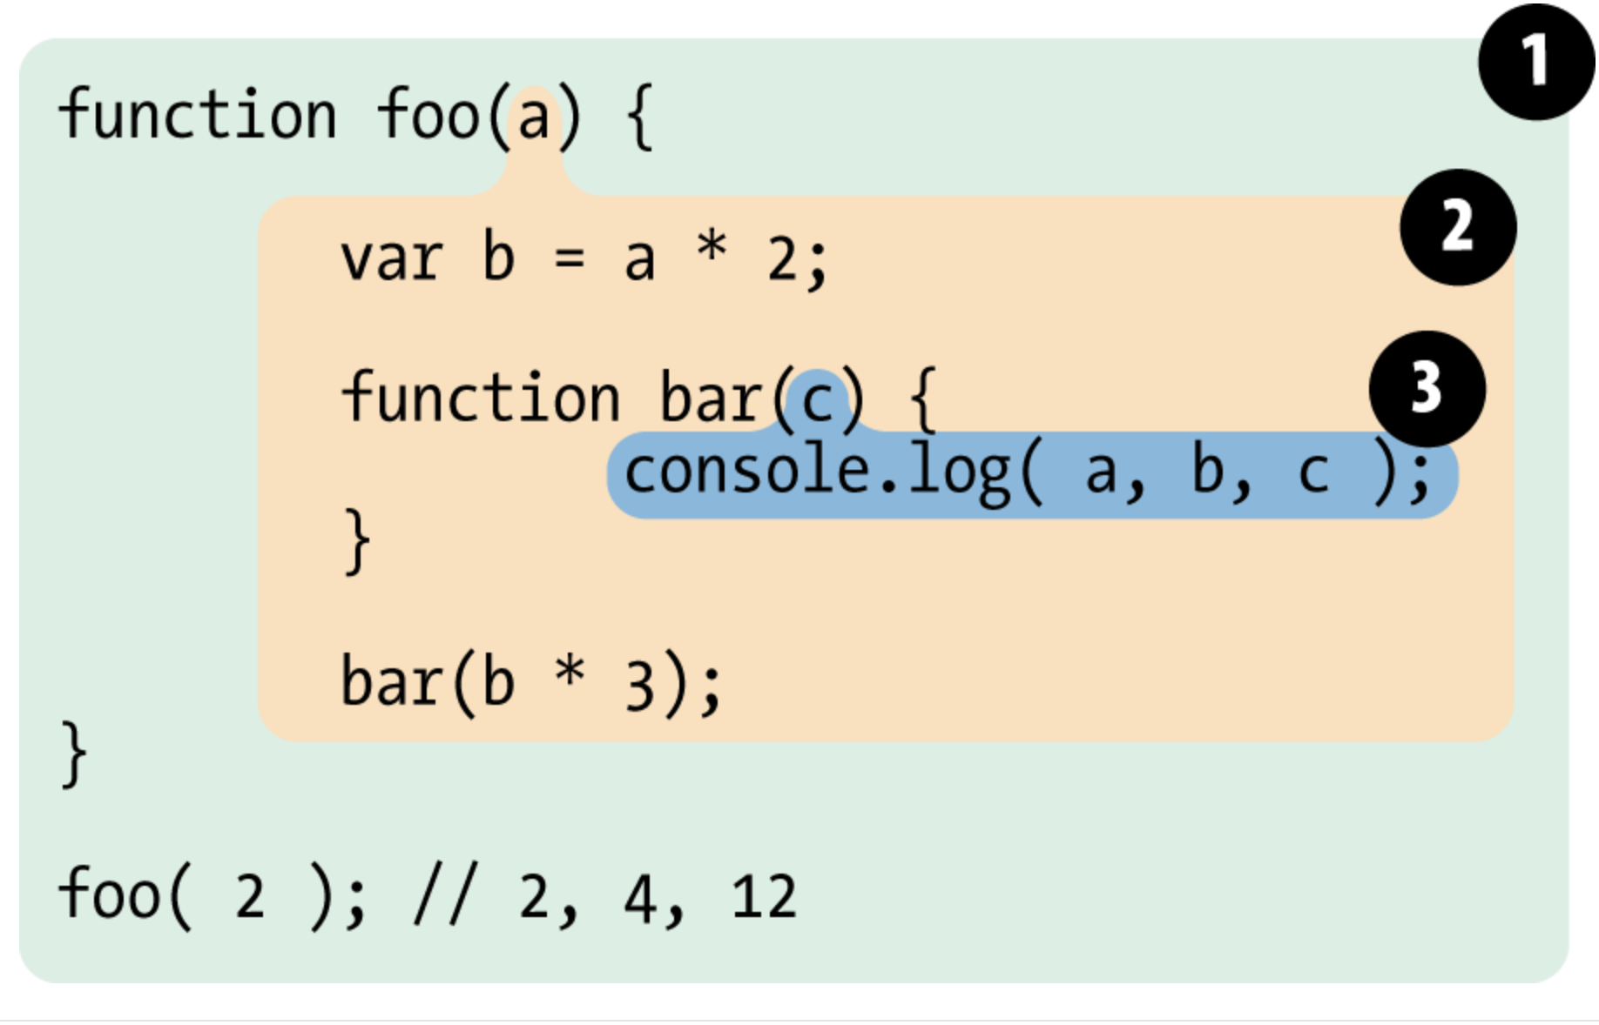
Scope

Slide 36
Closures

Slide 37
What is a Closure?
A closure is a feature in JavaScript where an inner function has access to the outer (enclosing) function’s variables — a scope chain.
The closure has three scope chains:
it has access to its own scope — variables defined between its curly brackets
it has access to the outer function’s variables
it has access to the global variables

Slide 38
Example
function getHobbyOf(name) {
return function(hobby) {
console.log(name + ' likes ' + hobby);
}
}
const johnLikes = getHobbyOf('John');
johnLikes('swimming'); // John likes swimming
johnLikes('footbal'); // John likes footbal

Slide 39
Thank you and until the next lesson!
E-mail:
clementii.cicali@gmail.com
LinkedIn:
linkedin.com/in/clementiicicali/

