Slide 1
Select the data aggregation window and encoders automatically
Nov 6, 2015

Slide 2
Goal and requirements
Automatically select the data aggregation window
Fast, without running the HTM models
Reliably works for most types of data
Must not hurt anomaly detection scores
Automatically select the encoder types
e.g., should we use time of day encoder for this data?
Leads to better anomaly detection scores in general

Slide 3
Rational of the algorithm
Aggregation window:
Aggregation removes high-frequency (fast time scale) component from the signal
We could apply aggregation if there is little modulation of the high-frequency power over time.
Encoder type:
A clear modulation at the daily level suggest timeOfDay encoder could be useful
How does the signal changes at different time scales?

Slide 4
Wavelet transformation

Slide 5
Example NYC-taxi data, 1 min resolution
Low variance
High variance
Variance of WT
coefficients across time reflects whether it is a “useful” time scale

Slide 6
Little power modulation at fast time scales, suggesting we could use larger aggregation window
Strong peak at
the daily level
Little modulation at fast time scales

Slide 7
EC2 cpu utilization data (5 min resolution)

Slide 8
Significant modulation at fast time scales, we shouldn’t apply data aggregation
No peak at the daily period
Strong modulation at fast time scales

Slide 9
Aggregation algorithm works for a wide range of threshold

Slide 10
The algorithm makes proper suggestion for timeOfDay encoder
If we naively include timeOfDay
encoder for all datasets, the encoder will lead to worse NAB score in about half of the datasets
The algorithm suggest to use timeOfDay
encoder for 39/58 datasets
Good suggestions
Bad suggestions
False suggestion rate: 0.26 (15/58)
Raw NAB score: 0.130 -> 0.183

Slide 12
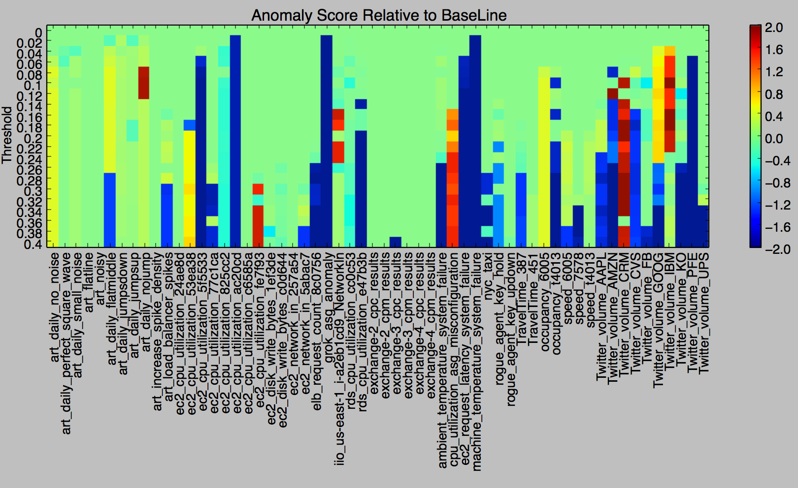
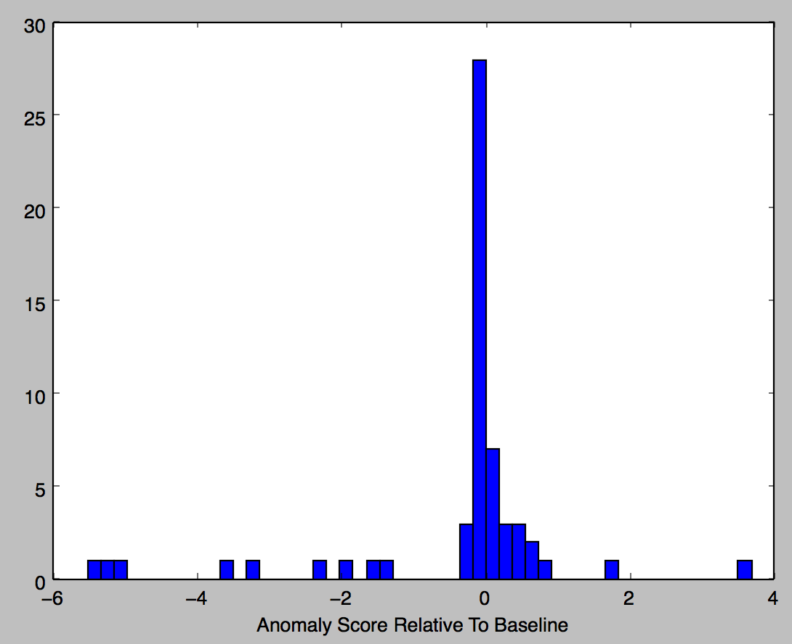
How reliable is the threshold?
Better anomaly score for 18 datasets
Worse anomaly score for 16 datasets

Slide 13
Runtime vs datasize

Slide 14
We could use the same method to select encoders

Slide 15
Daily
Weekly

