Slide 1
Automatically select the data aggregation window and encoders
October 23, 2015

Slide 2
Goal
Automatically select the data aggregation window
Fast, without running the models
Reliably works for most types of data
Do not hurt anomaly detection scores
Automatically select the encoder types
e.g., should we use time of day or day of week encoder for this data?

Slide 3
Wavelet transformation
Why transformation?
Mathematical transformations are applied to raw signals to obtain information that is not readily available in the raw signal
Example: Fourier transform gives the frequency component of a signal (For every frequency, we have an amplitude value)
The wavelet transformation provides a time-frequency representation of a signal, i.e., we know how the signal changes over time at different time scales (frequency bands).

Slide 4
Example wavelet transformation

Slide 5
Selecting the aggregation window
Aggregation removes high-frequency (fast time scale) component from the signal
We could apply aggregation if there is little modulation on the high-frequency power over time.

Slide 6
Example NYC-taxi data, 1 min resolution
Low variance
High variance
Variance of WT
coefficients across time reflects whether it is a “useful” time scale

Slide 7
Little power modulation at fast time scales, suggesting we could use larger aggregation window

Slide 8
EC2 cpu utilization data (5 min resolution)

Slide 9
Significant modulation at fast time scales, shouldn’t apply data aggregation

Slide 10
Summary of the algorithm
Wavelet transformation of the signal at the original sampling interval (dt0)
Calculate variance of the wavelet coeff at each frequency band (time scale)
Apply a threshold to the cumulative distribution of wavelet coeff. variance, find the corresponding time scale at the threshold (dt)
The suggested aggregation time scale is chosen as max(dt0, dt/10)

Slide 11
How to choose the threshold?

Slide 12
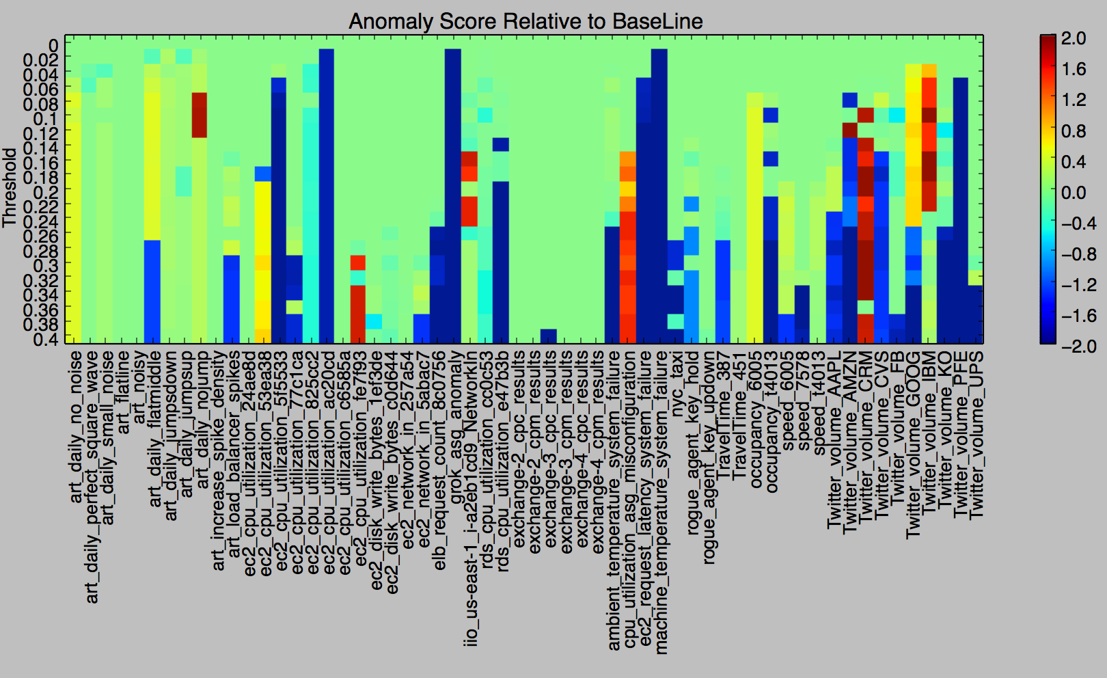
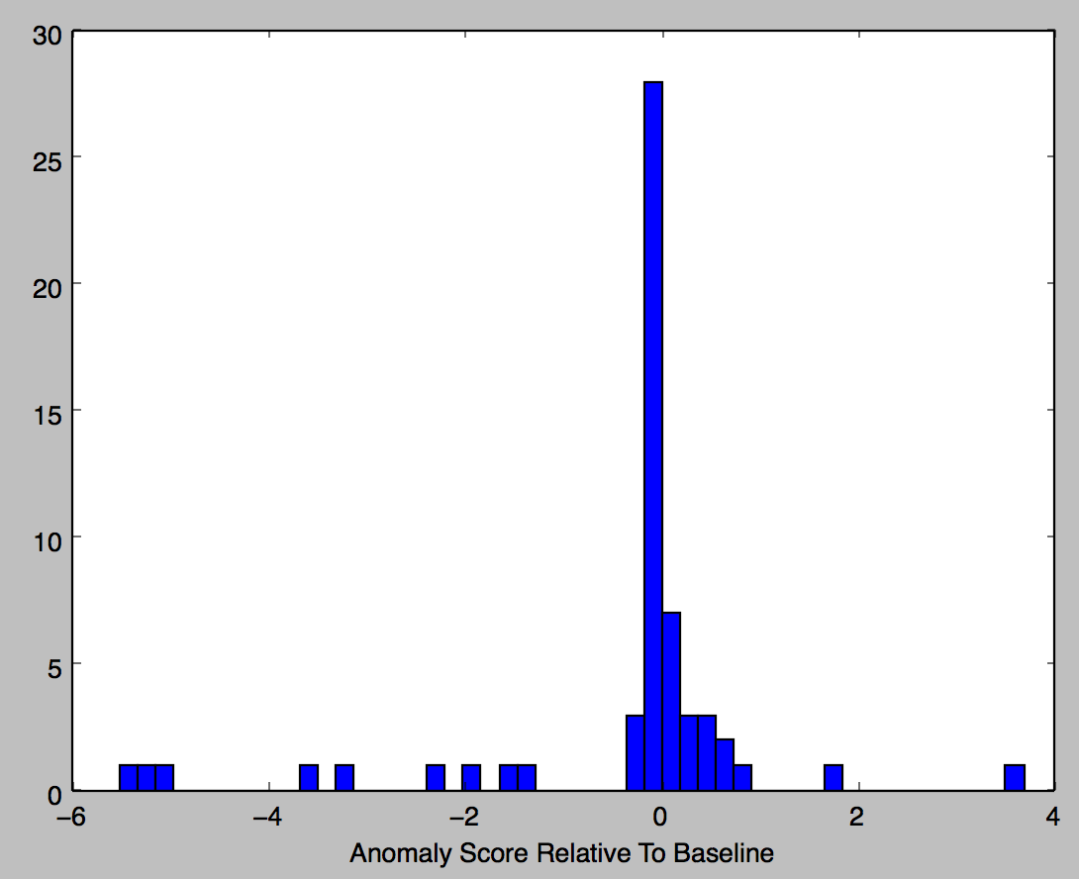
How reliable is the threshold?
Better anomaly score for 18 datasets
Worse anomaly score for 16 datasets

Slide 13
Runtime vs datasize

Slide 14
We could use the same method to select encoders

Slide 15
Daily
Weekly

