Slide 1
High Level Architecture Diagrams
By Orleando Dassi

Slide 2










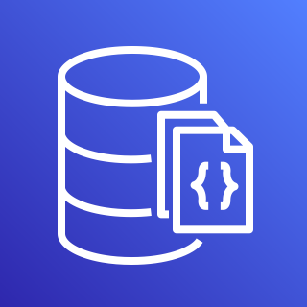






Client
Client
Server
JWT AUTH
Internet
AWS Cloud
VPC
VPC
Internet gateway
Peering connection
CRUD
PUB - SUB
API
GET - SET
MongoDB 1
AWS SNS
Monitoring
AWS API GATEWAY
AWS Lambda
MongoDB 2
ElastiCache - Redis
API
Backups Storage
GET - SET
PUB - SUB
AWS Certificate Manager (ACM)
CRUD
MongoDB 3
10.0.0.0/16

Slide 3
More detailed views are coming soon …
Subscribe to the newsletter to know more.
Or join our discord server to be kept in the loop.

