Slide 1
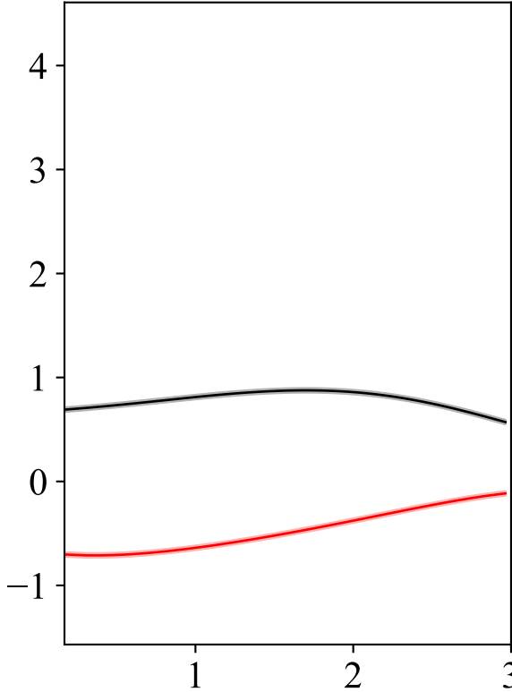
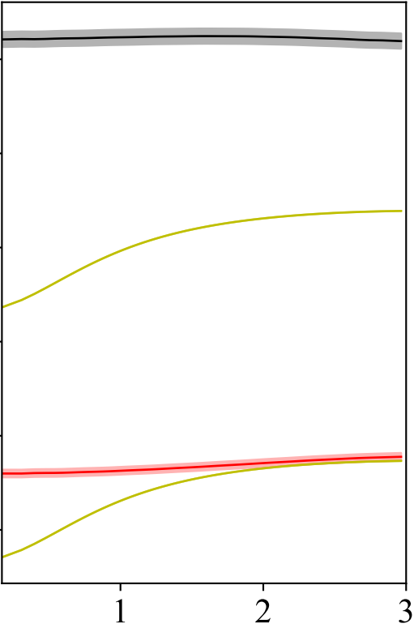
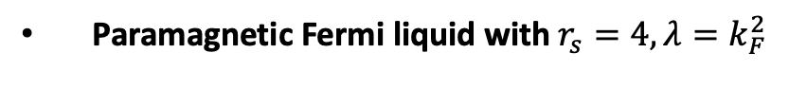




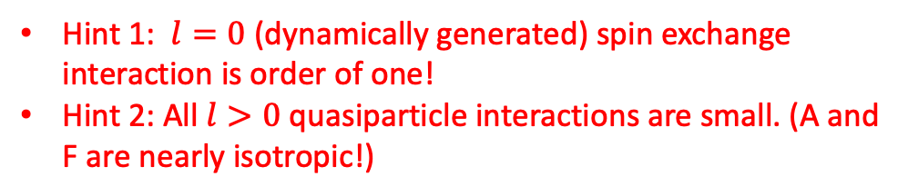

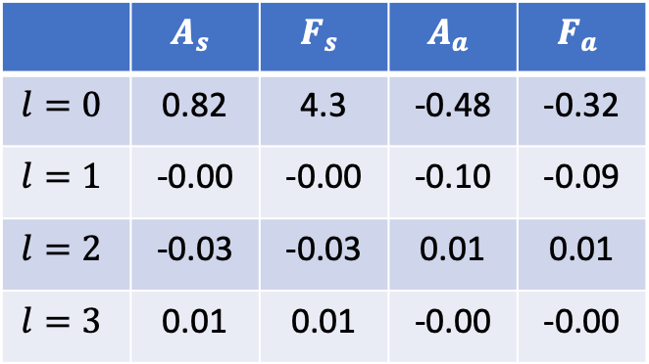
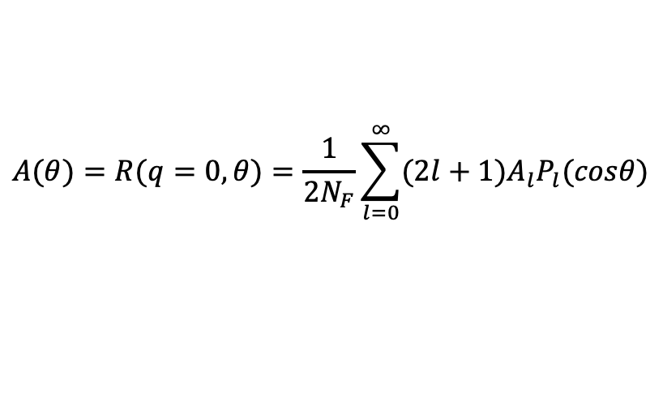

Quasiparticle Interaction of Yukawa Fermi Liquid
$$A(θ)=R(q=0, θ)=\frac{1}{2N_{F}}\sum_{l=0}^{∞}{{(2l+1)A}_{l}P_{l}(cosθ)}$$
Paramagnetic Fermi liquid with $r_{s}=4, λ=k_{F}^{2}$
$$A_{l}= A_{l}^{s}∙I + A_{l}^{a}\overset{⃑}{σ}∙\overset{⃑}{σ}$$
symmetric
Asymmetric
$$F^{s}(θ)$$
Landau Parameters:
$F_{l}^{s,a}=A_{l}^{s,a}/(1−A_{l}^{s,a}$)
 | $$A_{s}$$ | $$F_{s}$$ | $$A_{a}$$ | $$F_{a}$$
$$l=0$$ | 0.82 | 4.3 | -0.48 | -0.32
$$l=1$$ | -0.00 | -0.00 | -0.10 | -0.09
$$l=2$$ | -0.03 | -0.03 | 0.01 | 0.01
$$l=3$$ | 0.01 | 0.01 | -0.00 | -0.00
$$A^{s}(θ)$$
$$A^{a}(θ)$$
$$F^{a}(θ)$$
Hint 1: $l=0$ (dynamically generated) spin exchange interaction is order of one!
Hint 2: All $l>0$ quasiparticle interactions are small. (A and F are nearly isotropic!)
Notes:
Let’s consider a bosonic gas in a lattice. For a homogenous lattice, the particle density distribution is flat in long wave limit.

Slide 2
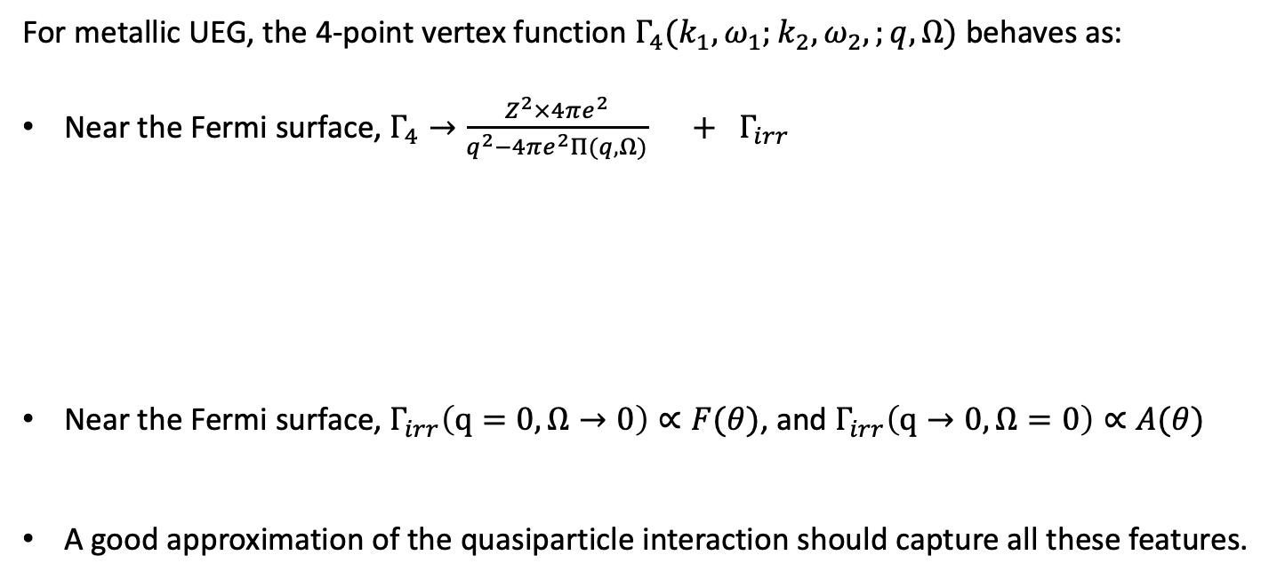



Quasiparticle Interaction of Coulomb Fermi Liquid
For metallic UEG, the 4-point vertex function $Γ_{4}(k_{1}, ω_{1};k_{2}, ω_{2},;q, Ω)$ behaves as:
Near the Fermi surface, $Γ_{4}→\frac{Z^{2}×4πe^{2}}{q^{2}−4πe^{2}Π(q,Ω)} + Γ_{irr}$
Near the Fermi surface, $Γ_{irr}\left(q=0, Ω→0\right)∝F(θ)$, and $Γ_{irr}\left(q→0, Ω=0\right)∝A(θ)$
A good approximation of the quasiparticle interaction should capture all these features.
$$Γ_{3}$$
$$Γ_{3}$$
One-interaction-irreducible
$$W$$
Notes:
Let’s consider a bosonic gas in a lattice. For a homogenous lattice, the particle density distribution is flat in long wave limit.

Slide 3

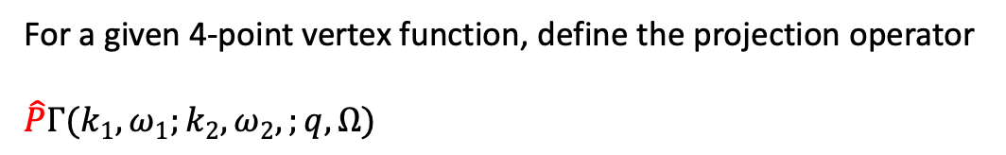





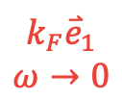

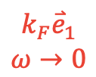
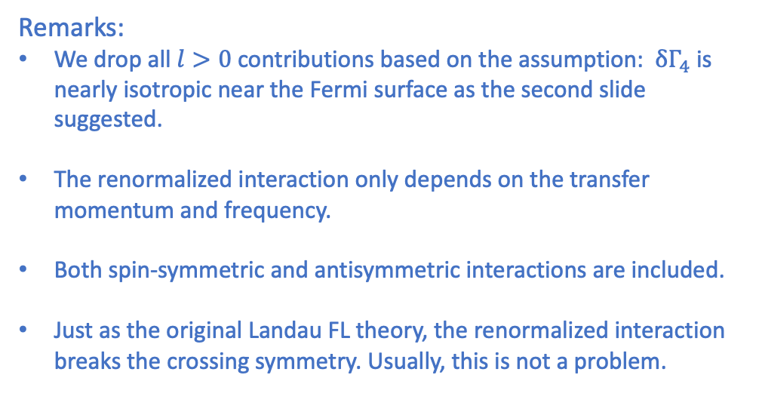
Projective Renormalization Condition
For a given 4-point vertex function, define the projection operator
$$\hat{P}Γ(k_{1}, ω_{1};k_{2}, ω_{2},;q, Ω)$$
Remarks:
We drop all $l>0$ contributions based on the assumption: $δΓ_{4}$ is nearly isotropic near the Fermi surface as the second slide suggested.
The renormalized interaction only depends on the transfer momentum and frequency.
Both spin-symmetric and antisymmetric interactions are included.
Just as the original Landau FL theory, the renormalized interaction breaks the crossing symmetry. Usually, this is not a problem.
$${\overset{⃑}{k}}_{1}−\overset{⃑}{q}$$
$${\overset{⃑}{k}}_{2}+\overset{⃑}{q}$$
$$k_{F}{\overset{⃑}{e}}_{1}−q$$
$$−Ω$$
$$k_{F}{\overset{⃑}{e}}_{1}+q$$
$$Ω$$
$$Γ$$
$$k_{F}{\overset{⃑}{e}}_{1}$$
$$ω→0$$
$$k_{F}{\overset{⃑}{e}}_{1}$$
$$ω→0$$
$${\overset{⃑}{k}}_{1}$$
$${\overset{⃑}{k}}_{2}$$
Notes:
Let’s consider a bosonic gas in a lattice. For a homogenous lattice, the particle density distribution is flat in long wave limit.

Slide 4
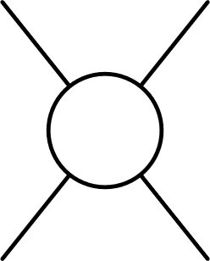
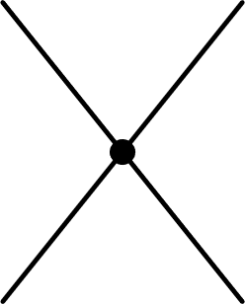
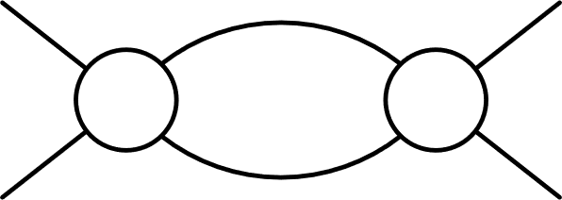
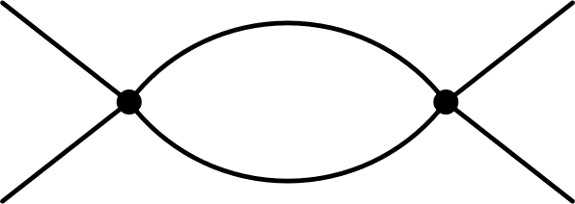









Renormalized Dyson Equation
$$R$$
$$=$$
$$F$$
$$+$$
$$F$$
$$Γ_{4}$$
For the one-loop order,
$$F=W_{dir}+W_{exch}+$$
$$+$$
$$Γ_{4} =R$$
For higher orders, one must use renormalized diagrammatic expansions to represent $F$ and $Γ_{4}$.
Notes:
Let’s consider a bosonic gas in a lattice. For a homogenous lattice, the particle density distribution is flat in long wave limit.

