Slide 1
Javascript
it’s reasonable

Slide 2


Slide 3
LiveScript ‘95

Slide 4


Slide 5
Don’t believe me!
(read the T-shirt)

Slide 6
I don’t hate Java
honestly

Slide 7
Systems Application

Slide 8
Systems Application
operating systems
database engines
file servers
device drivers
routers
browsers
anything for the user

Slide 9
Session 4
Javascript for Java developers

Slide 11
Systems Application
digital capability
computer science
write for machines
slow, painstaking
optimisation: byte and cycle level
lifetime: decades
costs up front
business value
computer engineering
write for people
fast, replaceable / updatable
optimisation: IO and algorithmic
lifetime: years
ongoing costs

Slide 12
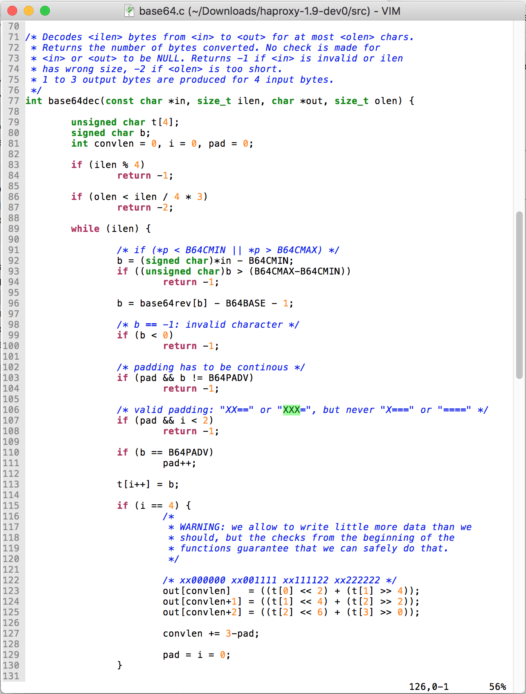
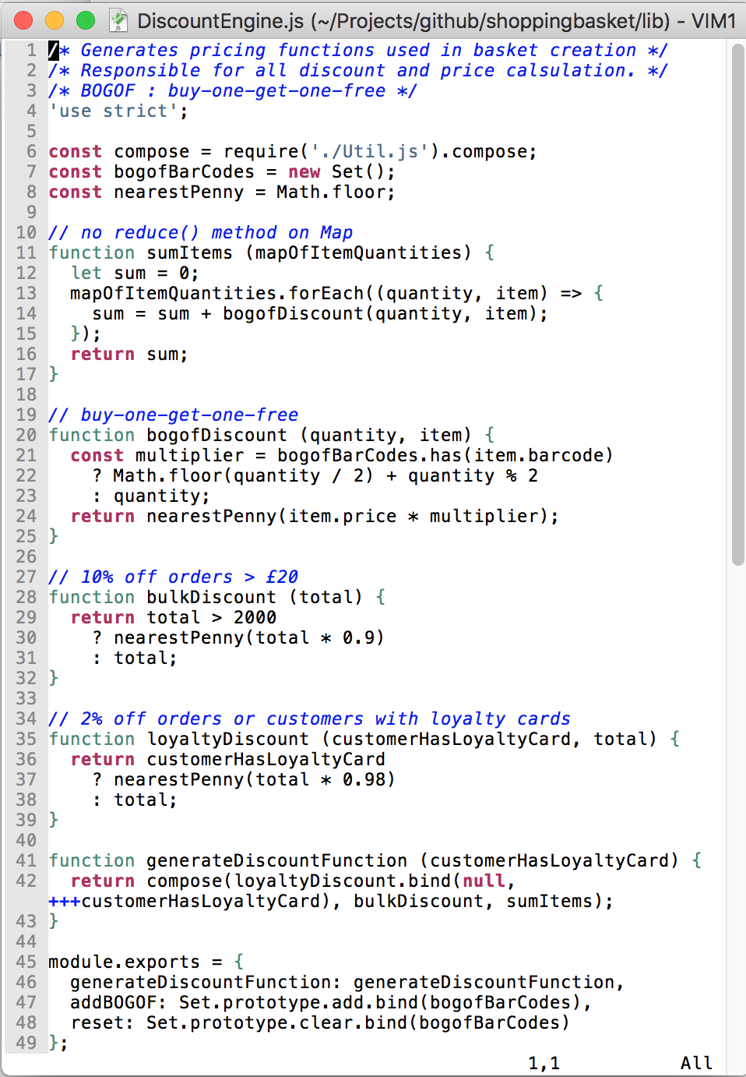
Systems Application

Slide 13
Systems Application
C (++)
Java
Python
Ruby
Javascript
etc.

Slide 14
Javascript Pro’s
easy to learn, not too hard to master
dynamic, i.e. not static!
single threaded, run-to-completion
no exposing OS primitives
supports a variety of styles
  imperative / functional
  classical / prototypical inheritance
  callbacks / continuation passing style

Slide 15
Javascript
it’s reasonable

Slide 16

Bugs

Slide 17
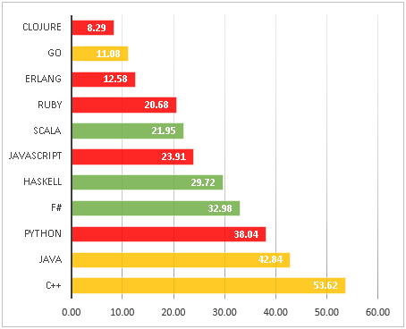
Round 3. Languages sorted by bug density. More than 100 stars repos
https://labs.ig.com/static-typing-promise

Slide 18

Speed

Slide 19
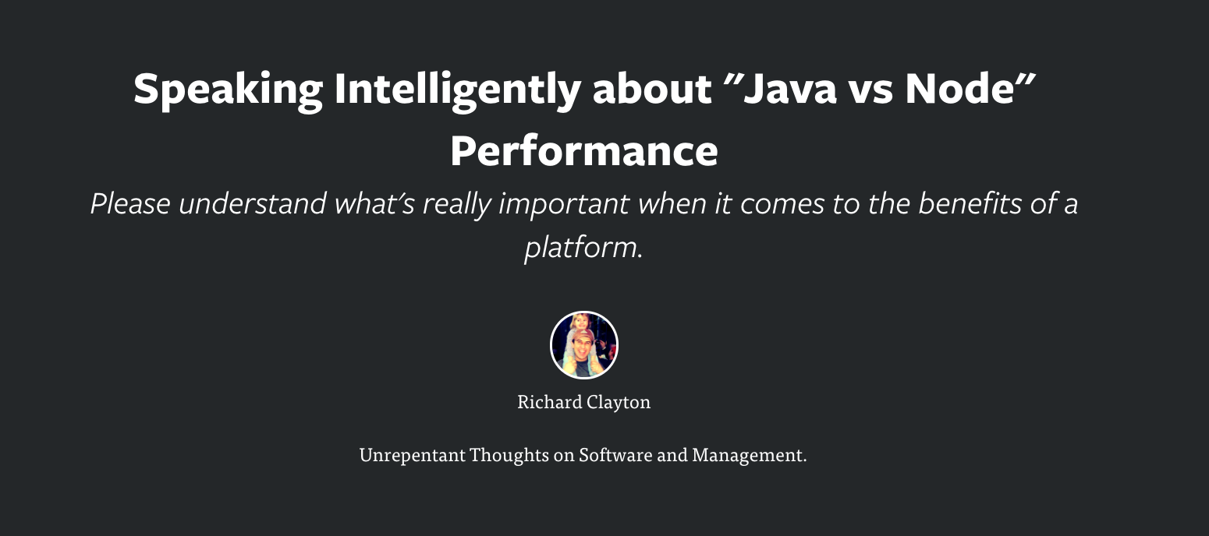
https://rclayton.silvrback.com/speaking-intelligently-about-java-vs-node-performance

Slide 20

Popularity

Slide 21
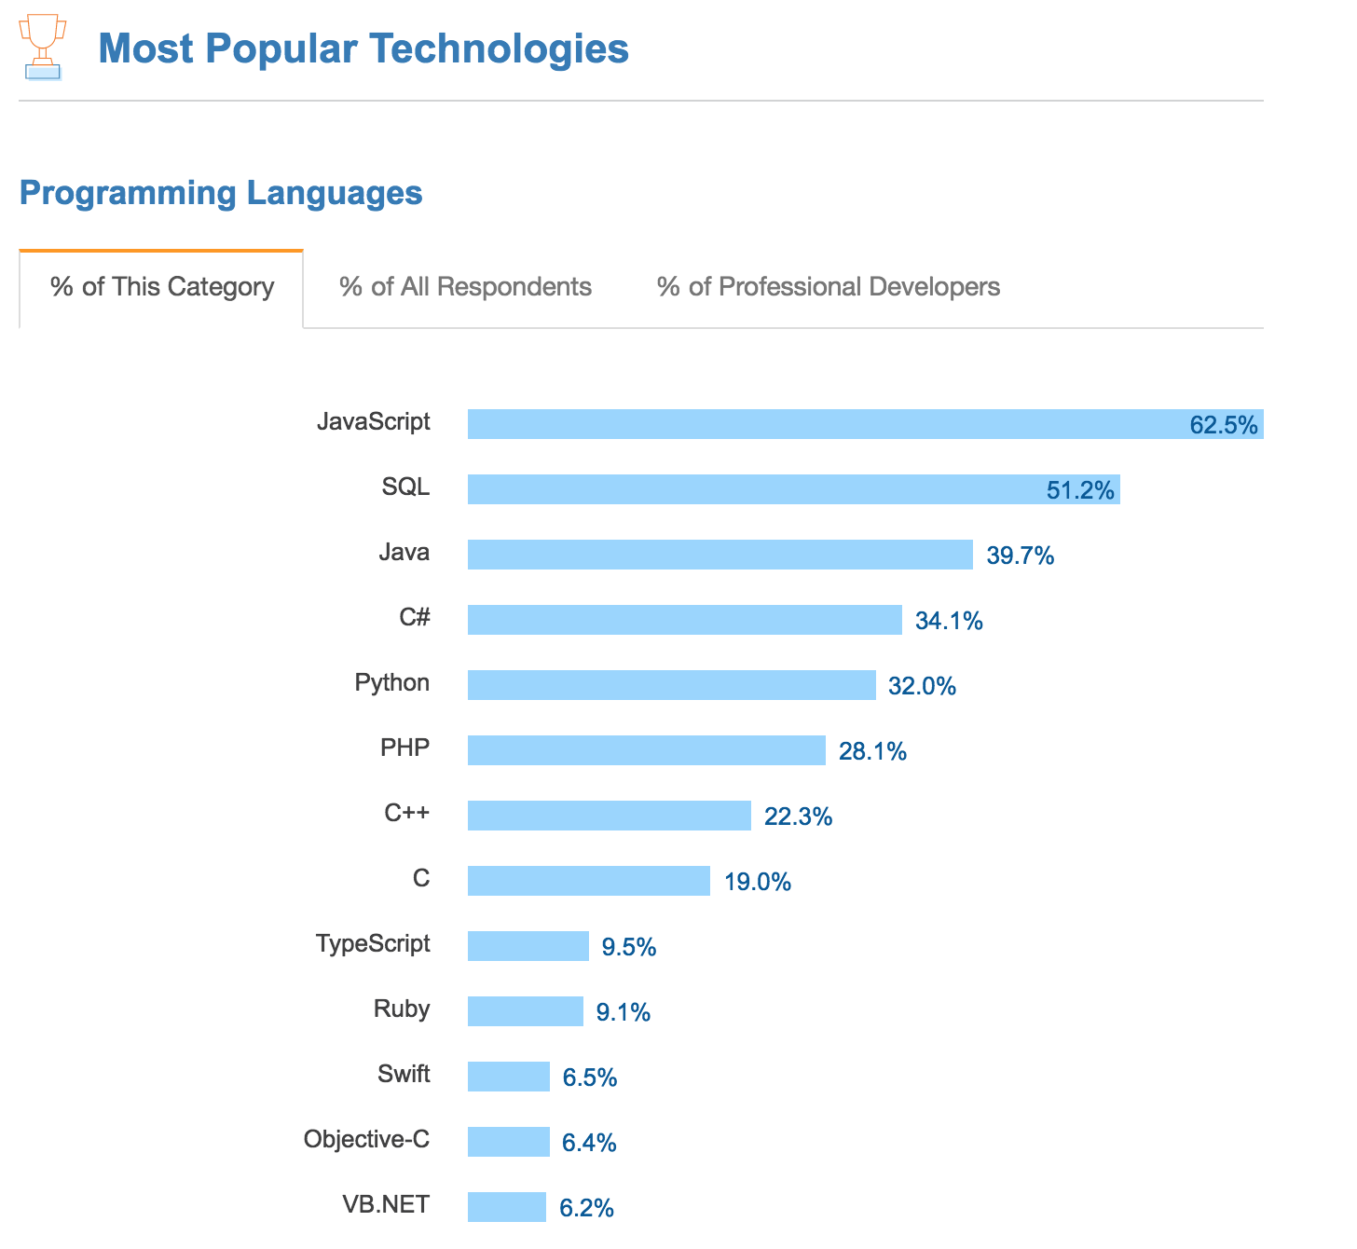
https://insights.stackoverflow.com/survey/2017#most-popular-technologies

Slide 22
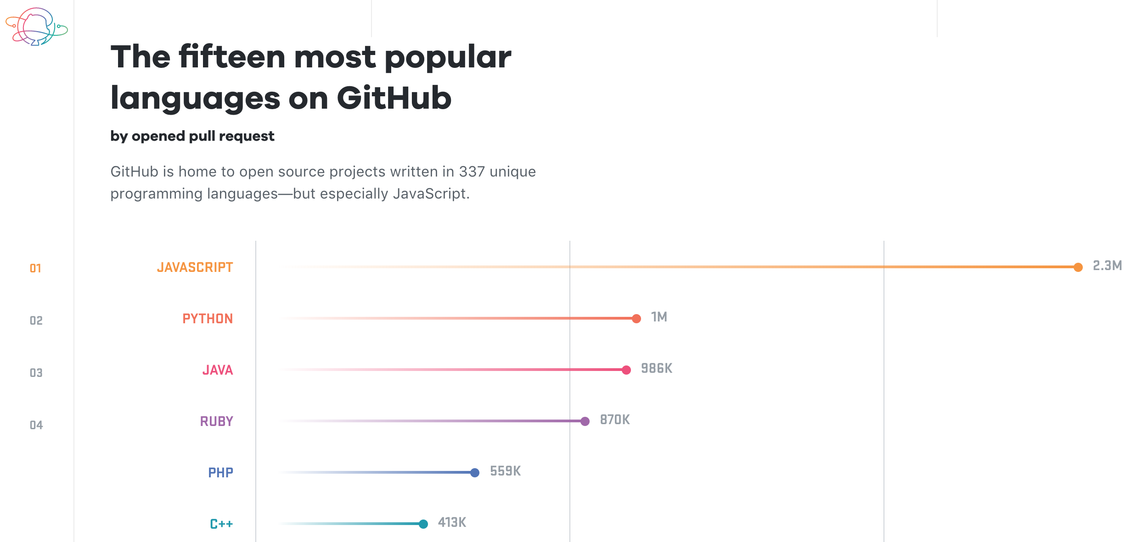
https://octoverse.github.com/

Slide 23
Session 2
Javascript: its natural habitat - the browser

Slide 24
Session 3
Javascript: its new natural habitat - everywhere

Slide 25
Node
Your Javascript code
application
system
V8 compiler
libuv

Slide 26
Session 4
Javascript for Java developers

Slide 27

Java
Javascript
bad
ok
good

Slide 28
Session 5 - Workshop
A Scary Walking Skeleton

Slide 29
Session 6 : Workshop
Grown up Javascript – the enterprise era

Slide 30
Pre-workshop homework
ensure your computer has
  git
  node
  access to:
    https://jsbin.com/
    https://github.com/
or find a coding buddy who does

