Slide 1
Ode to Node

Slide 2
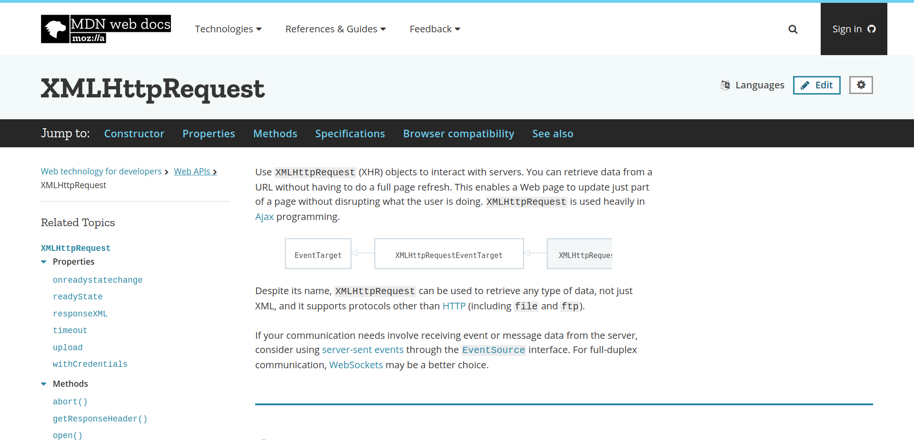
https://developer.mozilla.org/en-US/docs/Web/API/XMLHttpRequest

Slide 3
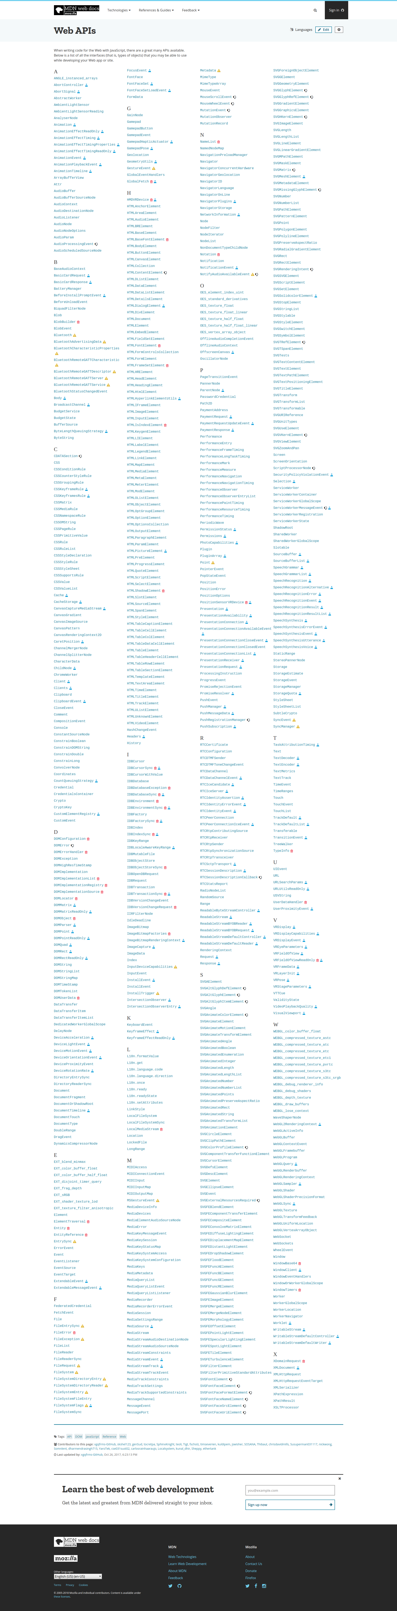
The Web Platorm
HTTP
HTML
Javascript
CSS
https://developer.mozilla.org/en-US/docs/Web/API

Slide 4
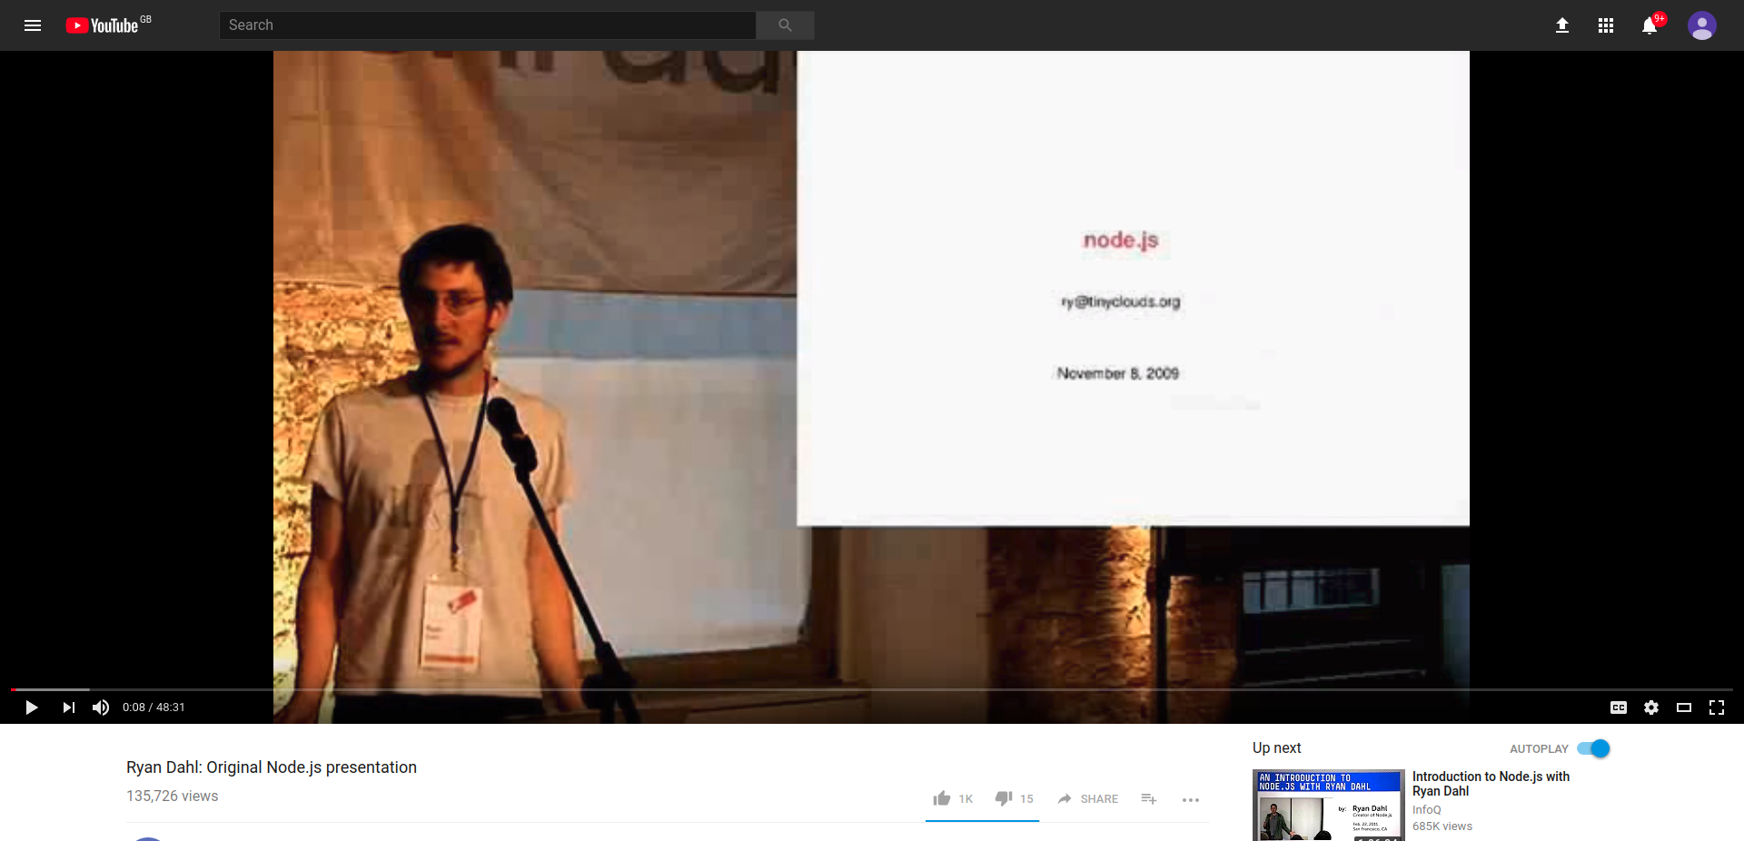
https://youtu.be/ztspvPYybIY?t=8

Slide 5
“ … a rather large C project, actually...”

