Slide 1
Preparation
chrome console – no errors

Slide 2
Javascript
it’s reasonable
Notes:
I’m Mike, Welcome & Thank you
Why are you here?
Why you should care about Javascript?
Would you be here is ObjectiveC or Prolog?
You do, else not here, a bandwagon? Is it justified?
Certainly the title of this talk is not a ringing endorsement
Target all technical abilities and none
This talk is for anyone involved in or interested in creating computer applications
2 mins (2)

Slide 3

Notes:
Nassim Nicholas Taleb
history dominated by highly unlikely events
Introduce one of the more unlikely Black Swans of the IT industry
1 min (3)

Slide 4
LiveScript ‘95
Notes:
Written by Brendan Eich
in 10 days to compliment Java
a ‘glue’ language for non-professionals
‘JavaScript’ to cash in on the cachet of Java
2 mins (5)

Slide 5
F*** You! Money
Notes:
Nassim Nicholas Taleb
Speaking truth to power
1 min (6)

Slide 6
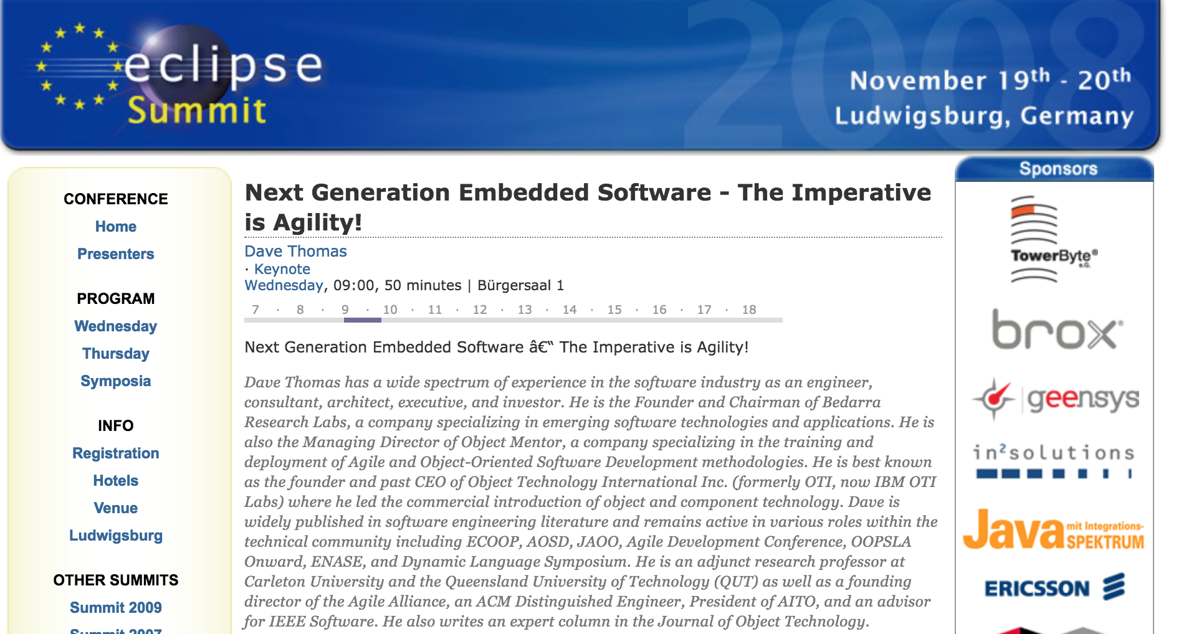
Notes:
EclipseCon 2008
Dave Thomas
dull title – provoke 400 javadevs
2 languages – C & JS
3 mins (9)
I largely agree
This series of talks and workshops is to explain, illustrate, and justify why
NOT: go through language syntax
If you want to learn to write JS, write JS
Instead issues for web programming / programming
At end, everyone better judge if bandwagon is justified…
But first a caveat..
2 min (11)

Slide 7
Don’t
(always)
believe
me
Notes:
as Dave Thomas in EclipseCon, speaking to provoke
opinionated, provocation
can be wrong
facts - referenced
might mislead but never to misinform
ask questions / challenge me
best possible response would be a 7th session
‘what Mike got wrong’
so with that caveat
2 mins (13)

Slide 8
Systems Application
Notes:
Dave Thomas proposed a dichotomy
clarify through comparison
black and white in a grey world
divide software development into two
systems = capability
application = business use
1 min (14)

Slide 9
Systems Application
operating systems
database engines
file servers
device drivers
routers
browsers
anything that answers business requirements
Notes:
os
db
file server
device driver
routers
might surprise you – come back to this – browsers -
application
– know what is but struggle for definition
- initially anything involving UX
miss out middleware
so: anything that answers business requirements
1 mins (15)

Slide 10
Systems Application
digital capability
computer science
write for machines
slow, painstaking
optimisation: byte and cycle level
lifetime: decades
costs up front
business value
computer engineering
write for people
fast, replaceable / updatable
optimisation: IO and algorithmic
lifetime: years
ongoing costs
Notes:
engineering vs science
bridge analogy
lots of people confused by their role
everyone in this room on right hand side!
5 mins to understand is a lot of nanoseconds
5 mins (20)

Slide 11
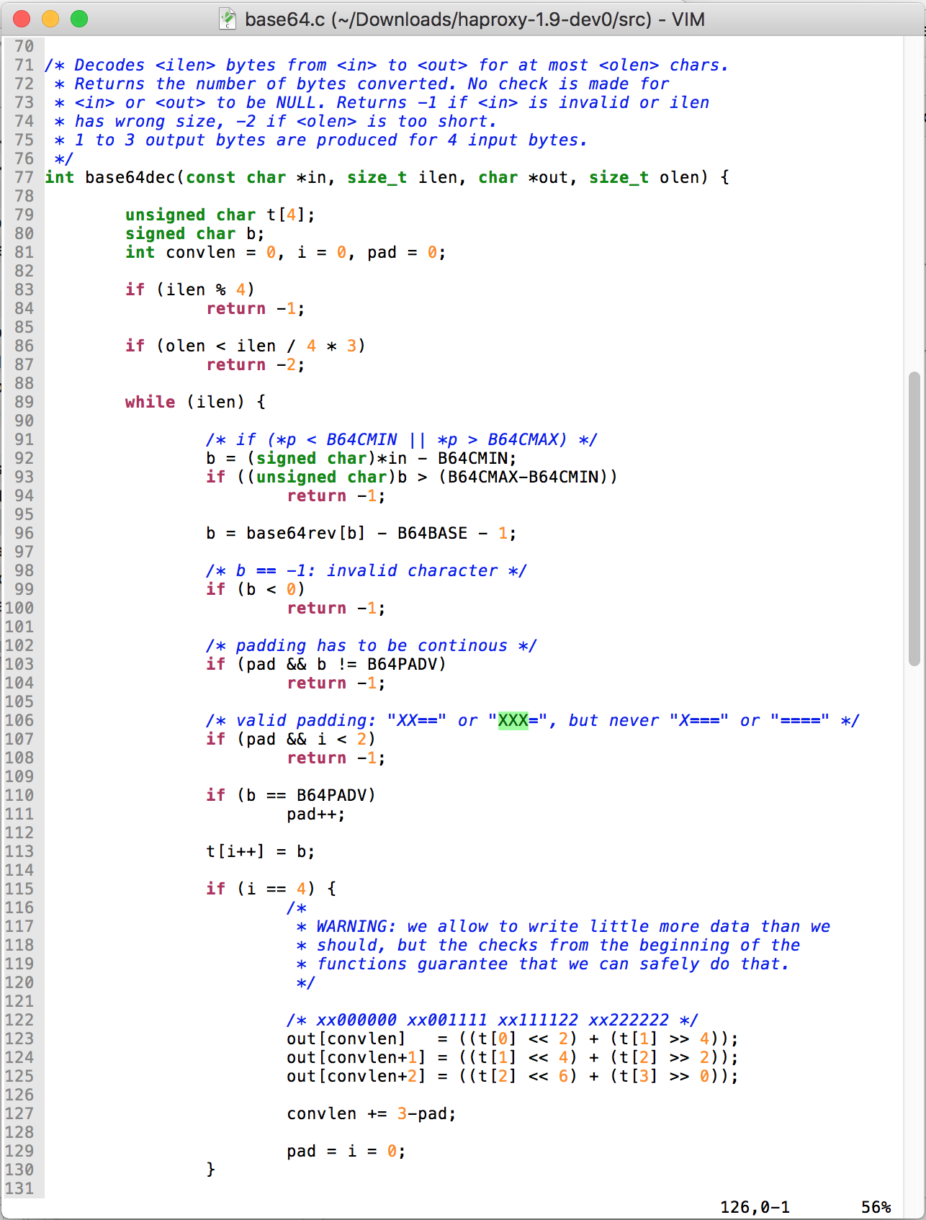
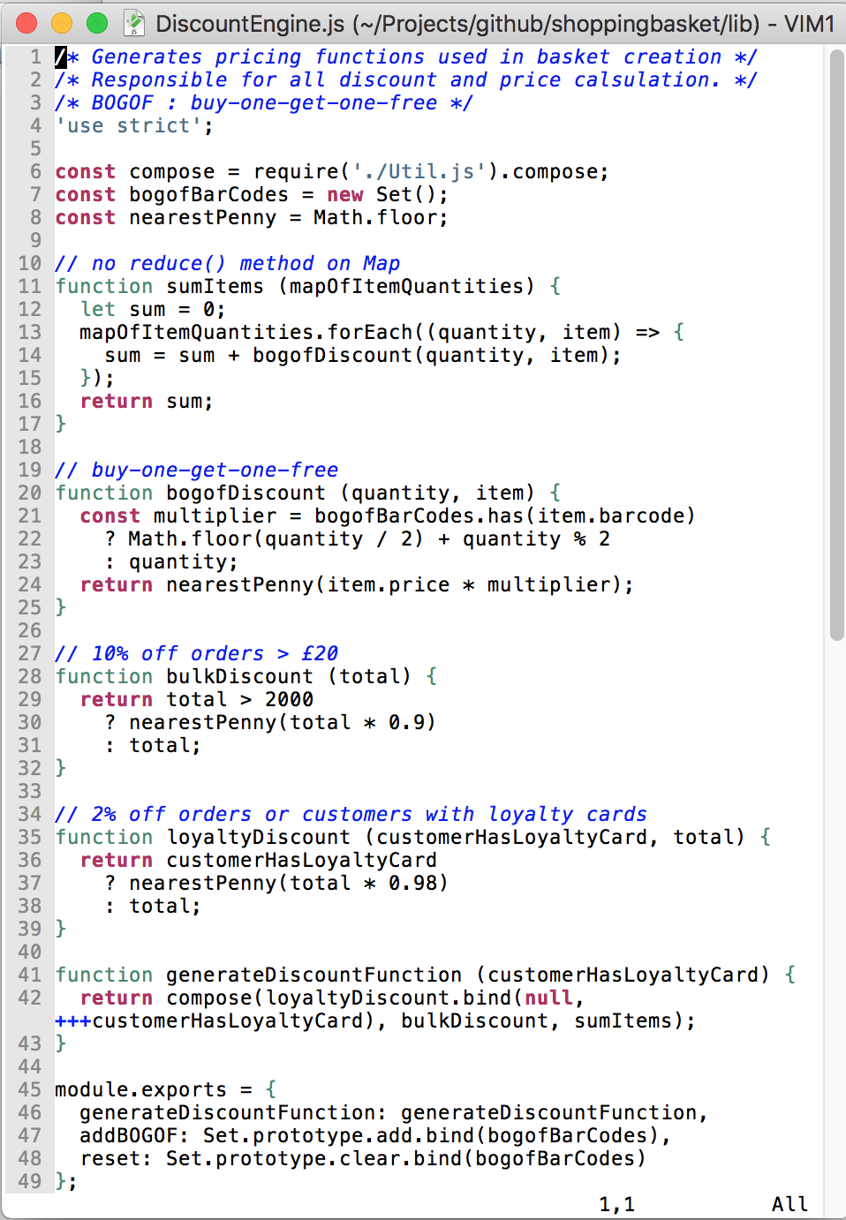
Systems Application
Notes:
haProxy vs example application
memory constructs vs business concepts
fundamental difference
2 mins (22)

Slide 12
Systems Application
C (++)
Java
Python
Ruby
Javascript
etc.
Notes:
so what are the contenders
in systems only 1 – C(++)
some exceptions – Apache Lucene
application – multiple contenders
etc.
so what makes a good application language
switch that – why I think JS is a good app language
2 mins (24)

Slide 13
Javascript Pro’s
easy to learn, not too hard to master
dynamic, i.e. not static
single threaded, run-to-completion
no exposing OS primitives
supports a variety of styles
  imperative / functional
  classical / prototypical inheritance
  callbacks / continuation passing style / es6
Notes:
apologies to non-techies – first case of broad audience
easy: designed, and with caveats (later in course) not too hard to master
no preemptive taxonomies, mix’m match function and structure
single threaded / run-to-completion: you only have to worry about one thing at once
not exposing system-level concepts – let older/younger wiser heads deal with that
forgiving and adaptable – different styles
mixed heritage
OO self/smalltalk
functional: lisp/scheme
what does this all mean?
4 mins (28)

Slide 14
Javascript
it’s reasonable
Notes:
for human beings: powerful enough but reasonable enough to be understood
lots of languages (...Java) confused by their role
Javascript is not
pure unadulterated applications language
2 mins (30)
language syntax and features not all
so other concerns that might disqualify it – will cover three that have been cited
1 min (31)

Slide 15

Speed
(almost) irrelevant
Notes:
much made that it is a script – i.e. interpreted
is not – as we will see later in course
however it is in pure terms a little slower (not asm)
all within same ballpark
does it matter?
client / UI code – event loop (next session)
servers – have to be parallel
Cloud context dev/debug costs hugely outweigh runtime costs
2 mins (33)

Slide 16
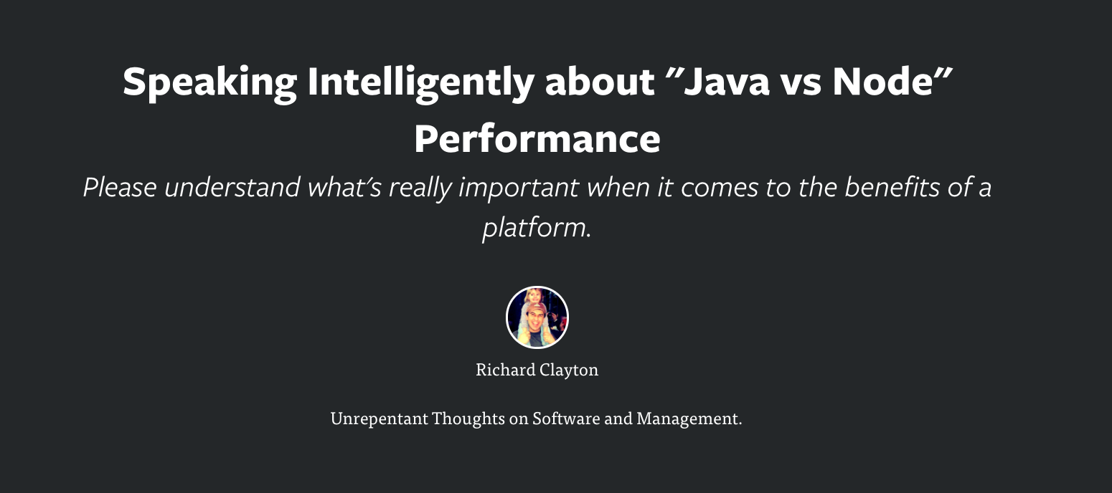
https://rclayton.silvrback.com/speaking-intelligently-about-java-vs-node-performance
Notes:
best summary
1 min (34)

Slide 17

Bugs
Notes:
so if debug costs so important, how buggy?
hard to avoid religious wars
how pull apart language characteristics from developer and testing
different categories of bugs – numerical types, Types
went searching for evidence…
2 mins (36)

Slide 18
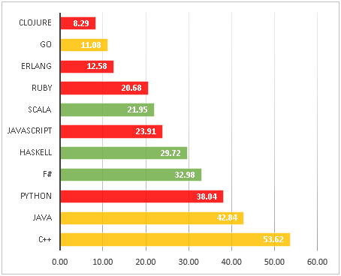
Round 3. Languages sorted by bug density. More than 100 stars repos
https://labs.ig.com/static-typing-promise
Notes:
cherry picking?
most important: functional vs imperative rather than static vs dynamic
1 mins (37)

Slide 19

Popularity
Notes:
‘bandwagon’ but popularity important for 3 things
1. getting help
2. ecosystem
3. useful skill
shockingly JS is popular
1 min (38)

Slide 20
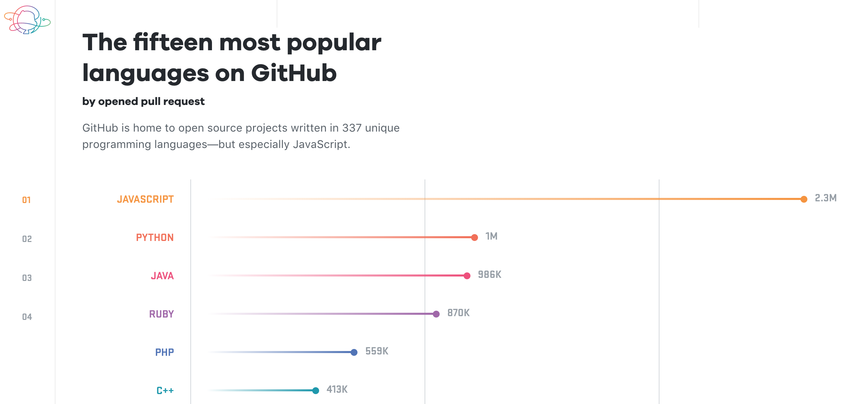
https://octoverse.github.com/
Notes:
github – what it is
octoverse
1 min (39)

Slide 21
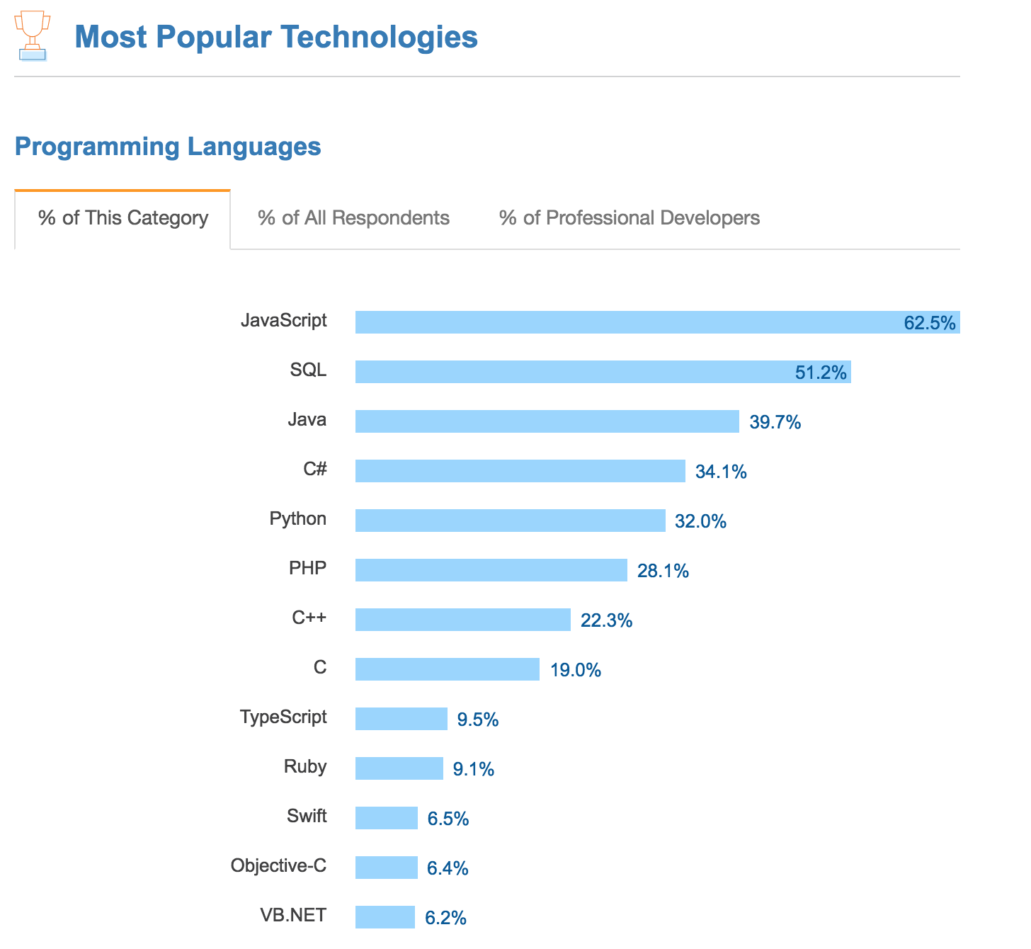
https://insights.stackoverflow.com/survey/2017#most-popular-technologies
Notes:
another (and last) chart
hummed and hawed
1 min (40)

Slide 22
Systems Application
C (++)
JS
Notes:
so there we have it
2 languages
JS is reasonable, fast enough, bug-free enough, vastly popular and supported/supportable
of its time
enough?
probably
but one more argument
only language that runs on every browser
is that compelling
next talk...
2 mins (42)

Slide 23


Session 2
Monday 12th March 12:45
Javascript: its natural habitat - the browser
Notes:
Next session
Same format as today
buzzwords: web 2.0, HTML5
my own: ‘Web Platform’
the power of the browser
issues of our day and how addressed
Why web matters vs 2 elephants in room
2 mins (44)

Slide 24
Session 3
Monday 26th March 12:45
Javascript: its new natural habitat - everywhere
Notes:
greatest innovation in JS world was node
server-side ‘browser’
the role of VM and package manager all rolled into one
of its time – containerisation
one other perspective...
1 mins (45)

Slide 25
Node
Your Javascript code
application
system
V8 compiler
libuv
Notes:
straddles system and application architecture
1 min (46)

Slide 26
Session 4
Monday 2nd April 12:30
Javascript for Java developers
Notes:
contrasting with Java
this talk will focus on how to concentrate in that area
warning non techies – unashamedly techie in bits
however Easter Monday so onllr expecting hard core techies
amongst techies, js has a bad reputation
CHROME CONSOLE: 1+2, 0.1+0.2
2 mins (50)

Slide 27

Notes:
Brendan Eich
when followed his brief, he introduced all the worst bits of Javascript
when he ignored his brief and followed his tech instincts, he over-engineered his solution and produced one of the most adaptable and flexible programming languages we have today
how deal with Janus type language
Douglas Crockford
introduced an approach that I scientifically illustrate here...
2 mins (52)

Slide 28
Session 5 - Workshop
Monday 9th April 12:30
A Scary Walking Skeleton
Notes:
normal service resumed – workshops but targetted at non-techies
web 101 – build up web app from basics
in true agile style ‘walking skeleton’
follow along or do yourself
1 min (54)

Slide 29
Pre-workshop preparation
ensure your computer has
  git
  node
  access to:
    https://jsbin.com/
    https://github.com/
or find a coding buddy who does
Notes:
1 min (55)

Slide 30
Session 6 : Workshop
Monday 16th April 12:30
Grown up Javascript – the enterprise era
Notes:
more advanced concepts
still simple code
nosde
1 min (56)

Slide 31
Thank You
https://www.surveymonkey.co.uk/r/79RVJWW

Slide 32
Preparation
https://css-tricks.com/dom/
http://www.evolutionoftheweb.com/
https://platform.html5.org/
https://caniuse.com/
http://latentflip.com/loupe/
https://www.owasp.org/
surface/client/build/styles-xx.css
speed cams

Slide 33
Javascript
its natural habitat the browser
Notes:
Welcome back
last session why Javascript natural application programming language
my last argument is that only one running on all browsers
in this talk introduce the idea of the web platform, bit of history, what that is and why it matters
also address some elephants in the room
2 mins (2)

Slide 34







Notes:
java applet
ActiveX
shockwave
flash
Quicktime
Silverlight
why all fail?
proximate causes – Steve Jobs not liking them etc.
ultimate cause:
all plugins to the browser
downloaded, security, sandboxes
2 mins (4)

Slide 35

Notes:
the all conquering browser
browser has all of this (cheekily)
where it does not – being built in
it’s all about the browser
1 min (5)

Slide 36
The Web Platform
~
The Browser
Notes:
‘html 5’, ‘web 2.0’ etc – I prefer ‘web platform’
technologies to leverage what the browser has…
what the browser gives you and how to use that
1 min (6)

Slide 37
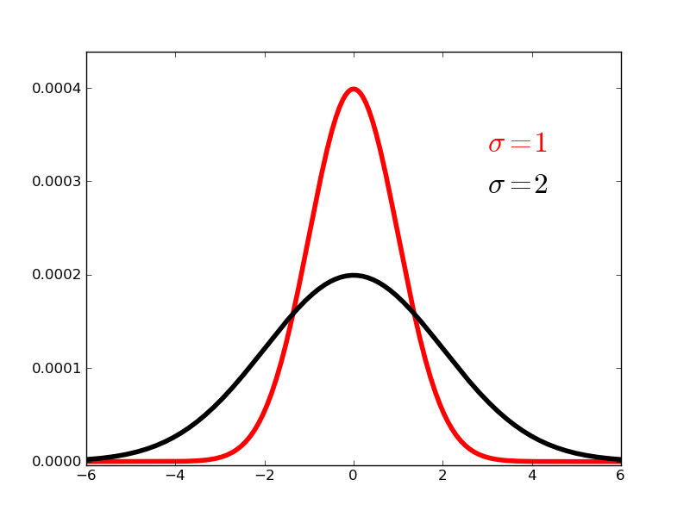
Java
Javascript
bad
ok
good
Notes:
contrasting with Java
this talk will focus on how to concentrate in that area
warning non techies – unashamedly techie in bits
however Easter Monday so onllr expecting hard core techies
1 min (53)

Slide 38
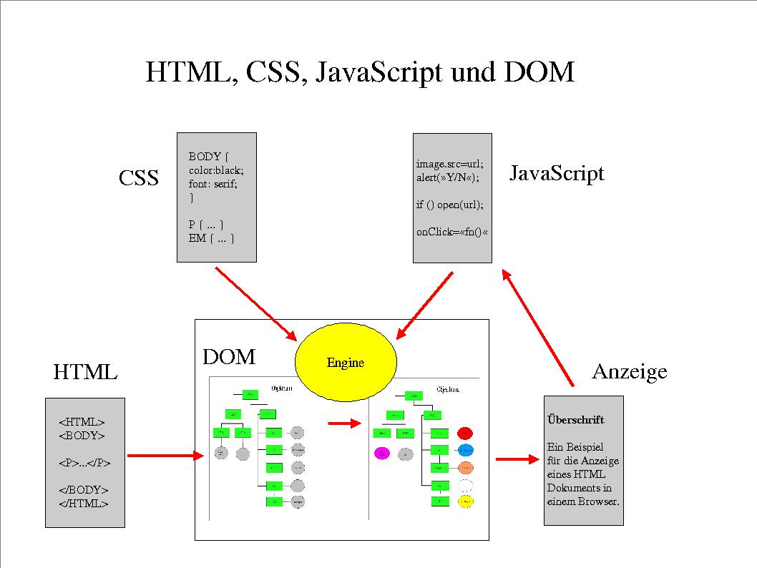
http://krum.rz.uni-mannheim.de/pk1-2002w/sess-5.html
Notes:
so what does the browser do?
from 2002! pretty much what you need until last few years
DOM important so next slide
first part 1991 Tim Berners-Lee file HTML > DOM
CSS
Javascript – here in its original planned usage
so for many years trilogy provided for a:
presentation device, limited interactivity
javascript lived up to, and no further, than its original intent – as a ‘glue’ language
4 mins (10)

Slide 39
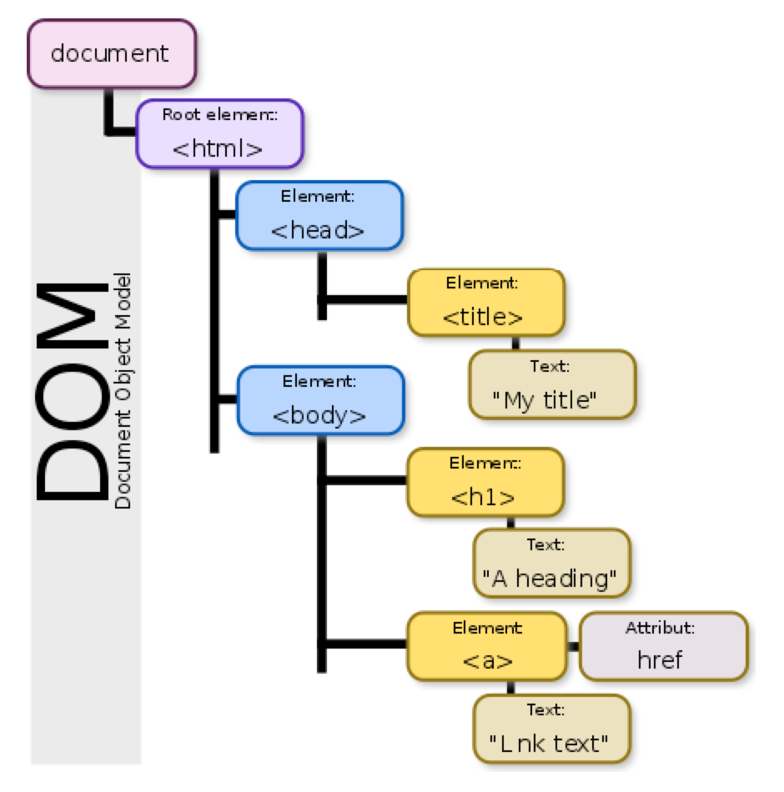
https://css-tricks.com/dom/
https://en.wikipedia.org/wiki/Document_Object_Model
Notes:
tree
representation html > DOM > screen
excellent link

Slide 40
http://www.evolutionoftheweb.com/
Notes:
2 big things changed - AJAX and competition returning
let me show cool graphic
1995 – 2004 bugger all innovation on client because of browser wars
where there was innovation was on server as different ways of generating files TBL-like for client
PHP > Java/JSP > ASP
however MS did one thing right:
spot that green line
3 mins (13)

Slide 41
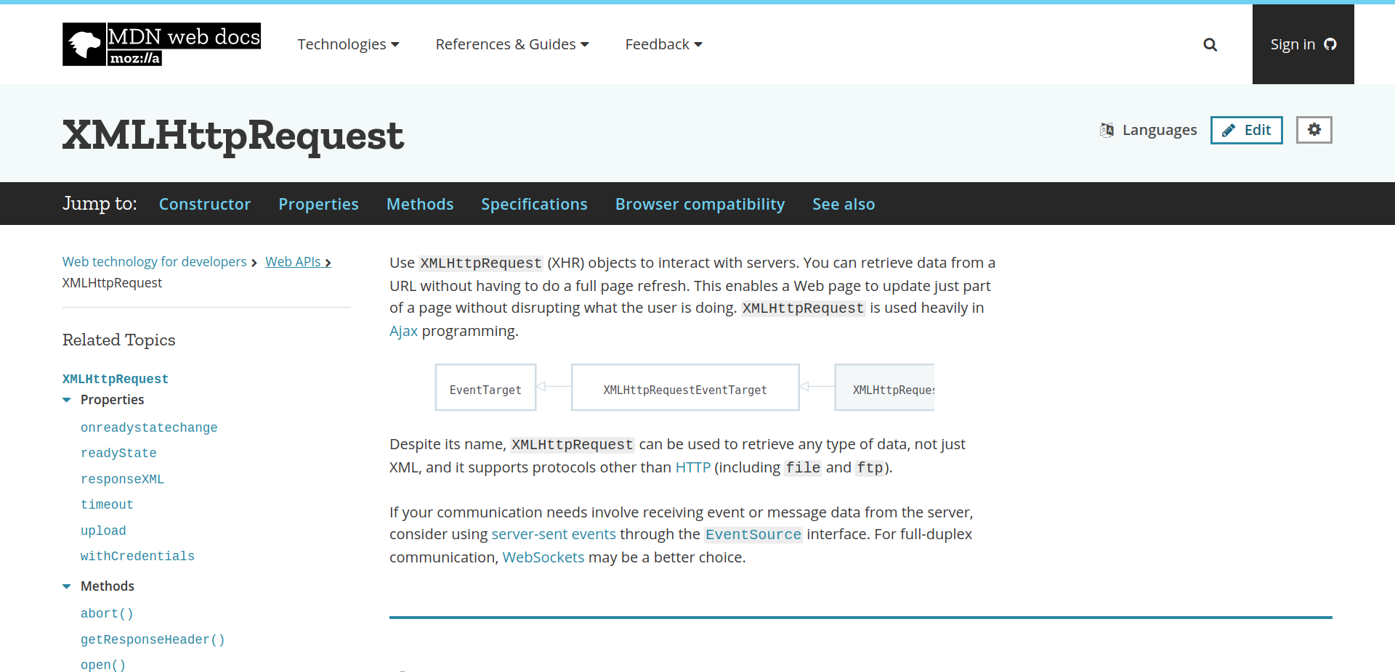
https://developer.mozilla.org/en-US/docs/Web/API/XMLHttpRequest
Notes:
what emerged was this guy – badly named
initially IE
standardise around 2004
so Jesse James Garret came up with ‘AJAX’
crucial: async calls with ability to mutate DOM
don’t need server to create pages for you
‘single page application’
good thing?
scalability / performance / interaction – start, start to compare with native apps
stopped being presentation and became interactive
session 5 – scary walking skeleton
4 mins (17)

Slide 42
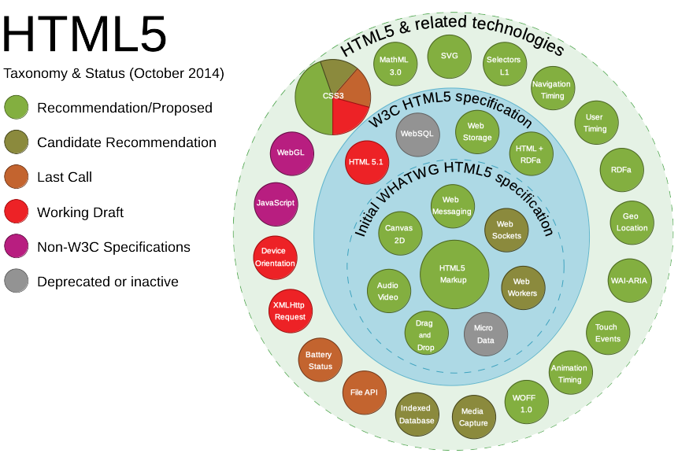
https://platform.html5.org/
https://en.wikipedia.org/wiki/HTML5
Notes:
second big thing – back to chart – competition
what browsers can do – more & more
accessed either through html or JS
see client-side version of application/system division
from link point out
notifications
geolocation / battery / clipboard
offline / service workers
note: relevant to later discussions
3 mins (20)

Slide 43
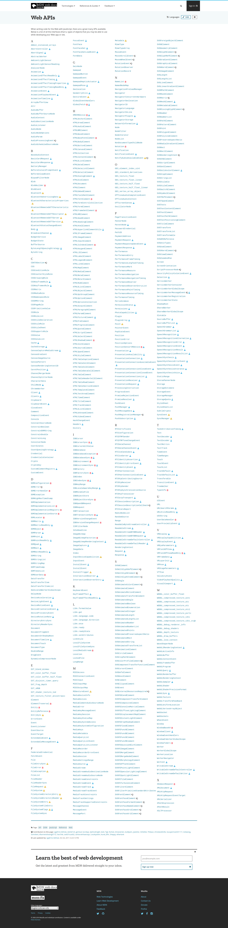
The Web Platform
Javascript
CSS
+
DOM
HTML
HTTP
https://developer.mozilla.org/en-US/docs/Web/API
Notes:
so core technologies
HTTP (HTTP2)
1 mins (21)

Slide 44

diversity
performance
security
responsive
how to write SPA’s
platform limits
Notes:
so browser is becoming all-singing all dancing
what are pain points?
1 min (22)

Slide 45







Notes:
browser diversity
Safari – way behind as development tool
MS – never forgive them
Amazon silk
UC browser
konqueror
of course others
1 mins (23)

Slide 46
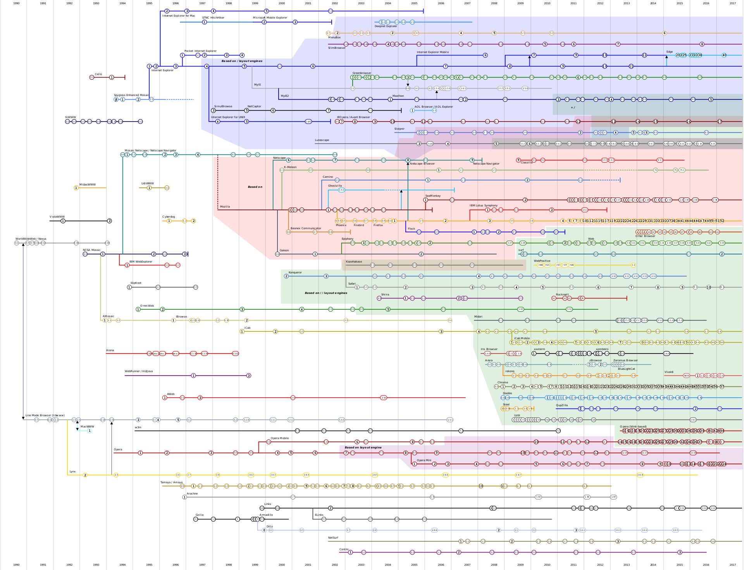
https://en.wikipedia.org/wiki/List_of_web_browsers
Notes:
how deal? after all, have always had ‘standards’
bad old days ‘optimised for IE’
first thing to say that diversity misleading – fewer engines
technical fixes
various libraries offer a common API – Jquery
polyfills – built into build tools (session 6)
procedural
standards = even MS obey now + well understood and accepted approvals process
which allows for canIUse – figure / geolocation
4 mins (27)

Slide 47
The Web Platform
Javascript
CSS
+
DOM
HTML
HTTP
https://developer.mozilla.org/en-US/docs/Web/API
Notes:
Performance
moving mobile meant reversing performance gains of past decade; much IO bound
all about perceived performance
truly need to understand ‘web platform’ to combine technologies
look at each layer
HTTP: understanding protocol ‘TCP slow start’, browser usage
HTML: controlling HTTP + headers
DOM: minimising manipulation (later - React)
CSS: using hardware
Javascript: understand event loop - loupe demo
Speed demo (explain via bbc)
5 mins (32 mins)

Slide 48
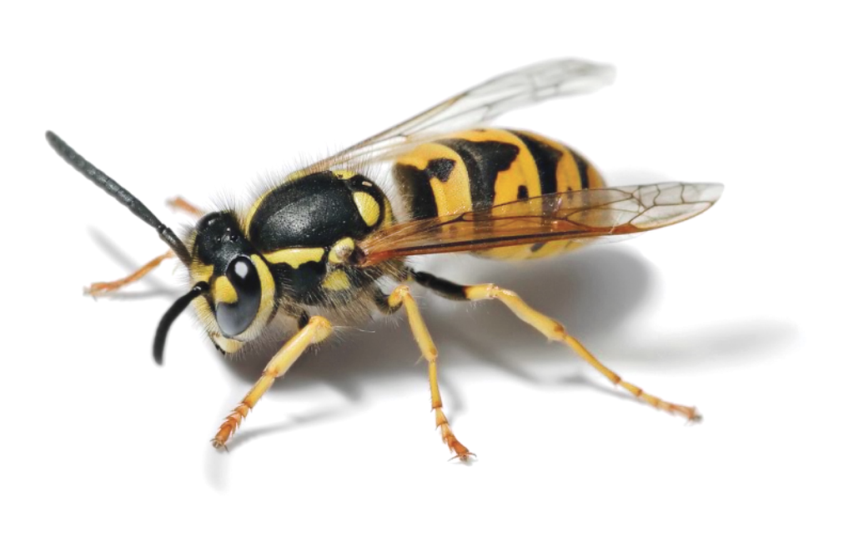
https://www.owasp.org/
Notes:
Security
web platform is inherently insecure
best make it very, very difficult and/or cost-ineffective
how? like browser diversity: awareness, public discourse, process
security by obscurity dead except in minds of politicians
follow guidelines, proactively test, proactive tooling – node security platform
owasp demo (top 10)
crucial dev & devops coordination
the result…
3 mins (35)

Slide 49
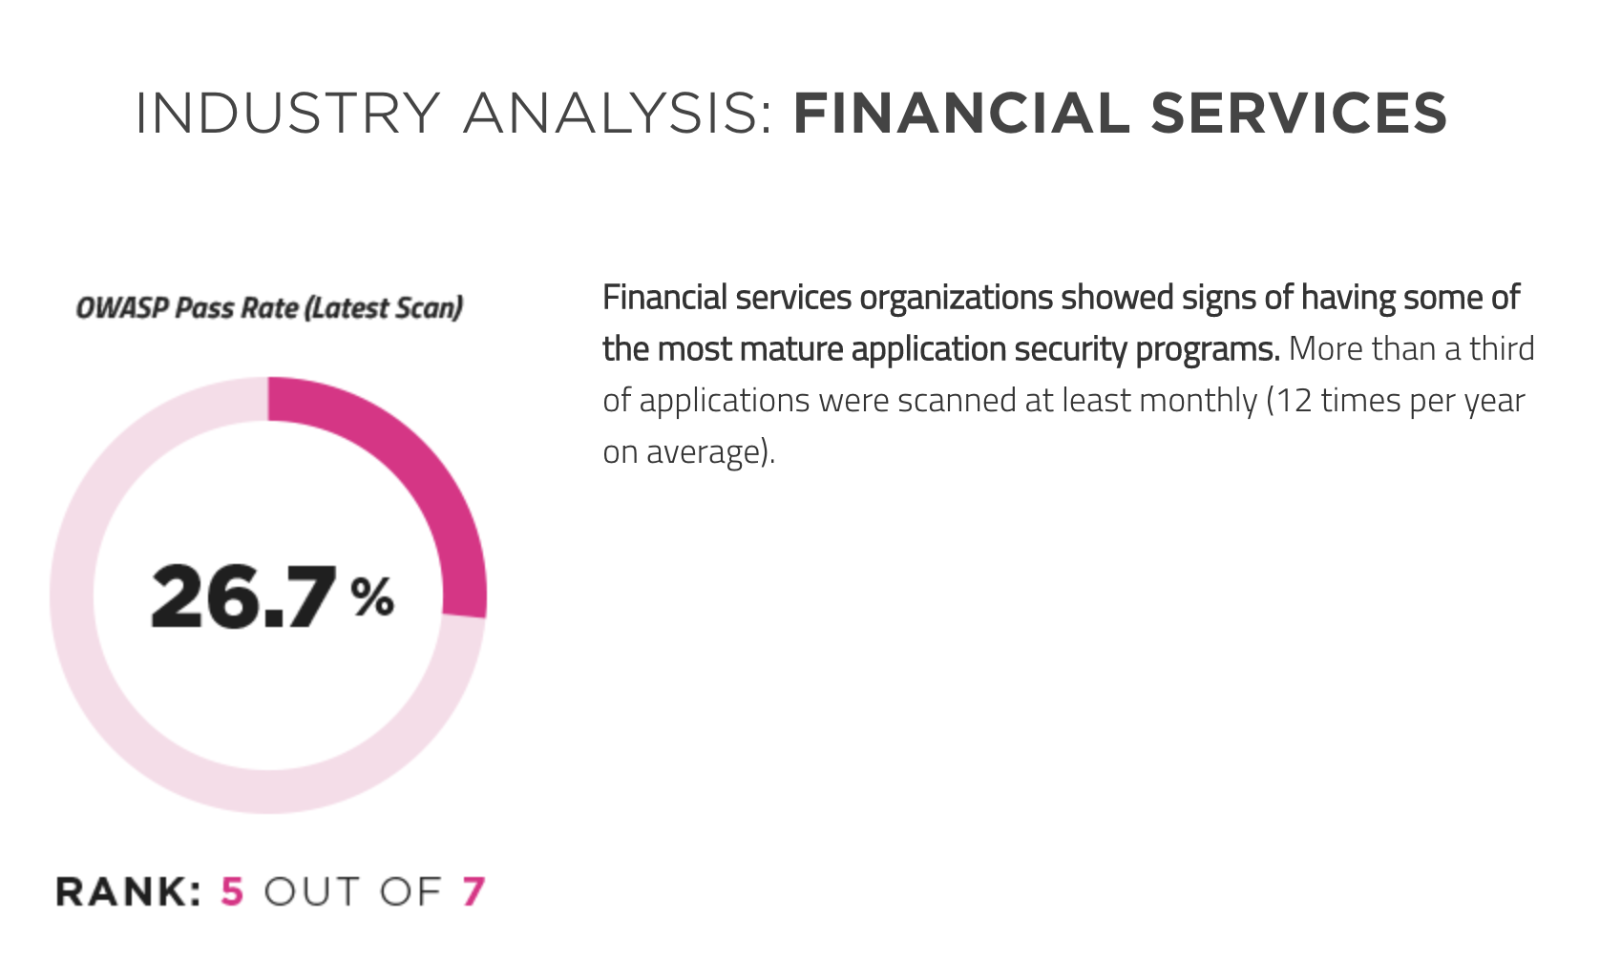
https://www.veracode.com/state-of-software-security-report
Notes:
Tesco Bank does much better, I’m sure
1 min (36)

Slide 50

https://medium.com/designing-medium/regular-and-compact-ios-display-size-breakdown-for-designers-d3ff3044e06e
Notes:
Onto happier story – responsive
browser all about putting things on a screen, lots of screens to consider
In past mobile sites
2015 iPad / iPhone range
UX design challenge has not gone away
But techy problems pretty well solved
2 issues – layouts, dimensions, working out size in first place
Layouts – CSS conceptually and syntactically difficult, now Flexbox / CSS Grid
dimensions – px, em’s, vh
Andy in audience – horror in surface.css
media queries @media
2 mins (38)

Slide 51
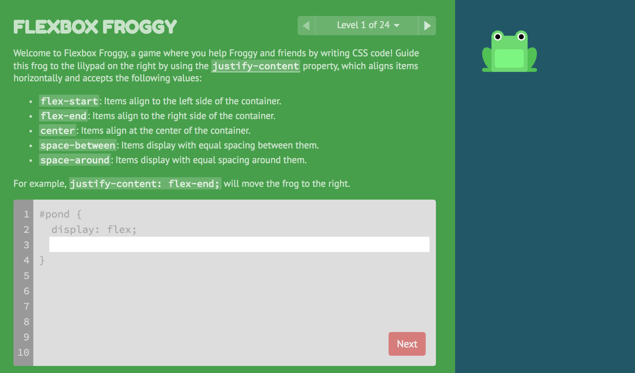
http://flexboxfroggy.com/
Notes:
shout out that even CSS can be fun!
1 min (39)

Slide 52
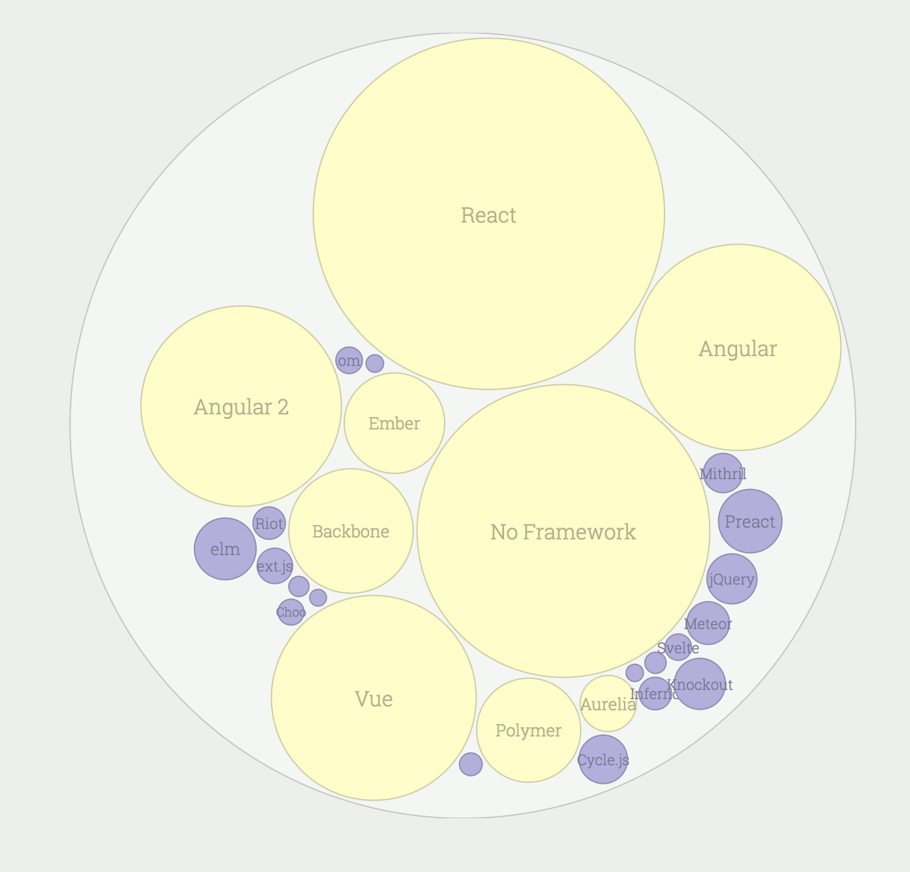
https://stateofjs.com/2017/front-end/other/
Notes:
how to write web applications
when XHR came in, suddenly moved off snippets of code and full applications
initially moved server patterns onto client
or combined server/client frameworks
move to libraries (run libraries in your code, not your code in libraries)
React – heard a lot – focus only on generating UI
tore up a lot of shibboleths
separation of concerns != separation of technologies
cohesion and coupling
session 5 – explanation
3 mins (42)

Slide 53
The Web Platform
Javascript
CSS
+
DOM
HTML
HTTP
https://developer.mozilla.org/en-US/docs/Web/API
Notes:
Platform
restrictions
e.g. Surface vs porn sites (allegedly)
1 min (43)

Slide 54
2,924,255 online banking
6,687,908 mobile app
logins last month
Notes:
so gone into briefly, why JS won the web, the challenges today, and how they are being met
now wish to switch tack
what are these 2 numbers?
2 mins (45)

Slide 55


Notes:
2 elephants
development is not js
winning on web – a pyrrhic victory?
undermine my whole notion that JS will be 1 of 2 languages?
I say No, and perhaps more interestingly how JS relates to the smart phone world
so first, some bold statements
1 min (46)

Slide 56
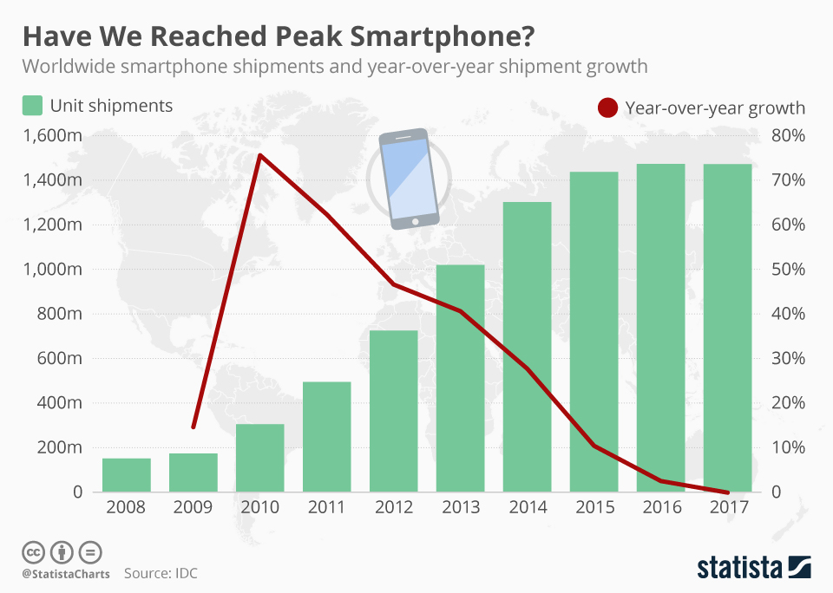
Some Bold Statements
the web owns B2B apps
we have reached peak smart phone
app fatigue is setting in
https://www.statista.com/chart/12798/global-smartphone-shipments/
Notes:
only to look at colleagues screens, not just techie
smart phone growth – click – not so bold
app fatigue? - reason for conversational interfaces (China WeeChat and Alibaba)
1 min (47)

Slide 57
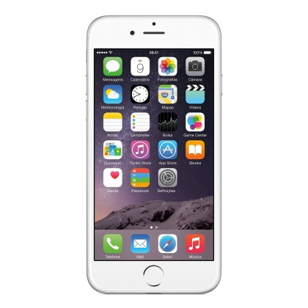
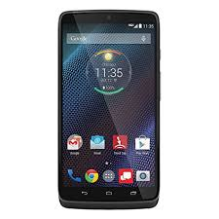

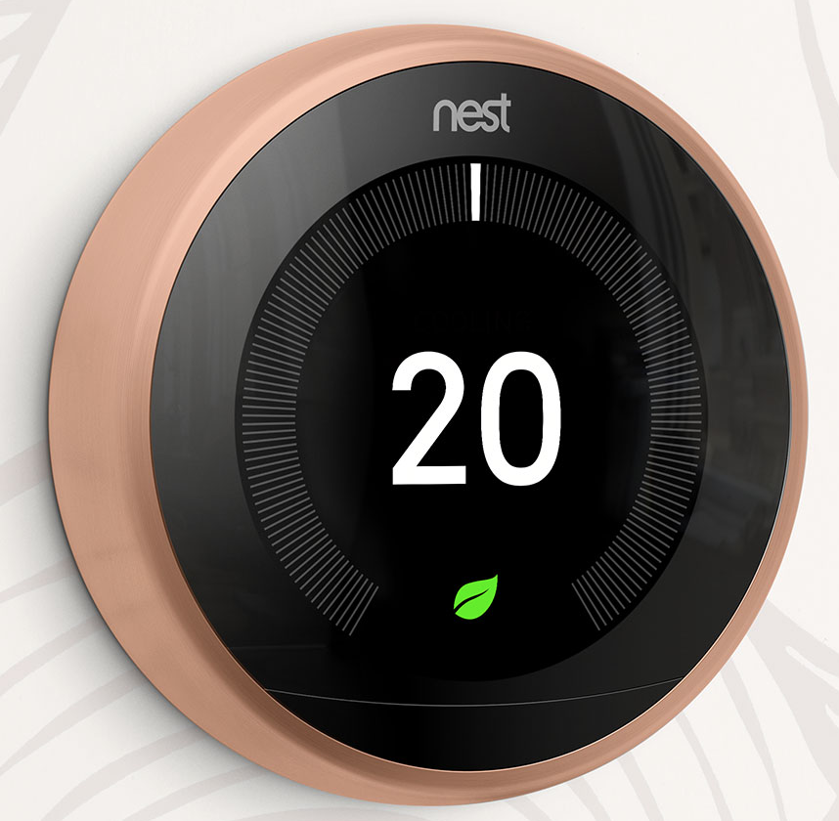
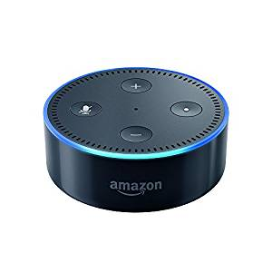
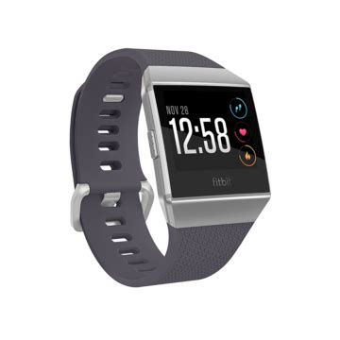
Notes:
smart phone growth but IoT and smart devices will grow and grow
language which patterns, libraries, practices for constrained, untrusted environments is already established
panasonic – js (samsung .net!)
nest – js, objectiveC, python
echo – js, c#, python, java
fitbit – js
(python strong showing)
2 mins (49)

Slide 58
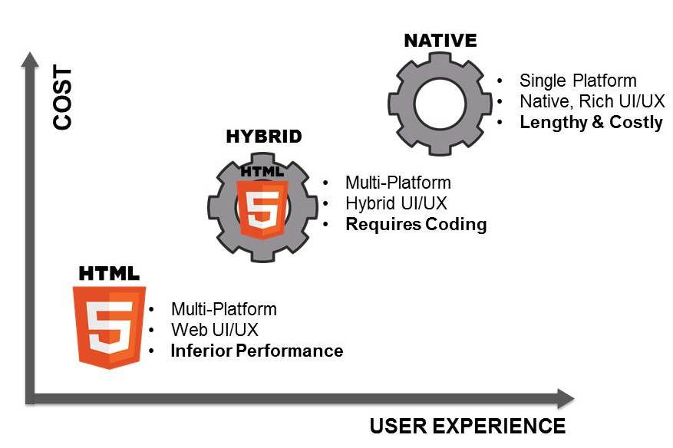
https://www.mobilesmith.com/html5-vs-native-debate-is-over/
Notes:
still 1.5 billion smartphones
switch to JS anytime soon?
slide demonstrates argument – url wrong!
1 min (50)

Slide 59
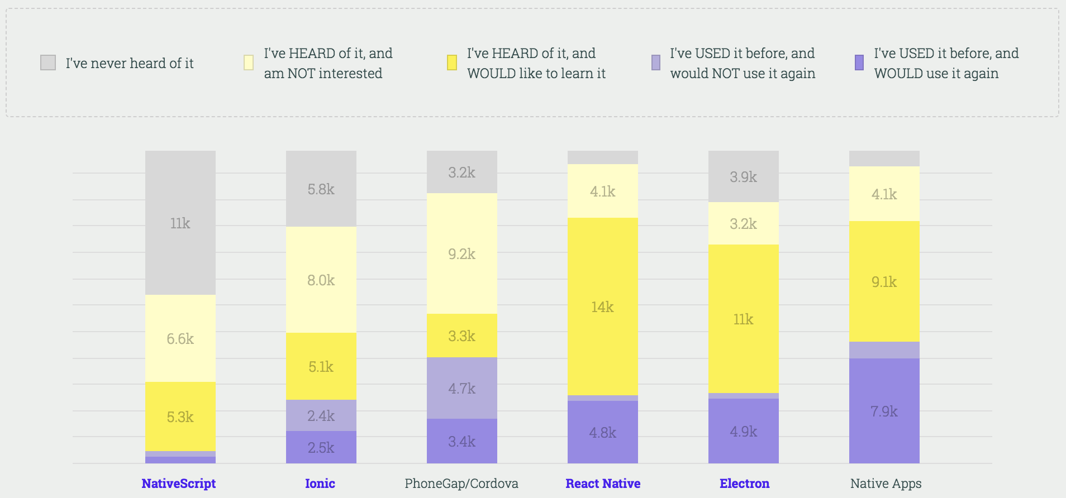
https://stateofjs.com/2017/mobile/results/
Notes:
slide supports that argument to a degree
but new approaches
common language/patterns/practices – React Native
message to my mobile colleagues – fine for now, but definitely keep coming to these talks :-p
2 mins (52)

Slide 60
Session 5 - Workshop
Monday 9th April 12:30
A Scary Walking Skeleton
Notes:
web 101 – build up web app from basics
in true agile style ‘walking skeleton’
in particular, how React changes things
follow along or do yourself
1 min (53)

Slide 61
Session 3
Monday 26th March 12:45
Javascript: its new natural habitat - everywhere
Notes:
Ode to Node
why changed so much
1 mins (54)

Slide 62
Thank You
https://www.surveymonkey.com/r/LPP5YV2

Slide 63
Preparation
chrome console – no errors
http://jsbin.com/?html,css,js,output
terminal on jsacademy/session3/
https://npmjs.org
IntelliJ surface server.js zoomed
set up Mercury demo (public IP)

Slide 64
Javascript
its new natural habitat everywhere
Notes:
Thank you for coming back!
Last week JS in the browser.
Much of its life only in browser
So to run it:
browser console
create a web app
clever websites such as jsbin
then this happened...
3 mins (3)

Slide 65
“… It’s a rather large C project actually ...”
Ryan Dahl, 2009
https://youtu.be/ztspvPYybIY?t=7
Notes:
‘it confuses a lot of people’
container for js – just like a browser
choice between Ryan and me…
content is gold
3 mins (6)

Slide 66


Node
Your Javascript code
application
system
V8 compiler
libuv
Notes:
whereas a browser handles IO and draws UI’s and JS is a supporting technology
in node, components are there to support js
V8 compiler – Google, same as chrome
libuv – IO abstraction over network & file, plus thread pool, DNS, signals etc.
here why 1 reason why such a success
straddles system and application programming
unicorn velociraptor library – geeks
3 mins (9)

Slide 67
demo
node01/process_hello.js
node02/console_hell0.js
node03/report.js
Notes:
time for a demo – don’t get too excited
show 3 examples
simpler than in browser!
go through flow of processing
beyond spanning app/system divide, three key features that have made node a success
first a sidebar…
I want to talk about fast things
network downloads vs chuckie egg
faster, in fact fastest light in vacuum
Ediburgh – New York 60x
3 GHz one clock cycle > 10 cm
4 mins (13)

Slide 68
IO: relative speeds
if processor = 1 second
then disk = days
network = weeks
Notes:
IO = Input Output, getting data to the processor
disparity between processor speeds
influences much if not all software design
Ryan Dahl called it ‘the problem of IO’
apache – threads – difficult to define (circular)
anthropomor phise - Alex
99.999% of time doing nothing
3 mins (16)

Slide 69
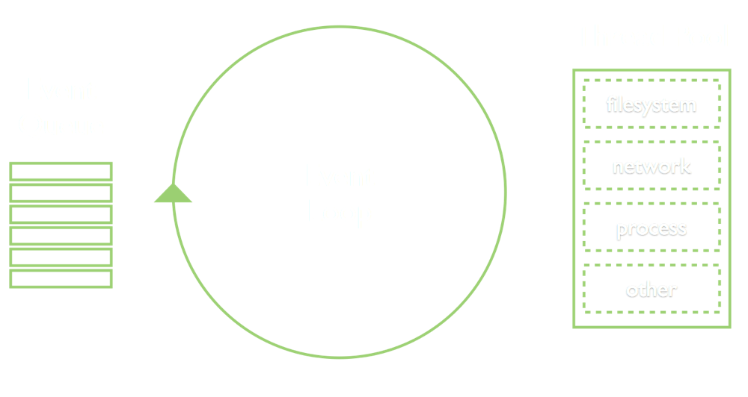
1: Event Loop
Notes:
another model
instead of 1000’s of threads – you have 1
performance & scalability
not unique to Node – webservers: nginx, vertx
language Ruby – eventmachine, Python - twisted
also in fact, familiar to UI programmers of any language
standard way of working
3 mins (19)

Slide 70
demo
node04/directory_listing.js
node05/directory_listing_X.js
Notes:
demo
ignore require
first class functions, closure – JS perfect fit
Ryan Dahl says reason for choosing JS
finally, for techies, above slide is conceptually correct, but technically wrong…
4 mins (23)

Slide 71

https://medium.com/the-node-js-collection/what-you-should-know-to-really-understand-the-node-js-event-loop-and-its-metrics-c4907b19da4c
https://www.youtube.com/watch?v=PNa9OMajw9w
Notes:
side note: techies only
libuv – thread pool of 4!
conceptually correct but
most async IO not on threads
1 min (24)

Slide 72
2: Modules
node02/console_hello.js
node02a/console_hell0.js
node04/directory_listing.js
Notes:
Breaking large lumps of code into smaller units
Javascript has no language specific modularisation, unlike static languages
In true JS fashion commonjs, amd, umd
Node settled on one, decorated it a little
standardised it
demo
ironically now es6 (latest Javascript), node a laggard
5 mins (29)

Slide 73
3: Node Package Manager (npm)
node06/server.js
Notes:
‘require’ - own code, node code, third party code
add on tool added a year or so after initial Node
makes bringing in modules trivial
create node06 with express
can do as quickly in other languages – but size of npm repo + combining with own code + other assets
example of real code – surface server.js
the bad - simplicity hide problems – directory depth with transitive dependencies / determinism
too easy? mash-up style of programming: left-pad March 2016
5 mins (34)

Slide 74
Javascript : a reasonable application language
a container that bridges system and application programming
event loop : a structured programming model
common.js / es6 : built-in modularisation
npm : huge library of easily used components
=> Productivity
Notes:
5 elements
most productive coding environment I have worked in
actually a sixth element, node permits JS ubiquity
to illustrate...
2 mins (36)

Slide 75
Notes:
least annotated diagram you have seen - security, security
orientation funny: start at right, clients
web ‘leaf’ servers’
intermediate servers – stateless, microservices
off to left systems land
bottom, developer machine - tools
what technologies to use...
2 mins (39)

Slide 76


Notes:
client – browser
servers – event model great for stateless
network & file IO essentially same form computer’s point of view
node tools to write node servers to serve javascript clients
all application programming
‘full stack’ - a single language, common programming model
might be a surprise to non-techies
always other choices, but compelling for
devs, companies, etc.
2 mins (41)

Slide 77
Javascript
its new natural habitat everywhere
Notes:
hence the title
use Tesco bank as an example
1 min (42)

Slide 78
Notes:
PSP – leaf server + SPA client
Surface – leaf server + SPA client
Chunk – middleware – also used by mobile
Build tools
what other uses?
Ryan Dahl – real-time websites’ with push technology
Demo – mercury
5 min (47)

Slide 79
Thank You
https://www.surveymonkey.com/r/GXLDBNC
Notes:
before I open to questions:
question about next session
who wants to/can come?
1 min (48)

Slide 80
Session 4
Monday 2nd April 12:30
Javascript for Java developers

Slide 81
Session 5 - Workshop
Monday 9th April 12:30
A Scary Walking Skeleton
Notes:
web 101 – build up web app from basics
in true agile style ‘walking skeleton’
in particular, how React changes things
follow along or do yourself

Slide 82
Pre-workshop preparation
ensure your computer has
  git
  node
  access to:
    https://jsbin.com/
    https://github.com/
or find a coding buddy who does

Slide 83
Preparation
chrome console
terminal on jsacademy/session4/
terminal on betterfuture/deed.it
github shopping basket (or terminal)
Surface – fetch composition - submitState
https://steve-yegge.blogspot.co.uk/2006/03/execution-in-kingdom-of-nouns.html
https://facebook.github.io/jest/docs/en/expect.html#tobeclosetonumber-numdigits
https://github.com/numical/shoppingbasket/blob/master/lib/Util.js

Slide 84
Javascript
for
Java developers
Notes:
welcome, most subjective of talks
not a workshop, no time nor space
talk as as a Java guy who very self-consiously switched to JS
offer some takeaways and occasional counter argument
assume some knowledge of JS
mainly semantics of the language, though library
1 min (1)

Slide 85
LiveScript ‘95
Notes:
Written by Brendan Eich
Anecdote: in 10 days to compliment Java
a ‘glue’ language for non-professionals
‘JavaScript’ to cash in on the cachet of Java
2 mins (5)

Slide 86
Notes:
Brendan Eich
JS - mixed heritage
OO – self/small talk; functional: scheme/lisp
when followed his brief, he introduced all the worst bits of Javascript
when he ignored his brief and followed his tech instincts, he over-engineered his solution and produced one of the most adaptable and flexible programming languages we have today
how deal with Janus type language
Douglas Crockford
introduced an approach that I scientifically illustrate here...
2 mins (52)

Slide 87
Java
Javascript
bad
ok
good
Notes:
may remember from first talk
Crockford quite subversive – just use good bits
1 min (2)

Slide 88
Numbers
Mike’s takeaways:
  live with it and don’t fret
Counter arguments
  asm & WebAssembly
  npm BigInt
Notes:
Chrome console: 1+ 2 / 1 + 0.2 / 0.1 + 0.2
IEEE754 double precision binary floating point
integer up to 9 trillian, but 32bit for bitshift operations > 2 billion
actually a good thing: no overflows – unlike Java
finance £1000 x 3%
be aware – e.g. Jest
Mike’s takeaway;
live with it and don’t fret
Counter arguments:
asm and webassembly
search npm BigInt
3 mins (5)

Slide 89
Coercion
Mike’s takeaways:
  only use truthy/falsy coercion: if (x) { … }
  only use ===, never ==
Counter arguments
  none!
Notes:
Chrome console: [] + [], [] + {}, {} + {} etc.
https://www.youtube.com/watch?v=eWuRwu2DhwU&t=131s
Mike’s takeaway:
only use if (x) { …} (truthy/falsy)
only use ===, not ==
2 mins (7)

Slide 90
Type
tells compiler how data will be used
provide a safety net for inappropriate usage
    (introspection also)
structure programmers’ thinking
https://steve-yegge.blogspot.co.uk/2006/03/execution-in-kingdom-of-nouns.html
Notes:
lot to unpick here
so start high level and then get onto practicalities
I was a true believer – example AbstractContactable - Collections not type-safe until generics
use to display what type is – how casting (127) and last method,
in Java, immersed in type – cannot not have type (in constrast to other OO langs)
1,2,3
compare to JS : 2-phase compilers / linters / verbs as well as nouns
3 mins (10)

Slide 91
Type
Mike’s takeaways:
  tooling: linting is more than mere formatting
  think in verbs as well as nouns
Counter arguments:
  TypeScript: https://www.typescriptlang.org/
  flow: https://flow.org/
Notes:
actually counter arguments not really
Verbs: behaviour on data
Nouns: behaviour with data
1 min (11)

Slide 92
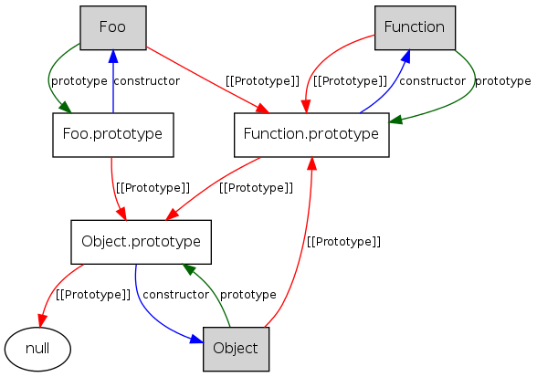
STOP!
http://iwiki.readthedocs.io/en/latest/javascript/js_core.html#inheritance
Notes:
JS - mixed heritage
OO – self/small talk; functional: scheme/lisp
prototypical inheritance offers fantastic flexibility – pseudo classical
slide – stop! Can go down the rabbit hole…
stop talking ‘Type’ and talk ‘Inheritance’
1 min (12)

Slide 93
Inheritance
myObject
a: 10
d: {}
e: function(){...}
anotherObject
a: 5
b: ‘hello’
c: function(){...}
prototype
const myObject = Object.create(anotherObject)
Notes:
Delegation – simple – that’s all it is
OLOO – Object.create() (Kyle Simpson)
also an ES6 Class syntax
Why use:
sometimes good – often with libraries – React – deed.it code – see how a function represents a very definite noun!
3 mins (15)

Slide 94
Inheritance
Mike’s takeaway:
      are you sure? think in verbs
      OLOO: Object.create(…)
      or ES6 Class
Notes:
only generic case is frameworks
might be useful for specific use cases in your code
1 min (16)

Slide 95
False Friends
new
instanceof
ES6: Class, constructor, extends
Notes:
Class is a terrible syntax for expressing delegation
instanceof: tests whether the prototype property of a constructor appears anywhere in the prototype chain of an object
new:
1. new object inheriting from constructor prototype;
2. constructor is called this this bound;
3. returned object is result of new expression
ES6 – use ‘as is’
2 mins (18)

Slide 96
Falsest of Friends: this
global context: global/window
functional context:
    unbound: global/window or null *
    method call: parent object
    fn.call/apply(xxx, …) : xxx for that call
    fn.bind(xxx, …) : xxx permanently
arrow fn’s: retains value of lexical scope
*: dependent on
‘strict’ mode
Notes:
actually ‘context’;
2 mins (20)

Slide 97
Falsest of Friends: this
Mike’s takeaways:
    don’t use it
    bind early : fn.bind(xxx)
Notes:
seems hard (Crockford) – actually not
e.g. in betterfutures – not so glorious part of the language(ChooseDeed.js)
1 mins (21)

Slide 98
Asynchronous Code
Mike’s takeaways:
  use: async/await
  but understand the hidden complexity
https://github.com/getify/You-Dont-Know-JS
Notes:
after type comes scope, but take break and instead talk about pizza
and async code: crucial to JS: node & browser
pizza0X.js & dominos0X.js
then floppy0X.jf
core points:
callback hell not formatting, but control
built on top of each other
many API’s Promise based or callback
async looks like blocking but isn’t
use of scope
best resource Kyle Simpson
6 mins (27)

Slide 99
Scope
Closure
Notes:
scope - what can see what
in Java scope is tied to inheritance
public, protected private
public is global, unless multi-classloader such as OSGi or container such as Spring
in JS, we delegating OLOO for seeing properties
but for ‘free’ variables - closure
much said about it - can be very complex
1 mins (28)

Slide 100
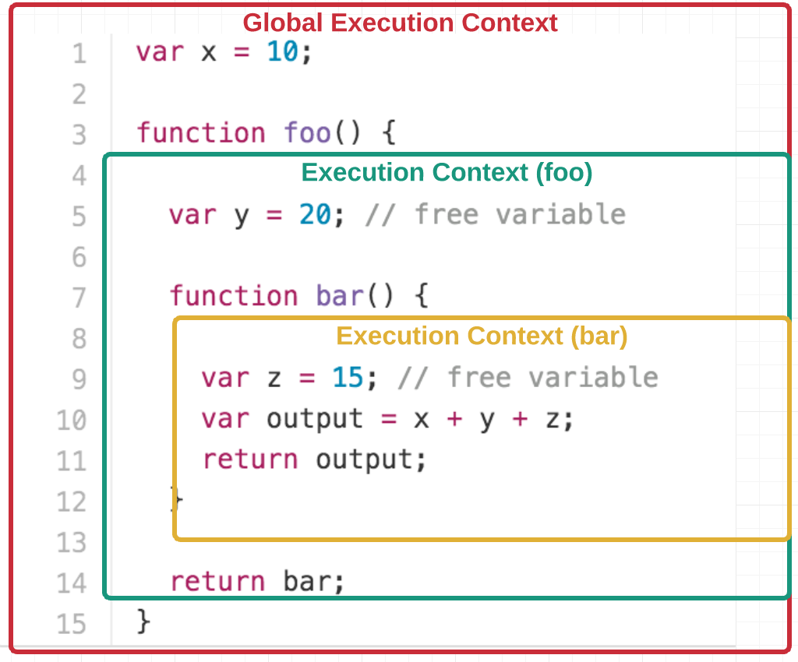
https://medium.freecodecamp.org/lets-learn-javascript-closures-66feb44f6a44
Notes:
execution context – stack of these referencing closure data on heap for scope chain lookup
core message – another rabbit hole
in fact quite intuitive with one caveat – use let, not var
2 mins (30)

Slide 101
Closure
Mike’s takeaways:
  don’t fret it!
  use ES6: let and const, not var
Notes:
1 min (31)

Slide 102
functional programming
Mike’s takeaways:
use as first class entities
use pure functions
partial application – bind(null, xxx)
composition
Notes:
note the small ‘f’ (another potential rabbit hole)
NOT: category theory, functors, monads etc., currying (/schoenfinkelling) – can do all of this in javascript
instead: concepts that matter
do almost everything through functions
core concepts:
first class
the flattening of callback hell
firstClassFunction0x.js
pure function
avoid state, enhance testing, composable
partial application, bind
surface fetch
compose
shopping basket (Util.js)
4 mins (35)

Slide 103
ESx
ES5
ES6 === ES2015
  async/await, let, =>, ...
ES7 === ES2016
ESNext ...
http://kangax.github.io/compat-table/es6/
Notes:
EcmaScript
2015 – has been the defacto browser
2016 – the ‘current’ one
async/await, let, arrow functions, …, destructuring, spread
1 min (36)

Slide 104
JVM
container
.java
.class
.jar
.war
compile: javac
package: jar
.xml
browser / node
.js
.js
.js
.js
.js
transpile: babel
package: webpack
.css
Notes:
java vs javacript
process same
most steps in javascript (technically) not needed
intermediate js as unreadable as bytecode
tooling
linting
transpiling / polyfills
uglification / minimisation
.browserslistrc in Surface – CSS and polyfills
modules
js – browers had no real concept of modules
new type=module and .jsm in node
3 mins (39)

Slide 105
Build Process
Mike’s takeaways:
  tooling essential
  a top skill!
Counter arguments:
  https://hackernoon.com/how-it-feels-to-learn-javascript-in-2016-d3a717dd577f
Notes:
essential skill for professional
devops!
more general point: get to know ecosystem
lists of tools – no point!
is still gloriously dynamic
1 mins (40)

Slide 106
Resources
https://github.com/getify/You-Dont-Know-JS
https://frontendmasters.com/
https://hive.intranet.group/groups/wecode-edinburgh

Slide 107
Thank You
Notes:
before I open to questions:
question about next session
who wants to/can come?
1 min (48)

Slide 108
Session 5 - Workshop
Monday 9th April 12:30
A Scary Walking Skeleton
Notes:
web 101 – build up web app from basics
in true agile style ‘walking skeleton’
in particular, how React changes things
follow along or do yourself
1 min (53)

Slide 109
Resources
https://nodejs.org/en/download/
https://git-scm.com/downloads
https://github.com/numical/jsacademy

Slide 110
http://krum.rz.uni-mannheim.de/pk1-2002w/sess-5.html
Notes:
so what does the browser do?
from 2002! pretty much what you need until last few years
DOM important so next slide
first part 1991 Tim Berners-Lee file HTML > DOM
CSS
Javascript – here in its original planned usage
so for many years trilogy provided for a:
presentation device, limited interactivity
javascript lived up to, and no further, than its original intent – as a ‘glue’ language
4 mins (10)

Slide 111
web01
$ git clone https://github.com/numical/jsacademy.git
$ cd jsacademy/session5
$ mkdir myproject
$ cd myproject
$ mkdir public
$ vim index.html

Slide 112
web02
$ cd ..
$ npm init
$ vim package.json
$ npm install express
$ vim package.json
$ vim server.js
$ node server.js
$ CTRL+c

Slide 113
Thank You
Notes:
before I open to questions:
question about next session
who wants to/can come?
1 min (48)

Slide 114
Session 6 : Workshop
Monday 16th April 12:30
Grown up Javascript – the enterprise era
Notes:
more advanced concepts
still simple code
nosde
1 min (56)

Slide 115
linting
testing
UI library
  react
build
  packaging
  minification / uglification
  transpiling – JSX, babel

Slide 116
http://krum.rz.uni-mannheim.de/pk1-2002w/sess-5.html
Notes:
so what does the browser do?
from 2002! pretty much what you need until last few years
DOM important so next slide
first part 1991 Tim Berners-Lee file HTML > DOM
CSS
Javascript – here in its original planned usage
so for many years trilogy provided for a:
presentation device, limited interactivity
javascript lived up to, and no further, than its original intent – as a ‘glue’ language
4 mins (10)

Slide 117
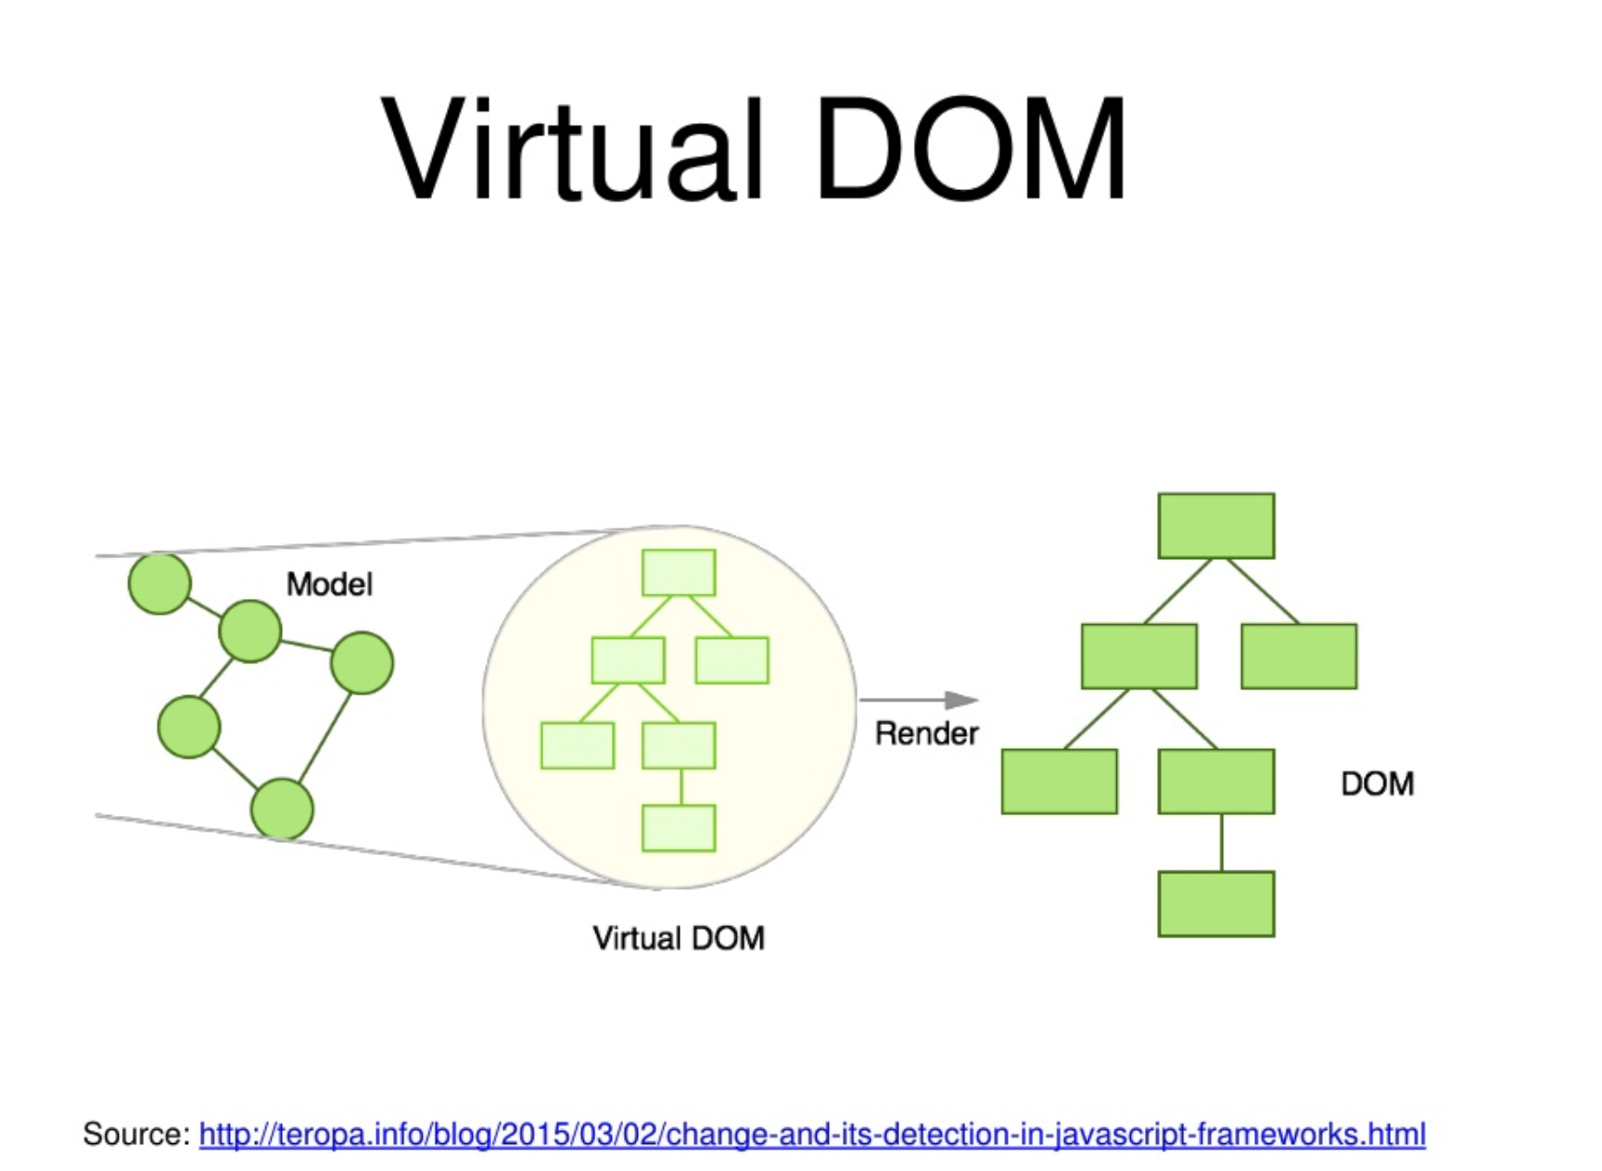

Slide 118
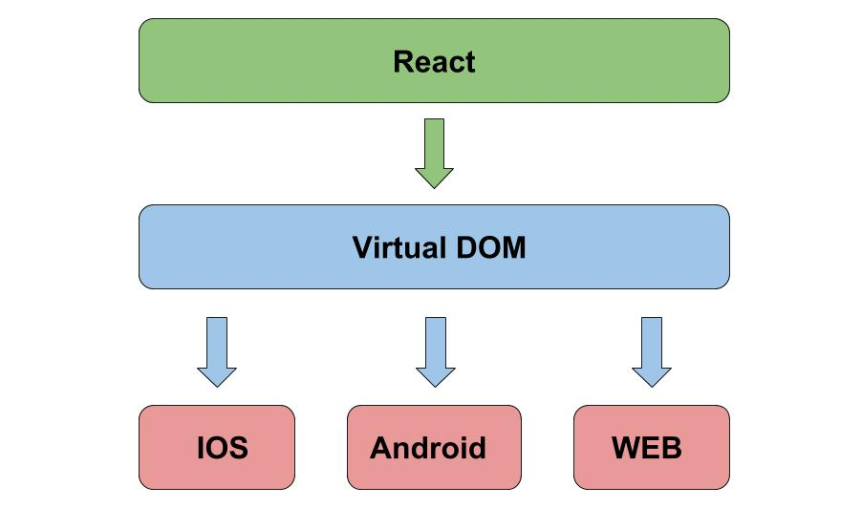

Slide 119
JVM
container
.java
.class
.jar
.war
compile: javac
package: jar
.xml
browser / node
.js
.js
.js
.js
.js
transpile: babel
package: webpack
.css
Notes:
java vs javacript
process same
most steps in javascript (technically) not needed
intermediate js as unreadable as bytecode
tooling
linting
transpiling / polyfills
uglification / minimisation
.browserslistrc in Surface – CSS and polyfills
modules
js – browers had no real concept of modules
new type=module and .jsm in node
3 mins (39)

Slide 120
Thank You
Notes:
before I open to questions:
question about next session
who wants to/can come?
1 min (48)

