Slide 1
Javascript
its new natural habitat everywhere
Notes:
Thank you for coming back!
Last week JS in the browser.
Much of its life only in browser
So to run it:
browser console
create a web app
clever websites such as jsbin
then this happened...
3 mins (3)

Slide 2
“… It’s a rather large C project actually ...”
Ryan Dahl, 2009
https://youtu.be/ztspvPYybIY?t=7
Notes:
‘it confuses a lot of people’
container for js – just like a browser
choice between Ryan and me…
content is gold
3 mins (6)

Slide 3


Node
Your Javascript code
application
system
V8 compiler
libuv
Notes:
whereas a browser handles IO and draws UI’s and JS is a supporting technology
in node, components are there to support js
V8 compiler – Google, same as chrome
libuv – IO abstraction over network & file, plus thread pool, DNS, signals etc.
here why 1 reason why such a success
straddles system and application programming
unicorn velociraptor library – geeks
3 mins (9)

Slide 4
demo
node01/process_hello.js
node02/console_hell0.js
node03/report.js
Notes:
time for a demo – don’t get too excited
show 3 examples
simpler than in browser!
go through flow of processing
beyond spanning app/system divide, three key features that have made node a success
first a sidebar…
I want to talk about fast things
network downloads vs chuckie egg
faster, in fact fastest light in vacuum
Ediburgh – New York 60x
3 GHz one clock cycle > 10 cm
4 mins (13)

Slide 5
IO: relative speeds
if processor = 1 second
then disk = days
network = weeks
Notes:
IO = Input Output, getting data to the processor
disparity between processor speeds
influences much if not all software design
Ryan Dahl called it ‘the problem of IO’
apache – threads – difficult to define (circular)
anthropomor phise - Alex
99.999% of time doing nothing
3 mins (16)

Slide 6
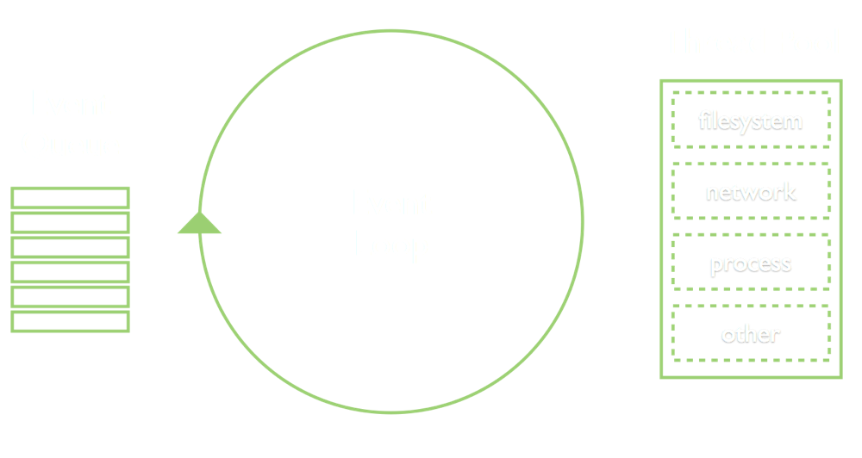
1: Event Loop
Notes:
another model
instead of 1000’s of threads – you have 1
performance & scalability
not unique to Node – webservers: nginx, vertx
language Ruby – eventmachine, Python - twisted
also in fact, familiar to UI programmers of any language
standard way of working
3 mins (19)

Slide 7
demo
node04/directory_listing.js
node05/directory_listing_X.js
Notes:
demo
ignore require
first class functions, closure – JS perfect fit
Ryan Dahl says reason for choosing JS
finally, for techies, above slide is conceptually correct, but technically wrong…
4 mins (23)

Slide 8

https://medium.com/the-node-js-collection/what-you-should-know-to-really-understand-the-node-js-event-loop-and-its-metrics-c4907b19da4c
https://www.youtube.com/watch?v=PNa9OMajw9w
Notes:
side note: techies only
libuv – thread pool of 4!
conceptually correct but
most async IO not on threads
1 min (24)

Slide 9
2: Modules
node02/console_hello.js
node02a/console_hell0.js
node04/directory_listing.js
Notes:
Breaking large lumps of code into smaller units
Javascript has no language specific modularisation, unlike static languages
In true JS fashion commonjs, amd, umd
Node settled on one, decorated it a little
standardised it
demo
ironically now es6 (latest Javascript), node a laggard
5 mins (29)

Slide 10
3: Node Package Manager (npm)
node06/server.js
Notes:
‘require’ - own code, node code, third party code
add on tool added a year or so after initial Node
makes bringing in modules trivial
create node06 with express
can do as quickly in other languages – but size of npm repo + combining with own code + other assets
example of real code – surface server.js
the bad - simplicity hide problems – directory depth with transitive dependencies / determinism
too easy? mash-up style of programming: left-pad March 2016
5 mins (34)

Slide 11
Javascript : a reasonable application language
a container that bridges system and application programming
event loop : a structured programming model
common.js / es6 : built-in modularisation
npm : huge library of easily used components
=> Productivity
Notes:
5 elements
most productive coding environment I have worked in
actually a sixth element, node permits JS ubiquity
to illustrate...
2 mins (36)

Slide 12
Notes:
least annotated diagram you have seen - security, security
orientation funny: start at right, clients
web ‘leaf’ servers’
intermediate servers – stateless, microservices
off to left systems land
bottom, developer machine - tools
what technologies to use...
2 mins (39)

Slide 13


Notes:
client – browser
servers – event model great for stateless
network & file IO essentially same form computer’s point of view
node tools to write node servers to serve javascript clients
all application programming
‘full stack’ - a single language, common programming model
might be a surprise to non-techies
always other choices, but compelling for
devs, companies, etc.
2 mins (41)

Slide 14
Javascript
its new natural habitat everywhere
Notes:
hence the title
use Tesco bank as an example
1 min (42)

Slide 15
Notes:
PSP – leaf server + SPA client
Surface – leaf server + SPA client
Chunk – middleware – also used by mobile
Build tools
what other uses?
Ryan Dahl – real-time websites’ with push technology
Demo – mercury
5 min (47)

Slide 16
Thank You
https://www.surveymonkey.com/r/GXLDBNC
Notes:
before I open to questions:
question about next session
who wants to/can come?
1 min (48)

