Slide 1
Introduction to R and RStudio, Programming in R
http://leucon.anu.edu.au/marcin/r_data/r_workshop.pptx
http://leucon.anu.edu.au/marcin/r_data/R_day_1.html
http://leucon.anu.edu.au/marcin/r_data/R_day_2.html
Dr Marcin Adamski
marcin.adamski@anu.edu.au
Research School of Biology and
John Curtin School of Medical Research
17th – 18th February 2020

Slide 2
What is R?
R is an open source programming language and software environment for statistical computing and graphics that is supported by the R Foundation for Statistical Computing. The R language is widely used among statisticians and data miners for developing statistical software and data analysis.
R was created by Ross Ihaka and Robert Gentleman at the University of Auckland, New Zealand. R is an implementation of the S programming language. R is named partly after the first names of the first two R authors and partly as a play on the name of S. The project was conceived in 1992, with an initial version released in 1995.
https://en.wikipedia.org/wiki/R_(programming_language)

Slide 3
What is R?
R is an open source programming language and software environment for statistical computing and graphics that is supported by the R Foundation for Statistical Computing. The R language is widely used among statisticians and data miners for developing statistical software and data analysis.
R was created by Ross Ihaka and Robert Gentleman at the University of Auckland, New Zealand. R is an implementation of the S programming language. R is named partly after the first names of the first two R authors and partly as a play on the name of S. The project was conceived in 1992, with an initial version released in 1995.
https://en.wikipedia.org/wiki/R_(programming_language)
What is S language?
S is a statistical programming language developed primarily by John Chambers and Rick Becker and Allan Wilks of Bell Laboratories. The aim of the language, as expressed by John Chambers, is “to turn ideas into software, quickly and faithfully”. https://en.wikipedia.org/wiki/R_(programming_language)

Slide 4
What is R?
R and its libraries implement a wide variety of statistical and graphical techniques, including linear and nonlinear modeling, classical statistical tests, time-series analysis, classification, clustering, and others.
R is easily extensible through functions and extensions, and the R community is noted for its active contributions in terms of packages.
Many of R's standard functions are written in R itself, which makes it easy for users to follow the algorithmic choices made. For computationally intensive tasks, C, C++, and Fortran code can be linked and called at run time.
https://en.wikipedia.org/wiki/R_(programming_language)

Slide 5
Programming languages
R is not the only programming language.
There are other languages:
General purpose: C++, Python, Java, Fortran, Pascal, Ada, Basic, Cobol, …
Web-programming: PHP, JavaScript.
Relational databases: SQL.
Logic programming: Prolog.
Machine languages, assemblers: Intel x86-64, Sun, ARM.
Statistical: R, S, SAS.
MATLAB – Matrix algebra, simulations, engineering, …
Knowing more than one language can help us to find the right tool for the job and avoid the golden hammer pitfall (Law of The Instrument).
“It is tempting, if the only tool you have (know) is a hammer, to treat everything as if it was a nail”. https://en.wikipedia.org/wiki/Law_of_the_instrument

Slide 6
Why R?
R is the leading tool for statistics, data analysis, and machine learning.
Popularity in the field. It’s good to speak the language your colleagues speak.
R is a programming language not a software package, meaning:
You are not limited to set of pre-defined operations (functions).
You can use a wealth of functions already created by others.
You can create your own functions, programs, and workflows.
R is interactively interpreted:
You can open R session and work in it as you would work with a notebook.
R will work with you in Read – Evaluate – Print Loop (REPL) meaning that when you type a command and then presses the Enter key, R reads the command, evaluates it, immediately prints its output, and is ready to read your next command.
R is system-independent, meaning it is available for Windows, OS-X and Linux.

Slide 7
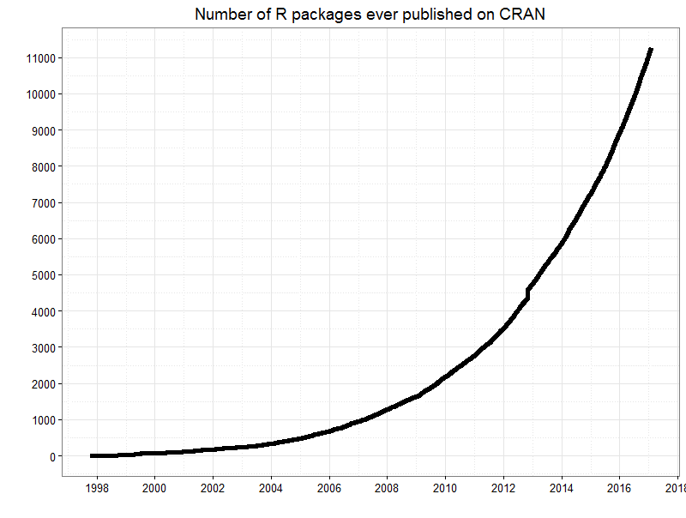
Why R?
Astounding selection of already written extensions (packages also known as libraries).
There usually is more than one package available for most problems and tasks you may encounter.
R primary package repositories
CRAN – the primary one, data from which is plotted on left
R-Forge – another core repository
Bioconductor – for the analysis and comprehension of high-throughput genomic data.
GitHub – growing quickly and gaining popularity
http://blog.revolutionanalytics.com/2017/01/cran-10000.html

Slide 8
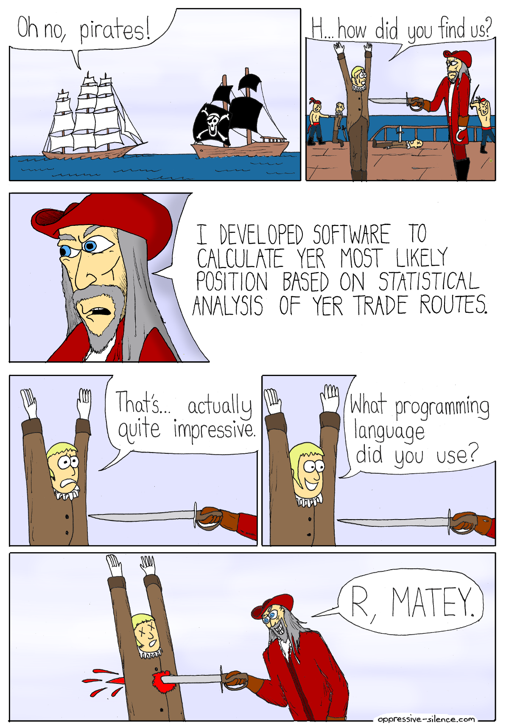
Why R?
Last but no least:
R is Pirates favourite
programming language
aRRRRR!!!
https://www.reddit.com/r/ProgrammerHumor/comments/5gt25z/piracy_software

Slide 10
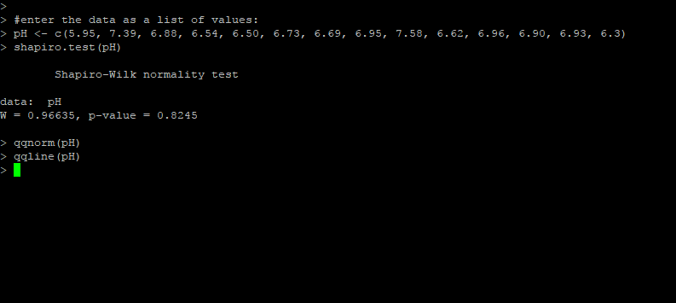
What is R Studio?
R Studio (written as RStudio without the space) is a free and open-source Integrated Development Environment (IDE) for R. https://en.wikipedia.org/wiki/RStudio
R console

Slide 11
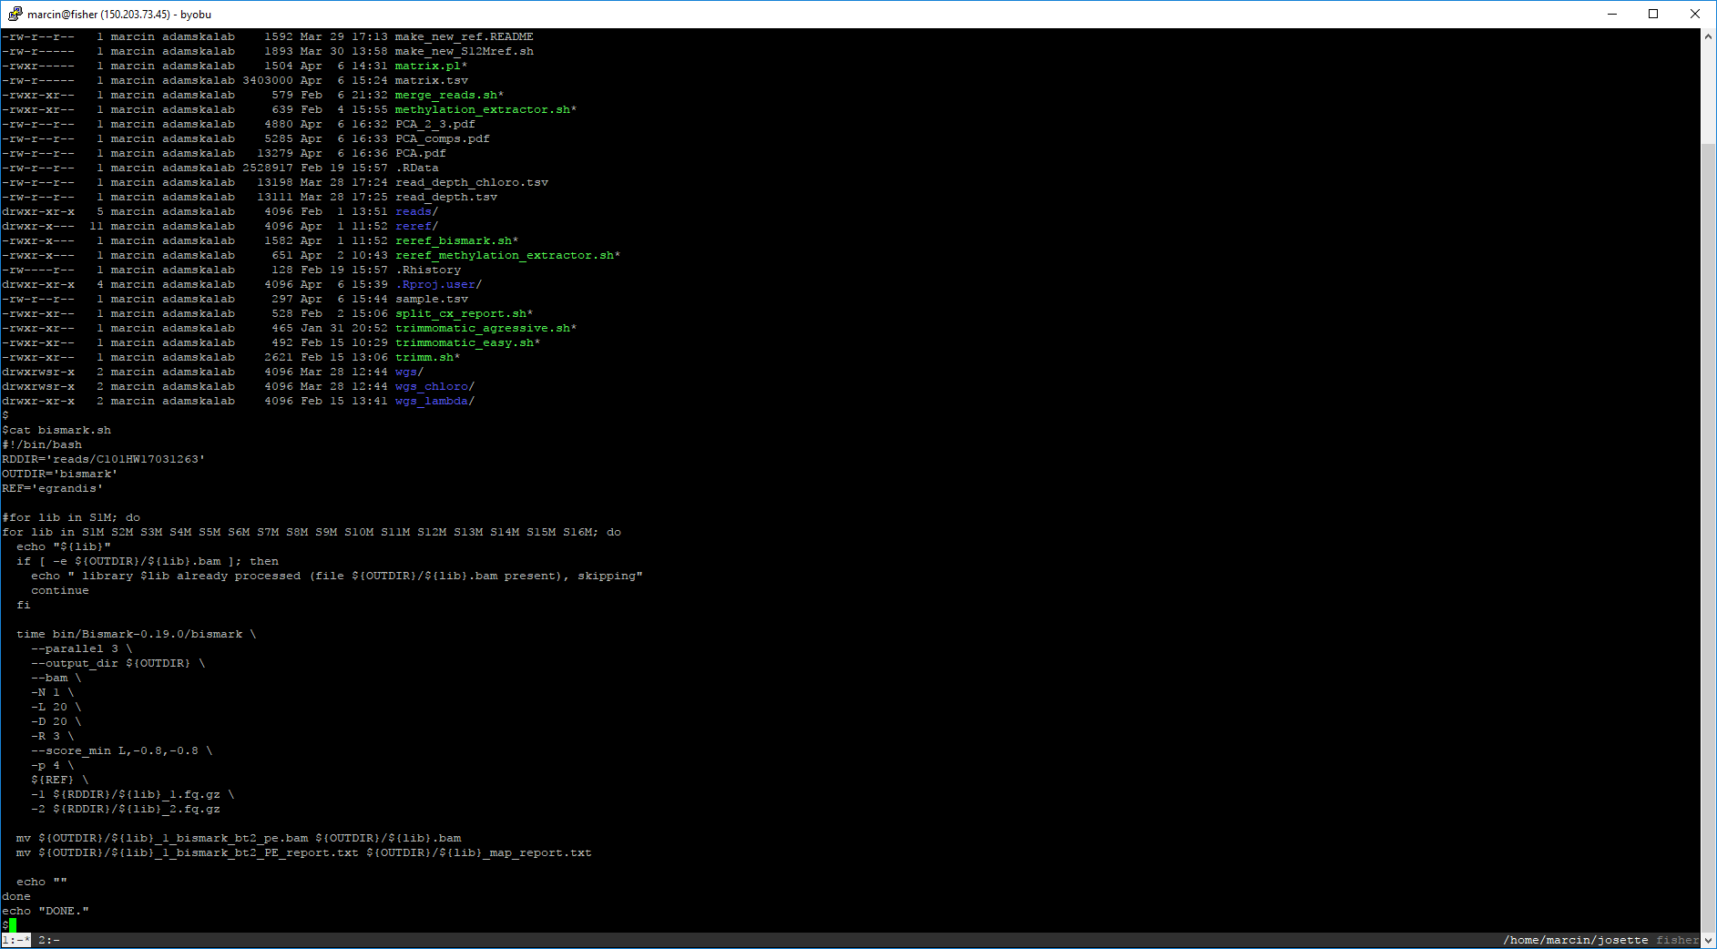
my computer screen often looks like this
but most of us prefer to enjoy some visual candy…

Slide 12
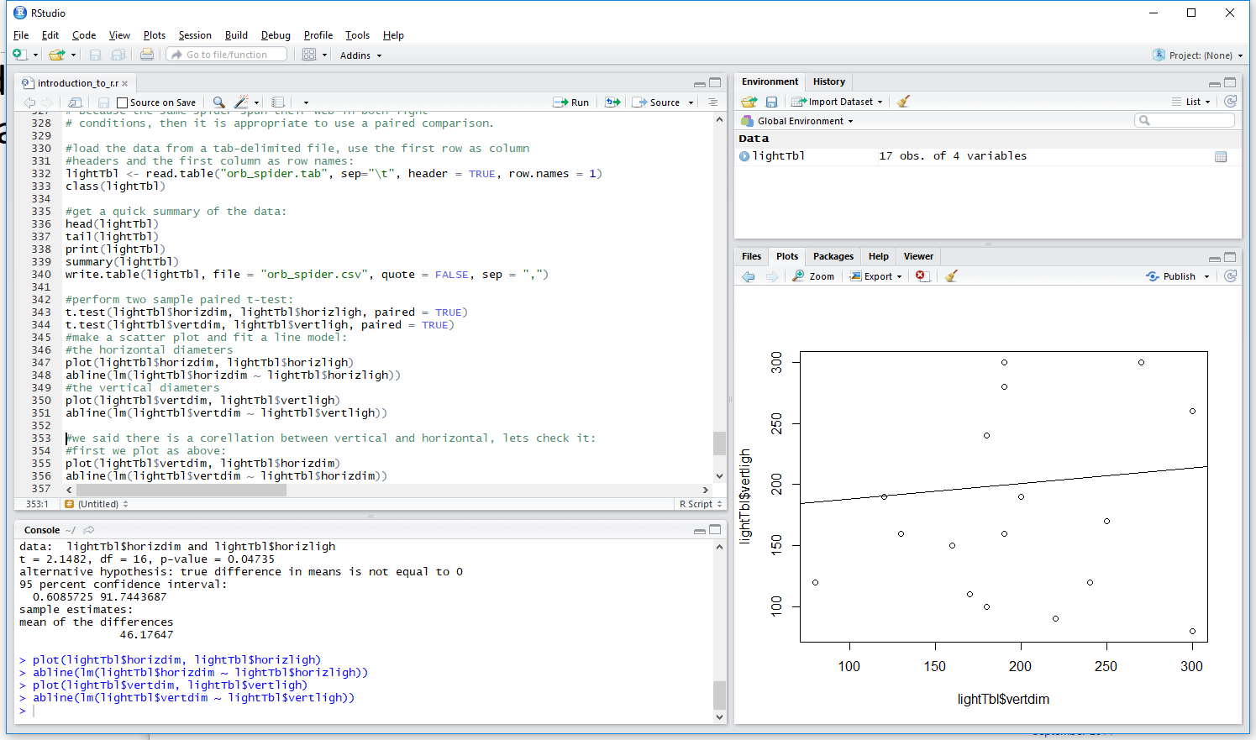
What is R Studio?
R Studio (written as RStudio without the space) is a free and open-source Integrated Development Environment (IDE) for R. https://en.wikipedia.org/wiki/RStudio
R console
RStudio IDE

Slide 13
What is R Studio?
R Studio (written as RStudio without the space) is a free and open-source Integrated Development Environment (IDE) for R. https://en.wikipedia.org/wiki/RStudio
R console
RStudio IDE
variables, structures,
history of your
commands
your scripts (programs),
data, etc.
your plots, files,
R help, etc.
R console (now it is only a
part of the environment)

Slide 14
What is R Studio?
R Studio (written as RStudio without the space) is a free and open-source Integrated Development Environment (IDE) for R. https://en.wikipedia.org/wiki/RStudio
R console
RStudio IDE
variables, structures,
history of your
commands
RStudio is a convenient tool for programming in R.
your scripts (programs),
data, etc.
your plots, files,
R help, etc.
R console (now it is only a
part of the environment)

Slide 15
Let the story begin…
R is interactively interpreted (actually it is one of two modes in which it can be used) Read – Evaluate – Print Loop (REPL)
R presents a prompt: ‘>’ symbol waiting to read your command.
After you type your command e.g. ‘2 + 2’ and hit ENTER, R evaluates it.
And prints the output: ‘[1] 4’.
And presents another prompt waiting to read your next command.
The actual session will look like this:
> 2 + 2 <ENTER key> ← this is the command
[1] 4 ← this is the output
> ← and this is the next prompt
We will use blue to show the command we enter and black to show the R output.
By the way, we have just learned the first operation in R: numerical summation.

Slide 16
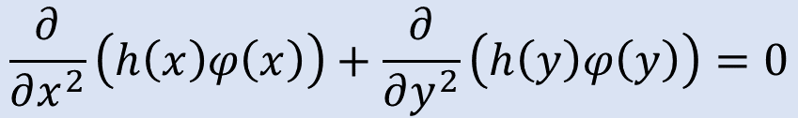
Variables
What variable is:
A variable is a symbolic name for information. The variable's name represents what information the variable contains. They are called variables because the represented information can change but the operations on the variable remain the same. http://www.cs.utah.edu/~germain/PPS/Topics/variables.html
Variables and assignments:
In computer programming, an assignment statement sets and/or re-sets the value stored in the storage location(s) denoted by a variable name; in other words, it copies a value into the variable. https://en.wikipedia.org/wiki/Assignment_(computer_science)
← variable
$$\frac{∂}{∂x^{2}}\left(h\left(x\right)φ\left(x\right)\right)+\frac{∂}{∂y^{2}}\left(h\left(y\right)φ\left(y\right)\right)=0$$
x = 8.34

Slide 17
Variables and Assignments in R
Assigning value to variable
symbol <- value
left-hand side assignment operator right-hand side
The right-hand side, or the expression is evaluated and the value of the evaluation is assigned to the left-hand side, the variable.
R’s dirty secrets:
Left and right sides may be reversed.
There is more than one assignment operator: ‘<-’, ‘<<-’, ‘=‘, ‘->>’, ‘->’.
Not all variable symbols are allowed (well, even this is not exactly true).
We will deal with them when the right time comes…
← value 8.34 assigned to variable x
$$\frac{∂}{∂x^{2}}\left(h\left(x\right)φ\left(x\right)\right)+\frac{∂}{∂y^{2}}\left(h\left(y\right)φ\left(y\right)\right)=0$$
x = 8.34

Slide 18
Variables and Assignments in R
A few examples:
> x <- 10
> y <- (2 + 8) ^ 3
> e <- 2.718281828459
> isTen <- x == 10
> welcome <- "Hallo World!"
Data Types, the type of variable:
integer – integer numbers as 0, 1, 98, -7
double (float) – floating-point numbers as 0.1, -2.1, 98.0
logical – Boolean logical values: TRUE and FALSE
character – text as “Home Sweet Home”, “R”, “23”, “TRUE” – character variables are always shown enclosed in quotation marks.

Slide 19
Variables and Assignments in R
A few examples:
> x <- 10
> y <- (2 + 8) ^ 3
> e <- 2.718281828459
> isTen <- x == 10
> welcome <- "Hallo World!"
Data Types, the type of variable:
integer – integer numbers as 0, 1, 98, -7
double (float) – floating-point numbers as 0.1, -2.1, 98.0
logical – Boolean logical values: TRUE and FALSE
character – text as “Home Sweet Home”, “R”, “23”, “TRUE” – character variables are always shown enclosed in quotation marks.
R is case sensitive!
> x <- 10
> X <- 20
will create two variables:
x (lower case) and X (upper case)

Slide 20
Types of Variables
To check the type of a variable or evaluation of an expression use:
typeof(x) where x is an ‘R object’ e.g. variable or expression
> x <- 10L
> typeof(x)
[1] "integer"
> e <- 2.718281828459
> typeof(e)
[1] "double"
> isTen <- x == 10
> typeof(x == 10)
[1] "logical"
note the ‘L’ – it denotes that the number
is intended to be integer, e.g. 10, not
double, e.g. 10.0.

Slide 21
Operators
Arithmetic operators return result of arithmetical evaluation
operator | use | description
+ | x + y | summation
– | x – y | subtraction
* | x * y | multiplication
/ | x / y | division
^, ** | x ^ y, x ** y | power
%% | x %% y | modulo
%/% | x %/% y | integer division
Example session in R
> 3 + 4
[1] 7
> 22 / 7
[1] 3.142857
> 22 %/% 7
[1] 3
> 22 %% 7
[1] 1
>

Slide 22
Operators
Logical operators return TRUE or FALSE
operator | use | description
< | x < y | less than
<= | x <= y | less than or equal to
> | x > y | greater than
>= | x >= y | greater than or equal to
== | x == y | exactly equal to
!= | z != y | not equal to
! | !x | negation of x; not x
| | x | y | x OR y
& | x & y | x AND y
Example session in R
> 3 < 4
[1] TRUE
> 3 == 4
[1] FALSE
> !TRUE
[1] FALSE
> (3 < 4) & (!FALSE)
[1] TRUE
>

Slide 23
Special Values
There are a few special values that are used in R
variable | description | example
NA | Not Available – represent missing values | v <- NA
Inf, -Inf | Infinity, -Infinity – Number too big (plus or minus) | 2 ^ 2000, -2 ^ 2000
NaN | Not a Number – result of evaluation has no sense | 0 / 0
NULL | NULL object – no value, undefined, empty | v <- NULL
variable | typeof()
NA | logical
Inf, -Inf | double
NaN | double
NULL | NULL

Slide 24
Data Structures
Data structure is a way of organizing and storing data in a computer.
Relation and difference between data structure and data type
Data structure is an abstract description of a way of organizing data.
Data type describes pieces of data that all share a common property.
It is easier to understand on example:
Vector of integer numbers, e.g. [1, 2, 3, 4]:
Vector is the data structure, integer is the data type. Vector is a way of organizing and storing data (1-dimensional, ordered list of elements); Integer is a property of the data being stored.
Scalar – a single value of a specified data type, e.g. 0, 9, TRUE, “Home”. Scalar can be seen as a naïve data structure storing only a single element of given type.

Slide 25
Data Structures
In most programming languages scalar is the basic way of storing data. That is how you store a result from e.g. summation of numbers, even the numbers themselves.
There are no scalars in R.
The simplest data structure is vector. Scalar is represented by a vector with only one element. Precisely speaking it is atomic vector. The ‘atomic’ means that all elements of the vector are of the same type, e.g. integer, double, character or logical. In other words it means that the atomic vector is homogenous in opposite to heterogeneous. Heterogeneous data structure do not require all elements to be of the same data type.

Slide 26
Data Structures in R
Fundamental Data structures in R
vector – as in algebra, 1-dimensional, ordered list of elements of the same type
list – similar as vector only the elements may be of different data type or even data structure
matrix – as in algebra, 2-dimensional extension to vector
data frame – 2-dimensional data structure: a list of vectors. Can be seen as a matrix where each row in a column must be of the same type, but the type may differ between columns.
homogenous | heterogeneous
vector (atomic) | list
matrix | data frame
array (multidimensional matrix)
factor (vector able to store only elements of predefined values)

Slide 27
Subsetting
Indexing with positive numbers
Indexing with vectors
Empty indexes
Negative indexes
Indexing with logical values
Dollar operator, $
R’s subsetting operators are powerful and fast. Mastery of subsetting allows you to succinctly express complex operations in a way that few other languages can match. Subsetting is hard to learn because you need to master a number of interrelated concepts (Advanced R, http://adv-r.had.co.nz/Subsetting.html)
[]

Slide 28
Indexing Vectors with Positive Numbers
Once, there was a good character vector:
v <- c("Lea", "Tia", "Amy", "Abi", "Leo", "Ian")
… and each of the vector’s elements could be called with their sequential number, the index:
v <- c("Lea", "Tia", "Amy", "Abi", "Leo", "Ian")
| | | | | |
v[1] v[2] v[3] v[4] v[5] v[6]
| | | | | |
"Lea" "Tia" "Amy" "Abi" "Leo" "Ian"

Slide 29
Indexing Matrices with Positive Numbers
A matrix M:
[,1] [,2] [,3] [,4]
[1,] 1 2 3 4
[2,] 5 6 7 8
[3,] 9 10 11 12
M <- matrix(1:12, nrow = 3, ncol = 4, byrow = TRUE)
As matrix has 2 dimensions, we need two indexes:
One for the row, and one for the column:
M[1, 2]will return 2
M[2, 1]will return 5
M[3, 4]will return 12
A matrix M:
$$\left(\begin{matrix}1 & 2 & 3 & 4 \\ 5 & 6 & 7 & 8 \\ 9 & 10 & 11 & 12\end{matrix}\right)$$
columns
rows

Slide 30
Indexing Vectors with… Vectors
Do you remember that there are no single values (scalars) in R, only vectors? Specifying index [1] we are actually specifying [c(1)], so why not to use a longer vector, e.g. c(1, 3, 5)?
v <- c("Lea", "Tia", "Amy", "Abi", "Leo", "Ian")
| | | | | |
v[c(1, 3, 5)]
| | |
"Lea" "Amy" "Leo"

Slide 31
Empty Index
Applied to vector empty index operator returns the whole vector:
v <- c("Lea", "Tia", "Amy", "Abi", "Leo", "Ian")
| | | | | |
v[]
| | | | | |
"Lea" "Tia" "Amy" "Abi" "Leo" "Ian"

Slide 32
Accessing a Row or a Column with Empty Index
[,1] [,2] [,3] [,4]
[1,] 1 2 3 4
[2,] 5 6 7 8
[3,] 9 10 11 12
Row is returned if no index specified for the column: M[1, ] will return: 1 2 3 4
Column returned if no index specified for the row: M[, 2] will return: 2 6 10
Consecutively M[, ] or M[] will return entire matrix .

Slide 33
Indexing with Negative Indexes
Negative index specifies dropping (rather than retaining) particular elements. When negative index is used all except the specified element(s) will be returned.
v <- c("Lea", "Tia", "Amy", "Abi", "Leo", "Ian")
| | | | | |
v[c(-1, -3, -5)]
| | | | | |
"Tia" "Abi" "Ian“
It is NOT allowed to mix negative and positive indexes.
v[-c(1, 3, 5)]

Slide 34
Indexing with Logical Values
Only elements for which the index is TRUE will be returned.
v <- c("Lea", "Tia", "Amy", "Abi", "Leo", "Ian")
| | | | | |
v[c(TRUE, TRUE, FALSE, FALSE, TRUE, FALSE)]
| | |
"Lea" "Tia" "Leo"

Slide 35
Indexing with Logical Values
Only elements for which the index is TRUE will be returned.
v <- c(10, 8, 0, 5, 7, -1)
| | | | | |
v[c(TRUE, TRUE, FALSE, FALSE, TRUE, FALSE)]
| | |
10 8 7

Slide 36
Logical Expressions Revisited
We have already seen logical comparisons. E.g.:
Vector recycling rule
x <- c(10, 8, 0, 5, 7, -1)
| | | | | |
x > c( 5, 5, 5, 5, 5, 5)
| | | | | |
(TRUE, TRUE, FALSE, FALSE, TRUE, FALSE)
> x <- 5
> x >= 5
[1] TRUE
And we know that R is vectorized meaning we can do:
> x <- c(10, 8, 0, 5, 7, -1)
> x > 5
[1] TRUE, TRUE, FALSE, FALSE, TRUE, FALSE

Slide 37
Indexing with Logical Values
Indexing with Logical Expressions
Only elements for which the index is TRUE will be returned.
v <- c(10, 8, 0, 5, 7, -1)
| | | | | |
v[c(TRUE, TRUE, FALSE, FALSE, TRUE, FALSE)]
| | |
10 8 7
v[v > 5]
v > 5

Slide 38
Indexing with Logical Values
Indexing with Logical Expressions
How to get the indexes, instead the value of elements for which the logical expression evaluates TRUE?
We already know how to get value of the elements (as discussed a few slides back):
v <- c(10, 8, 0, 5, 7, -1)
| | | | | |
v[v > 5]
| | |
10 8 7

Slide 39
Indexing with Logical Values
Get Indexes of Elements Evaluated TRUE
How to get the indexes, instead the value of elements for which the logical expression evaluates TRUE?
To get the indexes instead of the values we use function which(expression):
v <- c(10, 8, 0, 5, 7, -1)
| | | | | |
which(v > 5)
| | |
1 2 5

Slide 40
Matrix – Indexing with Logical Values
Only elements for which the two, row and column indexes are TRUE will be returned.
Matrix:
[,1] [,2] [,3] [,4]
[1,] 1 2 3 4
[2,] 5 6 7 8
[3,] 9 10 11 12
M[c(TRUE, TRUE, FALSE), c(TRUE, FALSE, FALSE, TRUE)] will return:
[,1] [,2]
[1,] 1 4
[2,] 5 8

Slide 41
Indexing Lists
Lists can be indexed like vectors with [] operator.
l <- list("Lea", "Tia", "Amy", "Abi", "Leo", "Ian")
l[2] will return a list with one element "Tia".
Elements of lists accessed with indices are always lists. They are not simplified even if such simplification (e.g. into a vector) seems natural to us.
Simplifying (unlisting) operator [[ ]] .
But, l[[2]] will return ‘unlisted’ element "Tia". The index, inx in [[inx]] operator has to be a single number – vector with only one element.

Slide 42
Indexing Named Lists
Named Lists can additionally be indexed like vectors with names of the elements.
l <- list(leader = "Lea", secretary = "Tia", member1 = "Amy", member2 = "Abi", memeber3 = "Leo", treasurer = "Ian")
l["leader"] will return a list with one element: "Lea".
l[c("leader", "treasurer")] will return a list with two elements…:
"Lea", "Ian".
Simplifying (unlisting) operator [[ ]]:
l[["leader"]] will return unlisted element "Lea".
l[[c("leader", "treasurer")]] is NOT correct!
[[]] takes only a single-element vector.

Slide 43
Subsetting Named Lists with $ operator
l <- list(leader = "Lea", secretary = "Tia", member1 = "Amy", member2 = "Abi", memeber3 = "Leo", treasurer = "Ian")
Simplifying (unlisting) operator [[ ]]:
l[["leader"]] will return ‘unlisted’ element "Lea".
[[]] takes only a single-element vector.
$ operator:
l$leader will return unlisted element "Lea"
l$secretary will return unlisted element "Tia"
l$member3 will return unlisted element "Leo"

Slide 44
Data Frames – Reading and Writing
Reading data frame from a file: The read.table function, e.g.:
data <- read.table(
file = "filename.tsv",
sep = "\t",
header = TRUE,
stringsAsFactors = FALSE)
will create a data frame variable data from tab-delimited text file “filename.tsv”. First row in the file will be used to name the columns (and possibly rows) and character columns will not be converted into factors.
What are factors???

Slide 45
Factors
Factors are categorical variables that are useful in statistical analyses (summary statistics, plots, regressions, etc.) to represent categorical data. They basically act like dummy variables that R codes for you. Factors are stored as integers, and have labels associated with these unique integers. While factors look (and often behave) like character vectors, they are actually integers under the hood, and you need to be careful when treating them like strings.
Complicated? Let’s use an example: In our experiment we have two categories of subjects: females and males. Gender of the 4 subject was recorded in a vector:
c("male", "female", "female", "male")
to create factors we use function factor:
factor(c("male", "female", "female", "male"))
R will assign 1 to the level “female” and 2 to the level “male” (because f comes before m, even though the first element in this vector is "male").
Example experiment: Weight gain during recovery of cancer patients after chemotherapy.
Factors in your experiment
state | sex | weight_gain
ACT | male | 2.1
ACT | male | 8.7
ACT | female | 1.2
NSW | female | 8.23
NSW | male | 1.3
1
2
1
2
1
1
2
1
2
2

Slide 46
Factors
> sex <- factor(c("male", "female", "female", "male"))
> print(sex)
[1] male female female male
Levels: female male
> levels(sex)
[1] "female" "male"
> nlevels(sex)
[1] 2
Factors are a very important part of R and are extensively used in statistical analyses and functions. Right now, we can think of them as ‘character vectors with extra features’ – unique values, the levels. (In next lecture we will see cases when this simplification is not correct.)
When reading data from files R readily converts character variables (columns) into factors assuming we are preparing for a statistical analysis. To stop this we use the stringsAsFactors = FALSE argument.

Slide 47
Data Frames – Reading and Writing
Writing data frame to a file: The write.table function, e.g.:
write.table(data,
file = "filename.tsv",
sep = "\t",
col.names = TRUE,
row.names = FALSE,
quote = FALSE)
Will write data frame variable data to a tab-delimited text file “filename.tsv”. First row of the file will contain names of the columns, names of the rows will not be used and character strings will not be quoted “”.

Slide 48
Indexing Data Frames
Data frames are indexed as matrices
data frame d:
d <- data.frame(
name = c("Lea", "Tia", "Amy"),
year = c(2009, 2012, 2015),
stringsAsFactors = FALSE
)
d[1, 2] will return 2009
d[3, 1] will return "Amy"
name | year
Lea | 2009
Tia | 2012
Amy | 2015

Slide 49
Indexing Data Frames
Indexing of data frames simplifies returned object to a vector if a single column is indexed.
data frame d:
Positive numbers indexes:
d[1:2, 1] will return: "Lea" "Tia", a vector. But doesn’t simplify if indexing more than one colum:
d[3, 1:2] will return:
a data frame (with just only row).
name | year
Lea | 2009
Tia | 2012
Amy | 2015
name | year
Amy | 2015

Slide 50
Indexing Data Frames
Indexing of data frames simplifies returned object to a vector if a single column is indexed.
data frame d:
Negative numbers indexes:
d[-(1:2), 1] will return: "Amy", a vector.
d[-3, 1:2] will return:
data frame:
name | year
Lea | 2009
Tia | 2012
Amy | 2015
name | year
Lea | 2009
Tia | 2012

Slide 51
Data Frames – The $ operator
The $ operator allows to access columns in data frames by the name of the column.
data frame d:
d$name will return vector "Lea" "Tia" "Amy"
d$year will return vector 2009 2012 2015
Columns == Variables
name | year
Lea | 2009
Tia | 2012
Amy | 2015
Rows == Observations
Columns in data frame can be seen as variables (vectors) in the context
of the data frame.

Slide 52
Data Frames – Subsetting
data frame d:
d$name will return vector…:
"Lea" "Tia" "Amy"
logical expression d$name == "Lea" will return vector…:
TRUE FALSE FLASE
d[d$name == "Lea", ] will return…:
data frame:
name | year
Lea | 2009
Tia | 2012
Amy | 2015
name | year
Lea | 2009

Slide 53
Data Frames – Subsetting
data frame d:
d[d$name == "Lea", 2] will return vector…:
2009
d[d$name == "Lea", "year"] will return vector…:
2009
d[d$name == "Lea", ]$year will return vector…:
2009
name | year
Lea | 2009
Tia | 2012
Amy | 2015
rows indexed by logical expression, columns indexed by positive number
rows indexed by logical expression, columns indexed by name
rows indexed by logical expression, columns indexed with empty index (all columns returned) followed by subsetting of the columns with $ operator

Slide 54
Data Frames – Replacing Elements
data frame d:
d[d$name == "Lea", "year"] <- 2000 will return data frame…:
name | year
Lea | 2009
Tia | 2012
Amy | 2015
name | year
Lea | 2000
Tia | 2012
Amy | 2015

Slide 55
Data Frames – Replacing Elements
data frame d:
d[d$name %in% c("Tia", "Lea"), "year"] <- 2000 will return data frame…:
name | year
Lea | 2009
Tia | 2012
Amy | 2015
%in% operator
returns logical vector (TRUE, FALSE) indicating if there is a match or not for its left operand in the right operand
name | year
Lea | 2000
Tia | 2000
Amy | 2015
d$name %in% c("Lea", "Tia")
d$name is ("Lea", "Tia", "Amy")
| | |
%in% c("Tia", "Lea")
| | |
TRUE TRUE FALSE

Slide 56
Functions
Functions are self contained modules of code that accomplish a specific task. Functions usually “take in” data, process it, and return a result. Once a function is written, it can be used over and over again. Functions can be called from the inside of other functions (a function can also call itself in a recursive manner).
Functions encapsulate a task (they combine many instructions into a single line of code). Most programming languages provide many built in functions that would otherwise require many steps to accomplish. We already used some functions in R. For example, typeof(), abs(), sqrt(), etc. They all are functions already built-in into R and available for the programmer to use.
inspired by http://www.cs.utah.edu/~germain/PPS/Topics/functions.html

Slide 57
Functions – User Defined Functions in R
name of the function
function keyword
Function definition:
name <- function(argument_list){
expression1
expression2
expression3
. . .
return(expression)
}
body of the function
an expression, often a
compound expression, {…}
value returned by function
argument_list – empty or one or more names or ‘name = expression’ terms.
expression – an R expression.

Slide 58
Loops
A common computer task is to repeatedly carry out some computations. E.g.:
Perform calculations for certain number of times, e.g. on all elements of a vector.
Carry out calculations while certain condition is TRUE, e.g. perform numerical integration while the level of convergence is still not met.
Task (1) is accomplished with a for loop in a the form:
for (variable in vector) expression
The expression will be evaluated as many times as there are elements in the vector.
Task (2) is accomplished with a while loop in a the form:
while (condition) expression
The expression will be evaluated as long the condition is TRUE.

Slide 59
for loop
diagram
statements before the loop
pseudocode*
statements before the loop
var
in
No More
Elements
1
1 2 3 4 5
2
3
4
5
sequence
Loop
for(var in sequence){
statements
in the loop
}
Next Element
Assigned
statements in the loop
(body of the loop)
statements after the loop
var a variable
sequence usually a vector or a list, e.g. 1:5
statements after the loop
*) Notation resembling a simplified programming language.

Slide 60
for loop
Example:
Perform some tasks for each of the four quarters of the year:
R code:
1 2 3 4
printed output:
print("code before loop")
code before loop
in loop quarter is 1
in loop quarter is 2
in loop quarter is 3
in loop quarter is 4
code after loop
for(quarter in 1:4){
print(paste(" in loop quarter is", quarter))
# you can add more lines of code here
}
print("code after loop")

Slide 61
while loop
diagram
statements before the loop
pseudocode*
statements before the loop
condition?
FALSE
Loop
while(condition){
statements
in the loop
}
TRUE
statements in the loop
(body of the loop)
statements after the loop
statements after the loop
condition a Boolean expression
e.g. variable < value, e.g. x < 5
*) Notation resembling a simplified programming language.

Slide 62
while loop
Example:
Perform some tasks for each year up to (and including) 2017:
R code:
printed output:
year <- 2013L
print(paste("before loop year is", year))
before loop year is 2013
in loop year is 2013
in loop year is 2015
in loop year is 2017
after loop year is 2019
while(year <= 2017L){
print(paste(" in loop year is", year))
year <- year + 2L
}
print(paste("after loop year is", year))

Slide 63
while and for loops
while loop
for loop
statements before the loop
statements before the loop
while(condition){
statements
in the loop
}
for(var in sequence){
statements
in the loop
}
statements after the loop
statements after the loop
Iterates while the
condition is TRUE.
Iterates for each element in the sequence. The elements from the sequence are assign-ed to variable var one-by-one.

Slide 64
Merging Data Frames
X
Y
X
Y
X
Y
X
Y
inner join
left outer join
right outer join
full outer join
join type | description
inner join | Keep only rows that match in both the data frames X and Y
left outer join | Include all the rows from data frame X and only those from Y that match.
right outer join | Include all the rows from data frame Y and only those from Y that match.
full outer join | Keep all rows from both data frames X and Y.

Slide 65
Merging Data Frames
inner join
full outer join
X
Y
X
Y
name | year
Lia | 2009
Tea | 2012
Amy | 2015
Abi | 2016
name | eye
Amy | grey
Leo | brawn
Lia | blue
Tea | green
Ian | blue
name | year
Lia | 2009
Tea | 2012
Amy | 2015
Abi | 2016
name | eye
Amy | grey
Leo | brawn
Lia | blue
Tea | green
Ian | blue
X inner join Y
X full outer join Y
name | year | eye
Lia | 2009 | blue
Tea | 2012 | green
Amy | 2015 | grey
name | year | eye
Lia | 2009 | blue
Tea | 2012 | green
Amy | 2015 | grey
Abi | 2016 | NA
Leo | NA | brawn
Ian | NA | blue

Slide 66
Merging Data Frames
left outer join
right outer join
X
Y
X
Y
name | year
Lia | 2009
Tea | 2012
Amy | 2015
Abi | 2016
name | eye
Amy | grey
Leo | brawn
Lia | blue
Tea | green
Ian | blue
name | year
Lia | 2009
Tea | 2012
Amy | 2015
Abi | 2016
name | eye
Amy | grey
Leo | brawn
Lia | blue
Tea | green
Ian | blue
X
X
X
X left outer join Y
X right outer join Y
name | year | eye
Lia | 2009 | blue
Tea | 2012 | green
Amy | 2015 | grey
Abi | 2016 | NA
name | year | eye
Lia | 2009 | blue
Tea | 2012 | green
Amy | 2015 | grey
Leo | NA | brawn
Ian | NA | blue

Slide 67
Merging Data Frames
Merging two data frames with function:
Z <- merge(X, Y, by, all.x, all.y)
Z – resulting data frame
X – first data frame
Y – second data frame
by – columns to use for merging
all.x all.y – type of merge
Z <- merge(X, Y, by = "name")

Slide 68
Merging Data Frames
key column
key column
X
Y
name | year
Lia | 2009
Tea | 2012
Amy | 2015
Abi | 2016
name | eye
Amy | grey
Leo | brawn
Lia | blue
Tea | green
Ian | blue
Z <- merge(X, Y, by = "name")

Slide 69
Merging Data Frames
Z <- merge(X, Y, by = "name")
join type | all.x | all.y
inner | FALSE | FALSE
left outer | TRUE | FALSE
right outer | FALSE | TRUE
full outer | TRUE | TRUE
inner: Z <- merge(X, Y, by = "name", all.x = FALSE, all.y = FALSE)
left outer: Z <- merge(X, Y, by = "name", all.x = TRUE, all.y = FALSE)
right outer: Z <- merge(X, Y, by = "name", all.x = FALSE, all.y = TRUE)
full outer: Z <- merge(X, Y, by = "name", all.x = TRUE, all.y = TRUE)

Slide 70
R Graphics
R has vary extensive graphics facilities. The quality of the graphs is often cited as a major reason for using it in preference to other statistical software systems.
Examples of R basic graphics functions are:
Pie Charts
Bar Charts
Histograms
Box Plots
Scatter Plots
Density Plots
Time Series Plots
Surface Plots
R graphic capabilities are extended by several graphic packages. Many of them were created to facilitate production of specific plots and graph. Others are more generic. Among those the two most popular ones are lattice and ggplot2. We will concentrate on ggplot2 utilizing the concept of Grammar of Graphics.

Slide 71
ggplot2 Fundamentals
Uses an underlying grammar of graphics to build graphs component-by-component rather than providing pre-made graphs.
Produces layered graphics.
Graph specification at a high level of abstraction.
Builds a graph from concepts rather than recall of commands and options.
Is easy enough to use without any exposure to the underlying grammar.
“ggplot2” package must be first installed with command:
install.packages("ggplot2")
The installation needs to be done only once.
After installation the package must be ‘loaded’ before it can be used with command:
library(ggplot2)

Slide 72
ggplot2 – Grammar of Graphics
The basic idea: independently specify plot building blocks and combine them to create just about any kind of graphical display you want. Building blocks of a graph include:
data (from data.frame structure)
aesthetic mapping
geometric object
statistical transformations
scales
coordinate system
faceting
Grammar of graphics defines the rules of structuring mathematic and aesthetic elements into a meaningful graph.
A very good introduction to ggplot2 can be found at a UCLA web page:
http://stats.idre.ucla.edu/r/seminars/ggplot2_intro

Slide 73
ggplot2 – Components
data.frame structure stores data for the graph.
ggplot() function creates the graph (a ggplot object).
aes() function performs the aesthetic mapping – the visually perceivable components of the graph.
geom_ family of functions renders layers of visual representation of the data
geom_point() – scatterplot
geom_area() – graph with a shaded area
geom_histogram() – histogram
geom_contour() – surface contour (as contour on a map)
geom_density() – density plots
many more!

Slide 74
ggplot2 – Components, Example
stat_ family of functions performs statistical transformation of the data
stat_sum() – counts the number of observations
stat_bin() – divides continuous variable into bins
stat_qq() – quantile-quantile plot
many more!
+ is the operator to add components, the layers to the ggplot object.
Quick example: data frame spider with data coming from experiment on comparing spiders weight with size of the web they wave.
spider_id | weight | web_dia | population
sp_1 | 2.1 | 25.6 | canberra
sp_2 | 3.4 | 32.2 | cooma
… | … | … | …
sp_78 | 11.2 | 108.3 | jervis

Slide 75
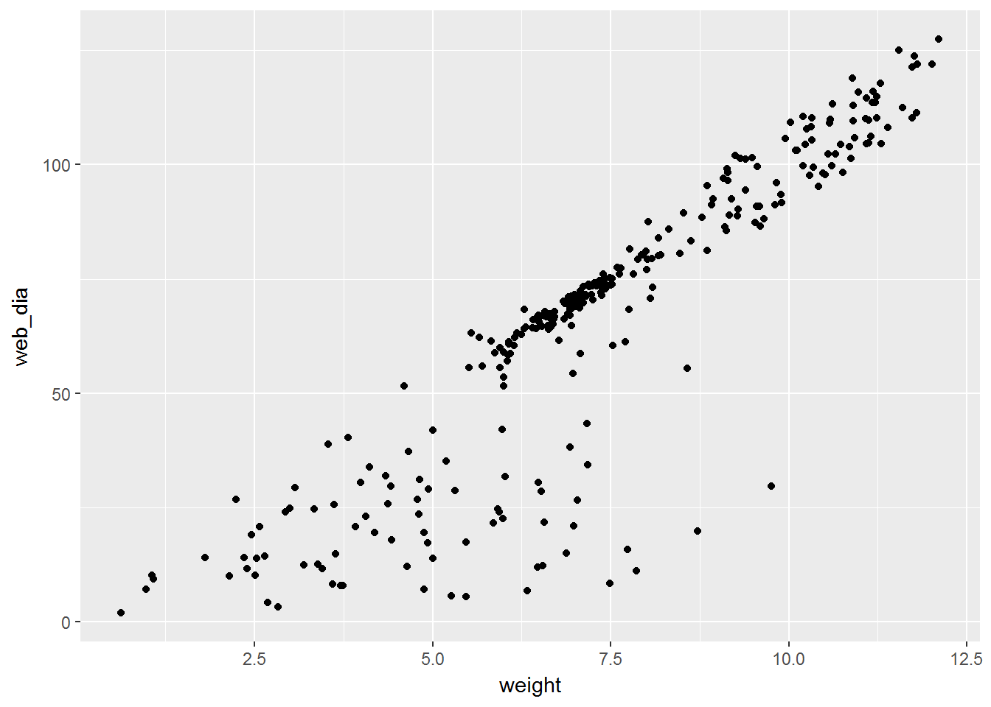
ggplot2 – Example
We want to make a scatterplot web diameter vs. spider weight and fit a linear model, a line to the data:
ggplot(data = spider, aes(x = weight, y = web_dia)) +
geom_point()
ggplot created the graph object
aes specified what is going to be plotted
geom_point created the scatterplot

Slide 76
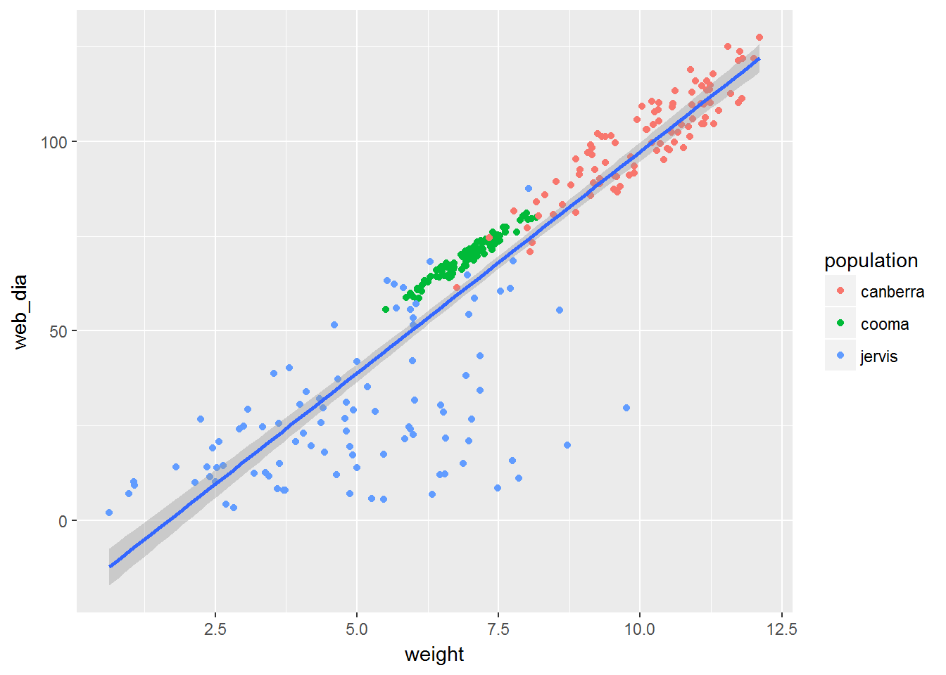
ggplot2 – Example
We want to make a scatterplot web diameter vs. spider weight and fit a linear model, a line to the data:
ggplot(data = spider, aes(x = weight, y = web_dia)) +
geom_point(aes(colour = population)) +
+ geom_smooth(method = 'lm')
ggplot created the graph object
aes specified what is going to be plotted
geom_point created the scatterplot
geom_smooth fit linear model to the data

Slide 77
The apply function
apply(X, MARGIN, FUN, ...) Runs on arrays-like structures processing rows or columns. Returns a vector, matrix, data frame or list of values obtained by applying a function to margins of a matrix or data frame.
X is a matrix or a data frame.
FUN is the function that you want to apply to the data. It can be any R function, including a User Defined Function (UDF).
MARGIN defines how the FUN function is applied: when MARGIN = 1, it works over rows, whereas with MARGIN = 2, it works over columns. Note that when MARGIN = c(1, 2), FUN is works on both rows and columns, on the cells .

Slide 78
The apply function – working on columns
apply(X, MARGIN, FUN, ...) calculate means from columns
vector of means from cols.
apply(X, 2, mean)
X | col_1 | col_2 | col_3 | col_4 | col_5
row_1 | -0.20 | 0.42 | -0.57 | -1.23 | 1.13
row_2 | -0.26 | 1.21 | 1.08 | 0.90 | 0.60
row_3 | 1.34 | 0.00 | 0.25 | -1.38 | 0.88
row_4 | 0.36 | 0.16 | -0.05 | -1.48 | -0.86
apply(X, 2, mean)
X – the data frame to work with
2 – apply function to columns
mean – the function to be applied
 | 0.31 | 0.45 | 0.18 | -0.80 | 0.44
#for loop equivalent of apply(X, 2, mean)
v <- c()
for(c in 1:ncol(X)){
v <- c(v, mean(X[, c]))
}
v

Slide 79
The apply function – working on rows
apply(X, MARGIN, FUN, ...) calculate means from rows
apply(X, 1, mean)
vector of means
from rows
X | col_1 | col_2 | col_3 | col_4 | col_5
row_1 | -0.20 | 0.42 | -0.57 | -1.23 | 1.13
row_2 | -0.26 | 1.21 | 1.08 | 0.90 | 0.60
row_3 | 1.34 | 0.00 | 0.25 | -1.38 | 0.88
row_4 | 0.36 | 0.16 | -0.05 | -1.48 | -0.86
-0.09
0.71
0.22
-0.37
apply(X, 1, mean)
X – the data frame to work with
1 – apply function to rows
mean – the function to be applied
#for loop equivalent of apply(X, 1, mean)
v <- c()
for(r in 1:nrow(X)){
v <- c(v, mean(unlist(X[r, ])))
}
v

Slide 80
The End
Please see next slides for additional subjects.

Slide 81
Adding New Columns to Data Frame
name | year | eye
Lia | 2009 | blue
Tea | 2012 | green
Amy | 2015 | grey
year2
9
12
15
data frame variable d
Add a column
Assign new value to column with index ncol(d) + 1 and give it the name
d[ , ncol(d) + 1] <- d$year – 2000
names(d)[ncol(d)] <- "year2"
Assign new value to column with a new name.
d$year2 <- d$year - 2000
As we already know, variables are created when they get values assigned for the first time.
In data frame columns are variables, so they are created when values are assigned to them for the first time.

Slide 82
Removing Columns and Rows from Data Frame
name | year | eye
Lia | 2009 | blue
Tea | 2012 | green
Amy | 2015 | grey
d <- data.frame(
name = c("Lia", "Tea", "Amy"),
year = c(2009, 2012, 2015),
eye = c("blue", "green", "grey")
)
data frame variable d
Delete a column (or several columns)
Index the data frame in a way that skips the column(s) you want to remove and re-assign the variable.
d <- d[ , 1:2] #index by positive number
d <- d[ , -3] #index by negative number
d <- d[ , c("name", "year")] #index by column name
d <- d[ , c(TRUE, TRUE, FALSE)] #index by logical value
Assign NULL value to the column to delete.
d[, 3] <- NULL
d$eye <- NULL

Slide 83
Removing Columns and Rows from Data Frame
name | year | eye
Lia | 2009 | blue
Tea | 2012 | green
Amy | 2015 | grey
data frame variable d
Delete a row (or several rows)
Index the data frame in a way that skips the row(s) you want to remove and re-assign the variable.
d <- d[c(1, 3), ] #index by positive number
d <- d[-2, ] #index by negative number
d <- d[!(d$name %in% c("Tea")), ] #index by logical expr.
You can't assign NULL value to the row to delete.
d[3, ] <- NULL

Slide 84
Accessing the Names
To get or set names of columns in a data frame or names in a list use function names.
d <- data.frame(
name = c("Lea", "Tia", "Amy"),
year = c(2009, 2012, 2015)
)
ln <- list(n1 = "Lea", n2 = "Tia", n3 = "Amy", n4 = "Abi")
names(d) will return vector: "name" "year"
names(ln) will return vector: "n1" "n2" "n3" "n4"

Slide 85
Changing the Names
To get or set names of columns in a data frame or names in a list use function names.
d <- data.frame(
name = c("Lea", "Tia", "Amy"),
year = c(2009, 2012, 2015)
)
names(d) <- c("nombre", "ano") will rename column ‘name’ to ‘nombre’ and column ‘year’ to ‘ano’.
ln <- list(n1 = "Lea", n2 = "Tia", n3 = "Amy", n4 = "Abi")
names(ln)[2] <- "master" will…
change name of element n2 to master.

Slide 86
The apply function – Use of User Defined Function
apply(X, MARGIN, FUN, ...) calculate mean + 2 std. dev. from each row
apply(X, 1, ???)
vector of mean
+2 sd from rows
X | col_1 | col_2 | col_3 | col_4 | col_5
row_1 | -0.20 | 0.42 | -0.57 | -1.23 | 1.13
row_2 | -0.26 | 1.21 | 1.08 | 0.90 | 0.60
row_3 | 1.34 | 0.00 | 0.25 | -1.38 | 0.88
row_4 | 0.36 | 0.16 | -0.05 | -1.48 | -0.86
1.53
1.76
2.07
1.01
mean2sd <- function(v){
mean(v) + 2 * sd(v)
}
mean2sd <- function(v) mean(v) + 2 * sd(v)
apply(X, 1, mean2sd)

Slide 87

The apply function – Use of Anonymous Function
FUN as anonymous function
mean2sd <- function(v) mean(v) + 2 * sd(v)
apply(X, 1, mean2sd)
apply(X, 1, function(v) mean(v) + 2 * sd(v))
anonymous function

Slide 88
The apply function – Passing Optional Arguments
Additional arguments to FUN
What if we want to calculate mean + n std. dev. where n is an additional argument specified to the function?
meanNsd <- function(v, n = 2) mean(v) + n * sd(v)
apply(X, 1, mean2sd, n = 2)
apply(X, MARGIN, FUN, ...)
... optional arguments to FUN
apply(X, 1, function(v, n = 2) mean(v) + n * sd(v), n = 2)

Slide 89
The apply function – working on rows and columns
apply(X, MARGIN, FUN, ...) multiply each value in X by n where n is an additional argument specified to the function
apply(X, c(1, 2), function(v, n) n * v, 2)
X | col_1 | col_2 | col_3 | col_4 | col_5
row_1 | -0.20 | 0.42 | -0.57 | -1.23 | 1.13
row_2 | -0.26 | 1.21 | 1.08 | 0.90 | 0.60
row_3 | 1.34 | 0.00 | 0.25 | -1.38 | 0.88
row_4 | 0.36 | 0.16 | -0.05 | -1.48 | -0.86
MARGIN defines how the FUN function is applied: when MARGIN = 1, it applies FUN over rows, whereas with MARGIN = 2, it applies FUN over columns. Note that when MARGIN = c(1,2), FUN is applied to both rows and columns. It means applied separately to each value in the data frame.
X | col_1 | col_2 | col_3 | col_4 | col_5
row_1 | -0.40 | 0.84 | -1.14 | -2.46 | 2.26
 | -0.52 | 2.42 | 2.16 | 1.80 | 1.20
row_2 | 2.68 | 0.00 | 0.50 | -2.76 | 1.76
row_3 | 0.72 | 0.32 | -0.10 | -2.96 | -1.72
row_4 | 0.62 | 0.90 | 0.36 | -1.60 | 0.88

Slide 90
The apply family (part of)
apply() – apply(X, MARGIN, FUN, ...) Runs on arrays-like structures processing rows or columns. Returns a vector or data frame or list of values obtained by applying a function to margins of an array or matrix. Coerces datatypes.
If apply was not enough for you, look for:
lapply() – lapply(X, FUN, ...) Runs on list-like structures. Returns a list of the same length as X, each element of which is the result of applying FUN to the corresponding element of X.
sapply() – sapply(X, FUN, ..., simplify = TRUE) like lapply but simplifies (unlists) the output
Other members:
Specifying type of the output of sapply() – vapply()
Recursive – mapply() and rapply()
Grouping – tapply()

Slide 91
The apply family (part of)
Where and when to use which when data processing??? Mostly (and if you are not a purist) you may consider using:
apply() – for processing arrays and data frames by rows and columns. This is the go-for function for matrices.
lapply() – for processing lists, vectors and columns in data frames when you want your output to be a list
sapply() – for processing lists, vectors and columns in data frames when you want your output to be a vector.
apply() coerces datatypes. Can be dangerous when applied on rows of data frame.
lapply() and sapply() can mimic each other using unlist(lapply()) or sapply(, simplify = FALSE)

Slide 92
Conditional Statements
E.g.: We require our program to calculate square root from a given number if the number is non-negative or, if the number is negative a negative square root from negation of that number.
1) x = 25 → √25 → 5
2) x = –25 → –(√25) → –5
We need to adjust flow of our program depending on evaluation (TRUE or FALSE) of Boolean expression (a condition):
x >= 0
And calculate either expression (1) or (2) depending on that evaluation.

Slide 93
Conditional Statements
The program flow control structure we need is called Conditional Statement and in R it has following form:
if(condition) expr₁ else expr₂
expr₁ is evaluated if condition is TRUE otherwise evaluated is expr₂.
In our example the statement will look as follows:
if(x >= 0) sqrt(x) else -sqrt(-x)

Slide 94
Conditional Statements
The program flow control structure we need is called Conditional Statement and in R it has following form:
if (condition) expr₁ else expr₂
expr₁ is evaluated if condition is TRUE otherwise evaluated is expr₂.
In our example the statement will look as follows:
if(x >= 0) sqrt(x) else -sqrt(-x)
example session in R:
> x <- 25
> if(x >= 0) sqrt(x) else -sqrt(-x)
[1] 5
> x <- -25
> if(x >= 0) sqrt(x) else -sqrt(-x)
[1] -5
>

Slide 95
Conditional Statements
If the program control flow requires to make an action only if the evaluation of the condition is TRUE and do not do anything if it is FALSE the conditional statemen can be simplified to:
if (condition) expr₁
In our example:
if(x >= 0) sqrt(x)
So far the expr₁ and expr₂ were simple expressions (single statements). What if our program was required to perform more complex operations, requiring more than one statement?
If we e.g. wanted to obtain both square roots and logarithms of the x? For that we need a compound expression.

Slide 96
Other flow-control statements
break – immediately exits the loop.
next – skipping to the next loop iteration.
repeat loop – repeating an expression indefinitely or till the break statement.
repeat expression
The expression is usually compound and includes if and break statements.
switch function – choosing between multiple alternatives (a generalized if-else statement with multiple ‘ifs’).
switch(expression, switch(index,
tag1 = statement1, option1,
tag2 = statement2, option2,
... ...
) )

Slide 97
Compound expression
Compound expression consists of simple expressions separated by semicolons ‘;’ or newlines and grouped within braces (curly brackets).
{ expr₁; expr₂; expr₃; …; expr_{n} }
Every expression in R; compound or simple returns a value. A compound expression returns value of its last expression as its own value. It will be the value of the expr_{n} above.
> { 1; 2 }
[1] 2
> z <- { x <- 2 ; y <- 2 * x; x ^ y }
> z
[1] 16
>

Slide 98
Compound expression
Compound expression consists of simple expressions separated by semicolons ‘;’ or newlines and grouped within braces (curly brackets).
{ expr₁; expr₂; expr₃; …; expr_{n} }
Every expression in R; compound or simple returns a value. A compound expression returns value of its last expression as its own value. It will be the value of the expr_{n} above.
compound expression may contain
just a single simple expression:
{
y <- 2 * x
}
> { 1; 2 }
[1] 2
> z <- { x <- 2 ; y <- 2 * x; x ^ y }
> z
[1] 16
>
with newline separator:
{
x <- 2
y <- 2 * x
x ^ y
}

