Slide 1
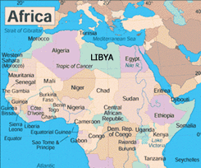
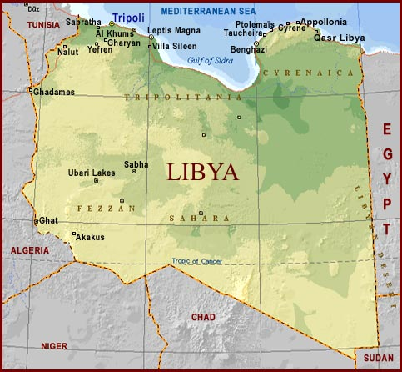

Paradisresor
”Grekernas och
romarnas Libyen”
19-26 mars 2007

Slide 2
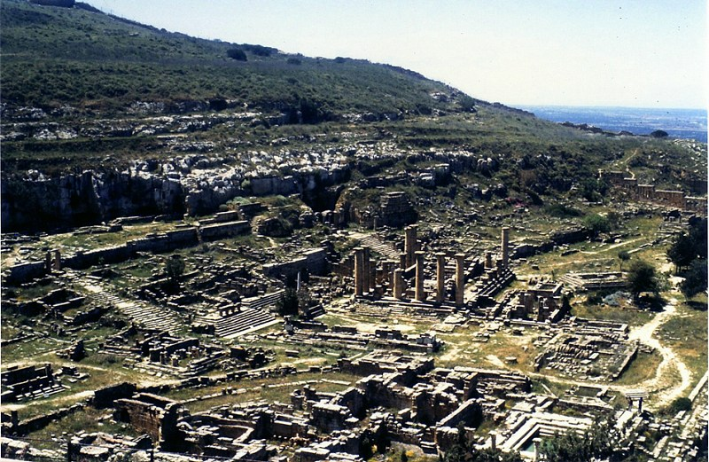
Sanctuary of Apollo, Cyrene

Slide 3
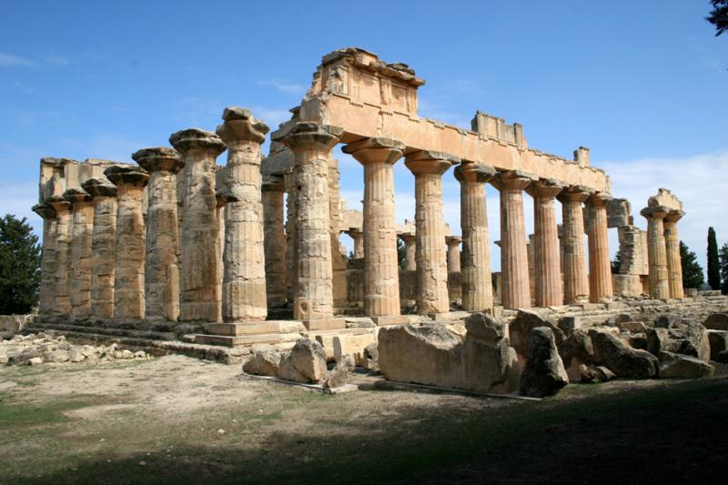
Temple of Zeus, Cyrene

Slide 4
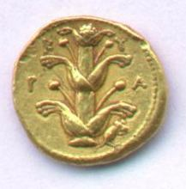
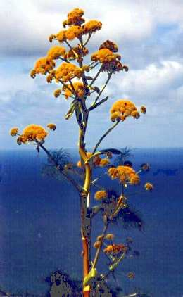
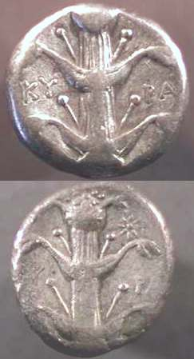
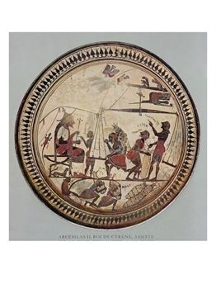
Silphium plant
on a coin from
Cyrenaica
Ferula communis
Giant fennel

Slide 5
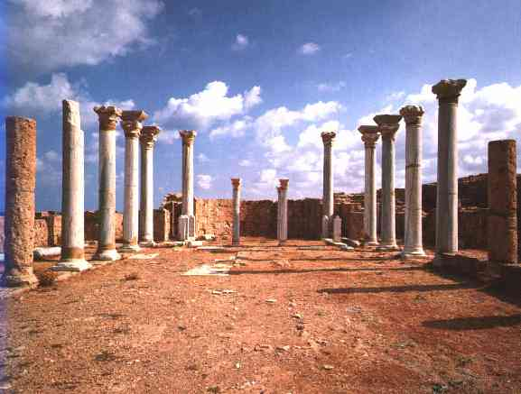
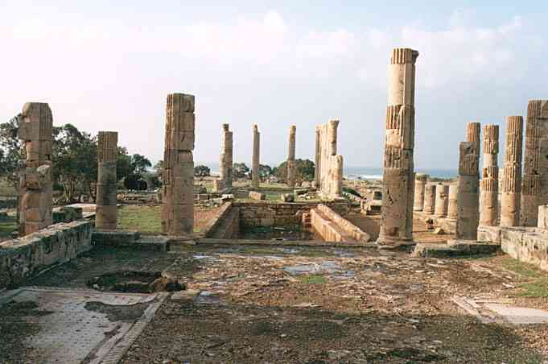
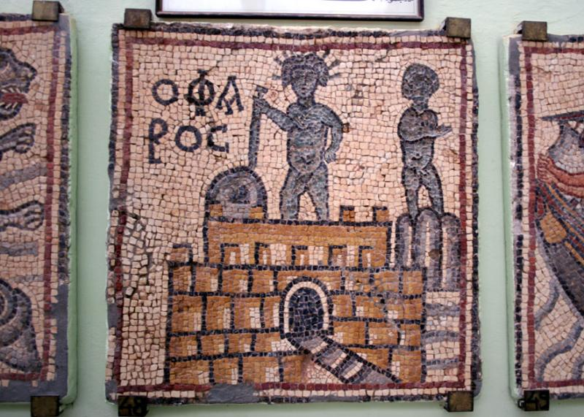
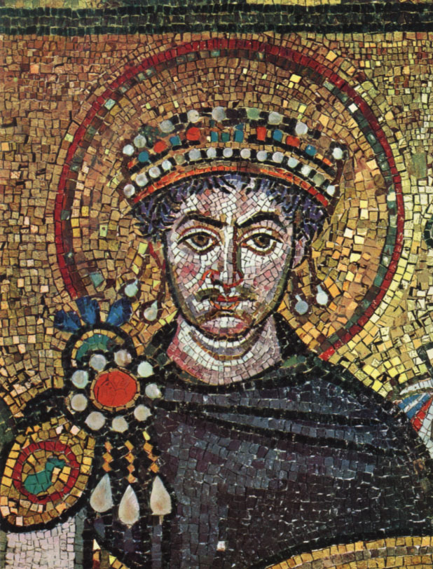
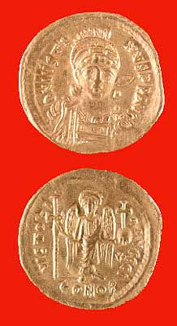
Central Basilica, Apollonia
The Coumned Palace, Ptolemais
Justinian I
Solidus
527 – 565 B.C.
Mosaic of the Pharos lighthouse from a Byzantine church in Qasr Libya

Slide 6
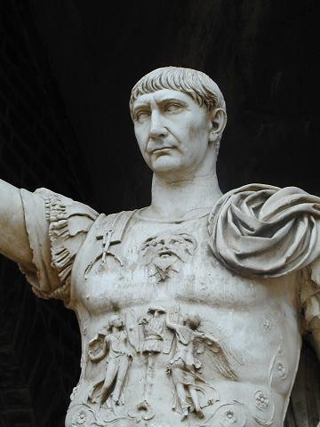
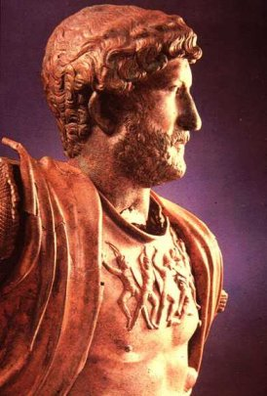
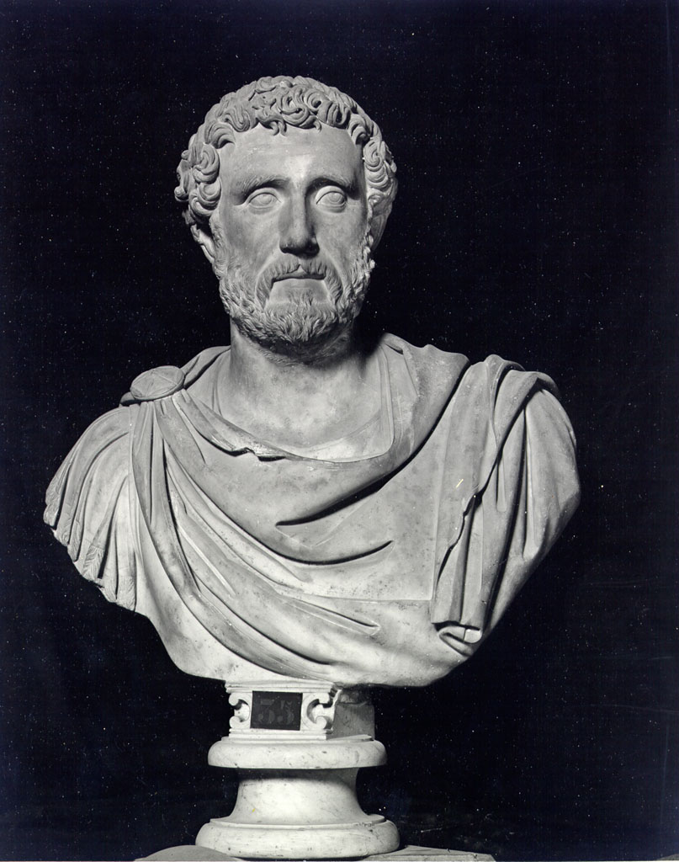
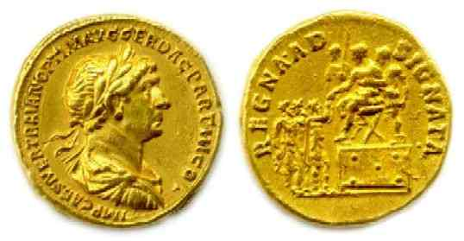
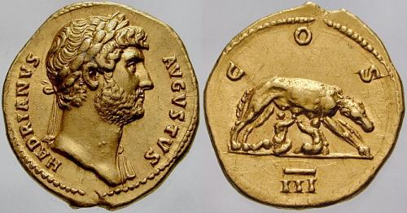
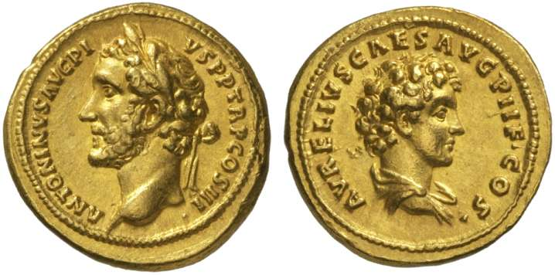
Trajan
A.D. 98 - 117
Hadrian
A.D. 117 - 138
Antoninus Pius
A.D. 138 - 161

Slide 7
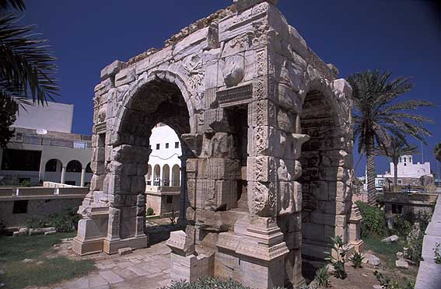
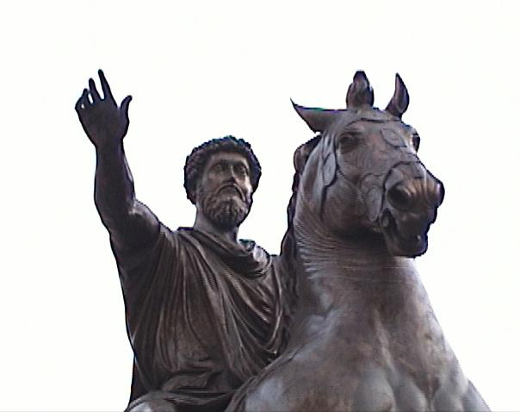
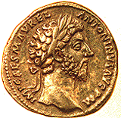
A.D. 161-180
Arch of Marcus Aurelius, Tripoli (Oea)

Slide 8
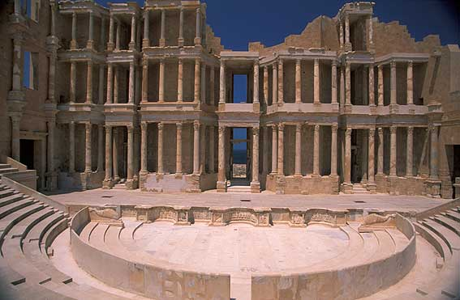
Theatre, Sabratha

Slide 9
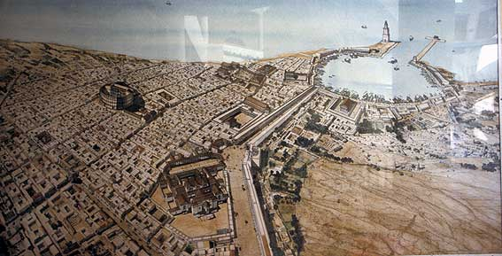
Severan Forum and Basilica
Theatre
Port
Hadrianic Baths
Arch of Septimius Severus
Leptis Magna

Slide 10
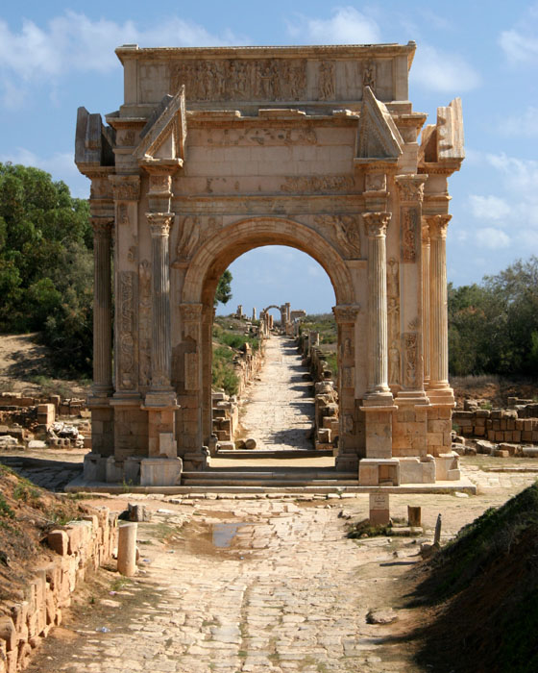
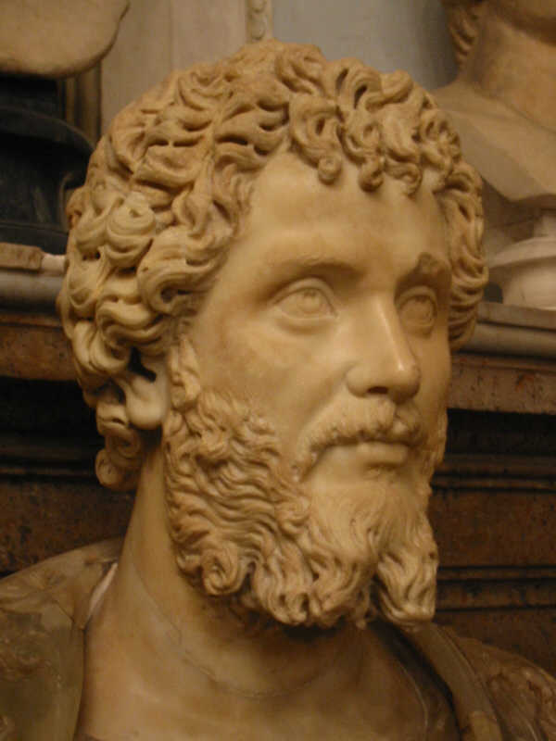
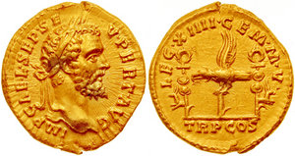
Septimius Severus
A.D. 193 - 211
Arch of Septimius Severus, Leptis Magna

Slide 11
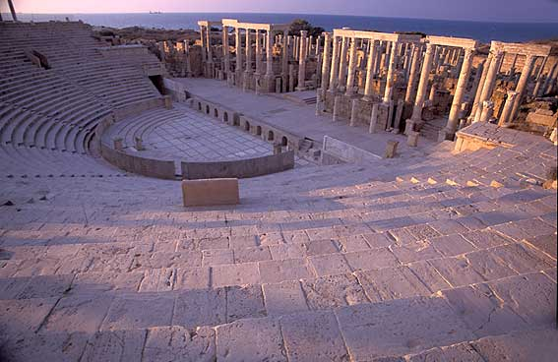
Theatre, Leptis Magna

Slide 12
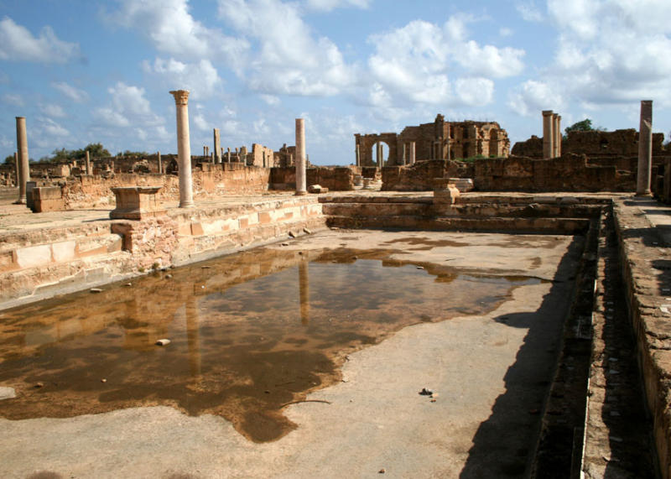
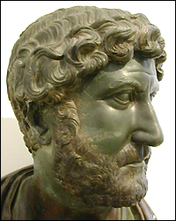
Hadrianic Baths, Leptis Magna
A.D. 117-138

