Slide 1
Fast new algorithms for computation of Higher
Order SVD (HOSVD): Randomized algorithms
May 2019
By
Salman Ahmadi-Asl

Slide 2
Outline
Randomized algorithms for low-rank matrix approximation.
Higher Order SVD (HOSVD) and related concepts.
Developing new fast algorithms for HOSVD.
Simulations.

Slide 3
Randomized Algorithms in numerical linear and multilinear algebra
Randomization is a framework for performing numerical linear and
multilinear algebra tasks more efficiently.

Slide 4
Randomized Algorithms low rank matrix and tensor decomposition
We focus on low-rank matrix-tensor approximation
Picture taken from:
https://arxiv.org/pdf/1608.02148.pdf
Krylov subspace algorithms: take advantage of structure of matrices and performing
matrix-vector efficiently but how about unstructured and dense data?
Also they need pass the data O(N) times!

Slide 5
Two categorizes for randomized low-rank approximations
Randomized Algorithms
Sketching-Sampling approach
Random projection

Slide 6
Randomized Algorithms for low rank matrix approximation
Picture taken from:
https://arxiv.org/pdf/1703.09074.pdf

Slide 7
Randomized Algorithms for low rank matrix approximation
Picture taken from:
https://arxiv.org/pdf/1608.02148.pdf

Slide 8
Randomized Algorithms for low-rank matrix approximation
Orthogonal projector onto the range space of matrix A

Slide 9
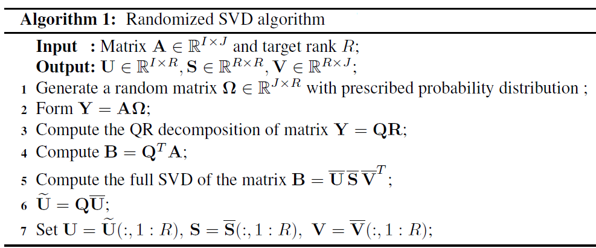
Randomized Algorithms for low rank matrix approximation
Multiple-pass algorithm
Single-pass algorithms
Randomized Algorithms
Multiple-pass algorithms
Fixed-Rank algorithms
Randomized Algorithms
Fixed-Precision algorithms

Slide 10
Single-pass algorithm
Solving well-conditioned
least-squares problem

Slide 11
Memory requirement for some data
Curse of
dimensionality
Data communication
Disk
Memory
! Constant passes over data !

Slide 12
Graphical representation of random projection algorithm
Picture taken from:
https://arxiv.org/pdf/1608.02148.pdf

Slide 13
Different types of random matrices can be utilized
Gaussian distribution with zero mean and variance 1
Uniform distribution over (0,1)
Preserving data non-negativity
Bernoulli distribution
Rademacher distribution
Improving storage and arithmetic costs.
Structured random matrices (sparse random matrices)
Preserving data sparsity and efficient matrix-matrix multiplications
In general, we have not seen any significant differences among different kinds of
distributions for our test and uses datasets.

Slide 14
Two tricks for improving the accuracy of randomized algorithms
Oversampling strategy: Here more columns are used in random projection step,
that is instead of R say R+P columns are used. For more accurate solution,
R+2k should be used.
Power iteration scheme: Here the original data matrix is replaced with a new one
with the same right and left singular vectors but faster decay rate of singular vectors.
The power iteration scheme is for those matrices whose singular values decay very
slowly.

Slide 15
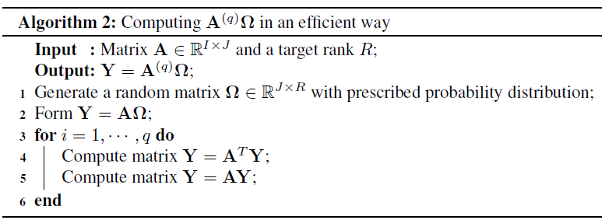
Randomized Algorithms for low rank matrix approximation
It is better to apply Randomized SVD on the following modified matrices
QR or LU decompositions for make the algorithm more robust against
round-off error

Slide 16
Impact of power iteration in accelerating the decay rate of singular values
Picture taken from:
https://arxiv.org/pdf/1608.02148.pdf
In practice P=5 and q=1,2,3 are enough for achieving a good accuracy.

Slide 17
Sampling techniques as a low rank approximation

Slide 18
Here different type of probability distributions can be utilized such as
uniform, length-squared sampling and also with replacement or not.
Additive error norm
Probability based on Leverage Score
Multiplicative error norm

Slide 20
Few practical comments concerning sampling strategy
For simplicity of theoretical derivation, selection with replacement is assumed
but our simulations show that this is less efficient than sampling without replacement.
More precisely, more columns are required to capture the range of a matrix if
sampling with replacement is utilized especially for wide and fat matrices.
Our simulation on low-rank Gaussian and uniform random data and also real data including
images and videos indicate the effectiveness of uniform sampling without replacement
though we are not the first one report this fact!
Williams, C. K. I., & Seeger, M. (2000). Using the Nystrom method to speed up kernel machines. NIPS (pp. 682–688).
de Silva, V., & Tenenbaum, J. (2003). Global versus local methods in nonlinear dimensionality reduction. NIPS (pp. 705–712).
Kumar, S., Mohri, M., & Talwalkar, A. (2009). Sampling techniques for the Nystrom method. AISTATS (pp. 304–311). Clearwater Beach, Florida:
JMLR: W&CP 5.

Slide 21
Few practical comments concerning sampling strategy
Although leverage score scheme provides multiplicative error but they are of less
Practical interest because of high computational cost of computing top singular vectors.
Here it is suggested to use an approximation of them instead of applying SVD which is
quite expensive.

Slide 22
Higher Order SVD (HOSVD)
Picture taken from:
A. Cichocki, R. Zdunek, A. H. Phan, S.-i. Amari, Nonnegative matrix
and tensor factorizations: applications to exploratory multi-way data
analysis and blind source separation, John Wiley & Sons, 2009.

Slide 23
L DE LATHAUWER - ‎2000- Cited by 3155
Why HOSVD????
LR Tucker - ‎1966 - ‎Cited by 2696
Orthogonality property makes much more easier developing algorithms for
Tensor decomposition.
Explicit error representation of approximation In terms of singular values of
unfolding matrices.
Pseudo-diagonal property of the core tensors. !Great Property!
Density in these directions are reduced.

Slide 24
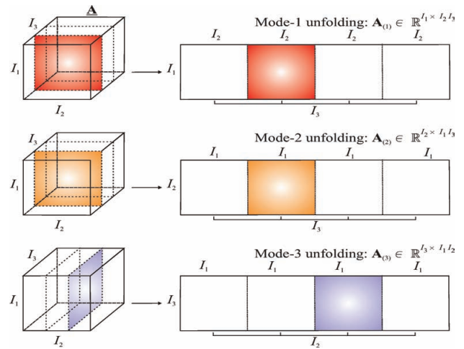
Unfolding matrices

Slide 25
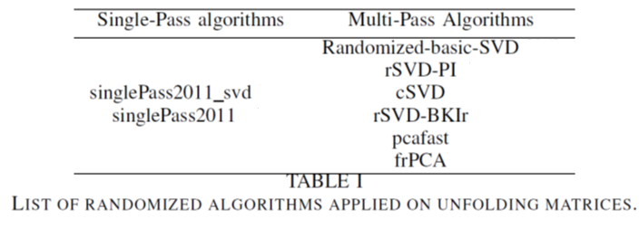
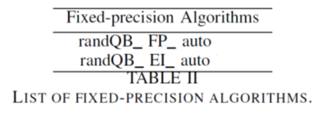
List of randomized algorithms applied on unfolding matrices

Slide 26
Simulations
Test 1: Synthetic Data:

Slide 31
Result for a fifth order tensor (40,40,40,40,40) of multilinear rank
(10,10,10,10,10)

Slide 34
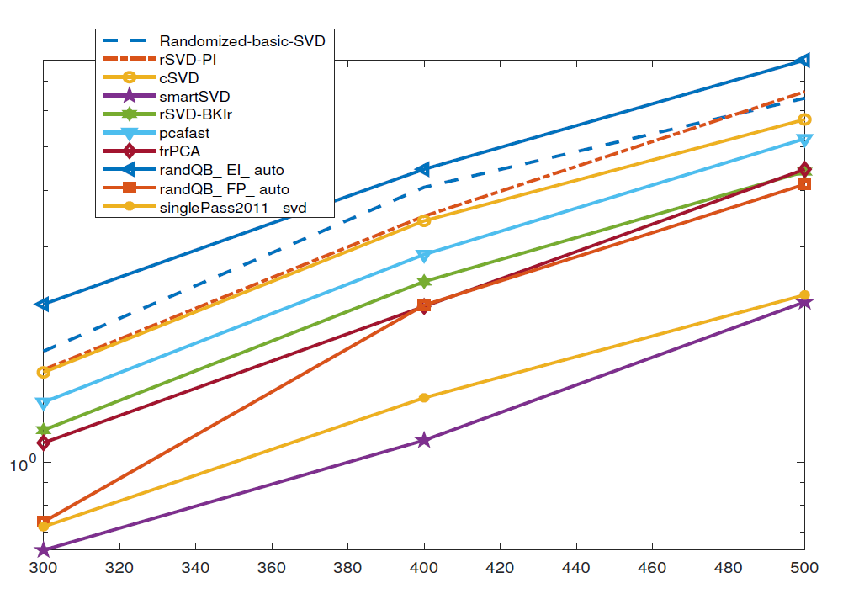
Result for a third order tensor (n,n,n) of multilinear rank
(70,70,70)

Slide 35
Test 1: Yale Face Database:
This data is a third order tensor of size 8736x 11 x 10 and has
multilinear rank (104,11,10)

Slide 38
Test 1: Video Data:
The documentary film is taken from https://www.youtube.com/watch?v=1qeWugmiGt4
The video duration is 89:93 and the FrameRate is 25 leading a 4th-order tensor of size 360 x 480 x 3 x 2248.
360 x 288000
480 x 216000
Video
Reshaping
360 x 480 x 200
200 x 518400
Film
51 x 155526
Voice
Reshaping
23 x 344862
3965913 x 2
153 x 51842

Slide 39
video
voice

Slide 46
Thanks for your attention!

