Slide 1
TRANS NUMERIQUES
NumPEx Sessions on the Computing Continuum
Co-animators: Gabriel Antoniu (Inria), François Bodin (Univ Rennes)

Slide 2
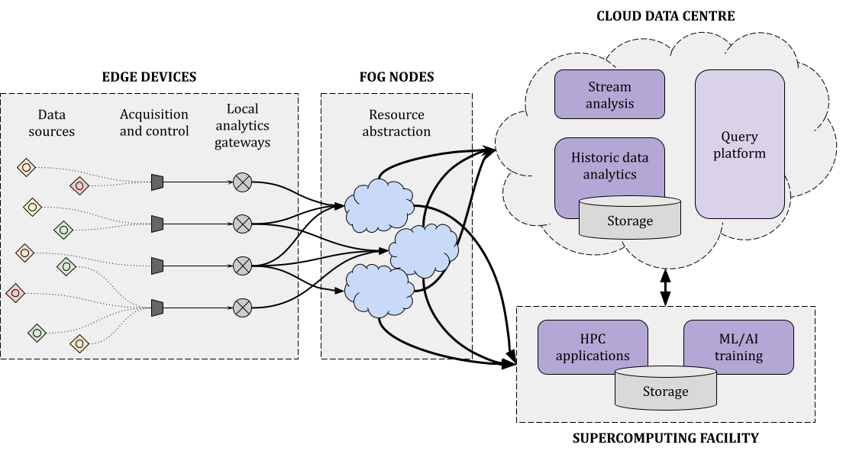
The Computing Continuum
Heterogeneous and geographically distributed
large-scale infrastructures

Slide 3
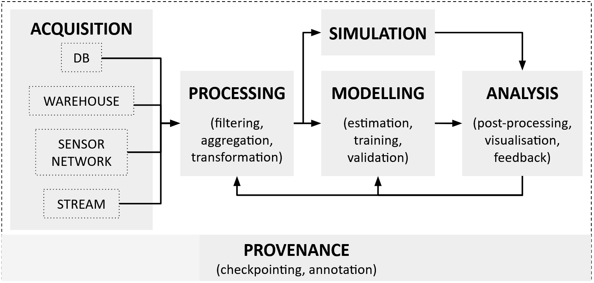
Application Workflows across the Continuum

Slide 4
Application Workflows across the Continuum
Mixed requirements: Big Data

Slide 5
Application Workflows across the Continuum
Mixed requirements: High-performance computing (HPC)

Slide 6
Application Workflows across the Continuum
Mixed requirements: AI/ML

Slide 7
A Post-Exascale Workflow: Square Kilometer Array Observatory
Mixed requirements: AI/ML

Slide 8
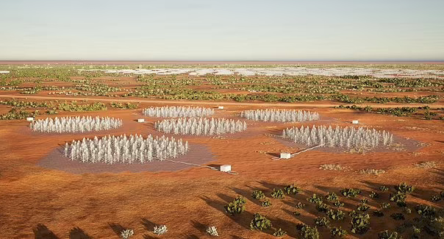
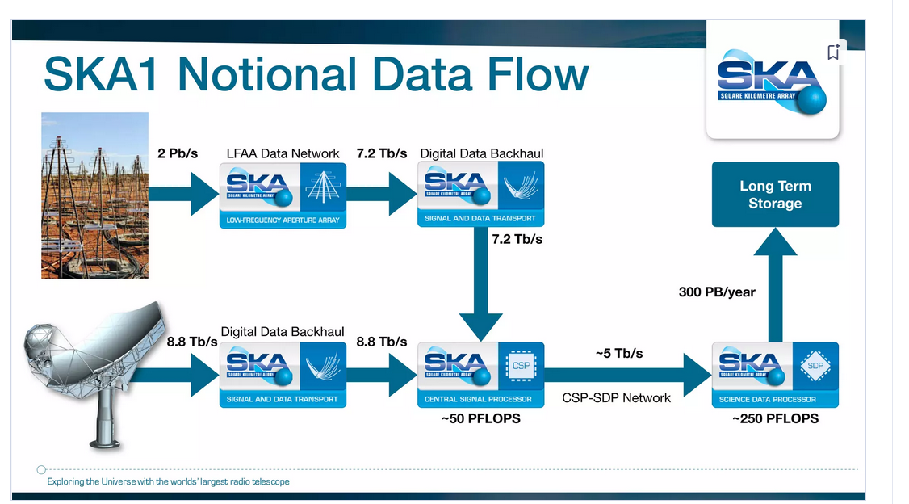
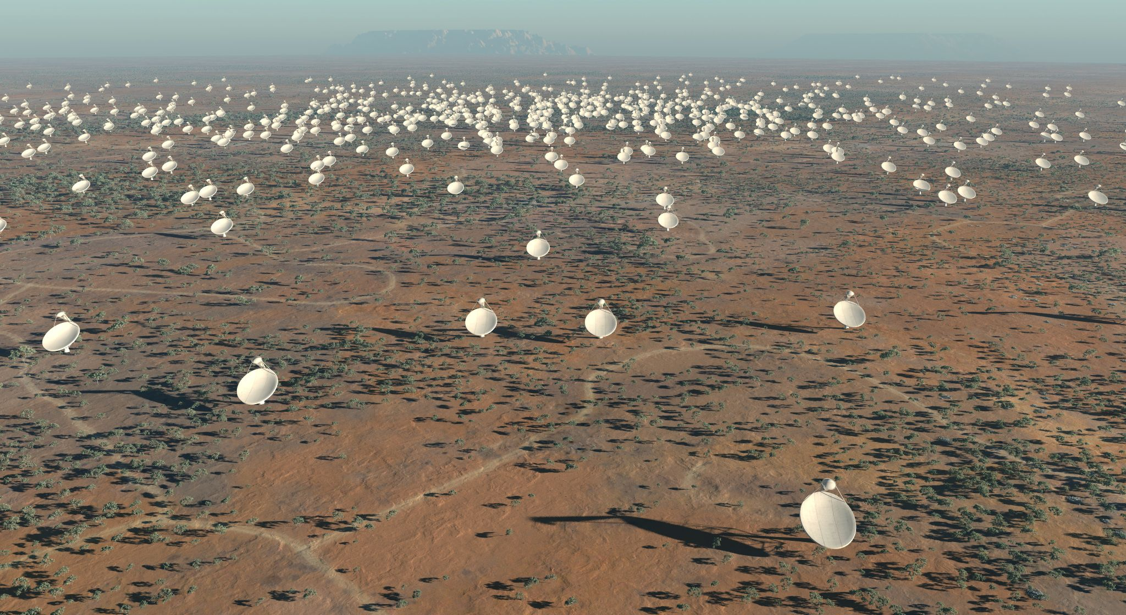

A Post-Exascale Workflow: Square Kilometer Array Observatory
Edge sensors create PB/s of data
Data acquisition
Credit: Square Kilometer Array Observatory (SKAO) / Damien Gratadour
Notes:
1Frontier - HPE Cray EX235a, AMD Optimized 3rd Generation EPYC 64C 2GHz, AMD Instinct MI250X, Slingshot-11, HPE
DOE/SC/Oak Ridge National Laboratory
United States
8,699,904 1,194.00 1,679.82 22,703
Cores Rmax (PFlop/s) Rpeak (PFlop/s) Power (kW)
2 Aurora - HPE Cray EX - Intel Exascale Compute Blade, Xeon CPU Max 9470 52C 2.4GHz, Intel Data Center GPU Max, Slingshot-11, Intel
DOE/SC/Argonne National Laboratory
United States
4,742,808 585.34 1,059.33 24,687
Cores Rmax (PFlop/s) Rpeak (PFlop/s) Power (kW)

Slide 9
A Post-Exascale Workflow: Square Kilometer Array Observatory
Edge Stream Processing
Data subsampling
Credit: Square Kilometer Array Observatory (SKAO) / Damien Gratadour
Notes:
1Frontier - HPE Cray EX235a, AMD Optimized 3rd Generation EPYC 64C 2GHz, AMD Instinct MI250X, Slingshot-11, HPE
DOE/SC/Oak Ridge National Laboratory
United States
8,699,904 1,194.00 1,679.82 22,703
Cores Rmax (PFlop/s) Rpeak (PFlop/s) Power (kW)
2 Aurora - HPE Cray EX - Intel Exascale Compute Blade, Xeon CPU Max 9470 52C 2.4GHz, Intel Data Center GPU Max, Slingshot-11, Intel
DOE/SC/Argonne National Laboratory
United States
4,742,808 585.34 1,059.33 24,687
Cores Rmax (PFlop/s) Rpeak (PFlop/s) Power (kW)

Slide 10
A Post-Exascale Workflow: Square Kilometer Array Observatory
HPC and Cloud Processing
Data correlation and reconstruction
Credit: Square Kilometer Array Observatory (SKAO) / Damien Gratadour
Notes:
1Frontier - HPE Cray EX235a, AMD Optimized 3rd Generation EPYC 64C 2GHz, AMD Instinct MI250X, Slingshot-11, HPE
DOE/SC/Oak Ridge National Laboratory
United States
8,699,904 1,194.00 1,679.82 22,703
Cores Rmax (PFlop/s) Rpeak (PFlop/s) Power (kW)
2 Aurora - HPE Cray EX - Intel Exascale Compute Blade, Xeon CPU Max 9470 52C 2.4GHz, Intel Data Center GPU Max, Slingshot-11, Intel
DOE/SC/Argonne National Laboratory
United States
4,742,808 585.34 1,059.33 24,687
Cores Rmax (PFlop/s) Rpeak (PFlop/s) Power (kW)

Slide 11
A Post-Exascale Workflow: Square Kilometer Array Observatory
Cloud Data Services for the Global Research Community
Data storage and analytics
Credit: Square Kilometer Array Observatory (SKAO) / Damien Gratadour
Notes:
Use this as link: Post-exascale uses cloud to Edge + HPC;;;

Slide 12
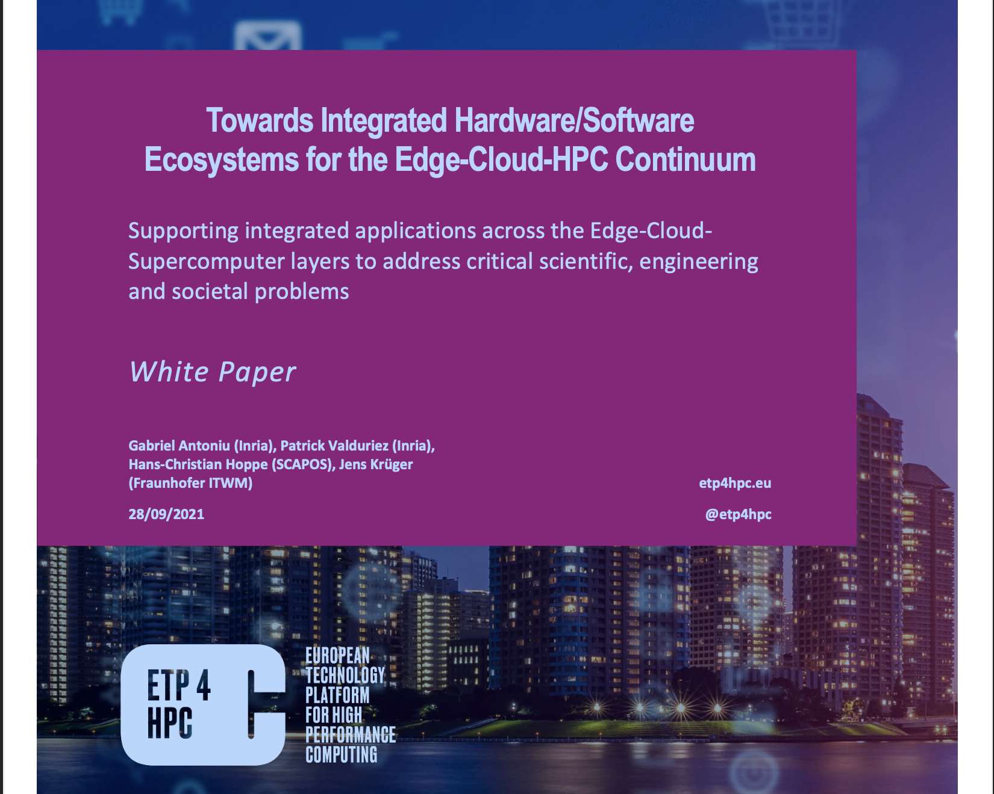


The Computing Continuum in European Strategic Documents: BDVA, ETP4HPC Strategic Agendas, TCI
16

Slide 13
Some Challenges
Application/workflow level
Programming models and API for worksflows across the continuum
HPC as a service
Portability of the benchmarks and codes
Middleware level
Deployment of the workflows and applications across the continuum
End-to-end workflow control and management
Transparent Edge-Cloud-HPC integration
Resource management
Interface to federation of resources (e.g. multiple EuroHPC centers)
Resources provisioning across the continuum
Data
Data logistics across the continuum
Data accessibility for the long term
Frugal storage solutions, e/g., computational storage
Semantics and quality of data
Security
Trust models, authentication
Enable confidential computing across the continuum
HPC cybersecurity operational constraints (e.g. ZRR)
Other
Application/software/hardware co-design for the post-exascale systems
Multi-tenancy
Notes:
middleware: ordo, interop, passage à l’échelle, tolérance aux fautes
Sécurité : surface d’attaque étendue;
en périférie : données mal protégées, authetification faible; approche zéro trust
dans le cloud :
Souveraineté numérique
conserver les données souveraines dans l’UE
conformité GDPR, Data Act (RGPD des données industrielles)
L’informatique confidentielle
calcul confidentiel dans le continuum
Besoin différents de perf et latence ->contraintes de placement et ordo
Hétérogénéité matérielle et logicielle ->complexité d’intégration, maintenance, enfermement propriétaire
Orchestration à grande échelle
Micro-services, virtualisation

Slide 14
Goal of the sessions and proposed organization
Days 1 and 2: Discussion of the challenges
Discuss initial challenges (list to be enriched)
Ongoing R&D efforts to address these challenges?
What important strategic actions do you see to address these challenges?
What are the technical milestones whose achievement would help to address these challenges?
What are the governance requirements?

Slide 15
Goal of the sessions and proposed organization
How to abstract the continuum?
AAI and other federation issue?
How to monitor the continuum?
How to implement data logistic?
How and where AI could/should help?
How to implement provenance at the continuum level?
Ontologies for the continuum?
Containers strategies/support continuum wide (e.g. cybersecurity issues)?
Day 3: synthesis and feedback to the plenary session

Slide 16
Thank you!

