Slide 1
Ecosystème logiciel: modèles de programmation et pile logicielle
H. Barucq, A. Buttari and R. Namyst

Slide 2
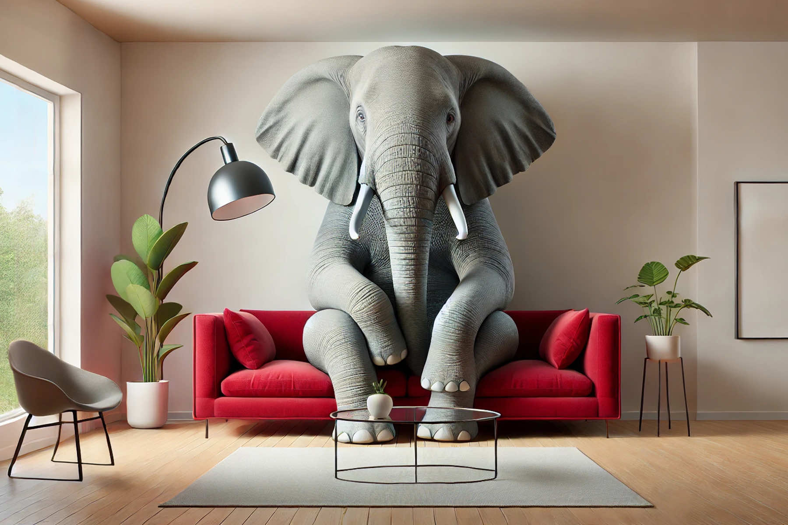
The elephant in the room

Slide 3
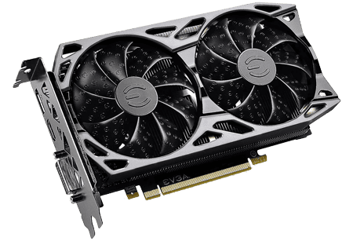
The elephant in the room: GPUs

Slide 4
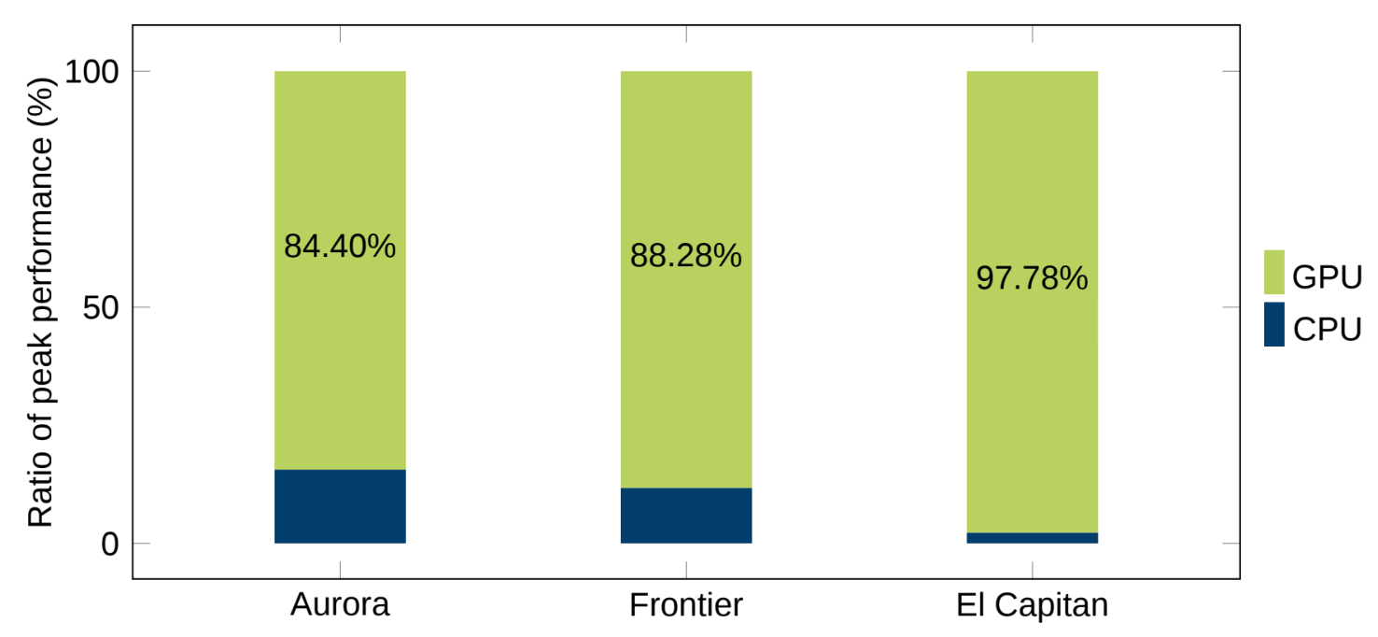
The elephant in the room: GPUs
courtesy of Ivo Kabadshow

Slide 5
Software
Software features that force us to rethink our algorithms and software
Issues
Heterogeneity
Scale
Variety
Objectives
Efficiency/scalability
Portability (functional and performance)
Maintenance and evolution

Slide 6
The situation
Different technologies address different needs:
Composability?
Portability?
Maintainability/durability?
Productivity?
Sovereignty?
Education?
Applications:
JAX, PyTorch, Julia
Algorithms, libraries:
MPI, PGAS, task-based…
Kernels: Kokkos, OpenMP,...

Slide 7
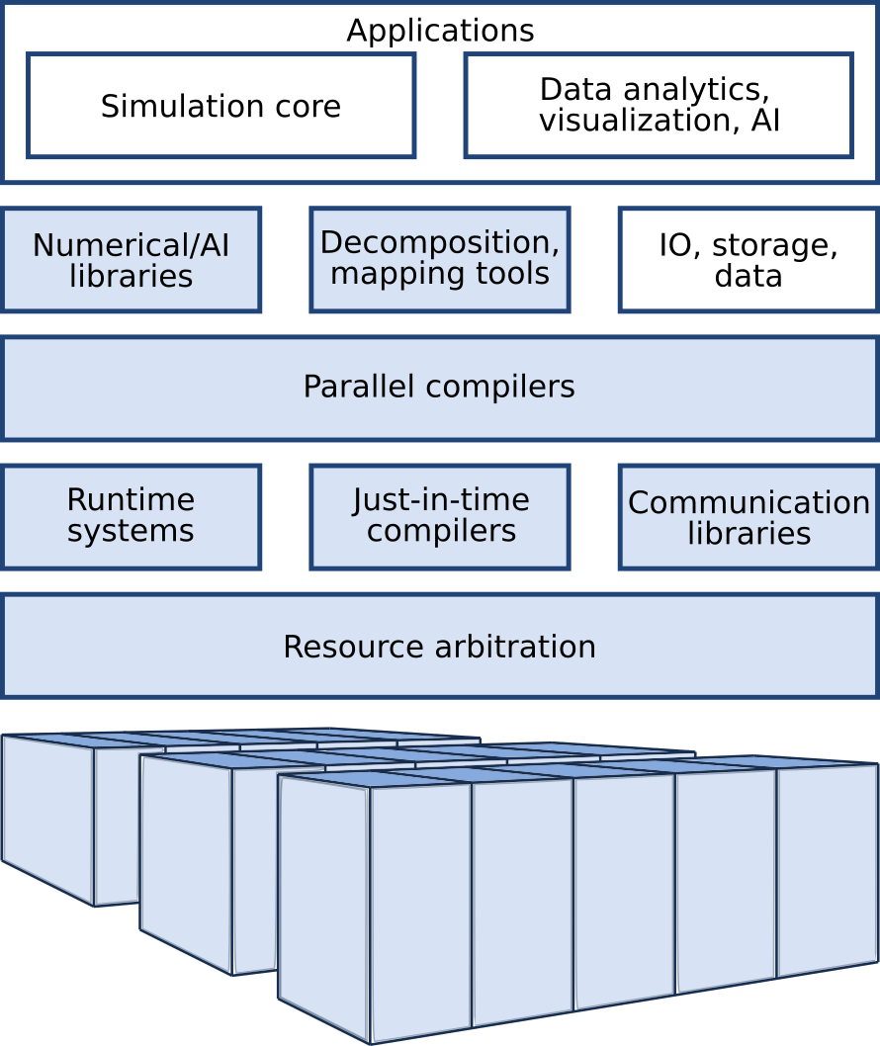
Software sovereignty
What software?
Which external software components do we critically depend on?
SWOT of the UE software stack
GPU software ecosystem?
Low level communication libraries?
How do we really setup a codesign approach with industry?
EVIDEN
SiPearl
Etc.

Slide 8
Directions in Software
What will the post-exascale software stack look like?
If machines are going “GPU-Only”
What software is still relevant?
US GPU companies are developing complete GPU software stacks
How do we decrease our dependency on these providers?
Will light come from hardware diversity and software composabilty?
Seems a sound approach for HPC/IA/Quantum hybridation
Disagregated architectures

Slide 9
Toward a unique (and boring) ecosystem?
The battle for the best programming model/language is over
Generative Ais will soon be able to translate Fortran to C++
Or better, Fortran to Kokkos!
Wait, why focusing on HPC-friendly languages?
GenAi can translate Fortran to Python (or JAX)
So maybe we should prepare for the big jump to world.py
Are we gonna throw all our HPC expertise to trash?
Or shall all expertise be integrated into Python libraries?

Slide 10

Software
How to write efficient and portable code: directive-based approaches
Advantages
(supposedly) wide support: OpenMP, OpenACC
Relatively easy and not very intrusive
Disadvantages
lack of flexibility, features and abstraction
shaky compilers support
Ongoing work ???

Slide 11
Software
How to write efficient and portable code: runtime-based approaches
Advantages
Architecture and data-agnostic expression of algorithms
Consistent handling of CPU, GPU and multinode parallelism
Disadvantages
Intrusive
Programming interfaces (e.g., STF, PTG) still lacking some features
Ongoing work: ANR SOLHARIS, Exa-SofT

Slide 12
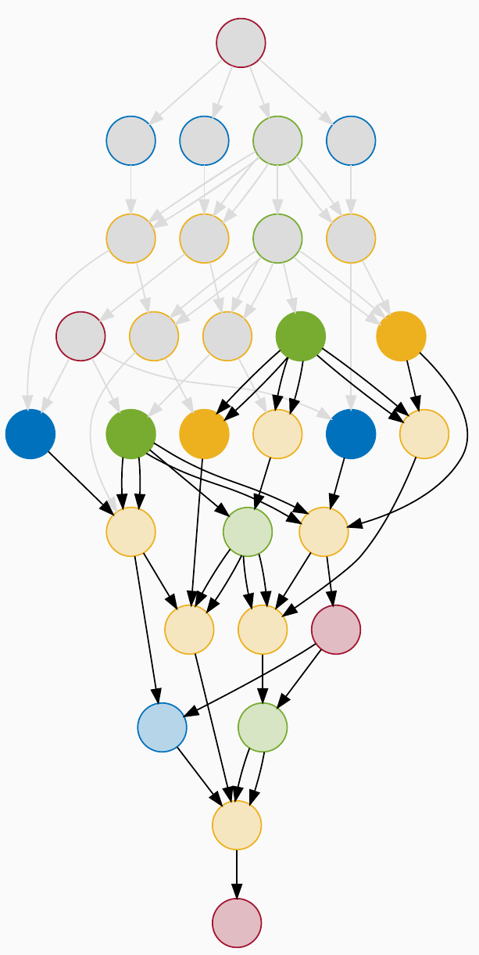
Software
Software features that force us to rethink our algorithms and software
How to write efficient and portable code: runtime-based approaches
Task-based parallelism and runtimes within SOLHARIS and Exa-SofT:
Split the work into tasks that are delegated to a runtime
Automatic detection of dependencies
Automatic handling of data transfers between units and nodes
work in progress:
improve programming interface
reduce overhead and improve scalability
investigate use of complex algorithms at large scale

Slide 13
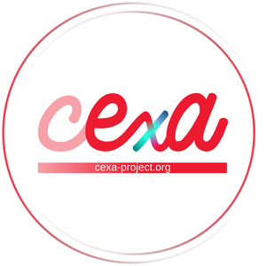

Software
How to write efficient and portable code: portability layer
Advantages
Easy to use
Performance portability
large community
Disadvantages
Performance limitation
Mostly loop parallelism
Limited precision support
Ongoing work: CExA Project, Exa-SofT, Exa-MA

Slide 14
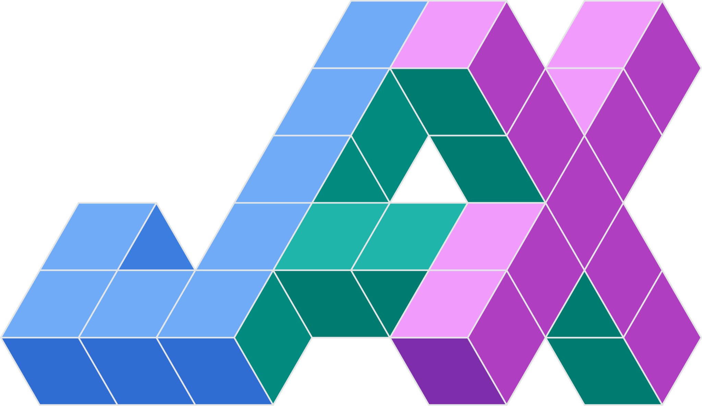

Software
Software features that force us to rethink our algorithms and software
How to write efficient and portable code: high productivity approaches
Advantages
Connected to user-friendly languages such as Python or Julia
Compilation techniques to maximize performance transparently
Precision optimization
Disadvantages
Profiling limitations
Based on JIT: pure functions requirement
Compilation overhead

