Slide 1
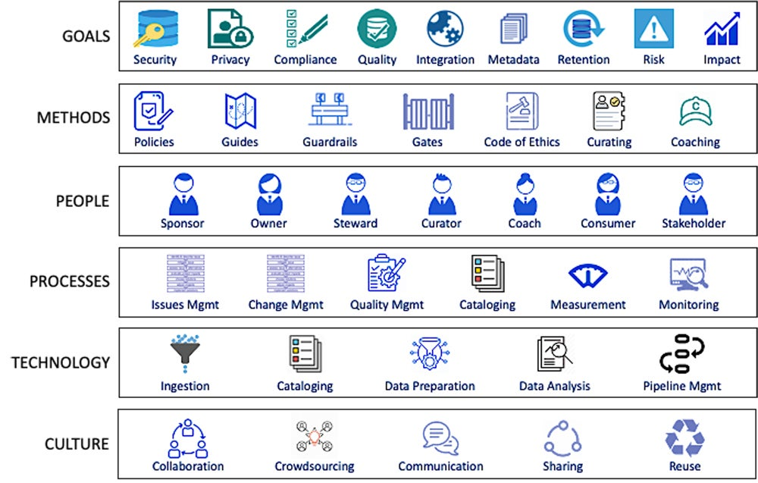

Slide 2
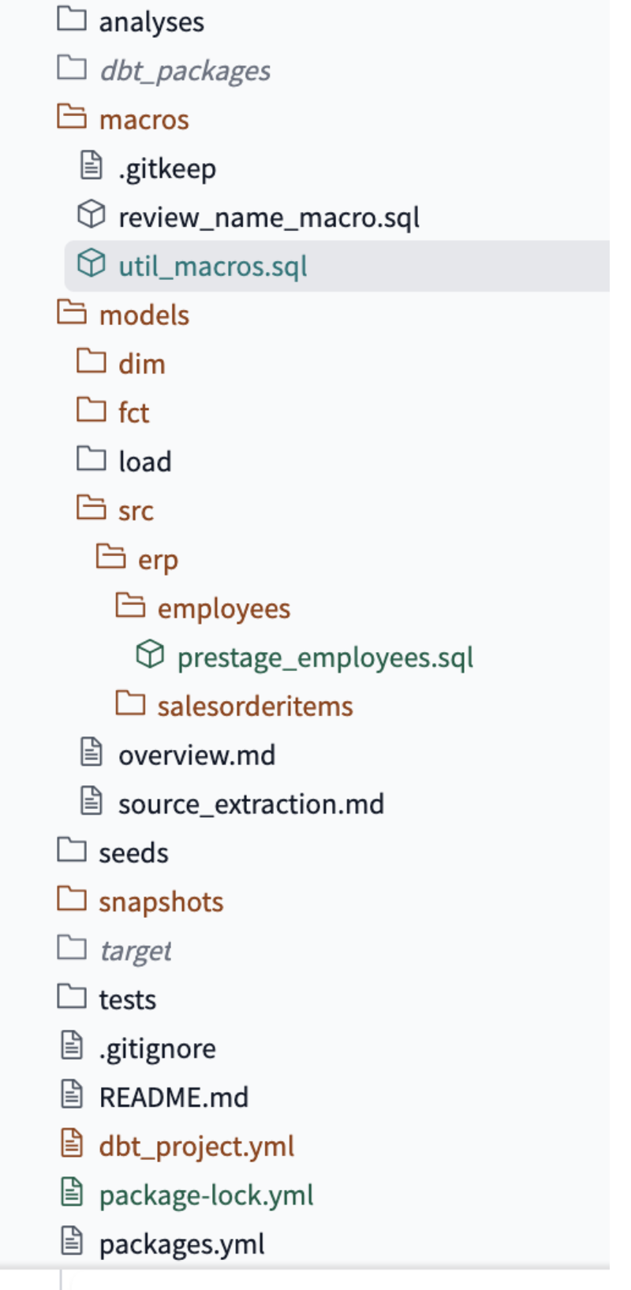
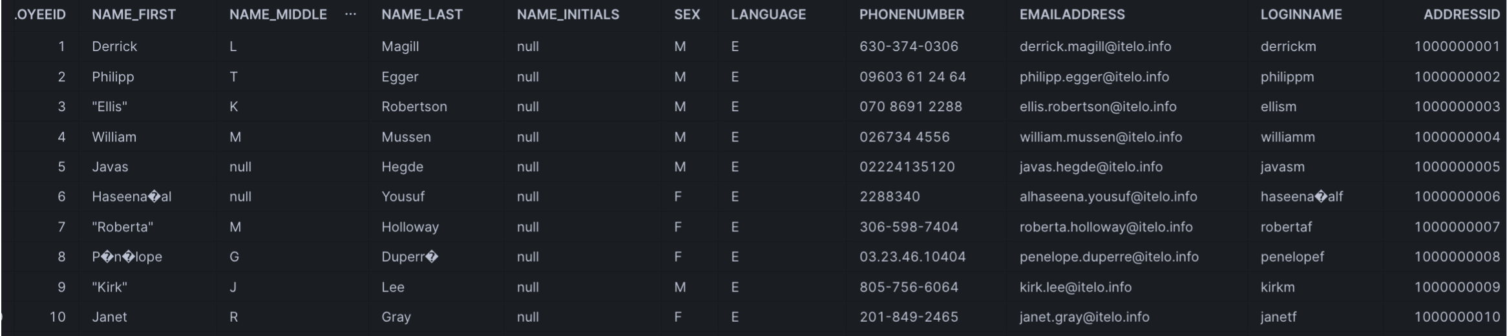
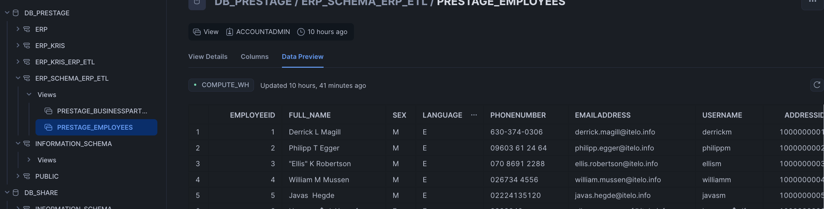

Slide 3
Sales System
* Customer ID: C123
* Product ID: P456
* Sale Date: 2024-07-22
Inventory System
* Product ID: P456
* Stock Level: 100
* Location: Warehouse A
CRM System
* Customer ID: C123
* Name: John Doe
* Email: john.doe@example.com
Finance System
* Transaction ID: T789
* Customer ID: C123
* Amount: $100

Slide 4
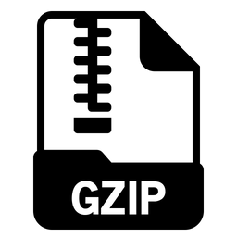






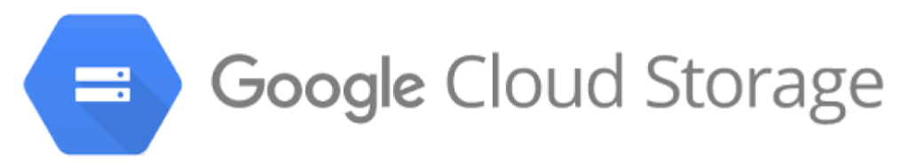
On-prem
Cloud
Google Cloud SDK
Python

Slide 5

EMR Serverless

Slide 6


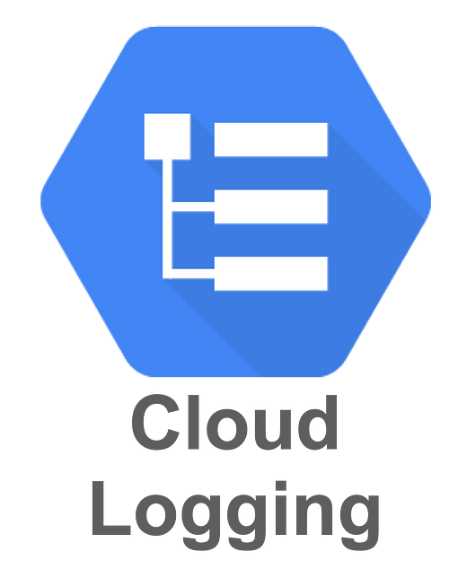
Cloud Monitoring
Triggers
Job Status Notification
Logs Job Status Notification
Extraction Query
Efficient Data Transfer
Security
Reliability and Monitoring
Automation and Scheduling

Slide 7



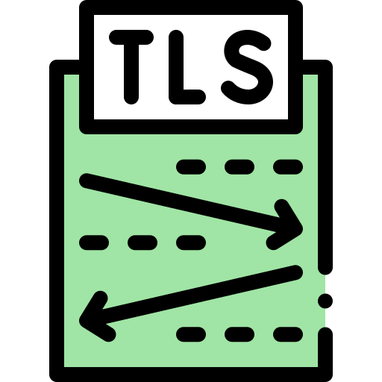





On-prem
Cloud
CRON
Google Cloud SDK
Python
Service Account
Security Key
Operational Excellence
Security & Privacy
Reliability
Cost Optimization
Performance Optimization
Scheduled: Job –Cron
Logging: Python Logging
Monitoring: GCP
Alerting: Pub/Sub Notification
Data in Transit: TLS (gcloud util
Identity: IAM , Service Account
Encrypt data at rest: Cloud Storage
Do not have any data around: Purge local after transfer
Retry: Python tenacity
Alerting: Pub/Sub Notification - EMail
Cron – Free
GCP SDK - Free
Compress - Parquet

Slide 9
Reliability
Security & Privacy
Cost Optimization
Performance Optimization
Operational Excellence

Slide 10



On-Prem
Cloud
Primary Key
Cursor (CHANGEAT)
EXTRACT
Full Load
Insert New Records
Update Change Records
Update With Delete Change
Increment
Append→ New
Deduplicate → Existing
Source Table
Full Dataset
Primary Key
No Duplicates
Cursor
Target Table
Full Dataset
Primary Key
No Duplicates
Cursor

Slide 11
On-Prem
Cloud
Primary Key
Cursor (CHANGEAT)
EXTRACT
Full Load
Insert New Records
Update Change Records
Update With Delete Change
Source Table
Full Dataset
Primary Key
No Duplicates
Cursor
Increment
Append→ New and Existing
Target Table
Full Dataset
Duplicate as separate columns
Primary Key
Cursor

Slide 12



Source
DB
Target
DB
EXTRACT
LOAD
Schema
Schema
FULL LOAD
Landing
DB
Initial Data Load & Data Reconciliation
Source
DB
Entire Dataset Extract
Entire Dataset Load
Operational Reporting
Downstream Delta Processing
Schema
Every time the process runs, the entire data set is collected
Schema
Backup, Recovery, Compliance & Audit
Source
DB
APPEND
Landing
DB
Immutable Target Database
Only Changes Extract
Append Changes Load
Log File Processing
Raw Layer
Schema
New records are added to the target without impacting existing
Schema
Limited Load Processing Capabilities

Slide 13


Source
DB
DELTA
Landing
DB
Daily Reporting
Only Changes Extract
Changes Loaded
Partitioned Load
Landing Zone
Schema
Changes are moved to a new Target with new records
Schema
Source
DB
UPSERT
Landing
DB
Only Changes Extract
Changes
Upserted
Schema
Changes are moved to the target to update existing or insert new
Schema
Source
DB
SCD2
Landing
DB
Only Changes Extract
Changes
tracked
Schema
Changes are moved to the target and changes are tracked
Schema

Slide 14
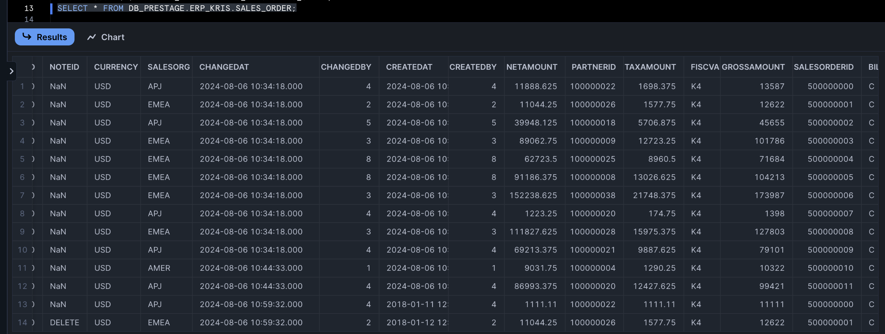
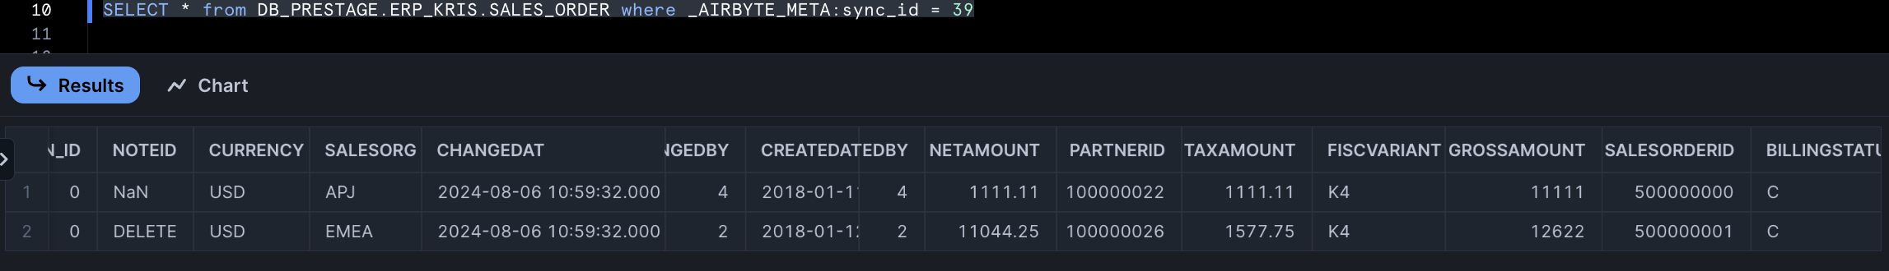

Slide 15
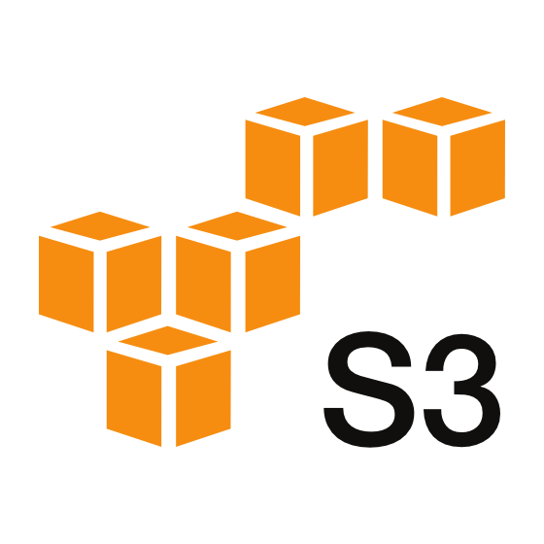

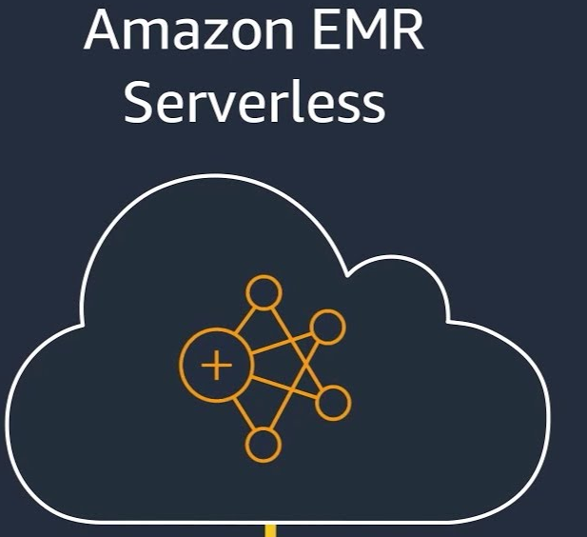
On-Prem
Cloud
LOAD
EXTRACT
LOAD
SQL
DataLake

Slide 16
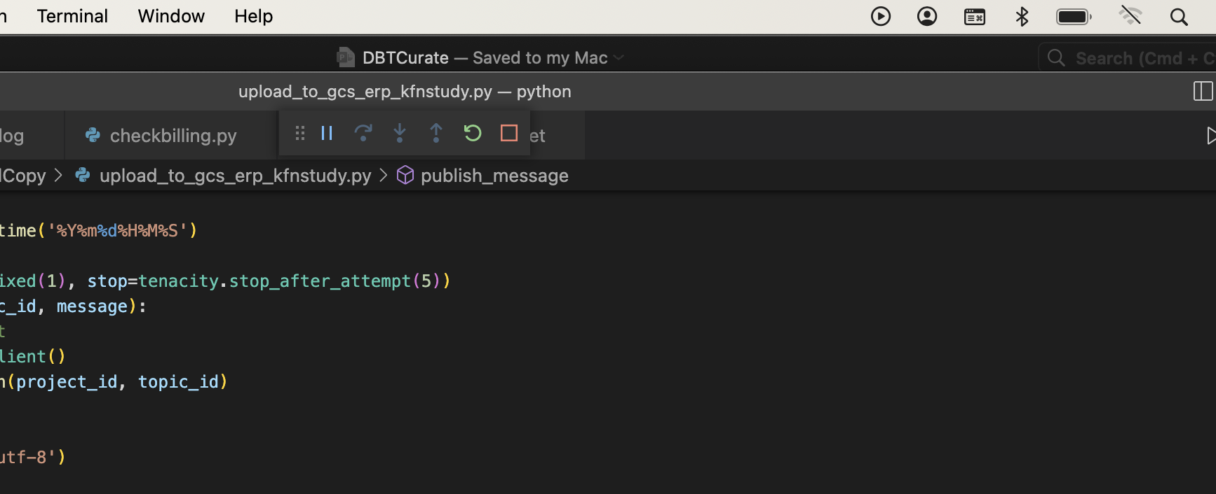

Slide 17


Single place
Self Service
Unified data
/Material /Customer /Supplier /Shop Order /Product
Curated (gold) data delivered seamlessly

Slide 18
Design Pattern 1: Unified Data Source

Slide 19

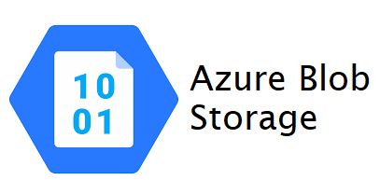



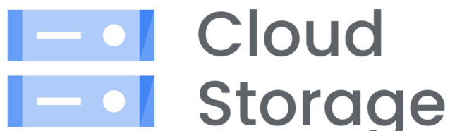

Storage Layer
Cloud Storage
How do we organize the data in Cloud Storages for data analytics
File Format
How do we store the data in distributed storages
Table Format
How do we interact with the stored data stored in Files
Data Domains
Separate processing concerns
Access Management
Encryption
Archival
Cost
Splitable across distributed storage
Encoding and compression
Columnar to support analytics
Embedded Schema
ACID (Update/Delete)
Schema Evolution
Read data from files efficiently
Manage indexes, partitions etc.
Query performance
Scale
Cost
Partition
Columnar
Encoding
ACID
Query Performance
Schema Evolution
Update / Delete

Slide 21
Curated Data
Security
Lineage
Ownership
Contract
Governance
Metadata
Interface
Monitoring
Data as a Product
Privacy
Data Domains
delivers
Processes
Product management
Production
Supply chain
Procurement
Finance & Control
Sales & Marketing
Customer Relationship
Product Service
Enterprise Support
Product Development
Delivery Model
implements
Data Management
Data Processing
Describe
Organize
Implement
Collect
Store
Curate
Integrate
Share
Data Platforms

Slide 22





Profile
Capture
Extract
Load
Collect

Slide 24
In the context of Gartner's data management capabilities, organizing data refers to the processes and practices that ensure data is structured, maintained, and managed in a way that makes it accessible, usable, and reliable. Organizing data involves several key activities:
Key Activities in Organizing Data
Data Structuring:
Definition: Defining how data is stored and arranged, typically through the use of schemas, tables, and relationships in databases.
Purpose: To ensure data is stored in a logical and coherent manner that supports efficient access and analysis.
Example: Designing a relational database schema that organizes customer data into tables such as customers, orders, and products with defined relationships.
Data Cataloging:
Definition: Creating and maintaining a catalog that lists all data assets, including metadata about each asset.
Purpose: To provide an inventory of available data, making it easier for users to find and understand the data.
Example: Using a data catalog tool to document datasets, their locations, descriptions, and usage guidelines.
Data Classification:
Definition: Categorizing data based on its characteristics and business value.
Purpose: To facilitate data management processes such as security, compliance, and lifecycle management.
Example: Classifying data into categories such as sensitive, confidential, and public to apply appropriate security measures.
Data Indexing:
Definition: Creating indexes on data to speed up retrieval and query performance.
Purpose: To improve the efficiency of data access and querying.
Example: Adding indexes to frequently queried columns in a database to enhance search performance.
Data Storage Management:
Definition: Managing the physical storage of data, including databases, data lakes, and cloud storage solutions.
Purpose: To ensure data is stored in a cost-effective, scalable, and reliable manner.
Example: Implementing tiered storage strategies where frequently accessed data is stored on faster, more expensive storage, and less frequently accessed data is stored on slower, cheaper storage.
Data Maintenance:
Definition: Regularly updating, cleaning, and optimizing data to ensure its accuracy, consistency, and relevance.
Purpose: To maintain the quality and integrity of data over time.
Example: Running data cleansing routines to remove duplicates, correct errors, and update outdated information.
Importance in Data Management
Organizing data is a critical capability in data management because it directly impacts the usability and reliability of data. Properly organized data ensures that:
Data Accessibility: Users can quickly and easily find the data they need.
Data Quality: Data remains accurate, consistent, and up-to-date.
Operational Efficiency: Data processes and workflows are streamlined, reducing redundancy and improving performance.
Compliance and Security: Data is managed in accordance with regulatory requirements and security policies.
By focusing on organizing data, organizations can enhance their ability to leverage data for strategic decision-making, operational efficiency, and competitive advantage.

Slide 25
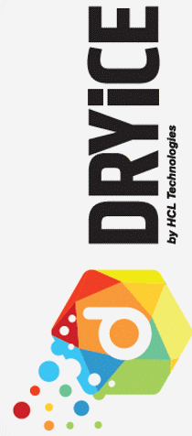

Business Groups
ASG
MPG
ITG
CSG
Service Management – Establish Common Tools, Processes, Policies and Procedures, Change Management
Enterprise Architecture, Project Portfolio Management, Demand Management,
Heico Help Desk
One ITSM Tool (Recommended)
Incidents
Service Requests
Enhancements
Analytics and Reporting
L1.5
Shift Left/SOPs
Onsite First Response Team
Team Design
Strategic Planning
Automated Monitoring/ Tools / Runbook Automation
Early preliminary analysis
Track Leads
HCL CoEs
L2 & L3
Governance
Skills Aligned based on Value Streams
Team Design
Engineering
Procure to pay
Order to Cash
Manufacturing
Finance
Process Champions
Innovation and Transformation Board
Core
Service Automation Platform - DRYiCE
Warehouse
Product
Production
CE
Inventory
Operations Management
Cross skill
Other skills
Flex
Near Site
SET Team
Reporting
EDI
Release
Code Change
Batch Jobs
Swift Generalist Development
Value Management
ISV and Other Apps Support
SDM
Problem management/ Ticket Analytics & Insights
HCL Managed
Heico Managed

Slide 26
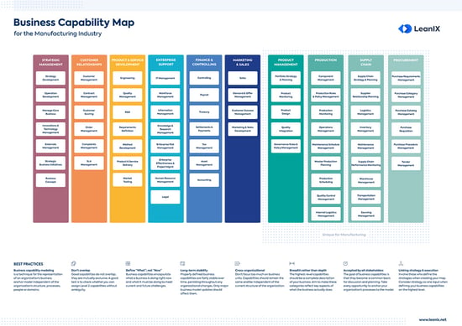

Slide 27
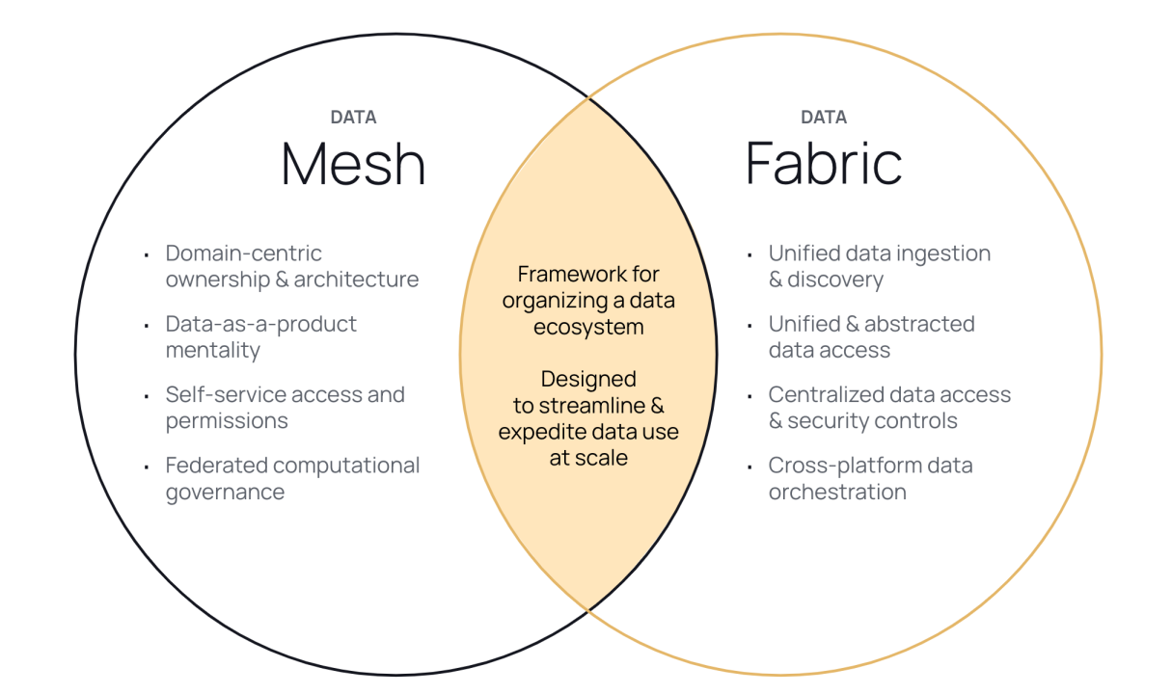

Slide 28
Decentralize
Bucket Management
Data Volume and Cost
Raw Layer
Security and Access
Decentralize
Schema Evolution
ACID Transactions
Performance and Scalability
Efficient Upserts and Deletes
Data Versioning and Time Travel
Partition Evolution
Data Compaction and Optimization

Slide 29
X
Centralized Collection Of Data And Deliver Services
Federated Delivery Of Data And Connected Services

Slide 30
Lake-houses and Decentralization
Mainframes
Big Data & Lakes
1980s-1990s
2010s
1960s-1970s
2000s
2020s
Data Warehousing
Real-Time Analytics and Cloud Computing

Slide 31
BI / Analytics
Data Lakehouse
Data Warehouse
Share
| Transformation Simplicity
Load
| ACID Transaction
| Schema Evolution
| Schema Enforcement
Metadata Management
Big Data Analytics
| Query performance
| Schema On-write
Integrate
Data Science
Transform
Structured Data
Machine Learning
Curate
Data Lake
Transform
Inexpensive Processing
| Diverse Datatypes
| Schema on Read
| Diverse Use cases
Scalable workloads
| Open Storage
| Decoupled Compute/Storage
Collect
Extract
Unstructured Structured Data
Collect
Curate
Integrate
Share
Ingest
Distillation
Processing
Load

Slide 32

Design Pattern: Integrated Data
Customer
Data is stored and managed in desperate data stores and are not automatically integrated together.
Integrated data refers to the process of combining data from different sources and providing a unified view. This process is crucial for organizations that need to analyze data from multiple systems or departments to make informed decisions. Integrated data ensures consistency, accuracy, and completeness by merging data into a cohesive dataset. Here are some key aspects of integrated data
Inventory
Material
Employee
Product
Shop Order
Sales Order
Purchase Order
Supplier
Sales Order
Customer
Supplier
Employee
Sales Order
Product
Purchase Order
Inventory
Material

Slide 33


IT Application Marketing
IT Application Sales
CountryCode
PersonCountryStatus
Unified representation of data
The various implementation refer to the same abstract representation
/Customer/legalcountry
ShippingCountry
Citizenship
IT Application Legal
IT Application Logistics

Slide 34


Source Data
Data Warehouse

Slide 35

Cleanse
Source Data
Data Warehouse

Slide 36
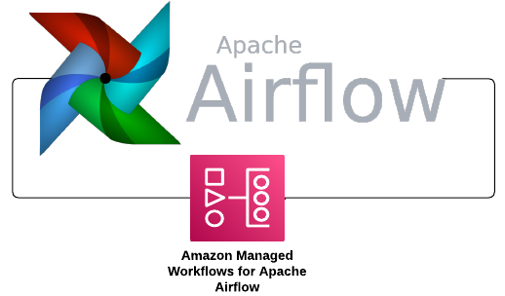

Create Connection
Bulk Load
Move to Archive

Slide 37
Information Integration
Master Data Management
Architecture
Data Staging
Meta Data
Authoring
Principles
Schema Definition
Data Configuration Management
Hierarchy Linking
Relationship CRUD
Attribute CRUD
Requirements
Information Integrity
Patterns
Profiling & Analysis
Data Event
Relationships
Lifecycle Management
Interface
Solution
Event Handling
Hierarchies
Views
CRUD
Use
Batch
Integration
Detection
Notification
Cross domain
Roll-up
Delta
Data Sources
Domains
Steward
Cleanse & Standardize
Deployment
Data Quality
Directory
API
Matching
Validation & Cleansing
Reconcile
Master Data
Model Data
Fine
Grained
Rule Specification
Rule Enforcement
Standardization
Deterministic Matching
Probabilistic Matching
Collapse & split
Network
History Data
Reference Data
Corse
Grained
ETL
Implementation
Foundation
Registry
Virtualize
Coexistence
Search
Workflow
Security
Log
Versioning
DR/HA
Federate
Consolidation
Transaction Hub

Slide 38
Patterns
Product
Engineering
Implementation
Consolidation
Registry
Addressable
Meta Data
Collect
Integrate
Audit Trails
Coexistence
Transaction Hub
Access
Reference Data
Change Data
Share
Incident Mgmt
Security
Compliance
Curate
Source Remediation
Audit Trails
Governance
Catalog
Quality
Source Remediation
Storage
Entity Resolution & Survivorship
Domain
Consumers
Projects
Standardization
Interoperable
Data Contract
Data Model
Lifecycle

Slide 39
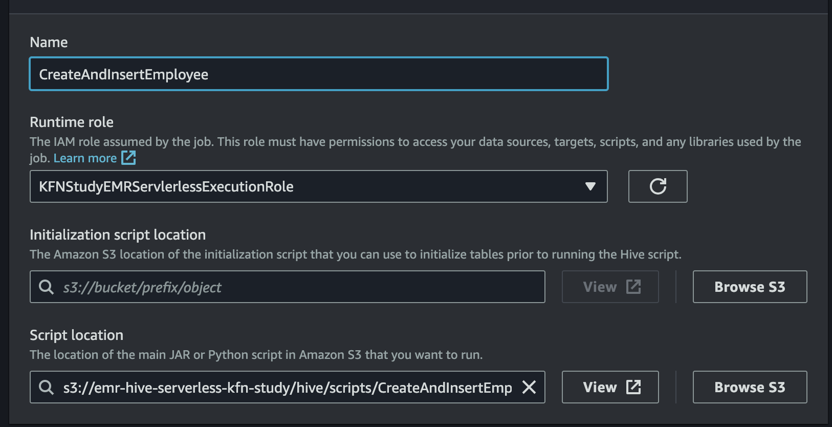
N
K

Slide 40





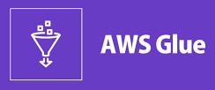

Cloud Storage
Lakehouse
Create
Query

Slide 41
SCD2

Slide 42
MDM Implementation patterns
Consolidation Pattern
Coexistence Pattern
Source System 1
Source System 1
Collect Data
MDM Consolidation
Integrate & Cleanse
Target systems
Collect Data
MDM Coexistence
Integrate & Cleanse
Publish Data
Target systems
Publish
Target systems
Target systems
Source System 2
Source System 2
Target System 1
Transactional Hub Pattern
MDM System 1
Registry Pattern
Collect Data
MDM Transaction Hub
Capture
Connect Identifiers
MDM Registry
Match
Publish Links
Target systems
Data entry
Target systems
Target System 2
MDM System 2

Slide 43




Central Registry Database
Data Mapping and Linking
Data Matching
Meta-data flow
Data flow
Data Matching Algorithms
APIs and Connectors
Network call
Legacy Consolidation MDM
Master Data
Business Unit MDM
Master Data
Subsidiary Coexistence MDM
Skeleton data to match and cross-unify data
Master Data
Semantic Layer UI
Key Transactional MDM
Master Data
Peripheral Transactional MDM
Master Data

Slide 44






Virtual Data
Subsidiary data sets is mastered by Informatica and refreshed with the curated data. Cloud data integration is used to move data across the perimeter.
BGS and Boeing Enterprise Systems can either curation the master data with its capabilities, or use 2CES curation services or use the Collect MDM (MarkLogic) when needed
Enterprise Master Data Reference services
Aviall Master Data System of Entry
Aviall Collect Coexistence Pattern MDM
Aviall Master Data Source
Search & Discovery Data
Data Search UI
Jeppesen Master Data System of Entry
Jeppesen Collect Coexistence Pattern MDM
Jeppesen Master Data Source
Data synchronization
Enterprise Connect Pattern Multi Data Set
Registry MDM
Dataset Mash-up UI
KLX Master Data System of Entry
KLX Collect Coexistence Pattern MDM
KLX Master Data Source
Data 360 UI
BGS Master Data System of Entry
BGS Master Data Source
Collect Consolidation MDM
Dataset Delivery API
OR
Boeing Master Data System of Entry
Connect Matching Services
Enterprise Master Data Source
Enterprise Transaction Data Reference services
Data Unification
Transactional Data Sources
Transactional Data Sources
Market Place / System of Engagement

