Slide 1
A Hands-On Introduction to Agile and Scrum

Slide 2
Purpose of this class…
What this is…
An Orientation on what Agile is
Through hands-on, activity-based learning
To trigger ideas on how Agile & Scrum can be helpful
Initiate interest, knowledge and awareness of Scrum & the associated roles, artifacts, and ceremonies
What this is NOT…
A comprehensive Agile or Scrum Training
A certification class
A Scrum Master or Product Owner Training
An Agile Team Start-Up Training
A

Slide 3
Ice Breaker
Find someone you don’t know
Introduce yourself
Share your role at 5/3rd
State your favorite part of your job.
A

Slide 4
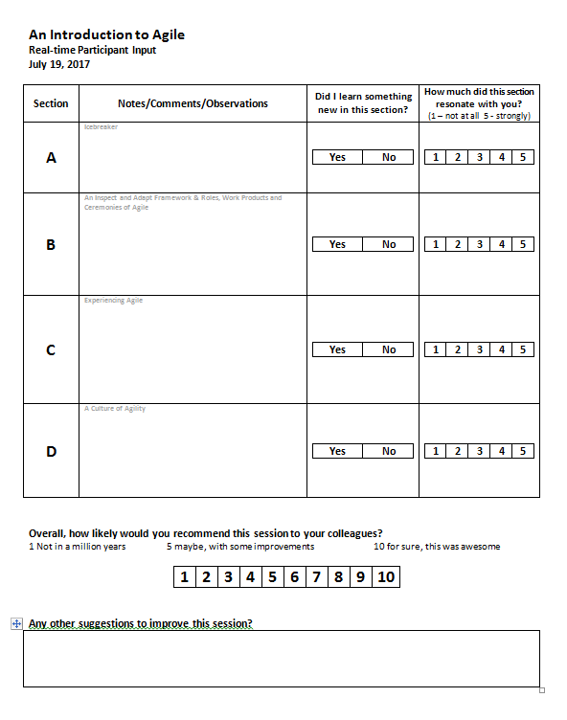
Feedback as we go…

Slide 5
As the rate of change is increasing, agile becomes a key capability
Frequent new functionality is expected, table stakes, and whenever releases are common place
Change dollars are scarce and there is vast inefficiency trapped in complex architectures and processes
Why Agile? There are good reasons
Talent competition is fierce. Digital talent does not want to work in old ways and feels unduly directed
Decision and matrix complexity is engrained in financial services and agile provides a way of breaking out
B

Slide 6
Agile is a set of Core Values
The Agile Manifesto
We are uncovering better ways of developing software by doing it and helping others do it. Through this work we have come to value:
Individuals and
interactions
Process and tools
Over
Working software
Comprehensive
documentation
Over
Customer
collaboration
Contract
negotiation
Over
Responding to
change
Following a plan
Over
That is, while there is value in the items on the right, we value the items on the left more
B
SOURCE: Agile manifesto (2001)

Slide 7
... as well as the core 12 principles supporting the Agile Manifesto
1. Our highest priority is to satisfy the customer through early and continuous delivery of valuable software
5. Build projects around [a few, 5 to 9] motivated individuals. Give them the environment and support they need, and trust them to get the job done
9. Continuous attention to technical excellence and good design enhances agility
2. Welcome changing require-ments, even late in develop-ment. Agile processes har-ness change for the cust-omer's competitive advantage
6. The most efficient and effective method of conveying information to and within a development team is face-to-face conversation
10. Simplicity - the art of maximizing the amount of work not done - is essential
3. Deliver working software frequently, from a couple of weeks to a couple of months, with a preference to the shorter timescale
7. Working software is the primary measure of progress [e.g., produce just in time, just enough documentation]
11. The best architectures, requirements, and designs emerge from self-organizing teams
4. Business people and developers must work together daily throughout the project
8. Agile processes promote sustainable development. The sponsors, developers, and users should be able to maintain a constant pace indefinitely
12. At regular intervals, the team reflects on how to become more effective, then tunes and adjusts its behaviour accordingly
SOURCE: Agile manifesto (2001)

Slide 8
Scrum is the most widely adopted methodology to implement Agile
Scrum
Scrum is a prescriptive framework used to manage and execute complex product development
Scrum defines the processes, ceremonies, team & roles, and artifacts, as well as the relationships among them
Scrum enables early value delivery through self-directed teams
Process: Iterative process - the sprint
Ceremonies: Concrete meetings –stand up, review, planning and review and retrospective
Team & roles: Scrum introduces new roles – product owner and scrum master
Artifacts: Defined artefacts – product backlog, sprint backlog, epics, stories
B

Slide 9
What, How, and Results
3
Roles
3
Artifacts
4
Ceremonies
Product owner
The person deciding what to build
Prioritizes the product backlog
Product backlog
Collection of items to work on
Prioritized based on value
Called “stories”
Planning
Decide what to work on this sprint
Figure out how to build it. (tasks)
Populate task wall
Scrum master
Champions the process
Removes impediments
Sprint backlog
A subset of the product backlog
Decided by the team at the beginning of each sprint
Daily standup
Synchronize the team
Identify/remove blockers
Review
Demonstrate progress
Update backlog
Team
Do the work
Self-organizes around the work
Product
The sprint backlog realized
The output of the team
Retro
Talk about how to get better
The Scrum Master will help facilitate the ceremonies
C

Slide 10



Scrum: An Inspect & Adapt Framework
Sprint
Planning
Product Owner
Review
Retrospective
Daily Standup
Product Backlog
Sprint Backlog
Product
Team
Scrum Master
B

Slide 11
Feedback as we go…

Slide 12
Let’s Experience Scrum
Organize into teams of 5 or 6
Identify a Product Owner
Identify a Scrum Master
Review Your Role/Ask Questions
C

Slide 13
Your Product: Produce a Marketing Brochure
Your Agile Assignment
C

Slide 14
Breaking It Down
Breakdown your vision into something the team can build.
Create a backlog of work items with your team.
????
Selling Points
????
Coupon
????
Call to Action
Map
????
5 minutes
Prioritize the backlog.
C

Slide 15

Bringing the Vision to Life
18 Minutes
Total
PLANNING
5 minutes
DAILY STANDUP 1 minute
DAY ONE
3 minutes
SPRINT
DAILY STANDUP 1 minute
DAY TWO
3 minutes
REVIEW
3 minutes
RETRO
2 minutes

Slide 16

Bringing the Vision to Life
18 Minutes
Total
PLANNING
5 minutes
DAILY STANDUP 1 minute
DAY ONE
3 minutes
SPRINT
DAILY STANDUP 1 minute
DAY TWO
3 minutes
REVIEW
3 minutes
RETRO
2 minutes

Slide 17
Show and Tell – Full Group Review
Show off what you built.
C

Slide 18
What did you learn? – Full Group Retrospective
Within your team, talk about your experience. Focus on how you built what you built.
Consider:
What was the experience during sprint 1 vs. sprint 2?
How well did we work together?
What did we learn during the sprint 1 retrospective?
How did we respond to impediments?
5 minutes
C

Slide 19
Feedback as we go…

Slide 20
A Culture of Agility, or What Agile “Feels” Like
Cross-functional and dedicated team members (everything you need to deliver)
Extreme collaboration (co-creation, “in community”)
Flowing and vibrant communication (co-location, virtually or physically)
Decision constraints (time/materials/people)
Immediate feedback (from users/customers/team members/the product)
Learning and experimentation (adaptability/thriving in change)
Results (always measured on frequently completed product)
Extreme focus (always working on the most important thing)
Transparency and illumination (barriers to agility are revealed quickly)
D

Slide 21
Feedback as we go…

Slide 22
Reminder: Purpose of this class…
What this was…
An Orientation on what is Agile
Through a hands-on, activity-based learning
To trigger ideas on how Agile & Scrum can be helpful
Initiate interest, knowledge and awareness of Scrum & the associated roles, artifacts, and ceremonies
What this was NOT…
A comprehensive Agile or Scrum Training
A certification class
A Scrum Master or Product Owner Training
An Agile Team Start-Up Training

Slide 23
Be Agile!
Thank you!!

