Slide 1
Auditoria e Teste de Software Parte III: Técnicas de Protecção
Segurança de Software
2019
Nuno Santos

Slide 2
Onde estamos
Parte I: Enquadramento e protecção (2 aulas)
Conceitos de segurança de software, mecanismos básicos de segurança
Parte II: Vulnerabilidades (3 aulas)
Buffer overflows, corridas e validação de entradas, vulnerabilidades na web e em bases de dados
Parte III: Técnicas de protecção (3 aulas)
Auditoria e teste de software, análise estática de código, protecção dinâmica, validação e codificação

Slide 3
Aula passada
Estudámos mais duas classes de vulnerabilidades:
Devido a corridas
Devido a validação de entradas

Slide 4
Plano para esta aula
Arquitectura das aplicações Web
Principais vulnerabilidades em aplicações Web

Slide 5
Modelação de ataques / ameaças

Slide 6
Modelação de ataques / ameaças
What is modeling? Why is it important in so many areas?
Objective is to model attacks, i.e., to characterize how they can affect the system
Then remediate the problems found
Can be part of the software development cycle (recommended) or done later

Slide 7
Benefícios de modelação de ataques
helps identity risks
helps understanding the application
helps find bugs
can help new team members understand the application
documents the application for other teams that may use it as a component
help testers define what has to be tested

Slide 8
Passos para modelação de ataques
Step 0: information gathering
Step 1: decompose the application into attack targets – create the model
Step 2: identify vulnerabilities
Step 3: describe the threats/attacks for each target
Step 4: rank risk for each attack

Slide 9
STRIDE taxonomy: Identificação das vulnerabilidades
Spoofing identity
attacker poses as a valid entity
Tampering with data
malicious modification of data
Repudiation
denying an event
Information disclosure
exposure of information to entities that were not supposed to
Denial of service
negation of some component’s service to users/components
Elevation of privilege
increase of the privileges of the attacker

Slide 10
DREAD: Classificação dos ataques / ameaças
Damage potential
10 if attacker circumvents all security mechanisms
Reproducibility
how easy is it to put the attack to work?
Exploitability
how much effort and expertise is required to mount the attack?
Affected users
if the attack is successful how many users are affected?
Discoverability
the better is to set it to 10…

Slide 11
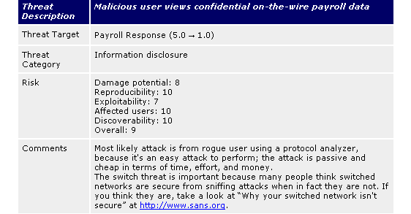
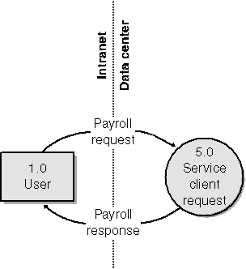
Exemplo de ataque
HOWARD 98
Attack
stride

Slide 12
Fuzzers

Slide 13
Fuzzers
“Operating system facilities, such as the kernel and utility programs, are typically assumed to be reliable. In our recent experiments, we have been able to crash 25-33% of the utility programs on any version of UNIX that was tested.”
Barton P. Miller, Lars Fredriksen e Bryan So, An Empirical Study of the Reliability of UNIX Utilities, CACM, Dec. 1990
The authors built a tool called fuzz
The tool reproduced conditions they found by accident
Origin: story in the beginning
Thunderstorm, then fuzz tool to inject random input
Fuzzers do “brute force search for vulnerabilities”;
Today fuzzing is much used for security testing
Many recent vulnerabilities were found using fuzzing

Slide 14
Um fuzzer simples
sharefuzz
simple fuzzer that tests environment variable usage (<100locs)
Method of insertion
Creates a shared library that:
is specified in LD_PRELOAD, thus always loaded
redefines getenv(), overriding the original one, that always returns a long list of identical characters for any environment variable (except DISPLAY) – by default returns 11500 A’s
Detection
If the application crashes it is vulnerable (no monitoring)

Slide 15
Exemplo de vectores de fuzzing
To test for SQL injection
’ or 1=1--
" or 1=1--
’ or 1=1 /*
or 1=1--
’ or ’a’=’a
" or "a"="a
’) or (’a’=’a
Admin’ OR ’
’ or 1 in (select @@version)--
’ union all select @@version--

Slide 16
Elementos para vectores de fuzzing
Think about known attacks: BOs, SQL inj., XSS,…
Metacharacters
HTML < >
SQL - ; ’ ”
OS . / %00 * | ‘ ’
Web server ../ %00
C / C++ %00
Examples
Long string: 10K A’s
Very long string: 100K A’s
Format strings %n%n%n…
Paths ../../../../../../../../../../../../etc/passwd
Paths ../../../../../../../../../../../../etc/passwd%00
Odd characters: metacharacters and others
XSS <script>alert(document.location);</script>

Slide 17
Tipos de fuzzers
In terms of knowledge of the target
Thin fuzzers – simple tools with little knowledge about the app tested; send random invalid input to the target
Fat fuzzers – can generate input that is valid (accepted by the parser) but irregular; better coverage
In terms of specialization
Specialized – implemented for a specific type of application, network protocol, file format; can be “intelligent”
Generic – can be applied on a large spectrum of targets (fuzzer frameworks)

Slide 18
Scanners de vulnerabilidades

Slide 19
Scanners de vulnerabilidades
The classical way to search for vulnerabilities in computer networks
COPS, SATAN, Nessus, OpenVAS, LANguard
Web vulnerability scanners – for web applications
Also called web application scanners, web application security scanners, web application vulnerability scanners

Slide 20
Scanners de vulnerabilidades para a web
NIST defined 14 mandatory classes of vulnerabilities that have to be detected
XSS, SQLI, command injection, XML injection, HTTP response splitting, file inclusion, direct reference to objects, CSRF, improper information disclosure, broken authentication / weak session management, session fixation, insecure communication, failure to restrict URL access
But not all vulnerabilities (impossible), only all the best-known classes

Slide 21
Scanners de vulnerabilidades vs. fuzzers
Web vulnerability scanners also “inject attacks”, similarly to attack injectors and fuzzers
Attack injectors / fuzzers – they do exhaustive search, so they look for new vulnerabilities
Scanners – they use known attacks and heuristics to look mostly for known vulnerabilities
Web vulnerability scanners are often commercial tools, while the others tend to be free/open
Acunetix WVS, IBM Rational AppScan, HPWebInspect
Why?

Slide 22
Conclusões
Corridas são violações das espectativas do programador sobre a atomicidade de um programa durante uma janela de vulnerabilidade
Os principais objectivos de explorar essas vulnerabilidades são escalar privilégios e as mais comuns são: TOCTOU, ficheiros temporários, e concorrência
Outra classe de vulnerabilidades é deficiente validação de entradas, que permite ao atancante injectar dados que resultem num desvio do comportamento normal do programa

Slide 23
Referências e próxima aula
Bibliografia
[Correia17] Capítulos 6 e 7
Próxima aula
Vulnerabilidades na Web e em bases de dados

