Slide 1
Desenvolvimento de Software Seguro Parte III: Técnicas de Protecção
Segurança de Software
2019
Nuno Santos

Slide 2
Onde estamos
Parte I: Enquadramento e protecção (2 aulas)
Conceitos de segurança de software, mecanismos básicos de segurança
Parte II: Vulnerabilidades (3 aulas)
Buffer overflows, corridas e validação de entradas, vulnerabilidades na web e em bases de dados
Parte III: Técnicas de protecção (3 aulas)
Auditoria e teste de software, análise estática de código, protecção dinâmica, validação e codificação

Slide 3
Aula passada
Estudámos mais duas classes de vulnerabilidades:
Devido a corridas
Devido a validação de entradas

Slide 4
Plano para esta aula
Validação de entradas
Segurança no desenvolvimento de software

Slide 5
Validação de entradas

Slide 6
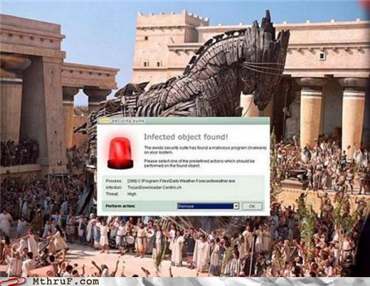
Motivação
Trojan horse – recall the story
Greeks put Troy under siege for 10 years
Ulysses and some soldiers hide inside a wooden horse
Trojans take the horse inside Troy
At night the Greeks leave the horse and open the city gates
Never trust input
But input is needed so: validate, encode

Slide 7
Três facetas da validação de entradas
Validation – to ensure that an input satisfies its:
type (e.g., contains only certain chars)
length boundaries (e.g., 4 characters)
syntax (e.g., numerical digits only)
the main problem are metacharacters so we focus on them
Two related concepts:
Integrity checking
Ensure that data was not tampered / modified (e.g., session management data), e.g., with HMAC, digital signature
Business rule enforcement
Ensure that the data satisfies the business rules of the application (e.g., that the interest rates fall within permitted boundaries)

Slide 8
Onde efecutar a validação de entradas?
1st principle: data validation has to be made whenever data crosses a trust boundary
i.e., whenever data crosses:
The attack surface of the application
A trust boundary inside the application – for defense in depth
For multi-tier apps, Validation has to be performed in every tier (each tier should validate according to its function)

Slide 9
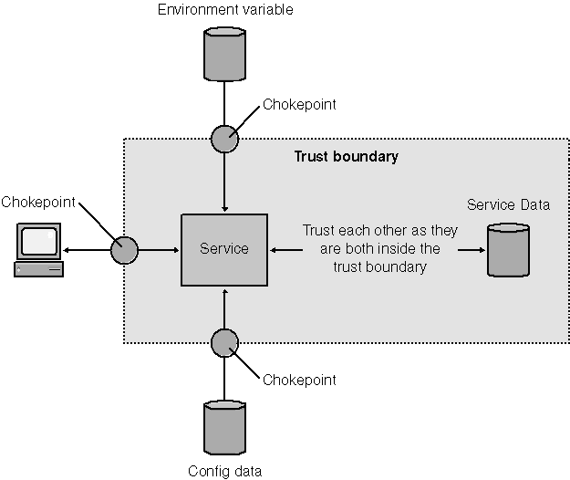
Onde efecutar a validação de entradas? (cont.)
2nd principle: there has to be a small set of well defined chokepoints where validations are done
Related to the design principle of complete mediation

Slide 10
Estratégias de validação de entradas
1- White listing – accept known good
if (inp.match(regular expression that defines good input) == false)
error();
If you expect a ZIP code, accept only a ZIP code (type, length and syntax). If not a ZIP code, reject
public String validateZipCode(String zipcode) {
return (Pattern.matches("^\d{4}(-\d{3})?$", zipcode)) ? zipcode : '';
}

Slide 11
Estratégias de validação de entradas (cont.)
2- Black listing – reject known bad
if (inp.match(regular expression that defines bad input) == true)
error();
If you don’t expect to see JavaScript, reject strings that contain it
public String removeJavascript(String input) {
Pattern p = Pattern.compile("javascript", CASE_INSENSITIVE);
p.matcher(input);
return (!p.matches()) ? input : '';
}
Bad strategy, violates principle of fail-safe defaults

Slide 12
Estratégias de validação de entradas (cont.)
3 - Sanear
Eliminate or encode (aka quote or escape) chars to make input safe
Ex: quote apostrophes
public String quoteApostrophe(String input) {
return str.replaceAll("[\']", "&rsquo;");
}
Similar problem as “reject known bad”…
But there are good encoding libraries so it can be ok (actually, it’s much used)

Slide 13
Muitas vezes não é fácil
Exemplo
When input is inserted in SQL statements it must be validated and/or encoded
Why not just validate?
Sometimes we can’t remove all SQL metacharacters from the input
Ex: do we want to remove all single quotes? What if the input is a name, e.g., O’Connor?

Slide 14
Segurança no desenvolvimento de software

Slide 15
Desenvolvimento de software
Goals are often contradictory themselves and with security
Functionality
Usability
Performance
Simplicity
Time-to-market
Windows Security Push was a shift-gears on Microsoft’s tradeoff
“During February and March 2002, all feature development on Windows pr ducts at Microsoft stopped so that the complete Windows development team could analyze the product design, code, test plans, and documentation for security issues. Our team at Microsoft named the process the Windows Security Push. (...) and since then, the company has performed many other pushes across its product line including SQL Server, Office, Exchange, and others.”

Slide 16
Selecionar a linguagem de programação
The language has an impact on security so it should be selected taking this aspect into account
Usually other factors have more weight: comfort with the language, performance, personal taste…
C/C++ are fast but prone to vulnerabilities
pointers, lack of array bound verifications
Java/C# are not perfect but limit these problems
no pointers, array bounds checked in runtime
programs run in a sandbox (enforces access control policies)
but there are also vulnerabilities, default policies, etc etc
PHP is a source of many security issues
Notes:
Perl is slower but has interesting security features
taint mode monitors variables in runtime to see if untrusted user input leads to a security violation

Slide 17
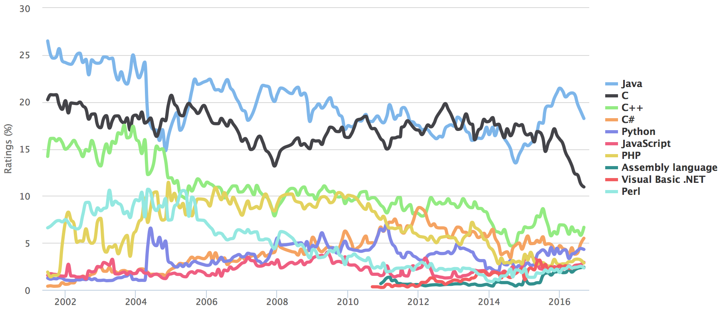
Mais popular, mais segura?
TIOBE Programming Community Index www.tiobe.com (September 2015)
gives an indication of the popularity of programming languages.
based on the world-wide availability of skilled engineers, courses and third party vendors.
popular search engines Google, MSN, and Yahoo! are used to calculate the ratings.
not about best programming language or language in which most lines of code have been written

Slide 18
Open source vs. closed source
A permanent debate…
“Open source is much better because many-eyeballs see the code and detect vulnerabilities”
but do they look?
can they see?
“Closed source is much better because it is harder for the attacker to find vulnerabilities”
that’s why so few vulnerabilities are found in commercial applications ☺
security by obscurity is not a good idea

Slide 19
Segurança no ciclo de desenvolvimento de SW
How shall security be introduced in the software development cycle?
In a nutshell: from the beginning , during all lifecycle
Popular software development processes: waterfall

Slide 20
Modelo de desenvolvimento em cascata
Consider current laws (Sarbanes-Oxley Act, Health Insurance Portability and Accountability Act (HIPAA)),
standards like ISO 17799, others like the Web Application Security Standards, etc.

Slide 21
Modelo de desenvolvimento em cascata
Translate generic requirements into specific software requirements. Can be done using misuse cases (using common vulnerability lists, resources used by the sw,…)

Slide 22
Modelo de desenvolvimento em cascata
Translate requirements into mechanisms; avoid introducing design vulnerabilities by following the design principles, doing threat modeling
Typ. considered together with design

Slide 23
Modelo de desenvolvimento em cascata
Avoid introducing coding vulnerabilities, using what we’ll see in Part II

Slide 24
Modelo de desenvolvimento em cascata
Security testing (attack injection, static analysis,…)
After deployment, e.g., patch distribution

Slide 25
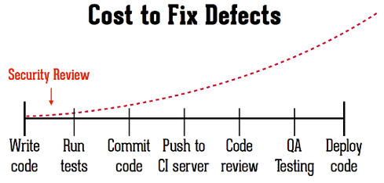
Considerar a segurança desde o início
Common bad practice: “build it first, secure it later” ☹
“We are very concerned about security, but the release date arrived and we didn’t have time bla bla”
Early design decisions have important security implications
Two equally sound paths may lead to two very different systems in terms of security
Put security later may have large costs and involve major redesign
It may also involve discarding functionality that had a cost to be built

Slide 26
Conclusões
Corridas são violações das espectativas do programador sobre a atomicidade de um programa durante uma janela de vulnerabilidade
Os principais objectivos de explorar essas vulnerabilidades são escalar privilégios e as mais comuns são: TOCTOU, ficheiros temporários, e concorrência
Outra classe de vulnerabilidades é deficiente validação de entradas, que permite ao atancante injectar dados que resultem num desvio do comportamento normal do programa

Slide 27
Referências
Bibliografia
[Correia17] Capítulos 6 e 7
Próxima aula
EXAME

