Slide 1
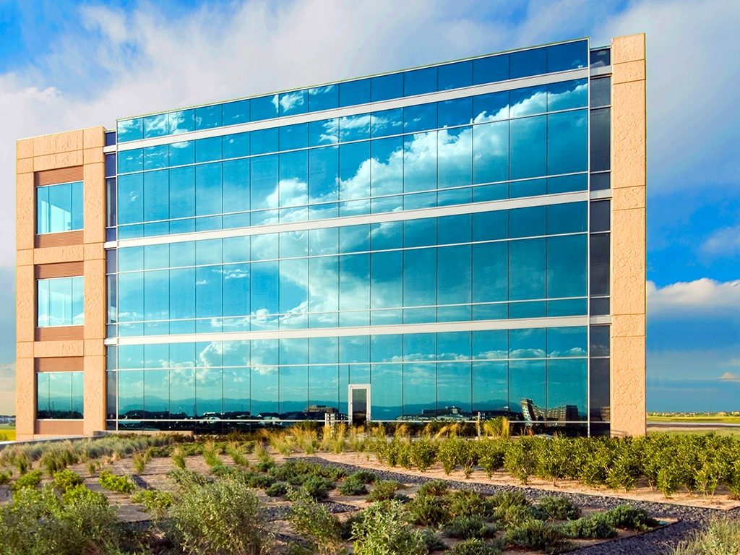
Deconstructing Cloud Computing
Matt McMillon
Staff Internet Engineer
Qwest Communications

Slide 2
The Problem with Emerging Technologies
No history of vulnerabilities and attacks to fall back on
No institutional knowledge
“I need the security requirements by 5 pm today”
Will it be sustaining/evolutionary, disruptive, or simply fail?
Easy to get bogged down in the new stuff, and forget the fundamentals!

Slide 3
What is Cloud Computing?

Slide 4
NIST Definition
On-demand self-service.
Broad network access.
Resource pooling.
Rapid elasticity.
Measured Service.
Does this really help us as auditors and security professionals?

Slide 5
Architecture and Service Definitions
Three Cloud Service Delivery Models:
      1. Infrastructure as a Service (IaaS)
      2. Platform as a Service (PaaS)
      3. Software as a Service (SaaS)
Four Cloud Service Deployment Models
      1. Public
      2. Private
      3. Community
      4. Hybrid

Slide 6
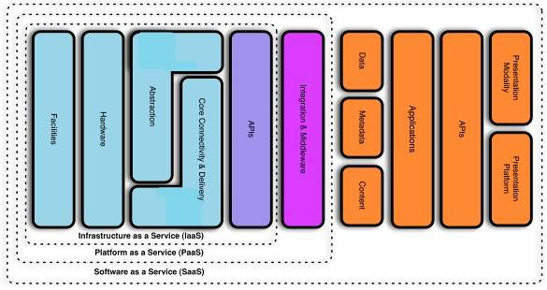
CSA Cloud Reference Model

Slide 7
Hypervisors
Runs multiple instances of an OS (or multiple OSes) on shared hardware
Native or “bare metal”
  PR/SM on the IBM System 370 (1972!)
  VMWare ESXi
  Microsoft Hyper-V
Host based
  Virtual PC
  VMWare Server
  Parallels
Can use direct physical storage and/or virtual disks
Mainly used for IaaS and PaaS

Slide 8
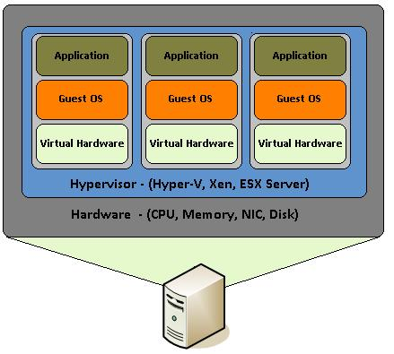
Native Hypervisor

Slide 9
What is Important Here?
Know where your organization ends and the other begins
  Patching, software licensing, data retention, etc.
Make sure that there is documented responsibility for EVERY layer in the cloud stack
  “Hey man, it’s my responsibility to patch the hypervisors not the OSes.”

Slide 10
Cloud Computing Threat Model

Slide 11
Threat Modeling 101
Systematic way to develop requirements, test plans and testing tools
Three basic ways to approach a threat model: attack focused, asset focused, design focused
Model can be represented in many ways, including UML, attack trees, and data flow diagrams
Microsoft Security Development Life Cycle (SDL), OCTAVE, Trike
Pick and choose what works best for your organization.

Slide 12
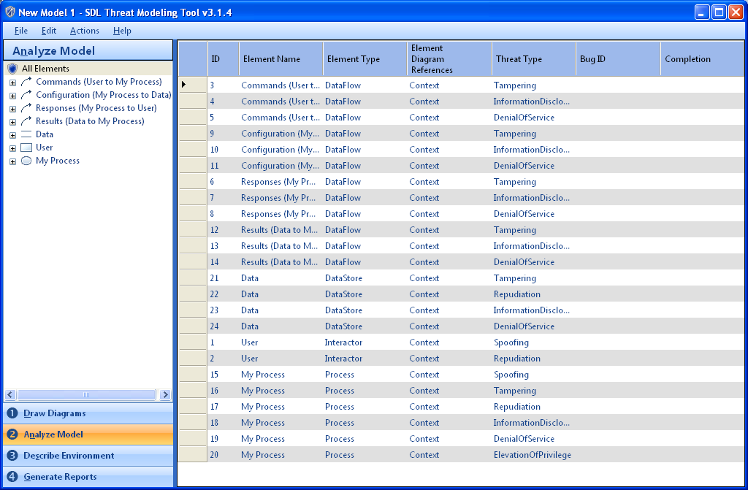
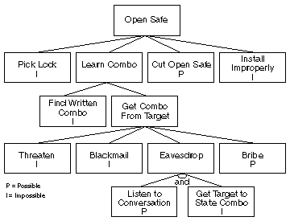
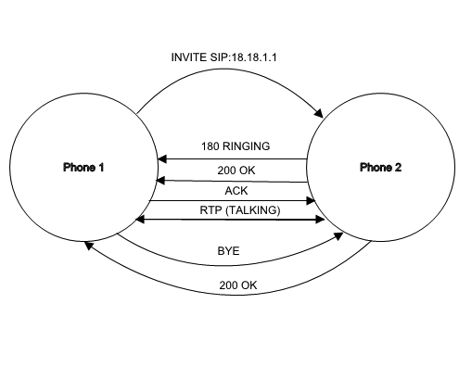
Examples

Slide 13
Cloud Computing Threat Model
ENISA
Cloud Computing Risk Assessment

Slide 14
Threat Model
Risk 1: Resource Exhaustion*
Risk 2: Customer Isolation Failure*
Risk 3: Management Interface Compromise
Risk 4: Interception of Data in Transmission
Risk 5: Data leakage on Upload/Download, Intra-cloud

Slide 15
Threat Model
Risk 6: Insecure or Ineffective Deletion of Data*
Risk 7: Distributed Denial of Service (DDoS)
Risk 8: Economic Denial of Service*
Risk 9: Loss or Compromise of Encryption Keys
Risk 10: Malicious Probes or Scans

Slide 16
Threat Model
Risk 11: Compromise of Service Engine/Hypervisor*
Risk 12: Conflicts between customer hardening procedures and cloud environment
Risk 13: Subpoena and E-Discovery*
Risk 14: Risk from Changes of Jurisdiction*
Risk 15: Licensing Risks*

Slide 17
Threat Model
Risk 16: Network Failure
Risk 17: Networking Management
Risk 18: Modification of Network Traffic
Risk 19: Privilege Escalation*
Risk 20: Social Engineering Attacks

Slide 18
Threat Model
Risk 21: Loss or Compromise of Operation Logs
Risk 22: Loss or compromise of Security Logs
Risk 23: Backups Lost or Stolen
Risk 23: Unauthorized Access to Premises, Including Physical Access to Machines and Other Facilities
Risk 25: Theft of Computer Equipment.*

Slide 19
Vulnerabilities

Slide 20
AAA
Insecure storage of cloud access credentials by customer
Insufficient roles available
Credentials stored on a transitory machine
Password-based authentication may become insufficient
  Strong or two-factor authentication for accessing cloud resources will be necessary

Slide 21
User Provisioning
Customer cannot control provisioning process
Identity of customer or billing information is not adequately verified at registration
Delays in synchronization between cloud system components
Multiple, unsynchronized copies of identity data are made
Credentials are vulnerable to interception and replay
De-provisioned credentials are still valid due to time delays in roll-out of revocation

Slide 22
Remote Access To Management Interface
Allows vulnerabilities in end-point machines to compromise the cloud infrastructure (single customer or CP) through, for example, weak authentication of responses and requests.

Slide 23
Hypervisor
Exploiting the hypervisor potentially means exploiting every VM!
Guest to host escape
VM hopping
Virtual machine-based rootkits

Slide 24
Lack of Resource Isolation
Side channel attacks
Shared storage
Insecure APIs
Lack of tools to enforce resource utilization

Slide 25
Lack of Reputation Isolation
Activities from one customer impact the reputation of another customer
And can impact the reputation of the CP

Slide 26
Communication Encryption
Reading data in transit via MITM attacks
Poor authentication
Acceptance of self-signed certificates

Slide 27
Weak or No Encryption
Data in transit
Data held in archives and databases
Un-mounted virtual machine images
Forensic images and data, sensitive logs and other data at rest puts customer data at risk

Slide 28
Unable to Process Data in Encrypted Form
Encrypting data at rest is easy, but implementing homomorphic encryption is not -- there is little prospect of any commercial system being able to maintain data encryption during processing.
Bruce Schneier estimates that performing a web search with encrypted keywords would increase the amount of computing time by about a trillion.

Slide 29
Poor Encryption Key Management
Hardware security modules (HSM) required in multiple locations
Key management interfaces which are accessible via the public Internet
The rapid scaling of certificate authorities issuing key pairs to new virtual machines
Revocation of keys for decommissioned virtual machines

Slide 30
Low Entropy for Random Number Generation
The combination of standard system images, virtualization technologies and a lack of input devices means that virtual systems have much less entropy than physical RNGs!

Slide 31
Inaccurate Modeling of Resource Usage
Overbooking or over-provisioning
Failure of resource allocation algorithms due to extraordinary events (e.g., outlying news events for content delivery).
Failure of resource allocation algorithms using job or packet classification because resources are poorly classified.
Failures in overall resource provisioning (as opposed to temporary overloads)

Slide 32
No Control of Vulnerability Assessment Process
Restrictions on port scanning and vulnerability testing are an important vulnerability which, combined with a AUP which places responsibility on the customer for securing elements of the infrastructure, is a serious security problem.

Slide 33
Internal (Cloud) Network Probing
Cloud customers can perform port scans and other tests on other customers within the internal network.

Slide 34
Co-residence Checks
Side-channel attacks exploiting a lack of resource isolation allow attackers to determine which resources are shared by which customers.

Slide 35
Lack of Forensic Readiness
While the cloud has the potential to improve forensic readiness, many providers do not provide appropriate services and terms of use to enable this.

Slide 36
Media Sanitization
Shared tenancy of physical storage resources means that sensitive data may leak because data destruction policies may be impossible to implement
Media cannot be physically destroyed because a disk is still being used by another tenant
Customer storage cannot be located or tracked as it moves through the cloud

Slide 37
SLA
Clauses with conflicting promises to different stakeholders
Clauses may also be in conflict with promises made by other clauses or clauses from other providers.

Slide 38
Audit or Certification Not Available to Customers
The CP cannot provide any assurance to the customer via audit certification.
Open source hypervisors or customized versions of them (e.g., Xen) may not have Common Criteria certification, etc.

Slide 39
Certification Schemes Not Adapted to Cloud
Very few if any cloud-specific control, which means that security vulnerabilities are likely to be missed.

Slide 40
Inadequate Resource Provisioning and Investments in Infrastructure
Infrastructure investments take time. If predictive models fail, the cloud provider service can fail for a long period.

Slide 41
No Policies for Resource Capping
If there is not a flexible and configurable way for the customer and/or the cloud provider to set limits on resources, this can be problematic when resource use is unpredictable.

Slide 42
Storage of Data in Multiple Jurisdictions
Mirroring data for delivery by edge networks and redundant storage without real-time information available to the customer of where data is stored.

Slide 43
Lack of Information on Jurisdictions
Data may be stored and/or processed in high risk jurisdictions where it is vulnerable to confiscation by forced entry.

Slide 44
Lack of Cloud Security Awareness
Cloud customers and providers are not aware of the risks they could face when migrating into the cloud, particularly those risks that are generated from cloud specific threats, i.e. loss of control, vendor lock-in, exhausted CP resources, etc.

Slide 45
Lack of Vetting Processes
Since there may be very high privilege roles within cloud providers, due to the scale involved, the lack or inadequate vetting of the risk profile of staff with such roles is an important vulnerability.

Slide 46
Unclear Roles and Responsibilities
Inadequate definition of roles and responsibilities in the cloud provider organization.

Slide 47
Poor Enforcement of Role Definitions
Within the cloud provider, a failure to segregate roles may lead to excessively privileged roles which can make extremely large systems vulnerable.

Slide 48
Need-to-know Principle Not Applied
Poorly defined roles and responsibilities
Parties should not be given unnecessary access to data.

Slide 49
Inadequate Physical Security Procedures
Lack of physical perimeter controls (smart card authentication at entry);
Lack of electromagnetic shielding for critical assets vulnerable to eavesdropping.

Slide 50
Mismanagement
System or OS vulnerabilities
Untrusted software
Lack of - or a poor and untested - business continuity and disaster recovery plan
Lack of - or incomplete or inaccurate - asset inventory
Lack of - or poor or inadequate - asset classification
Unclear asset ownership

Slide 51
Poor Identification of Project Requirements
Lack of consideration of security and legal compliance requirements
No systems and applications user involvement
Unclear or inadequate business requirements.

Slide 52
Application Vulnerabilities and Poor Patch Management
Bugs in the application code
Conflicting patching procedures between provider and customer
Application of untested patches
Vulnerabilities in browsers
Dormant virtual machines
Outdated virtual machine templates

Slide 53
Additional Vulnerabilities
Resource consumption vulnerabilities
Breach of NDA by provider
Liability from data loss (cp)
Lack of policy or poor procedures for logs collection and retention
Inadequate or misconfigured filtering resources

Slide 54
Resources
ENISA -- Cloud Computing Risk Assessment: http://www.enisa.europa.eu/act/rm/files/deliverables/cloud-computing-risk-assessment
NIST Cloud Computing: http://csrc.nist.gov/groups/SNS/cloud-computing/
Cloud Security Alliance: http://www.cloudsecurityalliance.org/
Microsoft SDL: http://www.microsoft.com/security/sdl/
OCTAVE: http://www.cert.org/octave/
QwestBusiness Blog: http://www.qwest.com/business/blog/

