Slide 1

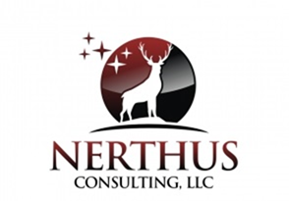
Cloud Security
ISC2 Denver Chapter Monthly Meeting
March 15, 2018

Slide 2

About Me
From Pennsylvania, lived in 10 states.
BS in Electrical Engineering, BS in Accounting
MBA University of PA, Wharton School of Business
GICSP, CISSP-ISSAP-ISSEP-ISSMP, HCISPP, CSSLP, DoDD 8140, DoD 8570 IAM_IAT I-II-III, IASAE I-II, CND-SP, CCSK, PCII, ITIL, MDQM, PMP
Certificate Program in Machine Learning, Columbia University
President of the Cheyenne, WY chapter of the Global Blockchain Association.
Represented the US on 3 ISO working groups.
I have worked in Aerospace, Government, Agriculture, Optics and Information Technology vertical markets.
I live in Cheyenne Wyoming with my husband, 3 dogs, and 11 horses.

Slide 3
Topics in This Presentation
Cloud Advantages & Disadvantages
Defining Cloud
Cloud Service Models
Cloud Design and Architecture
Cloud Security
Cloud Compliance
Key Points
Added short topic: Blockchain

Slide 4
Cloud Advantages & Models

Slide 5
What Are Advantages of Using the Cloud?
Efficiency
Cost
Time
Reliability
Availability
All environments, especially disaster recovery
Scalability
Elastic capacity
Manageability
Cost effective
Capital expenditure free

Slide 6
What Are Disadvantages of Using the Cloud?
To be fair we need to mention disadvantages however most can be overcome
Hard to establish clear governance
Unclear documentation and specifications
Vendor lock-in
Limited control
Security ****

Slide 7
What Are the Security Advantages of Using the Cloud?
Platform unity
Platform strength
Specialized technical resources
Resource Availability
Backup, Recovery and Incident Processes
Uniform, secured endpoints
Data concentration for mobile users

Slide 8
Defining Cloud
Cloud computing is a model for enabling ubiquitous, convenient, on-demand network access to a shared pool of configurable computing resources that can be rapidly provisioned and released with minimal management effort or service provider interaction. This cloud model is composed of five essential characteristics, three service models, and four deployment models.
Citation: Special Publication (NIST SP) - 800-145
On-demand self-service
Broad network access
Resource pooling
Rapid elasticity
Measured service

Slide 9
Cloud Service Models
Infrastructure as a Service (IaaS)
Standardized, highly automated offering, where compute resources, complemented by storage and networking capabilities are owned by a service provider and offered to customers on-demand. Customers are able to self-provision the infrastructure.
Platform as a Service (PaaS)
Offering is a broad collection of application infrastructure (middleware) services including application platform, integration, business process management and database services.
Software as a Service (SaaS)
Software is owned, delivered and managed remotely by a provider. The provider delivers software based on one set of common code and data definitions that is by contracted customers on a pay-for-use basis or as a subscription.

Slide 10
Cloud Service Models
Presentment
Application Programming Interfaces
Software as a Service
Applications/Software
Data
Metadata
Integration
Platform as a Service
Middleware
Interfaces
Connectivity/Network
Abstraction Layer
Infrastructure as a Service
Hardware
Facilities

Slide 11
Cloud Deployment Models
Public
Cloud infrastructure is available to the general public, owned by org selling cloud services
Private
Cloud infrastructure for single organization only, may be managed by the organization or a 3rd party, on or off premise
Hybrid
Cloud infrastructure shared by several organizations that have shared concerns, managed by org or 3rd party
Community
Combinations of clouds types

Slide 12
Chief Information Officers’ Cloud Concerns
Security
Availability
Performance
Costs
Standards

Slide 13
Shared Security Responsibility
Service Provider and Consumer roles, related to cloud model, are inverse of each other.
Consumer
IAAS
PAAS
SAAS
SAAS
Application
PAAS
Platform Architecture
Virtual Infrastructure
IAAS
Hardware
Facility
Service Provider

Slide 15
Data Types and Compliance

Slide 16
Data Types and Compliance
Data, being the key attribute of an information technology system, is the driving force in selecting the appropriate level of security.
Develop detail data flows
If security controls and approach is not matched to the characterization of data then:
The system will be more costly and utility reduced if over secured.
The system and data will be vulnerable and could lead to a breach.

Slide 17
Data Compliance
18 U.S.C. 641 Criminal Code: Public Money, Property or Records
18 U.S.C. 1905 Criminal Code: Disclosure of Confidential Information
CFR Title 21 - Food and Drugs: Parts 1 to 1499
CFR Title 45 (Parts 1-199)|Code of Federal Regulation Title 45 Public Welfare
Economic Recovery Act of 2009
Emergency Medical Treatment & Labor Act (EMTALA)
Federal Information Security Management Act of 2002 (FISMA)
Freedom of Information Act (FOIA)
Health Insurance Portability and Accountability Act (HIPAA) of 1996 P.L. 104-191
OMB Circular A-130, Appendix III, Security of Federal Automated Information Systems
Privacy Act of 1974, 5 U.S.C. § 552a
The Deficit Reduction Act of 2005
The Sarbanes-Oxley Act of 2002

Slide 18
Risk = (Data Type + Breach Probability)/Data Security Profile
Risk= (Data Type * Breach Probability)/Security Profile
Risk Profile
Data Pedigree
Data Security Profile + Data Owner + Originating System + Data Integrity Confidence
NIST SP 800-53v4
SP 800-53v4, Pub 1075, CJIS-SP
Security
Policies & Procedures Profile 1
Policies & Procedures Profile 2
Policies & Procedures Profile 3
Policies & Procedures Profile 4
Data Security Profile 1
Data Security Profile 2
Data Security Profile 3
Data Security Profile 4
Integrity Controls
Privacy Act FISMA
HIPAA PCI-DSS FERPA
Pub 1075 CJIS
Public Data
Classification: Low
Classification: Moderate
Classification: High
Data Object
Public Data
Confidential Data
Restricted Data
Public Data
Sensitive Data

Slide 19
Data Classification Comparison:
Project - Federal Agency – National Security
Direct comparison is difficult because data classification is specific to mission, context, aggregation and system.
Detailed review of data sets, usage and regulatory compliance yields appropriate classifications.
Data can transition up or down in classification levels based on certain factors.
National Security/Dept.
of Defense Classifications
Data Classifications
Federal Agency Classifications
Grave Damage
Classification: Top Secret
Pub 1075 CJIS
Moderate +
CFR Title 28, DOJ-BoPrisons
Severe Adverse Effect
Classification: High
Serious Damage
Classification: Secret
HIPAA PCI-DSS FERPA
Classification: Moderate
HIPAA PCI-DSS FERPA, Pub 1075
Serious Adverse Effect
Classification: Moderate
Damage
Classification: Confidential
Privacy Act FISMA
Classification: Low
Privacy Act FISMA
Limited Adverse Effect
Classification: Low
Limited Damage
Classification: For Official Use Only (FOUO)
DoDM 5200, E.O. 13256
Integrity Controls
Classification: Public
Integrity Controls
No Adverse Effect
Classification:
Public
No Damage
Classification: Unclassified
Regulations, NIST SP 800-53v4, FIPS, PUB 1075, Agency Specific Guidance

Slide 20
What is Cloud Security?

Slide 21
What is Cloud Security?
There is a lot of noise and distraction about cloud security.
The truth is that security controls need to be implemented if you use:
Stand alone servers
Physical servers in your data center
Virtualization in your data center
Cloud provided by a service provider
There are few differences when identifying what controls
Bottom line is that organizations feel vulnerability since they believe they lose control

Slide 22
NIST SP 800-53 rev4 Control Families
AC - Access Control
AU - Audit and Accountability
AT - Awareness and Training
CM - Configuration Management
CP - Contingency Planning
IA - Identification and Authentication
IR - Incident Response
MA – Maintenance
MP - Media Protection
PS - Personnel Security
PE - Physical and Environmental Protection
PL - Planning
PM - Program Management
RA - Risk Assessment
CA - Security Assessment and Authorization
SC - System and Communications Protection
SI - System and Information Integrity
SA - System and Services Acquisition

Slide 23
Endpoint Device Security
Host based Intrusion Detection Systems (HIDS)
Host based firewalls
Application whitelisting
Endpoint encryption
Trusted platform module
Mobile device management
Sandboxing

Slide 24
Cloud Security
TLS Encryption
Network Firewalls/Web Application Firewall
Data Encryption – FIPS 140-2
Central Logging
Authentication Layering
Network Scanning
Third Party Security Testing
Vulnerability Assessments
Penetration Testing
Security Audit
Statement on Standards for Attestation Engagements (SSAE) 16 Compliant Data Center

Slide 25
FEDRamp
FedRAMP is a governance program that provides a standardized approach to security authorization in accordance with FISMA and NIST security requirements.
Federal agencies are required by law to protect federal data stored in the cloud. Agencies do this by authorizing cloud services that demonstrate their compliance with one of the FedRAMP security control baselines (low, medium, high).
FedRAMP facilitates collaboration across the federal government.

Slide 26
FedRamp

Slide 27
Architectural Concepts and Design

Slide 28
Architectural Considerations
Attack Surface.
The hypervisor is an additional layer of software between an operating system and hardware platform. The hypervisor normally supports other application programming interfaces to conduct administrative operations, such as launching, migrating, and terminating virtual machine instances. This increases the attack surface.
Complicated Architectures
Virtual machines environments and their supportive software are complicated. Implementing organizational software in PaaS or IaaS creates additional complications that have to managed appropriately

Slide 29
Architectural Considerations
Virtual Network Protection
Most virtualization platforms have the ability to create software-based switches and network configurations as part of the virtual environment to allow virtual machines on the same host to communicate more directly and efficiently. Some hypervisors’ network monitoring capabilities are not as robust as physical network tools.
Virtual Machine Images.
IaaS cloud providers maintain repositories of virtual machine images. A virtual machine image includes a the software stack and speeds up the time to implementation. These are often shared. Shared virtual images must be validated and carefully controlled to not implement problems.

Slide 30
Architectural Considerations
Client-Side Protection
Web browsers, a key element for many cloud computing services, and the various plug-ins and extensions are notorious for their security problems. Security awareness is as important when dealing with a cloud application as any other alternately implemented application.
Identify and Access Management
Identification, authentication, authorization and accounting are critical to implement, enforce and monitor on any cloud based applications or cloud management portals.

Slide 31
Identity and Access Management
Identity Management includes:
Self-service
Registration
Password management
Provisioning
Access Management includes:
Authentication
Authorization
Policy Management
Federation
Identity Repository

Slide 32
Identity and Access Management
Identity repositories provide directory services for the administration of user accounts and their attributes.
Common Directory Services:
X.500 and LDAP
Microsoft Active Directory
Novell eDirectory
Metadata replication and synchronization
Directory as a Service

Slide 33
Federated Identity Management
Provides the policies and processes that manage identity and trusted access to systems across entities
Like Kerberos, but for separate domains
Federation Standards:
Security Assertion Markup Language (SAML)
WS-Federation
OpenID Connect (based on OAuth 2.0)
OAuth for web and mobile applications
Federated Identity Providers
Identity Provider – holds all the identities and generates a token for known users
Relying Party – the service provider who consumes these tokens

Slide 34
Security Threats

Slide 35
Security Threats
Malicious Code
Ransomware
Virus
Worms
Trojans
Logic bombs
Malware
Botnet
Malicious Code Countermeasures
Scanners
IDS/IPS
Security testing
Anti-malware
Code signing
Sandboxing
Appropriate patching

Slide 36
Security Threats
Malicious Activity
Social Engineering
Spoofing
Phishing
Spam
Botnets
Malicious Activity Countermeasures
User Awareness Training
System Hardening
Patching
Sandboxing
Policies and Procedures

Slide 37
Security Threats
Abuse and Nefarious use
Hackers continue to leverage technologies to improve their reach, avoid detection, and improve the effectiveness of their activities.
Cloud providers are actively being targeted, partially because their relatively weak registration systems facilitate anonymity, and providers’ fraud detection capabilities are limited.
Countermeasures: Patching, intrusion detection, security awareness training, background checks

Slide 38
Security Threats
Insecure interfaces and APIs
Cloud providers strive to provide security and that it is integrated into their service models.
Consumers of services need to understand the security implications associated with the usage, management, orchestration and monitoring of cloud services.
Reliance on a weak set of interfaces and APIs exposes organizations to a variety of security issues related to confidentiality, integrity, availability and accountability.
Countermeasures: Architecture review, security testing, patching schedules, Service Level Agreements, legal agreements (BAA)

Slide 39
Security Threats
Malicious insiders
The impact that malicious insiders can have on an organization is great because of their level of access and understanding of data and information technology assets.
Theft, reputation damage and loss of productivity are some examples of how malicious insider can affect an operation.
Organizations that adopt cloud services need to understand the human element and that the responsibility for a malicious insider is relevant for staff of the cloud provider.
Countermeasures: Background checks, policies and procedures, non-repudiation, two man work, security awareness training, least privilege

Slide 40
Security Threats
Shared technology issues
Attacks have surfaced in recent years that target the shared technology inside cloud computing environments.
As a result, attackers focus on how to impact the operations of other cloud customers, and how to gain unauthorized access to data.
Countermeasures: Patching, security testing, monitoring, security awareness training

Slide 41
Security Threats
Data loss or leakage
Data loss or leakage can have a devastating impact on a business and its impact is directly relevant to the type of data.
Compliance violations, legal ramifications
Loss of core intellectual property could have competitive and financial implications.
Countermeasures: Data Loss Prevention Applications, encryption, security awareness training, data classification, policies and procedures, least privilege

Slide 42
Security Threats
Account or service hijacking
Account and service hijacking, usually with stolen credentials, remains a top threat. With stolen credentials, attackers can often access critical cloud services, allowing them to compromise the confidentiality, integrity and availability of the services and the data.
Countermeasures: Policies and procedures, security awareness training, enforced password life, complexity and reuse

Slide 43
Security Threats
Unknown Risk Profile
When adopting a cloud service, the features and functionality may be well advertised, but one must understand the cloud service security posture/risk profile.
Understand the controls or compliance alignment
Make sure you agree with the cloud providers internal security procedures, configuration hardening, patching, auditing, and logging
Do they go through SSAE16 SOC2 audits or are FEDRamp certified?
Under what conditions can you have access to or be given an extract of logs?
Can you conduct vulnerability scanning or penetration testing on “your” infrastructure; and/or will you receive the regular reports of the results of their scanning and testing.
Countermeasures: Research, agreements, and governance

Slide 44
Governance

Slide 45
Cloud Governance
Cloud Governance by the Customer is Critical
Extend organizational practices pertaining to the policies, procedures, and standards implemented for users.
Practices pertaining to policies, procedures and standards implemented for application development and service provisioning.
Environment establishment such as development, testing, staging, training, production and disaster recovery in alignment with organizational standards.
Put in place audit mechanisms and tools to ensure organizational practices are followed such as log review and reporting.

Slide 46
Cloud Governance
Cloud Governance by the Customer is Critical
Cloud Customers need to define cloud strategy before entering into agreement with CSP
Organizational assets agreed upon and assessed for suitability for cloud
Define suitable business units or functions
Outline phased approach to cloud journey
Document exceptions, restrictions, and risks
List regulatory and compliance components (addressed either jointly or by the provider)
List business and system interdependencies.

Slide 47
Cloud Application Security

Slide 48
Cloud Application Security
Cloud development and applications must take into considerati0n service models and deployment models
Data sensitivity issues in cloud
Use RESTful vs SOAP APIs
Careful with multitenancy
Appropriate cryptography
Release management

Slide 49
Cloud Application Security
On-premises does not always port
Should follow appropriate Software Development Lifecycle
Not all applications are suitable for the cloud
Users and developers must understand and have appropriate security awareness
Document cloud applications thoroughly
Identify complexities of integration
Code for 2017 OWASP TOP 10 in mind
Code for ISO/IEC 27034-1 Information Technology – Security Techniques

Slide 50
Cloud Application Security
APIs are a very important part of cloud applications
Primary access method
Two of the possible formats for cloud APIs are:
Representational State Transfer (REST)
Uses HTTP
Supports many data formats (e.g., JSON, XML, YAML, etc.)
Good performance and scalability, uses caching
Widely used
Stateless
Simple Object Access Protocol (SOAP)
Uses SOAP envelope around HTTP, FTP, or SMTP
Only supports XML
Slower performance, complex scalability, no caching
Used where REST is not possible
Stateful

Slide 51
Cloud Operations & Maintenance

Slide 52
Cloud Operations & Maintenance
It is critical to research the cloud operations and maintenance of the cloud service provider to ensure they are operating appropriately for compliance and risk threshold.
You cannot assume that because they say they operate it appropriately they do.
Ask for patching schedules.
What type of continuous scanning is done and can you have a summary report.
And ensure the following:

Slide 53
Cloud Operations & Maintenance
Fault management
Problem management
Equipment management
Change management
Release management
Supplier management
Prevention management
Resource staffing
Architectural/network topology documentation

Slide 54
Cloud Compliance

Slide 55
Cloud Compliance
Align compliance requirements developed from regulations, standards, and organization mission to create a framework for acceptable:
Risk: Have risk management in place supported by leadership
Recovery Time Objective: How long can the system or components be down?
Recovery Point Objective: How much data can you lose before reaching the unacceptable threshold
Loss: Are there acceptable losses?
Budget: For losses, fines or hopefully controls
Controls: Dependent on identified risk and vulnerabilities.

Slide 56
Cloud Compliance
Customer chooses where to place data.
Customer organization needs to understand cloud computing.
Cloud providers generally have regions (AWS) that isolated by design
Data is not replicated to other regions does not move unless the customer chooses that option
Customers manage access to their data as well as AWS services and resources
Customers choose how their data is secured.

Slide 57
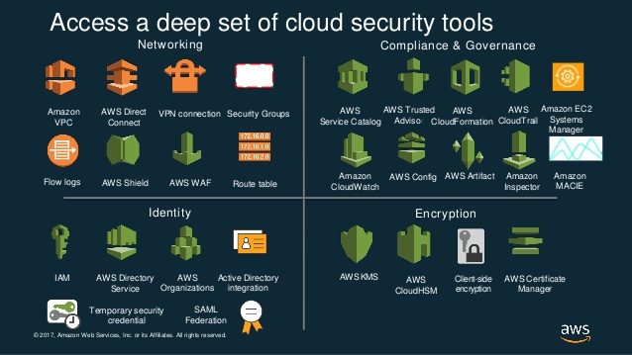
Cloud Compliance

Slide 58
Key Points

Slide 59
Some Key Points
Make sure you exercise due diligence when selecting a cloud service provider.
Make sure the cloud environment supports the regulatory requirements of your industry and data.
Conduct data classification to understand the sensitivity of your data before moving to the cloud.
Clearly define who owns the data and how it will be “returned” to you and the timing in the event you cancel your agreement.
Understand if you are leveraging the cloud in IaaS, PaaS, SaaS or other model.
Establish Service Level Agreements (SLAs) to ensure performance
Engage Cloud specific legal advice before moving to the cloud.

Slide 60
Some Key Points
Make sure your you schedule enough time to move your application or data center to the cloud.
Make sure you budget a sufficient amount.
Recognize that many organizational policies and procedures will need to be updated.
When using data provided by 3rd parties note that you may need to notify and append your agreement.
Do not let the IT skill level, who understands the business and your applications, weaken.

Slide 61
Blockchain

Slide 62
Blockchain
Blockchain will leverage the desire for better, faster and cheaper systems
Blockchain technology generally includes:
An open distributed database
Elliptic curve cryptography
Disintermediation - P2P
Decentralized autonomous entities (DAE/DAO) and distributed applications
Consensus based, hack proof

Slide 63
Blockchain
Trustless transfer of value - transactions
Definitive representation of value
Insert only, permanent
Supports Web 3.0
Supports fifth generation mobile infrastructure (5G)
Cloud services should hide all the complexities

Slide 64
Blockchain and Hashes
Hashes are the building blocks of blockchain.
A hash is simply a product of a hash function
Hashes are unique, one hash represents one specific input however multiple inputs can still generate 1 output.
Hashes can combine to form new hashes.
Hashes are random, if you change the input by a small little bit, the output will be completely different. You cannot tell whether two inputs are correlated based on their similarity in hash.
Hashes are asymmetrical, no reverse formula
The SHA-256 hash function used by bitcoin generates hashes of 256 bits. Each bit represents either a 0 or a 1. You can form 2^256 different hashes
Hashes are asymmetrical, no reverse formula

Slide 65
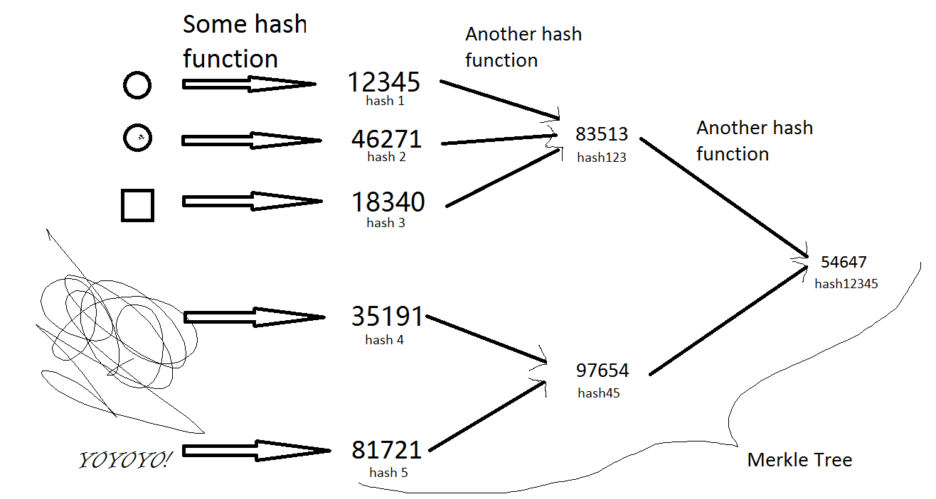
Blockchain
Merkle tree is a hash tree in which every leaf node is labelled with the hash of a data and every non-leaf node is labelled with the cryptographic hash of the labels of its child nodes.
Hash trees allow efficient and secure verification of the contents of large data structures.
Credit: Global Blockchain Association

Slide 66
Areas Where Government Believes Blockchain Can Be Valuable
Asset Management
Contract / Grant Management
Cybersecurity
Defense
Economic Analysis
Education
Emergency Management
Government Budgeting, Appropriations & Tracking
Health Care
Identity Management
Law Enforcement
Legislative & Legal
Oversight of Public Financial Institution Social Program Management (Welfare, Food Stamps)
Supply Chain & Logistics
Titling
Voting

Slide 67
Questions?
Thank you!

