Slide 1
Security of Cloud Computing
Hi – 5
Marcus Hogue
Chris Jacobson
Alexandra Korol
Mark Ordonez
Jinjia Xi

Slide 2
Topic Overview
Introduction
Cloud Basics
Securing the Cloud
Leveraging the Cloud
Final Recommendations

Slide 3
Introduction
Cloud Computing Industry is growing
According to Gartner, worldwide cloud services revenue is on pace to surpass $56.3 billion in 2009, a 21.3% increase from 2008 revenue of $46.4 billion, according to Gartner, Inc. The market is expected to reach $150.1 billion in 2013.
Businesses are increasing Cloud adoption
"We expect a great deal of migration towards cloud computing within the federal government in addition to the already robust private sector growth. The growth of the cloud should not outpace our ability to protect the data that goes into it..." ~ Former White House advisor Paul Kurtz, partner with Good Harbor Consulting, LLC
How can IT leaders ensure security in the cloud?
Notes:
“Worldwide cloud services revenue is on pace to surpass $56.3 billion in 2009, a 21.3 percent increase from 2008 revenue of $46.4 billion, according to Gartner, Inc. The market is expected to reach $150.1 billion in 2013.”
Business processes delivered as cloud services are the largest segment of the overall cloud services market, accounting for 83 percent of the overall market in 2008. The segment, consisting of cloud-based advertising, e-commerce, human resources and payments processing, is forecast to grow 19.8 percent in 2009 to $46.6 billion, up from $38.9 billion in 2008.
While much of the publicity for cloud computing currently centers on systems infrastructure delivered as a service, this is still an early-stage market. In 2008, such services accounted for only 5.5 percent of the overall cloud services market and are expected to account for 6 percent of the market in 2009. Infrastructure services revenue was $2.5 billion in 2008 and is forecast to reach $3.2 billion in 2009.

Slide 4
Cloud Basics
Cloud Characteristics
Service Models
SaaS
IaaS
PaaS
Deployment Models
Public
Private
Community
Hybrid

Slide 5
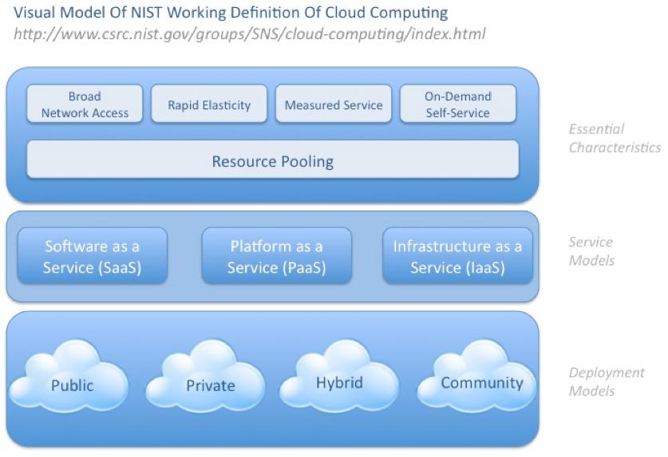
Cloud Characteristics
Notes:
General Definition – Cloud computing is the delivery of hosting services that are provided to a client over the Internet.
Cloud computing is different from traditional hosting because it is on demand, a user can specify how much of the service they want and the services are completely managed by the provider of the service.
http://searchcloudcomputing.techtarget.com/sDefinition/0,,sid201_gci1287881,00.html
On-Demand self-service – The client can allocate resources with no interaction with a person. Examples of this are network storage.
Broad network access – Access to resources on the network can be accesses by many different platforms(Cell phone, laptops, etc)
Resource pooling – The cloud provider pools computing resources to support many customers. Resources can be dynamically assigned based on customer demand. Also, customers do not know the exact location of resources, but generally know the region. Resources that are pooled can include but are not limited to storage, processing, network bandwidth. Private clouds also are able to pool resources between separate parts of the same organization.
Rapid Elasticity – Resources can be scaled up or down quickly. This is opaque to the customer, since the customer sees unlimited resources available and has the ability to purchase any amount of resources in any quantity for any amount of time
Measured Service – Service that consumers are using is tracked and metered. This allowed the cloud to “control and optimize” resources that are being leveraged by customers.
Three implementations of cloud computing – Infrastructure as a service, Platform as a service and Software as a service, which will be discussed on the next slide.
(15) CSA - Security Guidance for Critical Areas of Focus in Cloud Computing v2.1.pdf

Slide 6
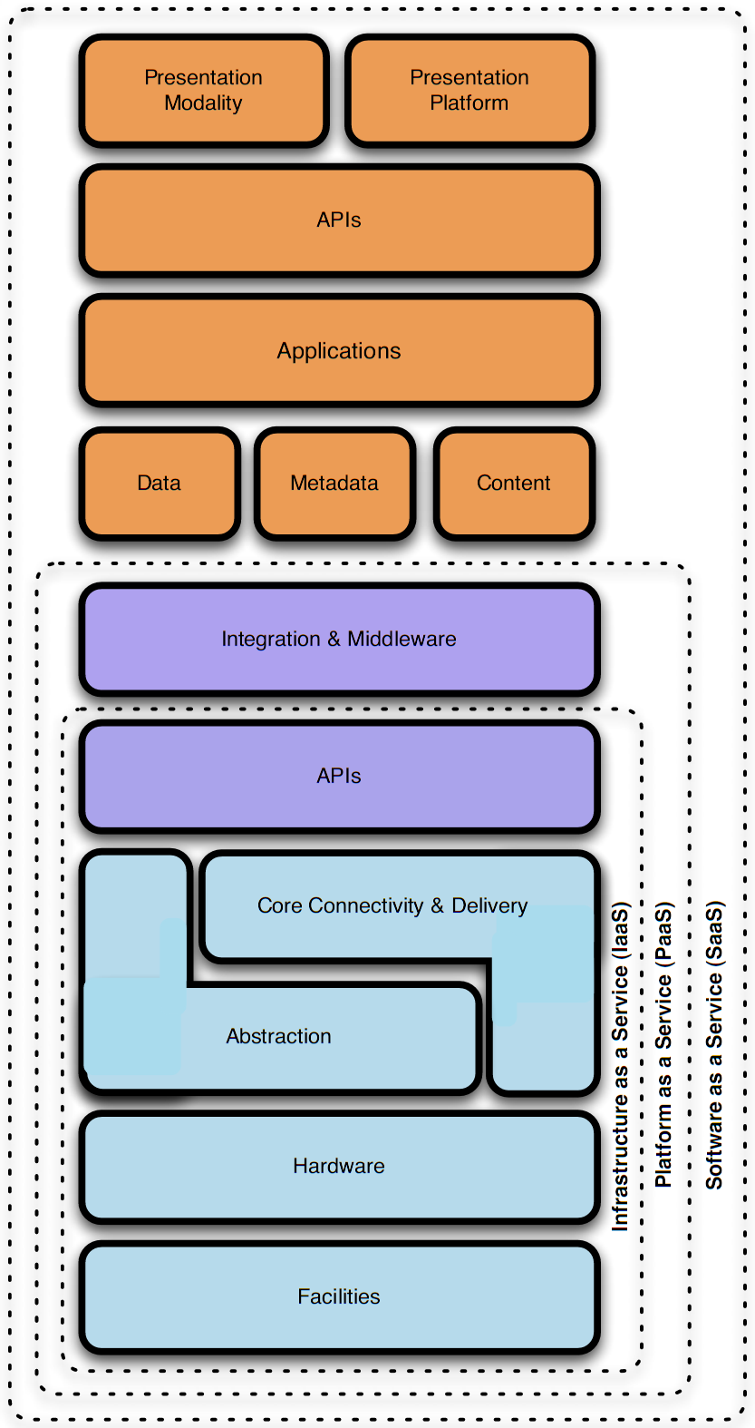
Cloud Service Models
Software as a Service (SaaS)
Platform as a Service (PaaS)
Infrastructure as a Service (IaaS)
Notes:
CSA, Security guidance for critical areas of focus in cloud computing
There are so many different cloud deployment options. This is a popular service model. It is called SPI service models.
SPI refers to Software as a Service, Platform as a Service, or Infrastructure as a Service, explained in depth in next slides
Higher layers are built on lower layers. Higher abstractions include lower ones.
IaaS:
Customer rent fundamental computing resources from service providers (for example: processing, storage, networks and so on).
And they are able to run their own operation system and applications. While they do not need manage and maintain hardware.
Example: Amazon EC2 provides resizable compute capacity in the cloud.
PaaS:
Customers deploy applications onto the provider’s infrastructure. These applications are created using programming languages and tools supported by the providers.
Beside the hardware, customers do not manage operation systems.
Example: Google App Engine supports two application environments: Java and Python
SaaS:
Customers use the provider’s application which is accessible over the Internet.
Customers only need control limited user-specific application configuration setting.
Example: Salesforce.Com offers CRM application. Customers use the CRM system as web application.

Slide 7
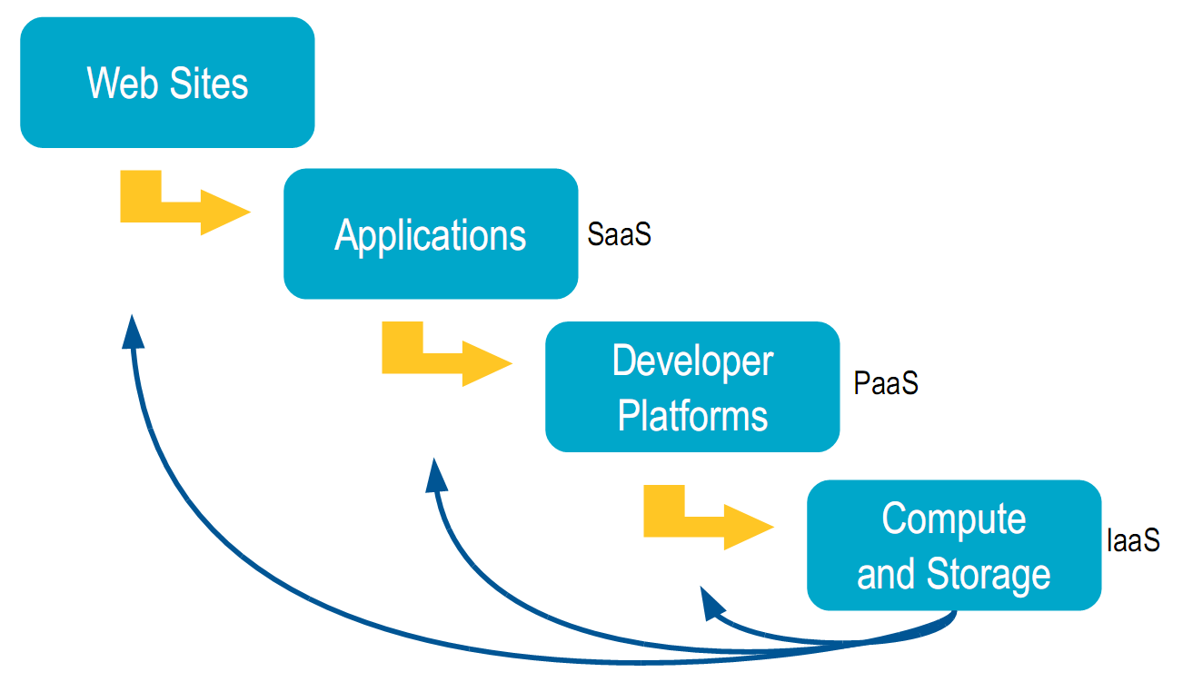
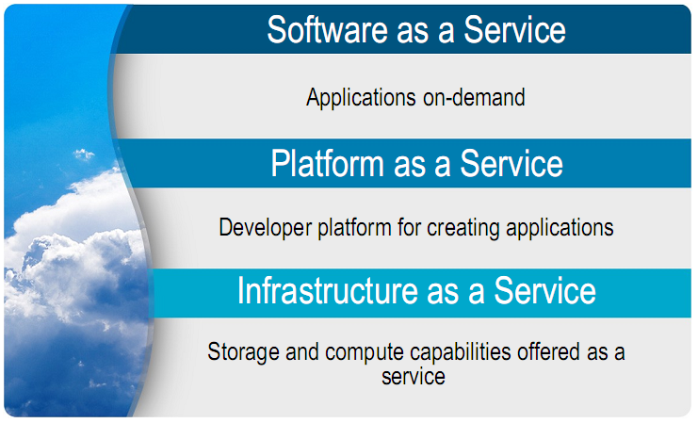
Natural Evolution of the Web
Source: Lew Tucker, Introduction to Cloud Computing for Enterprise Users
Notes:
Natural Evolution of the Web
How to set up new web sites traditionally? In general, there are three steps: buy compute and storage / hardware of servers, build developer platforms, create application => output is web sites
How cloud has changed this process? With cold computing, company can easily take a shortcut to build website. Some of the potential benefits include cost savings and the built-in flexibility.

Slide 8
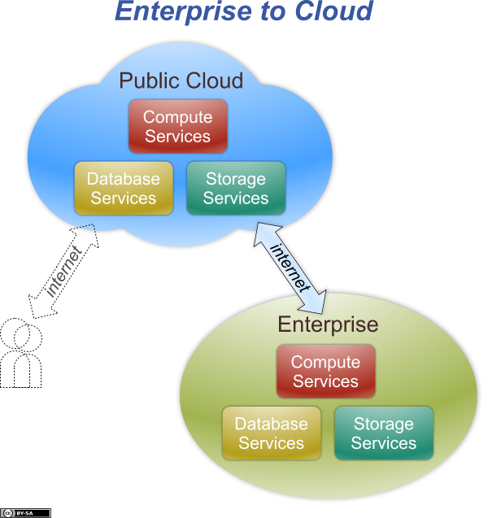
Four Deployment Models
Notes:
Regardless of the service model utilized (SaaS, PaaS, or IaaS) there are four deployment models for cloud services that address specific requirements:
Public Cloud
The cloud infrastructure is made available to any organizations.
For example: company may build their datacenter with Amazon Simple Storage Service, a secure VPN connect storage service and enterprise intranet.
(Both service providers and company are benefit from economies of scale.)

Slide 9
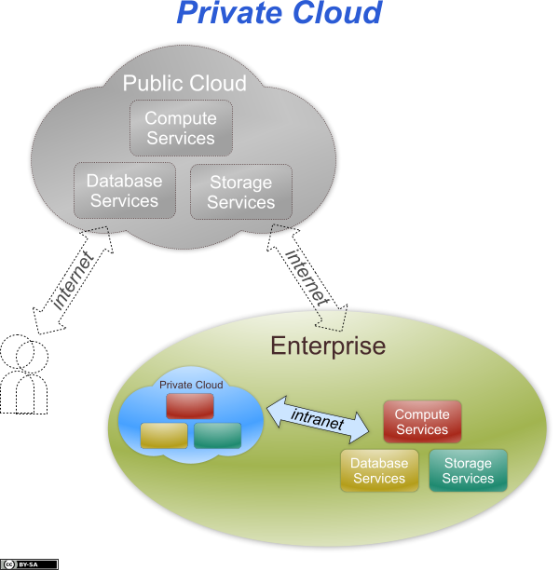
Four Deployment Models
Notes:
Private Cloud
If company has to keep lots of sensitive information in datacenter, public cloud maybe is not best approach.
The private cloud is usually a pool of resource inside a company. But it may be managed by either the company or a third party.
Private cloud offers the benefit and flexibility of cloud and does not scarify security.

Slide 10
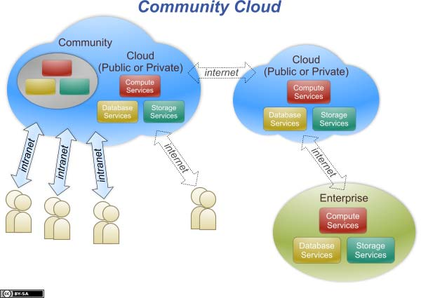
Four Deployment Models
Notes:
Community Cloud
The cloud infrastructure is shared by several organizations and supports a specific community that has shared concerns (e.g., mission, security requirements, policy, or compliance considerations).
The US Government and NASA created a community cloud for all US government agencies.

Slide 11
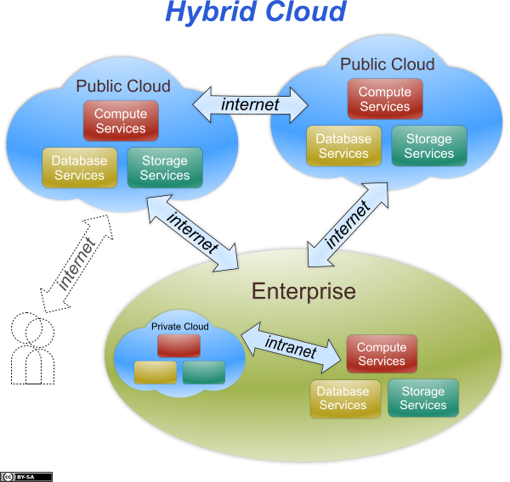
Four Deployment Models
Notes:
Hybrid Cloud
The cloud infrastructure is a combination of two or more clouds (private, community, or public) that remain unique entities.
The different types of clouds are bound together by standardized or proprietary technology that enables data and application portability.

Slide 12
Securing the Cloud
Security Interaction Model
Top Security Threats
Cloud Provider Security Practices – Google Case Study

Slide 13
Security Interaction Model
Notes:
Investigate provider security practices
Identify gaps between provider and consumer security policies; address as appropriate.

Slide 14
Top Security Threats
Abuse and nefarious use of cloud computing
Insecure interfaces & API’s
Unknown risk profile
Malicious insiders
Shared technology issues
Data loss or leakage
Account or service hijacking
Notes:
<TODO> Insert brief description of each type of threat

Slide 15
Threat Mitigation
Abuse and nefarious use of cloud computing | Stricter initial registration and validation processes. Enhanced credit card fraud monitoring and coordination. Comprehensive introspection of customer network traffic. Monitoring public blacklists for one’s own network blocks.
Insecure interfaces & API’s | Analyze the security model of cloud provider interfaces. Ensure strong authentication and access controls are implemented in concert with encrypted transmission. Understand the dependency chain associated with the API.
Unknown risk profile | Disclosure of applicable logs and data. Partial/full disclosure of infrastructure details Monitoring and alerting on necessary information.
Notes:
<TODO> Insert example of one of these threats

Slide 16
Threat Mitigation
Malicious insiders | Enforce strict supply chain management and conduct a comprehensive supplier assessment. Specify human resource requirements as part of legal contracts. Require transparency into overall information security and management practices, as well as compliance reporting. Determine security breach notification processes.
Shared technology issues | Implement security best practices for installation and configuration. Monitor environment for unauthorized changes/activity. Promote strong authentication and access control for administrative access and operations. Enforce service level agreements for patching and vulnerability remediation. Conduct vulnerability scanning and configuration audits.
Notes:
<TODO> Insert example of one of these threats

Slide 17
Threat Mitigation
Data loss or leakage | Implement strong API access control. Encrypt and protect integrity of data in transit. Analyze data protection at both design and run time. Implement strong key generation, storage and management, and destruction practices. Contractually demand providers wipe persistent media before it is released into the pool. Contractually specify provider backup and retention strategies.
Account or service hijacking | Prohibit the sharing of account credentials between users and services. Leverage strong two-factor authentication techniques where possible. Employ proactive monitoring to detect unauthorized activity. Understand cloud provider security policies and SLAs.
Notes:
<TODO> Insert example of one of these threats

Slide 18
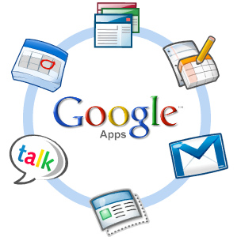
Google Security Practices
Organizational and Operational Security
Data Security
Threat Evasion
Safe Access
Privacy

Slide 19
Google Organizational and Operational Security
Holistic approach to security
Security team
Develop with security in mind
Regularly performs security audits and threat assessments
Employees screened, trained
Works with security community and advisors
Notes:
Google takes a holistic approach to security
They design security into products, architecture, infrastructure, and systems from the beginning.
Google employs a full time security team
They develop, document, and implement comprehensive security policies.
The team is divided into functional areas:
Perimeter defense
Infrastructure defense
Application defense
Vulnerability detection and response
The team focuses its efforts on preventative measures, and they respond to other security issues as they arise.
…

Slide 20
Google Data Security
Google Code of Conduct – “Don’t be evil.”
Physical security
Logical Security
Accessibility
Redundancy
Notes:
Google Code of Conduct
The corporate culture is security- and user-centric.
Physical security
Google has a large global network of distributed datacenters.
Geographic location of datacenters chosen to provide protection against catastrophic events.
Physical access to the datacenters is limited, tightly controlled, and audited.
Logical security
…
Accessibility
…
Redundancy
Multiple levels of redundancy are used to ensure reliability and availability.
Google maintains mirrors within a data center, as well as between datacenters.

Slide 21
Google Threat Evasion
Spam and virus protection built into products
Protects against application & network attacks
Notes:
Spam and virus protection
…
Application & network attacks
…

Slide 22
Google Safe Access
Avoids local storage
Access controls
Encrypted connections
Integrated security
Notes:
Avoids local storage
…
Access controls
…
Encrypted connections
…
Integrated security
…

Slide 23
Google Privacy
Privacy policy
Does not access confidential user data
Does not alter data
Maintain own IP rights
Indemnification, liability
End of use
Notes:
Privacy policy
…
Does not access confidential user data
…
Does not alter data
…
Maintain own IP rights
…
Indemnification, liability
…
End of use
…

Slide 24
Leveraging the Cloud
Decision Making Process
Clan Wars Case Study

Slide 25
Decision Making Process
Identify the asset for cloud deployment
Evaluate the asset requirements for confidentiality, integrity, and availability
Map the asset to potential cloud deployment models
Evaluate potential cloud service models and providers
Sketch the potential data flow
Draw conclusions
Notes:
Identify the asset for cloud deployment
Data
Applications / Functions / Processes
Evaluate the asset requirements for confidentiality, integrity, and availability. Sample questions to ask include:
1. How would we be harmed if the asset became widely public and widely distributed?
2. How would we be harmed if an employee of our cloud provider accessed the asset?
3. How would we be harmed if the process or function were manipulated by an outsider?
4. How would we be harmed if the process or function failed to provide expected results?
5. How would we be harmed if the information/data were unexpectedly changed?
6. How would we be harmed if the asset were unavailable for a period of time?
Map the asset to potential cloud deployment models
Public
Private, internal
Private, external
Community
Hybrid
Evaluate potential cloud service models and providers
Service models: SaaS, IaaS, PaaS
Providers: Google, Amazon, Microsoft, Rackspace
Sketch the potential data flow
Map data flow between organization, cloud, and other entities (i.e.: customer, vendor, etc)
Before making a decision, it is important to understand whether, and how, data can move in and out of the cloud
Draw conclusions

Slide 26
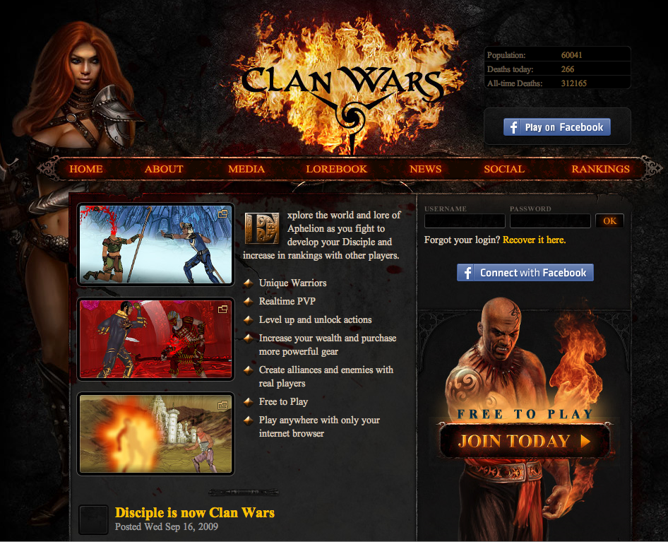
Case Study: Clan Wars Company Profile
Online multiplayer game
In Browser Flash
Processes credit card payments
Notes:
Since the game is multiplayer and browser based, there is a high risk for users attempting to modify the data stream. The concern grows when considering credit card data may be involved in the process.

Slide 27
Case Study: Clan Wars Decision Making Process
Identified all components as candidates
Evaluation concluded:
Payment = High concern on all factors
Game & data = Medium on all factors
Primary components mapped:
Infrastructure (Servers, storage, etc)
Payment Processing
Collaboration
Notes:
As the company was starting from scratch, all components were considered for cloud candidates.
The evaluation showed that the payment system was the highest concern. If the game was hacked in any way, we would restore from backup (and process refunds if needed).
The primary components were infrastructure, payment processing, and tools for collaborating internally (such as Google Apps, Dropbox, etc.)

Slide 28
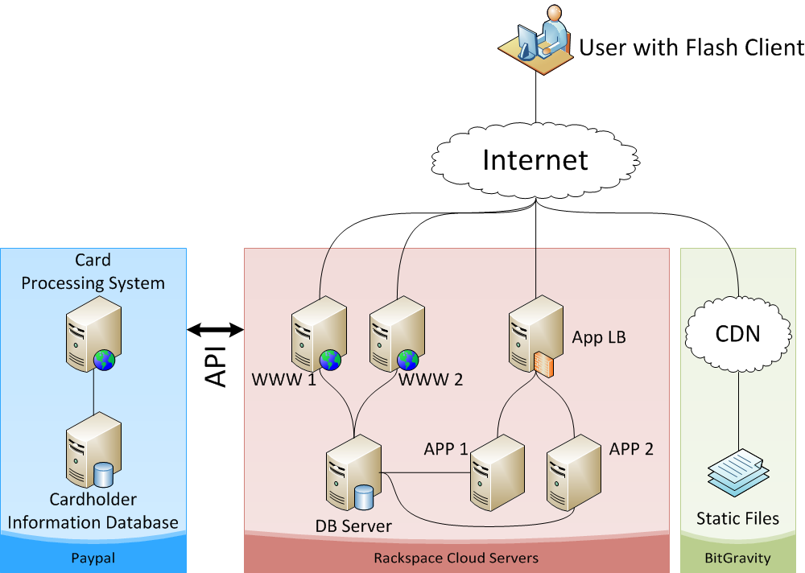
Case Study: Clan Wars Data Flow
Notes:
The user begins a session by browsing to the website where they will be directed to one of two web servers via DNS round-robin load balancing. Once the user initiates the game, the flash client (SWF files) are downloaded from the CDN and the flash client begins communicating with the Java application servers via an AMF gateway to the tomcat application server.
Payments happen via the web tier and the payments are processed directly via Paypal through calls to their API, rather than by Clan War’s web servers. The general process is:
Clan Wars tells PayPal “User X wants to make a payment to us for $Y”
PayPal handles the transaction
PayPal returns a succeed/fail code for the transaction
Clan Wars approves the transaction and the customer receives the item they are paying for.
At no step in the process does the credit card information reside on Clan War’s servers.

Slide 29
Case Study: Clan Wars Conclusion
Great fit
Risk requirements met
Data flow supports needs
Added benefits
Low cost (saving ~$500/month)
Low maintenance
Performance
Notes:
Usage based billing primary benefit in cost
Cost of servers ~$320/month
Cost of CDN ~$100/month
Cost of traditional servers ~$875/month
========
Maintenance benefits:
Backup/snapshots
Resize servers
Clone servers
Data Redundancy (RAID 0+1)
No concerns about maintaining file regional file servers

Slide 30
Final Recommendation
No universal answer
Evaluate your security needs versus the capabilities of the provider
Notes:
“Close the Gap”

Slide 31
Q & A

Slide 32
Supplemental Material
The sections that follow will not be covered during the presentation but are included for reference.

Slide 33
Rackspace Security Practices
Physical Security
System Security
Operational Infrastructure Security
Client Application Security
Notes:
Physical Security
Limited access to data centers
Biometric Scanning and access card access to datacenter
Visual Monitoring via security cameras
Auditing by independent firm
All employees have a background screening before getting hired
System Security
Systems run by secure OS that always has latest patches
Firewall and VPN access
User can get an optional IDS
Operational Security
Employee training on data and privacy policies
All systems are audited and logged, when someone accesses the system
Follows ISO17799 security policies and procedures
Application Security
Passwords are stored encrypted and transmitted encrypted
Random initial passwords
33

Slide 34
Cloud Consumer Best Practices
Governance Domains
Governance & Enterprise Risk Mgmt
Legal and Electronic Discovery
Compliance and Audit
Information Life Cycle Management
Portability and Interoperability
Operational Domains
Traditional Security, Business Continuity, and Disaster Recovery
Data Center operations
Incident Management
Application security
Encryption & Key Mgmt
Identity & access Mgmt
Virtualization

