Slide 1
Análise Estática e Protecção Dinâmica Parte III: Técnicas de Protecção
Segurança de Software
2019
Nuno Santos

Slide 2
Onde estamos
Parte I: Enquadramento e protecção (2 aulas)
Conceitos de segurança de software, mecanismos básicos de segurança
Parte II: Vulnerabilidades (3 aulas)
Buffer overflows, corridas e validação de entradas, vulnerabilidades na web e em bases de dados
Parte III: Técnicas de protecção (3 aulas)
Auditoria e teste de software, análise estática de código, protecção dinâmica, validação e codificação

Slide 3
Aula passada
Estudámos mais duas classes de vulnerabilidades:
Devido a corridas
Devido a validação de entradas

Slide 4
Plano para esta aula
Análise estática
Protecção dinâmica

Slide 5
Análise estática

Slide 6
Motivação
“So why do developers keep making the same mistakes? (…) Instead of relying on programmers’ memories, we should strive to produce tools that codify what is known about common security vulnerabilities and integrate it directly into the development process.”
David Evans e David Larochelle, Improving Security Using Extensible Lightweight Static Analysis

Slide 7
Análise estática de código fonte
Objective: to find vulnerabilities in the applications’ source code automatically
Similar to compiler’s error checking but for vulnerabilities
Similar to manual code reviewing but automatically
“Static” because the code is not executed
Some tools can analyze binary or intermediate code
but analyzing source code is simpler so more common

Slide 8
Procurar por strings perigosas
Simple tools like grep and findstr can do a very basic form of analysis; e.g.:
grep gets *.c grep strcpy *.c
Limitations
The user has to know which functions are dangerous
The user has to do all the “greps”
Do not distinguish between actual dangerous functions (e.g. gets) and instances of these strings that are not calls
Example:

Slide 9
Algumas ferramentas simples
Look for dangerous library/system calls
Detect calls, e.g., to gets, which are always dangerous (does not check array bounds), strcpy or sprintf (may be vulnerable to b.o.)
Examples: RATS, Flawfinder, ITS4
Attribute danger levels to the potential vulnerabilities they find
Main components
Database of vulnerable system/library calls
Code preprocessor (to check what will be really compiled)
Lexical analyzer (to read functions’ names)

Slide 10
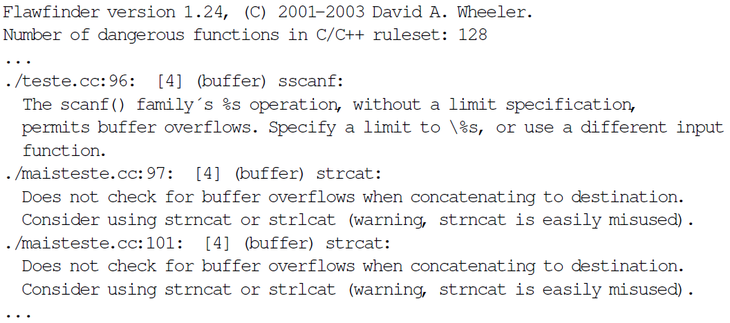
Exemplo de utilização do Flawfinder

Slide 11
Exemplo de uma base de dados (Flawfinder)

Slide 12
Falsos positivos
Basic analysis tools find vulnerabilities
They do something extra than grep: do not issue alarms if the function name is part of a longer word or inside a comment
But they generate many false positives
E.g., strcpy, sprintf, access, are dangerous but their use is not necessarily a vulnerability
Ex: a small program made by some students (WOO) was tested with Flawfinder and RATS, generating about 80 alarms, all false
False positives put burden of doing manual checking on the human
Therefore the quest in the area is for 2 goals:
Find all vulnerabilities (no false negatives)
Minimize number of false positives

Slide 13
Aspectos positivos da análise estática
Verifies code thoroughly and consistently, without bias or errors introduced by human auditors
Leads to the root of a security problem, not to its symptoms
Can find problems early in the development cycle, even before the code is run for the first time
When a new type of vulnerability appears, its definition can be inserted in the tool and the tool executed again (compare with manual code review)
Not only for security, also used to look for non-security bugs

Slide 14
Limitações da análise estática
Limited scope / false negatives
Only look for the types of problems they are programmed to look for
Analysis is necessarily limited: it is not possible to test all conditions (e.g., control flow options defined in runtime)
Tend to generate false positives
In fact a tradeoff: false positives vs false negatives (hits/misses)
Therefore manual work is still needed
Not a panacea to all problems
“A fool with a tool is still a fool”

Slide 15
Protecção dinâmica

Slide 16
Motivação
Also in security, passive mechanisms are not enough
Security development methodologies, testing, auditing, static analysis
Vulnerabilities still remain, so we need dynamic protection (or runtime protection)
Probably the cause of high descent on buffer overflow and other memory related attacks in recent years

Slide 17
Protecção dinâmica
The idea is to block attacks that may exploit existing vulnerabilities
We consider mostly the case of memory corruption attacks
They are one of the most pervasive classes of attacks: buffer overflows, format strings
Good idea to assume that they will not completely disappear…
so mechanisms to minimize their effects when they do happen are important
The topic is vast, there are many others

Slide 18
Canários / Stack cookies
void test(char *s) {
push canary;
char buf[10];
strcpy(buf, s);
…
if (canary is changed) {log; exit;};
}
Idea: canaries in the mines
Compile time technique
Canary = 32bit random value
Appeared in StackGuard; /GS flag in Visual Studio 7.0 and above
Implemented by the compiler
Stack smashing:
address of buf
address of s
buf
saved ebp
ret address
lower addresses on the top (stack goes up)
canary
overflow
Notes:
gcc:
-fstack-protector
Emit extra code to check for buffer overflows, such as stack smashing attacks. This is done by adding a guard variable to functions with vulnerable objects. This includes functions that call alloca, and functions with buffers larger than 8 bytes. The guards are initialized when a function is entered and then checked when the function exits. If a guard check fails, an error message is printed and the program exits.
-fstack-protector-all
Like -fstack-protector except that all functions are protected.
-fno-stack-protector

Slide 19
Canários / Stack cookies (cont.)
Detects some stack smashing attacks
Stack smashing attacks that overwrite the return address (saved EIP) – to jump to injected code or ret-to-libc
Off-by-one errors that overwrite the saved EBP
May not detect BO attacks that modify local variables (they are below the canary)
Function-pointer clobbering, Data-pointer modification, Exception-handler hijacking (Windows Structured Exception Handler – SEH)
Detects, but possibly too late, BO attacks against the function arguments (are above the ret address)

Slide 20
Protecção das variáveis locais
Canaries do not protect local vars from overflows
Solution: reorder the stack layout
All char buffers are put above all other local variables
Ex: ProPolice
buf
local variables
saved ebp
ret address
local variables
buf
saved ebp
ret address
overflow
lower addresses on the top (stack goes up)
canary

Slide 21
Stack não executável
Many buffer overflow attacks involve injecting shell code in the stack/heap
Simple protection: mark these memory pages as non-executable (NX)
Old idea but x86 CPUs did not support it until ~2004
Several names:
Intel – Execute Disable (XD-bit)
AMD – Enhanced Virus Protection
Microsoft – Data Execution Prevention (DEP)
others call it W^X (write or execute, but not both)
Activated by the compiler (e.g., -z noexecstack in gcc); usually on by default

Slide 22
Stack não executável (cont.)
Limitations of NX
Doesn’t protect from ret-to-libc/return-oriented programming attacks
There may be lib functions that can be called to turn-off NX
ex: in a Windows program a call to NtSetInformationProcess disables NX (to allow apps to load DLLs incompatible with NX)
not too critical as attacker would have to first exploit a vulnerability do call that function
Some apps can be incompatible with it
Apps that perform high-performance image manipulation/rendering sometimes create binary code in runtime
Some interpreted languages compile scripts into binary code
Partial solution is to limit this kind of “data that becomes code” into a limited set of memory pages

Slide 23
Array bound checking
BOs caused by lack of array bound checking, so doingt he check solves the problem
Already done in languages like Java
Currently supported in C compilers like gcc (flag Warray-bounds)
However, it’s easy to check a[3], but not *(a+3) or a[i]
gcc gives warning | gcc doesn’t give warning
char str[10]; int i; for (i=0; i<10; i++) { str[i] = 'a'; } str[10]='\0'; | char str[10]; int i; for (i=0; i<10; i++) { str[i] = 'a'; } str[i]='\0';
Notes:
Exemplo completo:
#include<stdio.h>
#include<string.h>
int main(int argc, char *argv[])
{
char str[10];
int i;
for (i=0; i<10; i++) {
str[i] = 'a';
}
str[i]='\0';
printf("string: %s", str);
return 0;
}

Slide 24
Conclusões
Corridas são violações das espectativas do programador sobre a atomicidade de um programa durante uma janela de vulnerabilidade
Os principais objectivos de explorar essas vulnerabilidades são escalar privilégios e as mais comuns são: TOCTOU, ficheiros temporários, e concorrência
Outra classe de vulnerabilidades é deficiente validação de entradas, que permite ao atancante injectar dados que resultem num desvio do comportamento normal do programa

Slide 25
Referências e próxima aula
Bibliografia
[Correia17] Capítulos 6 e 7
Próxima aula
Vulnerabilidades na Web e em bases de dados

