Slide 1
State-of-the-Art and Challenges for the Internet of Things Security
Internet-Draft (IRTF-T2TRG)
Henrique Pötter

Slide 2

Draft origins
Based in a draft from 2011
Security Considerations in the IP-based Internet of Things
Notes:
100 reviewers over 6 years

Slide 3
Draft origins
Based in a draft from 2011
Security Considerations in the IP-based Internet of Things
Becomes a IRTF Internet Draft in 2016
State-of-the-Art and Challenges for the Internet of Things Security
Last update 13 of February
Notes:
100 reviewers over 6 years

Slide 4

Draft origins
Based in a draft from 2011
Security Considerations in the IP-based Internet of Things
Becomes a IRTF Internet Draft in 2016
State-of-the-Art and Challenges for the Internet of Things Security
Last update 13 of February
Notes:
100 reviewers over 6 years

Slide 5
Draft origins
It’s a good summary of all ongoing standardizing efforts being done by the IETF
Notes:
100 reviewers over 6 years

Slide 6
The Internet Of Things
“It is a global network of interconnected objects, uniquely identifiable based on a standard communication protocol.” [CERP-IoT 2010]
“The Internet of Things allows people and things to be connected Anytime, Anyplace, with Anything and Anyone, ideally using Any path/network and Any service.” [Perera et al. 2014]

Slide 7


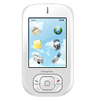









The Internet Of Things
Communication between objects with minimum or no human intervention
Internet

Slide 8
Internet of Things Security risks
Compromised IOT systems can cause physical harm
User dependency on sensors and actuators
Notes:
Brand image, privilege scalation and exploit other parts of a network, business death

Slide 9

Internet of Things Security risks
Compromised IOT systems can cause physical harm
User dependency on sensors and actuators
Notes:
Brand image, privilege scalation and exploit other parts of a network, business death

Slide 10

Internet of Things Security risks
Compromised IOT systems can cause physical harm
User dependency on sensors and actuators
Notes:
Brand image, privilege scalation and exploit other parts of a network, business death

Slide 11

Internet of Things Security risks
Compromised IOT systems can cause physical harm
User dependency on sensors and actuators
Scales with IOT
Bug exploit in one device means…
Brand image
Alter functionality
Notes:
Brand image, privilege scalation and exploit other parts of a network, business death

Slide 12
Internet of Things Security risks
Compromised IOT systems can cause physical harm
User dependency on sensors and actuators
Scales with IOT
Bug exploit in one device means…
Brand image
Alter functionality
Notes:
Brand image, privilege scalation and exploit other parts of a network, business death

Slide 13
Internet of Things Security risks
Compromised IOT systems can cause physical harm
User dependency on sensors and actuators
Scales with IOT
Bug exploit in one device means…
Brand image
Alter functionality
Compromised systems used to perform DDoS
Notes:
Brand image, privilege scalation and exploit other parts of a network, business death

Slide 14

Internet of Things Security
Security
Confidentiality
Notes:
Talking about security can be too broad so they define an application context to help better define each term

Slide 15

Internet of Things Security
Security
Confidentiality
Authentication
Notes:
Talking about security can be too broad so they define an application context to help better define each term

Slide 16

Internet of Things Security
Security
Confidentiality
Authentication
Integrity
Notes:
Assurance that the data you see have not been modified

Slide 17


Internet of Things Security
Security
Confidentiality
Authentication
Integrity
Authorization
Notes:
Talking about security can be too broad so they define an application context to help better define each term

Slide 18


Internet of Things Security
Security
Confidentiality
Authentication
Integrity
Authorization
Availability
24h available
Notes:
Talking about security can be too broad so they define an application context to help better define each term

Slide 19
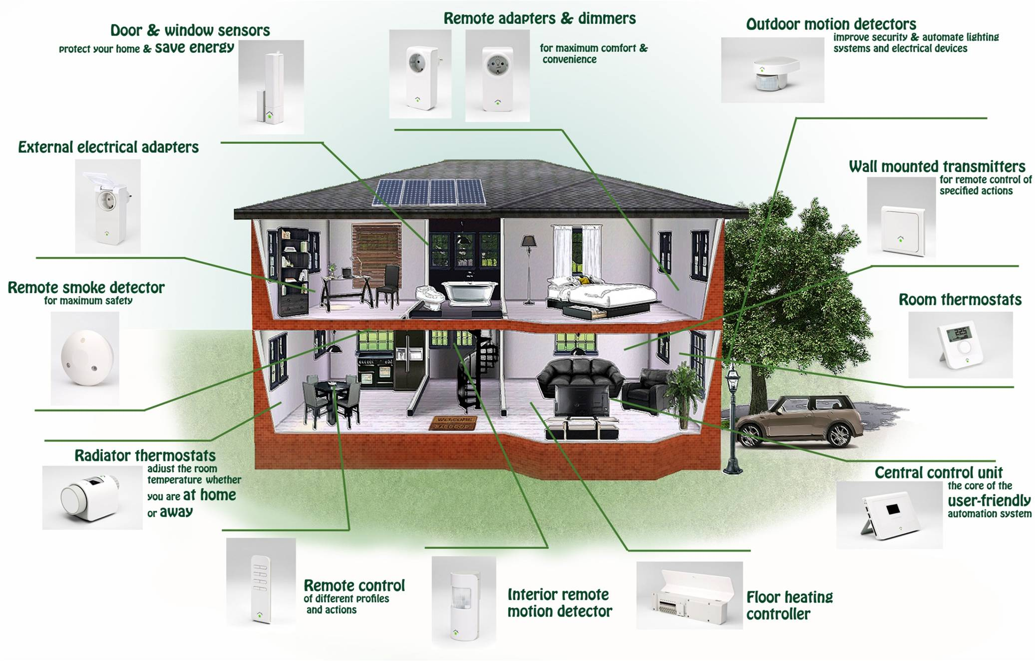
Application Scenario
Building Automation and Control (BAC)
Notes:
Interoperability and trust between nodes of different vendors

Slide 20
Application Scenario
Building Automation and Control (BAC)
Contains the domain of
Heating, Ventilating, and Air Conditioning (HVAC domain)
Lighting
Safety
Notes:
Interoperability and trust between nodes of different vendors

Slide 21
Application Scenario
Building Automation and Control (BAC)
Contains the domain of
Heating, Ventilating, and Air Conditioning (HVAC domain)
Lighting
Safety
Interconnected constrained nodes
Notes:
Interoperability and trust between nodes of different vendors

Slide 22
Application Scenario
Building Automation and Control (BAC)
Contains the domain of
Heating, Ventilating, and Air Conditioning (HVAC domain)
Lighting
Safety
Interconnected constrained nodes
Some battery operated and may rely on energy harvesting
Notes:
Interoperability and trust between nodes of different vendors

Slide 23
Application Scenario
Building Automation and Control (BAC)
Contains the domain of
Heating, Ventilating, and Air Conditioning (HVAC domain)
Lighting
Safety
Interconnected constrained nodes
Some battery operated and may rely on energy harvesting
Heterogeneous manufactures due to different applications (HVAC)
Notes:
Interoperability and trust between nodes of different vendors

Slide 24

The Thing Lifecycle
Device vulnerabilities?

Slide 25
The Thing Lifecycle

Slide 26

The Thing Lifecycle
Manufactured

Slide 27

The Thing Lifecycle
Manufactured
Installed

Slide 28

The Thing Lifecycle
Manufactured
Installed
Commissioned
Notes:
Commissioned , bring (something newly produced, such as a factory or machine) into working condition

Slide 29
The Thing Lifecycle
Manufactured
Installed
Commissioned
Bootstrapping

Slide 30

The Thing Lifecycle
Manufactured
Installed
Commissioned
Application Running
Bootstrapping
Operational

Slide 31


The Thing Lifecycle
Manufactured
Installed
Software update
Commissioned
Reconfigured
Application Running
Bootstrapping
Operational
Maintenance & re-bootstrapping

Slide 32
The Thing Lifecycle
Manufactured
Installed
Software update
Commissioned
Reconfigured
Application Running
Application Running
Bootstrapping
Operational
Maintenance & re-bootstrapping
Operational

Slide 33
The Thing Lifecycle
Manufactured
Installed
Software update
Decommissioned
Commissioned
Reconfigured
Application Running
Application Running
Bootstrapping
Operational
Maintenance & re-bootstrapping
Operational

Slide 34

The Thing Lifecycle
Manufactured
Installed
Software update
Decommissioned
Commissioned
Reconfigured
Removed & replaced
Application Running
Application Running
Bootstrapping
Operational
Maintenance & re-bootstrapping
Operational

Slide 35

The Thing Lifecycle
Manufactured
Installed
Software update
Decommissioned
Commissioned
Reconfigured
Removed & replaced
Reownership & recommissioned
Application Running
Application Running
Bootstrapping
Operational
Maintenance & re-bootstrapping
Operational

Slide 36
The Thing Lifecycle
Manufactured
Installed
Software update
Decommissioned
Commissioned
Reconfigured
Removed & replaced
Reownership & recommissioned
Application Running
Application Running
Bootstrapping
Operational
Maintenance & re-bootstrapping
Operational
Maintenance & re-bootstrapping
Notes:
This is not a comprehensive lifecycle. Composite devices can complicate this, but it’s a generic one that can be adapted.

Slide 37
Security Threats
Cloning of things
Clone firmware, security configurations
Reverse engineer
Change functionality/add a backdoor
Manufacturing
Application Running

Slide 38
Security Threats
Cloning of things
Clone firmware, security configurations
Reverse engineer
Change functionality/add a backdoor
Manufacturing
Application Running

Slide 39
Security Threats
Malicious substitution of things
Installation

Slide 40

Security Threats
Malicious substitution of things
Different device is installed during Installation phase
Installation

Slide 41
Security Threats
Eavesdropping attack
Commissioning
Application operational

Slide 42

Security Threats
Eavesdropping attack
Security parameters exchanged in clear text
Device lifetime exceeds the cryptographic algorithms lifetime
Messages during T2T communication
Commissioning
Application operational

Slide 43

Security Threats
Man-in-the-middle attack
Hub
Commissioning
Application operational

Slide 44

Security Threats
Man-in-the-middle attack
Security parameters update exchanged in clear text
If device authentication is human-assisted, it may create a weak link
Hub
Commissioning
Application operational

Slide 45
Security Threats
Firmware attacks
Software update
Application operational

Slide 46
Security Threats
Firmware attacks
During maintenance a new malicious firmware may be updated
Old firmware may contain security exploits
Software update
Application operational

Slide 47
Security Threats
Routing attack (6loWPAN)
Application operational
Notes:
Should not be here since is an already studied case and network related

Slide 48
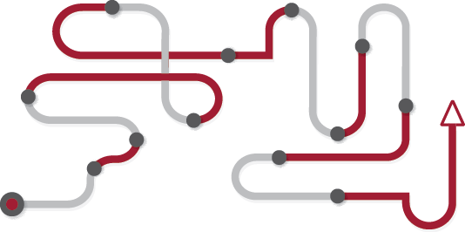
Security Threats
Routing attack (6loWPAN)
Spoofed
Altered
Replayed
Types
Sinkhole
Selective forwarding
Wormhole
Sybil attack
Application operational
Notes:
Packet priorities

Slide 49

Security Threats
Privilege scalation
Authentication system flaw
Low privileged user access higher priority resources
Notes:
Device impersonation

Slide 50
Security Threats
Privilege scalation
Authentication system flaw
Low privileged user access higher priority resources
Notes:
Device impersonation

Slide 51






Security Threats
Privacy threats
Notes:
Issue escalates as more and more people dominate Machine learning techniques

Slide 52

Security Threats
Privacy threats
Infer information based on device profile and messaging patterns
Also known as second channel attack
Notes:
Issue escalates as more and more people dominate Machine learning techniques

Slide 53

Security Threats
Denial-of-Service attack

Slide 54
Security Threats
Denial-of-Service attack
Physically jamming the network medium
Constrained devices are more vulnerable
Resource exhaustion
Compromised devices used in a Distributed DoS

Slide 55
State-of-the-Art IP-based Standards for IOT

Slide 56
IP-based Standards for IOT
There are many control protocols for enclosed systems
In the context of Building Automation and Control
ZigBee
BACNet by the American Society of Heating, Refrigerating and Air-Conditioning Engineers (ASHRAE)
DALI (Digital Addressable Lighting Interface)

Slide 57
IP-based Standards for IOT
There are many control protocols for enclosed systems
In the context of Building Automation and Control
ZigBee
BACNet by the American Society of Heating, Refrigerating and Air-Conditioning Engineers (ASHRAE)
DALI (Digital Addressable Lighting Interface)
Trend focus is an all-IP

Slide 58
IP-based Standards for IOT
IPv6 and CoAP are the IOT building blocks
Internet

Slide 59
IP-based Standards for IOT
IPv6 and CoAP are the IOT building blocks
CoAP
IPv6

Slide 60
IP-based Standards for IOT
6LoWPAN [RFC4944]

Slide 61
IP-based Standards for IOT
6LoWPAN [RFC4944]
Adapting IPv6 over Low Rate Wireless networks (IEEE 802.15.4)
Bluetooth Low Energy

Slide 62

IP-based Standards for IOT
6LoWPAN [RFC4944]
Adapting IPv6 over Low Rate Wireless networks (IEEE 802.15.4)
Bluetooth Low Energy
BLE Gateway

Slide 63
IP-based Standards for IOT
6LoWPAN [RFC4944]
Adapting IPv6 over Low Rate Wireless networks (IEEE 802.15.4)
Bluetooth Low Energy
IP
IP
IP
Wi-Fi and BLE Gateway

Slide 64
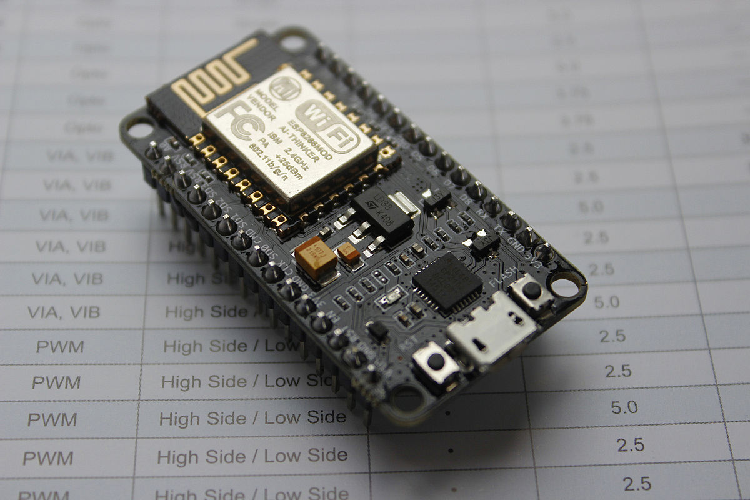
IP-based Standards for IOT
6LoWPAN [RFC4944]
Adapting IPv6 over Low Rate Wireless networks (IEEE 802.15.4)
Bluetooth Low Energy
Notes:
Esp8266 wifi modules that cost 2$ at scale
W32 wifi + BLE

Slide 65
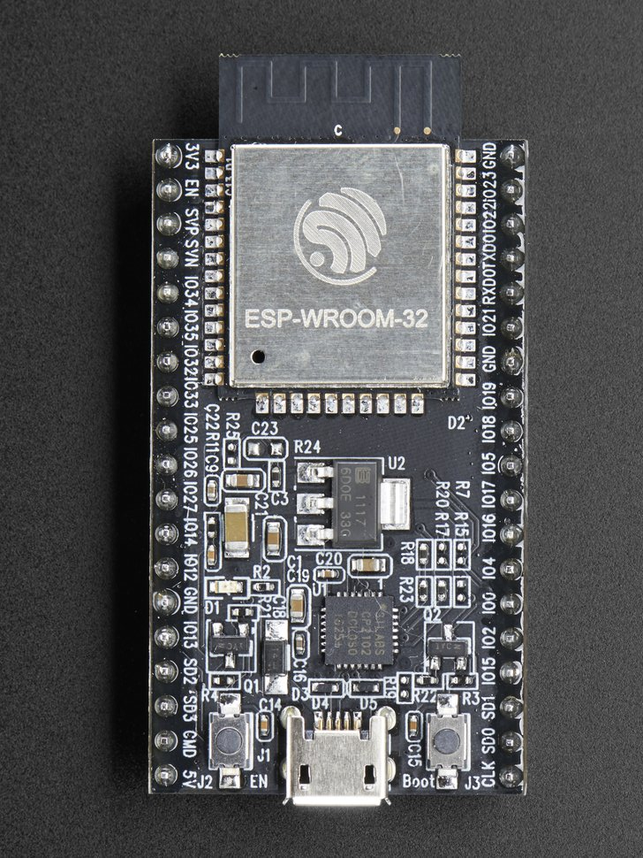
IP-based Standards for IOT
6LoWPAN [RFC4944]
Adapting IPv6 over Low Rate Wireless networks (IEEE 802.15.4)
Bluetooth Low Energy
Notes:
Esp8266 wifi modules that cost 2$ at scale
W32 wifi + BLE

Slide 66
IP-based Standards for IOT
Constrained Application Protocol (CoAP) [RFC7252]
Notes:
“if” describes an interface that defines the “verbs” of actions for that resource

Slide 67
IP-based Standards for IOT
Constrained Application Protocol (CoAP) [RFC7252]
RESTful protocol for constrained devices
REQ: GET /.well-known/core
Notes:
“if” describes an interface that defines the “verbs” of actions for that resource

Slide 68
IP-based Standards for IOT
Constrained Application Protocol (CoAP) [RFC7252]
RESTful protocol for constrained devices
REQ: GET /.well-known/core
RES: 2.05 Content
</sensors/temp>;if="sensor",
</sensors/light>;if="sensor"
Notes:
“if” describes an interface that defines the “verbs” of actions for that resource

Slide 69
IP-based Standards for IOT
Resource Directory (RD) [ID-rd]
Notes:
“rt” application specific semantic type. May even redirect to an Ontology description.

Slide 70
IP-based Standards for IOT
Resource Directory (RD) [ID-rd]
Hosts with descriptions of other nodes locations
Uses CoRE link format [RFC6690]
“GET /.well-known/core?rt=light-lux”
Notes:
“rt” application specific semantic type. May even redirect to an Ontology description.

Slide 71
IP-based Standards for IOT
The Sensor Measurement Lists (SenML) [ID-senml]

Slide 72
IP-based Standards for IOT
The Sensor Measurement Lists (SenML) [ID-senml]
Defines media types for simple sensor measurements and parameters

Slide 73
IP-based Standards for IOT
The Sensor Measurement Lists (SenML) [ID-senml]
Defines media types for simple sensor measurements and parameters
[
{"bn":"urn:dev:ow:10e2073a01080063:","n":"voltage","u":"V","v":120.1},
{"n":"current","u":"A","v":1.2}
]

Slide 74
IP-based Standards for IOT
The Sensor Measurement Lists (SenML) [ID-senml]
Defines media types for simple sensor measurements and parameters
[
{"bn":"urn:dev:ow:10e2073a01080063:","n":"voltage","u":"V","v":120.1},
{"n":"current","u":"A","v":1.2}
]
Property Name | SenML | JSON Type | XML Type | CBOR Label
Base Name | bn | String | String | -2
Base Time | bt | Number | Double | -3
Base Unit | bu | String | String | -4
… | … | … | … | …

Slide 75
IP-based Standards for IOT
Routing Protocol for Low-Power and Lossy Networks (RPL) [RFC6550]

Slide 76
IP-based Standards for IOT
Routing Protocol for Low-Power and Lossy Networks (RPL) [RFC6550]
For more then one hop direct connections between devices and a gateway

Slide 77
IP-based Standards for IOT
Routing Protocol for Low-Power and Lossy Networks (RPL) [RFC6550]
For more then one hop direct connections between devices and a gateway

Slide 78
IP-based Standards for IOT
Concise Binary Object Representation (CBOR)

Slide 79
IP-based Standards for IOT
Concise Binary Object Representation (CBOR)
JSON like
[
{"bn":"urn:dev:ow:10e2073a01080063:","n":"voltage","u":"V","v":120.1},
{"n":"current","u":"A","v":1.2}
]

Slide 80
IP-based Standards for IOT
Concise Binary Object Representation (CBOR)
JSON like
0000 87 a7 21 78 1b 75 72 6e 3a 64 65 76 3a 6f 77 3a |..!x.urn:dev:ow:|
0010 31 30 65 32 30 37 33 61 30 31 30 38 30 30 36 3a |10e2073a0108006:|
0020 22 fb 41 d3 03 a1 5b 00 10 62 23 61 41 20 05 00 |".A...[..b#aA ..|
0030 67 76 6f 6c 74 61 67 65 01 61 56 02 fb 40 5e 06 |gvoltage.aV..@^.|
0040 66 66 66 66 66 a3 00 67 63 75 72 72 65 6e 74 06 |fffff..gcurrent.|
0050 24 02 fb 3f f3 33 33 33 33 33 33 a3 00 67 63 75 |$..?.333333..gcu|
0060 72 72 65 6e 74 06 23 02 fb 3f f4 cc cc cc cc cc |rrent.#..?......|
0070 cd a3 00 67 63 75 72 72 65 6e 74 06 22 02 fb 3f |...gcurrent."..?|
0080 f6 66 66 66 66 66 66 a3 00 67 63 75 72 72 65 6e |.ffffff..gcurren|
0090 74 06 21 02 f9 3e 00 a3 00 67 63 75 72 72 65 6e |t.!..>...gcurren|
00a0 74 06 20 02 fb 3f f9 99 99 99 99 99 9a a3 00 67 |t. ..?.........g|
00b0 63 75 72 72 65 6e 74 06 00 02 fb 3f fb 33 33 33 |current....?.333|
00c0 33 33 33 |333|
00c3

Slide 81
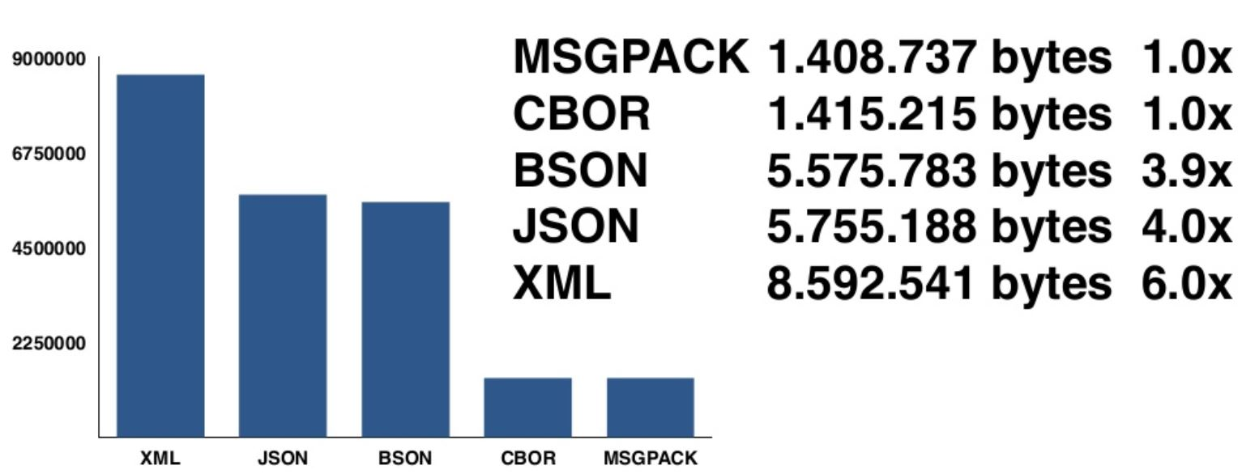
IP-based Standards for IOT

Slide 82
IP-based Security Standards for IOT
Security Objectives
IoT network
IoT applications, things and users
The Internet and other things from attacks of compromised things

Slide 83
IP-based Security Standards for IOT
CoAP with DTLS
NoSec
Notes:
DTLS is an implementation of TLS over UDP

Slide 84
IP-based Security Standards for IOT
CoAP with DTLS
NoSec
PreSharedKey
Notes:
DTLS is an implementation of TLS over UDP

Slide 85
IP-based Security Standards for IOT
CoAP with DTLS
NoSec
PreSharedKey
RawPublicKey
DTLS is enabled and the device has an asymmetric key pair without a certificate
Notes:
DTLS is an implementation of TLS over UDP

Slide 86
IP-based Security Standards for IOT
CoAP with DTLS
NoSec
PreSharedKey
RawPublicKey
DTLS is enabled and the device has an asymmetric key pair without a certificate
Certified mode
DTLS is enabled and the device has an asymmetric key pair with an X.509 certificate
"coaps:" "//" host [ ":" port ] path-abempty [ "?" query ]
Notes:
DTLS is an implementation of TLS over UDP

Slide 87
IP-based Security Standards for IOT
CoAP with DTLS
NoSec
PreSharedKey
RawPublicKey
DTLS is enabled and the device has an asymmetric key pair without a certificate
Certified mode
DTLS is enabled and the device has an asymmetric key pair with an X.509 certificate
"coaps:" "//" host [ ":" port ] path-abempty [ "?" query ]
coaps://example.net/.well-known/core
Notes:
DTLS is an implementation of TLS over UDP

Slide 88
IP-based Security Standards for IOT
Ongoing work on authentication schemes
The Authentication and Authorization for Constrained Environments (ACE)
Based on OAuth 2.0 framework

Slide 89
IP-based Security Standards for IOT
CBOR Object Signing and Encryption (COSE)
Specifies encodings cryptographic keys, message authentication codes, encrypted content, and signatures with CBOR

Slide 90
IP-based Security Standards for IOT
IoT Security Guidelines

Slide 91
IP-based Security Standards for IOT
IoT Security Guidelines
GSMA IoT security guidelines
BITAG Internet of Things (IoT) Security and Privacy Recommendations
CSA New Security Guidance for Early Adopters of the IoT
U.S. Department of Homeland Security
NIST
Open Web Application Security Project (OWASP)
IoT Security foundation
Best Current Practices (BCP) for IoT devices
The European Union Agency for Network and Information Security

Slide 92
Challenges for a Secure IoT

Slide 93
Challenges for a Secure IoT
Resource constraints
Lossy and low-bandwidth communication channels

Slide 94
Challenges for a Secure IoT
Resource constraints
Lossy and low-bandwidth communication channels
IEEE 802.15.4 supports 127-byte sized may result in fragmentation of larger packets required by security protocols
Possible DoS exploit, due to losses and retransmissions

Slide 95
Challenges for a Secure IoT
Resource constraints
Lossy and low-bandwidth communication channels
IEEE 802.15.4 supports 127-byte sized may result in fragmentation of larger packets required by security protocols
Possible DoS exploit, due to losses and retransmissions
Scarce processing and memory capacity limits the usage of resource expensive cryptographic primitives
Efforts in more efficient cryptography

Slide 96
Challenges for a Secure IoT
Resource constraints
Lossy and low-bandwidth communication channels
IEEE 802.15.4 supports 127-byte sized may result in fragmentation of larger packets required by security protocols
Possible DoS exploit, due to losses and retransmissions
Scarce processing and memory capacity limits the usage of resource expensive cryptographic primitives
Efforts in more efficient cryptography
Elliptic Curve Cryptography [RFC5246]
Diet HIP [ID-HIP-DEX]
Elliptic Curve Groups modulo a Prime [RFC5903]

Slide 97
Challenges for a Secure IoT
Denial-of-Service Resistance
Easy exploit in resource constrained devices

Slide 98
Challenges for a Secure IoT
Denial-of-Service Resistance
Easy exploit in resource constrained devices
T2T attacks is hard to detect until a service becomes unavailable

Slide 99
Challenges for a Secure IoT
Denial-of-Service Resistance
Easy exploit in resource constrained devices
T2T attacks is hard to detect until a service becomes unavailable
DTLS, IKEv2, HIP have DoS counter measures
Return routability delay the connection establishment at the responding host until the address of the initiating host is verified

Slide 100
Challenges for a Secure IoT
Denial-of-Service Resistance
Easy exploit in resource constrained devices
T2T attacks is hard to detect until a service becomes unavailable
DTLS, IKEv2, HIP have DoS counter measures
Return routability delay the connection establishment at the responding host until the address of the initiating host is verified
Not effective in broadcast media
Or if attacker can modify routing table

Slide 101
Challenges for a Secure IoT
Denial-of-Service Resistance
HIP uses puzzle mechanism
Each node needs to solve a cryptographic puzzle of varying difficulty
Powerful Attacker can force weak nodes to solve hard problems and exclude them from communication

Slide 102
Challenges for a Secure IoT
End-to-end security, protocol translation, and the role of middleboxes
Sender to receiver confidentiality and integrity
Encryption commonly used
Gateways can’t change or access the data

Slide 103
Challenges for a Secure IoT
End-to-end security, protocol translation, and the role of middleboxes
Sender to receiver confidentiality and integrity
Encryption commonly used
Gateways can’t change or access the data
Middlebox
Internet

Slide 104
Challenges for a Secure IoT
End-to-end security, protocol translation, and the role of middleboxes
Sender to receiver confidentiality and integrity
Encryption commonly used
Gateways can’t change or access the data
Constrained IoT networks uses different protocols that may needs translation at middleboxes
Forces middleboxes to have some access to the message being sent (no end-to-end security)
Middlebox
Internet

Slide 105
Challenges for a Secure IoT
Solutions
Share credentials with middleboxes

Slide 106
Challenges for a Secure IoT
Solutions
Share credentials with middleboxes
Selectively protecting vital and immutable packet parts with a message ,ay result in poor performance or poor security
[ID-OSCOAP] proposes a solution in this direction by encrypting and integrity protecting most of the message fields except those parts that a middlebox needs to read or change

Slide 107
Challenges for a Secure IoT
Solutions
Share credentials with middleboxes
Selectively protecting vital and immutable packet parts with a message ,ay result in poor performance or poor security
[ID-OSCOAP] proposes a solution in this direction by encrypting and integrity protecting most of the message fields except those parts that a middlebox needs to read or change
Homomorphic encryption techniques
Limited to arithmetic operations
Not many libraries with good support yet

Slide 108
Challenges for a Secure IoT
Bootstrapping of a Security Domain
Creating a security domain from unassociated IoT devices
T2TRG draft on bootstrapping [ID-bootstrap]
Manufactured
Installed
Commissioned
Bootstrapping

Slide 109
Challenges for a Secure IoT
Bootstrapping of a Security Domain
Creating a security domain from unassociated IoT devices
T2TRG draft on bootstrapping [ID-bootstrap]
Still an unresolved question
Manufactured
Installed
Commissioned
Bootstrapping

Slide 110
Challenges for a Secure IoT
Operational stage Challenges
Group Membership and Security
Group key solutions develop by the Multicast Security WG can be reused in IoT

Slide 111
Challenges for a Secure IoT
Mobility and IP Network Dynamics
Expected that things will be attached to different networks during its lifetime (wearable sensors)
Hub1
Hub2
Notes:
[draft-barrett mobile-dtls-00]

Slide 112
Challenges for a Secure IoT
Secure software update and cryptographic agility
IoT devices are often expected to stay functional for several years and decades
Notes:
As Daniel said, 5 years.

Slide 113
Challenges for a Secure IoT
Secure software update and cryptographic agility
IoT devices are often expected to stay functional for several years and decades
Unattended operation
Notes:
As Daniel said, 5 years.

Slide 114
Challenges for a Secure IoT
Secure software update and cryptographic agility
IoT devices are often expected to stay functional for several years and decades
Unattended operation
Software updates needed for new functionalities and security vulnerabilities
Notes:
As Daniel said, 5 years.

Slide 115
Challenges for a Secure IoT
Secure software update and cryptographic agility
IoT devices are often expected to stay functional for several years and decades
Unattended operation
Software updates needed for new functionalities and security vulnerabilities
No incentive by manufactures
No source code available
Manual update
All the update threats
Source authentication
Notes:
As Daniel said, 5 years.

Slide 116
Challenges for a Secure IoT
Thing End-of-Life
This may be planned or unplanned
A user should still be able to use and perhaps even update the device
Notes:
protect firmware packages

Slide 117
Challenges for a Secure IoT
Verifying device behavior
How guarantee e that a device is doing what it claims
Notes:
protect firmware packages

Slide 118
Challenges for a Secure IoT
Verifying device behavior
How guarantee e that a device is doing what it claims
Devices may need to connect to the manufactures server, how can a user tell what data is being sent?
Notes:
protect firmware packages

Slide 119
Challenges for a Secure IoT
Verifying device behavior
How guarantee e that a device is doing what it claims
Devices may need to connect to the manufactures server, how can a user tell what data is being sent?
Challenging
Devices are not only constrained in resources but also in interface
Place of deployment will vary
It’s a open question
Notes:
protect firmware packages

Slide 120
Challenges for a Secure IoT
Some solutions
Manufacturer Usage Description (MUD) files [ID-MUD]
A first step in this direction
Describes what the device is supposed to the network
network monitoring service can then alert the user if the device does not behave as expected
Notes:
protect firmware packages

Slide 121
Challenges for a Secure IoT
Testing and bug hunting and vulnerabilities
It remains an open issue how classic quality assurance and bug testing will adapt to IoT devices
Also the combination of devices from different vendors may lead to dangerous network configurations

Slide 122
Challenges for a Secure IoT
Privacy protection
Second channel attacks
Defined as
awareness of privacy risks imposed by smart things
individual control over the collection and processing of personal information
awareness and control of subsequent use and dissemination of personal information by those entities to any entity outside the subject’s personal control sphere
Notes:
protect firmware packages

Slide 123
Challenges for a Secure IoT
Threats
Identification - refers to the identification of the users and their objects
Localization - relates to the capability of locating a user and even tracking them
Profiling - is about creating a profile of the user and their preferences
Interaction - occurs when a user has been profiled and a given interaction is preferred (targeted marketing)
Lifecycle transitions - take place when devices are, for example, sold without properly removing private data
Inventory attacks - happen if specific information about (smart) objects in possession of a user is disclosed
Notes:
protect firmware packages

Slide 124
Challenges for a Secure IoT
Threats
Identification - refers to the identification of the users and their objects
Localization - relates to the capability of locating a user and even tracking them
Profiling - is about creating a profile of the user and their preferences
Interaction - occurs when a user has been profiled and a given interaction is preferred (targeted marketing)
Lifecycle transitions - take place when devices are, for example, sold without properly removing private data
Inventory attacks - happen if specific information about (smart) objects in possession of a user is disclosed
Notes:
protect firmware packages

Slide 125
Challenges for a Secure IoT
Threats
Linkage - is about when information of two of more IoT systems is combined so that a broader view on the personal data is created
Still an open issue
Notes:
protect firmware packages

Slide 126
Challenges for a Secure IoT
Trustworthy IoT Operation
Flaws in the design and implementation of a secure IoT device
Same built in password for all devices (as Dr. Mosse mentioned about routers)
Tools to find IoT devices in the Internet
https://www.shodan.io/
Notes:
protect firmware packages

Slide 127
Conclusions
There still is many challenges to be discussed
Good overview of IOT standards being developed by the IETF
Replay attacks are particularly dangerous for actuators
WiFi + BLE as solutions for LAN and PAN area networks

Slide 128
References
State-of-the-Art and Challenges for the Internet of Things Security https://tools.ietf.org/pdf/draft-irtf-t2trg-iot-seccons-11.pdf
Datagram Transport Layer Security Version 1.2 https://tools.ietf.org/pdf/rfc6347.pdf
The Constrained Application Protocol (CoAP) https://tools.ietf.org/pdf/rfc7252.pdf
Transport Layer Security (TLS) / Datagram Transport Layer Security (DTLS) Profiles for the Internet of Things https://tools.ietf.org/pdf/rfc7925.pdf

Slide 129
State-of-the-Art and Challenges for the Internet of Things Security
Internet-Draft (IRTF-T2TRG)
Henrique Pötter

