Slide 1
NRENs and IoT Security: Challenges and Opportunities
Karen O’Donoghue
TNC18 Trondheim 11 June 2018

Slide 2
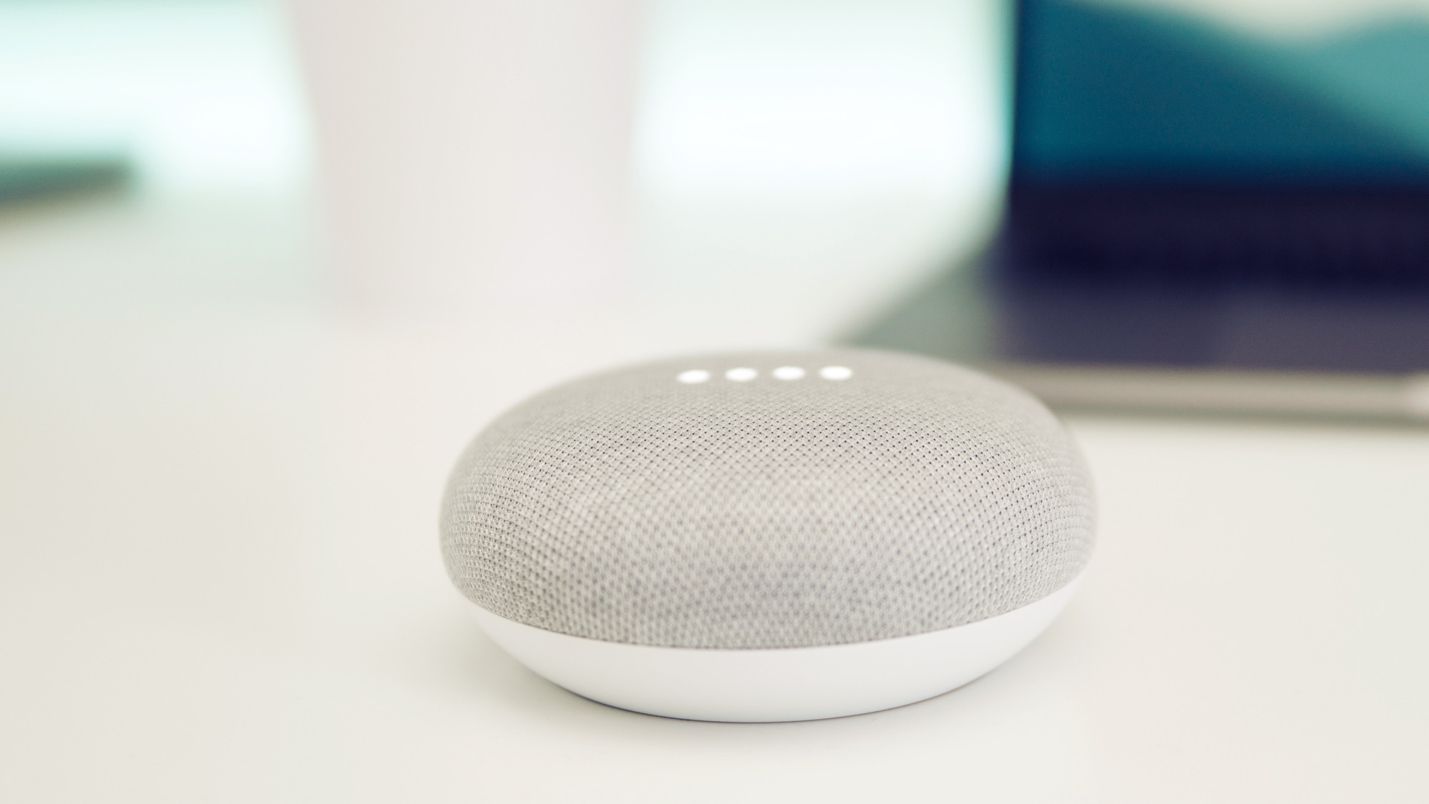
The number of IoT devices and systems connected to the Internet will be more than 2.5x the global population by 2020 (Gartner).

Slide 3
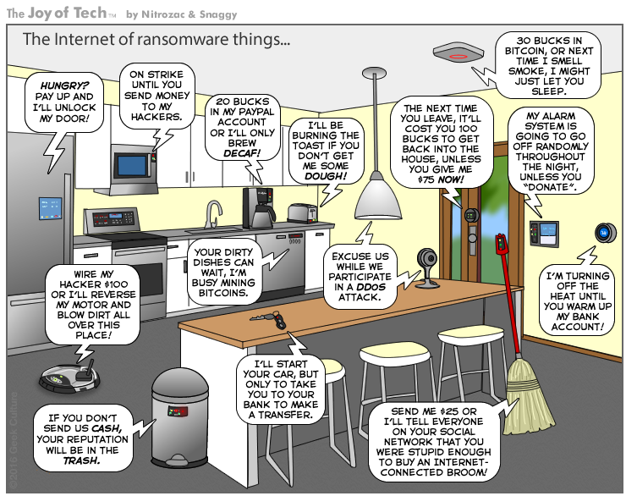
As more and more devices are connected, privacy and security risks increase.
Used with permission. http://www.geekculture.com/joyoftech/joyarchives/2340.html

Slide 4
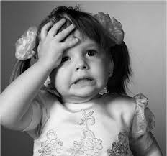
New devices, new vulnerabilities
The attributes of many IoT devices present new and unique security challenges compared to traditional computing systems.
Device Cost/Size/Functionality
Volume of identical devices (homogeneity)
Long service life (often extending far beyond supported lifetime)
No or limited upgradability or patching
Physical security vulnerabilities
Access
Limited user interfaces (UI)
Limited visibility into, or control over, internal workings
Embedded devices
Unintended uses
Bring Your Own
Notes:
Industry is not adequately addressing fundamental security, privacy and life-safety issues.
Many manufacturers are new to the networking and Internet arena, and lack experience.
There are STRONG competitive pressures for speed to market and cost reduction.
Security and privacy cost money, require specialized skills, and slow down the development process.
The proliferation of devices, and corresponding interactions with other devices, increase the “surface” available for cyberattack.
Poorly secured devices affect the security of the Internet and other devices globally, not just locally.

Slide 5
There are two ways to view IoT Security
Inward Security
Focus on potential harms to the health, safety, and privacy of device users and their property stemming from compromised IoT devices and systems
Outward Security
Focus on potential harms that compromised devices and systems can inflict on the Internet and other users
Notes:
Example of outward risk:
A home appliance may continue to function well as far as the direct user is concerned, and s/he may be unaware that it is part of a botnet participating in a DDoS attack
Toaster example:
- Someone may use it against you, and remotely decide to burn your hands our even your house (inward security related issue)
Your toaster works ok but is being used for a major DDOS attack (outward)
At ISOC, our focus is on the impact that IoT security and privacy has on the Internet and other users.

Slide 6

How do we improve things?
Research and Innovation
Open Standards
Frameworks and Best Practices
Certifications and Trustmarks
Policy and Regulation
Notes:
(new technologies, better user interfaces, better development tools)

Slide 7
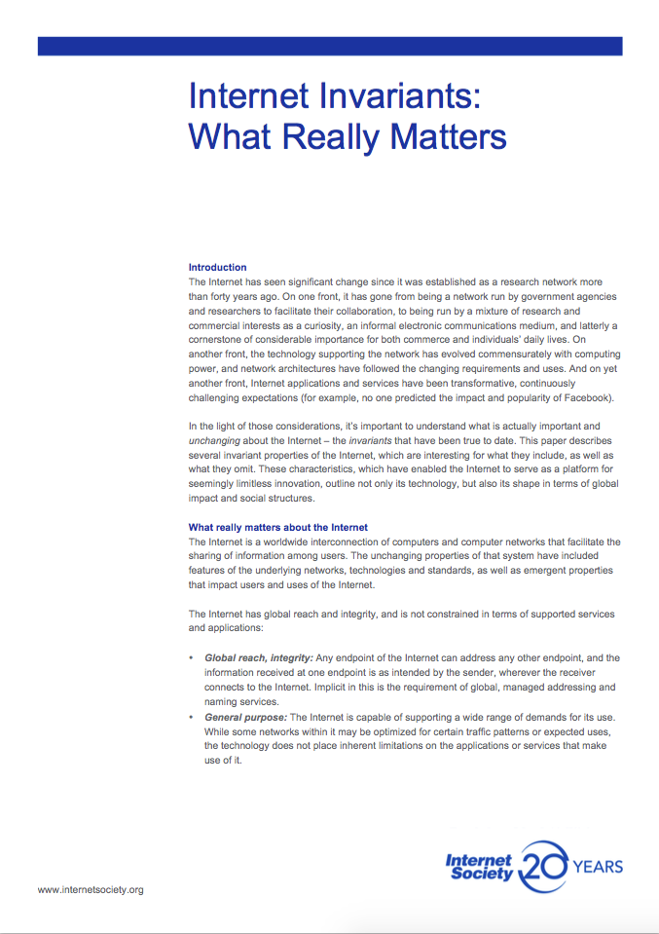
Internet Invariants
General Purpose
Interoperable Building Blocks
No Permanent Favorites
Global Reach &
Integrity
Interoperability & mutual agreement
Permissionless Innovation
Collaboration
Accessible
7
Notes:
We need to take a moment to remember what makes the Internet what it is and by extension what makes IoT possible.

Slide 8
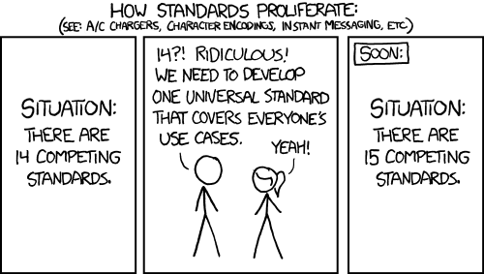
Current standards efforts
IETF
IEEE
ITU
W3C
OASIS
ISO/IEC
Various consortium
Etc…
https://xkcd.com/927/
Notes:
Right now we have a lot of standards organizations working on a lot of standards.

Slide 9
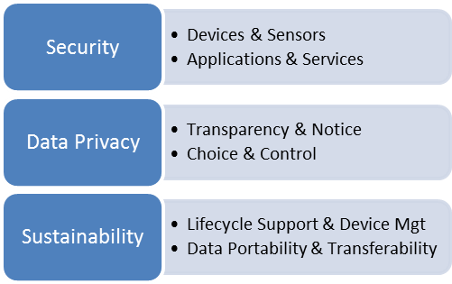
Online Trust Alliance IoT Security & Privacy Trust Framework
Measureable principles vs. standards development
Consumer grade devices (home, office and wearables)
Address known vulnerabilities and IoT threats
Actionable and vendor neutral
https://otalliance.org/iot/
Notes:
June 2015 kick off, consensus driven process with input from industry and policy-makers
Multi-stakeholder working group – 100 plus participants
Face-To-Face meetings / Public Call for Comments
Ongoing refinement
Working Group Focus

Slide 10

Online Trust Alliance IoT Security & Privacy Trust Framework
Four Key Areas:
Security Principles (1-12)
User Access & Credentials (13-17)
Privacy, Disclosures & Transparency (18-33)
Notifications & Related Best Practices (34-40)
https://otalliance.org/iot/
https://otalliance.org/system/files/files/initiative/documents/iot_trust_framework6-22.pdf
Notes:
June 2015 kick off, consensus driven process with input from industry and policy-makers
Multi-stakeholder working group – 100 plus participants
Face-To-Face meetings / Public Call for Comments
Ongoing refinement
Working Group Focus
Perfection the enemy of good
Measureable principles vs. standards development
Consumer grade devices (home, office and wearables)
Address known vulnerabilities and IoT threats
Actionable and vendor neutral

Slide 15
Enterprise IoT Security Checklist
Set of Best Practices for Enterprises
be proactive and fully consider the possible risks introduced by these devices;
understand that IoT devices are likely more vulnerable than traditional IT devices;
educate users on IoT device risks; and
strike a balance between controlling IoT devices vs creating “shadow IoT.”
https://otalliance.org/system/files/files/initiative/documents/enterprise_iot_checklist.pdf

Slide 16
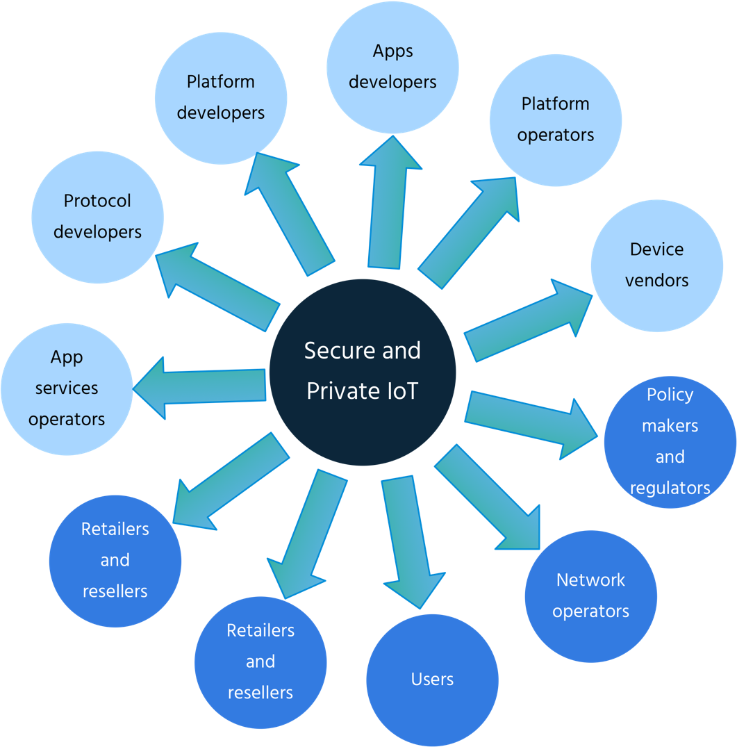
Who is responsible?
Developers and users of IoT devices and systems have a collective obligation to ensure they do not expose others and the Internet itself to potential harm
To scale up we need a collective approach, addressing security challenges on all fronts.

Slide 17

Where does the NREN community fit into this picture?
NRENs have historically led the way in innovation for the Internet.
NRENs are:
Consumers
Operators
Policy makers
Developers
Technical Leaders

Slide 18
Possible NREN Roles and Actions
Consumers Exercise procurement power

Slide 19
Possible NREN Roles and Actions
Consumers Exercise procurement power
Operators Build smartly

Slide 20
Possible NREN Roles and Actions
Consumers Exercise procurement power
Operators Build smartly
Policy makers Rule wisely

Slide 21
Possible NREN Roles and Actions
Consumers Exercise procurement power
Operators Build smartly
Policy makers Rule wisely
Developers Implement cautiously

Slide 22
Possible NREN Roles and Actions
Consumers Exercise procurement power
Operators Build smartly
Policy makers Rule wisely
Developers Implement cautiously
Technical Leaders Participate

Slide 23
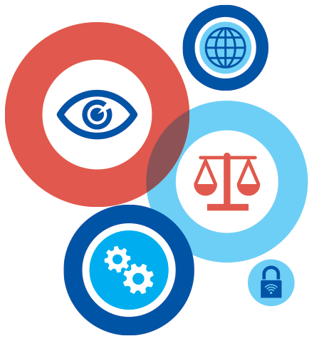
Enhancing Privacy in IoT
Strategies need to be developed that respect individual privacy choices across a broad spectrum of expectations, while still fostering innovation in new technologies and services.
Traditional online privacy models may not fit
Challenges in adapting or adopting basic privacy principles, such as:
Transparency/Openness
Meaningful Choice
Data Minimization
Use Limitation
Opportunities to opt out

Slide 24

Hot off the presses… Clearly Opaque Privacy Risks of the Internet of Things
Authors:
Dr. Gilad Rosner and Erin Kenneally, J.D.
https://www.iotprivacyforum.org/clearlyopaque/
Notes:
Hot off the presses
151 pages (yikes), but the executive summary is
Coming soon from the Internet Society:
IoT Privacy for Policymakers

Slide 25
Privacy Rules and Regulations
Policies and Regulations may be needed.
Let’s help to ensure these rules and regulations are correct, necessary and sufficient.
https://www.internetsociety.org/resources/2018/iot-security-for-policymakers/

Slide 26
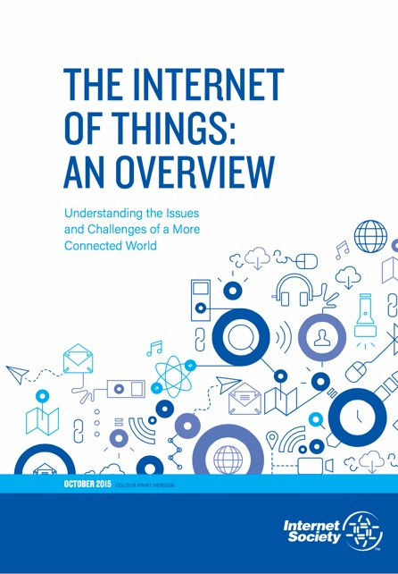
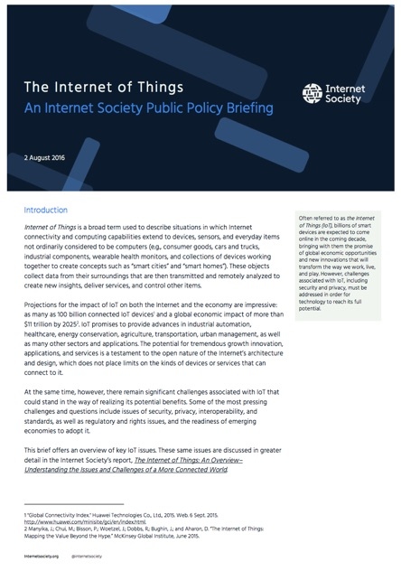
Additional Internet Society IoT Resources
https://www.internetsociety.org/iot

Slide 27
Final thoughts…
The Internet of Things is here and growing (be wary but not afraid).
NRENs are uniquely positioned to help lead the way forward to a healthy Internet ecosystem.
Use your NREN super powers wisely to:
Buy, Build, Rule, Implement, and Participate
in the emerging IoT Ecosystem

Slide 28
Acknowledgements
Steve Olshansky
Robin Wilton
Jeff Wilbur (and the whole OTA team)
… and a cast of thousands
Thank You!

Slide 29
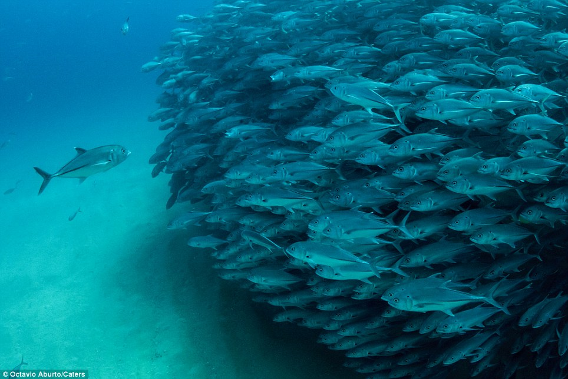
Questions?
http://www.dailymail.co.uk/news/article-2284287/Youre-going-wrong-way-Moment-confused-fish-tried-swim-opposite-direction-hundreds-companions-enormous-shoal.html

Slide 30
Thank You
Karen O’Donoghue odonoghue@isoc.org www.internetsociety.org/IoT

