Slide 1
Vulnerabilidades na Web e em Bases de Dados Parte II: Vulnerabilidades
Segurança de Software
2019
Nuno Santos

Slide 2
Aula passada
Estudámos mais duas classes de vulnerabilidades:
Devido a corridas
Devido a validação de entradas

Slide 3
E a Web?
“Hundreds of thousands of Facebook users were hit (...) by a trick that spreads a clickjacking worm once the victim has been fooled into “liking” a page. Once that is done the action installs a Trojan and recommends the page to the victim’s friends.”
Ellen Messmer, ‘Likejacking’ exploit fools Facebook users and friends, NetworkWorld.com, June 1st 2010

Slide 4
Na web encontramos muitas vulnerabilidades
The web suffers heavily from all the 3 causes of trouble:
complexity, extensibility, connectivity
Not 1 technology but a “blob” of technologies
HTTP, HTTPS, HTML, XML, PHP, Java, ASP.NET, PHP, cookies, SQL, web services, Flash, Silverlight, frameworks,…
Many vulnerabilities reported and exploited
OWASP Project Top 10 Vulnerabilities 2010

Slide 5
Plano para esta aula
Arquitectura das aplicações Web
Principais vulnerabilidades em aplicações Web

Slide 6
Arquitectura das aplicações Web

Slide 7

Aplicação Web: Um sistema distribuído
HTTP / HTTPS / SOAP
(sobre TCP/IP)
SQL / XML
(sobre TCP/IP)
Cliente
(browser)
Servidor Web
Base Dados
HTML(5) / pics / audio / video
JavaScript, VBScript,…
ActiveX / Java / Flash / …
Static content: HTML, pics, audio, vid
Dynamic content:
CGI, Server-Side Includes (SSI), Extensible Stylesheet Language Transformation (XSLT)
Server-side scripting (PHP, ASP, CFML, JSP); compiled “scripts” (Java servlets, ASP.NET, ColdFusion MX)
Frameworks (Hibernate, Struts, Spring,…)
SQL databases
XML files
Others...

Slide 8
Protocolo HTTP / HTTPS
two types of HTTP messages: request, response
HTTP request message:
ASCII (human-readable format)
carriage return character
request line
(GET, POST, ...
commands)
line-feed character
GET /index.html HTTP/1.1\r\n
Host: www-net.cs.umass.edu\r\n
User-Agent: Firefox/3.6.10\r\n
Accept-Language: en-us,en;q=0.5\r\n
Connection: keep-alive\r\n
\r\n
header
lines
carriage return,
line feed at start
of line indicates
end of header lines
optional body goes here
(no body in GET requests)

Slide 9
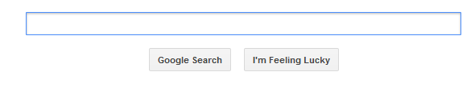
Interface de input (entradas) numa aplicação web
web page often includes form input; how is it sent to the server?
Using the POST method:
input is uploaded to server in entity body
In the URL:
uses GET method
input is uploaded in URL field of request line:
www.somesite.com/animalsearch.php?animal=monkey&food=banana

Slide 10
Manutenção do estado numa aplicação web
Basic model is stateless…
…but state is needed in all but basic Web applications
State info: is the user logged? Which is the user’s account?…
State tracking:
Basic idea: server gives the client ID that it has to include in every request (server stores info about the state for each ID)
In practice this is not so simple and has historically generated many vulnerabilities

Slide 11
Principais vulnerabilidades em aplicações web

Slide 12
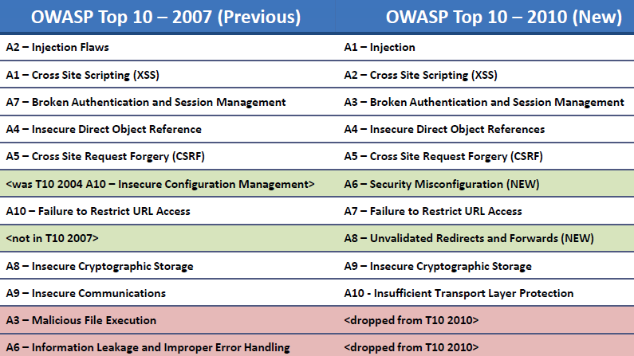
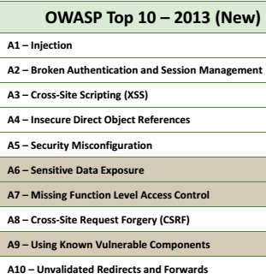
Vulnerabilidades no top 10
Top 10 2013 is similar to 2010’s; we will follow the 2010 version
Another classification: Web Application Security Consortium (WASC) but lower granularity

Slide 13
A1 – Falhas de injecção
Several kinds:
SQL Injection (most prevalent, but we leave it for next class)
Others: XML, LDAP, XPath, XSLT, HTML, OS command injection, etc
Main idea: web server accepts input that is badly interpreted by some interpreter
Examples of interpreters: DBMS, XML, LDAP,…

Slide 14
Exemplo de injecção de XML
Cliente
(browser)
Servidor Web
Base Dados
A password file:
<users>
<user>
<name>paulo</name>
<pwd>apples</pwd>
</user>
<user>
<name>miguel</name>
<pwd>grapes</pwd>
</user>
</users>

Slide 15
Um ataque de injecção de XML…
O que acontece se um utilizador malicioso mudar a password para a password seguinte?
oranges</pwd></user><user><name>pirate</name><pwd>potatoes
<users>
<user>
<name>paulo</name>
<pwd>apples</pwd>
</user>
<user>
<name>miguel</name>
<pwd>grapes</pwd>
</user>
<user>
<name>alice</name>
<pwd> oranges </pwd>
</user>
<user>
<name>pirate</name>
<pwd>potatoes</pwd>
</user>
</users>
Ficheiro antes
<users>
<user>
<name>paulo</name>
<pwd>apples</pwd>
</user>
<user>
<name>miguel</name>
<pwd>grapes</pwd>
</user>
</users>

Slide 16
SQL injection
Causes of these vulnerabilities:
User input pasted into SQL commands +
SQL uses several metacharacters / metadata
Example (PHP/MySQL):
$username = $HTTP_POST_VARS[‘username’];
$password = $HTTP_POST_VARS[‘passwd’];
$query = “SELECT * FROM logintable WHERE user = ‘” . $username . “’ AND pass = ‘” . $password . “’”;
$result = mysql_query($query);
if(!$result) die_bad_login();
metadata
username: root password: root’ OR pass <> ‘root
Query: SELECT * FROM logintable WHERE user = ‘root’ AND pass = ‘root’ OR pass <> ‘root’

Slide 17
A2 – Cross Site Scripting (XSS)
Widespread and pernicious web app security issue
Allows attacker to execute script in victim’s browser
Scripting language is typically JavaScript (JS), but others possible
OWASP Top 10 2013: Broken Authentication and Session Management [A3] changed places with XSS [A2]. This is because the impact is higher, but there are more XSS vulnerabilities

Slide 18
Reflected XSS
Cross-site scripting (XSS)
User does not trust email scripts but trusts a (vulnerable) site
The idea is to make a user trust untrustworthy data from server
Bom para obter cookiesou as credenciais (username / password)
email
Attacker
Victim:
URL w/ evil script
vulnerable web application
→ displays a script sent by the victim!
“click here”
example link:
<a href=“trusted.site.com/cgi-bin/post_message.pl? &lt;script&gt;alert(‘hello!’)&lt;/script&gt;”>click here</a>
page w/evil script reflected
browser runs evil script
message posted is a script that pops up window

Slide 19
Stored XSS
Scripts can be similar to the previous ones
Attacker
evil script
vulnerable web application
stores and later sends script
send by the attacker
evil script in web page
browser runs evil script

Slide 20
Outras vulnerabilidades
A3 – Broken authentication and session management
Ex: session hijacking - Attacker discovers an open session ID and sends commands to that session
A4 – Direct object reference
Site exposes a reference to an internal implementation object and no proper access control, e.g., photos, etc.
A5 – Cross Site Request Forgery (CSRF)
Force user to execute unwanted actions in a vulnerable site in which he/she is authenticated

Slide 21
Conclusões
Corridas são violações das espectativas do programador sobre a atomicidade de um programa durante uma janela de vulnerabilidade
Os principais objectivos de explorar essas vulnerabilidades são escalar privilégios e as mais comuns são: TOCTOU, ficheiros temporários, e concorrência
Outra classe de vulnerabilidades é deficiente validação de entradas, que permite ao atancante injectar dados que resultem num desvio do comportamento normal do programa

Slide 22
Referências e próxima aula
Bibliografia
[Correia17] Capítulos 6 e 7
Próxima aula
Vulnerabilidades na Web e em bases de dados

