Slide 1
Security and Privacy in the Age of Cloud Computing
15-421/08-731/46-869, Fall 2013 – Lecture 15
Ashwini Rao
October 31, 2013

Slide 2
The Big picture

Slide 3
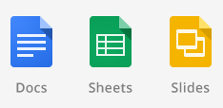








Cloud Computing Landscape

Slide 4
Cloud Computing Landscape
Applications
Storage
Computing
Development platform
Gartner predicts revenue of USD 131billion in 2013

Slide 5











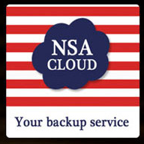
Who uses cloud computing?
Notes:
Many sectors including healthcare, government, finance, retail and automobile use the cloud for file sharing, web, mobile, HPC, CRM, ERP, data storage, analytics etc.
Lot of sensitive information stored, processed and transferred on the cloud
Educational records, IRB
IP, Health
Finance
Government
Games, Entertainment etc.

Slide 6
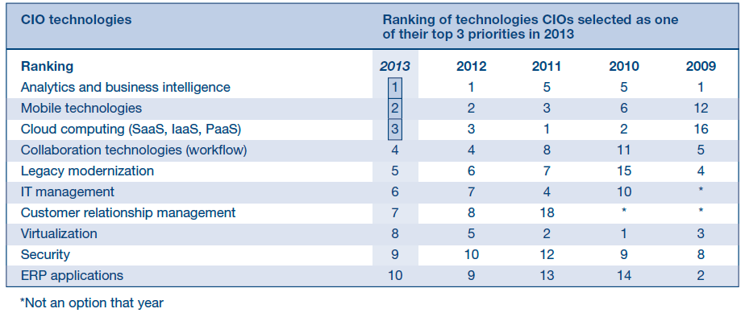
Adoption trends
CIO Agenda Report, Gartner, 2013 (2053 CIOs, 36 industries, 41 countries)

Slide 7
Adoption trends
CIO Agenda Report, Gartner, 2013 (2053 CIOs, 36 industries, 41 countries)

Slide 8
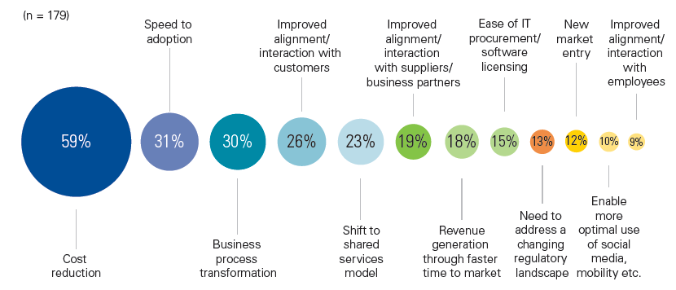
Why do customers use the cloud?
KPMG International’s 2012 Global Cloud Provider Survey (n=179)
Notes:
Why would customers save money?
What is speed to adoption? Low upfront investment, startup can grow as required
Why is licensing easier?

Slide 9
Cloud Anatomy

Slide 10
What is a “cloud”?
Attributes
Multi-tenancy (shared-resources)
Massive scalability
Elasticity
Pay per use
Self-provisioning of resources
Notes:
What is elasticity? Self-provisioning?

Slide 11
A simple definition
“In simple words, the Cloud refers to the process of sharing resources (such as hardware, development platforms and/or software) over the internet. It enables On-Demand network access to a shared pool of dynamically configurable computing resources. These resources are accessed mostly on a pay-per-use or subscription basis.”
The Cloud Changing the Business Ecosystem, KPMG, 2011

Slide 12
Service and deployment models
Service models | Deployment models
Software-As-A-Service (SaaS) | Public
Platform-As-A-Service (PaaS) | Private
Infrastructure-As-A-Service (IaaS) | Hybrid

Slide 13
SPI (SaaS, PaaS, IaaS)
Model | Cloud Service Provider (CSP) will provide | E.g.
SaaS | Application hosting, updates, Internet delivery/access to app, data partitioning | Google Docs, Evernote
PaaS | Browser-based software IDE (development, test, production), integration with external web services and databases, deploys customer apps on provider platform | Force.com, Microsoft Azure
IaaS | Infrastructure (server/VM, storage, network etc.) that can run arbitrary software | Amazon S3 and EC2, Rackspace

Slide 14
Public, Private, Hybrid
Hybrid
Private/
internal
Public/
external
On premises/internal
Off premises/third-party
Image reproduced from Cloud security and privacy, 2009, Mather et al.
Notes:
Why would I want to build a private cloud?
Notes copied in part from Chapter two, Cloud security and privacy, 2009, Mather et al.
Private cloud – emulate cloud computing on private network, single organization, customer or vendor with contractual obligations responsible for operation of private cloud
Types
- dedicated (onsite, customer owned, operated by internal IT)
- community (third-party premises; owned, managed and operated by vendor with strict contracts and SLAs)
- managed (customer owned, vendor managed)
Example: NASA Nebula, DOE
Strict control possible
Public cloud – shared resources, access via public Internet, owned and managed by third-party
Example: Amazon AWS, Salesforce
Low control
Hybrid cloud – combine public and private
Sensitive data on private

Slide 15
challenges
Notes:
Is everything good? Should we all start using the cloud/ Are there any challenges or issues?

Slide 16
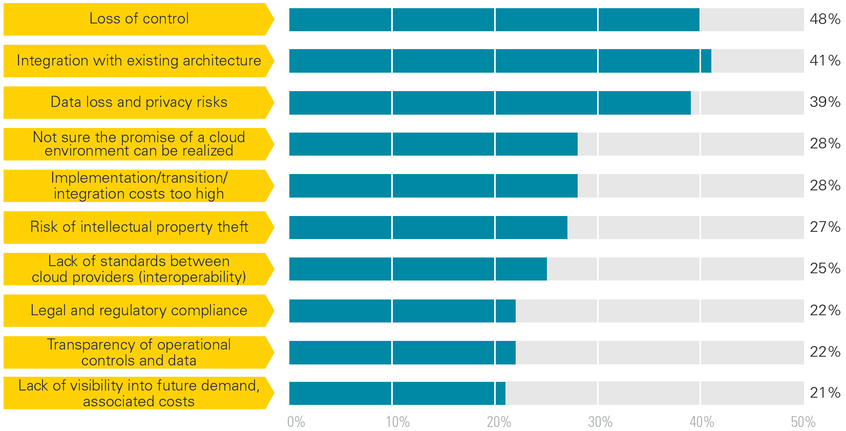
Customers’ biggest concerns
KPMG International’s 2012 Global Cloud Provider Survey (n=179)

Slide 17
Customers’ biggest concerns
KPMG International’s 2012 Global Cloud Provider Survey (n=179)

Slide 18
Customers’ biggest concerns
KPMG International’s 2012 Global Cloud Provider Survey (n=179)

Slide 19
Customers’ biggest concerns
KPMG International’s 2012 Global Cloud Provider Survey (n=179)

Slide 20
Customers’ biggest concerns
KPMG International’s 2012 Global Cloud Provider Survey (n=179)

Slide 21
Challenges in using the cloud
Security
Privacy
Compliance

Slide 22
Security

Slide 23
Cloud security
What’s not new?
Phishing, password, malware, downtime etc.
What’s new? Understand…
Change in trust boundaries
Impact of using
Public vs. private cloud
IaaS vs. PaaS vs. SaaS
Division of responsibilities between customer and Cloud Service Provider (CSP)
Notes:
Is downtime new? No, but it may manifest in new ways.
Access over the Internet. What could go wrong?
What security CSP provides; what customer is responsible

Slide 24
Control, liability and accountability
On premise
App
VM
Server
Storage
Network
On premise (hosted)
App
VM
Server
Storage
Network
IaaS
App
VM
Server
Storage
Network
PaaS
App
Services
Server
Storage
Network
SaaS
App
Services
Server
Storage
Network
Organization has control
Organization shares control with vendor
Vendor
has control
Image reproduced from Cloud security and privacy, 2009, Mather et al.
Notes:
Who is responsible for data loss or other issues in the cloud?
Organizational control decreases from private to public, and IaaS to SaaS
Liability depends on SLA and contract
Organization has accountability irrespective of control and liability
In a virtual machine environment, multiple operating systems can run on a single piece of hardware
A hypervisor, also called Virtual Machine Monitor (VMM), is computer software/hardware platform virtualization software that allows multiple operating systems to run on a host computer concurrently

Slide 25
Security management
Availability
Access control
Monitoring
Vulnerability, patching, configuration
Incident response

Slide 26
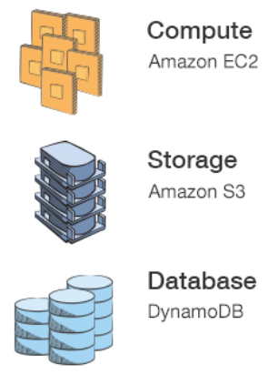
Amazon Web Services (AWS)
Elastic Cloud Compute (EC2)
“Virtual Servers in the Cloud”
Simple Storage Service (S3)
“Scalable Storage in the Cloud”
DynamoDB
“Fast, Predictable, Highly-scalable NoSQL data store”
Other services …
https://aws.amazon.com/

Slide 27
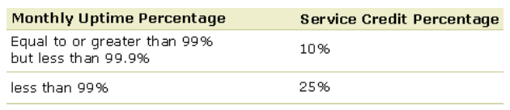
Availability
Why is this important?
“Amazon Web Services suffers outage, takes down Vine, Instagram, others,” Aug 26, 2013*
E.g. AWS features
Distributed denial of service (DDoS) protection
Fault-tolerant, independent failure zones
*http://www.zdnet.com/amazon-web-services-suffers-outage-takes-down-vine-instagram-flipboard-with-it-7000019842/
Notes:
What is independent failure zone? Why is it important?
-Geolocation: storms, thunder, earth quakes
-network disruption: under sea cable problem
What could be an issue though of storing data in multiple zones?
Is 99% acceptable? 1/3 day per month = 8 hours!

Slide 28
Access control
Who should have access?
To VM, app, services etc.
Users, admin, business admin, others?
E.g. AWS features
Built-in firewalls control access to instances
Multi-factor authentication: password + authentication code from MFA device
Monitor AWS employee accesses

Slide 29
Monitoring
Monitor
Availability, unauthorized activities etc.
E.g. AWS features
DoS, MITM, port scan, packet sniffing
Password brute-force detection
Access logs (request type, resource, IP, time etc.)
Notes:
What is packet sniffing? Shared physical machines, shared network

Slide 30
Vulnerability, patching, configuration
E.g. AWS features
Patching
Automatic Software Patching for Amazon supplied Windows image
Configuration
Password expiration for AWS employees
Vulnerability
Vulnerability scans on the host operating system, web application and DB in the AWS environment

Slide 31
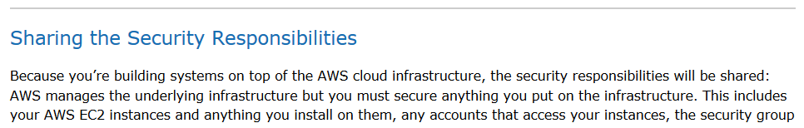
Customer responsibilities
Cloud is a shared environment

Slide 32
Customer responsibilities
Cloud is a shared environment
“AWS manages the underlying infrastructure but you must secure anything you put on the infrastructure.”

Slide 33
Customer responsibilities
AWS requires customers to
Patch VM guest operating system
Prevent port scans
Change keys periodically
Vulnerability testing of apps
Others…

Slide 34
Data issue: confidentiality
Transit between cloud and intranet
E.g. use HTTPS
Possible for simple storage
E.g. data in Amazon S3 encrypted with AES-256
Difficult for data processed by cloud
Overhead of searching, indexing etc.
E.g., iCloud does not encrypt data on mail server*
If encrypted, data decrypted before processing
Is it possible to perform computations on encrypted data?^
*iCloud: iCloud security and privacy overview, Retrieved Oct 30, 2013, https://support.apple.com/kb/HT4865
^See Fully Homomorphic Encryption Scheme, Wikipedia, http://en.wikipedia.org/wiki/Homomorphic_encryption
Notes:
CSP may decrypt your data for law enforcement
Why would you encrypt data? – theft. What about deletion? Securely?

Slide 35
Encryption management
Algorithms
Proprietary vs. standards
Key size
Key management
Ideally by customer
Does CSP have decryption keys?
E.g. Apple uses master key to decrypt iCloud data to screen “objectionable” content*
*Apple holds the master decryption key when it comes to iCloud security, privacy, ArsTechnica, Apr 3, 2012

Slide 36
Data issue: comingled data
Cloud uses multi-tenancy
Data comingled with other users’ data
Application vulnerabilities may allow unauthorized access
E.g. Google docs unauthorized sharing, Mar 2009
“identified and fixed a bug which may have caused you to share some of your documents without your knowledge.”

Slide 37
Privacy and compliance

Slide 38
Privacy challenges
Protect PII
Ensure conformance to FIPs principles
Compliance with laws and regulations
GLBA, HIPAA, PCI-DSS, Patriot Act etc.
Multi-jurisdictional requirements
EU Directive, EU-US Safe Harbor

Slide 39
Key FIPs requirements
Use limitation | It is easier to combine data from multiple sources in the cloud. How do we ensure data is used for originally specified purposes?
Retention | Is CSP retention period consistent with company needs? Does CSP have proper backup and archival?
Deletion | Does CSP delete data securely and from all storage sources?
Security | Does CSP provide reasonable security for data, e.g., encryption of PII, access control and integrity?
Accountability | Company can transfer liability to CSP, but not accountability. How does company identify privacy breaches and notify its users?
Access | Can company provide access to data on the cloud?

Slide 40
Laws and regulations
Require compliance with different FIPs
Laws in different countries provide different privacy protections
EU Directive more strict than US
In US, data stored on public cloud has less protection than personal servers
May be subpoenaed without notice*
Notes:
Add reference for *

Slide 41
Mitigation

Slide 42
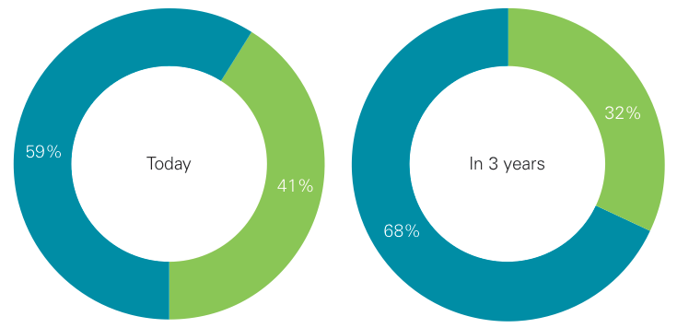

Service level agreements
Increasing to deal with loss of control
SLA permits CMU IRB data on Box.com; can’t use Dropbox
Do you [CSP] have SLAs in your cloud offerings today?
Do you expect to have SLAs in cloud offerings within 3 years?
KPMG International’s 2012 Global Cloud Provider Survey (n=179)

Slide 43
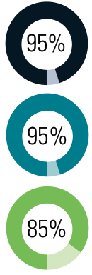
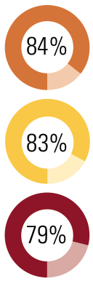
Top SLA parameters
System availability
Regulatory compliance
Data security
Response time
Other performance levels
Functional capabilities
What do you [CSP] believe are the most important SLA parameters today?*
*KPMG International’s 2012 Global Cloud Provider Survey (n=179)

Slide 44
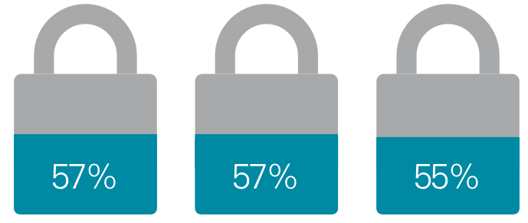
CSPs improving security
Tighter restrictions on user access
Greater use of data encryption
Improving real-time threat detection
What steps are you [CSP] taking to improve data security and privacy in your cloud offerings? (top 3)*
*KPMG International’s 2012 Global Cloud Provider Survey (n=179)

Slide 45
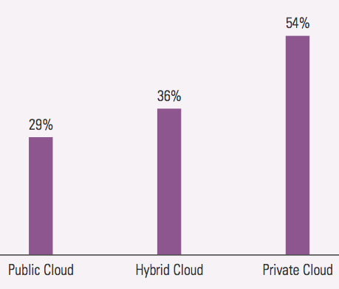
Private and hybrid clouds
Rise in hybrid and private cloud for sensitive data
Private cloud cost can be prohibitive
Hybrid cloud ranks 4 on Gartner top 10 strategic technology trends, 2014
Models companies use/intend to use*
(Larger companies prefer private)
KPMG's The Cloud: Changing the Business Ecosystem, 2011
Notes:
Cant find the distribution of companies in the KPMG survey

Slide 46
Other approaches
Move cloud to countries with better privacy protections
Many customers moving away from the US
US industry may lose $22 to $35 billion in next three years due to NSA surveillance*
Depend on third-party certifications
E.g. AWS has ISO 27001, PCI-DSS Level 1 etc.
Learn about CSP security under NDA
*How Much Will PRISM Cost the U.S. Cloud Computing Industry? ITIF Report, Aug. 2013

Slide 47
Summary
Cloud is a tradeoff between cost, security and privacy
Change in trust boundaries leads to security and privacy challenges
Mostly no new security or privacy issues per se

Slide 48
References
Cloud security and privacy, 2009, Mather et al.
CIO Agenda Report, Gartner, 2013
KPMG International’s Global Cloud Provider Survey, 2012
KPMG's The Cloud: Changing the Business Ecosystem, 2011
How Much Will PRISM Cost the U.S. Cloud Computing Industry? ITIF Report, Aug. 2013
Apple holds the master decryption key when it comes to iCloud security, privacy, ArsTechnica, Apr 3, 2012
AWS Whitepaper: Overview of Security Processes, Oct 30, 2013 http://media.amazonwebservices.com/pdf/AWS_Security_Whitepaper.pdf
iCloud: iCloud security and privacy overview, Oct 30, 2013, https://support.apple.com/kb/HT4865
Homomorphic Encryption Scheme, Wikipedia, http://en.wikipedia.org/wiki/Homomorphic_encryption

Slide 49
Additional slides

Slide 50
Shared infrastructure issues
Reputation-fate sharing
Blacklisting of shared IP addresses
E.g. Spamhaus blacklisted AWS IP range sending spam¹
An FBI takedown of data center servers may affect other companies co-hosted on the servers²
Cross virtual-machine attacks
Malicious VM can attack other VMs hosted on the same physical server³
E.g. stealing SSH keys
¹ https://blog.commtouch.com/cafe/ip-reputation/spamhaus-unblocks-mail-from-amazon-ec2-%E2%80%93-sort-of/
² http://www.informationweek.com/security/management/are-you-ready-for-an-fbi-server-takedown/231000897
³ Hey, you, get off of my cloud: exploring information leakage in third-party compute clouds, Ristenpart et al., ACM CCS 09

Slide 51
Lineage, provenance, remanence
Identifying lineage for audit is difficult
i.e. tracing data as it flows in the cloud
Ensuring provenance is difficult
i.e. computational accuracy of data processed by CSP
Residual data may be accessible by other users
CSP should securely erase data

Slide 52
Access and authentication
Protocol interoperability between CSPs
Support for access from multiple devices and locations
E.g. SSO, augmented authentication etc.
Finer grained access control
E.g. Support multiple roles such as user, admin, and business admin via RBAC

