Slide 1

Information Security – Theory vs. Reality 0368-4474, Winter 2015-2016 Lecture 10: Trusted Platform Architecture and SGX
Lecturer: Eran Tromer
Guest lecturer: Alon Jackson

Slide 2
Trusted Computing Architecture
Using presentation material from Dan Boneh, Stanford.

Slide 3
Background
TCG consortium. Founded in 1999 as TCPA.
Main players (promoters): (>200 members) AMD, HP, IBM, Infineon, Intel, Lenovo, Microsoft, Sun
Goals:
Hardware protected (encrypted) storage:
Only “authorized” software can decrypt data
e.g.: protecting key for decrypting file system
Secure boot: method to “authorize” software
Attestation: Prove to remote server what software is running on my machine.

Slide 4
Secure boot
History of BIOS/EFI malware:
CIH (1998): CIH virus corrupts system BIOS
Heasman (2007):
System Management Mode (SMM) “rootkit” via EFI
Sacco, Ortega (2009): infect BIOS LZH decompressor
CoreBOOT: generic BIOS flashing tool
Main point: BIOS runs before any defenses (e.g. antivirus)
Proposed defense: lock system configuration (BIOS + OS)
Today: TCG approach
Notes:
SMM: runs privileged code with no interrupts, not even from OS

Slide 5
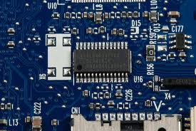
TCG: changes to PC
Extra hardware: TPM
Trusted Platform Module (TPM) chip
Single 33MhZ clock.
Vendors: Atmel, Infineon, National, STMicro, …
Cost: <$0.3
Integrated into other chips
Ethernet controller (Broadcom)
CPU’s chipset (Intel)
Software changes:
BIOS, EFI (UEFI)
OS and Apps
Notes:
7$ for TPM from National Semiconductors (per 1000 units)
Broadcom Ethernet controller with integrated TPM: https://www.broadcom.com/press/release.php?id=700509

Slide 6
TPMs in the real world
TPMs widely available on laptops, desktops and some servers
Software using TPMs:
File/disk encryption: BitLocker, IBM, HP, Softex
Attestation for enterprise login: Cognizance, Wave
Client-side single sign on: IBM, Utimaco, Wave

Slide 7
TPM Basics
What the TPM does
How to use it

Slide 8
Components on TPM chip
Non Volatile Storage (> 1280 bytes)
Other Junk
PCR Registers
(≥16 registers)
LPC bus
I/O
API calls
Crypto Engine:
RSA, SHA-1, HMAC, RNG
RSA: 1024, 2048 bit modulus
SHA-1: Outputs 20 byte digest

Slide 9
Non-volatile storage
1. Endorsement Key (EK) (2048-bit RSA)
Created at manufacturing time. Cannot be changed.
Used for “attestation” (described later)
2. Storage Root Key (SRK) (2048-bit RSA)
Used for implementing encrypted storage
Created after running
TPM_TakeOwnership( OwnerPassword, … )
Can be cleared later with TPM_ForceClear from BIOS
3. OwnerPassword (160 bits) and persistent flags
Private EK, SRK, and OwnerPwd never leave the TPM
Notes:
TPM_ForceClear requires “proof of presence,” namely holding down the Fn key

Slide 10
PCR: the heart of the matter
PCR: Platform Configuration Registers
Lots of PCR registers on chip (at least 16)
Register contents: 20-byte SHA-1 digest (+junk)
Updating PCR #n :
TPM_Extend(n,D): PCR[n] ← SHA-1 ( PCR[n] || D )
TPM_PcrRead(n): returns value(PCR(n))
PCRs initialized to default value (e.g. 0) at boot time
TPM can be told to restore PCR values in NVRAM via
TPM_SaveState and TPM_Startup(ST_STATE)
for system suspend/resume
Notes:
TPM_SaveState stores PCR values in NV-RAM

Slide 11
Using PCRs: the TCG boot process
BIOS boot block executes
Calls TPM_Startup (ST_CLEAR) to initialize PCRs to 0
Calls PCR_Extend( n, <BIOS code> )
Then loads and runs BIOS post boot code
BIOS executes:
Calls PCR_Extend( n, <MBR code> )
Then runs MBR (master boot record), e.g. GRUB.
MBR executes:
Calls PCR_Extend( n, <OS loader code, config> )
Then runs OS loader
… and so on
Notes:
0. During boot TPM receives a TPM_Init signal from LPC bus
1. TMP_Startup: does one of three things: (1) deactivates TPM, (2) resets PCRs, or (3) restores PCR values from data created with TPM_SaveState --- used for resume
2. TPM_Startup can only be called once after power-up (sets postInitialise flag to True)
3. Note: MBR is GRUB Stage 1

Slide 12
In a diagram
Hardware
BIOS
boot
block
OS
loader
BIOS
MBR
OS
Application
Root of trust in integrity measurement
measuring
TPM
Extend PCR
Root of trust in integrity reporting
After boot, PCRs contain hash chain of booted software
Collision resistance of SHA-1 ensures commitment
Notes:
Single PCR can identify entire platform

Slide 13
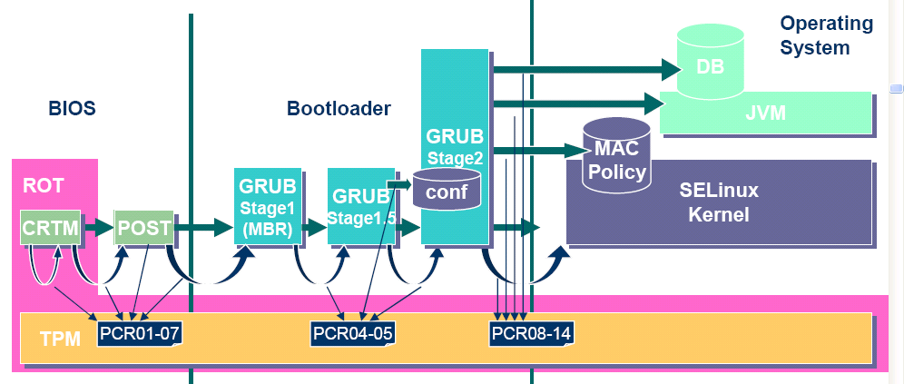
Example: Trusted GRUB (IBM’05)
What PCR # to use and what to measure specified in GRUB config file

Slide 14
Using PCR values after boot
Application 1: encrypted (a.k.a sealed) storage.
Step 1: TPM_TakeOwnership( OwnerPassword, … )
Creates 2048-bit RSA Storage Root Key (SRK) on TPM
Cannot run TPM_TakeOwnership again without OwnerPwd:
Ownership Enabled Flag ← False
Done once by IT department or laptop owner.
(optional) Step 2: TPM_CreateWrapKey / TPM_LoadKey
Create more RSA keys on TPM protected by SRK
Each key identified by 32-bit keyhandle
Notes:
OwnerPassword can later be used to change owner and remove SRK
SRK key handle ID is 0x40000000

Slide 15
Protected Storage
Main Step: Encrypt data using RSA key on TPM
TPM_Seal (some) Arguments:
keyhandle: which TPM key to encrypt with
KeyAuth: Password for using key `keyhandle’
PcrValues: PCRs to embed in encrypted blob
data block: at most 256 bytes (2048 bits)
Used to encrypt symmetric key (e.g. AES)
Returns encrypted blob.
Main point: blob can only be decrypted with TPM_Unseal when PCR-reg-vals = PCR-vals in blob.
TPM_Unseal will fail othrewise
Notes:
TPM_Seal: allows to specify arbitrary PCR values for unseal.

Slide 16
Protected Storage
Embedding PCR values in blob ensures that only certain apps on certain platform configuration can decrypt data.
e.g.: Messing with MBR or OS kernel will change PCR values.

Slide 17
Sealed storage: applications
Lock software on machine:
OS and apps sealed with MBR’s PCR.
Any changes to MBR (to load other OS) will prevent locked software from loading.
Prevents tampering and reverse engineering
Web server: seal server’s SSL private key
Goal: only unmodified Apache can access SSL key
Problem: updates to Apache or Apache config
General problem with software upgrades/patches: Upgrade process must re-seal all blobs with new PCRs

Slide 18
Security?
Resetting TPM after boot
Attacker can disable TPM until after boot, then extend PCRs arbitrarily (one-byte change to boot block) [Kauer 07]
Software attack: send TPM_Init on LPC bus allows calling TPM_Startup again (to reset PCRs)
Simple hardware attack: use a wire to connect TPM reset pin to ground
Once PCRs are reset, they can be extended to reflect a fake configuration.
Rollback attack on encrypted blobs
e.g. undo security patches without being noticed.
Can be mitigated using Data Integrity Regs (DIR)
Need OwnerPassword to write DIR
Notes:
K’07: Kauer, Usenix Security 2007.
Need owner password to write to DIR. Anyone can read DIR. Stored in NV RAM.

Slide 19
Attestation
Goal: prove to remote party what software is running on my machine.
Good applications:
Bank allows money transfer only if customer’s machine runs “up-to-date” OS patches.
Enterprise allows laptop to connect to its network only if laptop runs “authorized” software
Quake players can join a Quake network only if their Quake client is unmodified.
DRM:
MusicStore sells content for authorized players only.

Slide 20
Attestation: how it works
Recall: EK private key on TPM.
Cert for EK public-key issued by TPM vendor.
Step 1: Create Attestation Identity Key (AIK)
Involves interaction with a trusted remote issuer to verify EK
Generated: AIK private+public keys, and a certificate signed by issuer
Notes:
TPM can store multiple AIKs (for multiple identities)

Slide 21
Attestation: how it works
Step 2: sign PCR values (after boot)
Call TPM_Quote (some) Arguments:
keyhandle: which AIK key to sign with
KeyAuth: Password for using key `keyhandle’
PCR List: Which PCRs to sign.
Challenge: 20-byte challenge from remote server
Prevents replay of old signatures.
Userdata: additional data to include in sig.
Returns signed data and signature.
Notes:
TPM_Quote actually doesn’t take usedata argument. Instead one could do chal = Hash(chal,user-data)

Slide 22
Using attestation (to establish an SSL tunnel)
Attestation Request (20-byte challenge)
Generate pub/priv key pair
TPM_Quote(AIK, PcrList, chal, pub-key)
Send pub-key and certs
App
Validate:
Certs
PCR vals
Challenge
(SSL) Key Exchange using Cert
OS
Communicate with app using SSL tunnel
TPM
PC
Remote Server
Attestation must include key-exchange
App must be isolated from rest of system
Notes:
Focus on interactive applications such as Quake and network access control.
For non interactive applications (e.g. music distribution) there is no need for an SSL key exchange since pub-key is quoted.

Slide 23
Better root of trust: “late launch”
Late launch: securely load OS/VMM, even on a potentially-compromised machine
DRTM – Dynamic Root of Trust Measurement
New CPU instruction: Intel TXT: SENTER AMD: SKINIT
Atomically does:
Reset CPU. Reset PCR 17 to 0.
Load given Secure Loader (SL) code into I-cache
Extend PCR 17 with SL
Jump to SL
BIOS boot loader is no longer root of trust
Avoids TPM_Init attack: TPM_Init sets PCR 17 to -1

Slide 24
Trusting the CPU?
Trust the vendor?
System Management Mode (SMM)
Special execution mode with protected memory, “below” OS and hypervisor
Survives TXT launch, so compromised BIOS could load a malicious SMM that circumvents TXT.
Intel Management Engine (ME)
A microcontroller embedded in the processor, “next to” the OS and hypervisor
Independent of OS security policy.
Applications: originally, remote administration. Nowadays: EPID (chip-specific keys), Boot Guard (checks signature on boot code), Protected Audio and Video Path, SGX (secure enclaves)
Trustworthy?
ME includes its own, potentially vulnerable, custom OS and apps.
No public documentation of implementation and logic.
Could be used as an ideal rootkit / trojan horse.
Notes:
Today ME infrastructure runs: PTT (ME-implemented TPM), EPID (ME-rooted
chain of trust for remote attestation), Boot Guard, Protected Audio and Video
Path (PAVP), and SGX.

Slide 25
Security?
Resetting TPM after boot
Attacker can disable TPM until after boot, then extend PCRs arbitrarily (one-byte change to boot block) [Kauer 07]
Software attack: send TPM_Init on LPC bus allows calling TPM_Startup again (to reset PCRs)
Simple hardware attack: use a wire to connect TPM reset pin to ground
Once PCRs are reset, they can be extended to reflect a fake configuration.
Rollback attack on encrypted blobs
undo security patches
Large trusted base
Long, complex and potentially vulnerable chain of trust: OEM’s drivers, vendor’s peripherals, OS’s vendors.
Notes:
Klauser 07: Kauer, Usenix Security 2007.
Need owner password to write to DIR. Anyone can read DIR. Stored in NV RAM.

Slide 26
Protecting code on an untrusted platform
Can we run sensitive code on a potentially-compromised platform, without rebooting/replacing it?
Many ways to read and corrupt code!
Secure “enclave” using CPU hardware
Possible with SENTER/SKINIT but cumbersome (Flicker project)
Intel Software Guard Extensions (SGX) (discussed later)
ARM TrustZone
Cryptography
Fully-homomorphic encryption
Succinct zero-knowledge proofs (SNARKs) and Proof-Carrying Data

Slide 27
SGX
Using presentation material from Intel.

Slide 28
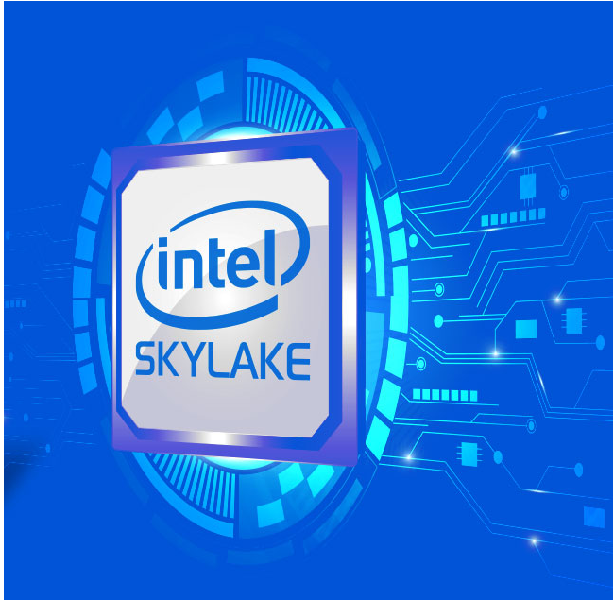
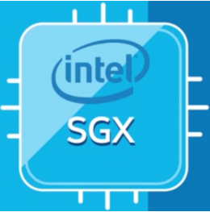
Some slides are courtesy of intel©

Slide 29
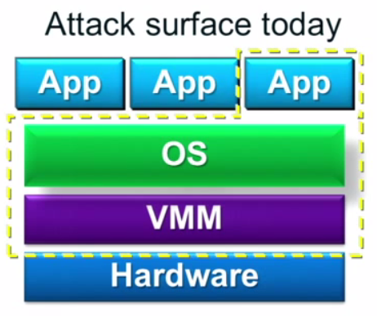
Why SGX?
Software security on commercial CPUs is pursued for many years
SW solutions have limited potential.
Closed HW systems have limited functionality.
Traditional TPMs have large TCB – commonly measure all platform.
TXT overcame some of these by introducing a Dynamic Root of Trust:
Dedicated TCB “mini OS”.
Run only sensitive logic in trusted OS.
Thus, needs to measure only mini OS and sensitive logic app.
But TXT still:
Halts main OS, restarts mini-OS and clears CPU.
Doesn’t support continuous run of trusted and
untrusted apps.
Cumbersome to develop for.
Large TCB - lots of potentially vulnerable SW.
Numerous vulnerabilities - Most Hazardous:
Compromised BIOS can load a malicious SMM that survives TXT launch.
Notes:
A usability wise, TPM shortcoming:
Attesting server, must always know the right PCR values for the platform - according to OS patch updates (for example).
answer was TXT.

Slide 30
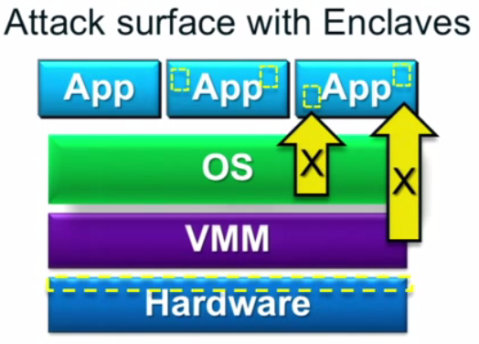
Why SGX?
SGX introduces the ENCALVE:
A protected TEE (Trusted Execution Environment) container.
Shrinks TCB (Trusted Computing Base) to HW and sensitive app logic.
Extends HW TCB on to enclaves in ring-3.
Runs TEE under untrusted OS or VMM.
Supports continuous run of:
Trusted and untrusted apps.
Multiple enclaves.
Multi-threaded enclave.
While maintaining application Integrity and confidentiality.
Notes:
Developers may focus on securing the smaller TCB
Applications run within OS environment
Dev. & Debugged with familiar tools
SMM - System Management Mode
VMM - Virtual Machine Manager

Slide 31
How?
Dedicated HW
18 new ISA instructions
Internal FW data structures
Tailored cryptographic functions
Suitable protocols

Slide 32
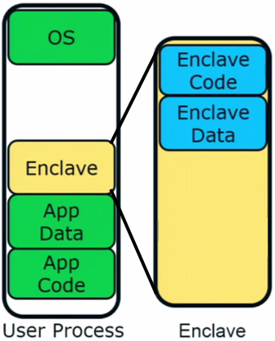
The Enclave – A trusted execution environment embedded in a process
Is part of the application & has full access
to its memory.
Measured and verified by HW on load.
Operation visible only within CPU borders.
Manageable by the OS, e.g:
CPU time slots
Paging and memory policy
Secrets are provisioned or acquired only
after enclave initialization.

Slide 33
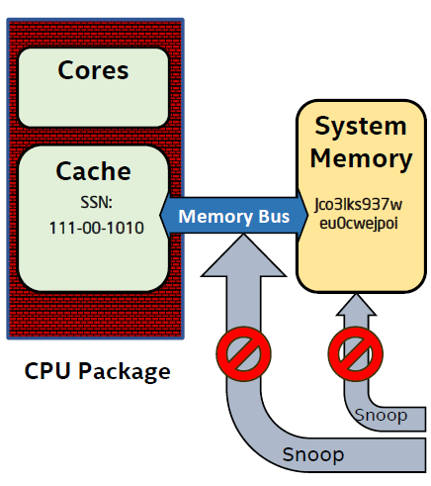
Security Perimeter
Security perimeter is the CPU package boundary.
Data and code unencrypted inside CPU package.
Data and code outside CPU is encrypted and integrity checked.
Single chip TCB avoids inter-chip HW attacks that threaten TPMs.
If the single TCB is the CPU, then we gain the opportunity for richer semantics by understanding platform state & app code.
MEE
* MME – Memory Management Engine, elaborated shortly.
Notes:
External memory reads and bus snoops see only encrypted data.

Slide 34
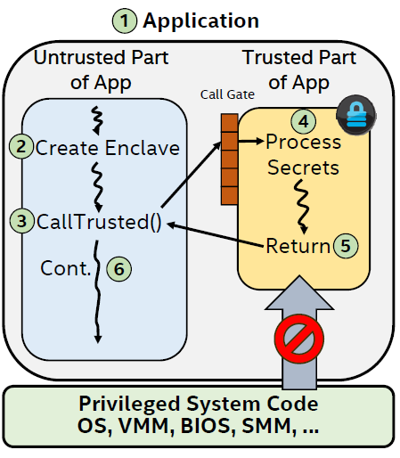
Execution Flow
Enclavize sensitive App parts defines
a partition to trusted and untrusted.
2. App runs & creates enclave in
trusted memory.
3. Trusted function transitions flow to
the enclave.
4. Enclave sees all process data, but
external access to enclave is denied.
5. Trusted function returns.
6. App continues normal execution.

Slide 35




Motivation – Some Usage Examples:
Cloud - Assure customers about the security standard of the “cloud enclave”. Confidential, also from vendors with physical access.
HSM - Implement HSM’s functionality and security such that existing software that supports HSMs can be adapted to using SGX instead.
DRM – On-line content provider that provides content only to authorized players hosting a trusted player enclave.
TOR - A node that could prove to users that it is not backdoored by its own admin and does not keep a log of how connections were routed.
35
Notes:
OS usage - Win10 will enclave LSSAS (no more Mimikatz)
Win10 is the first to support SGX.

Slide 36
Enclave Life Cycle
Virtual Address Space
Physical Address Space

Slide 37
Enclave Life Cycle
Virtual Address Space
Physical Address Space
BIOS setup
System Memory
EPCM
Enclave Page Cache
Invalid
Invalid
Invalid
Invalid Invalid
BIOS reserves memory address range for SGX use.

Slide 38
Enclave Life Cycle
Virtual Address Space
Physical Address Space
Enclave creation
Plaintext Code/Data
Code/Data
System Memory
Enclave
EPCM
Invalid
SECS
Valid, SECS, Range
ECREATE (Range(
Metadata
Enclave
Invalid
Invalid
Page
Cache
Invalid
Invalid
ECREATE - Stores enclave attributes (mode of operation, debug, etc.) in metadata.
Notes:
Metadata page = SECS page

Slide 39
Enclave Life Cycle
Virtual Address Space
Physical Address Space
Enclave creation
Plaintext Code/Data
Code/Data
System Memory
Copy page
Enclave
EPCM
Invalid
SECS
Valid, SECS, Range
ECREATE (Range)
EADD (Copy Page)
Metadata
Invalid
Invalid
Plaintext Coe/Data
Valid, REG,
LA,→SECS
Invalid
EADD – Commits new pages to enclave & updates security metadata.

Slide 40
Enclave Life Cycle
Virtual Address Space
Physical Address Space
Enclave creation
Plaintext Code/Data
Code/Data
System Memory
Enclave
EPCM
Invalid
SECS
Valid, SECS, Range
ECREATE (Range)
EADD (Copy Page)
Metadata
Invalid
Invalid
Plaintext Coe/Data
Valid, REG,
LA,→SECS
Invalid
EADD – Commits code, data or SGX control structure page types.

Slide 41
Enclave Life Cycle
Virtual Address Space
Physical Address Space
Enclave creation
Plaintext Code/Data
Code/Data
System Memory
Enclave
Update PTE
EPCM
Invalid
SECS
Valid, SECS, Range
Metadata
Invalid
ECREATE (Range)
EADD (Copy Page)
Invalid
Plaintext Coe/Data
Valid, REG,
LA,→SECS
Invalid

Slide 42
Enclave Life Cycle
Virtual Address Space
Physical Address Space
Enclave creation
Plaintext Code/Data
Code/Data
System Memory
Enclave
Code/Data
Update PTE
EPCM
Invalid
Metadata
Valid, SECS, Range
Invalid
Valid, REG, LA,→SECS
Valid, REG, LA,→SECS
Invalid
ECREATE (Range)
EADD (Copy Page)
Plaintext
Code/Data Plaintext Code/Data

Slide 43
Enclave Life Cycle
Virtual Address Space
Physical Address Space
Enclave creation
Plaintext Code/Data
Code/Data
System Memory
Enclave
Code/Data
Update PTE
EPCM
Invalid
Metadata
Valid, SECS, Range
Invalid
Valid, REG, LA,→SECS
Valid, REG, LA,→SECS
Invalid
ECREATE (Range)
EADD (Copy Page)
EEXTEND
Plaintext
Code/Data Plaintext Code/Data
EEXTEND - Measures the enclave with SHA256. (detailed shortly)

Slide 44
Enclave Life Cycle
Virtual Address Space
Physical Address Space
Enclave initialization
System Memory
Code/Data
Code/Data
Code/Data
Enclave
Code/Data
Code/Data
EPCM
Invalid
SECS
Valid, SECS, Range
Invalid
Valid, REG, LA,→SECS
Valid, REG, LA,→SECS
Invalid
Metadata
ECREATE (Range)
EADD (Copy Page)
EEXTEND
EINIT
Plaintext
Plaintext
Code/Data
Code/Data
Plaintext
Code/Data
Plaintext
Code/Data
EINIT - Finalizes measurements, validates them & enables enclave’s entry use.

Slide 45
Enclave Life Cycle
Virtual Address Space
Physical Address Space
Enclave active
System Memory
Code/Data
Code/Data
Code/Data
Enclave
Code/Data
Code/Data
EPCM
Invalid
SECS
Valid, SECS, Range
Invalid
Valid, REG, LA,→SECS
Valid, REG, LA,→SECS
Invalid
Metadata
ECREATE (Range)
EADD (Copy Page)
EEXTEND
EINIT
EENTER
Plaintext
Plaintext
Code/Data
Code/Data
Plaintext
Code/Data
Plaintext
Code/Data
EENTER - Verifies enclave entry & sets CPU operation mode to “enclave mode”.

Slide 46
Enclave Life Cycle
Virtual Address Space
Physical Address Space
Enclave active
System Memory
Code/Data
Code/Data
Code/Data
Enclave
Code/Data
Code/Data
EPCM
Invalid
SECS
Valid, SECS, Range
Invalid
Valid, REG, LA,→SECS
Valid, REG, LA,→SECS
Invalid
Metadata
ECREATE (Range)
EADD (Copy Page)
EEXTEND
EINIT
EENTER
Plaintext
Plaintext
Code/Data
Code/Data
Plaintext
Code/Data
Plaintext
Code/Data
Enclave flow is executed using the secured address range, obscured from all other SW.
Notes:
The entire ENCLAVE should appear as a ‘giant instruction’ to the debugger
(if the enclave is not in debug mode)

Slide 47
Enclave Life Cycle
Virtual Address Space
Physical Address Space
Enclave active
System Memory
Code/Data
Code/Data
Code/Data
Enclave
Code/Data
Code/Data
EPCM
Invalid
SECS
Valid, SECS, Range
Invalid
Valid, REG, LA,→SECS
Valid, REG, LA,→SECS
Invalid
Metadata
ECREATE (Range)
EADD (Copy Page)
EEXTEND
EINIT
EENTER
EEXIT
Plaintext
Plaintext
Code/Data
Code/Data
Plaintext
Code/Data
Plaintext
Code/Data
EEXIT – Clears CPU cache & Jumps out of enclave back to OS instruction address.
Notes:
CPU cache – includes: TLB, different SRAM caches, CPU registers, etc..

Slide 48
Enclave Life Cycle
Virtual Address Space
Physical Address Space
Enclave destruction
System Memory
Enclave
EPCM
SECS
Invalid
SECS
ECREATE (Range)
EADD (Copy Page)
EEXTEND
EINIT
EENTER
EEXIT
EREMOVE
Enclave
Invalid
Invalid
Page
Cache
Invalid
Invalid
EREMOVE – Clears enclave’s trusted virtual address range reserved by ECREATE.

Slide 49
Enclave Life Cycle
Virtual Address Space
Physical Address Space
BIOS setup
System Memory
EPCM
Enclave Page Cache
Invalid
Invalid
Invalid
Invalid Invalid

Slide 50
Making use of SGX Enclave
Independent software vendor (ISV) enclave development process.
Identify sensitive parts of application.
Move sensitive logic to enclave project and compile.
Multi-threaded enclave is supported by creating multiple TCS EPC entries.
Create accompanying enclave certificate (SIGSTRUCT)
Measure enclave content using SHA-256
Specify attributes
Set ISV information
Product ID
Security version number – SVN
Sign with ISV private key.
An enclave is in the clear before instantiation
Sections of code and data could be encrypted, but their decryption key can’t be pre-installed.
Secrets come from outside the enclave after it satisfies 3rd part’s trust.
Subsequent runs use provisioned secrets again.

Slide 51
Enclave creation process
Loads enclave binary into the EPC and establishes identity.
ECREATE
Finds a free EPC page and makes it the Enclaves SECS
Stores enclave initial attributes (mode of operation, debug, etc.)
EADD
Commits information (REG) or TCS as a new enclave EPC entry pages (4KB at a time)
Creates and updates associated EPCM entry.
EEXTEND
Measures 256Byte of info. into CryptoLog (thus runs 16 times to measure one page).
EINIT - ensures only measured code has enclave access!
Gets as input: SIGSTRUCT, EINITTOKEN
EINITTOKEN is generated using this CPU's Launch key, and contains: MRENCLAVE, MRSIGNER & ATTRIBUTES.
(These values must match the corresponding values in the SECS)
Verifies and creates enclave identities:
Finalizes measurements for MRENCLAVE.
Validates SIGSTRUCT with enclosed public key
Uses ISV’s signed SIGSTRUCT to validate MESIGNER and MRENCALVE.
Checks that no Intel-only bits are set in SIGSTRUCT.ATTRIBUTES unless SIGSTRUCT was signed by Intel.
Stores these and some other attributes in enclave’s SECS.
Enables enclave entry (mark as ready to be used)

Slide 52
Enclave Entry and Exit execution
CPU flow control under enclave mode
EENTER
Gets enclave TCS address as parameter
Verifies validity of enclave entry point
Check that TCS is not busy and marked it as “BUSY”.
Clears any translation remainder in cache (TLS)
Sets Asynchronous Exit Pointer (AEP) parameter
Change CPU mode of operation to “enclave mode”.
If not debug, set HW so the enclave appears as a single instruction.
ERESUME
AEP will mostly hold the ERESUME inst. address.
EEXIT
Clear any translation remainder in cache (TLB)
TCS is marked as “FREE”
Jumps out of enclave flow back to OS instruction address (stored in RBX)
Enclave developer is responsible for clearing registers state.

Slide 53
Handling enclave exceptions
AEX – Asynchronous Exit
Caused by interrupt, exception or fault
SGX reacts before the OS fault handler takes control.
All secrets and execution state are stored in enclave’s active SSA frame and replaced to prevent enclave leakage.
CPU registers are scrapped
After OS fault treatment, flow will jump to AEP.
SSA – State Save Area entry
Each TCS maintains a stack of SSA frames
The SSA frame is pre-defined by the ISV for that thread.

Slide 54










Enclave Measurement
When building an enclave, Intel® SGX generates a cryptographic log of all the build activities
Content: Code, Data, Stack, Heap
Location of each page within the enclave
Security flags being used
Order in which it was built
MRENCLAVE (“Enclave Identity”) is a 256-bit digest of the log
Represents the enclave’s software TCB
Data Chunk1
Chunk 1 MetaData
Data Chunk 2
Chunk 2 MetaData
Data Chunk n
Chunk n MetaData
SHA-256
SHA-256
SHA-256
MRENCLAVE
MRENCLAVE¹
MRENCLAVE²
MRENCLAVE^{n}
Notes:
Resembles TPM digest, where MRENCLAVE^n = PCR_value after extending it with data input.

Slide 55
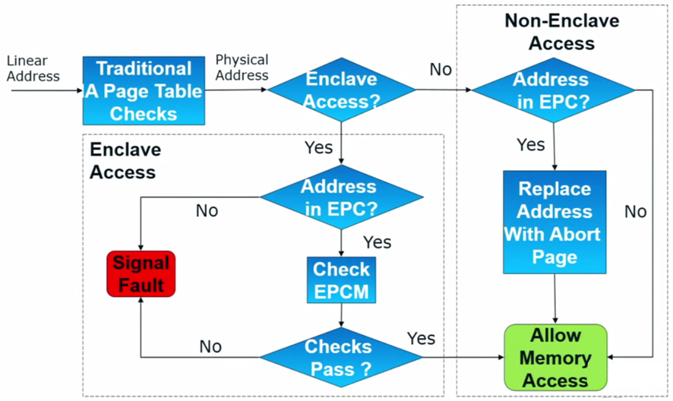
Execution Flow – Access Control

Slide 56
Memory Encryption Engine (MEE)
Resides within the CPU as a Memory Controller extension.
Encrypts, decrypts page swaps and integrity checks them
thus, providing data confidentiality and integrity.
TRNG generates at boot time separate keys for encryption and integrity.
Keys are held in MEE registers, accessible only to HW.
Does not hide the fact that data is written to the DRAM , when it is written, and to which physical address.
Defends system memory from cold boot attacks.
Uses version and counter controls to prevent page replay attack.
Problem – A lot of metadata stored in CPU…

Slide 57
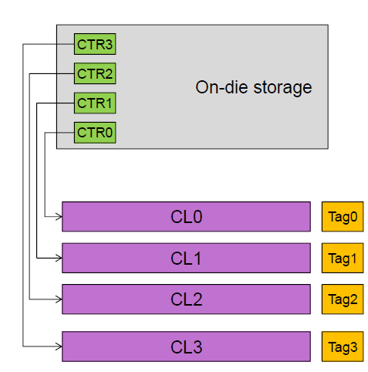
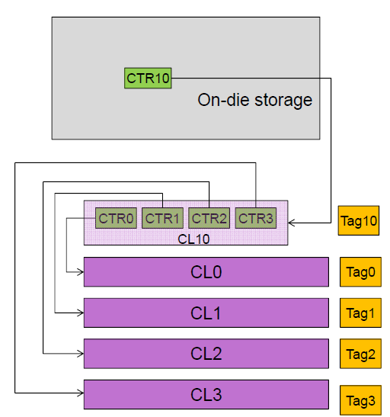
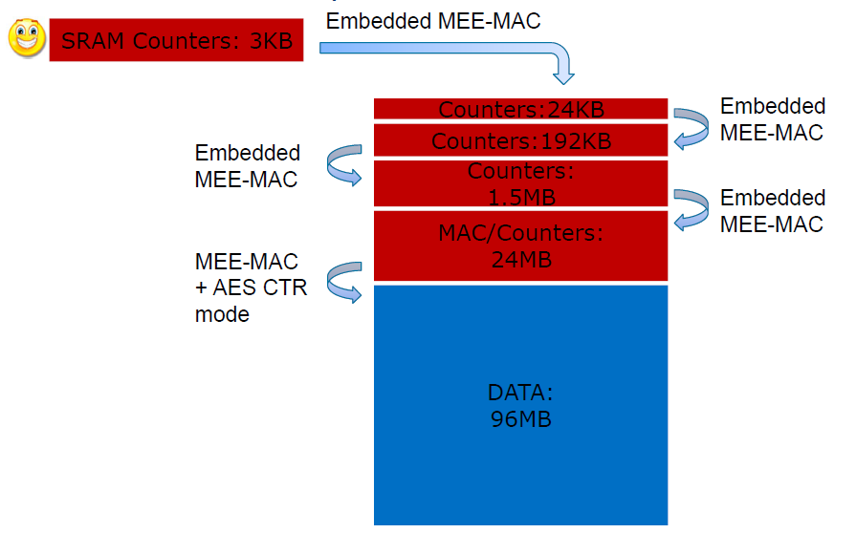
SGX Anti replay attack under HW limitations
Uses version and counter controls to prevent page replay attack.
Keeping this metadata for every evicted page is not scalable in SRAM terms.
How can we “compress” this?
Can be implemented as a merkle-tree.

Slide 58
Halfway recap
Enclave properties as a TEE
SGX Security Perimeter
lifecycle and execution flow
Enclave Measurement
Memory Encryption Engine
Sealing
Attestation
Provisioning
Overview summery
SGX usages
Q&A and open discussion

Slide 59
Sealing
Definition: Cryptographically protecting data when it is stored outside enclave.
Sealing enables enclave to pass data between consecutive runs.
Future enclave instantiation can acquire former provisioned sensitive data.
(Enclave shouldn’t ship with sensitive data, but be
provisioned with it after instantiation.)
Newer SVN (security version number) enclave can read older SVN data using a Key Recovery Transformation.
Notes:
:Key Recovery Transformation
Initial key = Choose “key” func form PRF family > F
Derivation String = Output F(“const”)
Derived Key = F(“const”) output, which given no clue about what F was chosen.

Slide 60





Sealing Actors
Sealing Authority – Developer
Enclave ISV that Signs the enclave certificate with its RSA-3072 Private key.
SIGSTRUCT - Enclave certificate.
Sealing Authority Public key (Used by HW to verify Certificate).
Enclave identity aka MRENCLAVE (Used by HW to verify enclave Integrity).
ISV SVN
Other enclave attributes.
Sealing Authority signature
MRSIGNER - Sealing Identity.
Created on enclave initialization.
Accessible only by the TCB.
Used to seal enclave data.
Includes:
sealing authority Public Key hash.
Product ID.
SVN – Security Version Number.
Notes:
Enclave binary is shipped with an accompanying SIGSTRUCT.
SIGSTRUCT is verified on ENCLAVE creation
MRSIGNER is built on ENCLAVE initialization (into MRSIGNER register).
MRSIGNER reflects Sealing Authority identity that signed the enclave’s certificate. (Pub_Key Hash)
Same MRSIGNER can be produced by different MRENCLAVES
TCB = CPU HW & FW.

Slide 61

EGETKEY Instruction
Key name, Policy, Enclave SVN
Called by an enclave to retrieve
desired key.
Key derivation :
Derived key is enclave and platform
specific.
EGETKEY Instruction
Intel SGX SVNs
Device Key
Owner Epoch
Key Derivation
Seal Key, Report Key, etc.

Slide 62
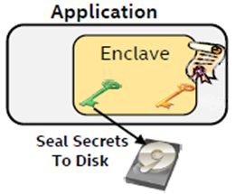
Sealing Process
Key name, Policy, Enclave SVN
Enclave calls EGETKEY:
Policy options are Enclave or Sealing Identity.
2. Sets sealing key SVN with key
recovery transformation.
3. Seals data with yielded key and ISV chosen encryption
scheme.
4. Writes sealed data to untrusted storage.
EGETKEY Instruction
Enclave and platform specific key
Data sealed under: 1. Processor key
CPU FW SVN
OwnerEpoch
Policy choice
Notes:
MRSIGNER is required as input for EGETKEY (as key name) to output the sealing key.
Enclave’s Identity Policy > a key for any instance of this exact enclave. Not future software. (e.g. after a vulnerability is found)
Sealing Identity Policy > a key that is available to enclaves signed by the same Sealing Authority (e.g. new SVN’s).

Slide 63
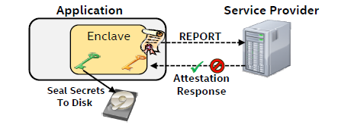
Attestation
SGX support local and remote HW based attestation capabilities.
Local Attestation
Allows one enclave to attest its TCB to another enclave on
the same platform.
Remote Attestation
Allows an enclave to attest its TCB to another 3-rd party entity
outside of the platform.

Slide 64

Local Attestation
Security instructions involved:
“Report”
Verifier MRENCLAVE, …
MRENCLAVE, Key name, …
EREPORT Instruction
EGETKEY Instruction
REPORT (Attestation assertion structure)
Claimer MRENCLAVE
Claimer MRSIGNER
Various addresser attributes
Developer additional information
kg
CMAC tag using verifier key
(To be Verified by "neighbored" enclave)
Enclave and platform specific key
Notes:
EGETKEY return the key that is used to cryptographically verify the REPORT (the key is derived from SECS.MRENCALVE).
Same symmetric key:
EGEYKEY returns report key associated with invoking enclave.
EREPORT uses the key to sign the report but doesn't reveal it to invoker.

Slide 65
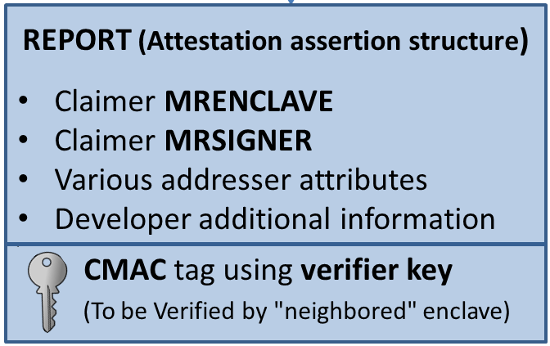
Local Attestation
Protocol flow:
Challenge (B’s MRENCALVE)
Response (REPORT)
Claimer
Verifier
REPORT*
Invokes EREPORT
Invokes EGETKEY
Verifies the REPORT:
HW (REPORT key)
SW (response details)
3. Invokes EREPORT
Invokes EGETKEY
Verifies the REPORT :
HW (REPORT key)
SW (response details)
* Optional
Notes:
Enclave B **can** then reciprocate by creating a REPORT for enclave A.

Slide 66
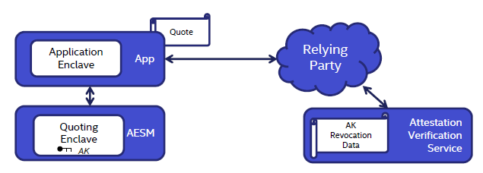
Remote Attestation
SGX uses a Quoting Enclave (QE) to convert LOCAL attestations to REMOTELY verifiable assertion.
QE locally verifies REPORT produced by Application Enclave and signs it as a QUOTE.
QE uses an asymmetric attestation key that reflects the platforms trustworthiness.
App sends Quote to the Relying Party to verify.
Platform
Local attestation
Remote attestation
Notes:
Problem – not same CPU - Remote party can not access it, how can it verify the TCB?
QE replaces the MAC over these REPORTs with a signature created with a device specific (private) asymmetric key.

Slide 67
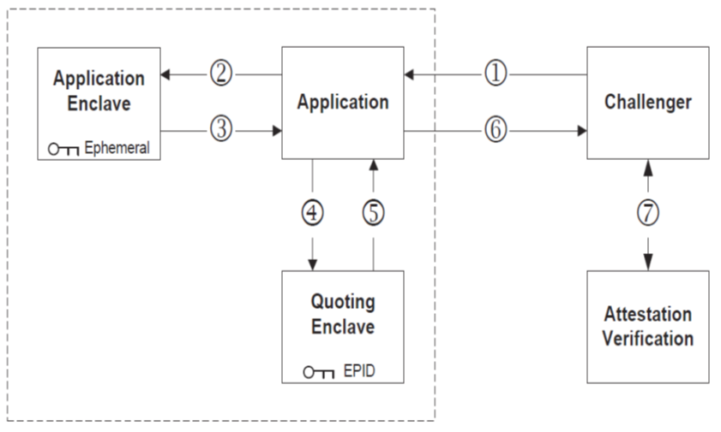

Remote Attestation
Protocol flow:
Challenge
Challenge
QOUTE
Claimer
Verifier
REPORT
Secrets
REPORT
8
QOUTE
QOUTE
Service /
Server run by intel
Verify report
Create Quote
Verify Quote
67
Notes:
Verification service - Public keys and revocation are issued to EPID
verifiers.
Can I fake QOUTEs? >>> EPID keys provide HW based platform identity.

Slide 68
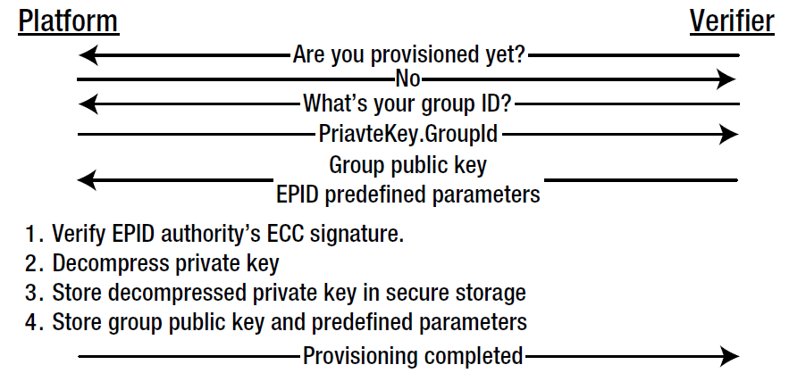
Provisioning the Attestation Key
To save expensive secure fuse space, a unique private key is generated on manufacturing and an unusable shorten form of it is fused on HW.
Group public key and other predefined parameters are sent to the device for it to extract and safely store the functional private key in a secure NVM.
Integrity is checked using hardcoded Intel EPID Authority public key.
Notes:
Provisioned info isn't secret.
Many manufacturers preform provisioning on manufacturing.

Slide 69
Summary
Enclave runs in ring-3 privilege level deriving trust directly from hardware.
Developers may focus on securing a smaller TCB.
Application can support multiple enclaves.
Resources are run & managed by OS, yet protected in face of a compromised OS/VMM.
Provides integrity and confidentiality, also in face of HW DMA attacks.
69

Slide 70
Questions & Open Discussion
Questions ?
What are the limitations of SGX?
Pinpoint the root of trust assumptions.
Techniques that can be implemented to try and breach enclave security.
Are they any drawbacks when utilizing SGX?
Innovative usages of SGX capabilities.
70

