Slide 1

Information Security – Theory vs. Reality 0368-4474-01, Winter 2011 Lecture 14: More on vulnerability and exploits, Fully homomorphic encryption
Eran Tromer
Slides credit: Vinod Vaikuntanathan (U. Toronto)

Slide 2
More on vulnerability exploitation

Slide 3
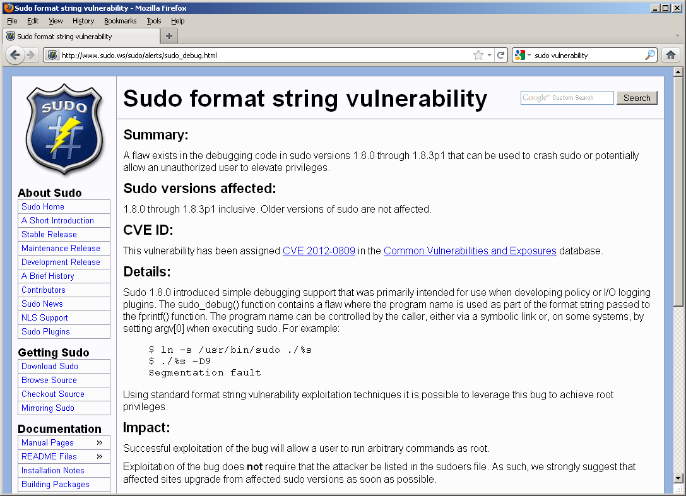
Case study: sudo format string vulnerability
Report: http://www.sudo.ws/sudo/alerts/sudo_debug.html

Slide 4
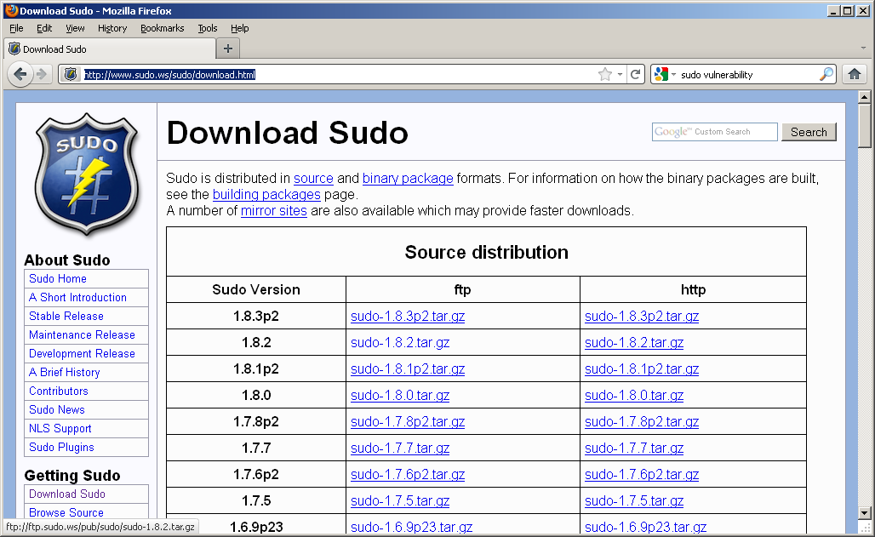
Case study: sudo format string vulnerability (cont.)
Sourcecode: http://www.sudo.ws/sudo/download.html

Slide 5
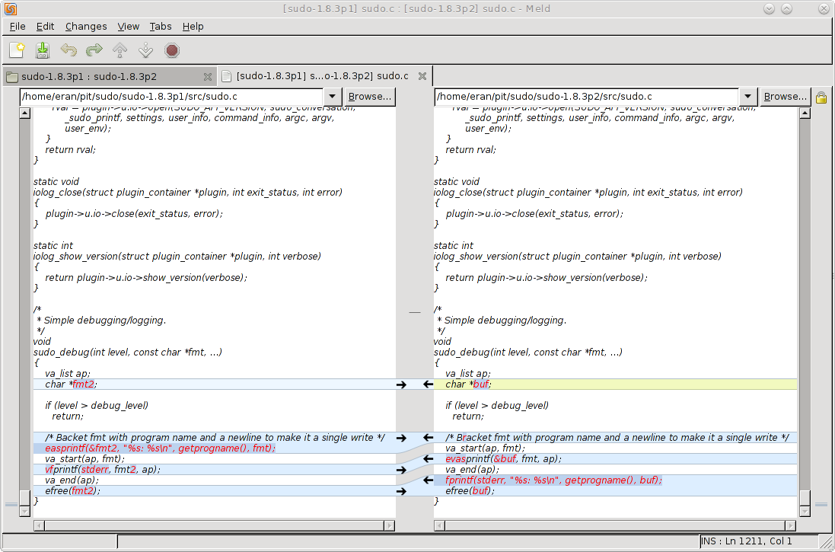
Case study: sudo format string vulnerability (cont.)
Sourcecode diff:

Slide 6
Case study: sudo format string vulnerability (cont.)
Report: http://www.sudo.ws/sudo/alerts/sudo_debug.html

Slide 7
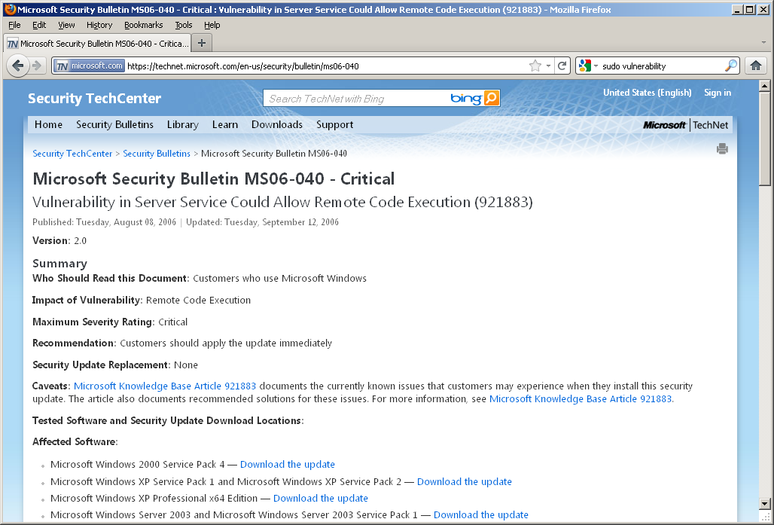
Case study: MS06-040 buffer overrun
Report: https://technet.microsoft.com/en-us/security/bulletin/ms06-040

Slide 8
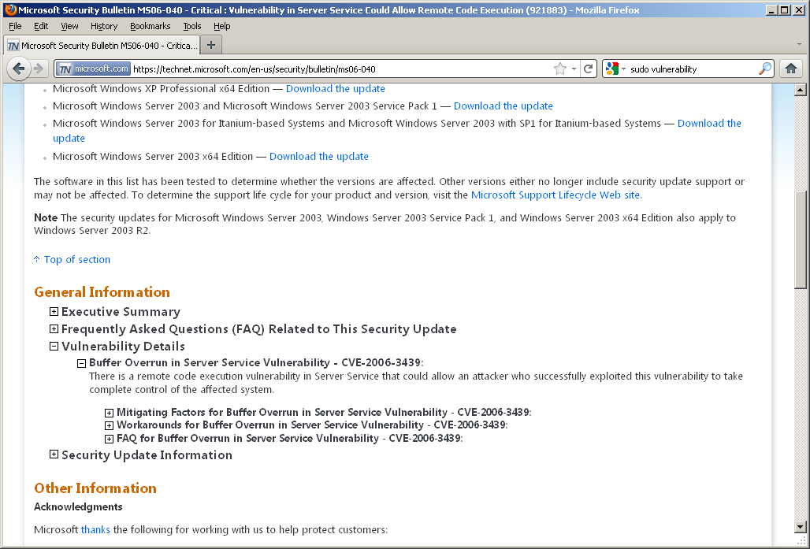
Case study: MS06-040 buffer overrun (cont.)
Report: https://technet.microsoft.com/en-us/security/bulletin/ms06-040

Slide 9
Case study: MS06-040 buffer overrun
Report: https://technet.microsoft.com/en-us/security/bulletin/ms06-040

Slide 10
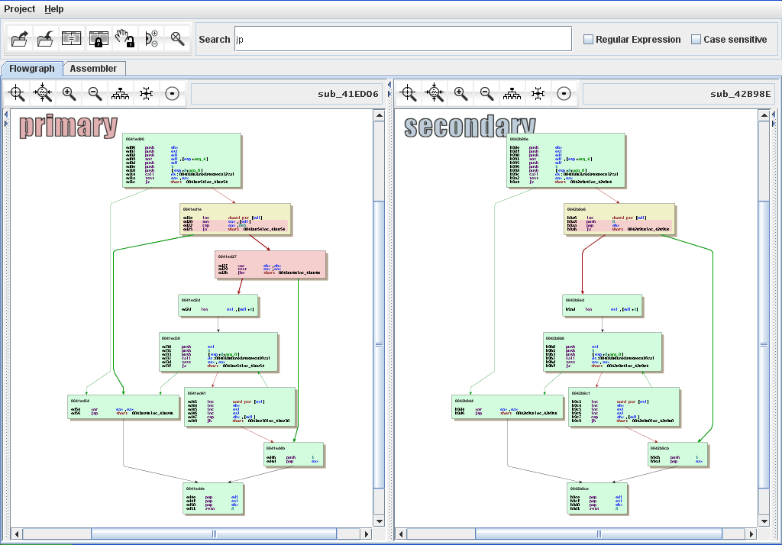
Understanding binary patches: BinDiff

Slide 11
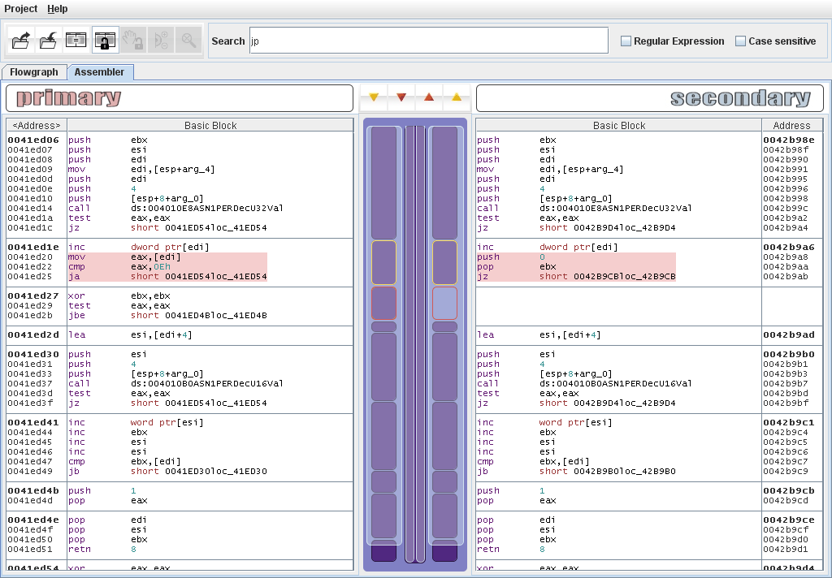
Understanding binary patches: BinDiff (cont.)

Slide 12
Metasploit Framework
Framework for vulnerability exploitation and penetration testing
Capabilities
Library of exploit codes
Library of payloads (shells, VNC)
Victim fingerprinting
Opcode database (instruction addresses for various software versions)
Exploit encoding (avoiding special character, intrustion and intrusion detection systems)
Modular architecture, many add-ons
Powerful scriptable command-line interface
Convenient GUI and web interfaces

Slide 13
Metasploit Framework (cont.)
http://www.metasploit.com/
Book: Kennedy, O’Gorman, Kearns, Aharoni, Metasplit: The Penetration Tester’s Guide (2011 edition)
Numerous on-line tutorials
Example: https://www.youtube.com/watch?v=mrLaUaowt-w
Notes:
https://www.youtube.com/watch?v=mrLaUaowt-w

Slide 14
Metasploit Framework: back to MS06-040
Demo:
https://www.youtube.com/watch?v=mrLaUaowt-w

Slide 15
Fully Homomorphic Encryption
Meanwhile, in theory-land…

Slide 16
The goal
Delegate processing of data
without giving away access to it
Notes:
Assume that I have a piece of data, I want some computation to be performed on this data nad I want to get the result. But for some reason, I don’t want to do the computation myself. Perhaps because the computation is too expensive and I don’t simply have enough resou to do it myself. In other words, I want to delegate processing to someone else, I want them to do the computation for me, but I don’t want them to see what my data is.

Slide 17



Example 1: Private Search
Delegate PROCESSING of data
without giving away ACCESS to it
You: Encrypt the query, send to Google
(Google does not know the key, cannot “see” the query)
Google: Encrypted query → Encrypted results
(You decrypt and recover the search results)

Slide 18

Example 2: Private Cloud Computing
Delegate PROCESSING of data
without giving away ACCESS to it
Encrypt x
Enc(x), P → Enc(P(x))
(Input: x)
(Program: P)

Slide 19
Fully Homomorphic Encryption
Encrypted x, Program P → Encrypted P(x)
Definition: (KeyGen, Enc, Dec, Eval)
(as in regular public/private-key encryption)
Correctness of Eval: For every input x, program P
If c = Enc(PK, x) and c′ = Eval (PK, c, P),
then Dec (SK, c′) = P(x).
Compactness: Length of c′ independent of size of P
Security = Semantic Security [GM82]

Slide 20




Fully Homomorphic Encryption
[Rivest-Adleman-Dertouzos’78]
Knows nothing of x.
Enc(x)
x
Function f
Eval: f, Enc(x) → Enc(f(x))
homomorphic evaluation

Slide 21
Fully Homomorphic Encryption
First Defined: “Privacy homomorphism” [RAD’78]
their motivation: searching encrypted data
Notes:
Here: Bring in the picture with the functions, all functions, and then ADD and MULT and QFs.

Slide 22
Fully Homomorphic Encryption
First Defined: “Privacy homomorphism” [RAD’78]
their motivation: searching encrypted data
Limited Variants:
RSA & El Gamal: multiplicatively homomorphic
GM & Paillier: additively homomorphic
c* = c₁c₂…c_{n} = (m₁m₂…m_{n})^{e} mod N
X
c₁ = m₁e
c₂ = m₂e
c_{n} = m_{n}^{e}
Notes:
Here: Bring in the picture with the functions, all functions, and then ADD and MULT and QFs.

Slide 23
Fully Homomorphic Encryption
First Defined: “Privacy homomorphism” [RAD’78]
their motivation: searching encrypted data
Limited Variants:
RSA & El Gamal: multiplicatively homomorphic
GM & Paillier: additively homomorphic
BGN’05 & GHV’10: quadratic formulas
NON-COMPACT homomorphic encryption:
Based on Yao garbled circuits
SYY’99 & MGH’08: c* grows exp. with degree/depth
IP’07 works for branching programs
Notes:
Here: Bring in the picture with the functions, all functions, and then ADD and MULT and QFs.

Slide 24
Fully Homomorphic Encryption
First Defined: “Privacy homomorphism” [RAD’78]
their motivation: searching encrypted data
Big Breakthrough: [Gentry09]
First Construction of Fully Homomorphic Encryption
using algebraic number theory & “ideal lattices”
Full course last semester
Today: an alternative construction [DGHV’10]:
using just integer addition and multiplication
easier to understand, implement and improve

Slide 25

Constructing fully-homomoprhic encryption assuming hardness of approximate GCD

Slide 26

A Roadmap
1. Secret-key “Somewhat” Homomorphic Encryption (under the approximate GCD assumption)
(a simple transformation)
2. Public-key “Somewhat” Homomorphic Encryption (under the approximate GCD assumption)
(borrows from Gentry’s techniques)
3. Public-key FULLY Homomorphic Encryption (under approx GCD + sparse subset sum)

Slide 27
Secret-key Homomorphic Encryption
Secret key: a large n²-bit odd number p
(sec. param = n)
To Encrypt a bit b:
pick a random “large” multiple of p, say q·p
(q ~ n⁵ bits)
pick a random “small” even number 2·r
(r ~ n bits)
Ciphertext c = q·p+2·r+b
“noise”
To Decrypt a ciphertext c:
c (mod p) = 2·r+b (mod p) = 2·r+b
read off the least significant bit
Notes:
Noise term growing by how much? N^1/2 versus N/2
What is the sec parameter?
What is the efficiency?
Noise growing???
Random large!!!
Introduce the term near-multiple here.

Slide 28
Secret-key Homomorphic Encryption
How to Add and Multiply Encrypted Bits:
Add/Mult two near-multiples of p gives a near-multiple of p.
c₁ = q₁·p + (2·r₁ + b₁), c₂ = q₂·p + (2·r₂ + b₂)
c₁+c₂ = p·(q₁ + q₂) + 2·(r₁+r₂) + (b₁+b₂)
« p
LSB = b₁ XOR b₂
c₁c₂ = p·(c₂·q₁+c₁·q₂-q₁·q₂) + 2·(r₁r₂+r₁b₂+r₂b₁) + b₁b₂
« p
LSB = b₁ AND b₂

Slide 29

Problems
Ciphertext grows with each operation
Useless for many applications (cloud computing, searching encrypted e-mail)
Noise grows with each operation
Consider c = qp+2r+b ← Enc(b)
c (mod p) = r’ ≠ 2r+b
lsb(r’) ≠ b
2r+b
r’
(q-1)p
qp
(q+1)p
(q+2)p

Slide 30
Problems
Ciphertext grows with each operation
Useless for many applications (cloud computing, searching encrypted e-mail)
Noise grows with each operation
Can perform “limited” number of hom. operations
What we have: “Somewhat Homomorphic” Encryption

Slide 31
Public-key Homomorphic Encryption
Secret key: an n²-bit odd number p
Δ
Public key: [q₀p+2r₀,q₁p+2r₁,…,q_{t}p+2r_{t}] = (x₀,x₁,…,x_{t})
t+1 encryptions of 0
Wlog, assume that x₀ is the largest of them
To Decrypt a ciphertext c:
c (mod p) = 2·r+b (mod p) = 2·r+b
read off the least significant bit
Eval (as before)

Slide 32
Public-key Homomorphic Encryption
Secret key: an n²-bit odd number p
Δ
Public key: [q₀p+2r₀,q₁p+2r₁,…,q_{t}p+2r_{t}] = (x₀,x₁,…,x_{t})
To Encrypt a bit b: pick random subset S [1…t]
c = + b (mod x₀)
To Decrypt a ciphertext c:
c = p[ ] + 2[ ] + b (mod x₀)
c = p[ ] + 2[ ] + b – kx₀ (for a small k)
c (mod p) = 2·r+b (mod p) = 2·r+b
read off the least significant bit
= p[ ] + 2[ ] + b
Eval (as before)
(mult. of p) + (“small” even noise) + b

Slide 33
Public-key Homomorphic Encryption
Ciphertext Size Reduction
Secret key: an n²-bit odd number p
Δ
Public key: [q₀p+2r₀,q₁p+2r₁,…,q_{t}p+2r_{t}] = (x₀,x₁,…,x_{t})
To Encrypt a bit b: pick random subset S [1…t]
Resulting ciphertext < x₀
c = + b (mod x₀)
Underlying bit is the same (since x₀ has even noise)
To Decrypt a ciphertext c:
Noise does not increase by much^{(*)}
c (mod p) = 2·r+b (mod p) = 2·r+b
read off the least significant bit
Eval: Reduce mod x₀ after each operation
(*) additional tricks for mult

Slide 34
A Roadmap
Secret-key “Somewhat” Homomorphic Encryption
Public-key “Somewhat” Homomorphic Encryption
3. Public-key FULLY Homomorphic Encryption

Slide 35
How “Somewhat” Homomorphic is this?
Can evaluate (multi-variate) polynomials with m terms, and maximum degree d if d << n.
or
f(x₁, …, x_{t}) = x₁·x₂·x_{d} + … + x₂·x₅·x_{d-2}
m terms
Say, noise in Enc(x_{i}) < 2^{n}
Final Noise ~ (2^{n})^{d}+…+(2^{n})^{d} = m•(2^{n})^{d}
Notes:
What happens to the noise? Does not increase by too much.

Slide 36
From “Somewhat” to “Fully”
Theorem [Gentry’09]: Convert “bootstrappable” → FHE.
FHE = Can eval all fns.
Augmented Decryption ckt.
“Somewhat” HE
“Bootstrappable”
NAND
Dec
Dec
c₁
sk
c₂
sk

Slide 37
Is our Scheme “Bootstrappable”?
What functions can the scheme EVAL?
(polynomials of degree < n)
(?)
Complexity of the (aug.) Decryption Circuit
(degree ~ n^{1.73} polynomial)
Can be made bootstrappable
Similar to Gentry’09
Caveat: Assume Hardness of “Sparse Subset Sum”

Slide 38
Security
(of the “somewhat” homomorphic scheme)

Slide 39

The Approximate GCD Assumption
Parameters of the Problem: Three numbers P,Q and R
p?
(q₁p+r₁,…, q_{t}p+r_{t})
q₁p+r₁
p
q₁ ← [0…Q]
r₁ ← [-R…R]
Assumption: no PPT adversary can guess the number p
odd p ← [0…P]
Notes:
TODO!!

Slide 40

(q₁p+r₁,…, q_{t}p+r_{t})
p?
p
Assumption: no PPT adversary can guess the number p
=
(proof of security)
Semantic Security [GM’82]: no PPT adversary can guess the bit b
PK =(q₀p+2r₀,{q_{i}p+2r_{i}})
Enc(b) =(qp+2r+b)
Notes:
TODO!!

Slide 41
Progress in FHE
“Galactic” → Efficient
[BV11a, BV11b, BGV11, GHS11, LTV11]
asymptotically: nearly linear-time* algorithms
practically: a few milliseconds for Enc, Dec [LNV11,GHS11]
Strange assumptions → Mild assumptions
[BV11b, GH11, BGV11]
Best Known [BGV11]: (leveled) FHE from worst-case hardness of n^{O(log n)}-approx short vectors on lattices
*linear-time in the security parameter

Slide 42

Multi-key FHE
sk₁, pk₁
x₁
c₁ = Enc(pk₁,x₁)
Function f
sk₂, pk₂
c₂ = Enc(pk₂,x₂)
x₂

Slide 43
Multi-key FHE
sk₁, pk₁
x₁
Function f
y = Eval(f,c₁,c₂)
Dec
sk₂, pk₂
x₂
Correctness:
Dec(sk₁,sk₂ y)=f(x₁,x₂)

Slide 44
Fully homomorphic encryption: discussion
Assumptions
Mathematical
Adversarial model
Applicability
Decryption? Keys?
Alternative: multiparty computation
When interaction is free
What about integrity?
Computationally-sound proofs, proof-carrying data

