Slide 1
Querying Encrypted Data
Arvind Arasu, Ken Eguro, Ravi Ramamurthy, Raghav Kaushik
Microsoft Research

Slide 2






Cloud Computing
Well-documented benefits
Trend to move computation and data to cloud
Database functionality
Amazon RDS
Microsoft SQL Azure
Heroku PostegreSQL
Xeround
[AF+09, NIST09]
Notes:
Motivating context for this tutorial arises due to cloud computing, which requires no detailed introduction
Cloud computing: well-documented benefits both for cloud provider and user
Trend: move computation and data to the cloud to the extent possible
We are specifically interested in databases – there are a number of cloud providers who offer database as a service in the cloud

Slide 3

Security Concerns
Data in the cloud vulnerable to:
Snooping administrators
Hackers with illegal access
Compromised servers
[CPK10, ENISA09a]
Notes:
These benefits come with some drawbacks.
Particularly security concerns.
[Slide]

Slide 4
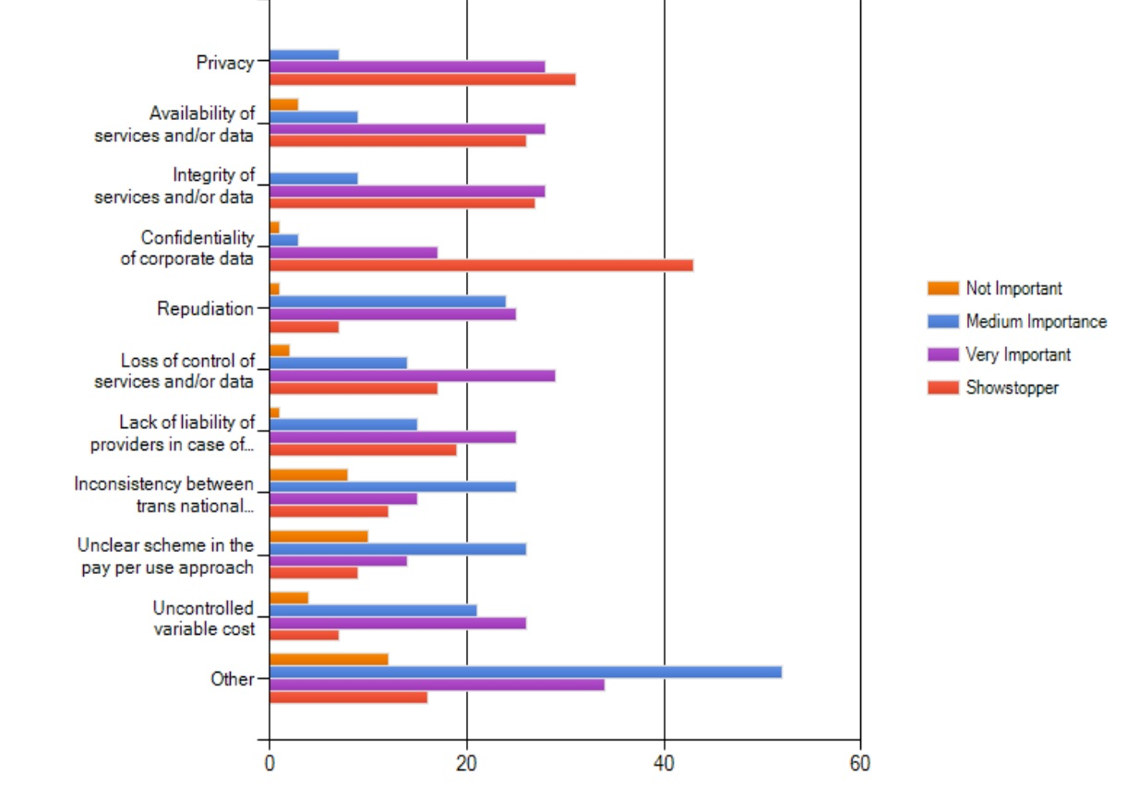
What are your main cloud computing concerns?
Survey: European Network and Information Security Agency, Nov 2009 [ENISA09b]
Notes:
In the post snowden era, I don’t need to spend a lot of time justifying this.
There are a lot of surveys which show that confidentiality and security of data in the cloud is a serious concern.
We know of organizations that have not moved to the cloud due to security concerns.

Slide 5
Sensitive Data in the Cloud: Examples
Software as a Service Applications
Billing
CRM
ERP
Health
Personal Data
Aria Systems
eVapt
nDEBIT
Redi2
Zuora
37 Signals
Capsule
Dynamics
Intouchcrm
LiveOps
Oracle CRM
Parature
Responsys
RO|Enablement
Salesforce.com
Save My Table
Solve 360
Acumatica ERP
Blue Link Elite
Epicor Express
NetSuite
OrderHarmony
Plex Online
CECity
SNO
Google Docs
Microsoft Office
Mint.com
Personal data
Corporate data
Source: http://cloudtaxonomy.opencrowd.com/taxonomy/
Notes:
This point is also clear if we look at examples of applications running in the cloud.
This is a sampling of applications that run fully in the cloud – or SaaS apps.
Billing, CRM, ERP: potentially sensitive corporate data
Health, Personal Data: potentially sensitive personal data

Slide 6


Data Encryption
a7be1a6997ad739bd8c9ca451f618b61
b6ff744ed2c2c9bf6c590cbf0469bf41
47f7f7bc95353e03f96c32bcfd8058df
Encr
Key
The quick brown fox jumps over the lazy dog
Notes:
A natural approach to securing the data in the cloud is encryption.
We keep data in the cloud encrypted.
Idea: the adversary can snoop at this data but cannot learn anything without the key used to encrypt the data which is ideally not stored in the cloud

Slide 7
AWS Security Advice
7.2. Security. We strive to keep Your Content secure, but cannot guarantee that we will be successful at doing so, given the nature of the Internet. Accordingly, without limitation to Section 4.3 above and Section 11.5 below, you acknowledge that you bear sole responsibility for adequate security, protection and backup of Your Content. We strongly encourage you, where available and appropriate, to use encryption technology to protect Your Content from unauthorized access and to routinely archive Your Content. We will have no liability to you for any unauthorized access or use, corruption, deletion, destruction or loss of any of Your Content.
Source: http://aws-portal.amazon.com/gp/aws/developer/terms-and-conditions.html

Slide 8

Encryption and DbaaS: Functionality
Notes:
So far our discussion on data confidentiality has been generic
Now we focus on db-as a service and the implications of using encryption as a technology
Most basic question: what does it mean in terms of functionality?

Slide 9
Example: Online Course Database
Student
StudentId | Name | Addr | GPA | CreditCard | …
Course
CourseId | Name | InstrId | …
StudentCourse
CourseId | StudentId | Grade | …
Notes:
At this point, introduce a running example: backend database for a hypothetical online course systems (e.g., Coursera).
Contains sensitive attributes shown circled.

Slide 10
Encryption and DbaaS: Functionality
SELECT *
FROM courses
WHERE StudentId = 1234
Client App
Notes:
Plaintext functionality

Slide 11
Encryption and DbaaS: Functionality
Encrypted
SELECT *
FROM courses
WHERE StudentId = 1234
Client App
[HIL+02]
SIGMOD Test of Time Award
Notes:
Desired functionality under encryption: encrypted data stored, encrypted queries, and encrypted results

Slide 12
Tutorial Overview
Survey of existing work
Building blocks
End-to-end systems
Security-Performance-Generality tradeoff
Taxonomy, organization
Open problems & Challenges
Random pontifications
Notes:
Goal of this tutorial: how we can build database systems that support this functionality.
While we will contain enough details to make the tutorial self-contained, our focus will be on end-to-end systems, how they trade off security, performance, and generality.
We will also spend some organizational effort classifying various systems along various dimensions. This is one of the contributions of this tutorial.
We also include lots of open problems and random pontifications on the subject.

Slide 13
Tutorial Goals & Non-Goals
Takeaway goals:
Interesting & Important area
Lots of open (systems) problems
Multi-disciplinary
Non-goals:
Latest advances Elliptic Curve Cryptography
Notes:
For a database systems person on how to use crypto as a blackbox mostly and build secure systems.

Slide 14
Roadmap
Introduction
Overview
Basics of Encryption
Trusted Client based Systems
Secure In-Cloud Processing
Security
Conclusion

Slide 15

Passive Adversary
Passive
Honest but curious
Does not alter:
Database
Results
Design systems for active adversary
Notes:
To understand security, we need to model powers of the adversary. This tutorial: passive adversary

Slide 16
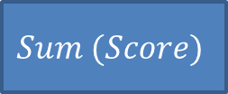
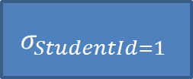
Encryption: Fundamental Challenge
$$Sum (Score)$$
Select Sum (Score)
From Assignment
Where StudentId = 1
$$σ_{StudentId=1}$$
StudentId | AssignId | Score
1 | 1 | 68
1 | 2 | 71
3 | 4 | 99
… | … | …

Slide 17
Encryption: Fundamental Challenge
$$Sum (Score)$$
Select Sum (Score)
From Assignment
Where StudentId = 1
$$σ_{StudentId=1}$$
Assignment
a7be1a6997ad739bd8c9ca451f618b61
b6ff744ed2c2c9bf6c590cbf0469bf41
47f7f7bc95353e03f96c32bcfd8058df
Notes:
Encryption “hides” data, so traditional query processing does not work in an obvious way

Slide 18
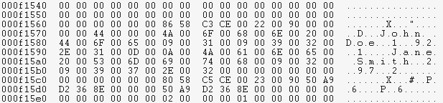


Encryption: Fundamental Challenge
$$Sum (Score)$$
Select Sum (Score)
From Assignment
Where StudentId = 1
$$σ_{StudentId=1}$$
Memory
$$Decr$$
$$Key$$
Assignment
a7be1a6997ad739bd8c9ca451f618b61
b6ff744ed2c2c9bf6c590cbf0469bf41
47f7f7bc95353e03f96c32bcfd8058df
Industry state-of-the-art:
[OTDE, STDE]
Storage
Notes:
Decrypt the data-on-the-fly?
Two problems: key is in the cloud
Plaintext data is visible at least for sometime
Most of the talk: working definition of security == data remains encrypted everywhere including memory at all times

Slide 19
Solution Landscape
Two fundamental techniques
Directly compute over encrypted data
Special homomorphic encryption schemes
Challenge: limited class of computations
Use a “secure” location
Computations on plaintext
Challenge: Expensive

Slide 20




Homomorphic Encryption
$$Enc (1)$$
7ad5fda789ef4e272bca100b3d9ff59f
$$+_{Enc}$$
7a9f102789d5f50b2beffd9f3dca4ea7
bd6e7c3df2b5779e0b61216e8b10b689
$$Enc (2)$$
$$Enc (1)$$
Encryption key is not an input
Notes:
Homomorphic encryption: directly compute on encrypted values

Slide 21
Solution Landscape
Two fundamental techniques
Directly compute over encrypted data
Special homomorphic encryption schemes
Challenge: limited class of computations
Challenge: Not composable
Use a “secure” location
Computations on plaintext
Challenge: Expensive

Slide 22

Secure Location
Inaccessible
Inaccessible

Slide 23
Solution Landscape
Two fundamental techniques
Directly compute over encrypted data
Special homomorphic encryption schemes
Challenge: limited class of computations
Use a “secure” location
Computations on plaintext
Challenge: Expensive
Build a plane from black box material

Slide 24
Systems Landscape
Full Homomorphic
Partial Homomorphic
CryptDB
Monomi
TrustedDB
Cipherbase
Non Homomorphic
“Blob”Store
AWS GovCloud
No Secure
Location
Secure Server
Crypto Coprocessor
Client
FPGA

Slide 25
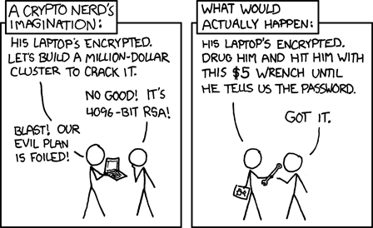
Encryption == Security?
Source: http://xkcd.com/538/
Notes:
There is a lot more to security than encryption. Considered in the last part of the tutorial.

Slide 26
Roadmap
Introduction
Overview
Basics of Encryption
Trusted Client based Systems
Secure In-Cloud Processing
Security
Conclusion

Slide 27
Encryption Scheme
Key:
000102030405060708090a0b0c0d0e0f
Plaintext
Ciphertext
Encr
a7be1a6997ad739bd8c9ca451f618b61
b6ff744ed2c2c9bf6c590cbf0469bf41
47f7f7bc95353e03f96c32bcfd8058df
The quick brown fox jumps over the lazy dog
Ciphertext
Plaintext
a7be1a6997ad739bd8c9ca451f618b61
b6ff744ed2c2c9bf6c590cbf0469bf41
47f7f7bc95353e03f96c32bcfd8058df
Decr
The quick brown fox jumps over the lazy dog
Key:
000102030405060708090a0b0c0d0e0f
Crypto Textbook: [KL 07]
Notes:
Encryption scheme – encryption function, decryption function. Given a key the encryption function maps input to seemingly random sequence of bytes. Given the key the decryption function, gets back the original input.

Slide 28
Encryption Scheme
Public Key:
000102030405060708090a0b0c0d0e0f
Plaintext
Ciphertext
Encr
a7be1a6997ad739bd8c9ca451f618b61
b6ff744ed2c2c9bf6c590cbf0469bf41
47f7f7bc95353e03f96c32bcfd8058df
The quick brown fox jumps over the lazy dog
Ciphertext
Plaintext
a7be1a6997ad739bd8c9ca451f618b61
b6ff744ed2c2c9bf6c590cbf0469bf41
47f7f7bc95353e03f96c32bcfd8058df
Decr
The quick brown fox jumps over the lazy dog
Private Key:
47b6ffedc2be19bd5359c32bcfd8dff5
Crypto Textbook: [KL 07]
Notes:
Some schemes use different keys (but related) keys for encryption and decryption – but this detail is not very relevant to our tutorial.

Slide 29
AES + CBC Mode
The quick brown
fox jumps over t
lazy dog........
Init. Vector (IV)
000000000001...
Key
AES
Key
AES
Key
AES
a7be1a6997a7...
b6ff744ed2c2...
47f7f7bc9535...
Variable IV => Non-deterministic
[AES, KL 07]
Notes:
There are scores of encryption schemes – we will pick 4-5 which are relevant for database encryption.
Industry standard encryption scheme used to encrypt most of your communication would be AES used in particular way called CBC mode. No need to follow all details.
One detail that is important: typically IV is variable -> overall encryption is non-deterministic

Slide 30
AES + CBC Mode
The quick brown
fox jumps over t
lazy dog........
Init. Vector (IV)
000000000002...
Key
AES
Key
AES
Key
AES
fa636a2825b3...
247240236966...
69c4e0d86a7b...
Variable IV => Non-deterministic
[AES, KL 07]
Notes:
Encrypting the same input multiple times results in totally different ciphertexts.

Slide 31
Nondeterministic Encryption Scheme
Key:
000102030405060708090a0b0c0d0e0f
Encr
a7be1a6997ad739bd8c9ca451f618b61
b6ff744ed2c2c9bf6c590cbf0469bf41
47f7f7bc95353e03f96c32bcfd8058df
The quick brown fox jumps over the lazy dog
000102030405060708090a0b0c0d0e0f
Encr
fa636a2825b339c940668a3157244d17
247240236966b3fa6ed2753288425b6c
69c4e0d86a7b0430d8cdb78070b4c55a
The quick brown fox jumps over the lazy dog
Example: AES + CBC + variable IV
Notes:
Implication: we cannot even determine if two ciphertexts came from the same plaintext

Slide 32
AES + ECB Mode
The quick brown
fox jumps over t
lazy dog........
Key
AES
Key
AES
Key
AES
a7be1a6997a7...
b6ff744ed2c2...
47f7f7bc9535...
[AES, KL 07]
Notes:
We can use AES slightly differently to get a deterministic encryption scheme.

Slide 33
Deterministic Encryption Scheme
Key:
000102030405060708090a0b0c0d0e0f
Encr
a7be1a6997ad739bd8c9ca451f618b61
b6ff744ed2c2c9bf6c590cbf0469bf41
47f7f7bc95353e03f96c32bcfd8058df
The quick brown fox jumps over the lazy dog
000102030405060708090a0b0c0d0e0f
Encr
a7be1a6997ad739bd8c9ca451f618b61
b6ff744ed2c2c9bf6c590cbf0469bf41
47f7f7bc95353e03f96c32bcfd8058df
The quick brown fox jumps over the lazy dog
Example: AES + ECB
More secure deterministic encryption: [PRZ+11]

Slide 34

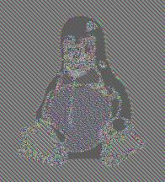

Strong Security => Non-Deterministic
Original
Deterministic
Non-Deterministic
Source: http://en.wikipedia.org/wiki/Block_cipher_modes_of_operation

Slide 35
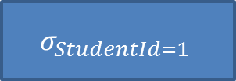
Deterministic Encryption
select *
from assignment
where studentid = 1
$$σ_{StudentId=1}$$
StudentId | AssignId | Score
1 | 1 | 68
1 | 2 | 71
3 | 4 | 99
… | … | …
Notes:
Why deterministic encryption?

Slide 36
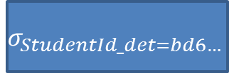
Deterministic Encryption
select *
from assignment
where studentid_det = bd6e7c3df2b5779e0b61216e8b10b689
$$σ_{StudentId_det=bd6…}$$
StudentId_DET | AssignId | Score
bd6e7c3df2b5779e0b61216e8b10b689 | 1 | 68
bd6e7c3df2b5779e0b61216e8b10b689 | 2 | 71
7ad5fda789ef4e272bca100b3d9ff59f | 4 | 99
… | … | …

Slide 37
Homomorphic Encryption
$$Enc (1)$$
7ad5fda789ef4e272bca100b3d9ff59f
$$+_{Enc}$$
7a9f102789d5f50b2beffd9f3dca4ea7
bd6e7c3df2b5779e0b61216e8b10b689
$$Enc (2)$$
$$Enc (1)$$
Encryption key is not an input
Notes:
Which brings us to the general idea of homomorphic encryption. Homomorphic encryption – special encryption that lets us do some computation directly on encrypted values. The remaining encryption schemes are all examples of homomorphic encryption schemes.

Slide 38

Order Preserving Encryption
Value | Enc (Value)
1 | 0x0001102789d5f50b2beffd9f3dca4ea7
2 | 0x0065fda789ef4e272bcf102787a93903
3 | 0x009b5708e13665a7de14d3d824ca9f15
4 | 0x04e062ff507458f9be50497656ed654c
5 | 0x08db34fb1f807678d3f833c2194a759e
$$x<y →Enc \left(x\right)<Enc (y)$$
[AKSX04, BCN11, PLZ13]
SIGMOD Test of Time Award 2014

Slide 39
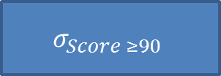
Order-Preserving Encryption
select *
from assignment
where score >= 90
$$σ_{Score ≥90}$$
StudentId | AssignId | Score
1 | 1 | 68
1 | 2 | 71
3 | 4 | 99
… | … | …

Slide 40
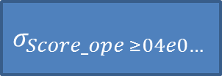
Order-Preserving Encryption
select *
from assignment
where score_OPE >= 0x04e062ff507458f9be50497656ed654c
$$σ_{Score_ope ≥04e0…}$$
StudentId | AssignId | Score_OPE
1 | 1 | 0x0065fda789ef4e272bcf102787a93903
1 | 2 | 0x009b5708e13665a7de14d3d824ca9f15
3 | 4 | 0x08db34fb1f807678d3f833c2194a759e
… | … | …

Slide 41





Homomorphic Encryption Schemes
Fully Homomorphic Encryption
(Any function)
[G09, G10]
Order-Preserving Encryption
$$(≤)$$
[BCN11, PLZ13]
Paillier Cryptosystem
$$(+)$$
ElGamal Cryptosystem
$$(×)$$
[P99]
[E84]
Deterministic Encryption
$$(==)$$
Non-Deterministic Encryption
$$(∅)$$
Notes:
Common homomorphic encryption schemes and what can be computed using them.
Non-deterministic encryption -> no computation

Slide 42
Homomorphic Encryption Schemes
Fully Homomorphic Encryption
(Any function)
[G09, G10]
Partial Homomorphic Encryption
Order-Preserving Encryption
$$(≤)$$
[BCN11, PLZ13]
Paillier Cryptosystem
$$(+)$$
ElGamal Cryptosystem
$$(×)$$
[P99]
[E84]
Deterministic Encryption
$$(==)$$
Non-Deterministic Encryption
$$(∅)$$
Notes:
In the middle -> encryption schemes that allow some computation -> PHE
Top -> fully homomorphic encryption

Slide 43
Homomorphic Encryption Schemes
Impractical
Fully Homomorphic Encryption
(Any function)
[G09, G10]
Partial Homomorphic Encryption
Order-Preserving Encryption
$$(≤)$$
[BCN11, PLZ13]
Paillier Cryptosystem
$$(+)$$
ElGamal Cryptosystem
$$(×)$$
[P99]
[E84]
Deterministic Encryption
$$(==)$$
Expensive
Non-Deterministic Encryption
$$(∅)$$
Practical
Notes:
In the middle -> encryption schemes that allow some computation -> PHE
Top -> fully homomorphic encryption

Slide 44
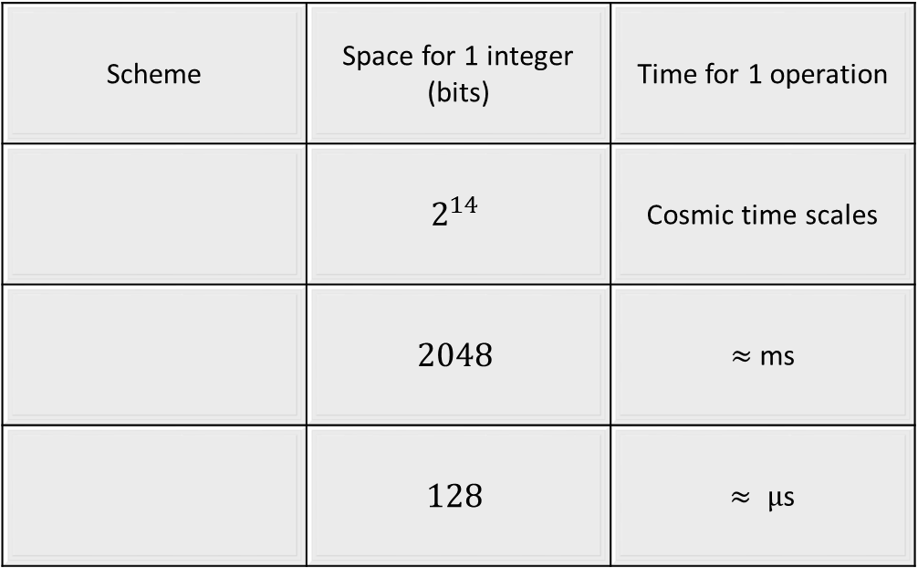
Homomorphic Encryption Schemes: Performance
Scheme | Space for 1 integer (bits) | Time for 1 operation
 | $$2^{14}$$ | Cosmic time scales
 | $$2048$$ | $≈$ms
 | $$128$$ | $≈ µ$s
Fully Homomorphic Encryption
Paillier ElGamal
Deterministic Order-preserving

Slide 45
Homomorphic Encryption Schemes: Notation
Fully Homomorphic Encryption
(FHE)
Partial Homomorphic Encryption (PHE)
Order-Preserving Encryption
$$(≤)$$
[BCN11, PLZ13]
(OPE)
Paillier Cryptosystem
$$(+)$$
ElGamal Cryptosystem
$$(×)$$
[P99]
[E84]
Deterministic Encryption
$$(==)$$
(DET)
Non-Deterministic Encryption
$$(∅)$$
(NDET)

Slide 46
How do I Encrypt a Database?
Encr
Cell granularity
Advantage:
Random access to a cell contents
Mix n Match encryption

Slide 47
Mix n Match Encryption
Plaintext
Deterministic
Non-deterministic
Id | SSN | Name | Score
Id | SSN_DET | Name_NDET | Score_OPE
Not covered: Deriving multiple keys. See [PRZ+11] for an example.

Slide 48
Example: Online Course Database
Student
StudentId | Name | Addr | GPA | CreditCard | …
Course
CourseId | Name | InstrId | …
StudentCourse
CourseId | StudentId | Grade | …
Notes:
Different columns have different security requirements.

Slide 49
Roadmap
Introduction
Overview
Basics of Encryption
Trusted Client based Systems
Secure In-Cloud Processing
Security
Conclusion

Slide 50
Design Choices
COMPUTE ON
ENCRYPTED DATA
USE SECURE
LOCATION
F.H.E
P.H.E
Client
Server
Notes:
If we need to provide a security guarantee that plain text corresponding to encrypted data will not be revealed in the cloud servers then there are two broad approaches for query processing on encrypted data: 1) compute directly on ciphertext (using partial homomorphic techniques) 2) use a secure location that can decrypt ciphertext.

Slide 51
Trusted Client based Systems
COMPUTE ON
ENCRYPTED DATA
USE SECURE
LOCATION
F.H.E
P.H.E
Client
Server
Notes:
In this part of the tutorial, we will focus on techniques that use a combination of P.H.E and a trusted client.

Slide 52
Trusted Client Architecture
Client
App
PlainText Query
PlainText Results
DBMS
Client
Component
Rewritten Query
Key
Encrypted Data
Data not decrypted in DBMS
Only ciphertext seen in the DBMS
No changes to DBMS/Client App
Notes:
The DBMS shown in red is untrusted. The client component which has access to the encryption keys is assumed to be trusted (this components is part of the domain of the client app). This architecture does not require any changes to the DBMS and thus can be deployed in today’s cloud services.

Slide 53
Systems
Minimal Client Computation
Use P.H.E (Cryptdb)
Residual Query Processing in Client
Blob Store
Use in conjunction with P.H.E (Monomi)
Notes:
We use the term “blob store” to refer to work that stores encrypted data in the cloud and uses the trusted client for any query processing on ciphertext. While there is a lot of work in space, we will discuss a few representative systems and focus on query processing.

Slide 54
CryptDB Architecture
Client
App
PlainText Query
PlainText Results
DBMS +
UDFs
Web
Proxy
Rewritten Query
Key
Encrypted Data
Web proxy rewrites queries, decrypts result
Leverage P.H.E techniques
[PRZ+11]
Notes:
We discuss CryptDB which uses P.H.E – we highlight certain aspects relevant to query processing, for a more detailed discussion refer to [PRZ+11].

Slide 55
Database Design
students(ID, grade)
Point Lookups on ID column
SELECT and AGGREGATION queries on grade
students(ID_DET, grade_OPE)
students(ID_DET, grade_OPE, grade_PAILLIER)
Need to store columns encrypted in multiple ways
Static/Dynamic design based on workload
[PRZ+11]
Notes:
Plaintext schema indicated in green – the corresponding schema in ciphertext is in red. We use the notation grade_OPE to indicate the grade column is encrypted using OPE.

Slide 56




Query Processing
Client
App
DBMS +
UDFs
Web
Proxy
Key
students(ID_DET, grade_OPE, grade_PAILLIER)
[PRZ+11]
Notes:
Example queries issued by the client and corresponding query fragments at the DBMS and the web-proxy.

Slide 57


Dynamic Database Design
students(ID_DET, grade**)
Client
App
DBMS +
UDFs
Web
Proxy
Key
DET
OPE
NDET
ID
grade
OPE
grade
[PRZ+11] [FK13a] [FK13b]
Notes:
So far we discussed static database design. CryptDB also has a novel design feature called onion layers in which each data item is encrypted using multiple layers and outer layers of encryption are removed at query time if necessary. For the example queries, for the first two queries no reorganization is needed but for the third query, the grade column, the outermost encryption layer is removed. See [PRZ+11] for more details on key management.

Slide 58
Systems
No Client Computation
Leverage P.H.E
e.g., Cryptdb
Residual Query Processing on Client
e.g., Blob store
Use in conjunction with P.H.E (e.g., Monomi)

Slide 59
Computation in Trusted Client
Client
App
PlainText Query
PlainText Results
DBMS
Shell
DBMS
Encrypted Data
Key
Client Query Fragment
Server Query Fragment
Distributed query processing between DBMS shell and untrusted DBMS
[HMI02]
[HIL+02]
[HMH08]
[TFM13]
Notes:
The main difference between the previous approach and the trusted client is that the trusted client performs non-trivial query processing. The related work gives pointers to different aspects of distributed query processing including query optimization and physical design.

Slide 60
Blob Store: Database Design
Encrypted data stored as ‘blobs’ (No computation)
students(ID, grade_blob)
Use additional “fake” partitions to index blobs
students(ID, grade_blob, partition##)
grade | partition##
0 - 1.0 | ccc##
1.0 – 2.0 | aaa##
2.0 – 3.0 | ddd##
3.0 – 4.0 | bbb##
[HIL+02]
Notes:
Since no query evaluation can occur on blobs, this approach uses additional fake partitions to index blobs so that additional filtering predicates can be used as part of the query sent to the DBMS. For example for the grade column, we use an additional partition## column.

Slide 61



Blob Store: Query Processing
Client
App
DBMS
DBMS
Shell
Key
students(ID, grade_blob, partition##)
Distributed query processing
Choosing appropriate partitioning
“Optimal” Query Splitting
[HIL+02]
[HIM05]
[HMT04]
Notes:
The efficiency of this approach relies on the appropriate choice of partitioning and efficient query splitting algorithms – refer to the suggested readings for more details.

Slide 62
Trusted Client based Systems
COMPUTE ON
ENCRYPTED DATA
COMPUTE ON
ENCRYPTED DATA
COMPUTE ON
ENCRYPTED DATA
USE SECURE
LOCATION
USE SECURE
LOCATION
USE SECURE
LOCATION
F.H.E
P.H.E
F.H.E
P.H.E
F.H.E
P.H.E
Client
Client
Server
Client
Server
Server
Notes:
We have explored techniques that use P.H.E and the trusted client approach in isolation – we now consider a recent approach that is a hybrid of both techniques.

Slide 63


Augmenting Blob Store
Client
App
DBMS
DBMS
Shell
Key
students(ID, grade_blob, partition##)
students(ID, grade_OPE)
Use P.H.E to push more computation to DBMS
Monomi
[TFM13]
Notes:
Monomi [TFM13] uses P.H.E to push more computation to the server as the above example illustrates, the entire predicate (grade > 3.5) can be pushed to the server. This is in contrast to the previous approach where only the corresponding predicate on the partition## column could have been pushed.

Slide 64


Pre-computation for complex queries
Find student submissions that have been handed in a day late
Students(ID_DET, submissiondate_DET, deadline_DET, deadlineplusone_DET)
Students(ID_DET, submissiondate_DET, deadline_DET, deadline_PAILLIER)
Cannot “Mix and Match” different encryptions
[TFM13]
Notes:
Note that the example query cannot be handled even if we store the deadline column encrypted using multiple functions. We can however anticipate such a query and pre-compute a column deadline_plusone which is stored encrypted using DET encryption in order to answer the query.

Slide 65
Trusted Client: Summary
No Server changes required to DBMS
Works well for workloads where amount of data shipped is small
Physical Design is important for distributed queries
Pre-computation is not free
Generality of approach is unproven
Integrity constraints, Triggers etc.
Automated tools to migrate database applications

Slide 66
Limitation: P.H.E
P.H.E is not “free” – space overheads
For Paillier, to store one integer (32 bits), the ciphertext need to use 2048 bits!
Compact representation for paillier/OPE that is updatable – open problem.
P.H.E is inherently limited – cannot address all of SQL
[GZ07]
Notes:
While P.H.E schemes like paillier have significant storage overheads, there is recent work [GZ07] that aims to optimize this overhead. However, such schemes are for static databases and do not work for updates.

Slide 67

Limitation: Robustness
Stored procedure to find student submissions that have been handed in late (with delay as a parameter)
Cannot pre-compute all possible input values
Why store the table in the cloud!
Notes:
If we consider a variant of the previous example where the delay is passed as a parameter, we cannot “anticipate” all possible invocations of a stored procedure and pre-compute the corresponding columns, thus some invocations of the stored procedure will need to ship the entire table to the client. If we keep doing this repeatedly for query evaluation, why even store the table in the cloud?

Slide 68
Still to come …
Is it possible to design an encrypted DBMS where only the results are shipped to the client irrespective of query complexity ?

Slide 69
Roadmap
Introduction
Overview
Basics of Encryption
Trusted Client based Systems
Secure In-Cloud Processing
Security
Conclusion

Slide 70
Secure In-Cloud Processing
COMPUTE ON
ENCRYPTED DATA
USE TRUSTED
MODULE
F.H.E
P.H.E
Client-End Solution
In-Cloud Solution
Notes:
Recap: query processing on encrypted data: partial homomorphic encryption -> works only for a subset of operations or we need to use a trusted location. Ravi: using the client as the trusted location.

Slide 71

Secure In-Cloud Processing
Inaccessible
Low bandwidth High latency
Inaccessible
Notes:
Drawbacks of the client: Low b/w and high latency
Idea: Fix the limitations if we can locate the trusted module in the cloud servers. [NEXT slide]

Slide 72
Secure In-Cloud Processing
Trusted Module
Inaccessible
Snooping admin Malicious hacker
Inaccessible
Notes:
We need to architect a database system for QPED using a trusted module.
What is a trusted module and how we can secure it from an adversary.
How to use the trusted module for query processing.
Start off with (1)
Recall adversary:

Slide 73
Trusted Module Design Space
Trusted Functionality (Trusted Computing Base)
 | OS+ | VMM+ | DBMS* | <<DBMS
Physical Server Protection
Secure Co-Processor
FPGA
Intel SGX
Physical protection & h/w provided isolation
Notes:
This slide lays out the main design choices for a trusted module. We will be coming back to this slide to understand various systems, techniques etc.
Design space: two main dimensions: 1) What functionality do we make trusted? 2) What kind of hardware technology we leverage?
Start with the functionality dimension and get to hardware dimension

Slide 74


Trusted Functionality (Simplified)
Larger Trusted Computing Base (TCB)
Smaller TCB
DBMS
Guest VM
DBMS
DBMS
DBMS
OS
OS
OS
OS
Mgmt VM
DBMS
VMM
Embedded OS
Expr Eval
Commodity h/w
Commodity h/w
Commodity h/w
Secure h/w
Commodity h/w
Secure h/w
OS+
VMM+
DBMS
<< DBMS
[AWSGC]
CloudVisor [ZCC+11]
TrustedDB [BS11]
Cipherbase [ABE+12]
Drawbridge [PBH+ 11]
Notes:
We can start off by considering the case where an entire server => OS + dbms (trusted module).
This would be a difficult sell for a cloud provider and not fundamentally different from claiming your entire cloud as secure.
Moderns OSes are large code bases => there have been known vulnerabilities, backdoor attempts in the past
There will be vulnerabilities in the future => OS as a trusted module would be a hard sell.
Pretty much what we get today: Amazon GovCloud
Security community: Trusted Module = Trusted computing base
Accepted wisdom: smaller tcb => fewer lines of code => fewer bugs => more security
Interesting work in making tcb smaller
OS community: there is work that brings isolation to a VM. Admin cannot look inside the memory contents of a VM
What is the point?
VM: single application => there exists work that can reduce the OS footprint
Database community:

Slide 75
Trusted Functionality (Simplified)
Less secure
More secure
DBMS
Guest VM
DBMS
DBMS
DBMS
OS
OS
OS
OS
Mgmt VM
DBMS
VMM
Embedded OS
Expr Eval
Commodity h/w
Commodity h/w
Commodity h/w
Secure h/w
Commodity h/w
Secure h/w
OS+
VMM+
DBMS
<< DBMS
[AWSGC]
CloudVisor [ZCC+11]
TrustedDB [BS11]
Cipherbase [ABE+12]
Drawbridge [PBH+ 11]
Notes:
Reiterate: larger tcb is undesirable for security, challenge is to see if we can build systems that work with smaller tcb

Slide 76
Trusted Functionality (Simplified)
More administration
Less administration
DBMS
Guest VM
DBMS
DBMS
DBMS
OS
OS
OS
OS
Mgmt VM
DBMS
VMM
Embedded OS
Expr Eval
Commodity h/w
Commodity h/w
Commodity h/w
Secure h/w
Commodity h/w
Secure h/w
OS+
VMM+
DBMS
<< DBMS
[AWSGC]
CloudVisor [ZCC+11]
TrustedDB [BS11]
Cipherbase [ABE+12]
Drawbridge [PBH+ 11]
Notes:
Related note: bigger the functionality of trusted module, more the need for administration;
Which goes against what we set out to achieve

Slide 77
Trusted Functionality (Simplified)
Formal verification for correctness
DBMS
Guest VM
DBMS
DBMS
DBMS
OS
OS
OS
OS
Mgmt VM
DBMS
VMM
Embedded OS
Expr Eval
Commodity h/w
Commodity h/w
Commodity h/w
Secure h/w
Commodity h/w
Secure h/w
OS+
VMM+
DBMS
<< DBMS
[AWSGC]
CloudVisor [ZCC+11]
TrustedDB [BS11]
Cipherbase [ABE+12]
Drawbridge [PBH+ 11]
Notes:
As we move to the right possibility of formal verification opens up.
Formal verification: verifying with the help of software tools that a piece of code does exactly what it is supposed to.

Slide 78
Formal Software Verification
seL4 microkernel [KEH+ 09]:
8700 lines of C code
22 person year effort
Verification tools:
Boogie [BCD+ 05]
Notes:
Just to give some context: seL4 is a OS microkernel that is completely verified,
Things have improved significantly since the last 5 years, but we are still very far off from verifying an entire linux OS, or even a small database system

Slide 79
Isolation
DBMS
OS
Commodity h/w
Notes:
Related to trusted module is the notion of isolation from the rest of the system.
For sake of argument let us assume we can achieve a secure database system which is bug free, backdoor free, even formally verified.
But we still cannot run it on top of an untrusted operating system.
OS compromised => dbms is compromised

Slide 80
Isolation
OS
DBMS
Embedded OS
Commodity h/w
Secure h/w
Notes:
One standard way => secure hardware
Interact with the rest of the system through a narrow interface
Even if the OS is compromised, we will have security

Slide 81
Trusted Module Design Space
Trusted Functionality (Trusted Computing Base)
 | OS+ | VMM+ | DBMS* | <<DBMS
Physical Server Protection
Secure Co-Processor
FPGA
Intel SGX
Physical protection & h/w provided isolation
Notes:
There is another dimension to trusted module design: physical protection
Adversary has physical access => all bets are off
Example: cold boot attacks
Data centers: elaborate physical protection
There also exist a whole class of special purpose hardware called secure hardware that provide physical protection

Slide 82
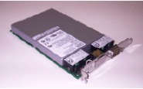
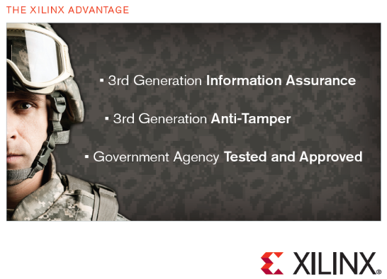
Previous Use of Secure Hardware
Secure Co-Processor
ATMs, smart cards
Hardware Security Modules
Tamper-proof crypto acceleration [CloudHSM]
FPGAs
Military use
TPM chips
Laptops, etc.
IBM 4764 PCI-X Cryptographic Coprocessor
Secure FPGA
[TCGNotes]
Notes:
In fact, specially designed secure hardware has a long history of use for security
Secure co-processors are used in ATMs, smart cards
Hardware security modules are tamper proof hardware supporting some crypto functions and are already available in some cloud providers for encryption key management
FPGAs are widely used by the military for securing control and information systems
TPM chips present in most laptops is another example

Slide 83

Trusted Hardware => Architectural Isolation
DBMS
DBMS
OS
OS
Separate memory space
DBMS
Embedded OS
Expr Eval
Commodity h/w
Secure h/w
Commodity h/w
Secure h/w
Notes:
Secure hardware: easy way of providing architectural isolation
We are in a separate memory space
We are not sitting on top of the OS

Slide 84
Intel Software Guard Extensions
Extensions to Intel Architecture
Isolation to code + data within a designated region called enclave
Confidentiality
Integrity
Virtual Addr Space
Enclave
Physical Memory
code/data
Encrypted & Integrity Protected
Ack: Andrew Baumann
[MAB+ 13, AGJ+ 13, HLP+ 13]
Notes:
Recently: Intel announced extensions to its processor architecture that enables one to build isolation from the OS using regular intel processors (future plans)
Essentially: we can use special instructions to identify some region of virtual memory as a protected unit – enclave
Processor ensures that no one outside the enclave can see or tamper with what is inside
E.g., when the pages in the enclave sit in physical memory => encrypted and integrity protected
Interesting technology for our purposes => querying encrypted data
Emphasis: still software could cause vulnerabilities

Slide 85
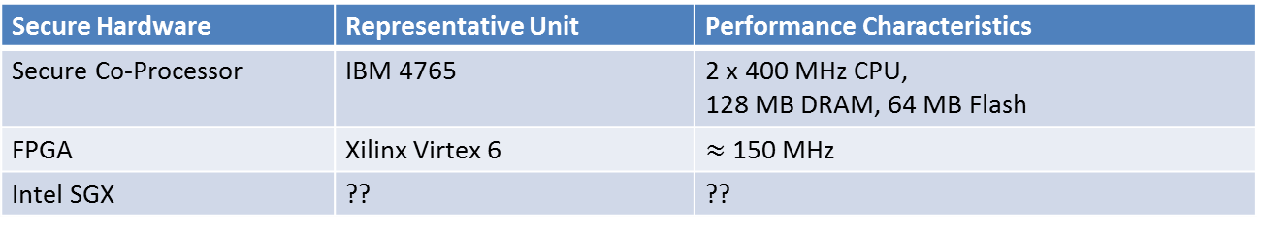
Performance Characteristics of Secure Hardware
Secure Hardware | Representative Unit | Performance Characteristics
Secure Co-Processor | IBM 4765 | 2 x 400 MHz CPU, 128 MB DRAM, 64 MB Flash
FPGA | Xilinx Virtex 6 | $≈$ 150 MHz
Intel SGX | ?? | ??
Notes:
So far, we have been focusing on security aspects of secure hardware
Important => perf characteristics since it strongly influences design of database systems that rely on them
General take away point => security comes with a cost
Current state of the art => secure hardware order of magnitude slower than commodity hardware
Lesser computation, memory: some sweet spots => lot of parallelism in fpga
Intel SGX => largely unknown beast at this point.
From the workshop – it seems their initial focus is low-end enclaves

Slide 86
Verifying Identity in the Cloud
Inaccessible
Notes:
A related issue: we could have designed the most secure, verified TM
How can the remote client be satisfied that the actual TM is being used

Slide 87
Verifying Identity in the Cloud
Accessible
Notes:
Perhaps the admin has installed a malicious version of OS, or VM, or dbms, or whatever the TCB is

Slide 88
Verifying Identity of Remote Code
Measure
Extend hash with SHA1
BIOS Boot Block
BIOS
OS Loader
OS
DBMS
TPM
Source: http://crypto.stanford.edu/cs155old/cs155-spring11/lectures/08-TCG.pdf
Notes:
There exists fairly well-tested technology based on TPM chips for verifying remote code

Slide 89
Trusted Module Design Space
Trusted Functionality (Trusted Computing Base)
 | OS+ | VMM+ | DBMS* | <<DBMS
Physical Server Protection | Traditional DBMS | Traditional DBMS
Secure Co-Processor
FPGA
Intel SGX
Physical protection & h/w provided isolation
Notes:
Interesting open problem: understand the implications of SGX technology for querying encrypted data

Slide 90

Trusted Module Design Space
Trusted Functionality (Trusted Computing Base)
 | OS+ | VMM+ | DBMS* | <<DBMS
Physical Server Protection | Traditional DBMS | Traditional DBMS
Secure Co-Processor |  |  | TrustedDB
FPGA |  |  |  | Cipherbase
Intel SGX |  |  | ? | ?
Physical protection & h/w provided isolation
Notes:
Interesting open problem: understand the implications of SGX technology for querying encrypted data

Slide 91
TrustedDB [BS11]
Distributed query processing
Untrusted: MySQL
Trusted: SQLite
Persistent storage: untrusted system
MySQL
PCI
SQLite
Embedded OS
OS
Storage
Commodity h/w
Secure Co-Processor
Intel Xeon E5: 10 x 3.6 GHz
IBM 4765: 2 x 400 MHz
60 GB RAM, etc
128 MB DRAM, 64 MB Flash
Source: http://meseec.ce.rit.edu/551-projects/fall2013/4-2.pdf
Notes:
One of the first research prototype to build on secure hardware
Within the secure hardware SQLite database system, on top embedded linux
Designed for the case that only some columns are sensitive
There is regular database – mysql – for query processing on non-sensitive columns
Query processing: distributed between sqlite and mysql databases
Why this design? Why not go with just the database within secure hardware
Answer: resource asymmetry between secure hardware and commodity hardware

Slide 92
TrustedDB [BS11]
Sensitive columns
SELECT SUM(l_extendedprice * l_discount) as revenue FROM lineitem
WHERE l_shipdate >= ‘1993-01-01’ AND
l_shipdate < ‘1994-01-01’ AND
l_discount between 0.05 and 0.07 AND l_quantity < 24
MySQL
PCI
SQLite
Embedded OS
OS
Storage
Commodity h/w
Secure Co-Processor
Intel Xeon E5: 10 x 3.6 GHz
IBM 4765: 2 x 400 MHz
60 GB RAM, etc
128 MB DRAM, 64 MB Flash
Notes:
To illustrate how query processing works consider the query:
Columns in red are sensitive, columns in green are not – can be kept in plaintext

Slide 93
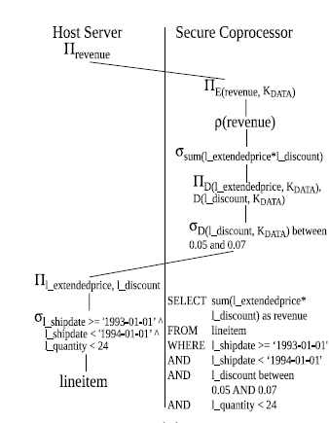
TrustedDB [BS11]
Sensitive columns
SELECT SUM(l_extendedprice * l_discount) as revenue FROM lineitem
WHERE l_shipdate >= ‘1993-01-01’ AND
l_shipdate < ‘1994-01-01’ AND
l_discount between 0.05 and 0.07 AND l_quantity < 24
Notes:
This is a possible query plan that trusted db would use.

Slide 94
Cipherbase [ABE+ 13]
Expression evaluation runs on secure hardware
Stack machine
Called as a “sub-routine” during query processing
Everything else: commodity hardware
Modified SQL server
Secure hardware:
Currently FPGA
Design mostly agnostic to choice of secure hardware
SQL Server
OS
Expr Eval
Commodity h/w
FPGA
Disclaimer: work done by tutorial presenters

Slide 95






Dedicated Expression Evaluation
Inter query memory governance
Admission control
Secure Expression Evaluation
Dec(C_Custkey1)>Dec(C_Custkey2)
Enc(Dec(O_totalprice) +
Dec(currentSum))
$$γsort, sum(o_totalprice)$$
Memory Mgmt
Spooling
Specifics of join/sort algorithm
$$⋈hash$$
Hash(Dec(C_Custkey))
Hash(Dec(O_Custkey))
Dec(O_Custkey)=Dec(C_Custkey)
$σ$_{C_Nationkey=x}
$σ$_{O_Orderdate>y}
Dec(O_Orderdate)>Dec(y)
$$Customer$$
$$Orders$$
Dec(C_Nationkey)=Dec(x)
Data-flow (GetNext calls)
Storage engine (buffer pool, locking)
[ABE+12, ABE+13]
Notes:
If we look at how a system like Cipherbase would work, even for a query that only operates on strongly encrypted data, we see very efficient division of labor.
The trusted hardware is only responsible for decryption, expression evaluation and re-encryption.
In a loosely-coupled architecture, all of the operations in the red box would need to run in the trusted system.

Slide 96



Loosely-Coupled (TrustedDB) vs. Tightly-Coupled (Cipherbase)
Feature | LC | TC | Comments
Performance |  |  | TC: smaller footprint on secure hardware
Security |  |  | Comparable. Both leak access pattern but keep data encrypted.
Small TCB |  |  | By design
Functionality |  |  | LC: cannot run heavy weight DBMS on secure hardware
Software Engg |  |  | TC: fine-grained changes to DBMS
Choice of secure h/w |  |  | TC: smaller footprint can work on different secure hardware
LC: Loosely coupled (TrustedDB)
TC: Tightly coupled (Cipherbase)

Slide 97

Summary
Secure in-cloud trusted compute resources
Relatively unstudied
Secure Hardware landscape changing
Lots of open issues
Architecture
Security
Details
Query Optimization

Slide 98
Roadmap
Introduction
Overview
Basics of Encryption
Trusted Client based Systems
Secure In-Cloud Processing
Security
Conclusion

Slide 99
Encryption and Security
Key:
000102030405060708090a0b0c0d0e0f
Encr
a7be1a6997ad739bd8c9ca451f618b61
b6ff744ed2c2c9bf6c590cbf0469bf41
47f7f7bc95353e03f96c32bcfd8058df
The quick brown fox jumps over the lazy dog
Notes:
Let us start with the basics of security. In order to analyze the security of an encryption scheme, we ask…. <next slide>

Slide 100
Encryption and Security
Key:
Encr
a7be1a6997ad739bd8c9ca451f618b61
b6ff744ed2c2c9bf6c590cbf0469bf41
47f7f7bc95353e03f96c32bcfd8058df
?
Notes:
… what information the adversary can learn about the plaintext given the ciphertext (without the key)

Slide 101
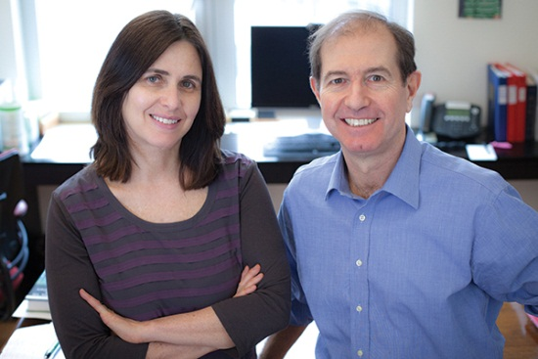
Encryption and Security
Key:
Encr
a7be1a6997ad739bd8c9ca451f618b61
b6ff744ed2c2c9bf6c590cbf0469bf41
47f7f7bc95353e03f96c32bcfd8058df
?
Semantic security:
No information leakage except input length
Winner of last year’s Turing Award
[KL07]
Notes:
The above problem is well-studied in classic cryptography. The classic notion of semantic security stipulates that no information should be revealed other than the length of the input. Incidentally, this contribution was recognized by this year’s Turing Award.
In this talk, we will talk about information leakage informally while noting that it is possible to formalize all that we are saying using the classic notion of semantic security.

Slide 102
Encryption and Security
Key:
Encr
a7be1a6997ad739bd8c9ca451f618b61
b6ff744ed2c2c9bf6c590cbf0469bf41
47f7f7bc95353e03f96c32bcfd8058df
?
Encryption schemes such as AES in CBC mode (non-deterministic) are believed to be semantically secure
Notes:
Encryption schemes such as AES discussed earlier are widely believed to be semantically secure.

Slide 103
Security of Database Encryption
Disease
Flu
Diabetes
Flu
Cold
Disease_NDET
!x8J
)zFr#x
^@tG
BxU3
Apply AES-CBC to every cell
Leaks cell lengths
Notes:
The first part of database security is the security of encrypting “data at rest”. If we apply AES (in non-det.) mode on every cell, what information does it leak? Answer: cell lengths. We ignore cell lengths henceforth in the tutorial. If we wish to prevent leaking cell lengths, we can pad.

Slide 104
Deterministic Encryption
Disease
Flu
Diabetes
Flu
Cold
Disease_DET
!x8J
)zFr#x
!x8J
BxU3
No. of distinct values + frequency distribution [BFO+08]
Notes:
Suppose that we encrypt every cell deterministically. Will we leak anything besides row sizes? Answer: no. of distinct values and frequency distribution. Bellare et al. have formally analyzed the security yielded by det. schemes.

Slide 105
Order-Preserving Encryption
[AKS+04, BCN11, PLZ13, SBMKV13]
Age
12
51
24
36
Age_OPE
0x000a
0x0f12
0x00a1
0x00b2
Ideal:
Security: Leak only order of cell values
Immutable: existing ciphertext does not change when new plaintext is inserted
Notes:
Order-preserving encryption seeks to leak cell lengths and ordering of cell values. However, the OPEs proposed in practice leak more than that. Designing an OPE that leaks only the ordering (and cell lengths) is an open problem.

Slide 106
Actual Proposals
Scheme | Guarantees | Leakage Besides Order
Agrawal et al. [AKS+04] | None | Yes
Boldyreva et al. [BCL09] | Yes | Half of plaintext bits
Popa et al. [PLZ13] | Yes | No, but a mutable scheme
Cipherbase [ABE+13] | Yes | No, and immutable

Slide 107

Overall Security of Data Encryption
Name | Age | Disease
Alice | 12 | Flu
Bob | 51 | Diabetes
Chen | 24 | Flu
Dan | 36 | Cold
Name_NDET | Age | Disease_DET
X%*! | 12 | !x8J
~4Yz | 51 | )zFr#x
T$H2 | 24 | !x8J
<*fB | 36 | BxU3
Name: AES-CBC non-deterministic
Age: Clear-text
Disease: AES deterministic
Total information leaked = “sum” of column-level leakage
Notes:
If we encrypt different columns differently, the total info leakage is essentially the sum of leakage from each individual column.

Slide 108
Impact of Querying & Updating
Trusted Client
Untrusted Server
Update Employee
Set Salary = *&@#
Where Name = ‘Alice’
Client
Server
Key
Name | Salary_NDET
Alice | X%*!
Bob | ~4Yz
Chen | T$H2
Dan | <*fB
Notes:
What happens when we query or update the data? Suppose that we have an employee table with a “Name” field and a “Salary” field. The “Salary” field is strongly encrypted and “Name” is stored in the clear. Since “Salary” is strongly encrypted, no information about it leaks other than row sizes.
Now suppose we modify the salary of an individual by identifying the individual’s name. Note that this process performs no computation on “Salary”, i.e. it treats “Salary” as a blob. While the adversary can see that Alice’s salary got modified, they presumably have no information about its old or new value since “Salary” is strongly encrypted.
However, suppose we have a series of updates….

Slide 109
Impact of Querying & Updating
Trusted Client
Untrusted Server
Update Employee
Set Salary = *!-#
Where Name = ‘Alice’
Client
Server
Key
Name | Salary_NDET
Alice | X%*!
Bob | ~4Yz
Chen | T$H2
Dan | <*fB
Notes:
…two to Alice’s salary

Slide 110
Impact of Querying & Updating
Trusted Client
Untrusted Server
Update Employee
Set Salary = 23=$<
Where Name = ‘Bob’
Client
Server
Key
Name | Salary_NDET
Alice | X%*!
Bob | ~4Yz
Chen | T$H2
Dan | <*fB
Notes:
…and three to Bob’s.

Slide 111
Impact of Querying & Updating
Trusted Client
Untrusted Server
Update Employee
Set Salary = +=$<
Where Name = ‘Bob’
Client
Server
Key
Name | Salary_NDET
Alice | X%*!
Bob | ~4Yz
Chen | T$H2
Dan | <*fB

Slide 112

Impact of Querying & Updating
Trusted Client
Untrusted Server
Update Employee
Set Salary = #2$^
Where Name = ‘Bob’
Client
Server
Key
Background knowledge
Full-time employees earn more
Salaries of hourly-wage employees updated more
Learn partial ordering of employee salary
Alice’s salary > Bob’s
Name | Salary_NDET
Alice | X%*!
Bob | ~4Yz
Chen | T$H2
Dan | <*fB
Query access patterns reveal information!
Notes:
Then, the adversary can observe the frequency with which a particular individual’s salary was updated. In this instance, the adversary knows that Alice’s salary was updated less often than Bob’s. Suppose that the adversary knows as part of background knowledge that full-time employees earn more, and that salaries of hourly wage employees are updated more often. Then, the adversary can learn some information about the ordering of employee salaries, in this instance that Alice likely has a higher salary than Bob.

Slide 113

Impact of Querying & Updating
True/False
Sort
TM
Record 1
<
Record 2
Sort leaks ordering
Notes:
What happens when we do computations over encrypted data? Let us consider a sort operator that uses a trusted module (whether in the client or in the server) to compare records. The adversary can observe the result of comparing various records and can hence infer the ordering. Note that this leakage happens even if the data stays encrypted throughout the system stack.
In other words, encryption of data alone does not prevent information leakage. The overall query workflow – query access patterns and data movement patterns – leak information. We will refer to this as “Dynamic” security to distinguish it from the security of data at rest.

Slide 114
What if input and outputs are all encrypted?
Still leaks ordering
TM
r1 <= r2
r2 < r1
r2
r1
r1’
r2’

Slide 115
Access Patterns Leak Information
Data
CPU (program P)
Encryption across the stack (disk + in-memory) does NOT imply no information leakage
The overall query workflow reveals information
Dynamic security (different from security of data at rest)
Notes:
There is previous work in an area known as oblivious computation that answers in the affirmative. The previous result is stated for programs not just DBMSes. Suppose that we model program execution simplistically as a trusted CPU that has the program accessing data in untrusted memory. A program in general accesses some data items more than others, defining its access pattern. The notion of “oblivious” computation recognizes that these access patterns leak information and attempts to hide them.

Slide 116
Design Space
Cipherbase, TrustedDB,
CryptDB,
Monomi,
BlobStore
Stop with encryption
Can we bridge this gap?
Operations on column | Leakage
Equality (including joins) | Frequency distribution
Indexing/Sorting/range predicates | Order
Full Leakage
No Leakage
Notes:
Now let’s see where the systems discussed previously fall. Briefly, none of them addresses dynamic security.
On the security spectrum, they all fall in between storing the data in the clear (full leakage) and leaking no information. The information leaked includes frequency distribution on columns on which equality is performed and ordering on columns in which sorting/indexing is performed.
We would like to point out that the security yielded by encryption is a significant improvement over today’s alternative, namely keeping the data in the clear in the cloud. It is hence a great starting point to build a secure DBMS-as-a-service. As we have seen before, there are sufficient system design challenges just in that space.
Having said that, the question remains whether we can bridge this gap. The short answer is that while is prior work on addressing dynamic security, it is generally impractical. In the rest of the talk, we will discuss some of the above ideas. The question of *practical* designs that bridge this gap is by and large open.

Slide 117
No Leakage
Trusted Client
Untrusted Server
Q2
Server
Client
Q1
Result2
Result1
Encrypted Database
Reveals size of query result
Hide query result size by making all query result sizes equal to maximum size
Joins reduce to cross products
Impractical
Notes:
Let’s start with what it takes to achieve “No Leakage”. The end-to-end protocol we presented where the client ships an encrypted query and gets back an encrypted result reveals the query result size. Essentially, the only way to hide the query result size is to make all result sizes equal which would imply that for example joins would reduce to cross products. This makes “no leakage” impractical.

Slide 118
Design Space
Cipherbase, TrustedDB,
CryptDB,
Monomi,
BlobStore
Stop with encryption
Full Leakage
Output Size
No Leakage
Impractical
Notes:
If we require efficient execution at the server, we must intuitively be willing to reveal at the least the output size and (similar to output size) running time so let’s consider whether we can achieve it.

Slide 119
Secure Query Processing [AK14]
Goal: Query Processing algorithms that reveal only output size
Algorithms for non-trivial subset of SQL
Approach: design oblivious algorithms that have same access pattern independent of input

Slide 120
Oblivious Sort
Bubble sort can be made oblivious
Same set of comparisons independent of input
O(n log n) oblivious sort algorithms known [Go11]
rMin
rMax
TM
r1
r2

Slide 121

Aggregation
Sum
Encrypted r1 + r2
Add
TM
r1, r2
Can extend these ideas to group-by, join, filters to cover a large class of SQL including most TPC-H queries [AK14]
Great for OLAP scenarios

Slide 122
Design Space
Cipherbase, TrustedDB,
CryptDB,
Monomi,
BlobStore
Stop with encryption
Full Leakage
Output Size,
Running Time
Output Size
OLAP
No Leakage
Impractical
What about full SQL?
Updates
Indexing
Transactions (concurrency)
Stored procedures
Constraints
Triggers
Notes:
If we require efficient execution at the server, we must intuitively be willing to reveal at the least the output size and (similar to output size) running time so let’s consider whether we can achieve it.

Slide 123
Oblivious Simulation
Data
CPU (oblivious program P’)
Simulation: P’ equivalent to P
Theoretically Efficient: Running time of P’ within polylog factor of running time of P
Oblivious: Access patterns of P’ look random
Information leakage: input size, output size, running time
[GO96, W12, SS13]
Notes:
There is a well-known result that shows that any program has an efficient simulation that is oblivious. That is, there is a program P’ that is a simulation (equivalent), efficient (polylog) and oblivious (access patterns look random). It is known that by keeping memory contents encrypted, an oblivious simulation leaks only the output size and running time of P.

Slide 124
Application to DBMS
Data
Oblivious simulation of DBMS
Notes:
We could apply this technology to achieve our goal by running the oblivious simulation of a DBMS.

Slide 125
But…
Destroys spatial and temporal locality of reference
Data
DBMS
Range scan
Notes:
But the simulation destroys spatial and temporal locality of reference by design. A range scan is reduced to…

Slide 126

But…
Destroys spatial and temporal locality of reference
Data
Oblivious Simulation of DBMS
Random seeks
Range scan of 100M records on hard disk → 100M seeks
10^5 seconds (~1 day)
Notes:
Random seeks. This can be prohibitively inefficient.

Slide 127
Design Space
Cipherbase, TrustedDB,
CryptDB,
Monomi,
BlobStore
Stop with encryption
Full Leakage
Output Size,
Running Time
Impractical
Output Size
OLAP
No Leakage
Impractical
Is there a stronger and practically achievable security model for full SQL?
Notes:
This brings us to the end of this segment. Wrapping up, I would like to reiterate that the systems proposed stop with encryption for a good reason. Designing a stronger and practically achievable security model for DBMSes is an open problem.

Slide 128
Summary
Trusted Client
Untrusted Server
DBMS
DBMS
Key
Data
EncryptedData
Homo-morphic Encryption
Cloud Admin
Super-user with console access
Name | Age | Disease
Alice | 12 | Flu
Bob | 51 | Diabetes
Chen | 24 | Flu
Dan | 36 | Cold
Name | Age | Disease
X%*! | )C | !x8J
~4Yz | ## | )zFr#x
T$H2 | !* | ^@tG
<*fB | @$ | BxU3
Notes:
Let me summarize the tutorial. The overall problem is that we want to migrate data to the cloud where untrusted cloud administrators could get access to it. Encrypting the data before migration addresses this problem but it makes the problem of query processing challenging.
One approach is to use homomorphic encryption. There are several open problems in this space – improving FHE, improving PHE, designing new PHE. However, given the state of the art, this approach is incomplete.

Slide 129
Summary
Trusted Client
Untrusted Server
Trusted Machine
Untrusted Machine
Key
Encrypted Database
Name | Age | Disease
X%*! | )C | !x8J
~4Yz | ## | )zFr#x
T$H2 | !* | ^@tG
<*fB | @$ | BxU3
Notes:
So we consider adding a trusted machine that has access to the key into the mix. The TM can run in the client or in the server.
Either way, this makes QP a distributed QP problem. This is however a non-standard QP problem where one node is trusted and the other is not. Moreover, there is a resource asymmetry between the two. This leads to many exciting systems design/performance problems as well as security problems that we have introduced. Furthermore, even designing a trusted machine to be hosted in the cloud is a challenging area.

Slide 130
Summary
Untrusted Server
Trusted Machine
Untrusted Machine
Key
Encrypted Database
Name | Age | Disease
X%*! | )C | !x8J
~4Yz | ## | )zFr#x
T$H2 | !* | ^@tG
<*fB | @$ | BxU3

Slide 131
Other Challenges
Application Security
DBMS is only a part of the overall system stack
Usability
Clients need tools and interpretable security models to navigate security-performance tradeoff
Connections to other areas of security
Data privacy, access control, auditing
Notes:
We end with other challenges in this space not covered in the main tutorial.

Slide 132
Bibliography
[ABE+12] Arvind Arasu, Spyros Blanas, Ken Eguro, Manas Joglekar, Raghav Kaushik, Donald Kossmann, Ravishankar Ramamurthy, Prasang Upadhyaya, Ramarathnam Venkatesan: Engineering Security and Performance with Cipherbase. IEEE Data Eng. Bull. 35(4): 65-72 (2012).
[ABE+13] Orthogonal Security With Cipherbase. Arvind Arasu, Spyros Blanas, Ken Eguro, Raghav Kaushik, Donald Kossmann, Ravi Ramamurthy, and Ramaratnam Venkatesan. CIDR 2013.
[AGJ+ 13] Ittai Anati, Shay Gueron, Simon Johnson and Vincent Scarlata. Innovative Technology for CPU Based Attestation and Sealing. Workshop on Hardware and Architectural Support for Security and Privacy. 2013.
[AKSX04] R. Agrawal, J. Kiernan, R. Srikant, Y. Xu. Order Preserving Encryption for Numeric Data. SIGMOD 2004.
[AES] AES Standard. FIPS 197. http://csrc.nist.gov/publications/fips/fips197/fips-197.pdf
[AF+ 09] Above the Clouds: A Berkeley View of Cloud Computing. by Michael Armbrust, Armando Fox, and others. Tech Report EECS-2009-28, Univ. of Calif., Berkeley.
[AKS+04] R. Agrawal, J. Kiernan, R. Srikant, and Y. Xu. Order-preserving encryption for numeric data. In SIGMOD 2004.

Slide 133
Bibliography
[AWSGC] Amazon GovCloud. http://aws.amazon.com/govcloud-us/.
[BS13] S.Bajaj, R. Sion. CorrectDB: SQL Engine with Practical Query Authentication. PVLDB 6(7). 2013.
[B68] K.E. Batcher, Sorting networks and their applications, Proceedings of the AFIPS Spring Joint Computer Conference 32, 307–314 (1968).
[BCD+ 05] Michael Barnett, Bor-Yuh Evan Chang, Robert DeLine, Bart Jacobs, K. Rustan M. Leino: Boogie: A Modular Reusable Verifier for Object-Oriented Programs. FMCO 2005: 364-387
[BCL09] Order-Preserving Symmetric Encryption. Alexandra Boldyreva, Nathan Chenette, Younho Lee, Adam O'Neill. EUROCRYPT 2009.
[BCN11] Order-Preserving Encryption Revisited: Improved Security Analysis and Alternative Solutions. Alexandra Boldyreva, Nathan Chenette, Adam O’Neill. CRYPTO 2011.
[BFO+08] M. Bellare, M. Fischlin, A. O'Neill, T. Ristenpart: Deterministic Encryption: Definitional Equivalences and Constructions without Random Oracles. CRYPTO 2008.

Slide 134
Bibliography
[BG11] Luc Bouganim, Yanli Guo: Database Encryption. Encyclopedia of Cryptography and Security (2nd Ed.) 2011.
[BM76] R. Bayer, J. K. Metzger. On the encipherment of search trees and random access files. ACM TODS 1(1) 1976.
[BOA] Buffer Overflow Attack. Lecture Notes. http://www.cse.scu.edu/~tschwarz/coen152_05/Lectures/BufferOverflow.html
[BP02] Luc Bouganim, Philippe Pucheral: Chip-Secured Data Access: Confidential Data on Untrusted Servers. VLDB 2002
[BS11] Sumeet Bajaj, Radu Sion: TrustedDB: a trusted hardware based database with privacy and data confidentiality. SIGMOD Conference 2011.
[CloudHSM] Amazon Cloud HSM. http://aws.amazon.com/cloudhsm/
[CPK 10] What’s New About Cloud Computing Security?. Yanpei Chen, Vern Paxson and Randy H. Katz. Tech Report EECS-2010-5. Univ. of Calif., Berkeley.

Slide 135
Bibliography
[E84] A public key cryptosystem and a signature scheme based on discrete logarithms. Taher El Gamal. CRYPTO 1984.
[ENISA 09a] Cloud Computing Risk Assessment. European Network and Information Security Agency. 2009.
[ENISA 09b] An SME perspective on cloud computing (survey). European Network and Information Security Agency, 2009.
[G09] Fully homomorphic encryption using ideal lattices. Craig Gentry. STOC 2009.
[G10] Computing arbitrary functions of encrypted data. Craig Gentry. CACM 2010.
[G11] Michael T. Goodrich. Data-oblivious external-memory algorithms for the compaction, selection, and sorting of outsourced data. In SPAA, pages 379–388, 2011.
[GO96] O. Goldreich, R. Ostrovsky: Software Protection and Simulation on Oblivious RAMs. J. ACM 43(3): 431-473 (1996)
[GZ07] Tingjian Ge, Stanley B. Zdonik. Answering Aggregation Queries in a Secure System Model. VLDB 2007.

Slide 136
Bibliography
[GZ07b] Tingjian Ge, Stanley B. Zdonik: Fast, Secure Encryption for Indexing in a Column-Oriented DBMS. ICDE 2007.
[HIL+02] Executing SQL over Encrypted Data in the Database-Service-Provider Model. Hakan Hacigumus, Balakrishna R. Iyer, Chen Li, Sharad Mehrotra, SIGMOD 2002.
[HIM04] Hakan Hacigümüs, Balakrishna R. Iyer, Sharad Mehrotra: Efficient Execution of Aggregation Queries over Encrypted Relational Databases. DASFAA 2004.
[HIM05] Hakan Hacigümüs, Balakrishna R. Iyer, Sharad Mehrotra: Query Optimization in Encrypted Database Systems. DASFAA 2005.
[HIM05b] Efficient Execution of Aggregation Queries over Encrypted Relational Databases. Hakan Hacigümüs, Balakrishna R. Iyer, Sharad Mehrotra. DASFAA 2005.
[HLP+ 13] Matthew Hoekstra, Reshma Lal, Pradeep Pappachan and others. Using Innovative Instructions to Create Trustworthy Software Solutions. Workshop on Hardware and Architectural Support for Security and Privacy. 2013.

Slide 137
Bibliography
[HMH08] Bijit Hore, Sharad Mehrotra, Hakan Hacigümüs: Managing and Querying Encrypted Data. Handbook of Database Security 2008
[HMI02] Providing Database as a Service. Hakan Hacigumus, Sharad Mehrotra, Balakrishna R. Iyer. ICDE 2002.
[HMT04] Bijit Hore, Sharad Mehrotra, Gene Tsudik: A Privacy-Preserving Index for Range Queries. VLDB 2004.
[K09] G. Klein et al, “seL4: formal verification of an OS kernel” SOSP 2009.
[KEH+ 09] Gerwin Klein, Kevin Elphinstone, Gernot Heiser, June Andronick, David Cock, Philip Derrin, Dhammika Elkaduwe, Kai Engelhardt, Rafal Kolanski, Michael Norrish, Thomas Sewell, Harvey Tuch, Simon Winwood: seL4: formal verification of an OS kernel. SOSP 2009
[KL07] Introduction to Modern Cryptography. Jonathan Katz and Yehuda Lindell. Chapman & Hall/CRC Press. 2007.

Slide 138
Bibliography
[MAB+ 13] Frank Mckeen, Ilya Alexandrovich, Alex Berenzon and others. Innovative Instructions and Software Model for Isolated Execution. Workshop on Hardware and Architectural Support for Security and Privacy. 2013.
[MT05] E. Mykletun, G. Tsudik. Incorporating a Secure Coprocessor in the Database-as-a-Service Model. IWIA Workshop 2005.
[NIST 09] P. Mell and T. Grance. NIST definition of cloud computing. National Institute of Standards and Technology. October 7, 2009.
[OTDE] Oracle Transparent Data Encryption. http://www.oracle.com/technetwork/database/options/advanced-security/index-099011.html
[P99] Public-Key Cryptosystems Based on Composite Degree Residuosity Classes. Pascal Paillier. EUROCRYPT 1999.
[PBH+ 11] Donald E. Porter, Silas Boyd-Wickizer, Jon Howell, Reuben Olinsky, Galen C. Hunt: Rethinking the library OS from the top down. ASPLOS 2011

Slide 139
Bibliography
[PLZ13] An Ideal-Security Protocol for Order-Preserving Encoding. Raluca Ada Popa, Frank H Li, Nickolai Zeldovich. Symp on Security and Privacy, 2013.
[PRZ+11] CryptDB: protecting confidentiality with encrypted query processing. Raluca A. Popa, Catherine M. S. Redfield, Nickolai Zeldovich, Hari Balakrishnan. SOSP 2011.
[RAD78] R. Rivest, L. Adleman, M. Dertouzos. On Data Banks and Privacy Homomorphisms. In Foundations of Secure Computation, pages 169-178, 1978
[S96] Applied Cryptography. Bruce Schneier. John Wiley & Sons, 1996.
[SS05] Trusted Computing Platforms: Design and Applications. Sean W Smith. Springer. 2005.
[SS13] E. Stefanov, E. Shi. ObliviStore: High Performance Oblivious Cloud Storage. IEEE S&P. 2013.
[STDE] Sql Server Transparent Data Encryption. http://technet.microsoft.com/en-us/library/bb934049.aspx

Slide 140
Bibliography
[TCGNotes] Trusted Computing Architecture and its applications. CS255 Lecture Notes. Stanford University. http://crypto.stanford.edu/cs155old/cs155-spring11/lectures/08-TCG.pdf
[TFM13] Stephen Tu, M. Frans Kaashoek, Samuel Madden et al. Processing Analytical Queries over Encrypted Data. VLDB 2013.
[TPMSpec] TPM Main Specification. http://www.trustedcomputinggroup.org/resources/tpm_main_specification
[VYK12] Vaibhav Khadilkar, Kerim Yasin Oktay, Murat Kantarcioglu, Sharad Mehrotra: Secure Data Processing over Hybrid Clouds. IEEE Data Eng. Bull. 35(4): 46-54 (2012).
[W12] P. Williams. Oblivious Remote Data Access Made Parallel. PhD Thesis. 2012.
[ZCC+] Fengzhe Zhang, Jin Chen, Haibo Chen, Binyu Zang: CloudVisor: retrofitting protection of virtual machines in multi-tenant cloud with nested virtualization. SOSP 2011

