Slide 1
Inteligência Artificial
Trabalho 1
Juan Bellon, up201908142
Luísa Araújo, up201904996
Nuno Melo, up202003324

Slide 2
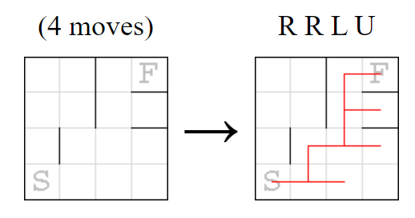
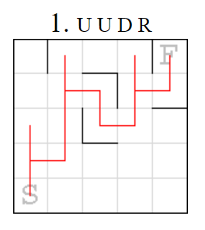
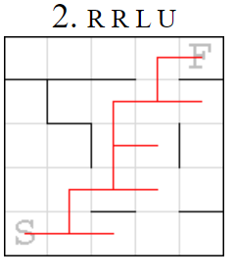
Robot Mazes
Single player game.
Main goal: Find the shortest sequence of necessary moves to reach the exit.
From the departure point until the exit the robot is going to follow every move of the sequence in a cycle.
If the robot bumps into a wall it does not move and passes to the next instruction (operator) of the sequence.
Example:

Slide 3
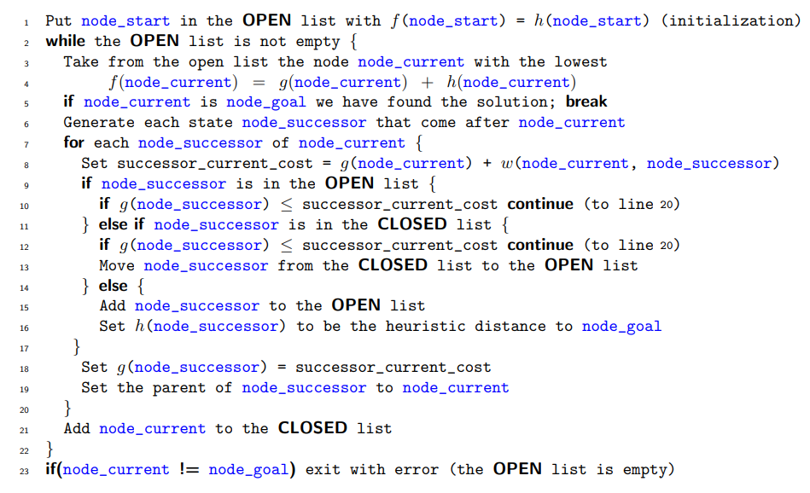
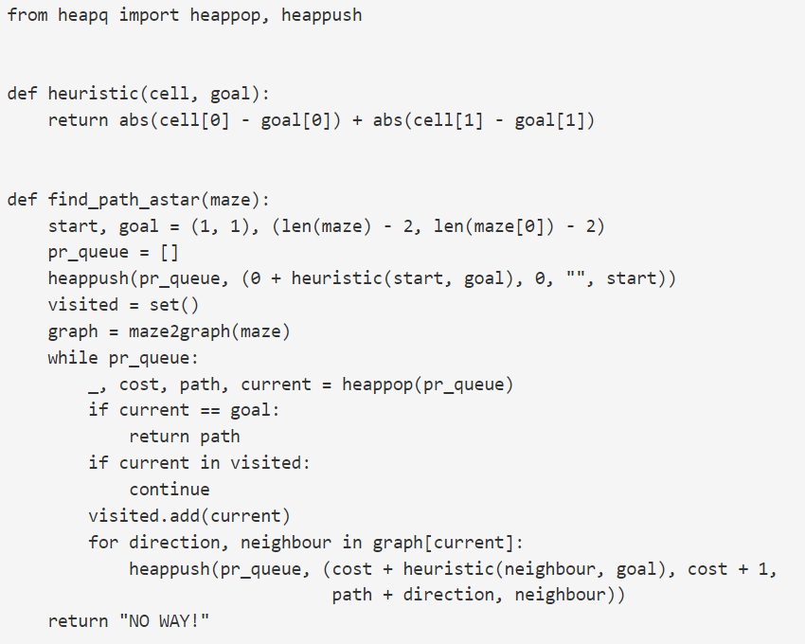
References
https://mat.uab.cat/~alseda/MasterOpt/AStar-Algorithm.pdf
http://bryukh.com/labyrinth-algorithms/

Slide 4
Formulation as a search problem (Part 1)
State Representation: place(x,y) represents what is located in the (x,y) coordinates. It can be a wall, the exit door or even nothing! Let’s assume:
(x,y) – Represents the robot’s current position.
if place(x,y) == 0 then (x,y) is free.
if place(x,y) == 1 then a wall occupies (x,y).
If place(x,y) == 2 then the exit is in (x,y).
Initial State: Can be any (x,y) where place(x,y) = 0. For example, (0,0) & place(0,0) = 0 can be our initial state.
Objective Test: Any (x,y) where place(x,y) = 2
Heuristic Function: h(n) = | n.x – f.x | + | n.y – f.y |, where f is the final coordinate.
Cost: Length of the sequence of moves. A* = Heuristic + Cost

Slide 5
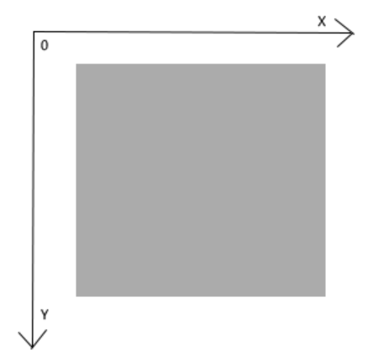
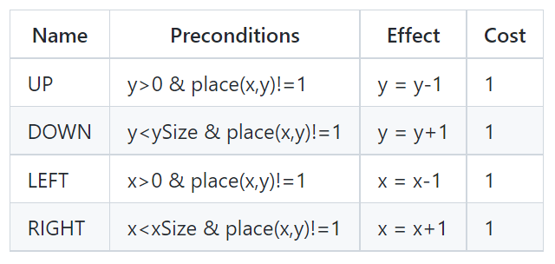
Formulation as a search problem (Part 2)
Operators:
Let’s assume xSize and ySize are the labyrinth’s dimensions.
Considering the xy axis has its origin in the superior left corner.

Slide 6
Implementation
Programming language: Python.
Development Environment: Visual Studio Code and/or Pycharm.
Data Structures:
Maze - Two dimensions array or vector, for example:
[[1,0,0,1],[1,0,1,1],[1,0,0,2],[1,1,0,1]]
2. Robot – List with length = 2 [x,y], for example:
[1,5]
Code

