Slide 1

HackerSpace Camp
Nuno Alves, Michael Framarin, Neeraj Magotra

Slide 2
What are we going to do?
Learn how to control anything that is mechanical or electrical!
Who cares???
What can I do with this???

Slide 3

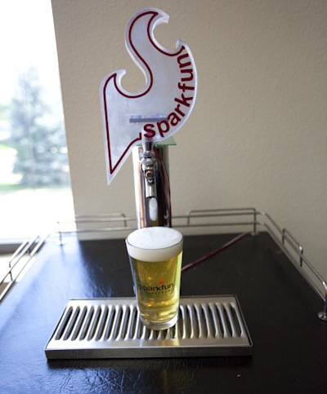
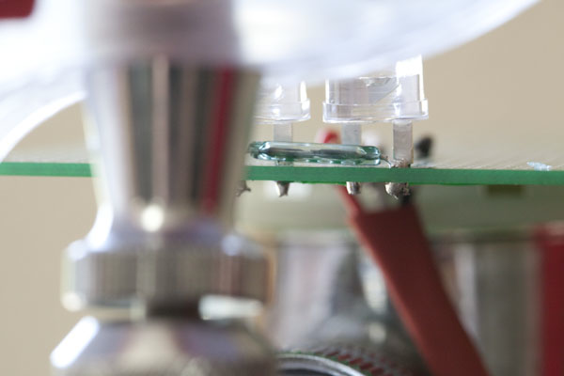

Keg monitor
So, how much (root) beer is left in my keg?
100-lb Force sensor reports weight
Switch closes when a magnetic field is near

Slide 4
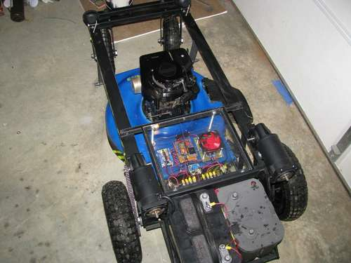
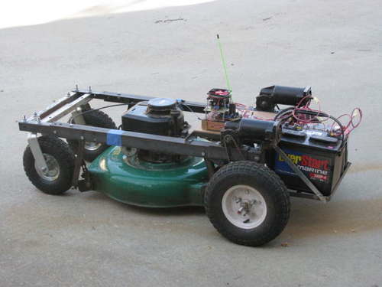

Remote controlled lawnmower
How can we make mowing the lawn fun?
Mowing the lawn - Video
Carrying topsoil - Video

Slide 5
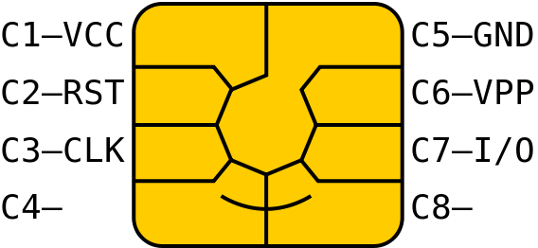
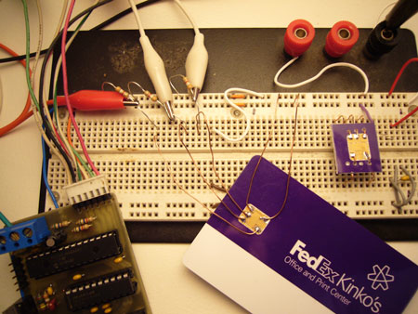
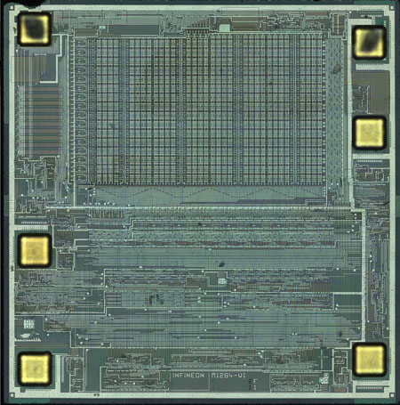
Reading smart cards
How much money I have left?

Slide 6


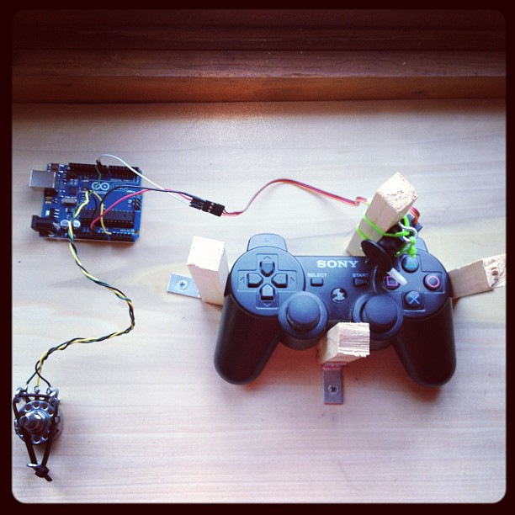

Automated gameplay
What more fun that playing Castlevania?
Grinding - Video

Slide 7
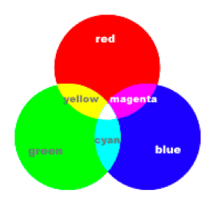
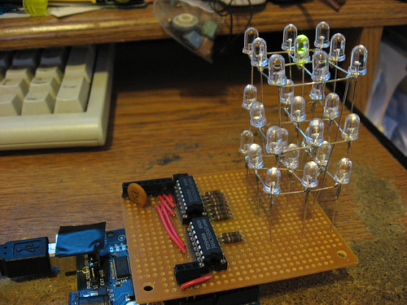
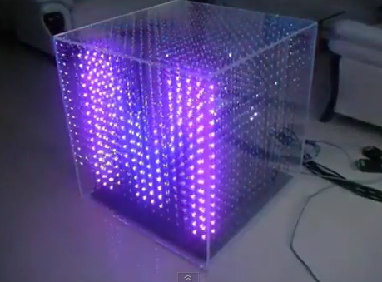
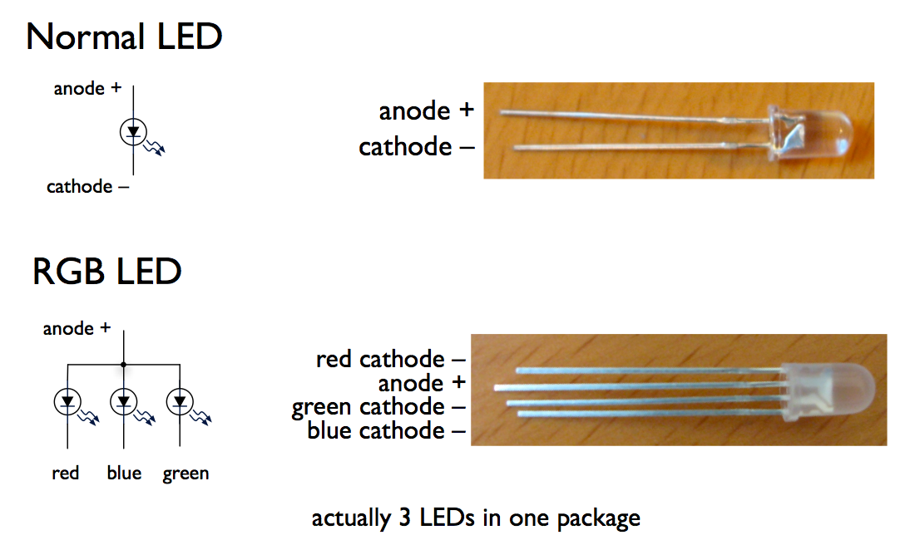
3D RGB LED Cube
You can create your own 3D display.
In action - Video

Slide 8
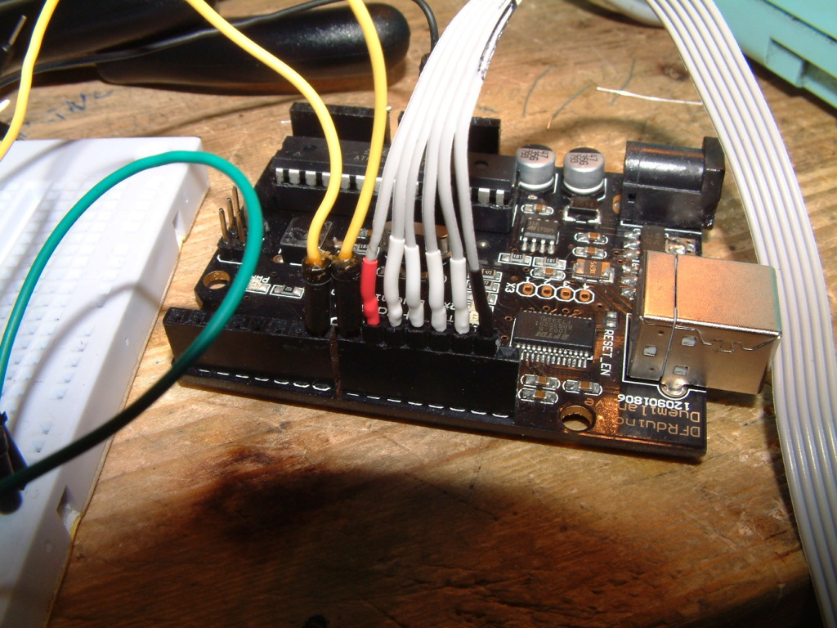
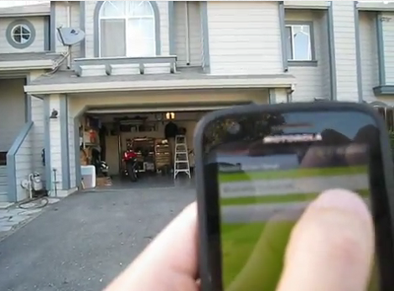
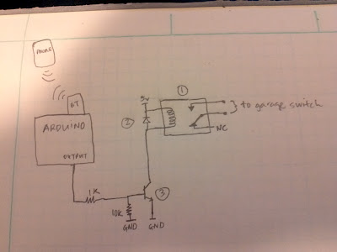
Garage door opener
I want an app to open my garage door!
In action - Video

Slide 9
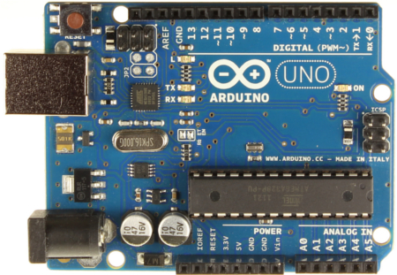
How? With a micro-controller...
It’s just a tiny computer.
On your computer you program something (in the C language)
You put that program into the board
The micro-controller will run that program as long as it has power.
Your program can:
  Turn ON/OFF pins.
  Read ON/OFF data from pins.
Pins

Slide 10
Micro-controller?
Pretty slow (16MHz)
Little memory.
No operating system.
No way you can put windows 7 in there.
Micro-controllers are all over the place: cars, micro-waves, projectors, remote controls...
Look around... Where can you find micro-controllers in this room?
Micro-controller

Slide 11
We will use the Arduino in our camp!
This board is called Arduino

Slide 12
Digital I/O with the Arduino
Digital I/O pins
Input/Output (I/O) is done through pins.
Input = read stuff from the real-world.
Output = write stuff to the real-world.
You put a wire into a pin and connect it to something else.
You say if a pin is input or output.
A Digital pin can have two values: HIGH or LOW.

Slide 13



Put your hacker hat on!
This means you are about to make something...
Hackers help each other... Not going forward till everyone is done!
A hacker is a person who modifies stuff.
Building, rebuilding, modifying, and creating software, hardware.
Other kids wish things... YOU make them!
“I wish I could control my PS3 with my brain.” Well, YOU can do it!

Slide 14
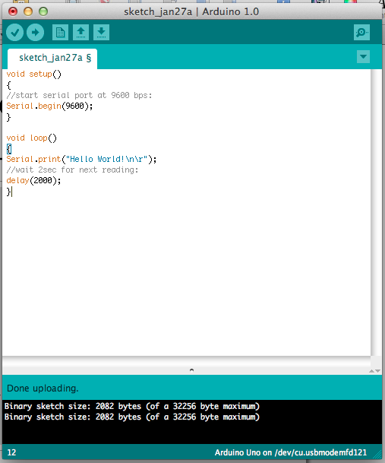
Install the Arduino software
http://arduino.cc
http://arduino.cc/it/Guide/Windows
Yeah...read these instructions!

Slide 15
Arduino software
You connect the Arduino into your computer with the USB cable.
You write some stuff here.
You press the arrow to send your stuff to the Arduino.

Slide 16
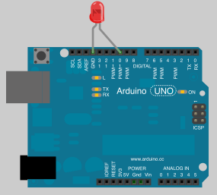
Turn ON/OFF an LED
int ledPin = 10;
void setup()
{
  pinMode(ledPin, OUTPUT);
}
void loop()
{
  digitalWrite(ledPin, HIGH);
  delay(1000);
  digitalWrite(ledPin, LOW);
  delay(1000);
}
Connect a LED to pin 10 and ground!
Type the code.
Make it blink faster!

Slide 17
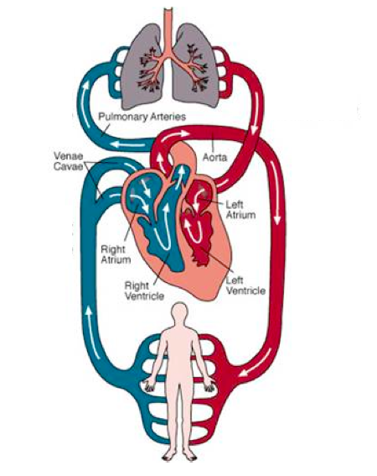
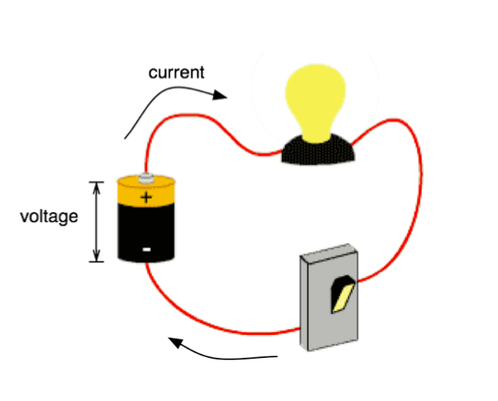
What is an electrical circuit
Heart pumps, Blood flows
Voltage pushes,
Current flows

Slide 18
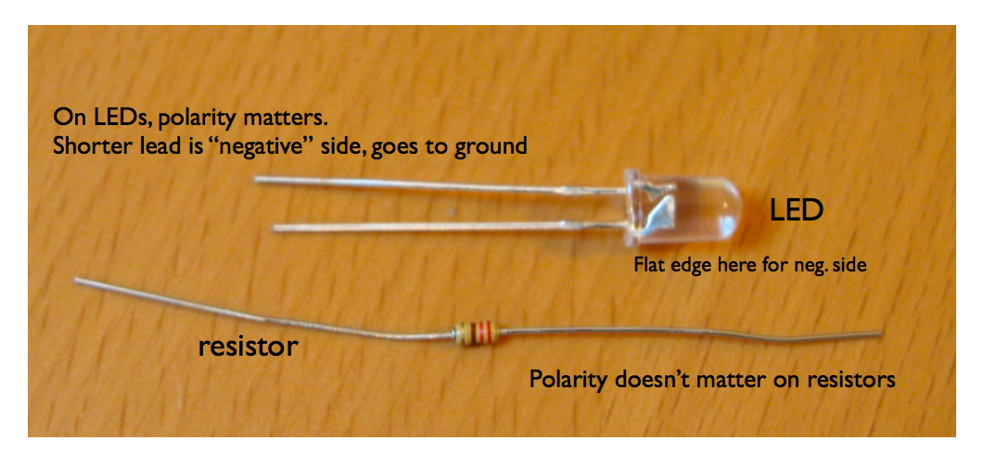
LEDs and resistors

Slide 19
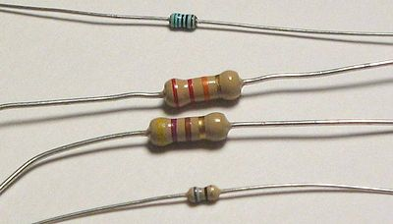
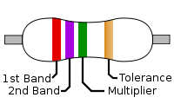
Resistors?
Think of current as cars.
Resistors are then bumps in the road.
Big resistance, means lots of bumps.
Lots of bumps, the cars (current) will slow down...
Why do we need to decrease current?

Slide 20
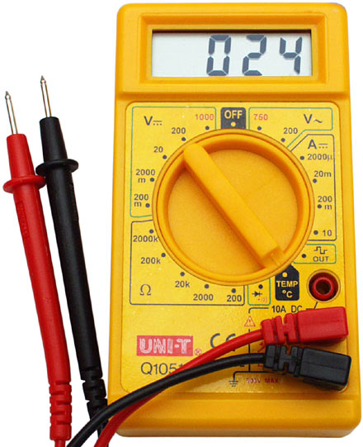
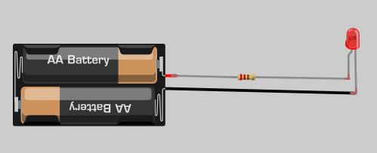
Lighting an LED
A hacker ALWAYS questions everyone until he tries by himself.
Too much current destroys.
So... resistors protect the circuit by reducing the current.
Attach the LED into a battery without a resistor.
Keep changing the resistors.
Use a multi-meter to measure resistance.

Slide 21
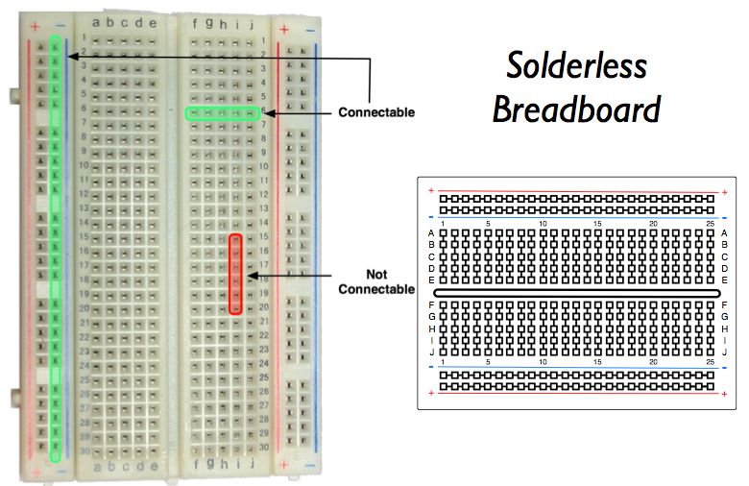
We use solderless breadboards to hold circuits in place!

Slide 22
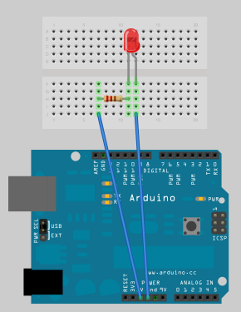
Playing with breadboards
Connect an LED and a resistor between 5V and GND.
Pick a resistor that makes the LED really dim and blink it every 2 seconds on pin #3!

Slide 23
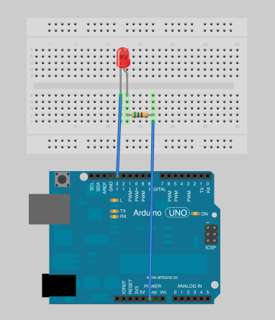
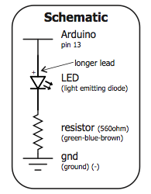
Always add resistors
The schematic and wiring diagram show the same thing.
Write the code that will blink the LED on pin13 every 5 seconds.

Slide 24
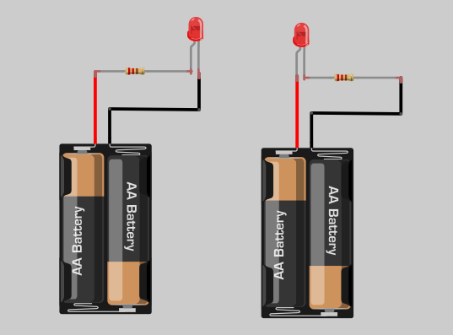
There is no difference between these two circuits

Slide 25
Arduino programming flow
Write code in program
upload to board
Connect USB to Board
Upload Code
verify code
(compile)
Board LED blinks fast
status area
Your code runs

Slide 26
Anatomy of a “sketch”
Global Variables
Declare variables on top...
a variable is like a box of stuff.
Setup()
Stuff that is executed only once at beginning (eg: set pins)
Loop()
Stuff that runs repeatedly, after setup()

Slide 27
Arduino language
You can tell the Arduino to do lots of useful stuff.
This is done with functions:
pinMode() – set a pin as input or output
digitalWrite() – set a digital pin high/low
digitalRead() – read a digital pin’s state
delay() – wait an amount of time
millis() – get the current time

Slide 28
“Hello World”
void setup(){ //start serial port at 9600 bps Serial.begin(9600); }void loop(){
//print something on the computer Serial.print("Hello World!\n"); //wait 2sec delay(2000);}
the Arduino ignores anything after //
click here to establish a (serial) connection PC to arduino

Slide 29
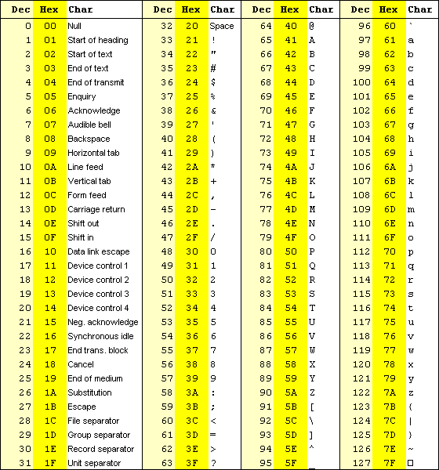
ASCII table and serial connections
It is possible to control the Arduino through a serial connection
Every time you press a key, the computer converts it into a number
Each key has a different number and this is called ASCII.
We can send that number to the Arduino through the cable.

Slide 30
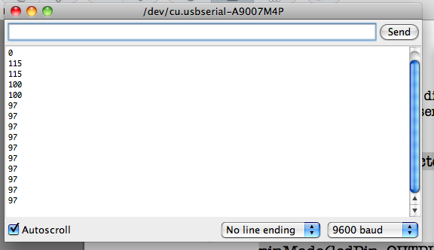
Character ‘a’ turns on LED
int ledPin = 10; int inByte = 0;void setup(){ pinMode(ledPin, OUTPUT);
Serial.begin(9600);} void loop(){ while (Serial.available()>0)
{ inByte = Serial.read(); }
Serial.println(inByte); if (inByte==97) { digitalWrite(ledPin, HIGH); } else { digitalWrite(ledPin, LOW); } delay(1000);
}
pressed ‘s’
pressed ‘d’
pressed ‘a’ and LED turns ON
Attach a LED to pin 10 and run this code.
Now attach another LED to pin 7 and modify the code.
Whenever ‘b’ is pressed, this new LED should go ON.

Slide 31
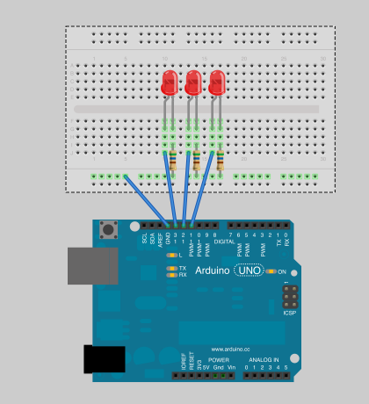
Dealing with 3 LEDs
Put this circuit together
When:
‘a’ is pressed, onlyLED#1 is ON
‘b’ is pressed, only LED#2 is ON
‘c’ is pressed, only LED #3 is ON

Slide 32
Dealing with 3 LEDs
(possible code)
int ledPinA = 11, ledPinB = 12, ledPinC = 13; int inByte = 0;void setup(){ pinMode(ledPinA, OUTPUT); pinMode(ledPinB, OUTPUT); pinMode(ledPinC, OUTPUT); Serial.begin(9600);}
void loop(){ while (Serial.available()>0) { inByte = Serial.read(); } Serial.println(inByte); if (inByte==97) { digitalWrite(ledPinA, HIGH); digitalWrite(ledPinB, LOW); digitalWrite(ledPinC, LOW);} if (inByte==98) { digitalWrite(ledPinA, LOW); digitalWrite(ledPinB, HIGH); digitalWrite(ledPinC, LOW);} if (inByte==99) { digitalWrite(ledPinA, LOW); digitalWrite(ledPinB, LOW); digitalWrite(ledPinC, HIGH);} delay(1000);}

Slide 33
Random numbers
The Arduino can give you random numbers.
However, you must use a fancy function called random.
What will the Arduino print out?
void setup(){ Serial.begin(9600); }
void loop()
{ int randNumber; //print a number from 0 to 299 randNumber = random(300); Serial.println(randNumber); // print a number from 10 to 19 randNumber = random(10, 20); Serial.println(randNumber); delay(1000);}

Slide 34
Circuit with 3 LEDS
Create a circuit with 3 LEDs in pins 11,12 and 13.If ‘1’ is pressed only one RANDOM LED will be ON.If ‘2’ is pressed at most two RANDOM LED’s will be ON.If ‘3’ is pressed ALL three LED’s will be ON.

Slide 35
Circuit with 3 LEDS
(possible code)
int ledPinA = 11, ledPinB = 12;
int ledPinC = 13, inByte = 0;void setup(){ pinMode(ledPinA, OUTPUT); pinMode(ledPinB, OUTPUT); pinMode(ledPinC, OUTPUT); Serial.begin(9600);} void loop(){ while (Serial.available()>0) { inByte = Serial.read(); } Serial.println(inByte); if (inByte==49) { digitalWrite(ledPinA, LOW); digitalWrite(ledPinB, LOW); digitalWrite(ledPinC, LOW); int rnd = random(11,14); digitalWrite(rnd, HIGH); }
if (inByte==50) { digitalWrite(ledPinA, LOW); digitalWrite(ledPinB, LOW); digitalWrite(ledPinC, LOW); digitalWrite(random(11,14), HIGH);
digitalWrite(random(11,14), HIGH); }
if (inByte==51) { digitalWrite(ledPinA, HIGH); digitalWrite(ledPinB, HIGH); digitalWrite(ledPinC, HIGH); } delay(1000);}

Slide 36

Cylon
BattleStar Gallatica is an awesome TV show.
A group of robots are trying to destroy all humans.
Their eyes are LEDS that move in a neat pattern.
We can do that pattern too!
Video - #1 #2

Slide 37
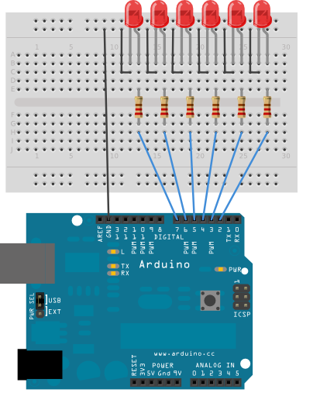
Cylon eyes
Often you want to iterate over a series of pins and do something to each one.
We can use a for() loop to cycle back and forth through digital pins 2-7.
The LEDS are turned on and off, in sequence, by using both the digitalWrite() and delay() functions.

Slide 38
Make your own Cylon eyes
//Higher number, means slower timing.int timer = 100;
void setup() { //for loop to make each pin an output for (int thisPin=2; thisPin<8; thisPin++)
{ pinMode(thisPin, OUTPUT); }}void loop() { // loop from lowest to highest pin for (int thisPin=2; thisPin<8; thisPin++)
{ digitalWrite(thisPin, HIGH); delay(timer); digitalWrite(thisPin, LOW);
}
}

Slide 39
Tweak the Cylon
Make the LEDS cycle LEFT to RIGHT and then RIGHT to LEFT.
Change the sweeping speed.

Slide 40
Tweak the Cylon
(possible code)
int timer = 50;void setup(){ for (int thisPin=2; thisPin<=8; thisPin++) pinMode(thisPin, OUTPUT); }void loop(){ // loop from lowest to highest pin for (int thisPin=2; thisPin<=8; thisPin++) { digitalWrite(thisPin, HIGH); delay(timer); digitalWrite(thisPin, LOW); } for (int thisPin=8; thisPin>=2; thisPin--){ digitalWrite(thisPin, HIGH); delay(timer); digitalWrite(thisPin, LOW); }}

Slide 41
Sensors and inputs
Many sensors are variations on switches Switches make or break a connection.
Button ON:
  Closed circuit, so current flows
Button OFF:
  Open circuit, no current

Slide 42
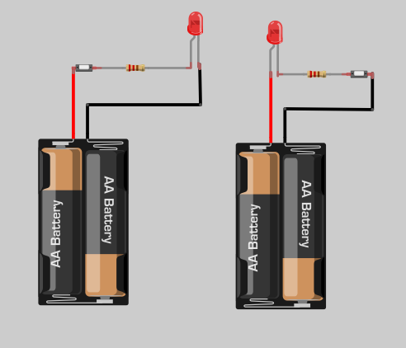
Push buttons and LEDs
Once again, there is no difference between these two circuits.
Button

Slide 43
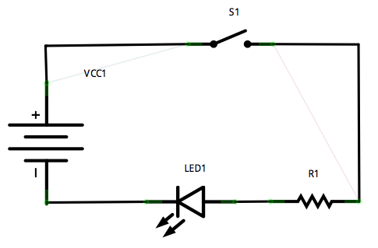
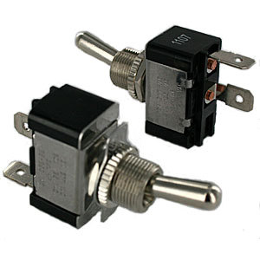
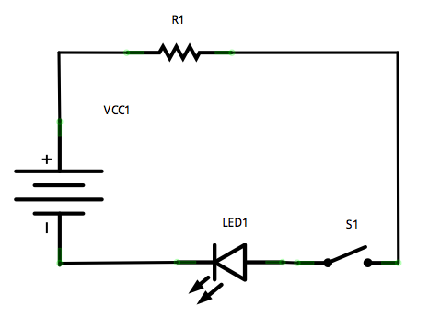
Single pole, single throw (SPST)
SPST Symbol
What is the difference
between these two circuits?

Slide 44
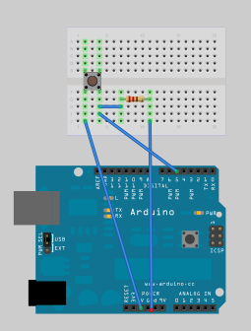
Reading input button
int pinUT=5;int data=0;void setup() { //pin5 in set to receive data pinMode(pinUT, INPUT); //initiate serial communication Serial.begin(9600); }void loop() { data=digitalRead(pinUT); Serial.println(data); delay(1000); }
Serial monitor will report “1” when button is pressed. It will report “0” otherwise.

Slide 45
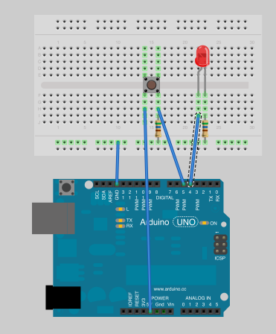
Turn ON a LED on pin #4 with a input button
int pinUT=5, pinLED=4, data=0;void setup() { //pin #5 in set to receive data pinMode(pinUT, INPUT); //pin #4 has an LED pinMode(pinLED, OUTPUT); }void loop() { data=digitalRead(pinUT); if (data==1)
    digitalWrite(pinLED,HIGH);
else
    digitalWrite(pinLED,LOW); delay(1000); }

Slide 46
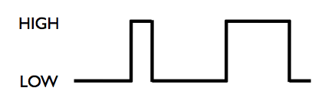
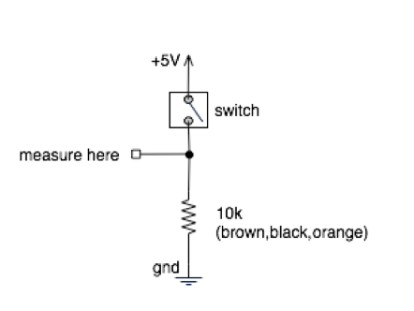
Why do we read button input like that?
Switches make or break a connection
But Arduino wants to see a voltage
Specifically, a “HIGH” (5 volts) or a “LOW” (0 volts)
How do you go from make/break to HIGH/LOW?

Slide 47
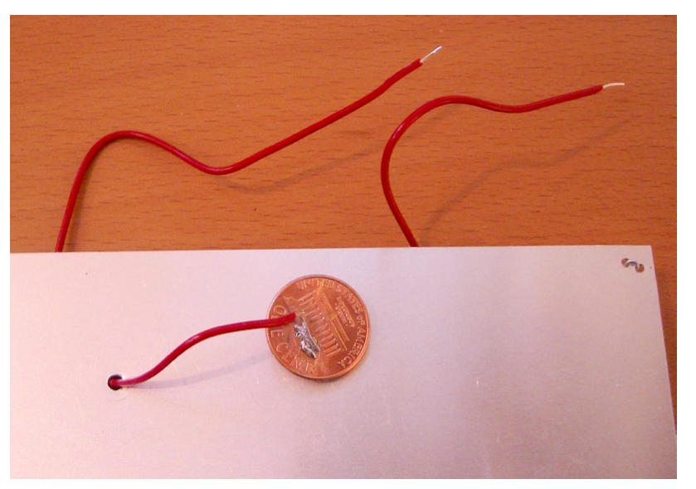
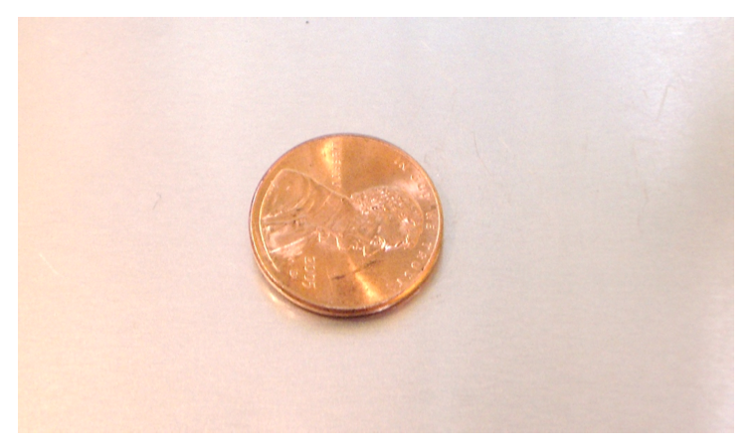
One possible switch
Switches : “Make” or “Break” an electrical connection
Eg: Penny on a surface. When the penny is lifted, alarms go off

Slide 48
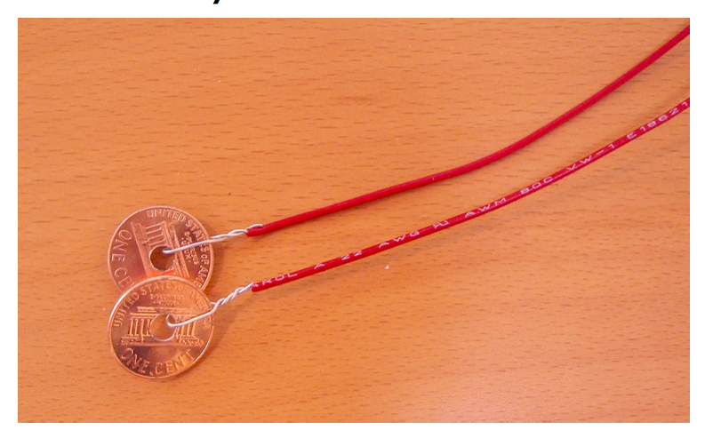
Another possible switch
Pennies instead
of a button
Turn ON/OFF a LED on based on the collision of two pennies.
Collision ensures an electrical connection.

Slide 49
Analog input
You’ve seen how Arduino can output HIGH/LOW signals... what about a medium signal?
Easy... with analog I/O!
Output : 0 to 255
Input: 0 to 1023
Analog input: we can use it to determine the distance of an object via infra-red sensor.
Analog output: we can use it to set speed of a motor or the brightness of a LED.
Analog Input

Slide 50
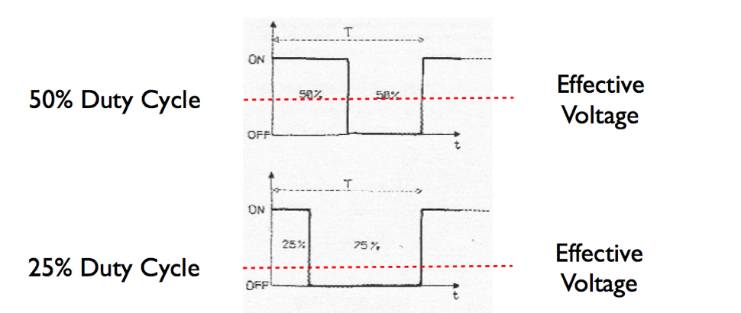
Analog output
Some digital ports can be programmed to output analog signals.
We enable those ports for output with pulse width modulation (PWM).
PWM is obtained by varying between HIGH and LOW at the appropriate interval of time.
Digital pins with PWM

Slide 51
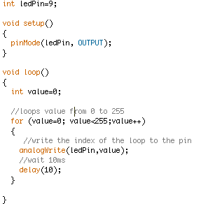
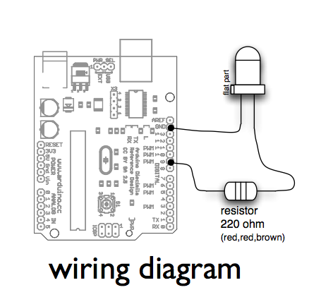
Dimming light

Slide 52
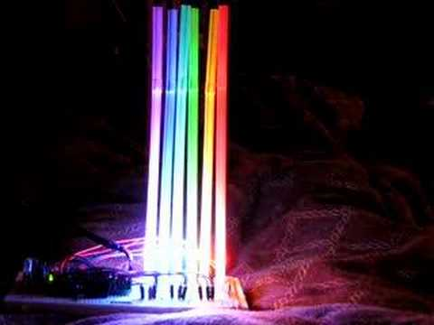
Dimming light
Add a couple of different LEDs at different PWM pins.Specify different delays to emulate candlelight flicker.Measure Voltage on a PWM pin. What’s going on?

Slide 53
Analog input
Arduino has six analog inputs
Reads voltage between 0 to 5 volts
Resolution is 10-bit (1024 values)
In other words, 5/1024 = 4.8 mV smallest voltage change you can measure
Examples of varying voltage inputs: Temperature sensors, light sensors, ...

Slide 54
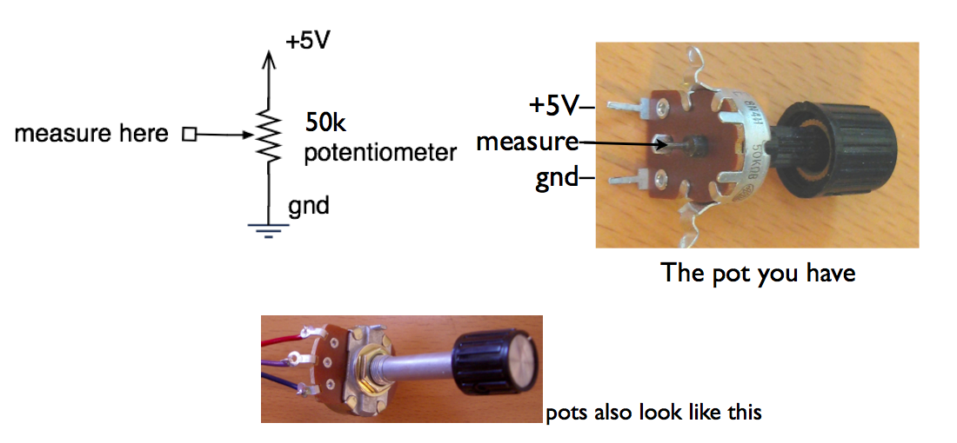
Potentiometers
With a potentiometer we can create an analog input.

Slide 55

Potentiometers
Moving the knob is like moving where the arrow taps the voltage on the resistor

Slide 56

Analog read: Blink an LED at different speeds!
int ledPinA = 9; //output pin (led)int sensorPinA = 2; //input pin for pot.void setup() { Serial.begin(9600); pinMode(ledPinA, OUTPUT); }void loop() { int inputVal = analogRead(sensorPinA); digitalWrite(ledPinA, HIGH); Serial.println(inputVal); delay(inputVal); digitalWrite(ledPinA, LOW); delay(inputVal);}
See that sensorValueA goes from 0 to 1024.

Slide 57

Replace the LED with a speaker
int ledPinA = 9; //output pin (led)int sensorPinA = 2; //input pin for pot.void setup() { Serial.begin(9600); pinMode(ledPinA, OUTPUT); }void loop() { int inputVal = analogRead(sensorPinA); digitalWrite(ledPinA, HIGH); Serial.println(inputVal); delay(inputVal); digitalWrite(ledPinA, LOW); delay(inputVal);}

Slide 58
Turn one LED
... as you move potentiometer
int ledPinA = 9; //output pin (led)int sensorPinA = 2; //input pin for pot.void setup() { pinMode(ledPinA, OUTPUT); }void loop() { int inputVal = analogRead(sensorPinA); if (inputVal>512) digitalWrite(ledPinA, HIGH); else digitalWrite(ledPinA, LOW); }
See that sensorValueA goes from 0 to 1024.

Slide 59

Turn one or two LEDs
... as you move potentiometer
int ledPinA = 9, ledPinB=7; int sensorPinA = 2; //input pin for pot.void setup(){ pinMode(ledPinA, OUTPUT); pinMode(ledPinB, OUTPUT); }void loop() { int inputVal = analogRead(sensorPinA); digitalWrite(ledPinA, LOW); digitalWrite(ledPinB, LOW); if (inputVal>512){ digitalWrite(ledPinA, HIGH); digitalWrite(ledPinB, LOW); } if (inputVal>714){ digitalWrite(ledPinA, HIGH); digitalWrite(ledPinB, HIGH); }}

Slide 60

Voltage divider
Potentiometers are example of a voltage divider.
Voltage divider splits a voltage in two.
Same as two resistors, but you can vary them...

Slide 61

Sensing the dark: photocells
Photoresistor, light-dependent resistor
A variable resistor
Brighter light == lower resistance
Photocells you have range approx. 0-10k-1M

Slide 62


PhotoCell circuit
int sensorPinA = 4;void setup() { Serial.begin(9600);}void loop() { int inputVal = analogRead(sensorPinA); Serial.println(inputVal); delay(1000);}
How much does the input value changes when you cover the photocell?

Slide 63

If the value > a (certain) number then turn ON LED
int sensorPinA = 4, ledPin=6;void setup() { pinMode(ledPin,OUTPUT); Serial.begin(9600);}void loop() { int inputVal = analogRead(sensorPinA); Serial.println(inputVal); if (inputVal>400) digitalWrite(ledPin,HIGH); else digitalWrite(ledPin,LOW); delay(1000);}
You pick!

Slide 64

Resistive sensors

Slide 65

Replace the photocell with pressure sensor!
int sensorPinA = 4, ledPin=6;void setup() { pinMode(ledPin,OUTPUT); Serial.begin(9600);}void loop() { int inputVal = analogRead(sensorPinA); Serial.println(inputVal); if (inputVal>400) digitalWrite(ledPin,HIGH); else digitalWrite(ledPin,LOW); delay(1000);}
You pick!

Slide 66

Lets play some music
#define NOTE_C4 262#define NOTE_G3 196#define NOTE_A3 220int melody[]={NOTE_C4,NOTE_G3,NOTE_G3,NOTE_A3, NOTE_G3};int noteDurations[] = {4,8,8,4,4,4};void setup() {}void loop() { for (int thisNote = 0; thisNote < 5; thisNote++) { int noteDuration = 1000/noteDurations[thisNote]; tone(8, melody[thisNote],noteDuration); int pauseBetweenNotes = noteDuration * 1.30; delay(pauseBetweenNotes); noTone(8); }}

Slide 67

Theremin
“ooo-weee-ooooo”The original spooky sound machineWorks by measuring your body’s electric fieldWe’ll use a resistive sensor in lieu of RF
Leo Theremin in his own words - video

Slide 68

Lets build our own theremin!
#define NOTE_C4 262#define NOTE_G3 196#define NOTE_A3 220int sensorPinA = 4, speakerPin=3;void setup() { Serial.begin(9600); }void loop() { int inputVal = analogRead(sensorPinA); Serial.println(inputVal); if (inputVal<=500) tone(speakerPin, NOTE_C4,8); if ((inputVal>500) && (inputVal<=900)) tone(speakerPin, NOTE_G3,8); if (inputVal>900) tone(speakerPin, NOTE_A3,8); delay(10); noTone(speakerPin);}
Press and hear the music!
You pick!

Slide 69
RGB LED

Slide 70



Write up this circuit...
Then we write the code
560ohm is Green, Blue, Brown

Slide 71
Green color
int red=9, green=10, blue=11;void setup() { pinMode(red,OUTPUT); pinMode(green,OUTPUT); pinMode(blue,OUTPUT);}void loop() { analogWrite(red,0); analogWrite(green,255);//255 is MAX analogWrite(blue,0);}

Slide 72
Blue color
int red=9, green=10, blue=11;void setup() { pinMode(red,OUTPUT); pinMode(green,OUTPUT); pinMode(blue,OUTPUT);}void loop() { analogWrite(red,0); analogWrite(green,0); analogWrite(blue,255);}

Slide 73
Generating random colors!
int red=9, green=10, blue=11;void setup() { pinMode(red,OUTPUT); pinMode(green,OUTPUT); pinMode(blue,OUTPUT);}void loop() { analogWrite(red,random(0,256)); analogWrite(green,random(0,256)); analogWrite(blue,random(0,256)); delay(500);}
Every 0.5 seconds, a new color will be generated!

Slide 74

Lets use the potentiometer to generate new colors!
int red=9, green=10, blue=11;void setup() { pinMode(red,OUTPUT); pinMode(green,OUTPUT); pinMode(blue,OUTPUT);}void loop() { int pot=analogRead(0); int data = map(pot, 0, 1024, 0, 255); analogWrite(red,0); analogWrite(green,data); analogWrite(blue,0);}

Slide 75
Use two(!) potentiometers to generate new colors!
int red=9, green=10, blue=11;void setup() { pinMode(red,OUTPUT); pinMode(green,OUTPUT); pinMode(blue,OUTPUT);}void loop() { int pot1=analogRead(0); int pot2=analogRead(1); int data1 = map(pot, 0, 1024, 0, 255); int data2 = map(pot, 0, 1024, 0, 255); analogWrite(red, data1); analogWrite(green,data2); analogWrite(blue,0);}
You have to put together the circuit... What about three potentiometers????

Slide 76


Servo motors
A Servo is a small device that has an output shaft.
This shaft can be positioned to specific angular positions (0-180 degrees) by sending the servo a coded signal.
As the coded signal changes, the angular position of the shaft changes.

Slide 77


Moving a servo
#include <Servo.h> Servo myservo; int pos = 0; void setup() { myservo.attach(9); } void loop()
{
//move servo to 45 degrees
myservo.write(45);
delay(1000); //wait 1 second
//move servo to 90 degrees myservo.write(90);
//wait 1 second delay(1000);
}

Slide 78
Moving a servo back and forth!
#include <Servo.h> Servo myservo; void setup() { myservo.attach(9); }
void loop() { for (int i=0; i<180; i++) { myservo.write(i); delay(200); }
for (int i=180; i>0; i--) { myservo.write(i); delay(200); } }

Slide 79

Using a potentiometer to specify the servo angle
Instead of sweeping all angles, use a potentiometer to define an angle. You need to determine what are the potentiometer analog input ranges.
//connect potentiometer to analog pin #0//connect servo control to digital pin#9#include <Servo.h> Servo myservo; int potpin = 0; int val; void setup(){ myservo.attach(9); } void loop() { val = analogRead(potpin); // scale analog input to an angle val = map(val, 0, 1023, 0, 179); myservo.write(val); delay(15); }

Slide 80

DC Motors
They come in all forms and sizes.
With or without gears
How much juice it needs to spin?
How fast it spins
How strong it spins
Size, shaft diameter, shaft length,...

Slide 81

How to connect a DC motor?

Slide 82

DC motors as generators

Slide 83


Same idea as a dynamo

Slide 84

Transistors and motors
Transistors are small switches. A little juice in once leg, will close the switch.
Transistors switch big signals with small signals.

Slide 85

Protecting your circuit
Since motors can act like generators, need to prevent them from generating juice back into the circuit.

Slide 86


Run a DC motor
const int DCMotorpin=9;void setup() { pinMode(DCMotorpin, OUTPUT); };void loop() { analogWrite(DCMotorpin,200);};
Implement the DC motor circuit and run it. Change the analog values, for different speeds.
Adjust the speed of the motor using a potentiometer.
Adjust the speed of the motor using any other resistive sensor.

Slide 87


7-Segment LED Displays
Old school method of displaying numbers.
A seven segment display has seven LEDS.
You can turn each LED ON/OFF to display a number.

Slide 88



7-Segment display
The segments of a 7-segment display are referred to by the letters A to G.
Some displays have a decimal point.
Circuit connections vary from different manufacturers.

Slide 89

How does it work?
Determine the connections of the 7-Segment display I’ve handed out.

Slide 90
Type number on keyboard
... show it on the 7-Segment!
int pinA=4; int pinB=7; int pinC=9; int pinD=10;int pinE=5; int pinF=6; int pinG=8; int readKey=-1;void setup(){ pinMode(pinA,OUTPUT); pinMode(pinB,OUTPUT); pinMode(pinC,OUTPUT); pinMode(pinD,OUTPUT); pinMode(pinE,OUTPUT); pinMode(pinF,OUTPUT); pinMode(pinG,OUTPUT); Serial.begin(9600);}void loop(){ while (Serial.available()>0) readKey = Serial.read(); if (readKey=='0'){ digitalWrite(pinA,LOW); digitalWrite(pinB,LOW); digitalWrite(pinC,LOW); digitalWrite(pinD,LOW); digitalWrite(pinE,LOW); digitalWrite(pinF,LOW); digitalWrite(pinG,HIGH); } }

