Slide 1
Quantum Fluids of Light
Numerical Methods

Slide 2
Fluids of Light – NLSE
analytical considerations
how to solve it?
Computational Tools

Slide 3
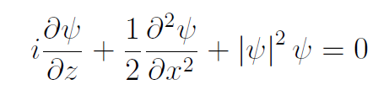
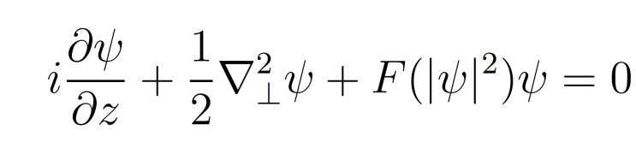
Generalized Nonlinear Schrödinger equation
Generalization of the nonlinear term of the normal Nonlinear Schrödinger equation: commonly called GNLSE

Slide 4
Generalized Nonlinear Schrödinger equation
Generalization of the nonlinear term of the normal Nonlinear Schrödinger equation: commonly called GNLSE
Envelope/Mean field model

Slide 5
Generalized Nonlinear Schrödinger equation
Generalization of the nonlinear term of the normal Nonlinear Schrödinger equation: commonly called GNLSE
Envelope/Mean field model
Describes the evolution of the envelope of a wave propagating in nonlinear media

Slide 6
Generalized Nonlinear Schrödinger equation
Generalization of the nonlinear term of the normal Nonlinear Schrödinger equation: commonly called GNLSE
Envelope/Mean field model
Describes the evolution of the envelope of a wave propagating in nonlinear media
Dynamical equilibrium between dispersion/diffraction and nonlinear effects

Slide 7
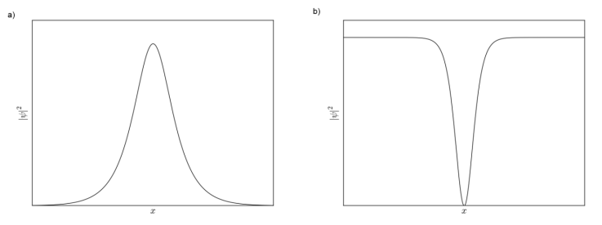
Generalized Nonlinear Schrödinger equation
Admits solitons and solitary-type solutions, i.e. localized solutions (in some of the dimensions) that maintains its shape throughout propagation

Slide 8
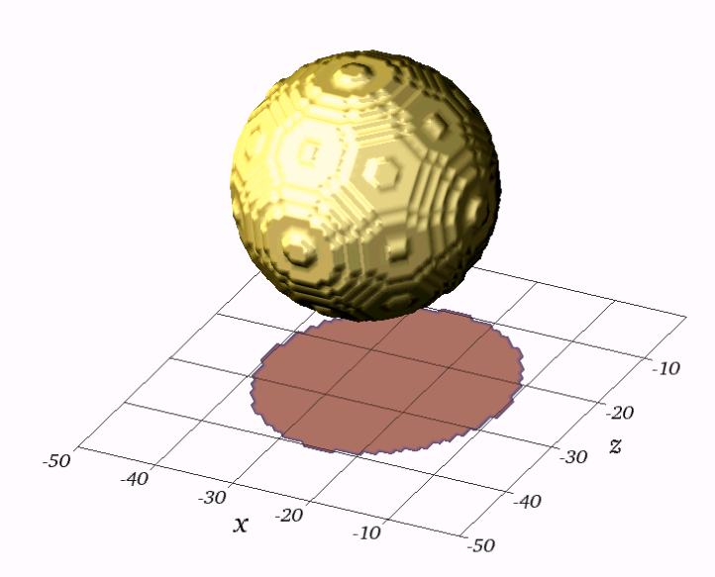
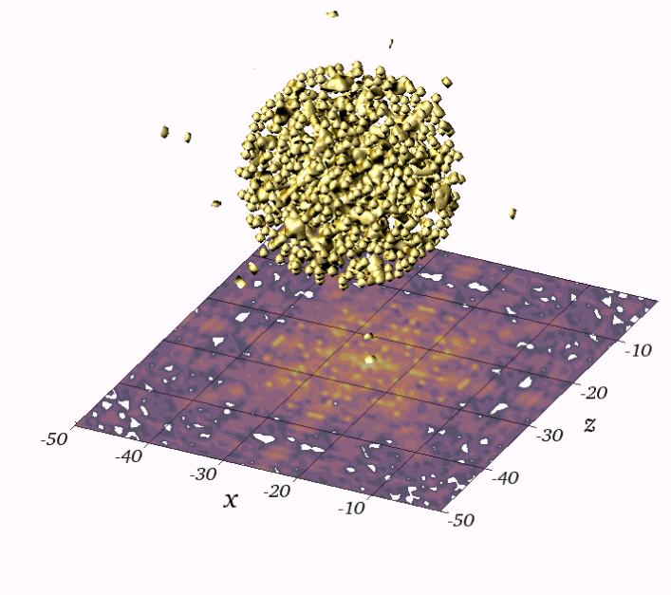
Generalized Nonlinear Schrödinger equation
Admits solitons and solitary-type solutions, i.e. localized solutions (in some of the dimensions) that maintains its shape throughout propagation
Generally non-integrable if not the usual (1+1)-dimensional equation

Slide 9
Generalized Nonlinear Schrödinger equation
Applications: nonlinear optics, Bose-Einstein Condensates, Plasma physics, superfluids, Black-holes, (insert any other physics branch here)

Slide 10
Mathematical methods
Direct space – Finite Differences
Advantages : Versatility; Stable;
Disadvantages: Computational load (smaller integration steps)
Reciprocal Space – Pseudospectral Methods
Advantages: FFT;
Disadvantages: Periodic Boundary Conditions;

Slide 11
Split-Step Fourier Method
Formal mathematical solution for the GNLSE

Slide 12
Split-Step Fourier Method
Formal mathematical solution for the GNLSE
Solution:

Slide 13
Split-Step Fourier Method
Formal mathematical solution for the GNLSE
Solution:

Slide 14
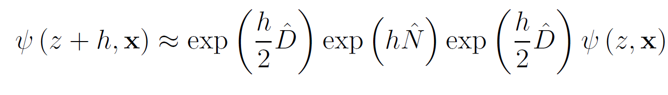
Split-Step Fourier Method
Strang-splitting formulation

Slide 15
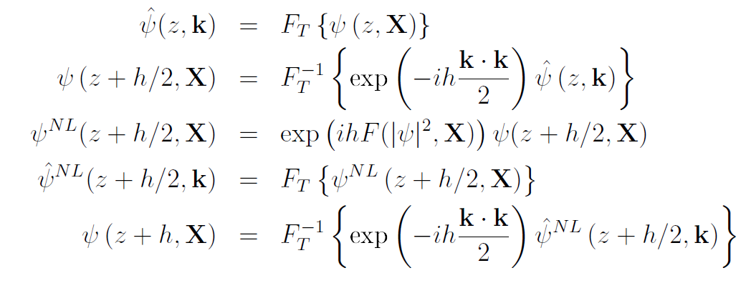
Split-Step Fourier Method
Strang-splitting formulation
Split-step Fourier method (second order)

Slide 16
Split-Step Fourier Method
Advantages:
Concatenate two consecutive linear steps (First Same as Last)
FFT is a fast algorithm for dealing with the Laplacian term
Admits larger integration steps than the finite differences methods for the same accuracy.

Slide 17
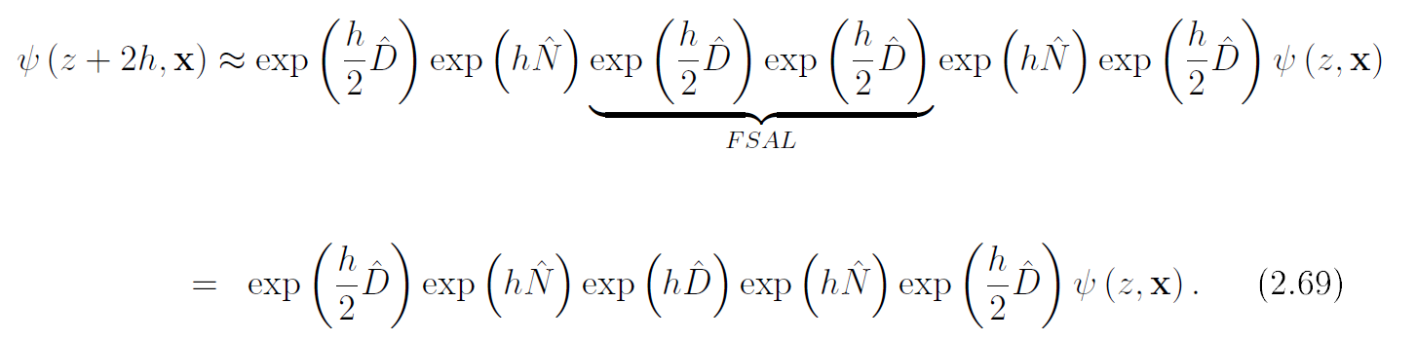
Split-Step Fourier Method
Advantages:
Concatenate two consecutive linear steps (First Same as Last)
FFT is a fast algorithm for dealing with the Laplacian term
Admits larger integration steps than the finite differences methods for the same accuracy.

Slide 18
Split-Step Fourier Method
Advantages:
Concatenate two consecutive linear steps (First Same as Last)
FFT is a fast algorithm for dealing with the Laplacian term
Admits larger integration steps than the finite differences methods for the same accuracy.

Slide 19
Split-Step Fourier Method
Advantages:
Concatenate two consecutive linear steps (First Same as Last)
FFT is a fast algorithm for dealing with the Laplacian term
Admits larger integration steps than the finite differences methods for the same accuracy.

Slide 20









Scientific Computing
Many languages, with distinct complexity
Many tools, with distinct purposes
Many hardware, with distinct performances

Slide 21
Exercise 1
In (1+1)d, plot the dynamics of a gaussian shape wave propagating along z.
a) Start with a width of 20 micrometers. Compare with the results of 600 micrometers.
b)Vary the intensity (e.g. 40mW/cm^2 to 4000mW/cm^2) and see what happens;
c) Collide two gaussians by adding a velocity (i.e. gradient of a phase)

Slide 22



Exercise 2
Compute the Bogoliubov dispersion relation of a 1d fluid using an oceanographic technique.
a)Simulate a 1d fluid + random noise;
b)Compute the dispersion relation by taking the 2d fourier transform of (abs(field)**2-1), perform the necessary fftshifts and display on a 2d density plot(use imshow and log10(fft..))
c)Compare with the predicted results for the Bogoliubov theory

Slide 23
Exercise 3
Compute the momentum decay for a fluid interacting with a defect.
a)Simulate the 2d fluid with a gaussian defect;
b)Compute the momentum for each z;
integral(1j * conj(psi)*(Dx psi))/2
c)Plot (1d) the evolution of Px in z;

