Slide 1
Implementing an Extreme Learning Machine with a Nonlinear Chain of Oscillators
Theoretical Foundations

Slide 2
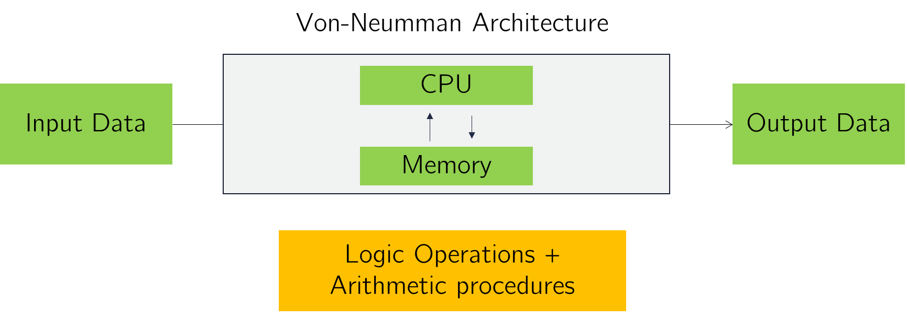
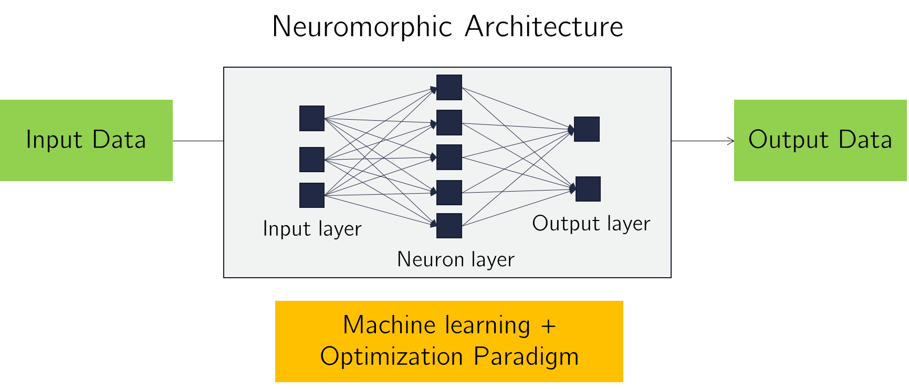
Concept
Paradigm shift
from Von Neumman Logic-based operations to optimization/data-driven strategies

Slide 3
Extreme Learning Machines
Why an extreme learning machine?
The neuromorphic approach requires designing and optimizing a large amount of weights
Increases the computation time
Makes physical implementations more challenging (fine tuning a large amount of physical parameters

Slide 4
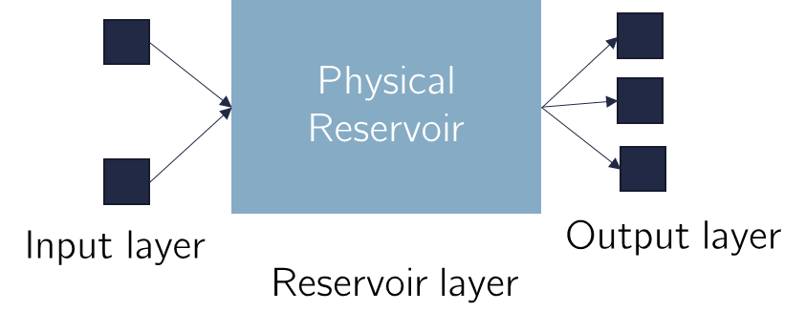
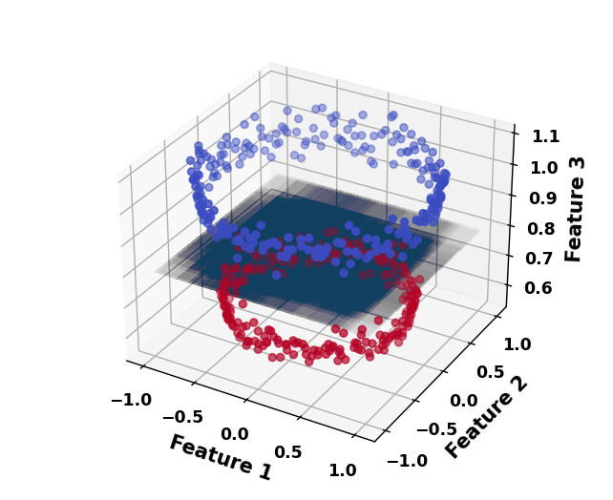
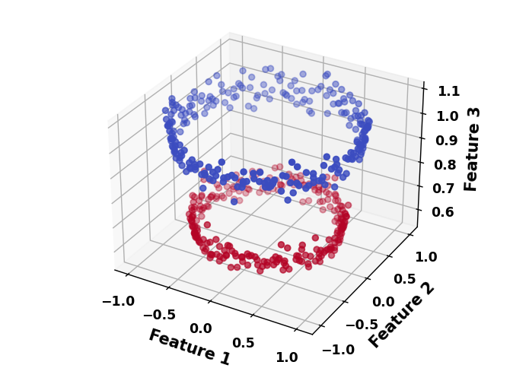
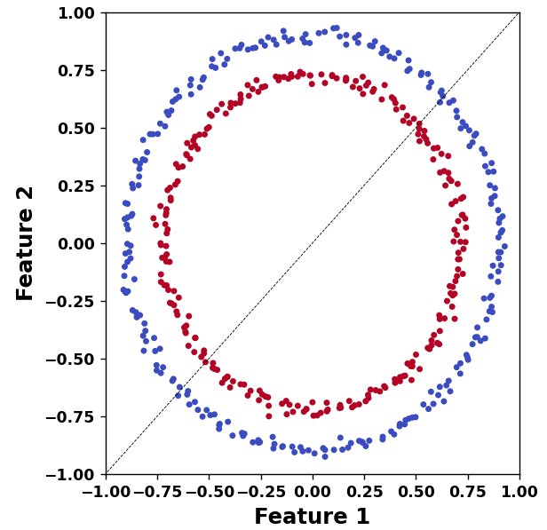
Extreme Learning Machines
How does it work?
The reservoir dynamics projects the input data onto a higher-dimensional space.
The nonlinear projection allows to turn nonlinear separable tasks into linear ones.

Slide 5
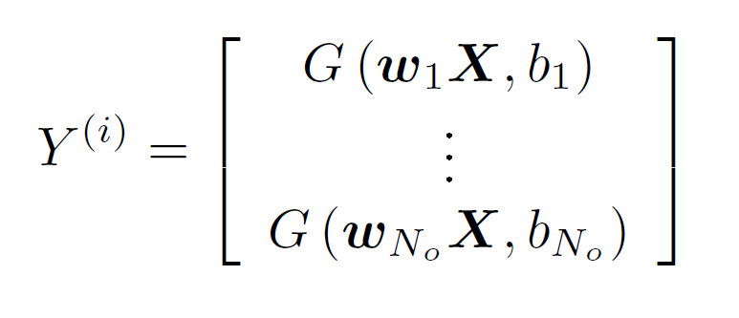

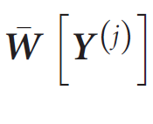
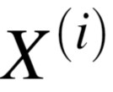

Extreme Learning Machines
As such, an extreme learning machine bypasses the tuning of the weights of intermediate layers, optimizing only at the output layer
Eases the training process
Makes physical implementations possible
Take each Input state
Project onto an output space
Train a linear transformation that minimizes a given loss function
Compute!

Slide 6
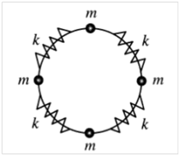
Implementing an extreme learning machine
We will make use of a nonlinear oscillator chain, described by the Toda Lattice Equation
Properties:
The limit of the harmonic oscillator can be recovered for small v and small displacements
System can either feature linear or nonlinear dynamics (chaotic or not) varying these parameters

Slide 7
Implementing an extreme learning machine
Take each Input state
Project onto an output space
Train a linear transformation that minimizes a given loss function
Compute!

Slide 8
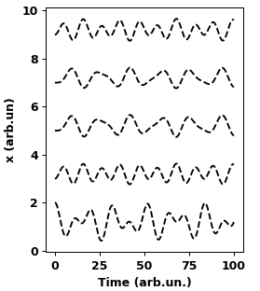
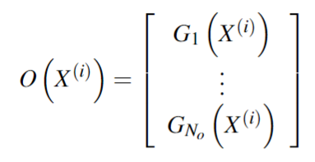
Implementing an extreme learning machine
Encode the feature space into initial displacements
Recover the output state at the final simulation time t_stop
Compute the output space and train the necessary transformation

Slide 9


Regression Tasks
Approximate a given function

Slide 10
Regression Tasks
Typical Results

Slide 11
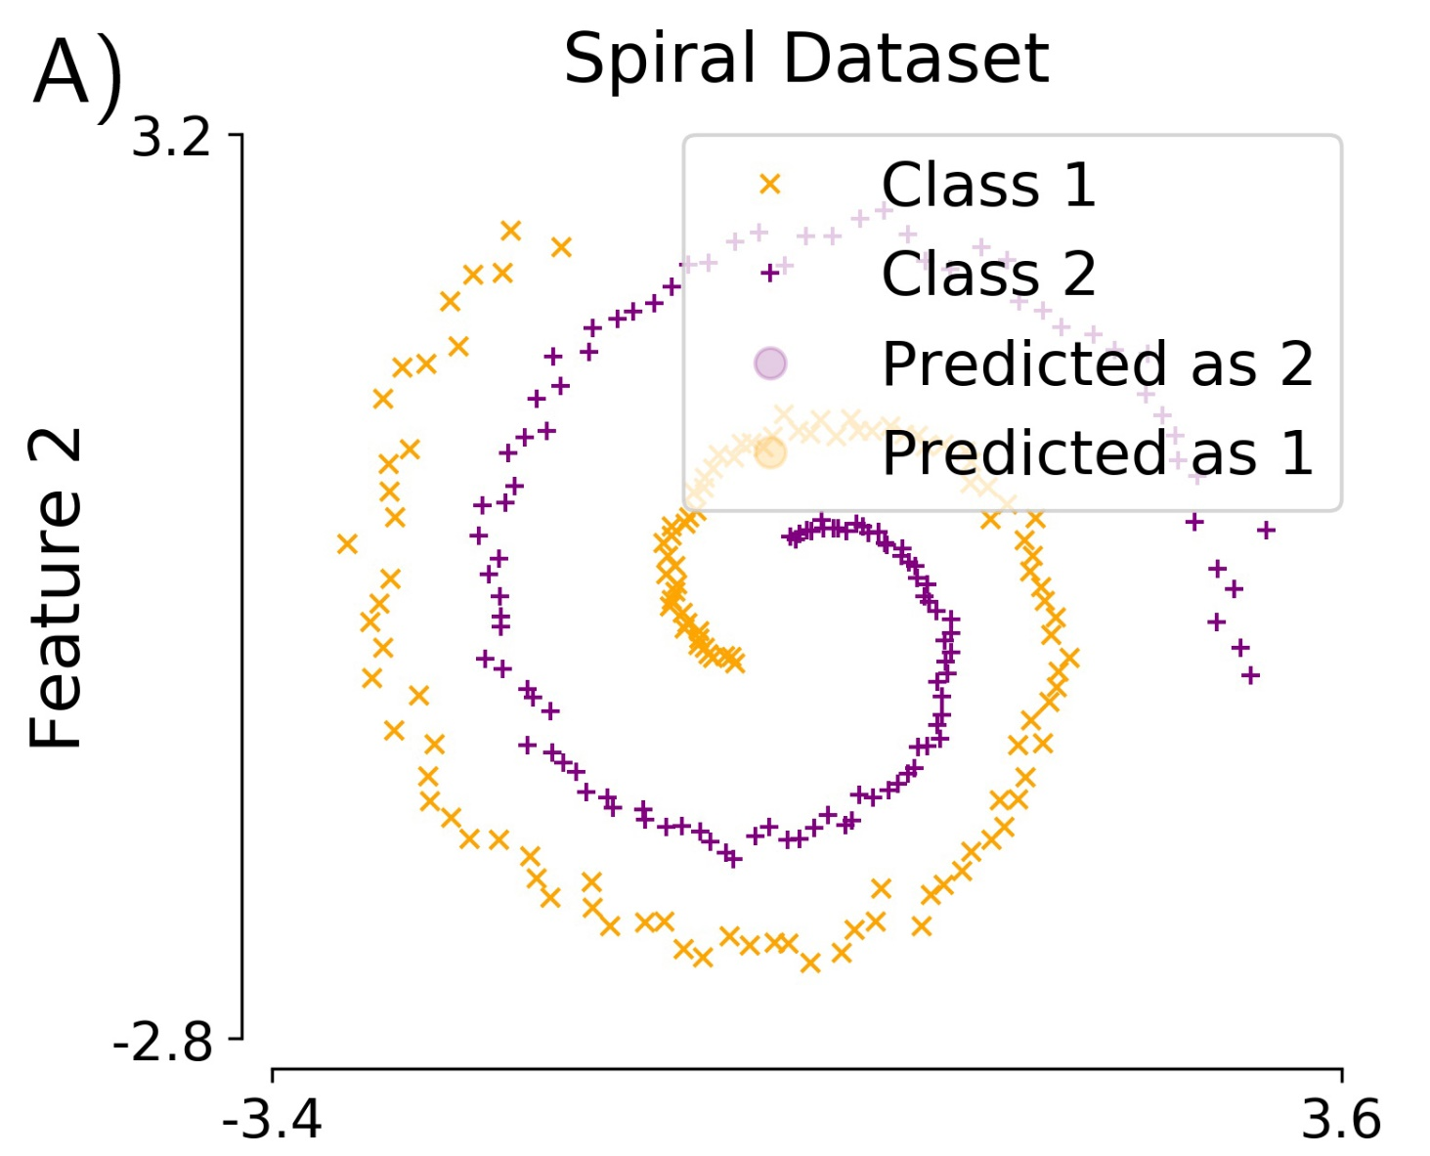
Classification Task
Classify a two-feature dataset of two classes (Spiral dataset)

Slide 12
Classification Tasks
Typical Results

Slide 13
Performance of the ELM
What determines the performance of our ELM?
Empirically, both the encoding scaling A and v are crucial to the performance of the ELM

Slide 14
Performance of the ELM
What determines the performance of our ELM?
In the literature, it is discussed [refs] that the performance of a nonlinear dynamical system will increase until the edge of chaos, where the performance breakdown due to the chaoticity of the system.
Can we verify this in our system?

Slide 15
Measuring Chaos
Some metrics:
Qualitative
Bifurcation Diagrams
Quantitative
Lyapunov Exponents

Slide 16
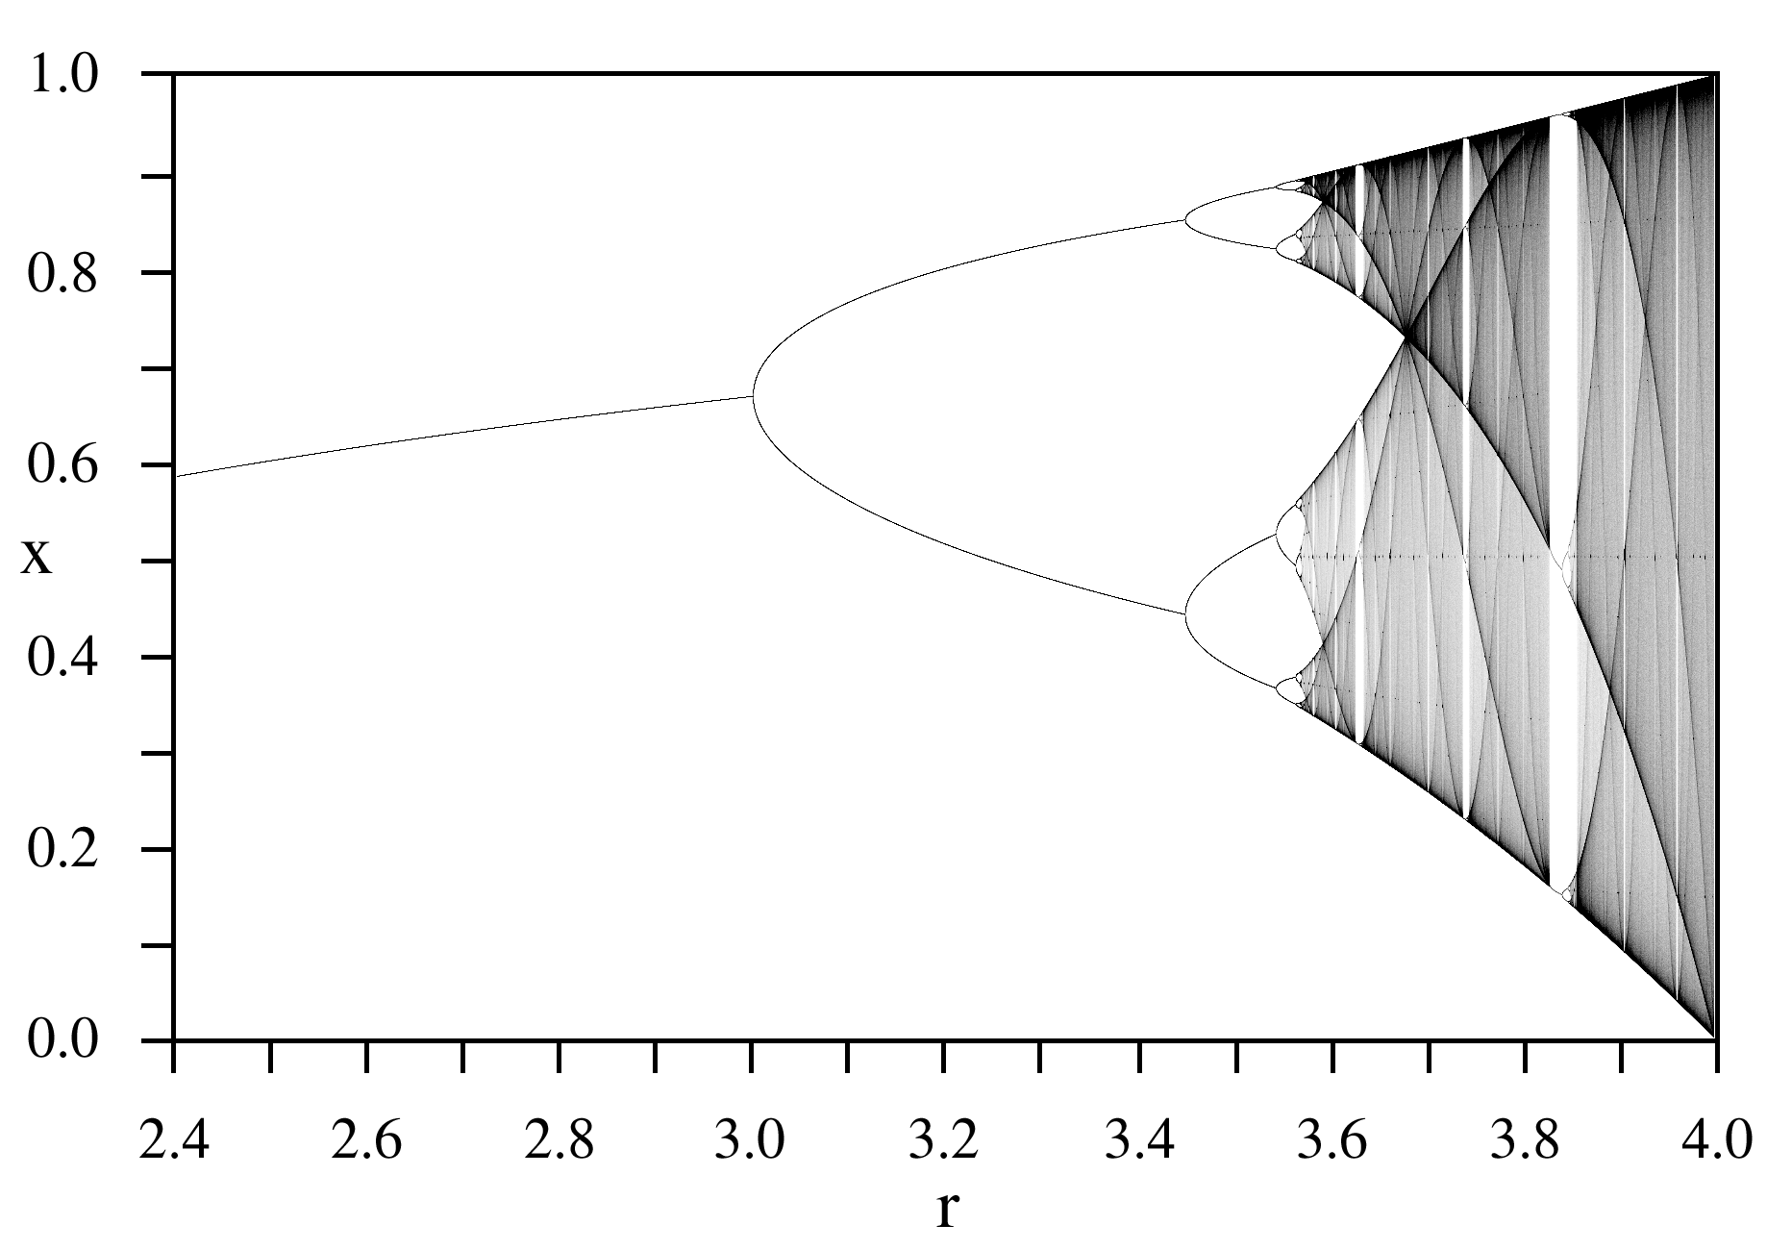
Bifurcation Diagrams
Concept
Follow the maximum value of a variable (after a dropout time) in function of the parameter

