Slide 1
Sensors and Signal Analysis
Week 1: Exercises and Hands-on Activity

Slide 2
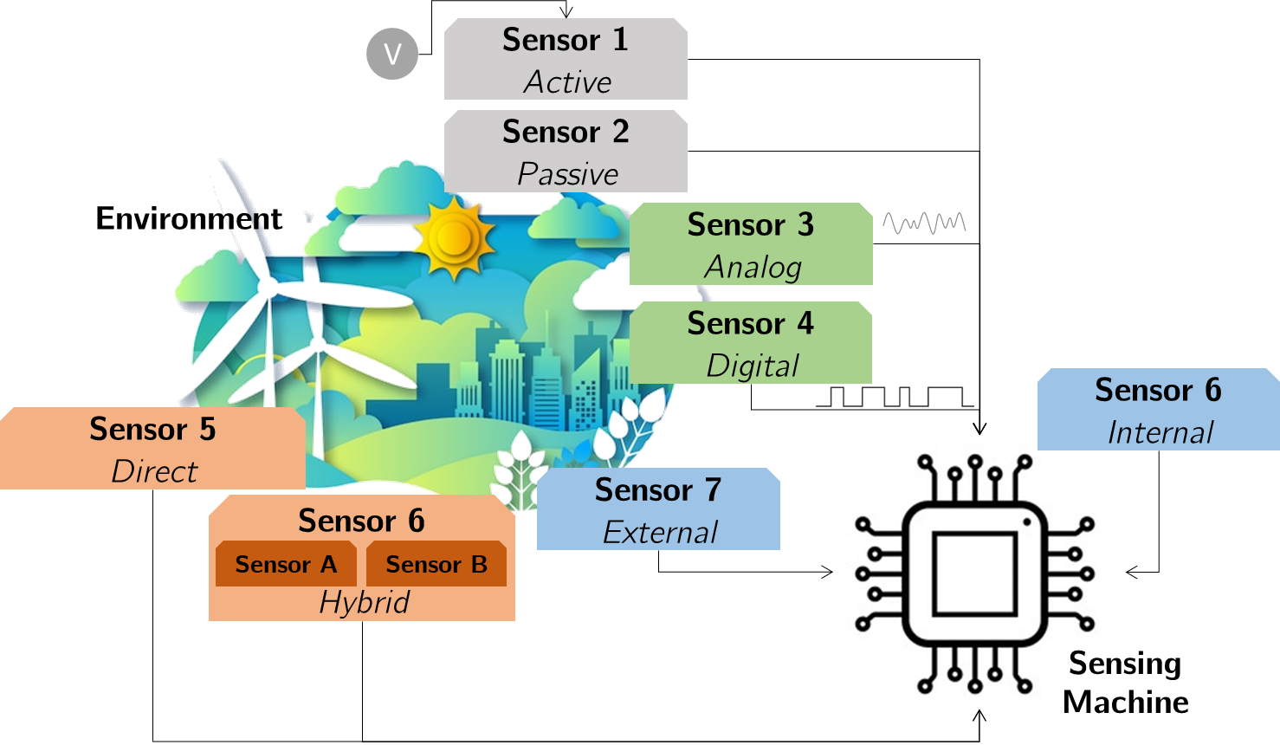
Sensor: A device(transducer) that detects and measures physical properties or changes in a physical system, producing a usable output signal (typically an electric signal) in response to a stimulus.

Slide 3
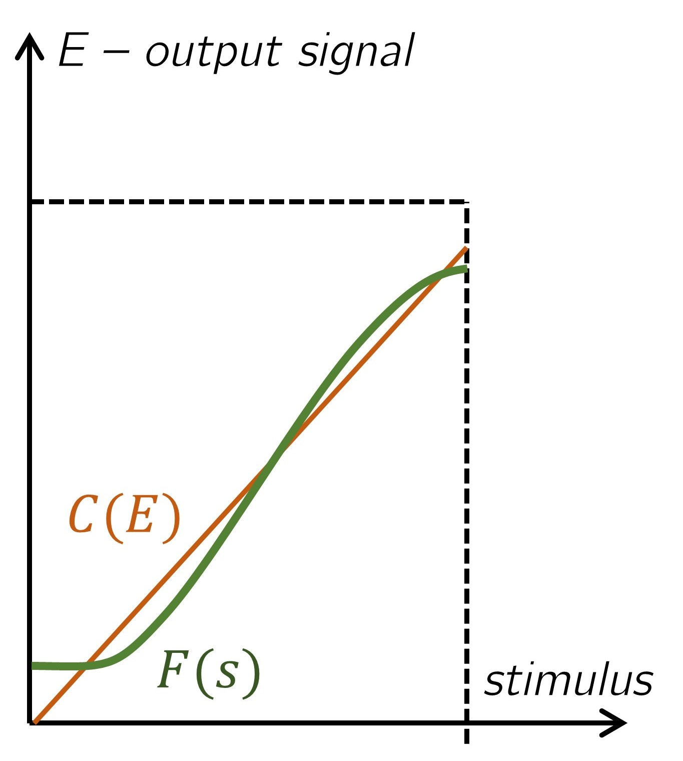
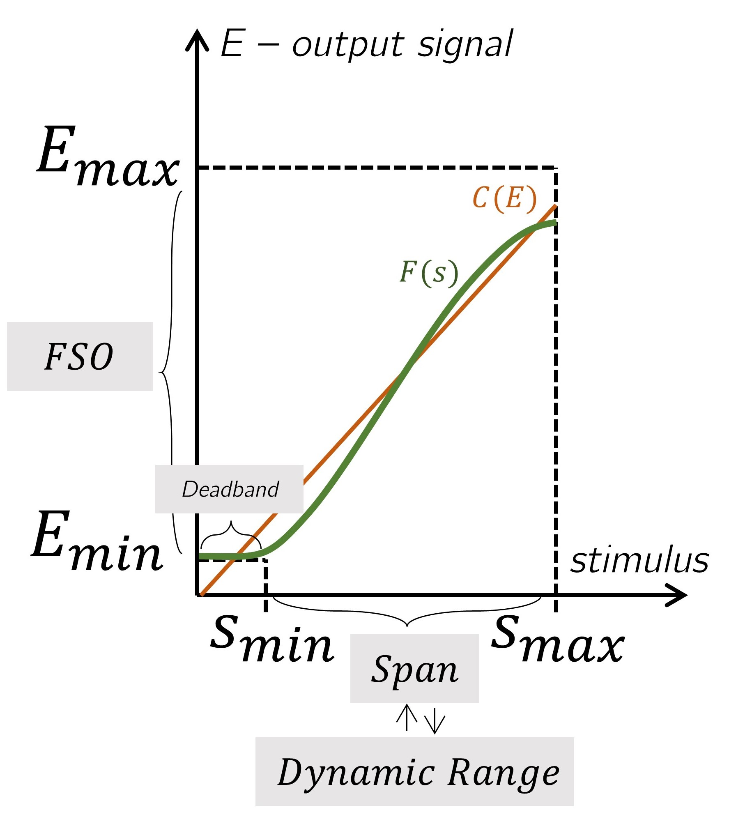
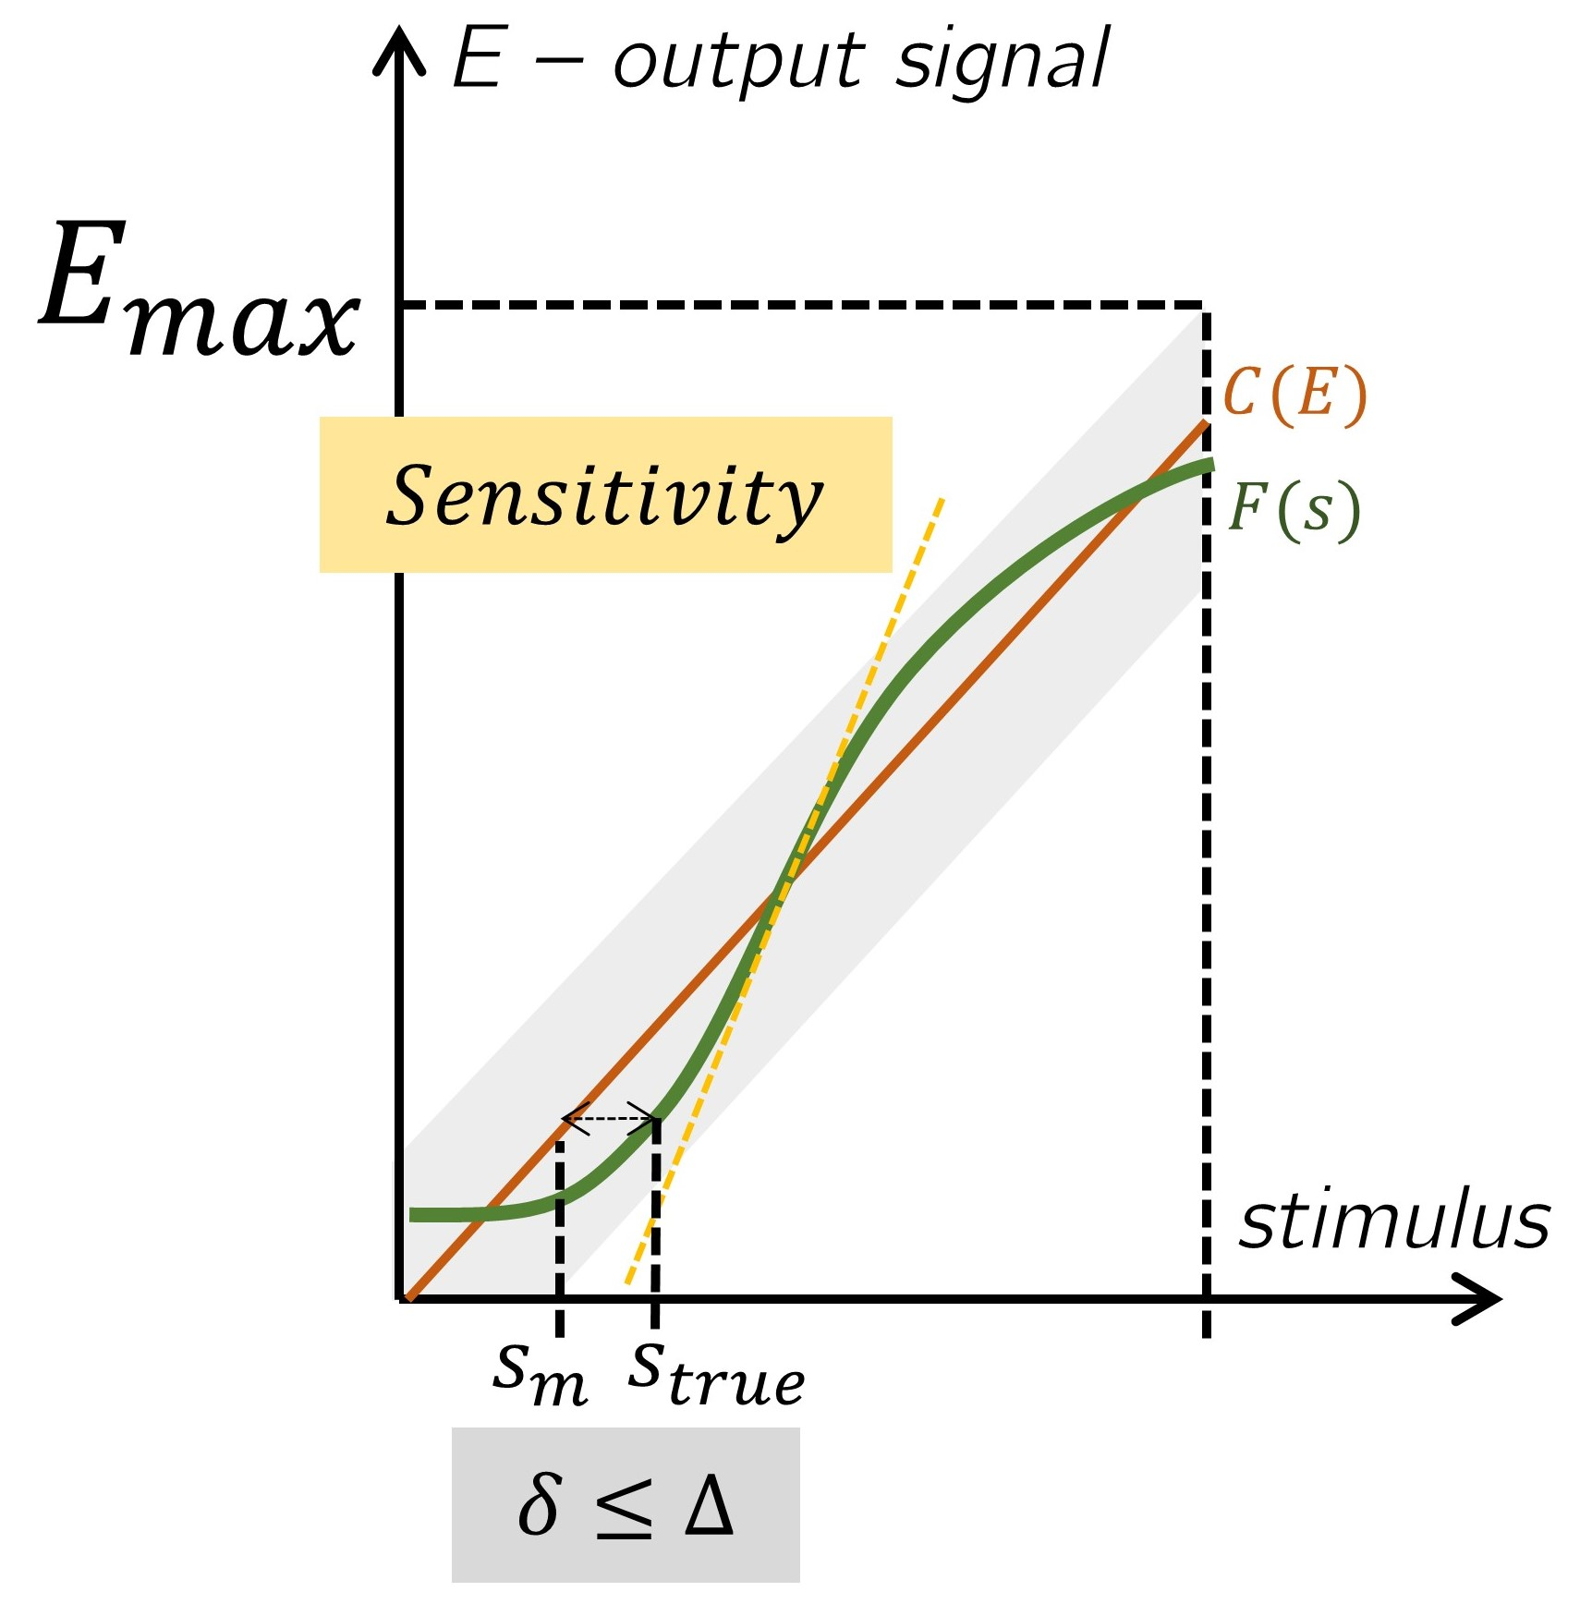
Sensor Characteristics

Slide 4
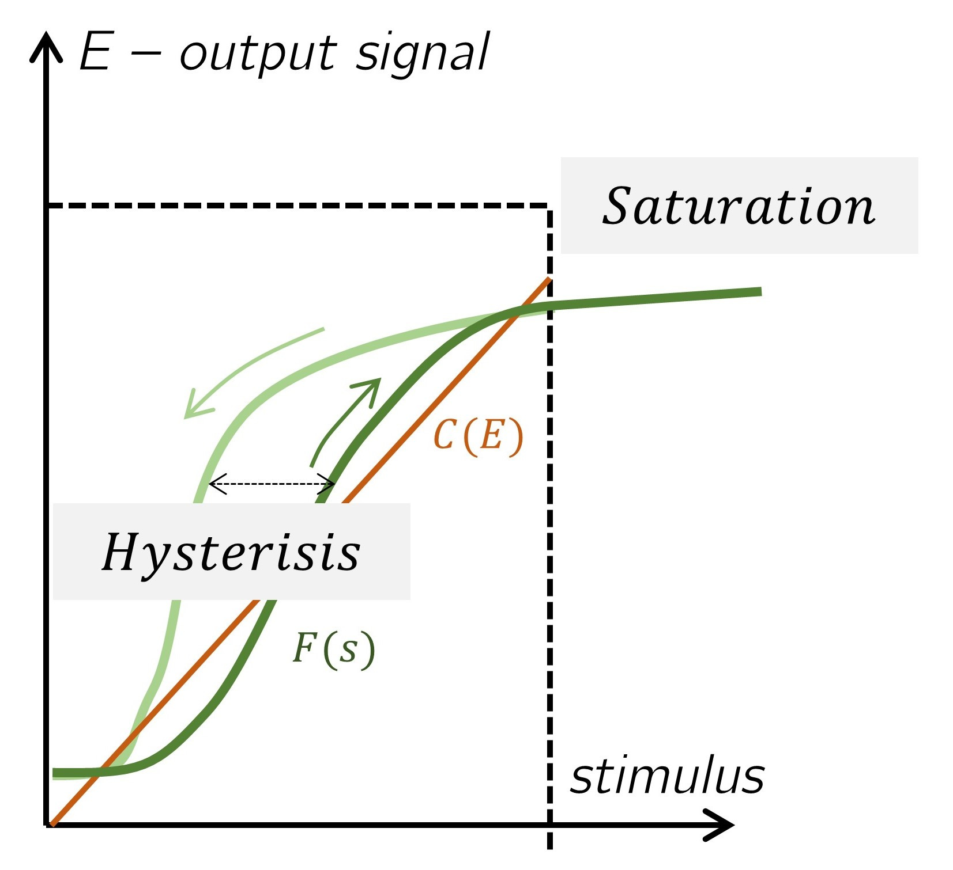

Sensor Characteristics
E – output signal
$$F(s)$$
stimulus

Slide 5
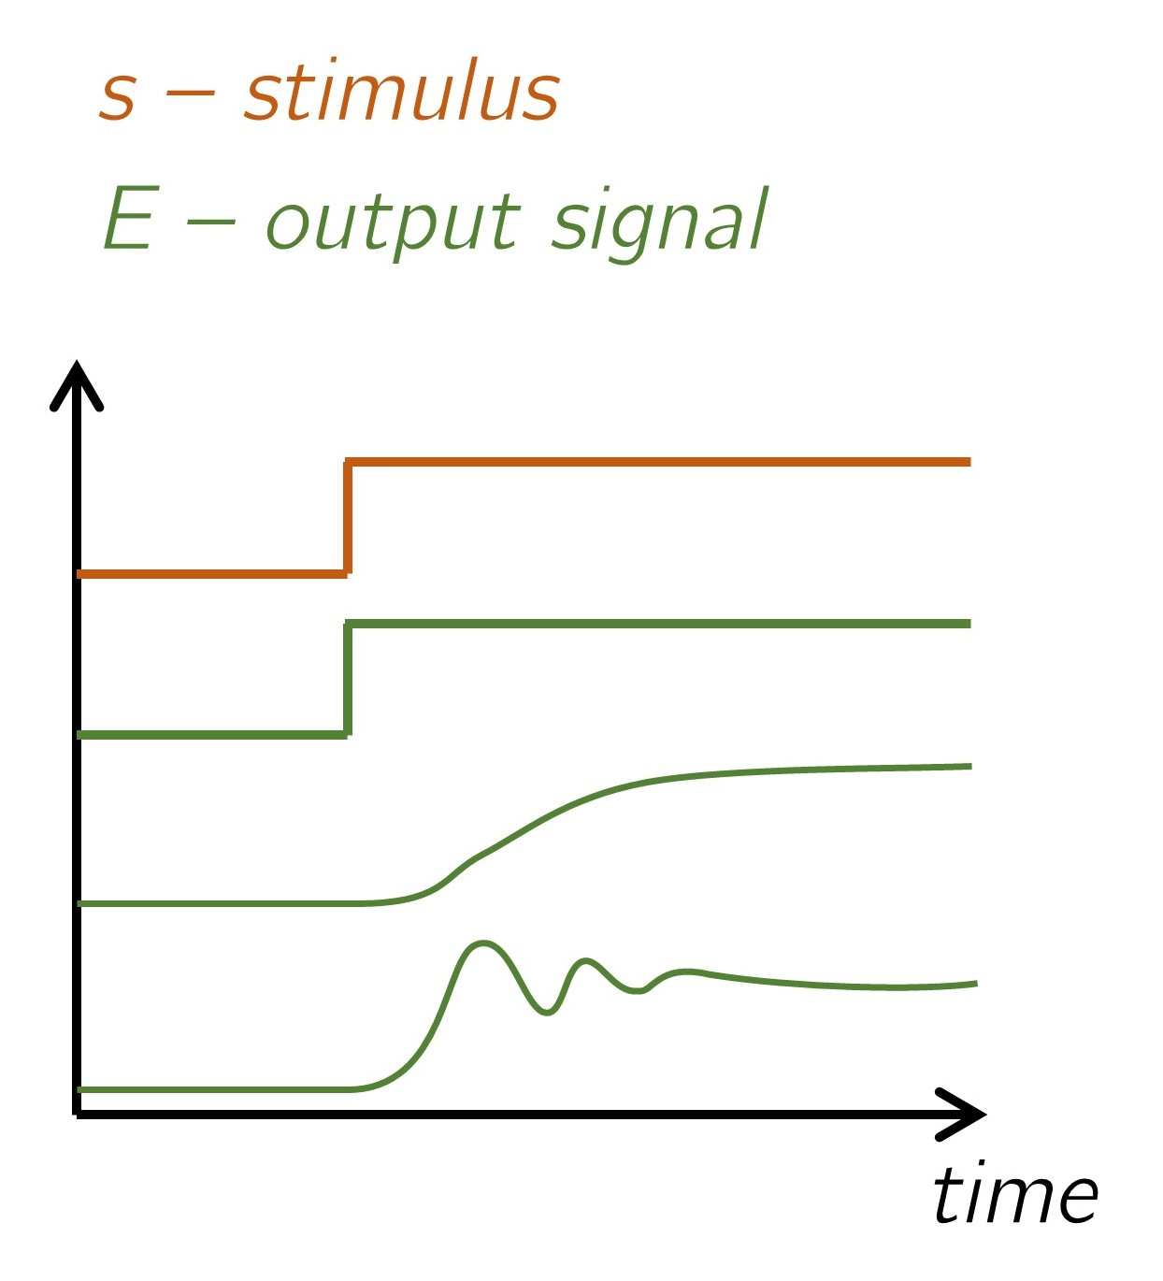
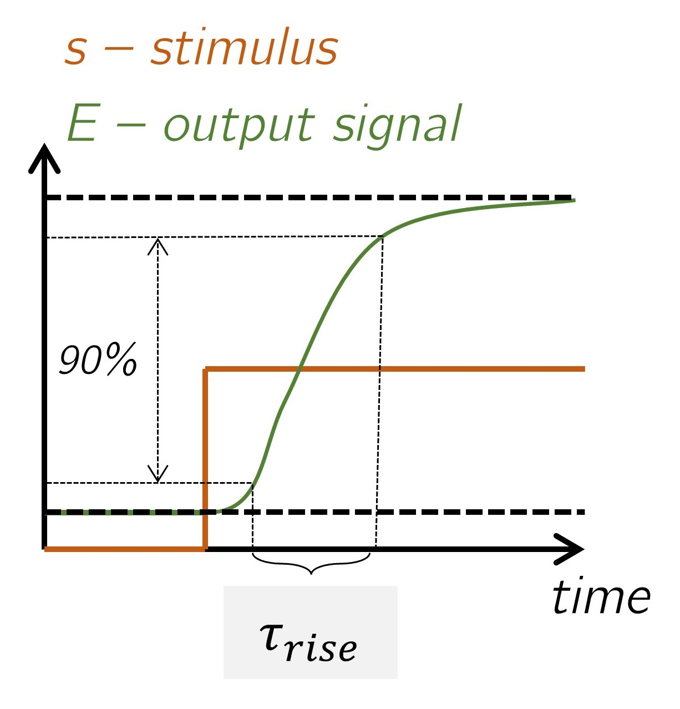
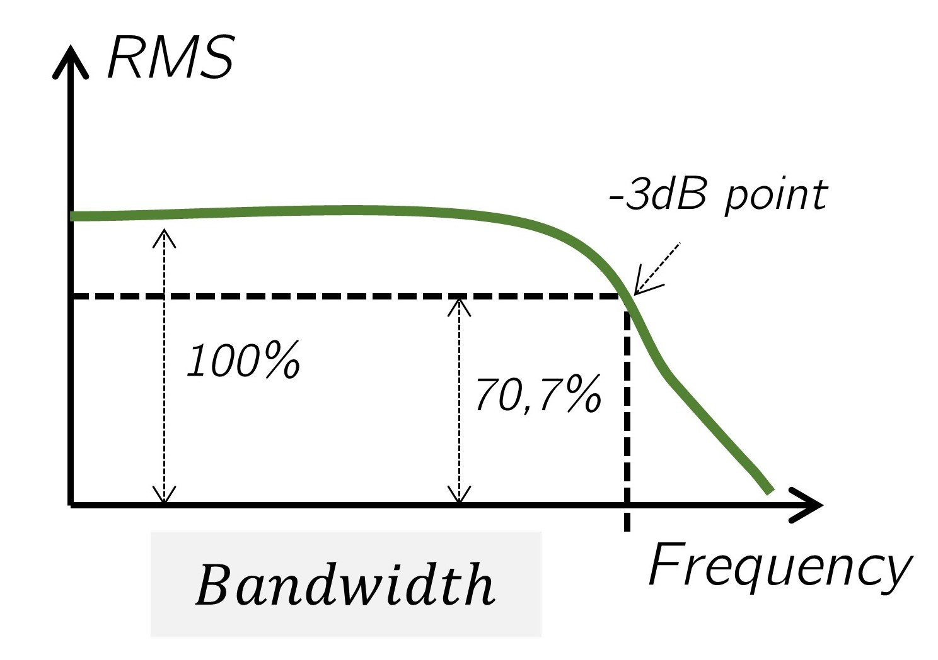
Sensor Characteristics

Slide 6
Today
1. Rapid assessment on our current understanding
2. Hands-on Activity: Sensors and Navigating Specsheets
3. Creative Catalyst: Sensors and real-world applications

Slide 7
Assessing our understanding
A. What is the primary purpose of a sensor?
A) To amplify signals
B) To interact with the environment and allow for information extraction
C) To provide mechanical motion
D) To store data

Slide 8
Assessing our understanding
A. What is the primary purpose of a sensor?
A) To amplify signals
B) To interact with the environment and allow for information extraction
C) To provide mechanical motion
D) To store data

Slide 9
Assessing our understanding
B. Which type of sensor requires external power to operate?
A) Passive sensor
B) Active sensor
C) Analog sensor
D) Digital sensor

Slide 10
Assessing our understanding
B. Which type of sensor requires external power to operate?
A) Passive sensor
B) Active sensor
C) Analog sensor
D) Digital sensor

Slide 11
Assessing our understanding
C. An example of a transducer that is not a sensor is:
A) Microphone
B) Thermocouple
C) Loudspeaker
D) Photodiode

Slide 12
Assessing our understanding
C. An example of a transducer that is not a sensor is:
A) Microphone
B) Thermocouple
C) Loudspeaker
D) Photodiode

Slide 13
Assessing our understanding
D. Which statements are true about analog and digital sensors?
A. Analog sensors produce a continuously varying output signal, while digital sensors produce discrete outputs
B. Analog sensors are always more accurate than digital sensors.
C. Digital sensors operate without any external power, unlike analog sensors.
D. Digital sensors can only be used in wireless systems
E. Digital sensors are good for communication systems and may benefit from noise resilience

Slide 14
Assessing our understanding
D. Which statements are true about analog and digital sensors?
A. Analog sensors produce a continuously varying output signal, while digital sensors produce discrete outputs
B. Analog sensors are always more accurate than digital sensors.
C. Digital sensors operate without any external power, unlike analog sensors.
D. Digital sensors can only be used in wireless systems
E. Digital sensors are good for communication systems and may benefit from noise resilience

Slide 15
Assessing our understanding
E. A sensor that incorporates more than one transducer is called:
A) Direct sensor
B) Hybrid sensor
C) Passive sensor
D) Active sensor

Slide 16
Assessing our understanding
E. A sensor that incorporates more than one transducer is called:
A) Direct sensor
B) Hybrid sensor
C) Passive sensor
D) Active sensor

Slide 17
Assessing our understanding
F. Dynamic range is usually expressed in:
A) Newtons
B) Volts
C) Decibels (dB)
D) Watts

Slide 18
Assessing our understanding
F. Dynamic range is usually expressed in:
A) Newtons
B) Volts
C) Decibels (dB)
D) Watts

Slide 19
Assessing our understanding
True or False
1. All transducers are sensors.
2. A deadband is a range of input values where the output is either zero, constant, or equal to noise.
3. The definition of a sensor includes the conversion of one form of energy into another.
4. Repeatability refers to a sensor's ability to perform as expected over a period of time.
5. A digital sensor’s output signal varies continuously within a specific range.

Slide 20
Assessing our understanding
True or False
6. Bandwidth indicates how a sensor responds to signals at different frequencies.
7. Sensitivity can be expressed as a variation of the output electrical signal of a sensor and the input.
8. The accuracy of a sensor is determined using its calibration function.
9. A push-button switch is a digital sensor.
10. If I want to characterize a sensor I need a calibration curve.

Slide 21
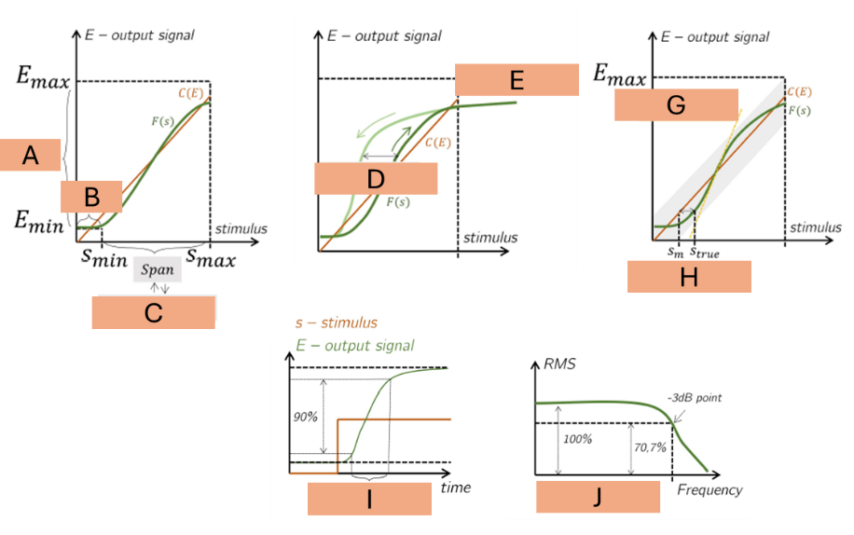
Assessing our understanding
Saturation
Dynamic Range
Bandwidth
Hysteresis
Rise Time
Full-Scale Output
Sensitivity
Accuracy
Dynamic Range
Dead Band

Slide 22
Hands-on Activity: Sensors and Navigating Spec sheets
Given the sensors you are provided and their associated specsheets, you have 7 minutes to characterize your sensors before passing it to other groups:
explain the working principle, characterize in terms of family of sensors, possible applications, and some characteristics you found to be important for that.
The last sensor you’ll pitch it in 1 minute presentation to the class.

Slide 23
Creative Catalyst: Sensors for real-world applications
Think of a product or application that integrates one or more than one sensors of the box.
It can be anything, doesn’t need to be possible, there are no limits. (e.g. robot for gardening assistant, intelligent vacuum cleaner, Intelligent Waste Sorting Bin, Assistant for free-space optical alignments, health wearable)
Work an idea with your colleagues, add features, iterate and add sensors and possibly actuators.
Pitch to the classroom:
What your prototype intends to do
What sensors and actuators do you utilize
What information you extract, and what action it produces

