Slide 1
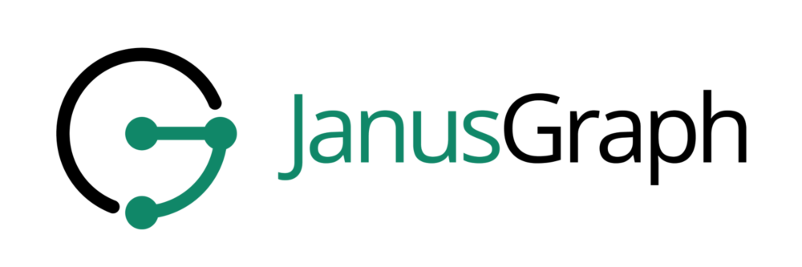
NUNO MIGUEL MARQUES
PEDRO DIOGO VELUDO TAVARES
PAULO ANDRÉ AREIAS GOMES LEAL PINTO

Slide 2
Overview
JanusGraph is an open-source modular graph database, designed as follows :
Free with Open-Source development on github.
Participants from Google, IBM, Amazon, and many others.
It is developed in Java and runs in a JVM.
Graphs consist of vertices and edges defined by an id and a label.
Schema can be implicit or explicit, vertices and edges can have any number of properties.
Very configurable and modular design:
JanusGraph connects various modules, even leverages other NoSQL technologies.
Distribution, consistency, availably, etc all depend on the modules chosen.
Supports external index backends that enable features such as full-text search.
Supports big data platforms that improve analytical queries.
CLI through Gremlin

Slide 3
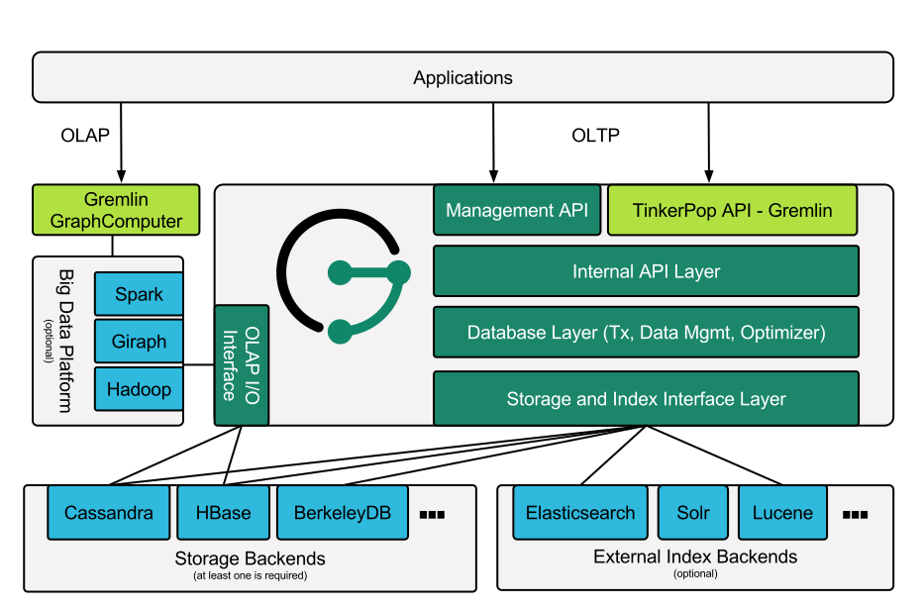
Overview
Janus Graph architectural overview (docs.janusgraph.com)

Slide 4
Installation
Through docker very simple to get up and running:
$ docker run -it -p 8182:8182 janusgraph/janusgraph
Local installation, also easy but requires manual download of the package:
wget …/download/v0.6.2/janusgraph-0.6.2.zip
unzip janusgraph-0.6.2.zip
./bin/janusgraph-server.sh start
External modules need to be installed and setup separately
Client connects through Gremlin or through Java using TinkerPop’s API. No administration panel out of the box but modules like gremlin-visualizer are available.

Slide 5
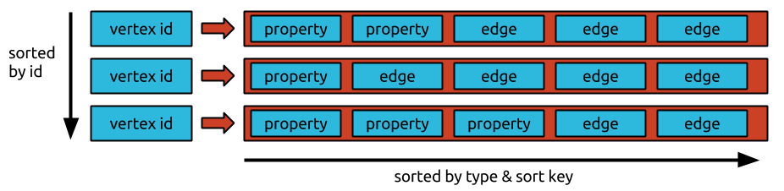
Data Model
In TinkerPop vertices and edges are stored in hashmap with ids as keys, in the storage backends the data is stored as an adjacency list as seen below:
Janus Graph data model (docs.janusgraph.com)
Notes:
Edge retrieval is O(log(k))
Add, edit, remove properties

Slide 6
Storage Backend
InMemory
BerkeleyDB
Cassandra
Not persistent
Not distributed
Ideal for tests
Embedded in Janus
Key-Value store
Not distributed
Column-oriented
Distributed
Availability over consistency
HBase
Services
Non-Official
Column-oriented
Consistency over availability
Amazon EC2 (Cassandra)
Google Bigtable (HBase)
ScyllaDB
Other less popular options
Notes:
Services like amazon EC2 and google bit table

Slide 7
Storage Backend
Distribution
Multiple JanusGraph instances can share one backend
When connecting multiple backends to one instance of JanusGraph the graph is partitioned between the backends
To achieve replication backend instances connect with each other
InMemory, BerkeleyDB and Cassandra can be embedded in the same JVM as JanusGraph
Notes:
Services like amazon EC2 and google bit table

Slide 8
External Indexing and Big data
Big Data Platforms
External Indexing
Improves performance in OLAP queries with algorithms that parallelize the traversal of the graph
TinkerPop provides program for common problems such as Page Rank, Bulk Loading and Peer Pressure.
Most popular platforms include Apache Spark and Apache Hadoop
Allows for geo, numeric range and full-text search
Apache Solr and Elasticsearch provide the most scalability and performance for large graphs
Apache Lucene performs better with single machines and smaller graphs, normal used in testing.
Notes:
OLAP = Online Analytical processing
Example how many movies in each genre

Slide 9
API
JanusGraph exposes TinkerPop’s API for Java applications, most applications will use Gremlin to interact with the graph. Most popular languages have libraries that enable interaction with gremlin servers.
Gremlin is a functional, path-oriented query language where traversal operators are chained together to form queries.
Gremlin queries can be long but are typically easy to read, here’s an example:
g.V().hasLabel("person").has("name", "Kevin Bacon").outE(“movies”).outV()
.has(“year”, 2017).outE(“crew”).has(“job”, “Director”).outV().elementMap()

Slide 10
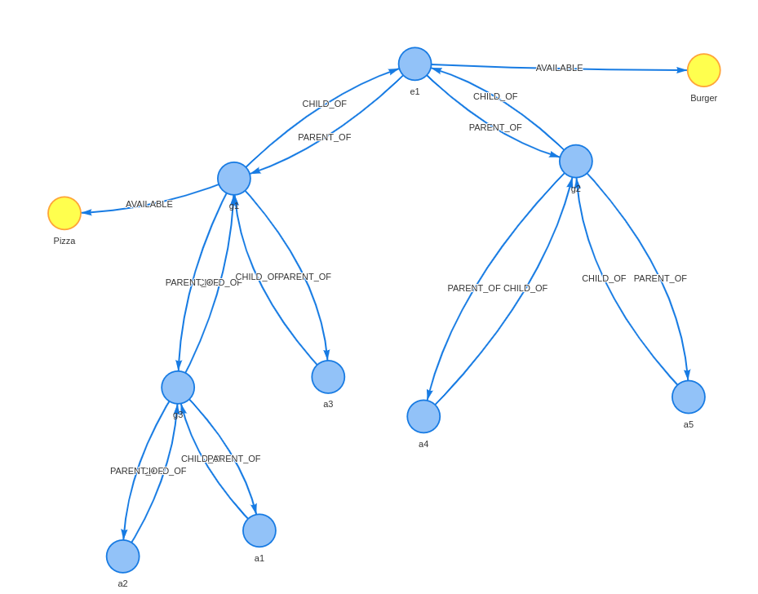

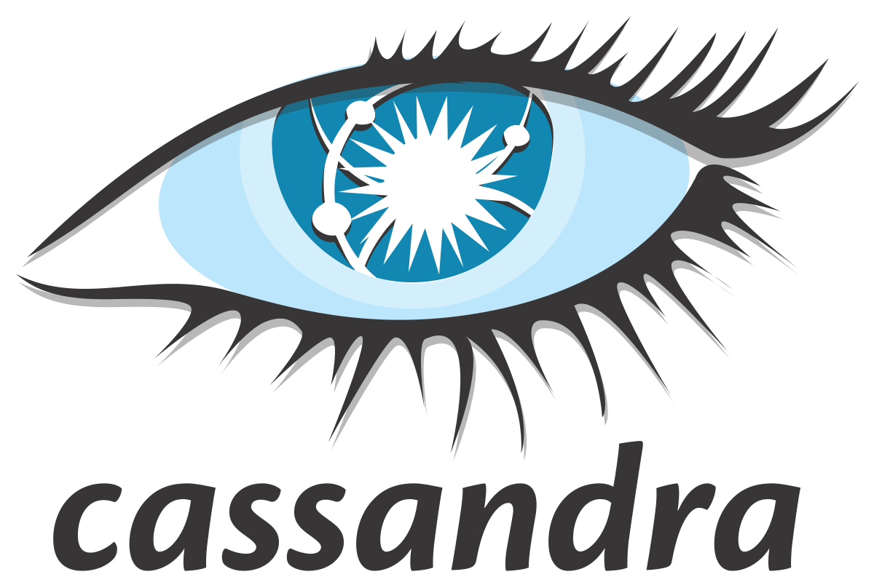
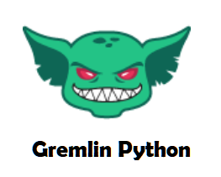


Prototype Overview
The prototype implemented a movie database website, using the following architecture:
Gremlin-Visualizer
Partition 1
Replica 1
Gremlin Server
JanusGraph
Partition 2

Slide 11
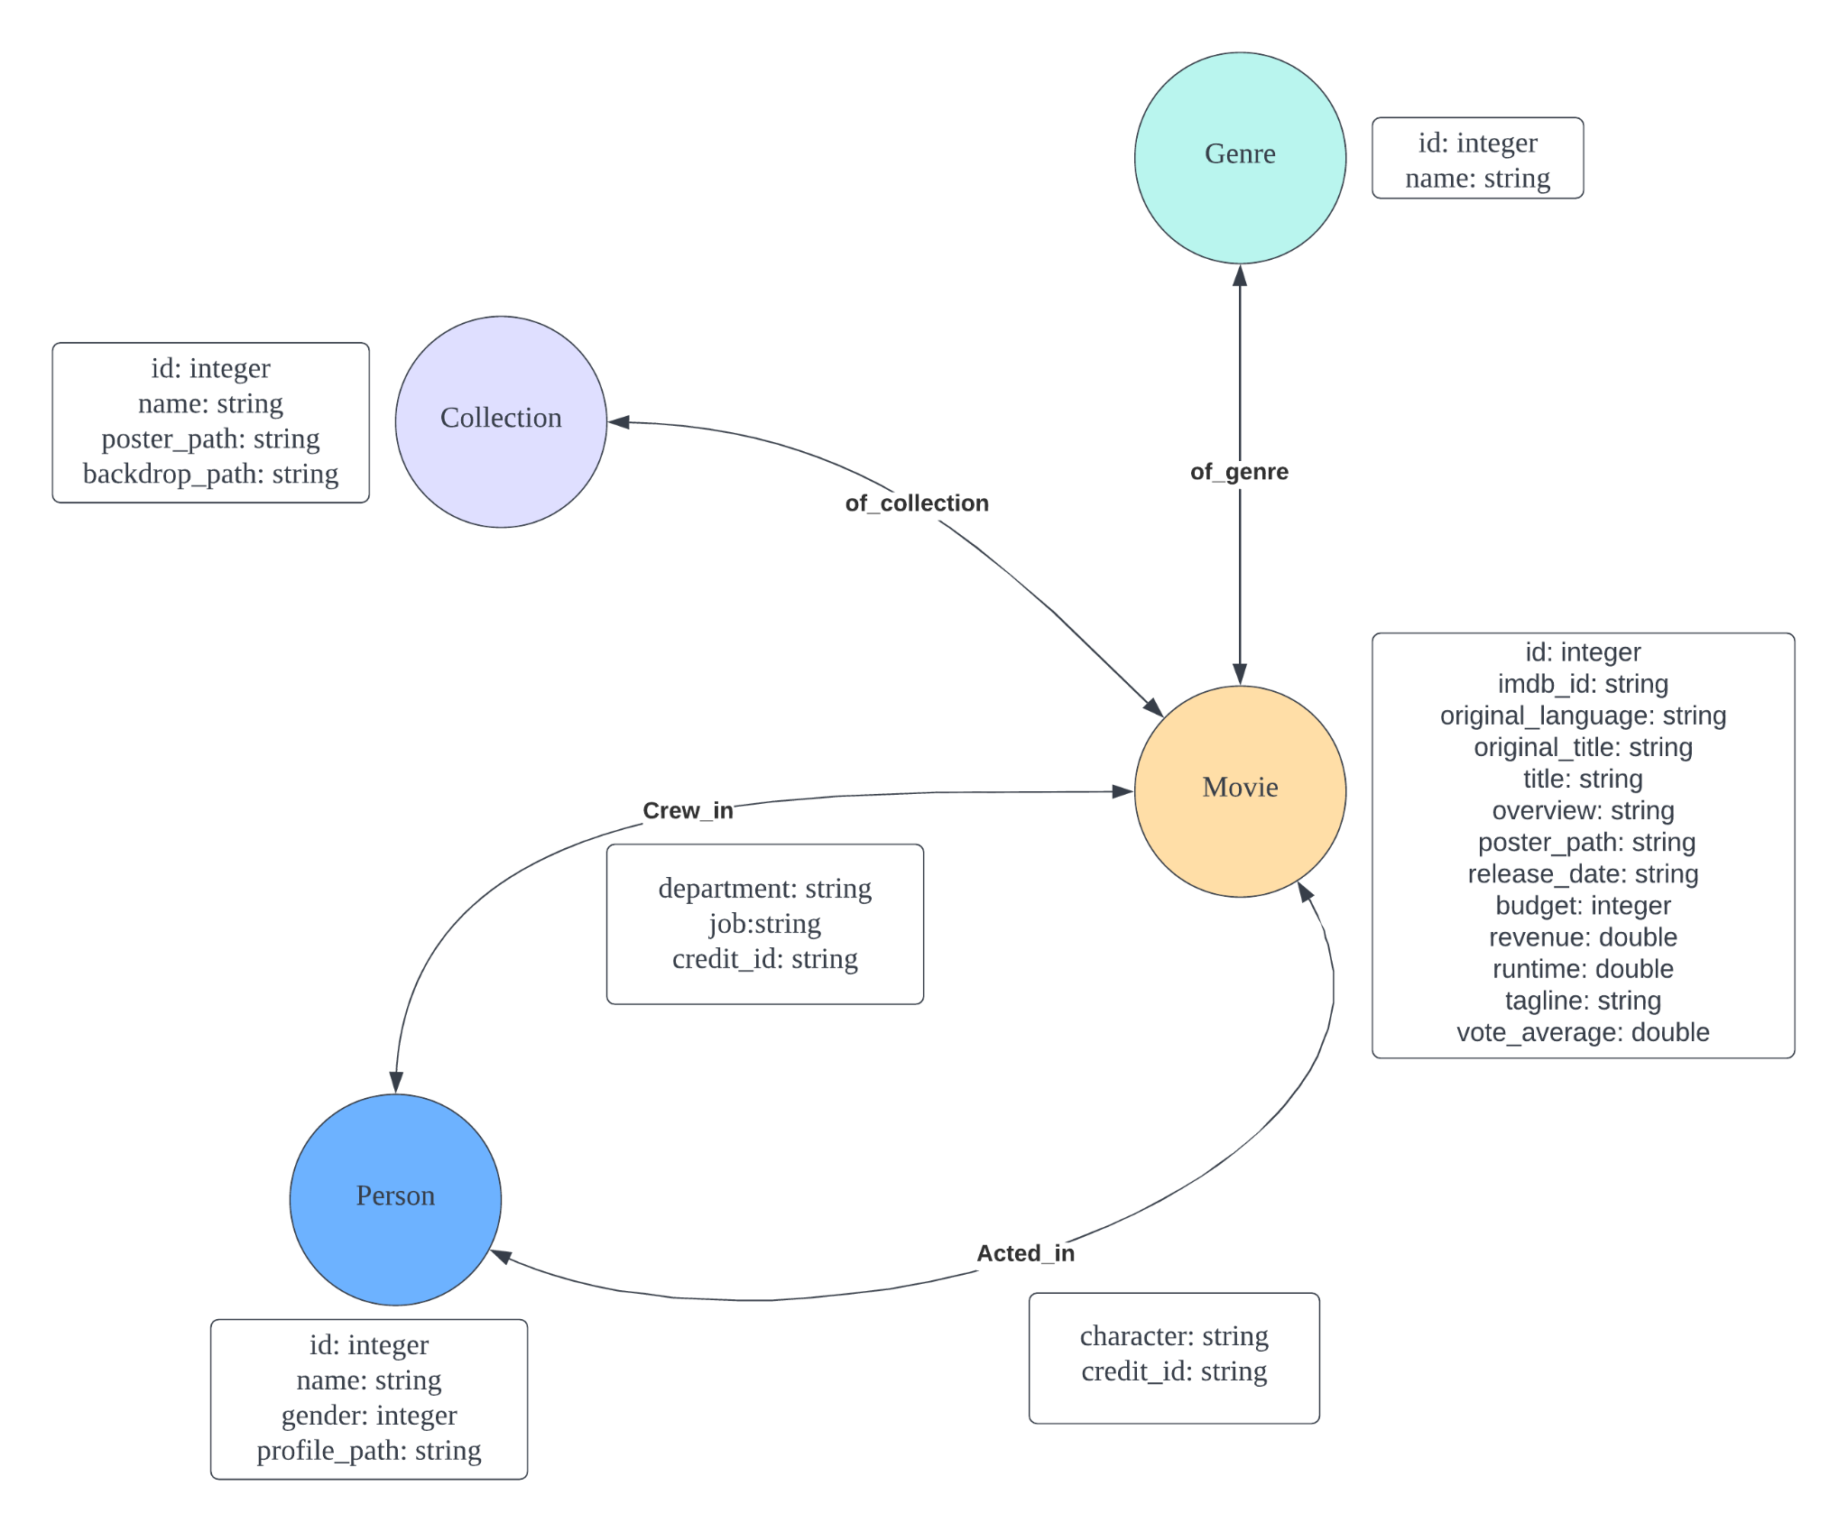
Conceptual Data Model
Due to hardware limitations the dataset of the prototype was reduced to about 50000 Nodes.

