Slide 1
Who Finds the Invariant?
From Floyd (1967) → Constrained Horn Clauses → LLMs
1967
2000s
today
a human writes it
a solver finds it
one more guesser
Orna Grumberg · Technion
FLoC 2026 Mentoring Workshop
Notes:
30 minutes. The whole talk is about one object: the invariant. Three eras, three answers to who supplies it.

Slide 2
From Program Verification to Constrained Horn Clauses
Orna Grumberg
Technion

Slide 3
Program Verification
Given
a program and
a formal specification – a logical formula
does the program satisfy the specification?
Not decidable!
Floyd, Hoare (late 1960’s) suggested methods to verify input-output specifications

Slide 4




Program Verification
Program
Formal Verifier
Safe
Specification
Buggy

Slide 5
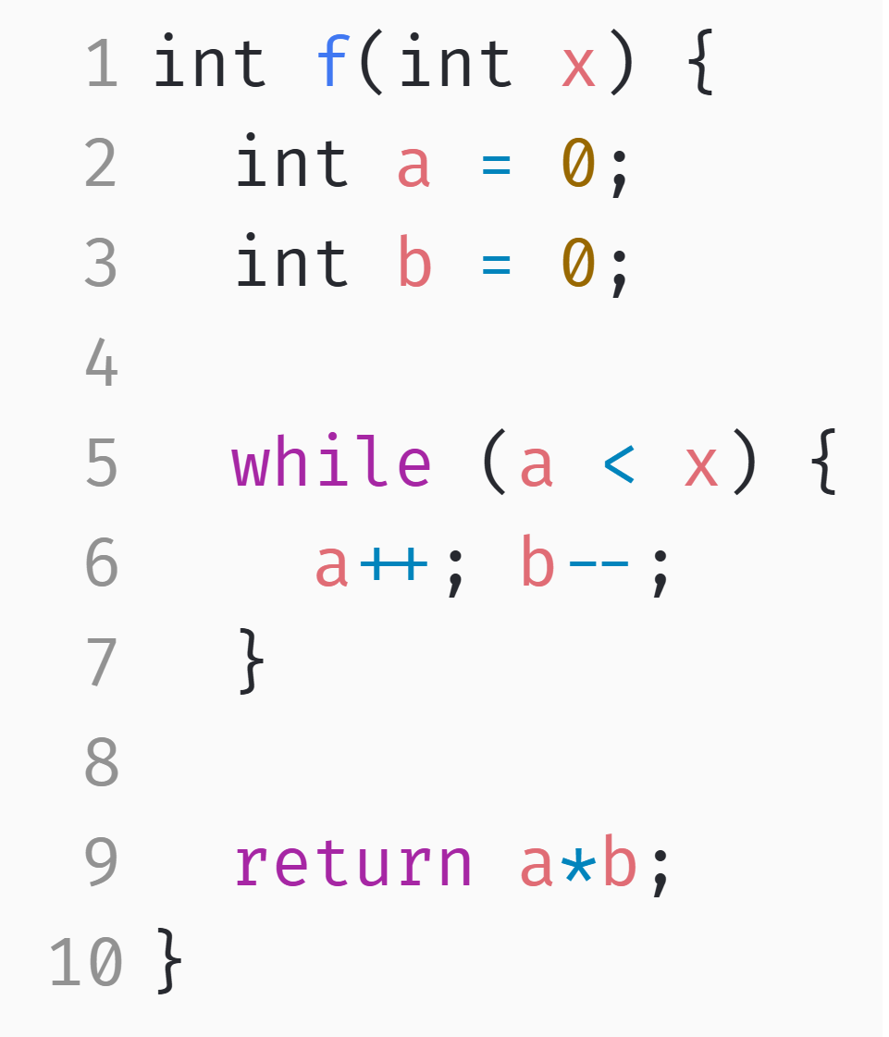

An Example of Verification Problem
Input-output specification:
If Pre holds at the beginning, then Post holds at the end
Pre: $x>0$
Post: $a∗b<0$

Slide 6


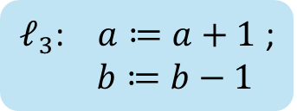




Program Verification (Floyd method)
$ℓ_{0}$: $entry$
Pre:: X > 0
Pre
$ℓ_{1}$: $a≔0 ; b≔0$
Inv
$ℓ_{2}$: $a<x ?$
Inv:: ??
$$true$$
Post
$ℓ_{3}$: $a≔a+1$ ;
$b≔b−1$
$$false$$
$ℓ_{4}$: r$eturn(a∗b$)
Post:: a*b < 0
Control Flow Graph

Slide 7
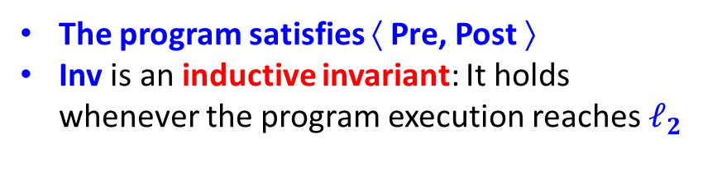
Program Verification (Floyd method)
$ℓ_{0}$: $entry$
Pre:: x > 0
We prove:
Initiation: Pre∧ ( a=0 ∧ b=0 ) → Inv(x, 0, 0)
Consecution: Inv(x, a, b) ∧ a < x ∧ a’ = a+1 ∧ b’=b-1 → Inv(x, a’, b’)
Safety: Inv ∧ ¬(a < x) → Post
$ℓ_{1}$: $a≔0 ; b≔0$
$ℓ_{2}$: $a<x ?$
Inv:: ??
$$true$$
$ℓ_{3}$: $a≔a+1$ ;
$b≔b−1$
$$false$$
The program satisfies ⟨ Pre, Post ⟩
Inv is an inductive invariant: It holds whenever the program execution reaches $ℓ_{2}$
$ℓ_{4}$: r$eturn(a∗b$)
Post:: a*b < 0
Control Flow Graph

Slide 8
Program Verification (Floyd method)
$ℓ_{0}$: $entry$
Pre:: x > 0
We prove:
Initiation: Pre∧ ( a=0 ∧ b=0 ) → Inv(x, 0, 0)
Consecution: Inv(x, a, b) ∧ a < x ∧ a’ = a+1 ∧ b’=b+1 → Inv(x, a’, b’)
Safety: Inv ∧ ¬(a < x) → Post
$ℓ_{1}$: $a≔0 ; b≔0$
$ℓ_{2}$: $a<x ?$
Inv:: ??
$$true$$
$ℓ_{3}$: $a≔a+1$ ;
$b≔b−1$
Is a+b=0 a good inductive invariant?
$$false$$
$ℓ_{4}$: r$eturn(a∗b$)
Post:: a*b < 0
Control Flow Graph

Slide 9
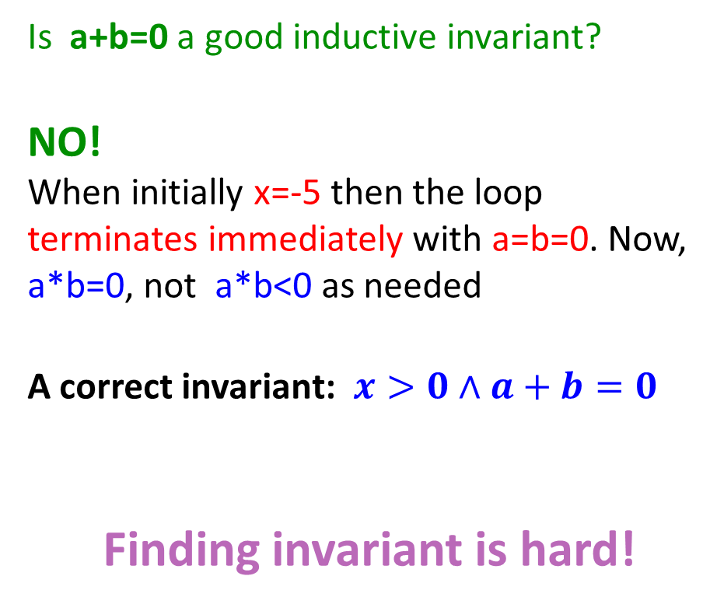
Program Verification (Floyd method)
$ℓ_{0}$: $entry$
Pre:: x > 0
Is a+b=0 a good inductive invariant?
NO!
When initially x=-5 then the loop terminates immediately with a=b=0. Now, a*b=0, not a*b<0 as needed
A correct invariant: $x>0∧a+b=0$
Finding invariant is hard!
$ℓ_{1}$: $a≔0 ; b≔0$
$ℓ_{2}$: $a<x ?$
Inv:: ??
$$true$$
$ℓ_{3}$: $a≔a+1$ ;
$b≔b−1$
$$false$$
$ℓ_{4}$: r$eturn(a∗b$)
Post:: a*b < 0
Control Flow Graph

Slide 10
Let the machine find the invariant for us
Model checking, symbolic verification, and Constrained Horn Clauses

Slide 11
AUTOMATION
Two ways to make it automatic
Restrict until decidable
Keep programs — hand it to a solver
Model checking (Clarke, Emerson, Sifakis, early 1980s)
finite-state model + temporal-logic property
answers yes, or no with a counterexample
But programs are not finite state
Represent the program symbolically — as logical formulas.
Reduce verification to: is this formula satisfiable?
Let very good solvers answer that question.
SAT → SMT → CHCs
the invariant becomes the unknown that the solver is asked to find
Notes:
Do not linger. The point is only: one road restricts the problem, the other keeps it and buys a better search.

Slide 12
Back to Program Verification
Program
Formal Verifier
Safe
Specification
Buggy

Slide 13
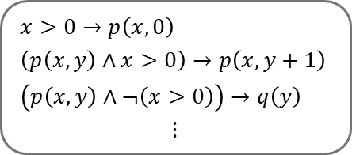
Program Verification via CHCs
Satisfiability Checking
Encoding
SAT
Program
$$x>0→p\left(x,0\right)$$
$$\left(p\left(x,y\right)∧x>0\right)→p\left(x,y+1\right)$$
$$\left(p\left(x,y\right)∧¬\left(x>0\right)\right)→q\left(y\right)$$
$$⋮$$
Safe
Encoder
CHC Solver
Set of Constrained Horn Clauses (CHCs)
UNSAT
Specification
Buggy

Slide 14

Constrained Horn Clauses (CHCs)
A constrained Horn clause is a first order logic formula of the form:
where
$ℬ\left[\overline{x}\right]≔p_{1}\left({\overline{x}}_{1}\right)∧⋯∧p_{k}\left({\overline{x}}_{k}\right)∧φ$
$ℋ\left[\overline{x}\right]$ is either $p_{k+1}\left({\overline{x}}_{k+1}\right)$ or$φ′$
Example: $∀x,y,z. \left(p_{1}\left(x,y\right)∧p_{2}\left(y,z\right)∧z=x+y\right)→p_{3}\left(x,z\right)$
$$∀\overline{x}. ℬ\left[\overline{x}\right]→ℋ\left[\overline{x}\right]$$
body
head
uninterpreted predicate
constraint
Notes:
Another example: $∀x,y,z. p_{3}\left(x,z\right)→x≤z$ "The predicate symbols $p_{1},…,p_{k}$ are uninterpreted, but the constraint $φ$ already has a meaning. That meaning is provided by a background theory."

Slide 15
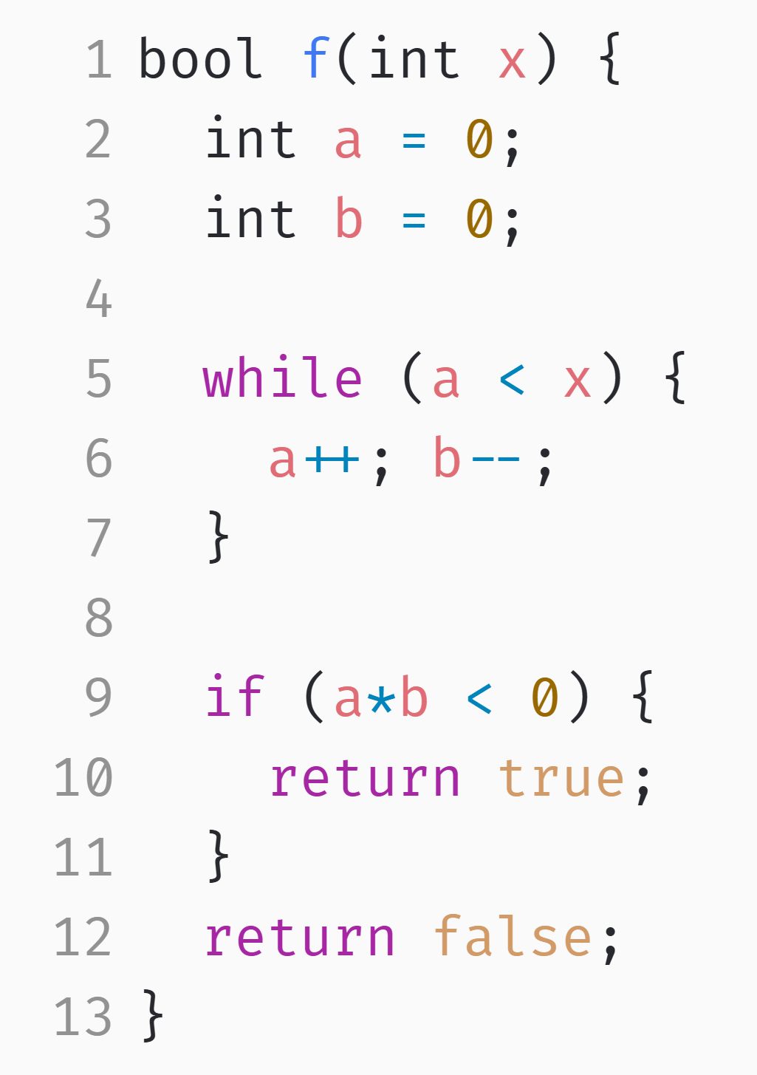
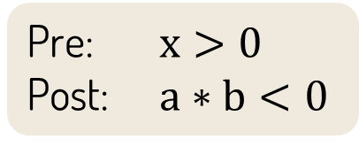
An Example Verification Problem
Pre: $x>0$
Post: $a∗b<0$

Slide 16

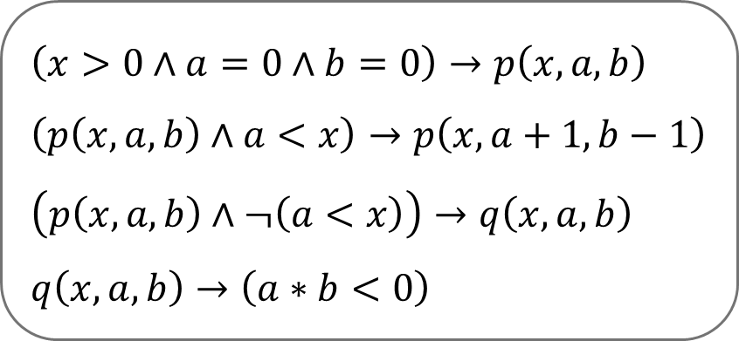
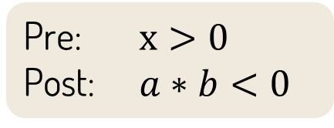

An Example Verification Problem
Encoding
$$p$$
$$\left(x>0∧a=0∧b=0\right)→p\left(x,a,b\right)$$
$$\left(p\left(x,a,b\right)∧a<x\right)→p\left(x,a+1,b−1\right)$$
$$\left(p\left(x,a,b\right)∧¬\left(a<x\right)\right)→q\left(x,a,b\right)$$
$$q\left(x,a,b\right)→\left(a∗b<0\right)$$
Encoder
$$q$$
Set of CHCs
Pre: $x>0$
Post: $a∗b<0$

Slide 17




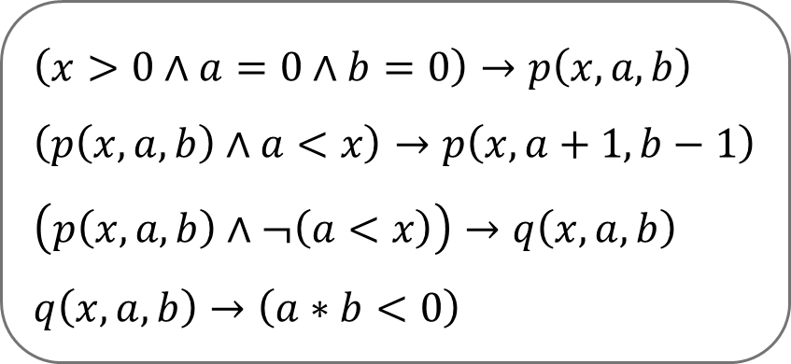

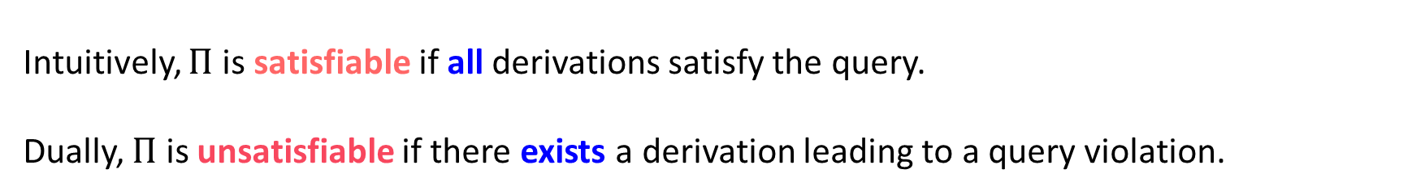

Derivations
$$\left(x>0∧a=0∧b=0\right)→p\left(x,a,b\right)$$
$$\left(p\left(x,a,b\right)∧a<x\right)→p\left(x,a+1,b−1\right)$$
$$\left(p\left(x,a,b\right)∧¬\left(a<x\right)\right)→q\left(x,a,b\right)$$
$$q\left(x,a,b\right)→\left(a∗b<0\right)$$
$$p\left(1,0,0\right)$$
$$p\left(1,1,−1\right)$$
$$q\left(1,1,−1\right)$$
$$1∗−1<0$$
$$Π$$
Derivation
Query Check
Intuitively, $Π$ is satisfiable if all derivations satisfy the query.
Dually, $Π$ is unsatisfiable if there exists a derivation leading to a query violation.
Notes:
A derivation corresponds to an execution of the program.

Slide 18
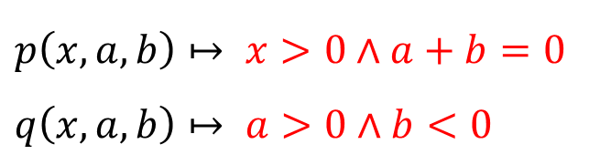
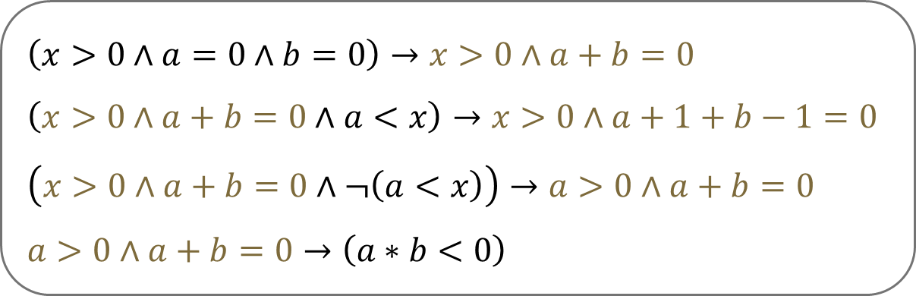

Proving Satisfiability with Interpretations
Enumerating all derivations is usually infeasible.
Instead, CHC solvers search for symbolic interpretations of the uninterpreted predicates that satisfy all CHCs.
$$\left(x>0∧a=0∧b=0\right)→p\left(x,a,b\right)$$
$$\left(p\left(x,a,b\right)∧a<x\right)→p\left(x,a+1,b−1\right)$$
$$\left(p\left(x,a,b\right)∧¬\left(a<x\right)\right)→q\left(x,a,b\right)$$
$$q\left(x,a,b\right)→\left(a∗b<0\right)$$
$$p\left(x,a,b\right)↦ x>0∧a+b=0$$
$$q\left(x,a,b\right)↦ a>0∧b<0$$
$$Π$$
Satisfying
Interpretation I
I(p) is an inductive invariant!

Slide 19
THE SAME OBJECT, SIXTY YEARS APART
Floyd’s obligations are the three CHCs
1967 · you supply Inv
today · the solver supplies p
Pre ∧ init → Inv
Inv ∧ guard ∧ body → Inv′
Inv ∧ ¬guard → Post
x>0 ∧ a=0 ∧ b=0 → p(x,a,b)
p(x,a,b) ∧ a<x → p(x,a+1,b−1)
p(x,a,b) ∧ ¬(a<x) → a*b<0
Same three obligations — only who produces the invariant changed.

Slide 20
Can LLM help us find invariants?
Notes:
The talk proper has ended. This is an appendix — drop it entirely if you are short of time. Nothing earlier depends on it.

Slide 21
The loop, concretely
LLM
Checker
Proof
candidate
valid
or any generator
not valid — send back the failed condition + counterexample
The dark box is the central building block. The pale box is replaceable.
Not valid → the same information Floyd’s checks gave a human.

Slide 22
Conclusion
This talk presents a very limited view of what formal verification is: an invariant finding for proving a program correctness
Floyd method and solvers can handle program with much richer structures
More complex specifications
Recent works apply LLM in different ways to assist formal methods
NOT to replace them
They do not guarantee correctness unless they are checked by a formal checker

Slide 23
Questions?
a human writes it
a solver finds it
an LLM guesses it — a solver still checks it

